Slide 1
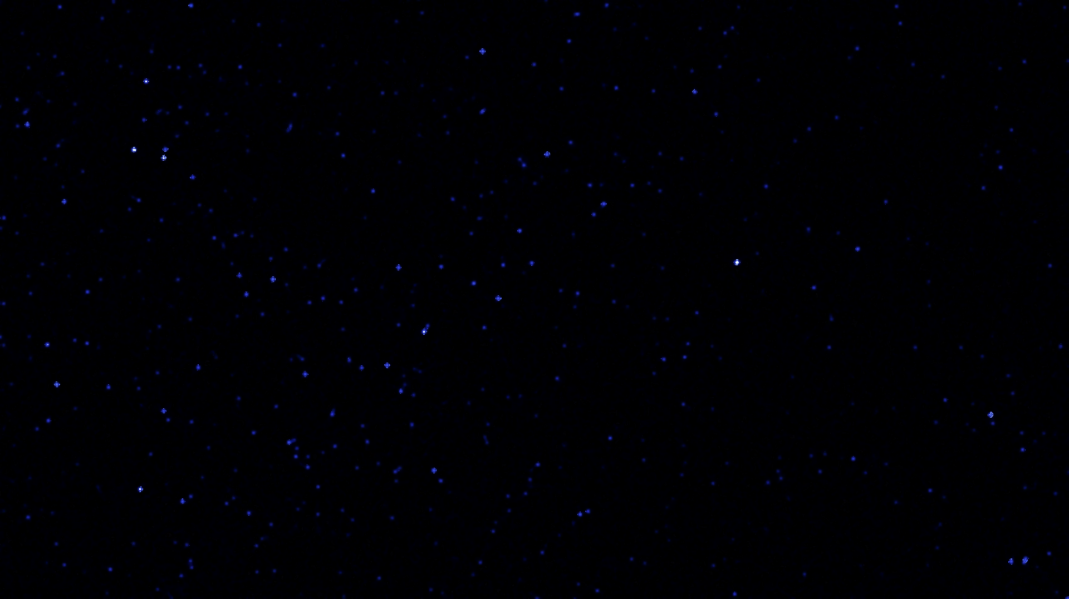

Planetary variables and their affects on species variation
Anna Harvey
DSC 530
Term Project

Slide 2
Statistical question:
Do physical variables of planets affect the attributes of the dominant species in the Star Wars universe?
Dataset source:
https://www.kaggle.com/jsphyg/star-wars
Originally sourced from Wookiepedia. www.starwars.fandom.com
Datasets used:
species.csv
planets.csv

Slide 3


Planet variables:
Rotation period – how long it takes (in hours) for a full planetary rotation
Orbital period – how long it takes (in standard days) for a planet to make a complete orbit around its sun
Diameter – the diameter (in kilometers) of the planet
Climate – the dominant climate of the planet
Surface water – the percentage of the planet surface covered by water

Slide 4
Planet variable notes:
Data cleaning
Climate – The original data includes multiple climates for some of the planets. The most dominant climate was chosen in these cases. Additionally, two planets (Kalee and Malastare) were relabeled as “subtropical” as they both shared the same three descriptions of arid, temperate, and tropical.
Surface water – Many planets did not have data available for the amount of surface water. These NaN values were replaced with 0. With the exception of Coruscant (which does have 0% surface water) and Nal Hutta (which is a swamp planet), the other NaN values likely fall between 5-10%.
Other NaN values – Planets were removed from the analysis if they had NaN values for rotation period, orbital period, diameter, or climate.

Slide 5

Species variables:
Classification – Is the species mammal, amphibian, insectoid, or other?
Average height – Average height (in centimeters) of the species.
Species variable notes:
Data cleaning
Classification – NaN values were replaced with “unknown”.
Species associated with planets with NaN values were dropped.

Slide 6

Other notes on data:
Information about terrain is available in the planet dataset and would likely affect certain characteristics of the dominant species. However, the data is categorized as lists of descriptive variables and would not be easily analyzed without further research.
Lifespan information is available in the species dataset and would be interesting to compare to planetary variables. However, very few species actually have a known lifespan.

Slide 7
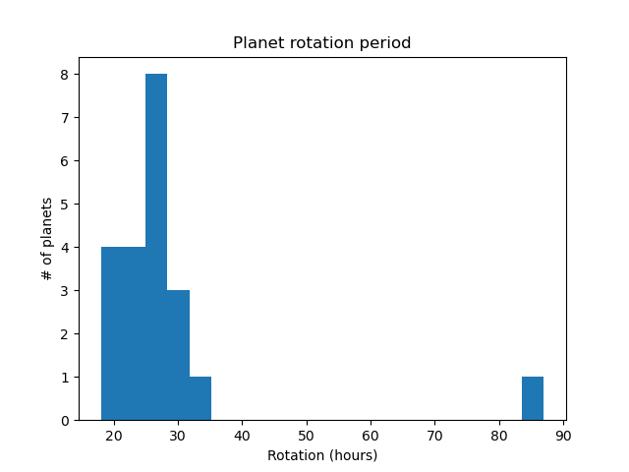
Mean: 28.1 hours
Mode: 26 hours
Variance: 1.96 e+02
Tails:
Data extends farther to the right, even disregarding the outlier.
Outlier: Nal Hutta (87 hours)
Should be left in because the Hutts have other outlier characteristics and there could be a correlation.

Slide 8
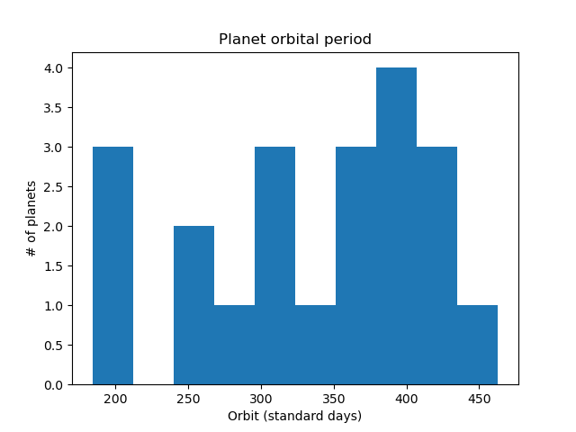
Mean: 335.6 days
Mode: 305 days
Variance: 6.323 e+03
Tails:
Values extend farther to the left.
Data is not normally distributed.

Slide 9
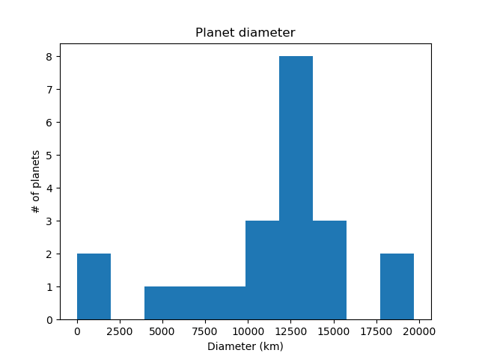
Mean: 11,355 km
Mode: 0 (two missing values)
Variance: 2.543 e+07
Tails:
Tail extends farther to the left, even when disregarding the 0 values.
Cato Nemoidia and Trandosha have a listed diameter of 0 km.
Obviously, they cannot have a diameter of 0. I will leave them in because other factors may help indicate their approximate diameters.
Kamino and Malastare are larger than 17500 km.
These are not outliers.

Slide 10
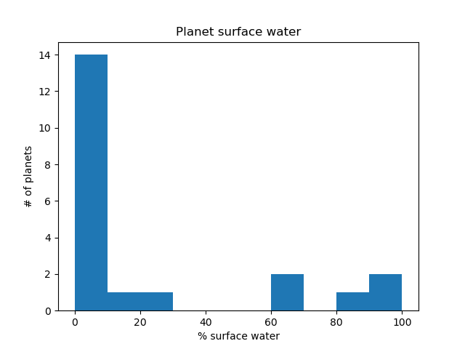
Mean: 21.95%
Mode: 0
Variance: 1.22 e+03
Tails:
The planets with 0% surface water throw off the histogram of this variable.
I want to leave these planets in because their other information can be helpful. The other variables may help indicate how much surface water the planets actually have.
It is likely that the actual distribution of planets along the x-axis is evenly distributed.

Slide 11
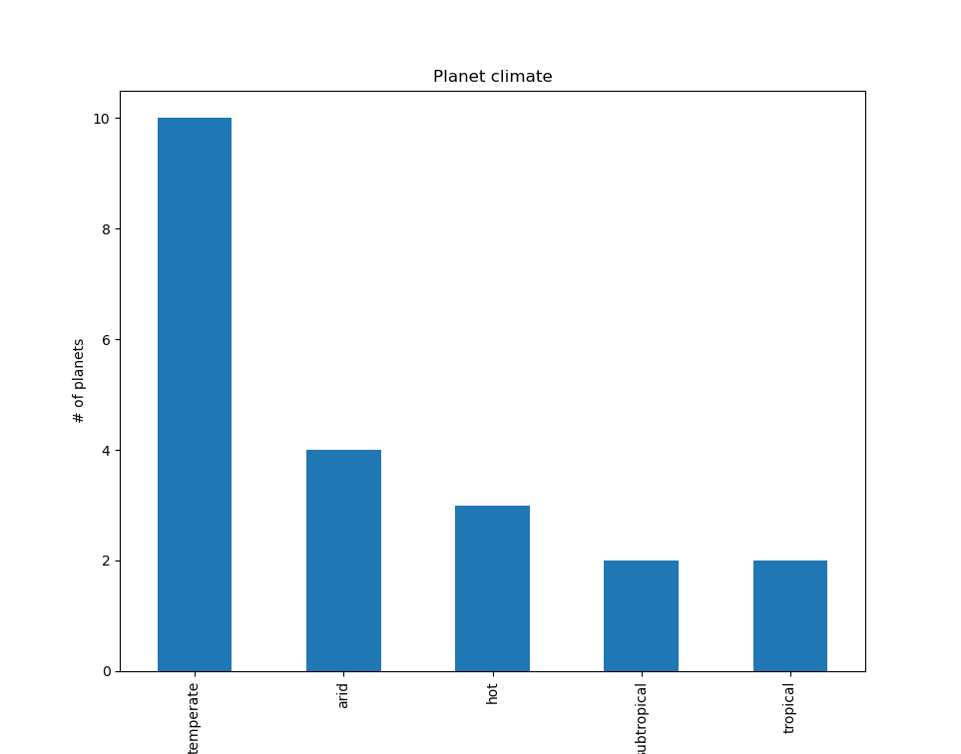
Mode: Temperate
Outliers:
None

Slide 12
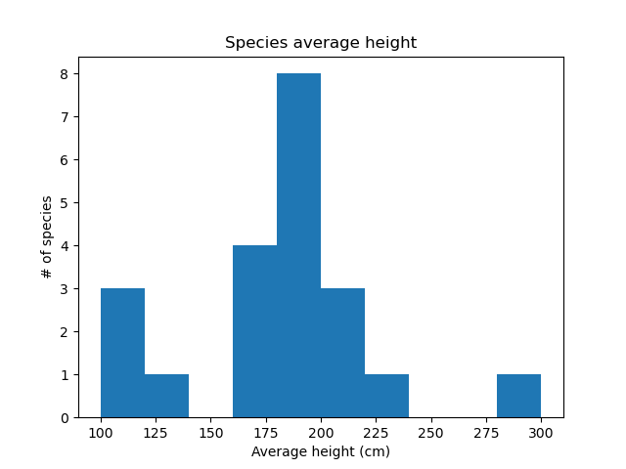
Mean: 176.1 cm
Mode: 180 cm
Variance: 2.05 e+03
Tails:
Data extends further to the right due to outlier
Hutts (Nal Hutta) are 300 cm on average.
Leave in because Nal Hutta’s other unique variables may indicate a correlation.

Slide 13
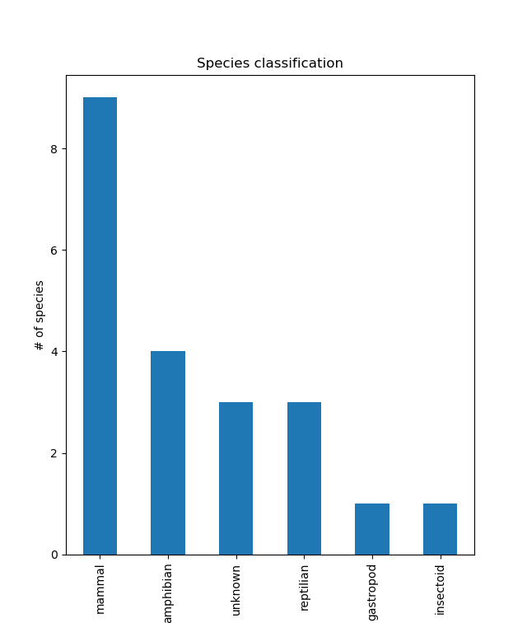
Mode: Mammal
Outliers:
There is only one gastropod species (Hutts – Nal Hutta) and one insectoid species (Geonosian – Geonosia).
Will leave in due to the possible significance of related variables.

Slide 14
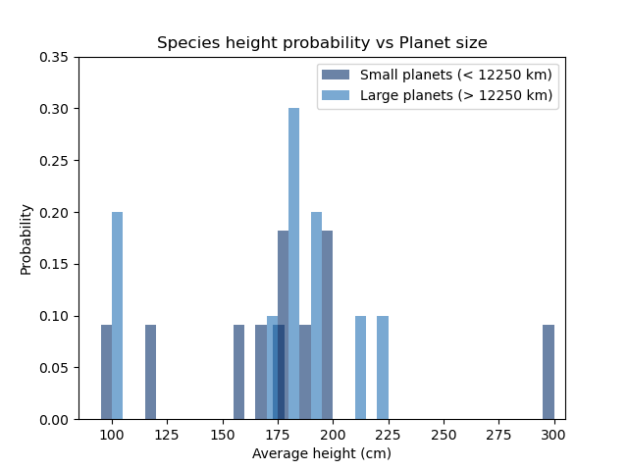
Prediction of species height based on planet size:
Most of the average heights have similar distributions between large and small planets.
The distribution for small planets has a long tail extending to the left.
The distribution for large planets is somewhat normal.
The outlier for small planets lies in the largest height. The outlier for large planets lies in the second smallest height.
From this PMF, it would be difficult to determine species height based on planet size.

Slide 15
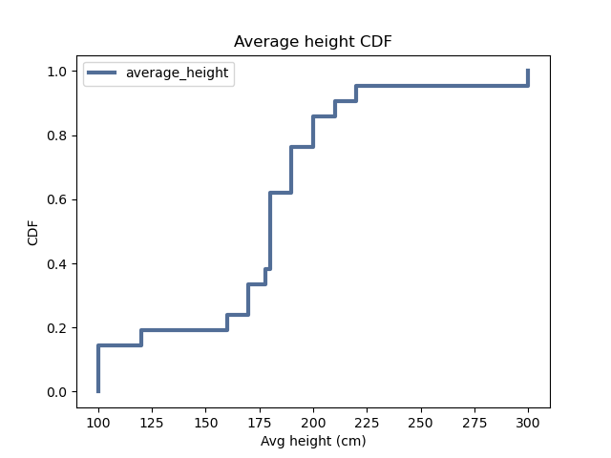
Approximately 95% of the average heights lie below 225 cm.
75% of the heights lie between 125 cm and 225 cm.
This is still a fairly wide range of heights.
The CDF shows that the largest height in the data and the smallest height are outliers.
Comparing this to the information from the PMF, it still seems unlikely that planetary variables affect species height.
More detailed analysis would be required to parse the 100 cm range to see if there is a more direct correlation. This would require more data.

Slide 16
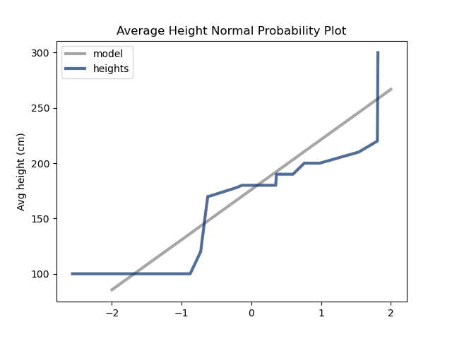
The distribution of average species heights does not match the model. This suggests that the distribution is not normal.
Since the distribution of heights is not normal, it is possible that heights correlates to another variable.

Slide 17
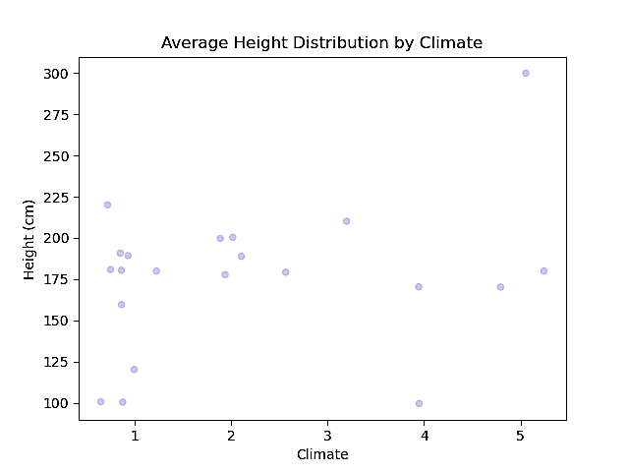
Spearman’s correlation:
0.134
A fairly weak positive correlation
Climate key:
1 = Temperate
2 = Arid
3 = Tropical
4 = Subtropical
5 = Hot
There are more temperate planets than any other which provides more opportunities for a variety of heights on those planets.
Temperate planets have the shortest species.
The Hutts on Nal Hutta (the tallest species) are still a clear outlier.
Main clusters:
Heights between 175 cm and 200 cm on temperate planets and arid planets

Slide 18
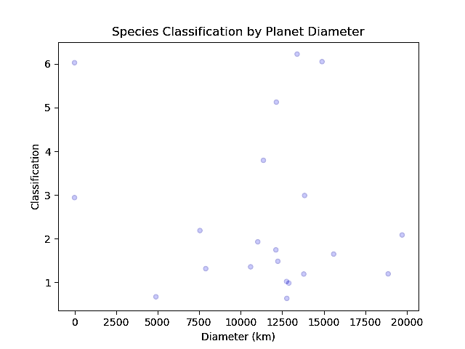
Spearman’s correlation:
-0.0728
A very weak negative correlation
Classification key:
1 = Mammal
2 = Amphibian
3 = Reptilian
4 = Insectoid
5 = Gastropod
6 = Unknown
Mammals and amphibians are found on planets with a variety of different diameters.
The insectoid, gastropod, and unknown species range around a similar diameter range (~11000-15000 km)
Main cluster:
Mammals and amphibians on planets with diameters around 12500 km

Slide 19

 | P-VALUES
Planet variable | Species classification | Average height (cm)
Orbital period (days) | 0.12 | 0.384
Rotation period (hours) | 0.001 | 0.207
Diameter (km) | 0.887 | 0.385
Climate | 0.212 | 0.843
Surface water (%) | 0.485 | 0.38
Testing the Correlation
Thinkstats2 CorrelationPermute Test
Statistically significant p-values:
Rotation period vs species classification
0.001
It is unlikely that this value occurred by chance, however, it does not necessarily indicate that the effect is important.

Slide 20
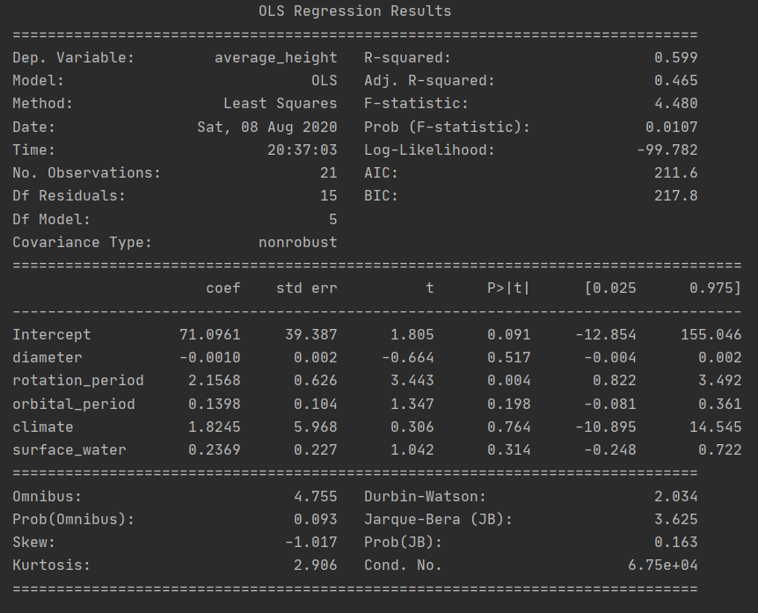

Linear Regression Analysis
Statsmodels OLS Regression
Average height vs planetary variables

