Slide 1
Statistical Modeling & Learning in R
Data Science and Programming Summer Workshop Series
07/25/2018
Anh T. Bui
IEMS, Northwestern University

Slide 2
Information
This workshop is a part of the Data Science and Programming Summer Workshop Series: https://sites.northwestern.edu/summerworkshops
Workshop materials can be found in this repository: https://github.com/anhbui2013/Statistical-Modeling-and-Learning-in-R
Instruction for downloading from GitHub can be found here: https://sites.northwestern.edu/summerworkshops/resources/downloading-from-github/
There will be an practice session starting at 1:30PM in this room.
Please sign in on the attendance page.

Slide 3
Setup
Open RStudio
Open file “Rmain.R” from the workshop GitHub repository.
This R script contains all the R commands used in this presentation.

Slide 4
Outline
Introduction
Part I: Parametric Models
Linear Regression
Binary Logistic Regression
Multilevel Regression
Break (15 mins)
Part II: Nonparametric Models
Regression Trees
Decision Trees
Random Forests
Summary

Slide 5
Part I: Parametric Regression
Linear Regression
Binary Logistic Regression
Multilevel Regression

Slide 6
Linear Regression
Quick Start with a Toy Example
Writing R’s Formulas
Working with Categorical Predictors
Stepwise Regression
Basic Diagnostic Tools
Predictions
Practice Examples: Car Price Prediction

Slide 7
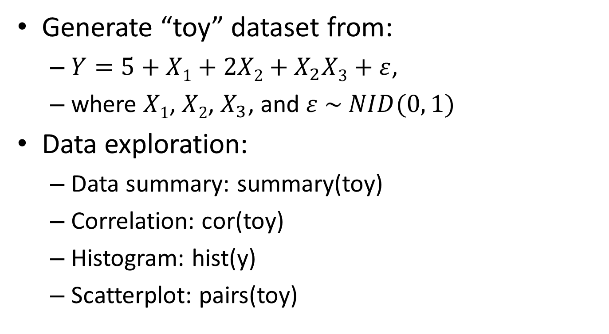
Toy Example
Generate “toy” dataset from:
$Y=5+X1+2X2+X_{2}X3+ε$,
where $X1$, $X2$, $X_{3}$, and $ε \sim NID(0, 1)$
Data exploration:
Data summary: summary(toy)
Correlation: cor(toy)
Histogram: hist(y)
Scatterplot: pairs(toy)

Slide 8
Toy Example
Fit a linear regression model:
toy.lm1 <- lm(formula=y ~ x1 + x2 + x3, data=toy)
Need to provide a “formula”
“data” is not needed if the variables in the formula are already in the global environment.
See model outputs:
Simple: toy.lm1 or print(toy.lm1)
Detailed: summary(toy.lm1)

Slide 9
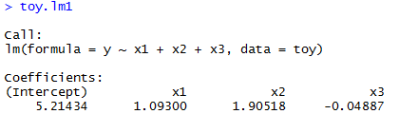
Simple Model Output
The intercept is automatically added.
No quotation marks needed for dataset name

Slide 10
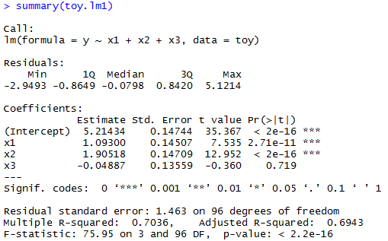
Detailed Model Output

Slide 11
Practice 1: Car Price Prediction
Use the “Cars93” dataset in the “MASS” package: require(MASS)
Explore this dataset.
Fit a linear regression model to predict “Price” based on “Horsepower” and “Weight”.
Which variables are statistically significant with 99% confidence level?

Slide 12
Writing R’s Formulas
Use all variables in the dataset:
lm(y ~ ., data=toy)
Add variable interactions:
lm(y ~ . + x1:x2 + x1:x3 + x2:x3, data=toy)
Or: lm(y ~ (x1 + x2 + x3)^2, data=toy)
Or: lm(y ~ . + .^2, data=toy)
Add all possible interactions:
lm(y ~ x1*x2*x3, data=toy)
Or: lm(y ~ (x1 + x2 + x3)^3, data=toy)
Or: lm(y ~ . + .^2 + .^3, data=toy)

Slide 13
Writing R’s Formulas
Remove intercept:
lm(y ~ x1*x2*x3 - 1, data=toy)
Remove a variable
lm(y ~ x1*x2*x3 - x3, data=toy)
Remove all variables:
lm(y ~ x1*x2*x3 - ., data=toy)
Formulas are evaluated from left to right. The below commands produce different models:
lm(y ~ . + x1*x2*x3 - (x1+x2+x3)^2, data=toy)
lm(y ~ x1*x2*x3 - (x1+x2+x3)^2 + ., data=toy)
To make sure a term is included or excluded, we can add/subtract it at the end of the formula.

Slide 14
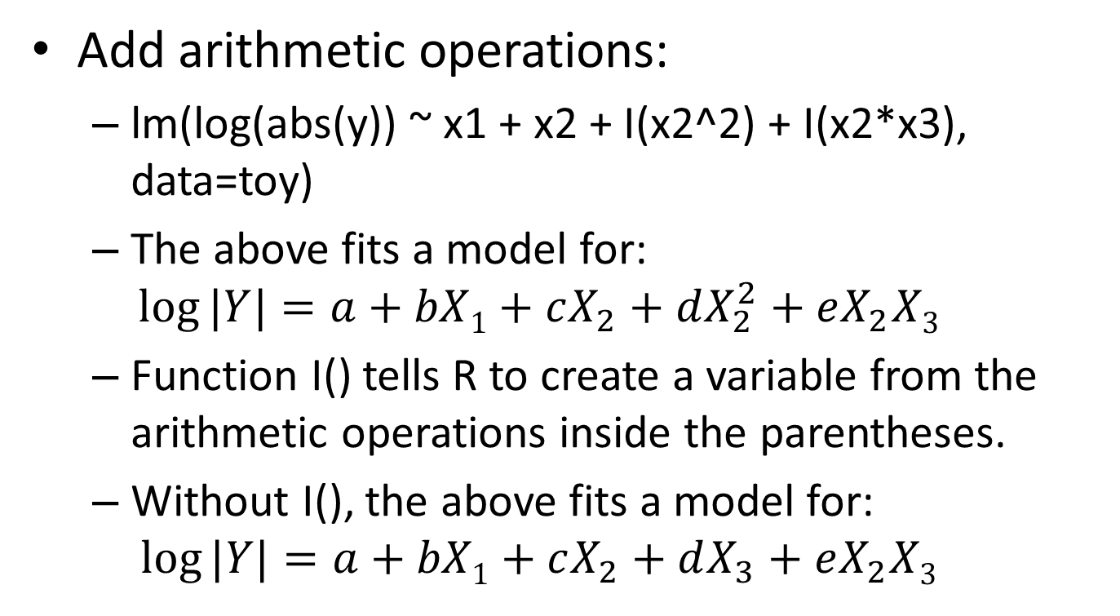
Writing R’s Formulas
Add arithmetic operations:
lm(log(abs(y)) ~ x1 + x2 + I(x2^2) + I(x2*x3), data=toy)
The above fits a model for:
$$\log{|Y|}=a+bX1+cX_{2}+dX_{2}^{2}+eX_{2}X3$$
Function I() tells R to create a variable from the arithmetic operations inside the parentheses.
Without I(), the above fits a model for:
$$\log{|Y|}=a+bX1+cX_{2}+dX_{3}+eX_{2}X3$$

Slide 15
R’s Formula Summary
Symbol | Example | Description
~ | y ~ x1 | Defines the formula (necessary to create a formula object)
+ | y ~ x1 + x2 | Include the variable
- | y ~ -1 +x1 | Delete a term, usually a 1 for the intercept
: | y ~ x1 + x1:x2 | Interaction term
* | y ~ x1*x2 | Interaction between the variables and each individually; same as y ~ x1 + x2 + x1:x2
^ | y ~ (x1, x2, x3)^3 | Include variables and all interactions, up to 3-way interactions
I() | y ~ I(x1^2) | Wrapper for transforming variables without having to create a new variable
poly() | y ~ poly(x1, 2) | Creates polynomial terms up to the degree specified
Note that the intercept is formulas are evaluated from left to right.
Useful note: http://faculty.chicagobooth.edu/richard.hahn/teaching/formulanotation.pdf

Slide 16
Practice 2: Car Price Prediction
Use the “Cars93” dataset in the “MASS” package.
Fit a linear regression model to predict “Price” (with log-transform) based on “Horsepower”, “Weight”, and their interaction.
Which terms are statistically significant with 99% confidence level?

Slide 17
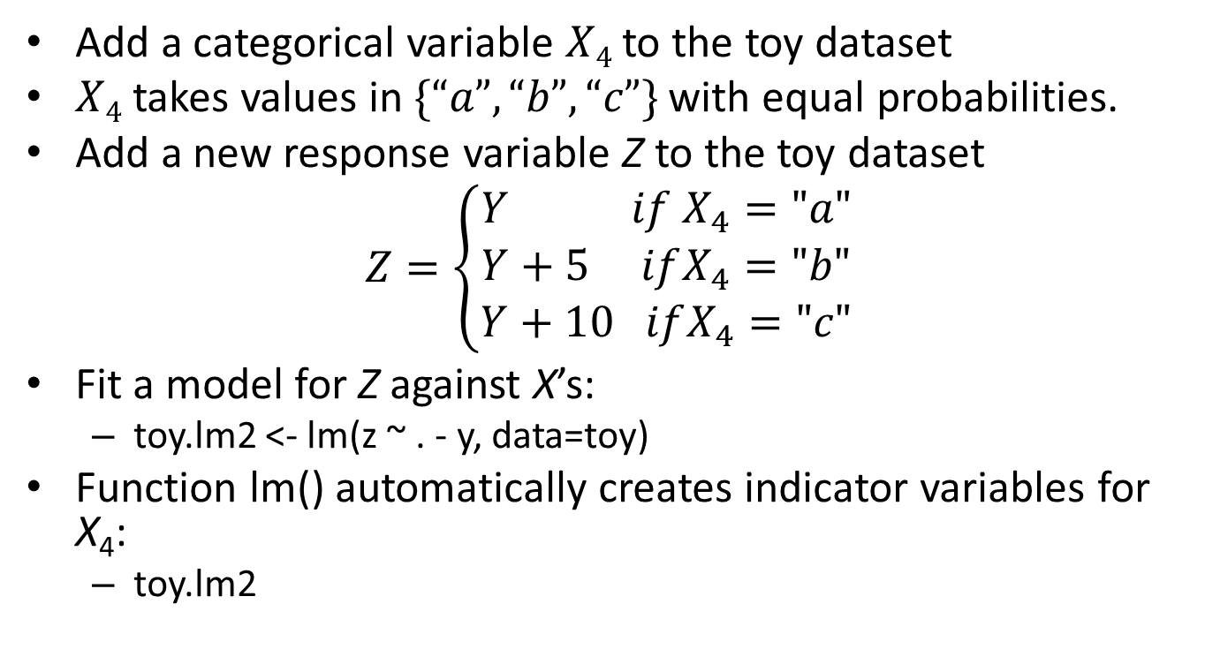
Working with Categorical Predictors
Add a categorical variable $X4$ to the toy dataset
$X4$ takes values in $\{“a”, “b”, “c”\}$ with equal probabilities.
Add a new response variable Z to the toy dataset
$$Z=\left\{\begin{aligned}Y if X_{4}="a" \\ Y+5 ifX_{4}="b" \\ Y+10 ifX_{4}="c"\end{aligned}\right.$$
Fit a model for Z against X’s:
toy.lm2 <- lm(z ~ . - y, data=toy)
Function lm() automatically creates indicator variables for X₄:
toy.lm2

Slide 18
Stepwise Regression
Perform stepwise regression:
toy.lm3 <- step(object=toy.lm2, scope=~ .^2)
Need to provide an initial model to “object” argument
“scope” is optional.
The above asks step() to additionally consider the second-order interactions of the variables used in toy.lm2:
summary(toy.lm3)

Slide 19
Basic Diagnostics Tools
Basic plots:
plot(toy.lm3)
Find more tools (e.g., partial-regression/added-variable plot, partial-residual/component-residual plot, etc.):
Use the “car” package
Tip: Call methods(class=‘lm’). This returns all the generic functions (from all installed packages) that can be used for the class provided to its “class” argument .
Influential points:
influence.measures(toy.lm3) computes many measures related to influential points.
Call summary(influence.measures(toy.lm3)) to quickly obtain potentially influential points.

Slide 20
Predictions
Point predictions:
predict(object=toy.lm3, newdata=toy)
Prediction intervals:
predict(object=toy.lm3, newdata=toy, interval = "prediction")
Confidence intervals:
predict(object=toy.lm3, newdata=toy, interval = "confidence")

Slide 21
Practice 3: Car Price Prediction
Fit an initial linear regression model to predict “Price” (with log-transform) based on “Horsepower”, “Weight”, and “AirBags” using the “Cars93” dataset in the “MASS” package.
Use stepwise regression to select the final model that considers second-order variable interactions.
Produce basic diagnostic plots for the final model.
Compute residuals of the final model.

Slide 22
Part I: Parametric Regression
Linear Regression
Binary Logistic Regression
Multilevel Regression

Slide 23
Binary Logistic Regression
Fitting a Binary Logistic Regression Model for the Iris Dataset
Model Outputs & Basic Diagnostic Tools
Predictions
Practice Examples: Classifying Iris Flowers

Slide 24
Fitting a Binary Logistic Regression Model for the Iris Dataset
Iris dataset
summary(iris)
pairs(iris)
cor(iris[,-5])
Fit a logistic regression model to classify Iris “virginica” against other Iris flowers based on “Sepal.length”, “Sepal.width”, “Petal.Length”, and “Petal.width”.
iris.glm1 <- glm(formula=Species != "virginica" ~ ., family=binomial, data=iris)
family=binomial specifies the binary classification problem.
Call ?family to see more supported distributions and link functions.
!= "virginica “ makes sure glm() to classify two groups: “virginica” and “non-virginica”.

Slide 25
Model Outputs and Basic Diagnostic Tools
Model outputs:
Simple: iris.glm1 or print(iris.glm1)
Detailed: summary(iris.glm1)
Basic diagnostic tools: similar to those of lm()
Basic: plot(iris.glm1)
Find more in: methods(class=‘glm’)

Slide 26
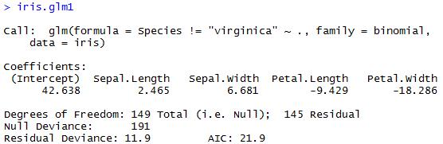
Simple Model Output

Slide 27
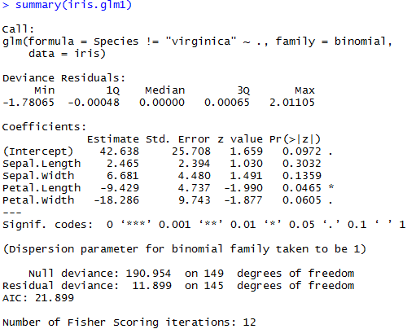
Detailed Model Output
Notes:
deviance plays the role of RSS for a broader class of models. The deviance is negative two times the maximized log-likelihood; the smaller the deviance, the better the fit.

Slide 28
Predictions
Predicted probability values:
iris.glm1_prob <- predict(object=iris.glm1, newdata=iris, type='response')
Predicted log-odd (link function) values:
iris.glm1_logodd <- predict(object=iris.glm1, newdata=iris, type='link')
This is the default for “type” argument

Slide 29
Practice 4: Classify Iris Flowers
Fit a logistic regression model to classify Iris “versicolor” against other Iris flowers based on “Sepal.length”, “Sepal.width”, “Petal.Length”, and “Petal.width”.
Which variables are statistically significant with 95% confidence level?
Create basic diagnostic plots.
Produce the model outputs.
Compute predicted probabilities.

Slide 30
Part I: Parametric Regression
Linear Regression
Binary Logistic Regression
Multilevel Regression

Slide 31
Multilevel Regression
Motivation Example: sleepstudy dataset
Fitting Multilevel Models
More on Multilevel Model Formulas
Model Outputs and Predictions
Basic Diagnostic Plots
Practice Examples: Sleep Study

Slide 32
Sleepstudy Example
Model average reaction time per day for subjects in the sleepstudy dataset of the lme4 package.
Data summary: str(sleepstudy), summary(sleepstudy)
Plot Reaction against Days for each subject:
require(lattice)
xyplot(Reaction ~ Days | Subject, sleepstudy, pch= 20, layout=c(9,2), panel = function(x, y) {panel.grid(h = -1, v = 2)
panel.xyplot(x, y)
panel.lmline(x, y, span=1)})
This plot (next slide) suggests varying intercepts and slopes for different subjects.
Figure 1 in Bates et al. (2015)

Slide 33
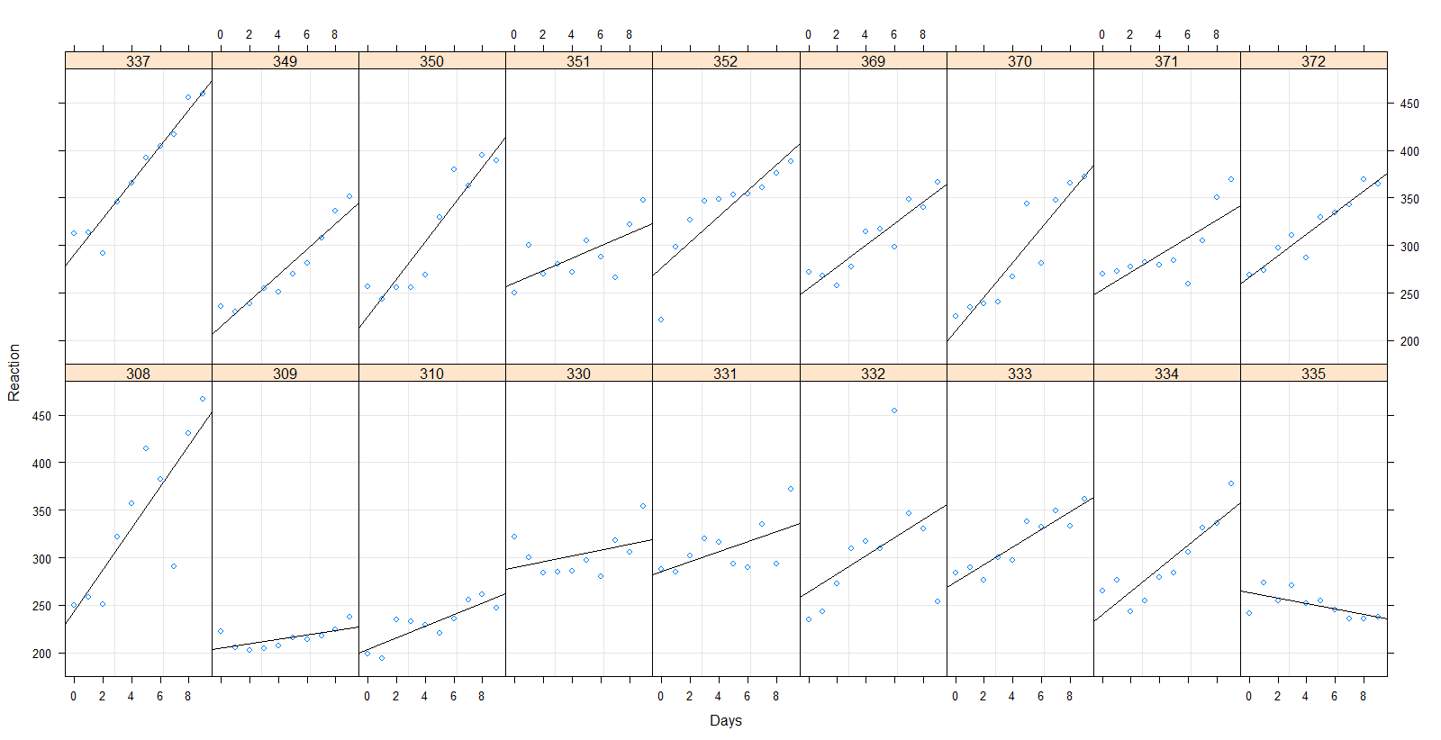
Sleepstudy Example

Slide 34
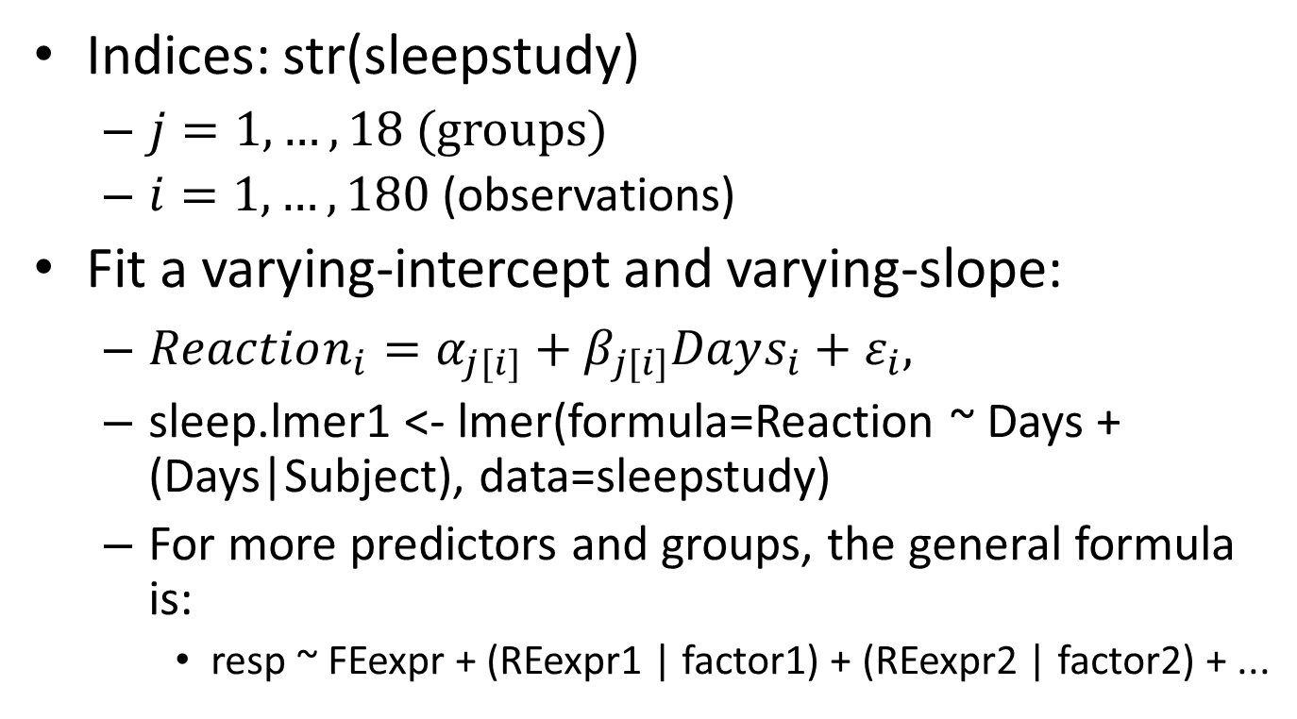
Fitting Multilevel Models
Indices: str(sleepstudy)
$j=1,…,18$ (groups)
$i=1,…,180$ (observations)
Fit a varying-intercept and varying-slope:
$Reaction_{i}=α_{j[i]}+β_{j[i]}Days_{i}+ε_{i},$
sleep.lmer1 <- lmer(formula=Reaction ~ Days + (Days|Subject), data=sleepstudy)
For more predictors and groups, the general formula is:
resp ~ FEexpr + (REexpr1 | factor1) + (REexpr2 | factor2) + ...

Slide 35
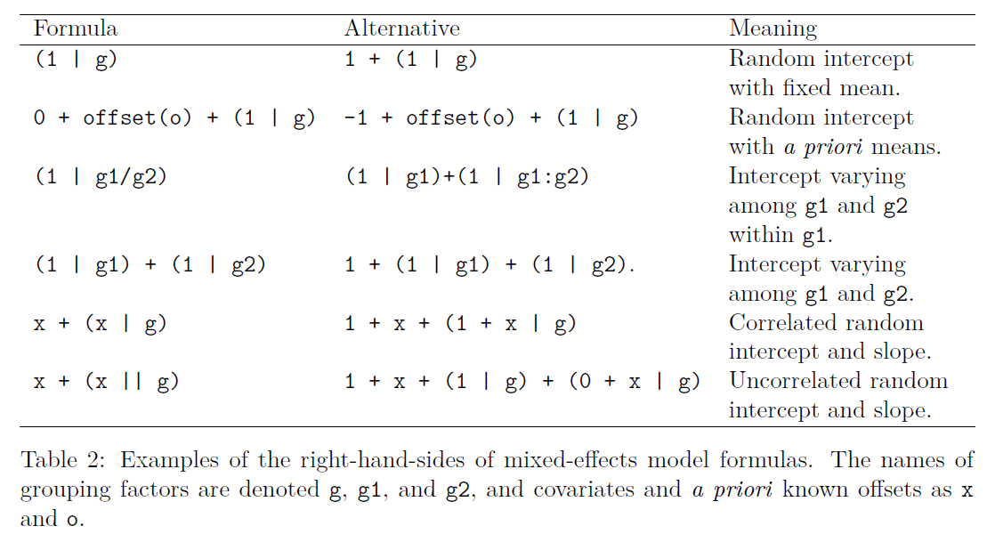
More on Multilevel Model Formulas
Table 2 in Bates et al. (2015)

Slide 36
Model Outputs and Predictions
Outputs:
Model summary: summary(sleep.lmer1)
Model coefficients:
Fixed-effects: fixef(sleep.lmer1)
Conditional modes of random-effects: ranef(sleep.lmer1)
Sums of coefficients of fixed and random effects: coef(sleep.lmer1)
Predictions:
predict(sleep.lmer1, sleepstudy)
Notes:
For linear mixed models the conditional modes of the random effects are also the conditional means.

Slide 37
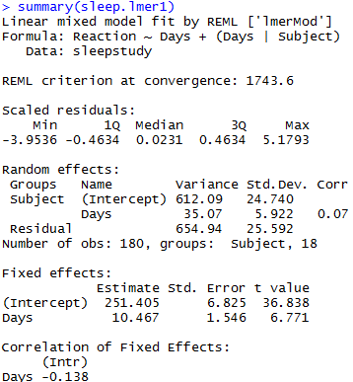
Model Summary
The Restricted Maximum Likelihood value at convergence.
Summary the residuals scaled by standard deviation.
Correlation between intercept in slope

Slide 38
Basic Diagnostic Plots
Fitted vs. residual plots:
plot(sleep.lmer1, type = c("p", "smooth"))
Scale-location plots:
plot(sleep.lmer1, sqrt(abs(resid(.))) ~ fitted(.), type = c("p", "smooth"))
Quantile-quantile plots:
lattice::qqmath(sleep.lmer1, id = 0.05)

Slide 39
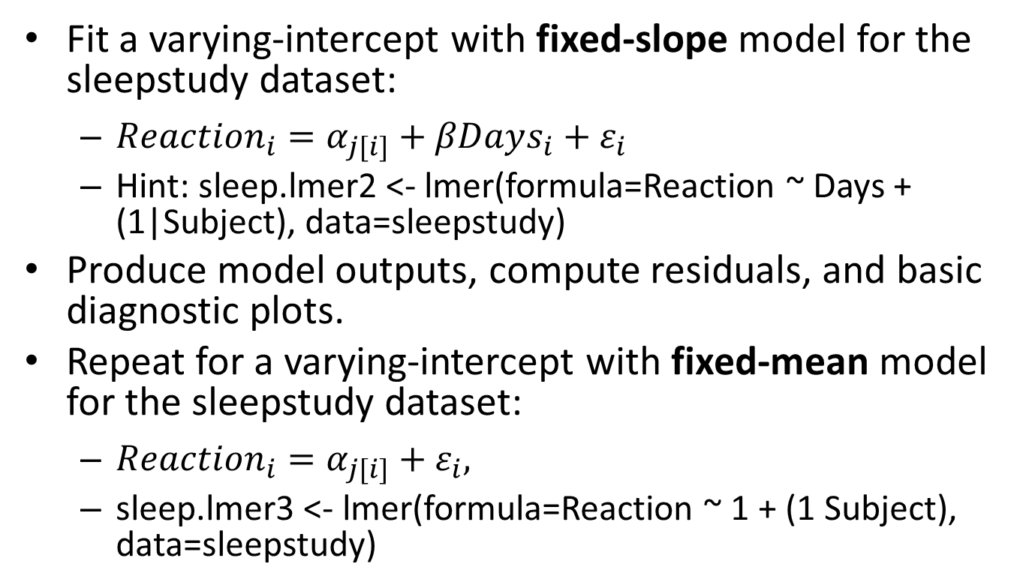
Practice 5: Sleep Study
Fit a varying-intercept with fixed-slope model for the sleepstudy dataset:
$Reaction_{i}=α_{j[i]}+βDays_{i}+ε_{i}$
Hint: sleep.lmer2 <- lmer(formula=Reaction ~ Days + (1|Subject), data=sleepstudy)
Produce model outputs, compute residuals, and basic diagnostic plots.
Repeat for a varying-intercept with fixed-mean model for the sleepstudy dataset:
$Reaction_{i}=α_{j[i]}+ε_{i},$
sleep.lmer3 <- lmer(formula=Reaction ~ 1 + (1 Subject), data=sleepstudy)

Slide 40
Part II: Nonparametric Regression
Regression Trees
Decision Trees
Random Forests

Slide 41
Regression trees
Regression Trees
Recursive Partitioning
Tree Properties
Fitting Regression Trees
Tree Growing and Outputs
Tree Pruning with Cross-validation and Predictions
Practice Examples: Car Price Prediction
Regression Tree Diagnostics (if time permits)

Slide 42
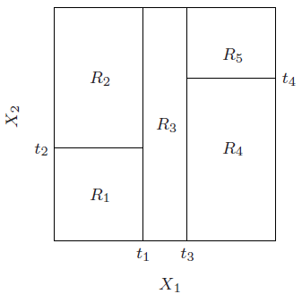
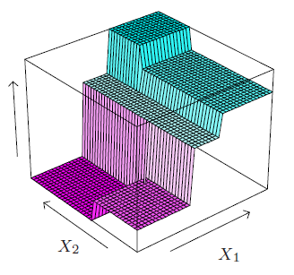
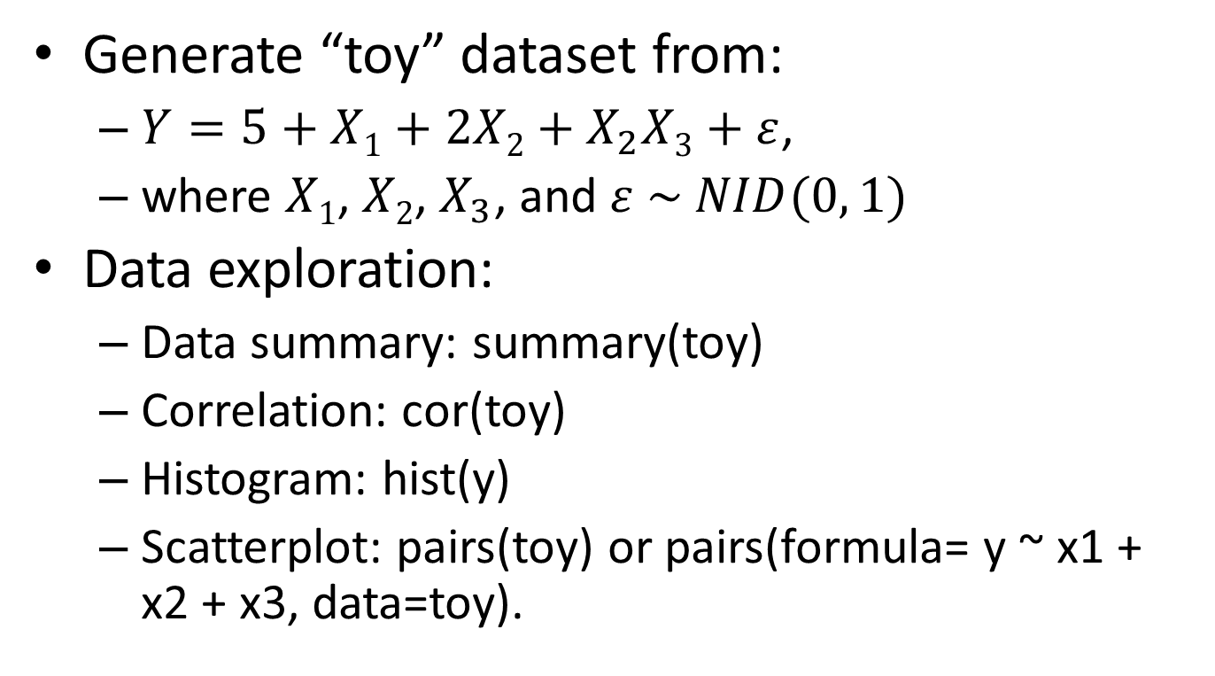
Regression trees
Problem: Predict $y_{i}∈ℝ$given $x_{i}∈ℝ^{d}, i=1, 2, …, n.$
Solution:
Partitioning: $ℝ^{d}$ into M rectangular regions $R_{1},R_{2},…,R_{M}$
Estimation: ${\hat{y}}_{i}=\sum_{m=1}^{M}{{\hat{c}}_{m}\left(y_{i}\right|x_{i}∈R_{m})I(x_{i}∈R_{m})}$
Common choice: ${\hat{c}}_{m}={\overline{y}}_{m}=ave\left(y_{i}\right|x_{i}∈R_{m})$ (least square criterion)
From Figure 9.2 in Hastie et al. (2009)

Slide 43
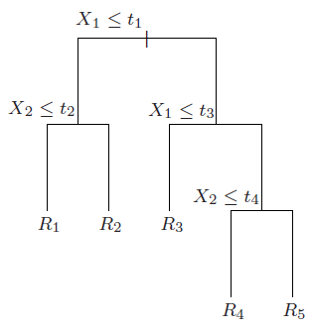
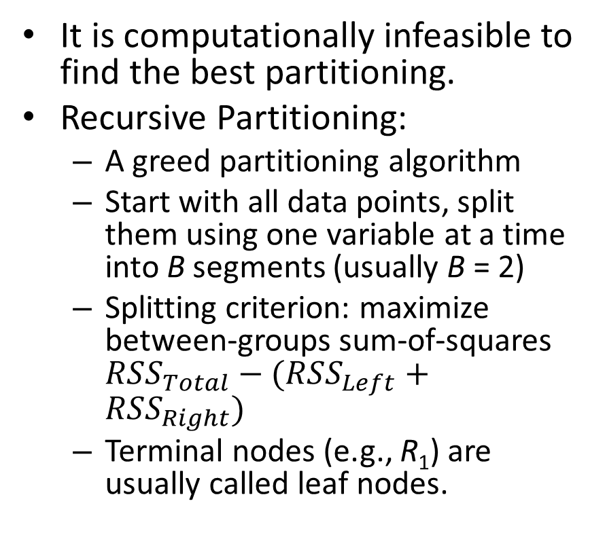
Recursive Partitioning
It is computationally infeasible to find the best partitioning.
Recursive Partitioning:
A greed partitioning algorithm
Start with all data points, split them using one variable at a time into B segments (usually B = 2)
Splitting criterion: maximize between-groups sum-of-squares $RSS_{Total}−(RSS_{Left}+RSS_{Right})$
Terminal nodes (e.g., R₁) are usually called leaf nodes.
From Figure 9.2 in Hastie et al. (2009)

Slide 44
Tree Properties
Pros:
General non-linear relationship (complex variable interaction)
Work directly with categorical predictors
Interpretability
Intrinsically handle missing data by surrogate splits
Fast to fit
Provide variable importance measures
Missing X₂?
X₃ ≤ s₁
R₁ R₂
From Figure 9.2 in Hastie et al. (2009)

Slide 45
Tree Properties
Cons:
Over-fitting: tree pruning with cross-validation.
Instable tree structure: does not affect prediction accuracy.
Non-smooth prediction surface: conditional inference trees.
Not great prediction accuracy: random forests and boosting trees, at the expense of interpretability.
Overall: good for providing quick results, variable screening, and easy model interpretation.

Slide 46
Fitting Regression Trees
We will use rpart, a popular package for fitting regression/decision trees
To see the current parameter setting: rpart.control()
minsplit: can’t split node with less observations.
minbucket: minimum number of observations in a leaf node.
cp: complexity parameter. rpart stops splitting further if the overall R² improvement is less than cp.
maxdepth: maximum depth of the tree.
To change them:
control <- rpart.control(cp=0.01, max.depth=10)

Slide 47
Tree Growing
Use the “Cars93” dataset in the “MASS” package.
Fit a regression tree to predict “Price” based on all variables, except “Manufacturer”, “Model”, “Min.Price”, “Max.Price”, and “Make”.
car.tree1 <- rpart(Price ~ . , data=Cars93[, -c(1, 2, 4, 6, 27)], method="anova", control=control)
cp = reduction in rel error if splitting.

Slide 48
Tree Outputs
Simple: car.tree1
Detailed: summary(car.tree1)
Plotting the fitted tree:
plot(fit, uniform=FALSE, branch=1)
text(fit, use.n = TRUE)
Left branch means the condition is true
Branch lengths indicate reduction in deviance (if uniform=FALSE)
cp = reduction in rel error if splitting.
Notes:
Deviance = Residual sum-of-square of the node
yval = predicted value of the node
Star symbols: leaf nodes

Slide 49
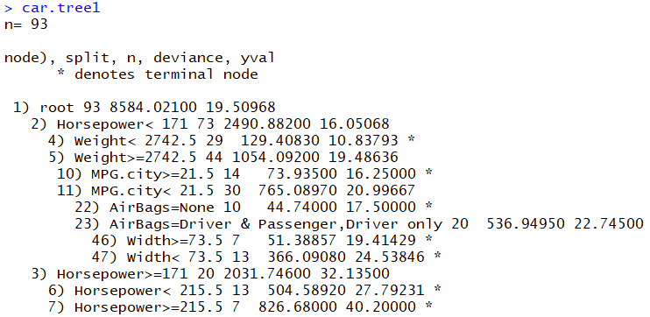
Simple Output
deviance = Residual sum-of-square of the node
yval=Prediction value
* = Leaf node

Slide 50
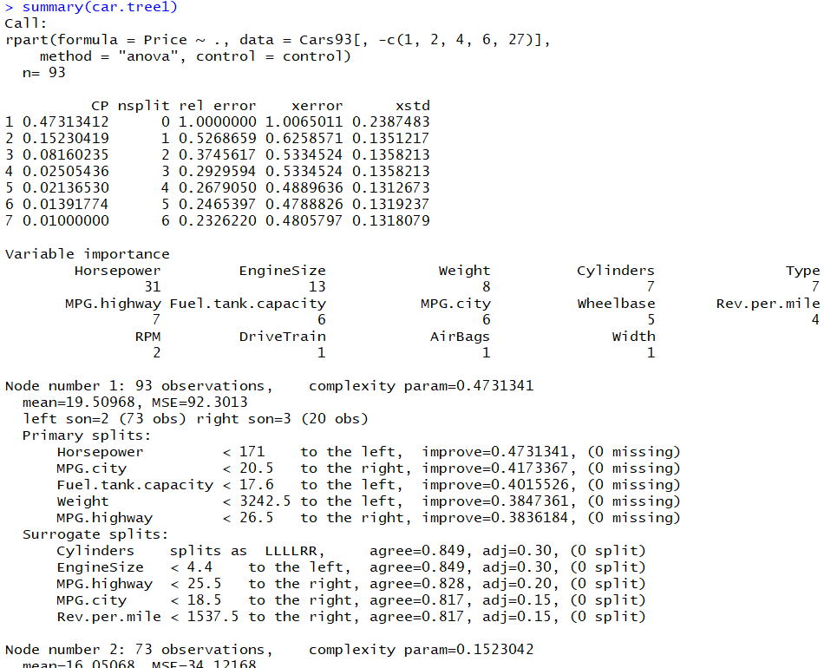
Detailed Output
Cross-validation error table.
(%)
Improve = {RSS reduction in splitting node j}/RSS_{j}
Observations that take one of the first 4 levels of Cylinders is sent to the left node; else they are sent to the right node.
#missing values in this variable
agreement level with the primary split

Slide 51
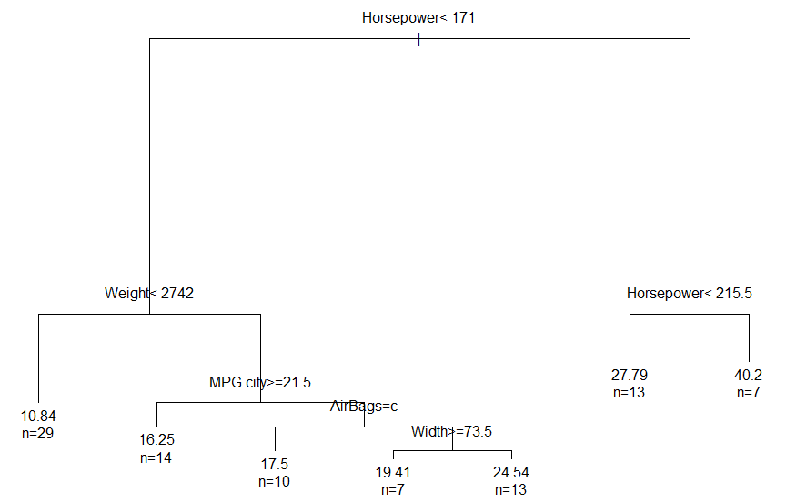
Plot the Tree
YES
NO
Branch lengths indicates the split “improvement”, if uniform=FALSE
Primary splits

Slide 52
Practice 6: Car Price Prediction
Grow a larger tree using cp=0.001
Plot the tree:
Which variables are shown in this tree?
What would be the price predicted for a car with Horsepower = 180?
What are the three most important variables in this tree?
Hint: Call summary()
Do they agree with what we see in the plotted tree?
If you only know EngineSize = 5, can you guess the predicted Price?

Slide 53
Remarks
The tree plots only show primary splits
Although surrogates splits are not plotted, they are still in the model (they are shown in the detailed output)
The variable importance measure in rpart takes into account both primary and surrogate splits.

Slide 54
Best Tree Size?
A common strategy is to grow a large tree and then prune it back based on cross-validation.
R₄

Slide 55
Cross-validation (CV)
Used for estimating “expected prediction error”
Divide data into k partitions (k-fold CV)
For 1 to k:
Fit the model using all but one fold
Compute average prediction error for the validation fold
Compute mean of the k average prediction errors
Training | Training | Training | Training | Validation
Validation error
Validation error
Training | Training | Training | Validation | Training
Validation error
average error
Training | Training | Validation | Training | Training
Validation error
Training | Validation | Training | Training | Training
Validation | Training | Training | Training | Training
Validation error

Slide 56
Internal rpart Cross-validation
rpart() automatically performs cross-validation if setting “xval” > 1 (default is xval = 10).
Plot (relative) CV error against tree size (or complexity parameter):
plotcp(car.tree2), see next slide.
The horizontal dotted line in this plot is Choose the tree size below this line. Usually, a smaller tree is preferred.
Remarks:
Do not use the rpart internal cross-validation for comparing with other models.

Slide 57
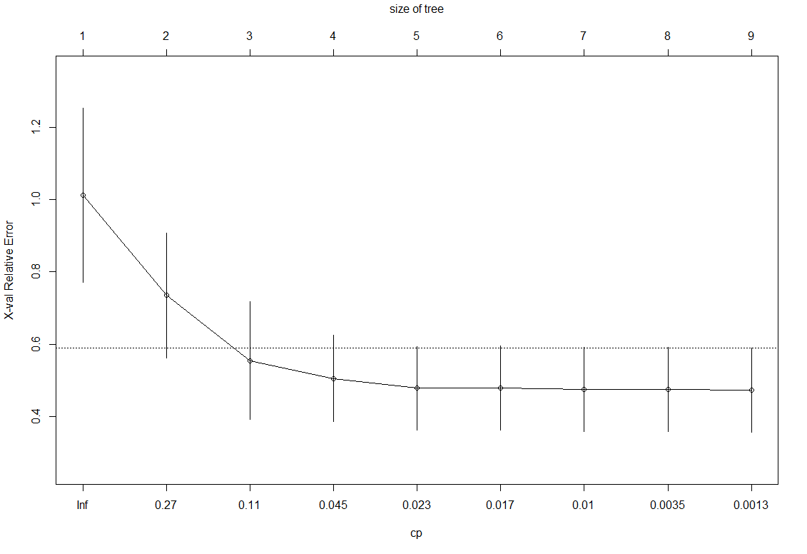
Internal rpart Cross-validation
Relative CV error = 1 – R²
“min relative CV error + 1 standard error”

Slide 58
Tree Pruning
To prune tree:
car.tree3 <- prune(car.tree2, cp=.017)
Plot the new tree:
plot(car.tree3, uniform=FALSE, branch=1, margin=rep(.1, 4))
text(car.tree3, use.n = TRUE)

Slide 59
Predictions
To make predictions:
predict(object=car.tree3, newdata=Cars93, type='vector')
Suppose we only know EngineSize = 5:
Create such an observation:
newob <- Cars93[1:2,]
for (i in 1:ncol(Cars93)) newob[1, i] <- NA
newob[1,]$EngineSize <- 5
Predict car price for this new observation:
predict(object=car.tree3, newdata=newob[1,], type='vector')

Slide 60
Practice 7: Car Price Prediction
Plot (relative) CV error against tree size for the pruned tree.
Prune further this tree to the smallest size without compromising much CV error.
Compute residuals

Slide 61
Regression Tree Diagnostics
Based on the lecture of Tom Minka, provided in this webpage.
This discussion uses the below R commands:
control <- rpart.control(minscplit=20, cp=0.01)
car.tree5 <- rpart(Price ~ Horsepower + Weight , data=Cars93, control=control)
plotcp(car.tree5)
res <- residuals(car.tree5)
plot(Cars93$Price, res)
car.tree6 <- rpart(res ~ ., data=Cars93[,-c(1, 2, 4, 5, 6, 27)])
plot(car.tree6, uniform=FALSE, branch=1, margin=rep(.1, 4)); text(car.tree6, use.n = TRUE)
car.tree7 <- rpart(res ~ Wheelbase + Turn.circle, data=Cars93)
plot(car.tree7, uniform=FALSE, branch=1, margin=rep(.1, 4)); text(car.tree7, use.n = TRUE)

Slide 62
Part II: Nonparametric Regression
Regression Trees
Decision Trees
Random Forests

Slide 63
Decision Trees
Decision Trees
Fitting Decision Trees
Outputs and Predictions
Practice Example: Iris flower classification

Slide 64
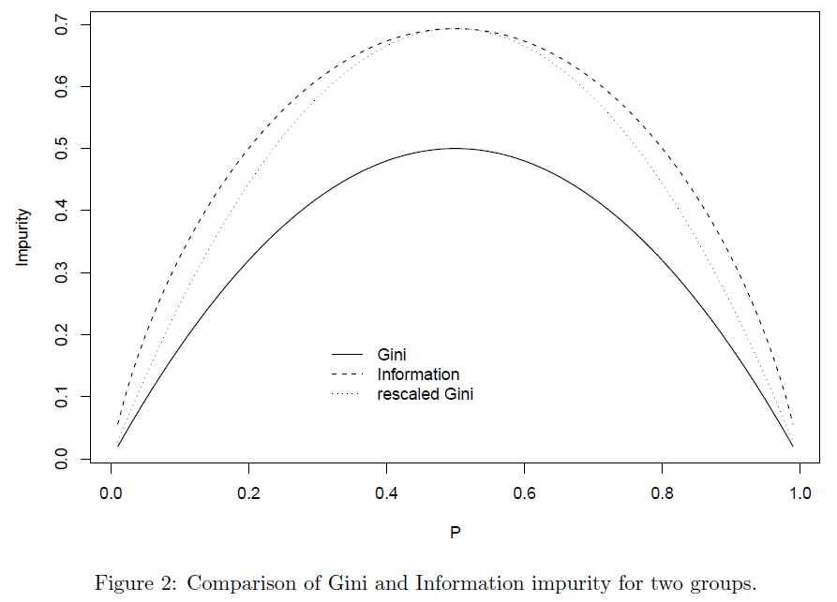
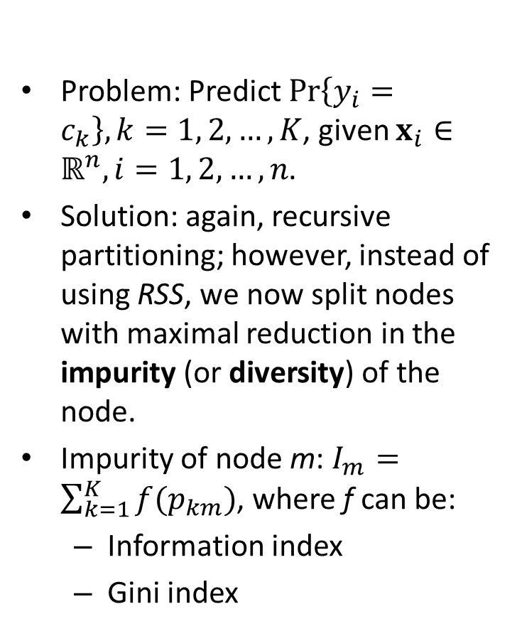
Decision Trees
Problem: Predict $Pr\left\{y_{i}=c_{k}\right\}, k=1, 2,…,K$, given $x_{i}∈ℝ^{n}, i=1, 2, …, n$.
Solution: again, recursive partitioning; however, instead of using RSS, we now split nodes with maximal reduction in the impurity (or diversity) of the node.
Impurity of node m: $I_{m}=\sum_{k=1}^{K}{f(p_{km})}$, where f can be:
Information index
Gini index
-p*log(p)
p(1 - p)
Figure 2 in Therneau and Atkinson (2018).

Slide 65
Fitting Decision Trees
Fit a decision tree to classify three types of Iris flowers based on “Sepal.length”, “Sepal.width”, “Petal.Length”, and “Petal.width”.
Everything is similar to fitting a regression tree, except that method = “class”:
control <- rpart.control(cp=0.001)
iris.tree1 <- rpart(Species ~ ., data=iris, method='class', control=control)

Slide 66
Decision Tree Outputs
iris.tree1
summary(iris.tree1)
plot(iris.tree1, uniform=FALSE, branch=1, margin=rep(.1, 4))
text(iris.tree1, use.n = TRUE, fancy=TRUE)
plotcp(iris.tree1)
Notes:
Loss = 0/1 loss
yval (yrpob) = Predicted class (class probabilities)

Slide 67
Predictions
Predicted class probabilities:
predict(iris.tree1, iris, type="prob")
Predicted classes:
predict(iris.tree1, iris, type="class")
Training errors can be accessed via:
residuals(iris.tree1)

Slide 68
Practice 8: Iris Flower Classification
Change rpart parameters to:
minsplit=10, cp=0.01, xval=5
Fit a decision tree to classify Iris flowers (Species variable) using all other variables using the iris dataset.
Prune the tree to the smallest size possible without compromising much CV error rate.
Produce model outputs and plot the pruned tree.
Predicted classes for the training data?

Slide 69
Part II: Nonparametric Regression
Regression Trees
Decision Trees
Random Forests

Slide 70
Random Forests
Random Forests
Fitting Random Forests
Plots, Predictions, and some other tools
Practice Example: Car Price Prediction

Slide 71
Random Forests
Random forest is a bagging approach.
The prediction of a random forest is the average/majority-vote of the predictions of B regression/decision trees.
Each tree is fitted on a bootstrap sample of the training data.
To decorrelate trees (i.e., to reduce the appearance of highly important variables in the trees), each split only considers a subset of m variables out of the total p variables.

Slide 72
Fitting Random Forests
Fit a random forest to classify three types of Iris flowers based on “Sepal.length”, “Sepal.width”, “Petal.Length”, and “Petal.width”.
iris.rf1 <- randomForest(Species ~ ., data=iris, ntree=1000, mtry=2, importance=TRUE)
Model output:
iris.rf1

Slide 73
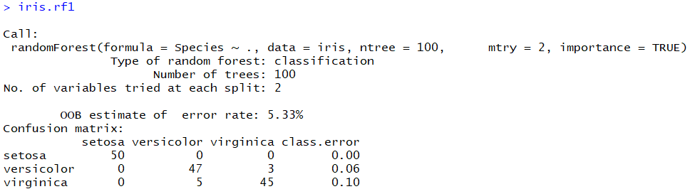
Random Forest Output
OOB means Out-of-Bag. Each bootstrap sample contains a training sample and a OOB sample.
Hence, the error rate reported here is not the training error rate, but an estimate of the expected classification error rate.

Slide 74
Plots
Out-of-bag classification error rate against number of trees:
plot(iris.rf1)
a curve for each class + a curve for the average
Variable importance plots:
varImpPlot(iris.rf1)
Partial dependence plots:
partialPlot(x=iris.rf1, pred.data=iris, x.var=Petal.Width, which.class="versicolor")
Notes:
Partial dependence plots capture the marginal effect of the selected variables on the response after integrating out the other variables.

Slide 75
Predictions
Predicted values:
predict(object=iris.rf3, newdata=iris, type='response’)
Predicted class probabilities:
predict(object=iris.rf3, newdata=iris, type='prob')

Slide 76
Some Other Tools
Add more trees:
iris.rf2 <- grow(iris.rf1, how.many=100)
iris.rf2
Combine two random forests:
iris.rf3 <- combine(iris.rf1, iris.rf2)
iris.rf3
Find optimal “mtry” value:
tuneRF(iris[,-5], iris[,5], mtryStart=1, stepFactor = 2)
Notes:
Find optimal “mtry” value with respect to OOB error

Slide 77
Practice 9: Car Price Prediction
Fit a random forest to predict “Price” based on all variables, except “Manufacturer”, “Model”, “Min.Price”, “Max.Price”, and “Make”, using the “Cars93” dataset in the “MASS” package.
Note: the randomForest package automatically detect the problem via (probably) the type of the response variable. To check variable type, call: class(Cars93$Price). To set variable type, call: as.numeric(), as.factor(), etc.
randomForest() cannot handle data with missing values. The below can be used to impute the data.
cars <- rfImpute(Price ~ ., data=Cars93[, -c(1, 2, 4, 6, 27)], iter=5, ntree=300)

Slide 78
Practice 9: Car Price Prediction
Find the optimal “mtry”.
Fit a random forest to predict Price using all other variables in the “cars” data frame.
What is the model R²?
How many trees are enough?
Which variables are important?
Plot partial dependence plot on Horsepower.
Compute residuals.

Slide 79
Summary
Part I: Parametric Models
Linear Regression: lm()
Binary Logistic Regression: glm()
Multilevel Regression: lme4::lmer()
Part II: Nonparametric Models
Regression Trees: rpart::rpart()
Decision Trees: rpart::rpart()
Random Forests: ramdomForest:: ramdomForest()

Slide 80
References
Bates D., Mächler M., Bolker B.M., and Walker S.C. (2015), “Fitting Linear Mixed-Effects Models Using lme4”, Journal of Statistical Software, v67. DOI 10.18637/jss.v067.i01
Therneau T. and Atkinson B. (2018) rpart: Recursive Partitioning and Regression Trees. R package version 4.1-13. https://CRAN.R-project.org/package=rpart

