Slide 1
Statistical Modeling & Learning in R
Data Science and Programming Summer Workshop Series
07/25/2018
Anh T. Bui
IEMS, Northwestern University

Slide 2
Information
This workshop is a part of the Data Science and Programming Summer Workshop Series: https://sites.northwestern.edu/summerworkshops
Workshop materials can be found in this repository: https://github.com/anhbui2013/Statistical-Modeling-and-Learning-in-R
Instruction for downloading from GitHub can be found here: https://sites.northwestern.edu/summerworkshops/resources/downloading-from-github/
There will be an practice session starting at 1:30PM in this room.
Please sign in on the attendance page now.

Slide 3
Setup
Open RStudio
Open file “Rmain.R” from the workshop GitHub repository.
This R script contains all the R commands used in this presentation.

Slide 4
Outline
Introduction
Part I: Parametric Models
Linear Regression
Binary Logistic Regression
Multilevel Regression
Break (15 mins)
Part II: Nonparametric Models
Regression Trees
Decision Trees
Random Forests
Summary

Slide 5
Part I: Parametric Regression
Linear Regression
Binary Logistic Regression
Multilevel Regression

Slide 6
Linear Regression
Quick Start with a Toy Example
Writing R’s Formulas
Working with Categorical Predictors
Stepwise Regression
Basic Diagnostic Tools
Predictions
Practice Examples: Car Price Prediction

Slide 7
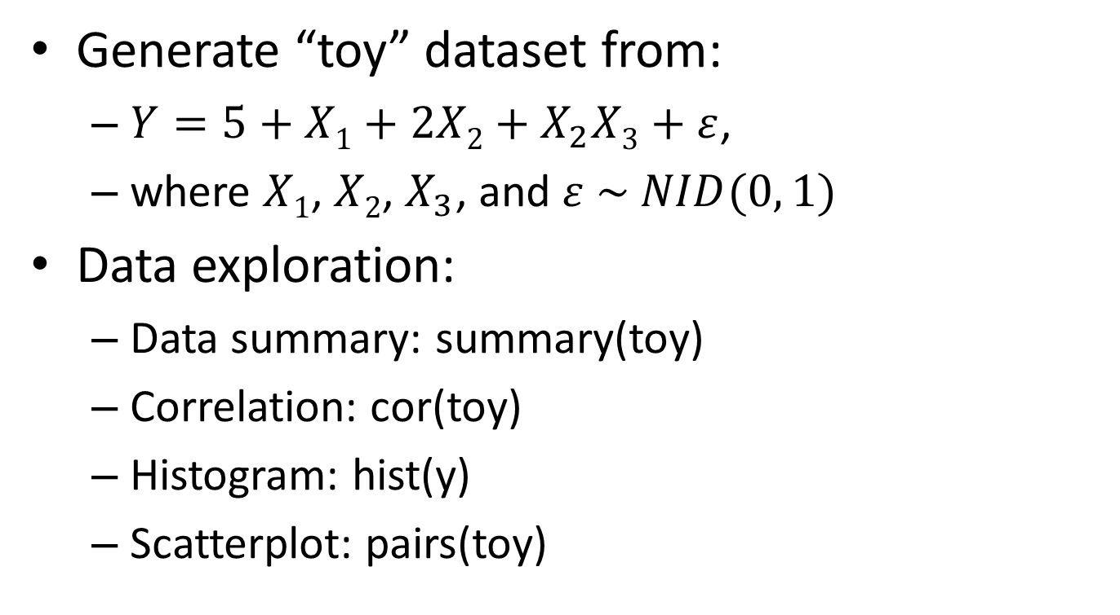
Toy Example
Generate “toy” dataset from:
$Y=5+X1+2X2+X_{2}X3+ε$,
where $X1$, $X2$, $X_{3}$, and $ε \sim NID(0, 1)$
Data exploration:
Data summary: summary(toy)
Correlation: cor(toy)
Histogram: hist(y)
Scatterplot: pairs(toy)

Slide 8
Toy Example
Fit a linear regression model:
toy.lm1 <- lm(formula=y ~ x1 + x2 + x3, data=toy)
Need to provide a “formula”
“data” is not needed if variables in the formula are already in the global environment.
See model outputs:
Long: summary(toy.lm1)
Short: toy.lm1 or print(toy.lm1)

Slide 9
Practice 1: Car Price Prediction
Use the “Cars93” dataset in the “MASS” package: require(MASS)
Explore this dataset.
Fit a linear regression model to predict “Price” based on “Horsepower” and “Weight”.
Which variables are statistically significant?

Slide 10
Writing R’s Formulas
Use all variables in the dataset:
lm(y ~ ., data=toy)
Add variable interactions:
lm(y ~ . + x1:x2 + x1:x3 + x2:x3, data=toy)
Or: lm(y ~ (x1 + x2 + x3)^2, data=toy)
Or: lm(y ~ . + .^2, data=toy)
Add all possible interactions:
lm(y ~ x1*x2*x3, data=toy)
Or: lm(y ~ (x1 + x2 + x3)^3, data=toy)
Or: lm(y ~ . + .^2 + .^3, data=toy)

Slide 11
Writing R’s Formulas
Remove intercept:
lm(y ~ x1*x2*x3 - 1, data=toy)
Remove a variable
lm(y ~ x1*x2*x3 - x3, data=toy)
Remove all variables:
lm(y ~ x1*x2*x3 - ., data=toy)
Formulas are evaluated from left to right. The below commands produce different models:
lm(y ~ . + x1*x2*x3 - (x1+x2+x3)^2, data=toy)
lm(y ~ x1*x2*x3 - (x1+x2+x3)^2 + ., data=toy)

Slide 12
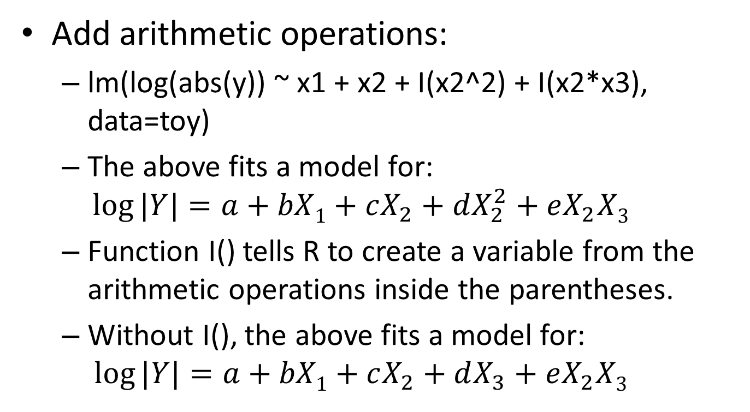
Writing R’s Formulas
Add arithmetic operations:
lm(log(abs(y)) ~ x1 + x2 + I(x2^2) + I(x2*x3), data=toy)
The above fits a model for:
$$\log{|Y|}=a+bX1+cX_{2}+dX_{2}^{2}+eX_{2}X3$$
Function I() tells R to create a variable from the arithmetic operations inside the parentheses.
Without I(), the above fits a model for:
$$\log{|Y|}=a+bX1+cX_{2}+dX_{3}+eX_{2}X3$$

Slide 13
Practice 2: Car Price Prediction
Use the “Cars93” dataset in the “MASS” package.
Fit a linear regression model to predict “Price” (with log-transform) based on “Horsepower”, “Weight”, and their interaction.
Which terms are statistically significant?

Slide 14
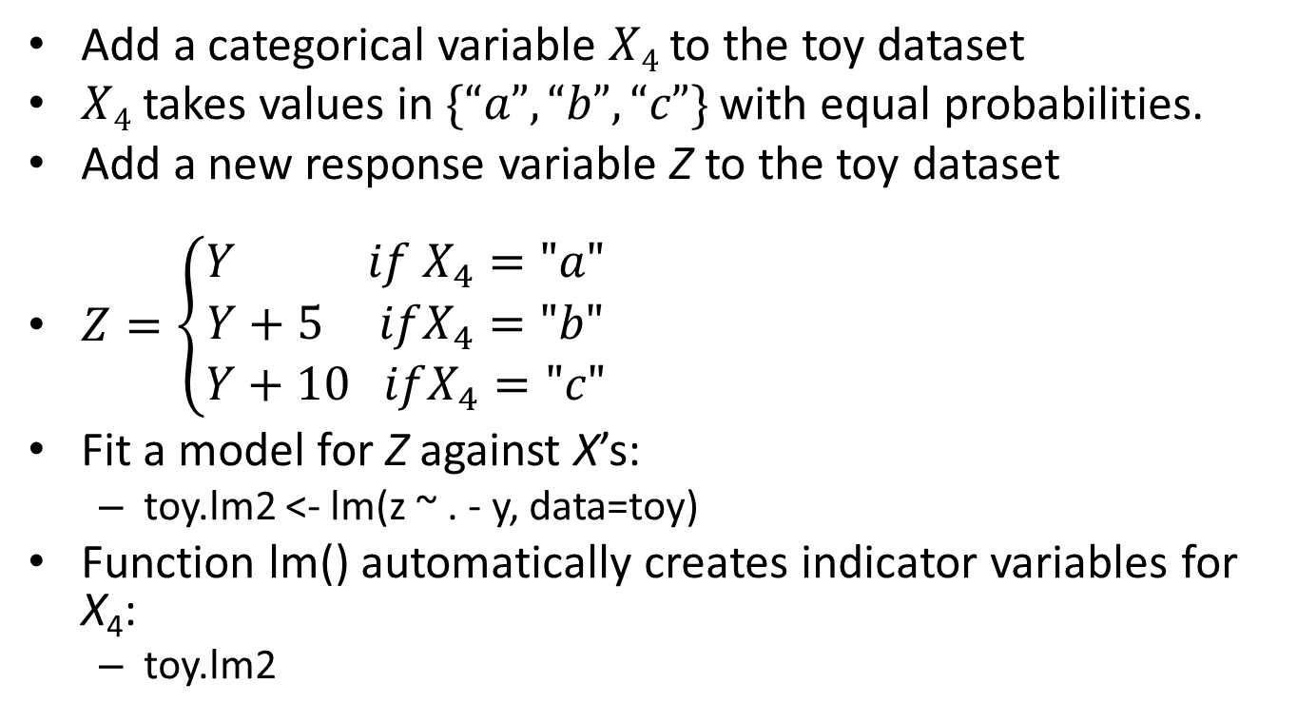
Working with Categorical Predictors
Add a categorical variable $X4$ to the toy dataset
$X4$ takes values in $\{“a”, “b”, “c”\}$ with equal probabilities.
Add a new response variable Z to the toy dataset
$Z=\left\{\begin{aligned}Y if X_{4}="a" \\ Y+5 ifX_{4}="b" \\ Y+10 ifX_{4}="c"\end{aligned}\right.$
Fit a model for Z against X’s:
toy.lm2 <- lm(z ~ . - y, data=toy)
Function lm() automatically creates indicator variables for X₄:
toy.lm2

Slide 15
Stepwise Regression
Perform stepwise regression:
toy.lm3 <- step(object=toy.lm2, scope=~ .^2)
Need to provide an initial model to “object” argument
“scope” is optional.
The above asks step() to additionally consider the second-order interactions of the variables used in toy.lm2:
summary(toy.lm3)

Slide 16
Basic Diagnostics Tools
Basic plots:
plot(toy.lm3)
Find more tools (e.g., partial-regression/added-variable plot, partial-residual/component-residual plot, etc.) using:
methods(class=‘lm’)

Slide 17
Predictions
Point Predictions:
predict(object=toy.lm3, newdata=toy)
Prediction Intervals:
predict(object=toy.lm3, newdata=toy, interval = "prediction")
Confidence intervals:
predict(object=toy.lm3, newdata=toy, interval = "confidence")

Slide 18
Practice 3: Car Price Prediction
Fit an initial linear regression model to predict “Price” (with log-transform) based on “Horsepower”, “Weight”, and “AirBags” using the “Cars93” dataset in the “MASS” package.
Use stepwise regression to select the final model that considers second-order variable interactions.
Produce basic diagnostic plots for the final model.
Compute residuals of the final model.

Slide 19
Part I: Parametric Regression
Linear Regression
Binary Logistic Regression
Multilevel Regression

Slide 20
Binary Logistic Regression
Fitting a Binary Logistic Regression Model for the Iris Dataset
Model Outputs & Basic Diagnostic Tools
Predictions
Practice Examples: Classifying Iris Flowers

Slide 21
Fitting a Binary Logistic Regression Model for the Iris Dataset
Iris dataset
summary(iris)
pairs(iris)
cor(iris$Petal.Length, iris$Petal.Width)
Fit a logistic regression model to classify Iris “virginica” against other Iris flowers based on “Sepal.length”, “Sepal.width”, “Petal.Length”, and “Petal.width”.
iris.glm1 <- glm(formula=Species != "virginica" ~ ., family=binomial, data=iris)

Slide 22
Model Outputs and Basic Diagnostic Tools
Model outputs:
summary(iris.glm1)
Basic diagnostic tools: similar to those of lm()
Basic: plot(iris.glm1)
Find more in: methods(class=‘glm’)

Slide 23
Predictions
Predicted probability values:
iris.glm1_prob <- predict(object=iris.glm1, newdata=iris, type='response')
Predicted log-odd (link function) values:
iris.glm1_logodd <- predict(object=iris.glm1, newdata=iris, type='link')
This is the default for “type” argument

Slide 24
Practice 4: Classify Iris Flowers
Fit an initial logistic regression model to classify Iris “versicolor” against other Iris flowers based on “Sepal.length”, “Sepal.width”, “Petal.Length”, and “Petal.width”.
Use stepwise regression to select the final model.
Create basic diagnostic plots
Produce final model outputs.
Compute predicted probabilities of the final model.

Slide 25
Part I: Parametric Regression
Linear Regression
Binary Logistic Regression
Multilevel Regression

Slide 26
Multilevel Regression
Motivation Example: sleepstudy dataset
Fitting Multilevel Models
More on Multilevel Model Formulas
Model Outputs and Predictions
Basic Diagnostic Plots
Practice Examples: Sleep Study

Slide 27
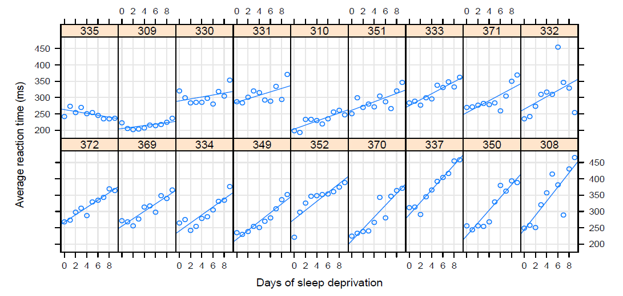
Sleepstudy Example
Model average reaction time per day for subjects in the sleepstudy dataset of the lme4 package.
The below plots this relationship for each subject, suggesting varying intercepts and slopes for different subjects.
Figure 1 in Bates et al. (2015)

Slide 28
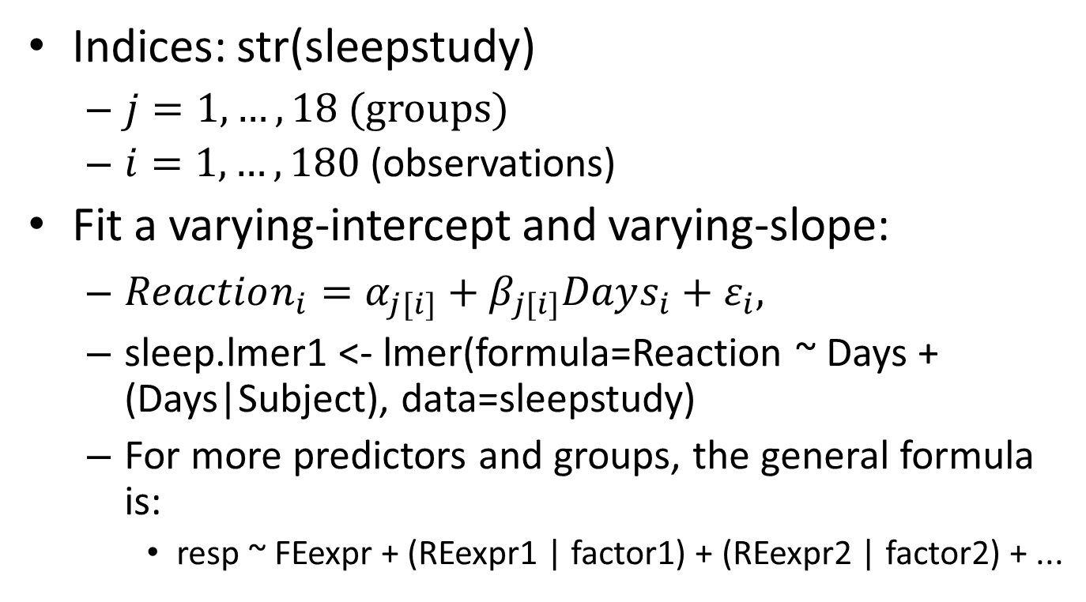
Fitting Multilevel Models
Indices: str(sleepstudy)
$j=1,…,18$ (groups)
$i=1,…,180$ (observations)
Fit a varying-intercept and varying-slope:
$Reaction_{i}=α_{j[i]}+β_{j[i]}Days_{i}+ε_{i},$
sleep.lmer1 <- lmer(formula=Reaction ~ Days + (Days|Subject), data=sleepstudy)
For more predictors and groups, the general formula is:
resp ~ FEexpr + (REexpr1 | factor1) + (REexpr2 | factor2) + ...

Slide 29
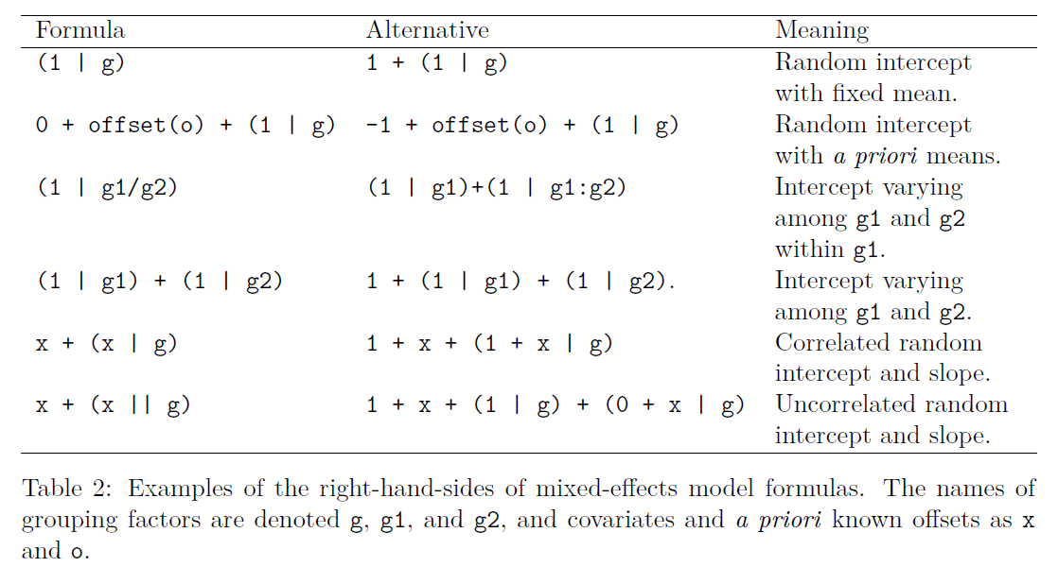
More on Multilevel Model Formulas
Table 2 in Bates et al. (2015)

Slide 30
Model Outputs and Predictions
Outputs:
summary(sleep.lmer1)
coef(sleep.lmer1)
Predictions:
predict(sleep.lmer1, sleepstudy)

Slide 31
Basic Diagnostic Plots
Fitted vs. residual plots:
plot(sleep.lmer1, type = c("p", "smooth"))
Scale-location plots:
plot(sleep.lmer1, sqrt(abs(resid(.))) ~ fitted(.), type = c("p", "smooth"))
Quantile-quantile plots:
lattice::qqmath(sleep.lmer1, id = 0.05)

Slide 32
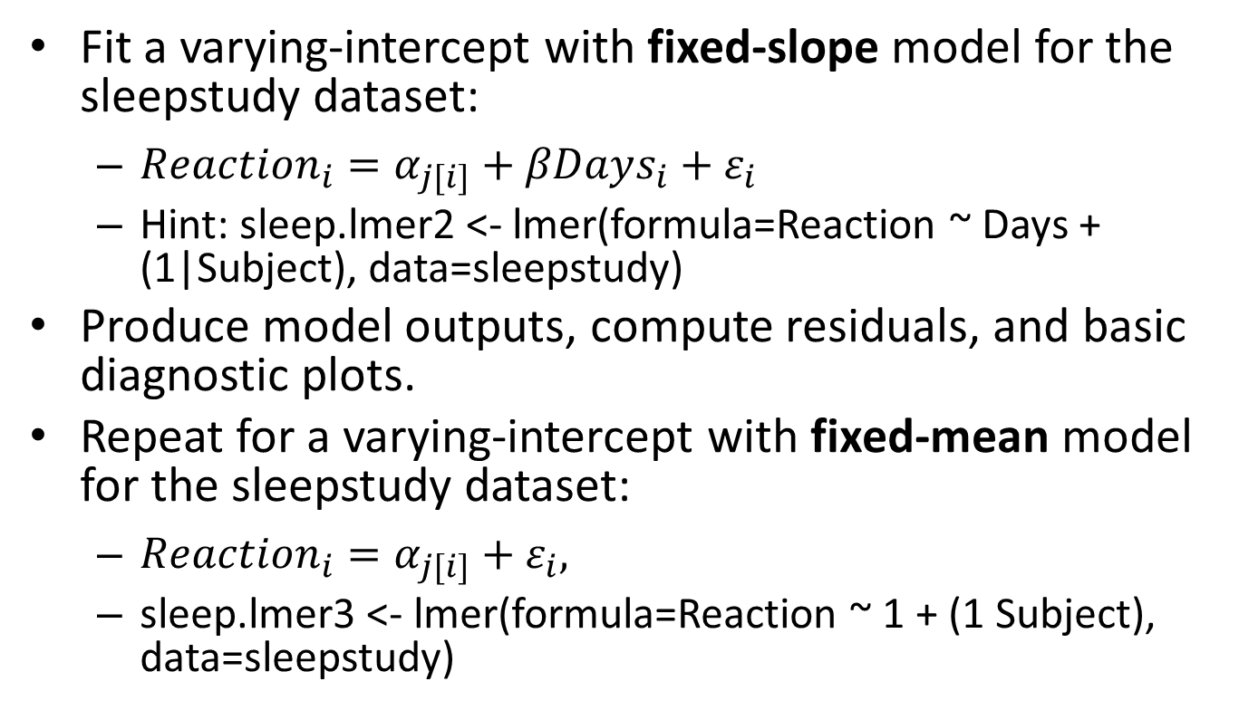
Practice 5: Sleep Study
Fit a varying-intercept with fixed-slope model for the sleepstudy dataset:
$Reaction_{i}=α_{j[i]}+βDays_{i}+ε_{i}$
Hint: sleep.lmer2 <- lmer(formula=Reaction ~ Days + (1|Subject), data=sleepstudy)
Produce model outputs, compute residuals, and basic diagnostic plots.
Repeat for a varying-intercept with fixed-mean model for the sleepstudy dataset:
$Reaction_{i}=α_{j[i]}+ε_{i},$
sleep.lmer3 <- lmer(formula=Reaction ~ 1 + (1 Subject), data=sleepstudy)

Slide 33
Part II: Nonparametric Regression
Regression Trees
Decision Trees
Random Forests

Slide 34
Regression trees
Regression Trees
Recursive Partitioning
Tree Properties
Fitting Regression Trees
Tree Growing and Outputs
Tree Pruning with Cross-validation and Predictions
Practice Examples: Car Price Prediction
Regression Tree Diagnostics (if time permits)

Slide 35
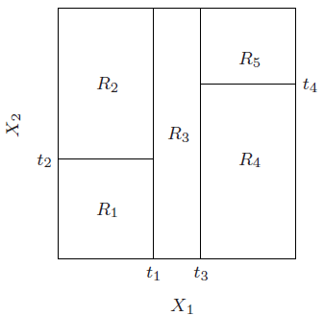
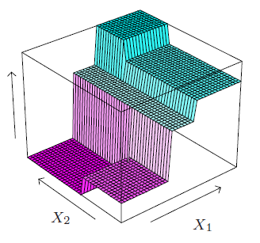
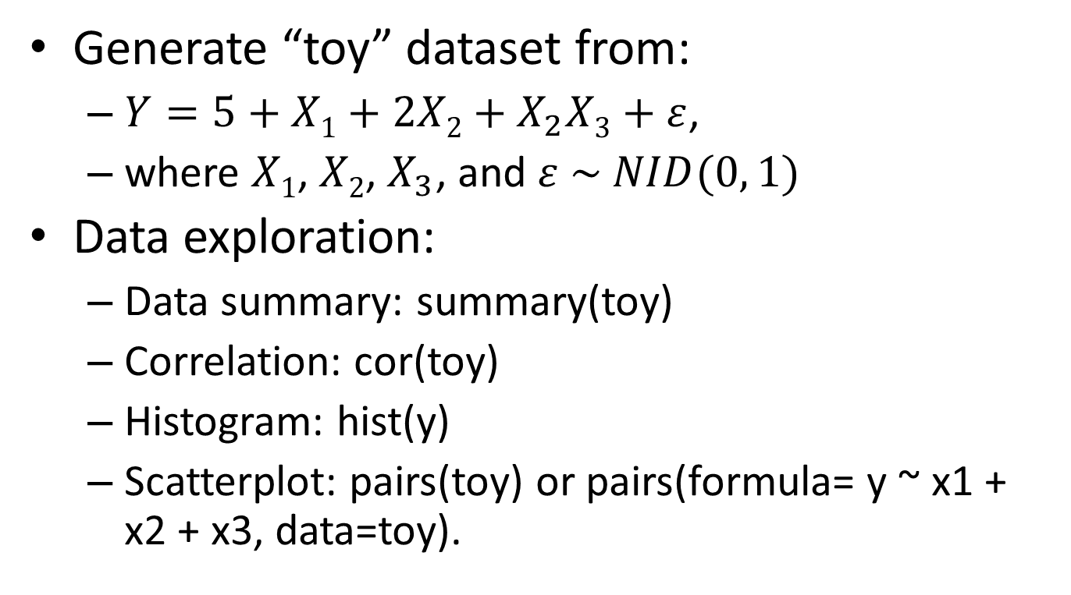
Regression trees
Problem: Predict $y_{i}∈ℝ$given $x_{i}∈ℝ^{d}, i=1, 2, …, n.$
Solution:
Partitioning: $ℝ^{d}$ into M rectangular regions $R_{1},R_{2},…,R_{M}$
Estimation: ${\hat{y}}_{i}=\sum_{m=1}^{M}{{\hat{c}}_{m}\left(y_{i}\right|x_{i}∈R_{m})I(x_{i}∈R_{m})}$
Common choice: ${\hat{c}}_{m}={\overline{y}}_{m}=ave\left(y_{i}\right|x_{i}∈R_{m})$ (least square criterion)
From Figure 9.2 in Hastie et al. (2009)

Slide 36
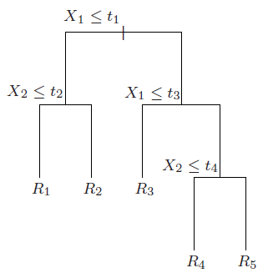
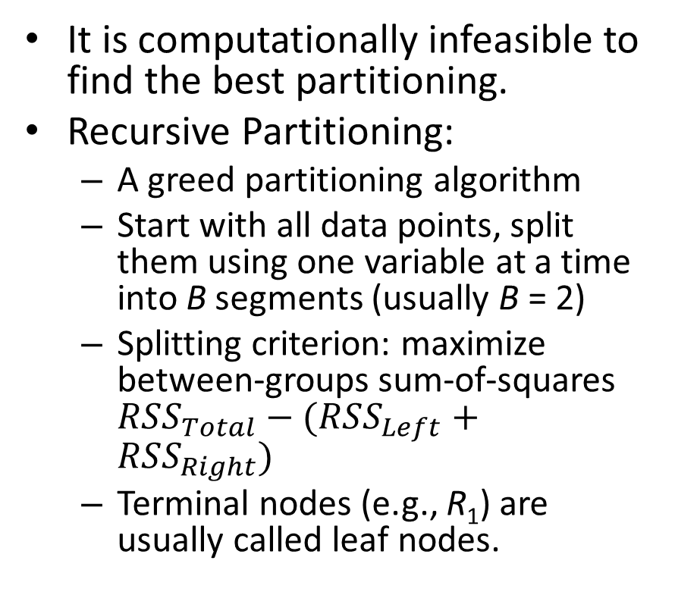
Recursive Partitioning
It is computationally infeasible to find the best partitioning.
Recursive Partitioning:
A greed partitioning algorithm
Start with all data points, split them using one variable at a time into B segments (usually B = 2)
Splitting criterion: maximize between-groups sum-of-squares $RSS_{Total}−(RSS_{Left}+RSS_{Right})$
Terminal nodes (e.g., R₁) are usually called leaf nodes.
From Figure 9.2 in Hastie et al. (2009)

Slide 37
Tree Properties
Pros:
General non-linear relationship (complex variable interaction)
Work directly with categorical predictors
Interpretability
Intrinsically handle missing data by surrogate splits
Fast to fit
Provide variable importance measures
Missing X₂?
X₃ ≤ s₁
R₁ R₂
From Figure 9.2 in Hastie et al. (2009)

Slide 38
Tree Properties
Cons:
Over-fitting: tree pruning with cross-validation.
Instable tree structure: does not affect prediction accuracy.
Non-smooth prediction surface: conditional inference trees.
Not great prediction accuracy: random forests and boosting trees, at the expense of interpretability.
Overall: good for providing quick results, variable screening, and easy model interpretation.

Slide 39
Fitting Regression Trees
We will use rpart, a popular package for fitting regression/decision trees
To see the current parameter setting: rpart.control()
minsplit: can’t split node with less observations.
minbucket: minimum number of observations in a leaf node.
cp: complexity parameter. rpart stops splitting further if the overall R² improvement is less than cp.
maxdepth: maximum depth of the tree.
To change them:
control <- rpart.control(cp=0.01, max.depth=10)

Slide 40
Tree Growing
Use the “Cars93” dataset in the “MASS” package.
Fit a regression tree to predict “Price” based on all variables, except “Manufacturer”, “Model”, “Min.Price”, “Max.Price”, and “Make”.
car.tree1 <- rpart(Price ~ . , data=Cars93[, -c(1, 2, 4, 6, 27)], method="anova", control=control)
cp = reduction in rel error if splitting.

Slide 41
Tree Outputs
Simple: car.tree1
Detailed: summary(car.tree1)
Plotting the fitted tree:
plot(fit, uniform=FALSE, branch=1)
text(fit, use.n = TRUE)
Left branch means the condition is true
Branch lengths indicate reduction in deviance (if uniform=FALSE)
cp = reduction in rel error if splitting.
Notes:
Deviance = Residual sum-of-square of the node
yval = predicted value of the node
Star symbols: leaf nodes

Slide 42
Practice 6: Car Price Prediction
Grow a larger tree using cp=0.001
Plot the tree:
Which variables are used in this tree?
What would be the price predicted for a car with Horsepower = 180?
What are the three most important variables in this tree?
Hint: use summary()
Do they agree with what we see in the plotted tree?
If you only know EngineSize = 5, can you guess the predicted Price?

Slide 43
Remarks
The tree plots only show primary splits
Although surrogates splits are not plotted, they are still in the model (use summary() to see them)
The variable importance measure in rpart takes into account both primary and surrogate splits.
This is necessary when multicollinearity is present.

Slide 44
Best Tree Size?
A common strategy is to grow a large tree and then prune it back based on cross-validation.
R₄

Slide 45
Cross-validation (CV)
Used for estimating “expected prediction error”
Divide data into k partitions (k-fold CV)
For 1 to k:
Fit the model using all but one fold
Compute average prediction error for the validation fold
Compute mean of the k average prediction errors
Training | Training | Training | Training | Validation
Validation error
Validation error
Training | Training | Training | Validation | Training
Validation error
average error
Training | Training | Validation | Training | Training
Validation error
Training | Validation | Training | Training | Training
Validation | Training | Training | Training | Training
Validation error

Slide 46
Internal rpart Cross-validation
rpart() automatically performs cross-validation if setting “xval” > 1 (default is xval = 10).
Plot (relative) CV error against tree size (or complexity parameter): plotcp(car.tree2)
The y-axis is the relative CV error = 1 – R²
The x-axis is the tree size (increasing) or complexity parameter (decreasing)
The horizontal dotted line in this plot is “min relative CV error + 1 standard error”.
Choose the tree size below this line. Usually, a smaller tree is preferred.
Remarks: Do not use the rpart internal cross-validation for comparing with other models.

Slide 47
Tree Pruning
To prune tree:
car.tree3 <- prune(car.tree2, cp=.017)
Plot the new tree:
plot(car.tree3, uniform=FALSE, branch=1, margin=rep(.1, 4))
text(car.tree3, use.n = TRUE)

Slide 48
Predictions
To make predictions:
predict(object=car.tree3, newdata=Cars93, type='vector')
Suppose we only know EngineSize = 5:
Create such an observation:
newob <- Cars93[1:2,]
for (i in 1:ncol(Cars93)) newob[1, i] <- NA
newob[1,]$EngineSize <- 5
Predict car price for this new observation:
predict(object=car.tree3, newdata=newob[1,], type='vector')

Slide 49
Practice 7: Car Price Prediction
Plot (relative) CV error against tree size for the pruned tree.
Prune further this tree to the smallest size without compromising much CV error.
Compute residuals

Slide 50
Regression Tree Diagnostics
Based on the lecture of Tom Minka, provided in this webpage.
This discussion uses the below R commands:
car.tree5 <- rpart(Price ~ Horsepower + Weight , data=Cars93, control=control)
plotcp(car.tree5)
res <- residuals(car.tree5)
plot(Cars93$Price, res)
car.tree6 <- rpart(res ~ ., data=Cars93[,-c(1, 2, 4, 5, 6, 27)])
plot(car.tree6, uniform=FALSE, branch=1, margin=rep(.1, 4)); text(car.tree6, use.n = TRUE)
car.tree7 <- rpart(res ~ Wheelbase + Turn.circle, data=Cars93)
plot(car.tree7, uniform=FALSE, branch=1, margin=rep(.1, 4)); text(car.tree7, use.n = TRUE)

Slide 51
Part II: Nonparametric Regression
Regression Trees
Decision Trees
Random Forests

Slide 52
Decision Trees
Decision Trees
Fitting Decision Trees
Outputs and Predictions
Practice Example: Iris flower classification

Slide 53
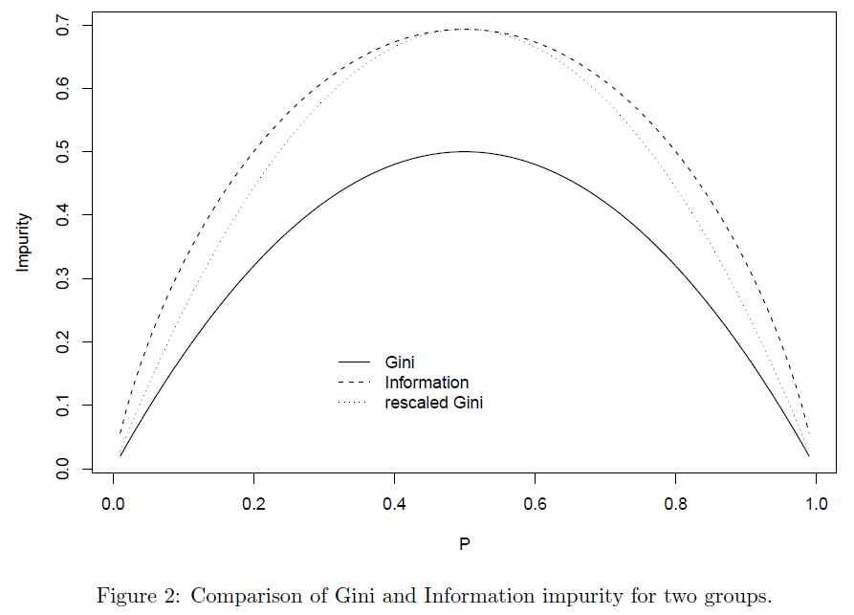
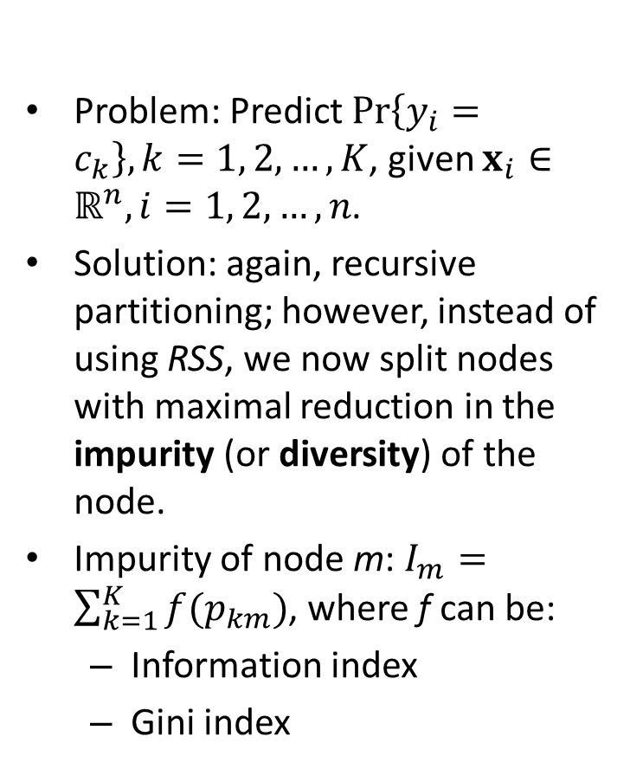
Decision Trees
Problem: Predict $Pr\left\{y_{i}=c_{k}\right\}, k=1, 2,…,K$, given $x_{i}∈ℝ^{n}, i=1, 2, …, n$.
Solution: again, recursive partitioning; however, instead of using RSS, we now split nodes with maximal reduction in the impurity (or diversity) of the node.
Impurity of node m: $I_{m}=\sum_{k=1}^{K}{f(p_{km})}$, where f can be:
Information index
Gini index
-p*log(p)
p(1 - p)
Figure 2 in Therneau and Atkinson (2018).

Slide 54
Fitting Decision Trees
Fit a decision tree to classify three types of Iris flowers based on “Sepal.length”, “Sepal.width”, “Petal.Length”, and “Petal.width”.
Everything is similar to fitting a regression tree, except that method = “class”:
control <- rpart.control(cp=0.001)
iris.tree1 <- rpart(Species ~ ., data=iris, method='class', control=control)

Slide 55
Decision Tree Outputs
iris.tree1
summary(iris.tree1)
plot(iris.tree1, uniform=FALSE, branch=1, margin=rep(.1, 4))
text(iris.tree1, use.n = TRUE, fancy=TRUE)
plotcp(iris.tree1)
Notes:
Loss = 0/1 loss
yval (yrpob) = Predicted class (class probabilities)

Slide 56
Predictions
Predicted class probabilities:
predict(iris.tree1, iris, type="prob")
Predicted class:
predict(iris.tree1, iris, type="class")
Training error can be accessed via:
residuals(iris.tree1)

Slide 57
Practice 8: Iris Flower Classification
Change rpart parameters to:
minsplit=10, cp=0.01, xval=5
Fit a decision tree to classify Iris flowers (Species variable) using all other variables using the iris dataset.
Prune the tree to the smallest size possible without compromising much CV error rate.
Produce model outputs and plot the pruned tree.
Predicted classes for the training data?

Slide 58
Part II: Nonparametric Regression
Regression Trees
Decision Trees
Random Forests

Slide 59
Random Forests
Random Forests
Fitting Random Forests
Plots, Predictions, and some other tools
Practice Example: Car Price Prediction

Slide 60
Random Forests
Random forest is a bagging approach.
The prediction of a random forest is the average/majority-vote of the predictions of B regression/decision trees.
Each tree is fitted on a bootstrap sample of the training data.
To decorrelate trees (i.e., to reduce the appearance of highly important variables in the trees), each split only considers a subset of m variables out of the total p variables.

Slide 61
Fitting Random Forests
Fit a random forest to classify three types of Iris flowers based on “Sepal.length”, “Sepal.width”, “Petal.Length”, and “Petal.width”.
iris.rf1 <- randomForest(Species ~ ., data=iris, ntree=1000, mtry=2, importance=TRUE)
Outputs:
iris.rf1

Slide 62
Plots
Out-of-bag Classification Error Rate:
plot(iris.rf1)
a curve for each class + a curve for the average
Variable Importance Plots:
varImpPlot(iris.rf1)
Partial Dependence Plots:
partialPlot(x=iris.rf1, pred.data=iris, x.var=Petal.Width, which.class="versicolor")

Slide 63
Predictions
Predicted values:
predict(object=iris.rf3, newdata=iris, type='response’)
Predicted class probabilities:
predict(object=iris.rf3, newdata=iris, type='prob')

Slide 64
Some Other Tools
Add more trees:
iris.rf2 <- grow(iris.rf1, how.many=100)
iris.rf2
Combine two random forests:
iris.rf3 <- combine(iris.rf1, iris.rf2)
iris.rf3
Find optimal “mtry” value:
tuneRF(iris[,-5], iris[,5], mtryStart=1, stepFactor = 2)
Notes:
Find optimal “mtry” value with respect to OOB error

Slide 65
Practice 9: Car Price Prediction
Fit a random forest to predict “Price” based on all variables, except “Manufacturer”, “Model”, “Min.Price”, “Max.Price”, and “Make”, using the “Cars93” dataset in the “MASS” package.
Note: the randomForest package automatically detect the problem via (probably) the type of the response variable. To check variable type, use: class(Cars93$Price). To set variable type, use: as.numeric(), as.factor(), etc.
randomForest() cannot handle data with missing values. The below can be used to impute the data.
cars <- rfImpute(Price ~ ., data=Cars93[, -c(1, 2, 4, 6, 27)], iter=5, ntree=300)

Slide 66
Practice 9: Car Price Prediction
Find optimal “mtry”.
Fit a random forest to predict Price using all other variables in the “cars” data frame.
What is the model R²?
How many trees are enough?
Which variables are important?
Plot partial dependence plot on Horsepower.
Compute residuals.

Slide 67
Summary
Part I: Parametric Models
Linear Regression: lm()
Binary Logistic Regression: glm()
Multilevel Regression: lme4::lmer()
Part II: Nonparametric Models
Regression Trees: rpart::rpart()
Decision Trees: rpart::rpart()
Random Forests: ramdomForest:: ramdomForest()

Slide 68
References
Bates D., Mächler M., Bolker B.M., and Walker S.C. (2015), “Fitting Linear Mixed-Effects Models Using lme4”, Journal of Statistical Software, v67. DOI 10.18637/jss.v067.i01
Therneau T. and Atkinson B. (2018) rpart: Recursive Partitioning and Regression Trees. R package version 4.1-13. https://CRAN.R-project.org/package=rpart

