Slide 1
Tet Holiday In My Hometown

Slide 2
Main Item
I.
II.
Activiti
Food
III.
IV.
Decor
Clothes

Slide 3
I.
Activiti

Slide 4
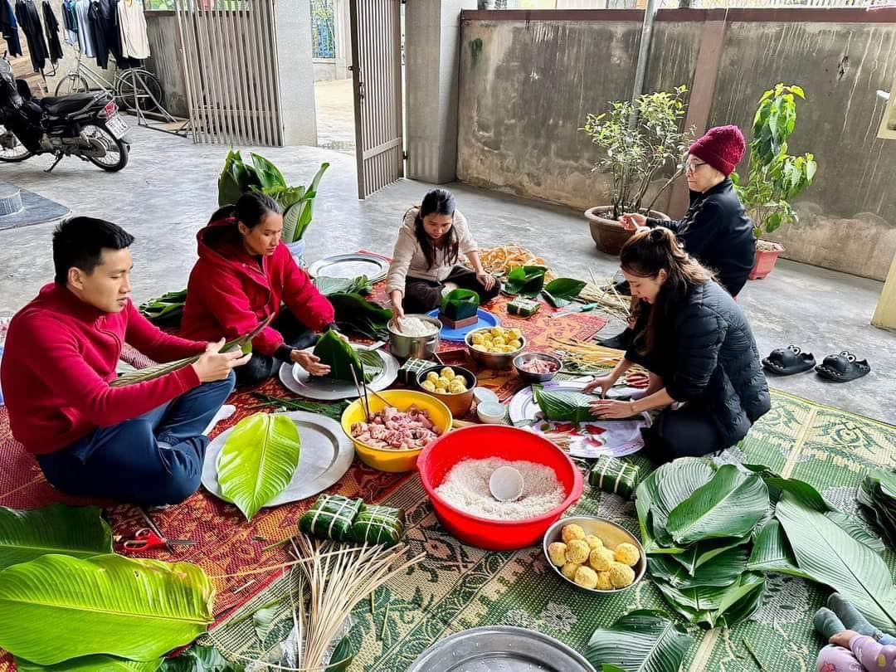
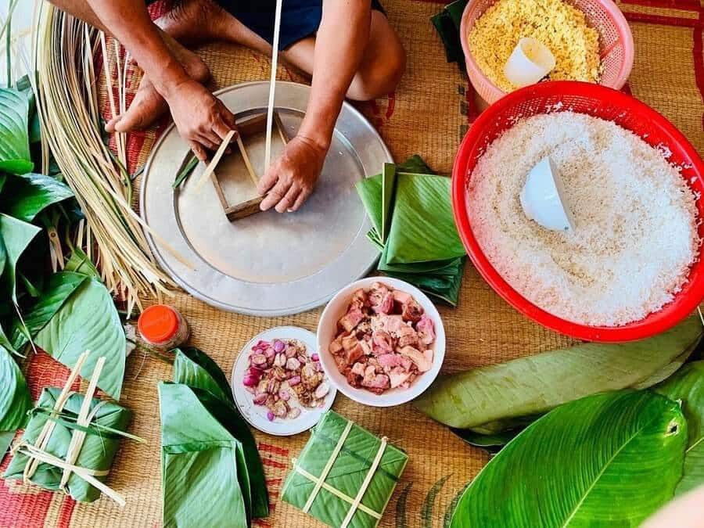
I. Activiti
Banh Chung
Banh Tet

Slide 5
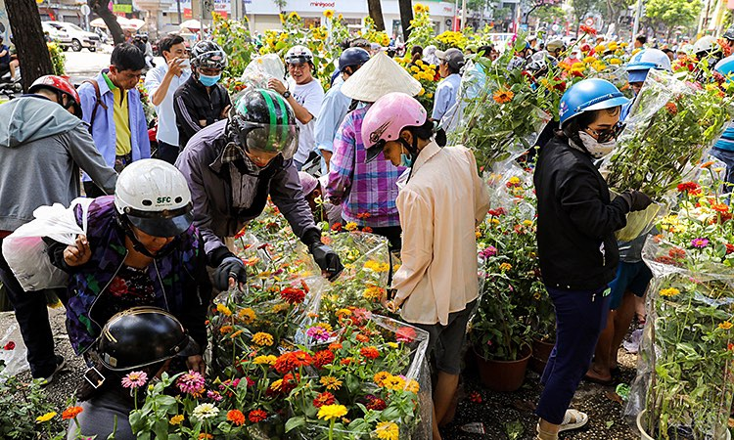
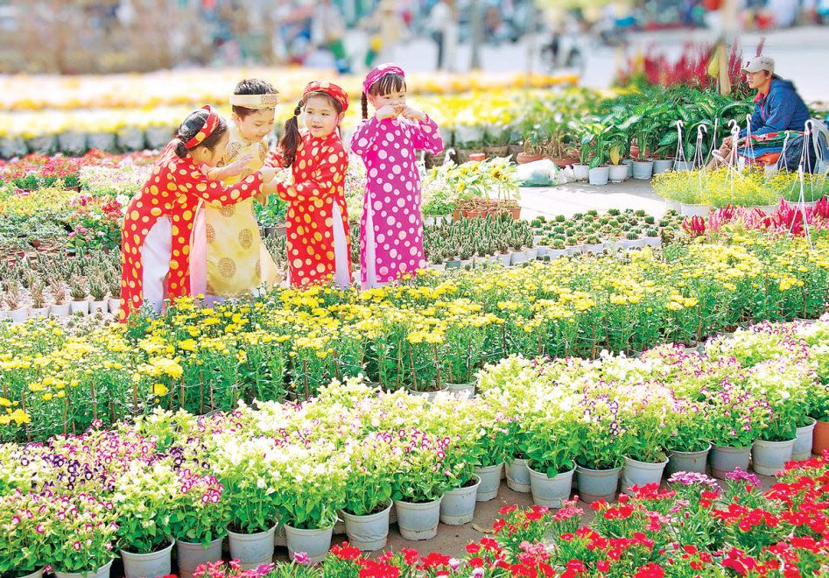
I. Activiti
Flower Market

Slide 6
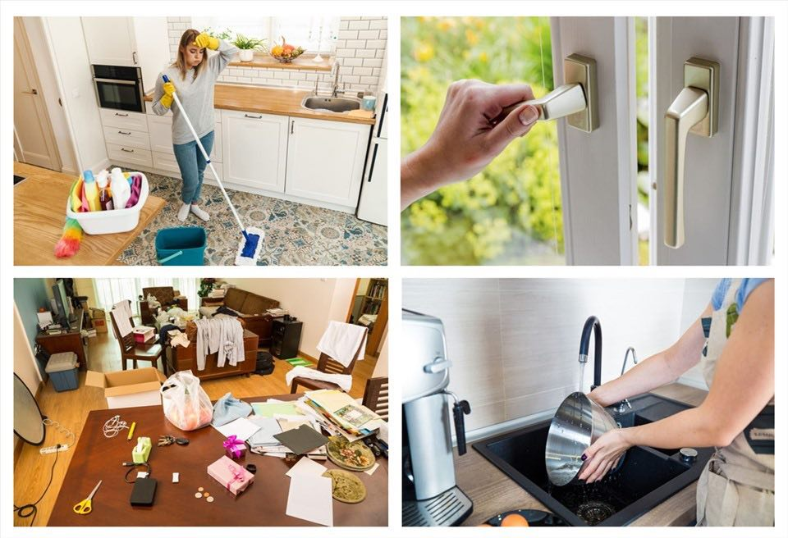
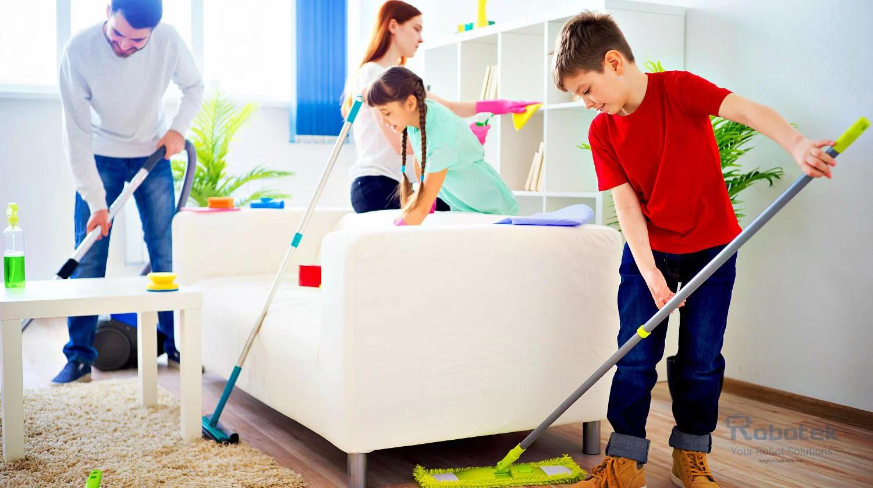
I. Activiti
Spring cleaning for Tet

Slide 7
II.
Food

Slide 8
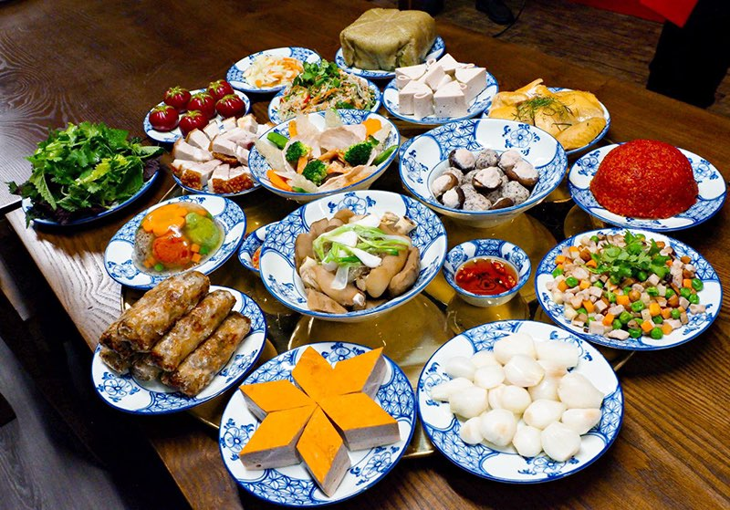
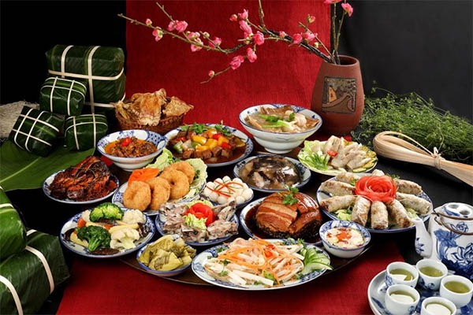
II. Food
Tet offering tray

Slide 9
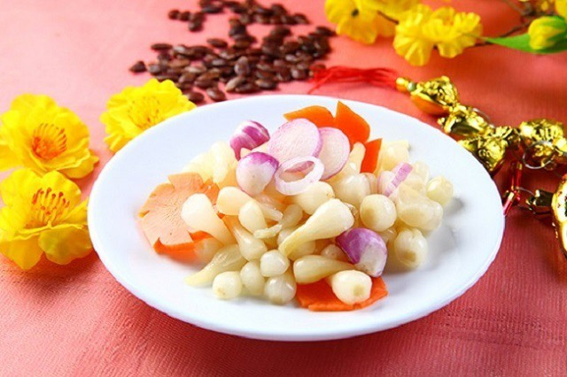
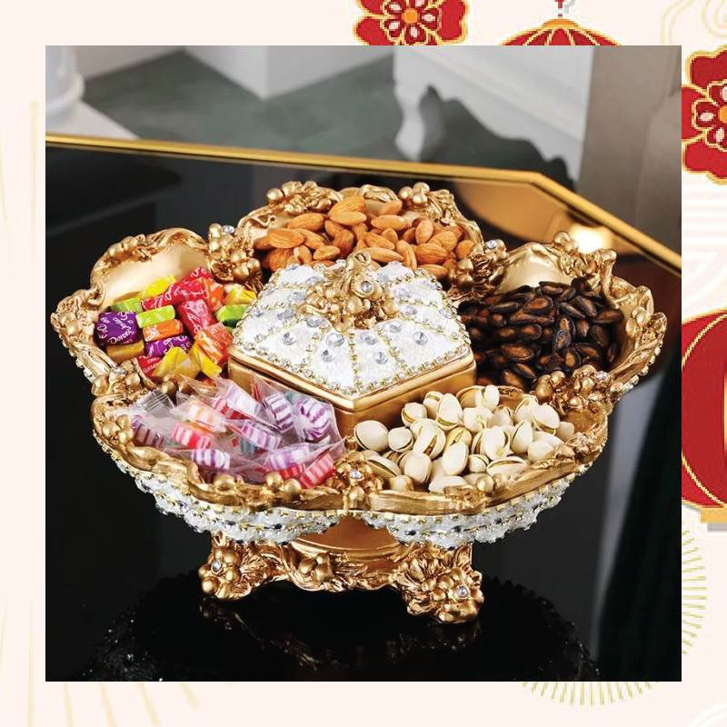
II. Food
Cu Kieu
Cake and candy tray

Slide 10
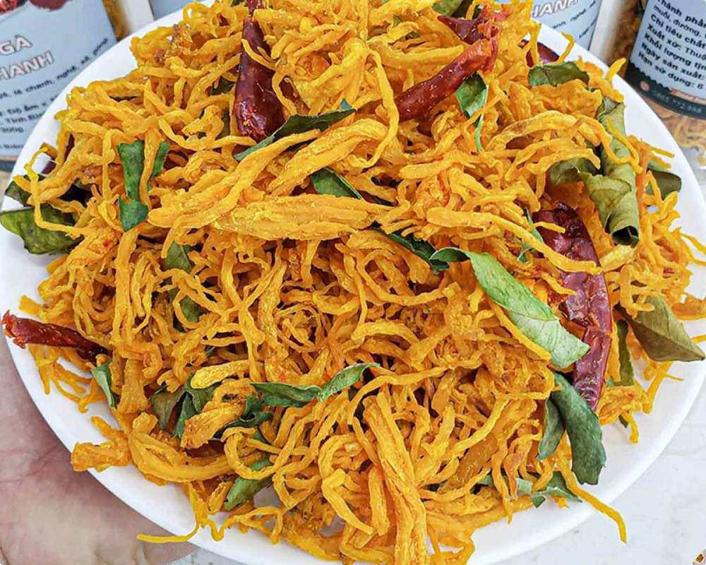
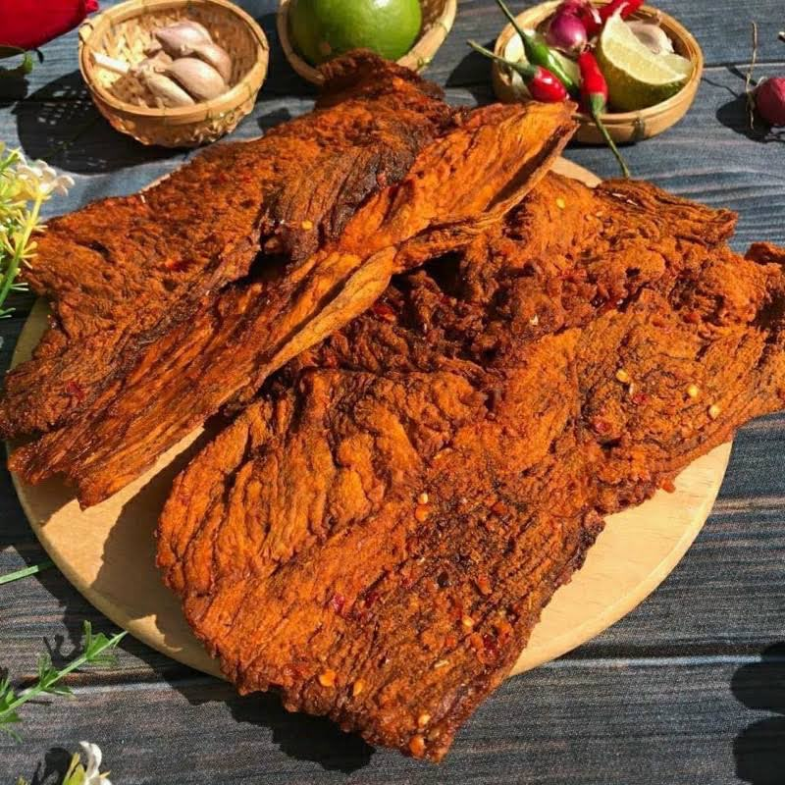
II. Food
Dry chicken
Dry beef

Slide 11
III.
Decor

Slide 12
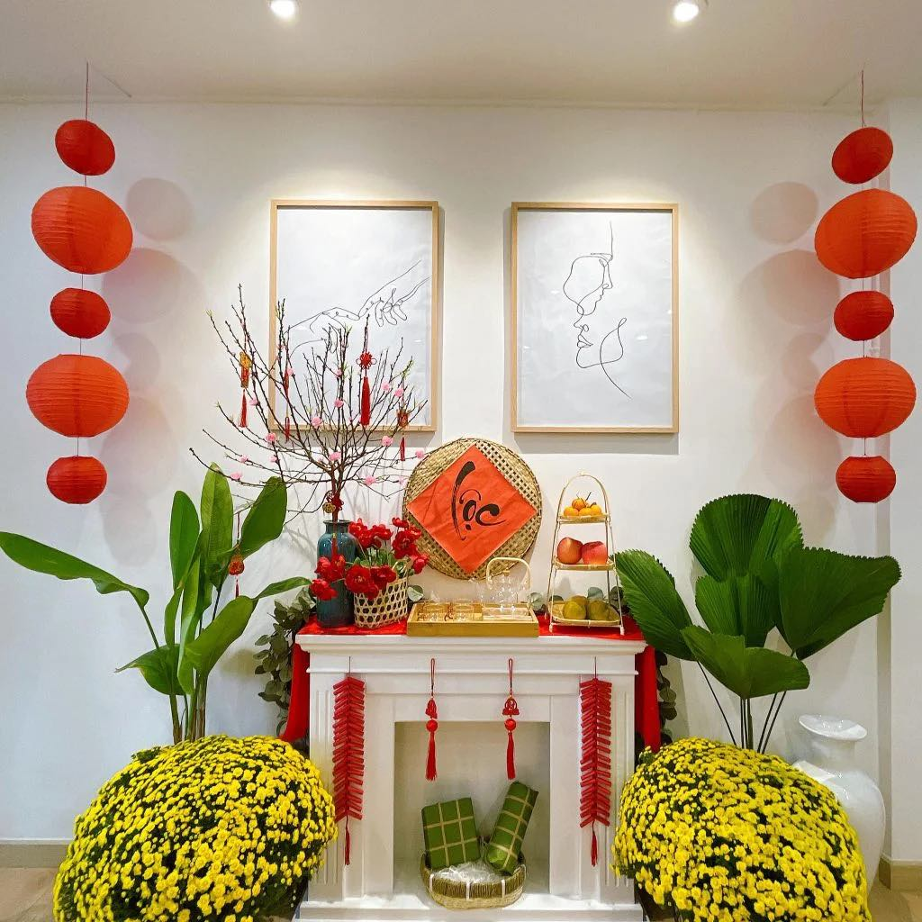
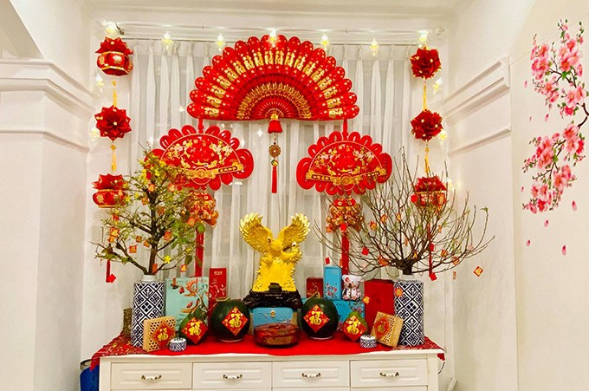
III. Decor
Decorating the home with decorative items.

Slide 13
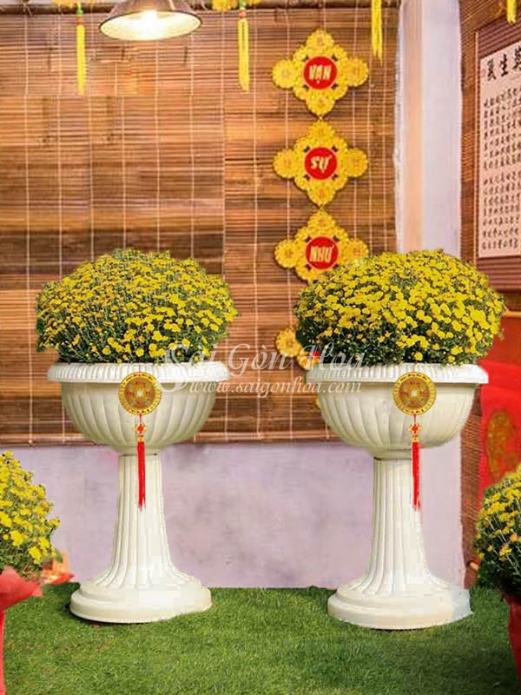
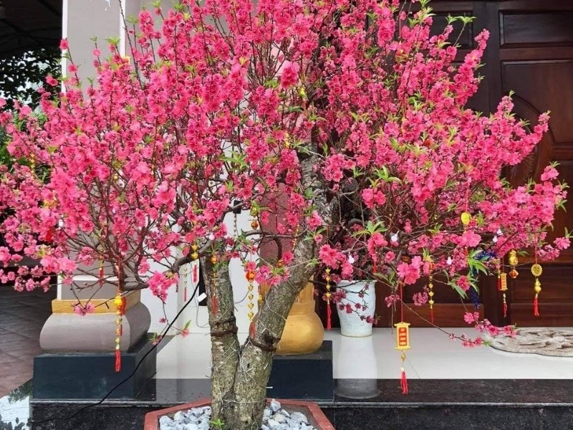
III. Decor
Decorating for potted flowers

Slide 14
Clothes
IV.

Slide 15
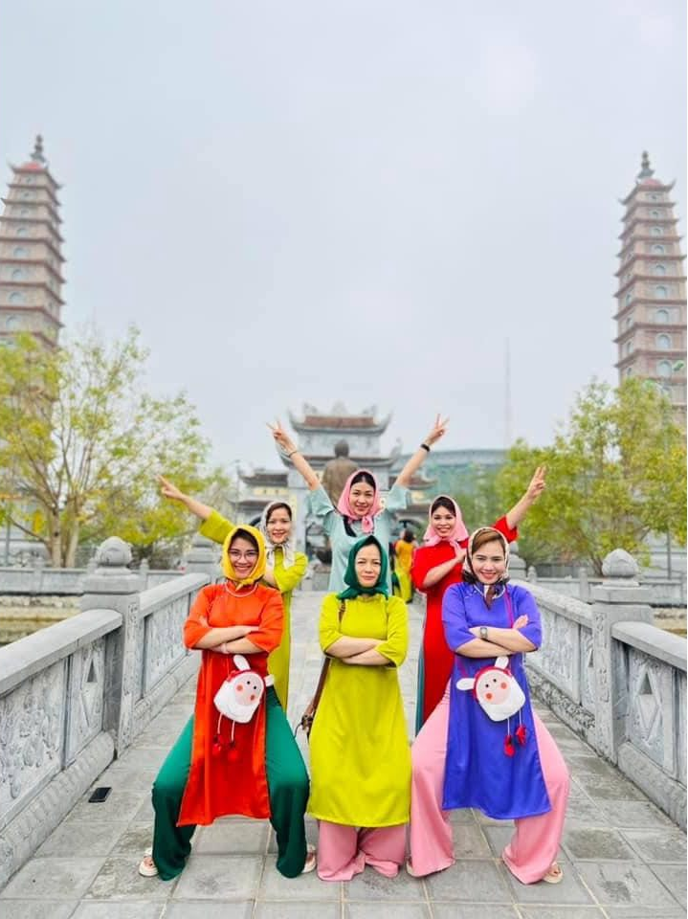
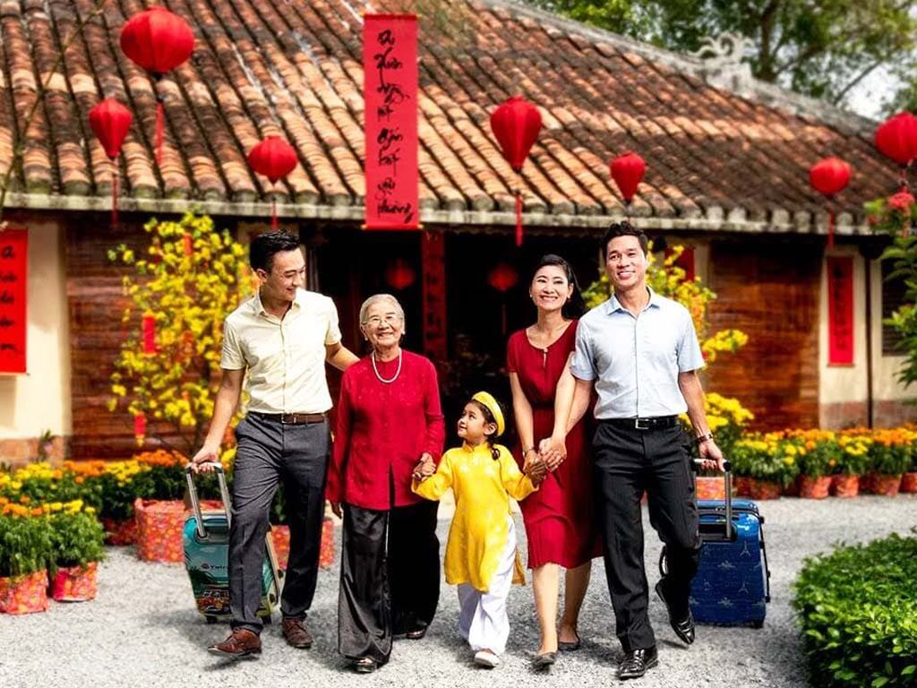
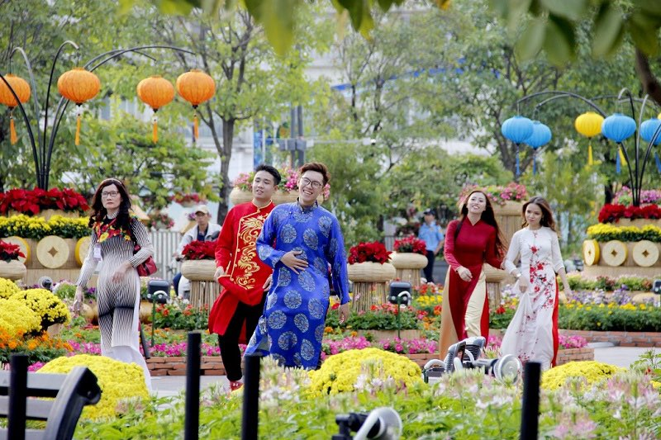
IV. Clothes
Costumes are usually ao dai and modern costumes with bright colors

Slide 16
Include
Tet is one of the most important times for family reunions. With each different region, there will be different customs and traditions. Above are Tet activities in my hometown. Thank you everyone for listening and following.

Slide 17

Thanks you!

