Slide 1
Periodic Table Of Elements seminar project
Anh Dang

Slide 2
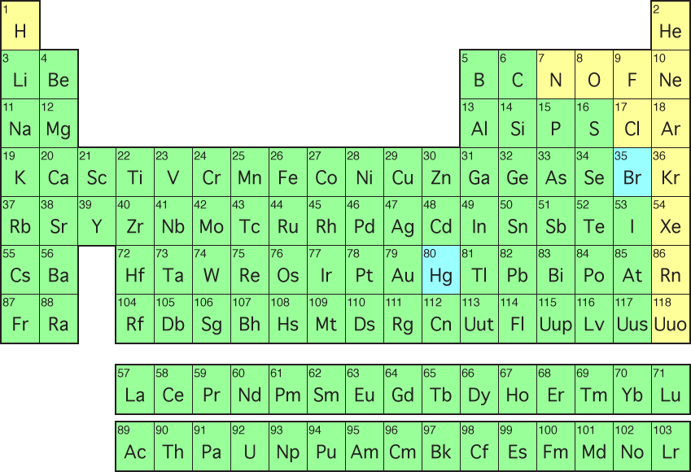
Overview
The periodic table of elements interface will be created using SQLite and python 2.0 and tkinter

Slide 3
Goals
Allow students to have easy access to information on each element
I want be done with researching and inputting the data in 3 weeks
After inputting the data, I will write the codes for python for the interactions

Slide 4
Difficulties
The animation when the area is clicked on
Refreshing my knowledge on python
Get used to tkinter

Slide 5

Interface
The user clicks on the coordinate on the periodic table, a pop up comes up and reveals the information of that element .

Slide 6
How the codes interact
I will put all the data of each element in SQLite
I will use python to get the user interface
When the coordinates of the element is clicked on, I will pull out all the information that in stored in the database and output them.

