Slide 1
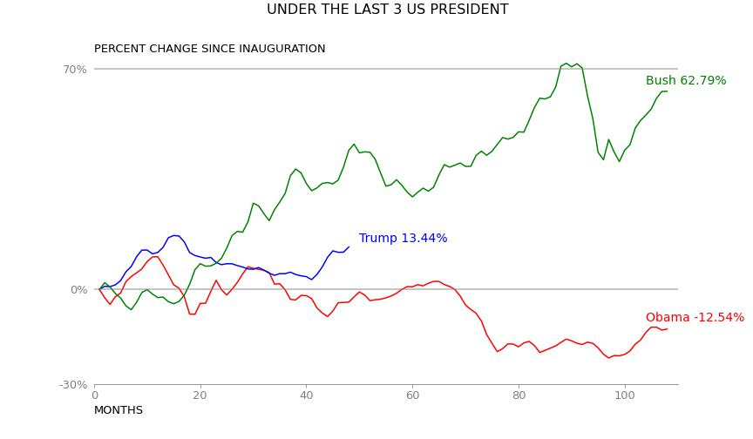
We can observe that Euro-dollar price tend to increase under president Bush and Trump, especially the rate of 62.79% compare to the first day since inauguration of Bush. While this feature decrease about 12.54% under Barack Obama term.

Slide 2
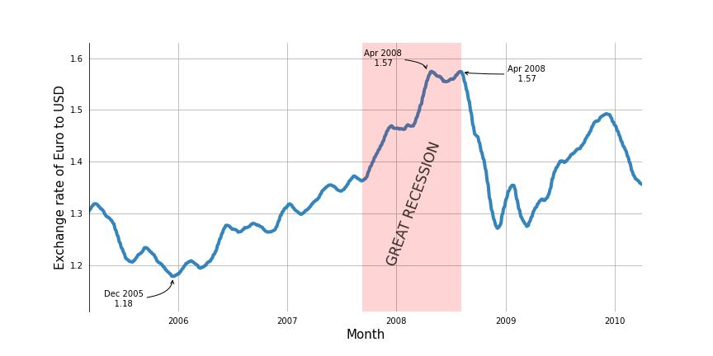
The EUR/USD price have a upward trend since December 2005, it continued to raise and reach the peak of 1.57$ during 2008 Recession. Although we mignt see a drop after April 2008, it still climp in the early of 2009.

Slide 3
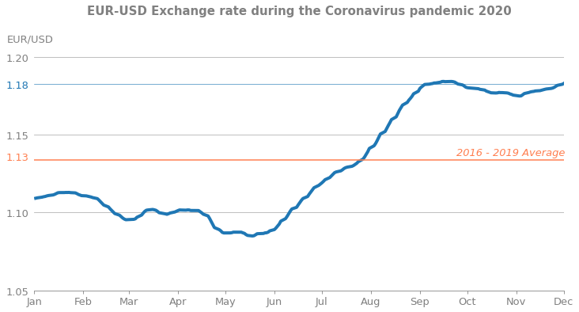
Not until June 2020 did the pandemic have a huge impact on the EUR-USD price, making it increase rapidly. It soon overcame the average price of 1.13$ of years before in August, before peaking at over 1.18$ in September. At the end of the period, it remained at 1.18$.

