Slide 1

Design of an Automatic AHB/AHB-Lite Bus Generation System
DucAnh
15/09/2024

Slide 2
Contents
Introduction
Design Description
Verification Guidance And CheckList

Slide 3
Introduction
Learn about AHB/AHB-lite Bus based AMBA Architecture
Using Verilog to Design RTL
Design Test Plan and Verification Design
Check Coverage Report
Presentation and Reporting of design results

Slide 4
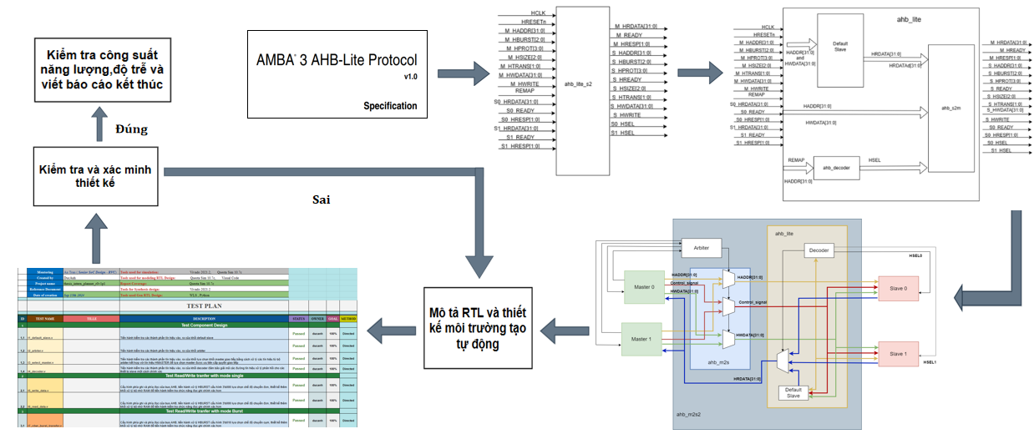
Steps to follow:

Slide 5
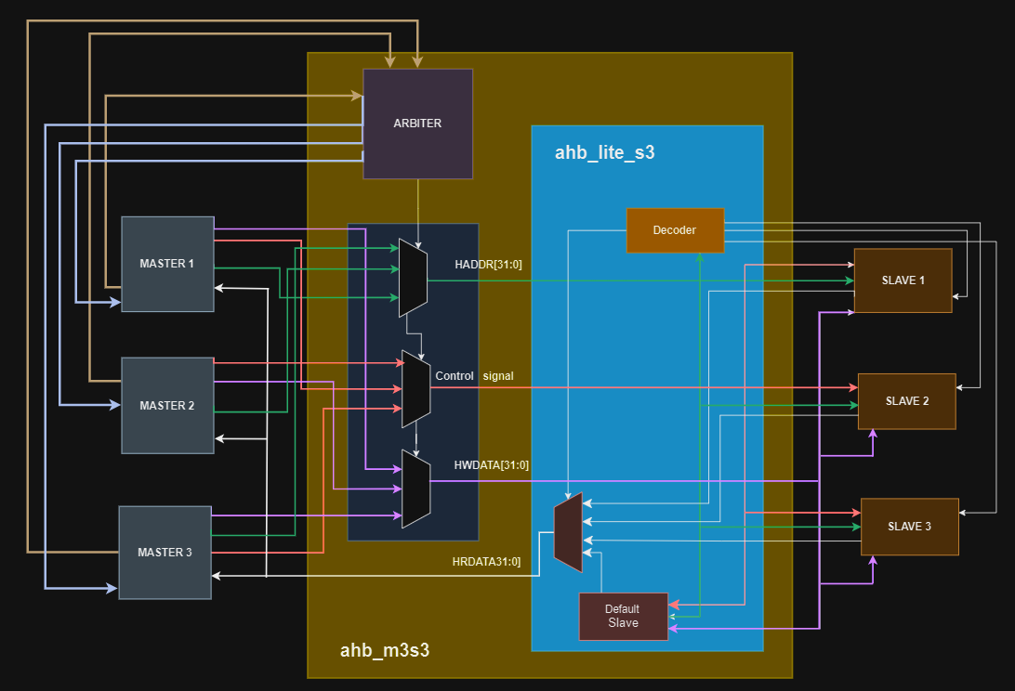
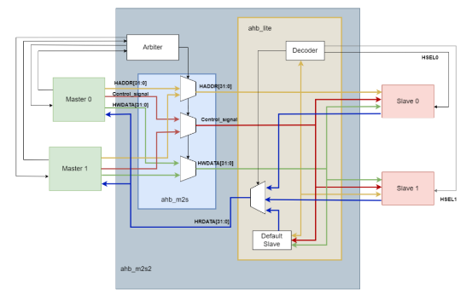
Design Description
TOP MODULE AHB M2S2 AND M3S3

Slide 6
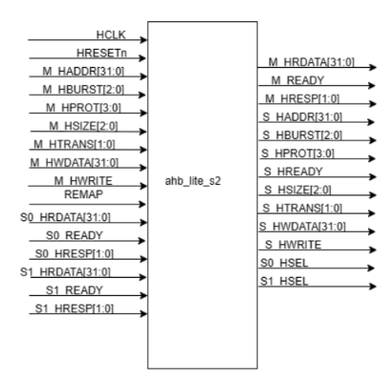
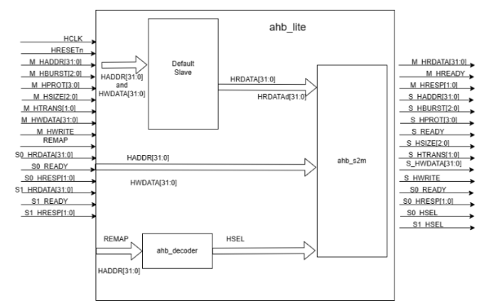
Design Description
AHB – Lite 2 Slave

Slide 7
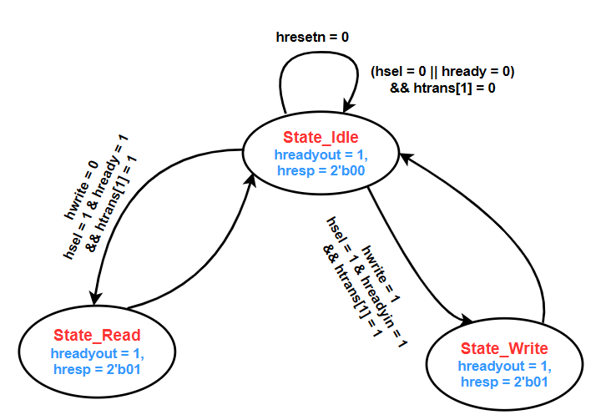
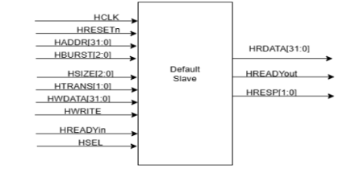
Design Description
AHB – Lite 2 Slave
AHB Default Slave
The State machine of an ahb default slave block
The Default Slave is used to handle invalid AHB bus request.
When no slave is selected, the Default Slave respond to Master’s request to ensure that bus doesn’t hang or an undifined state.

Slide 8
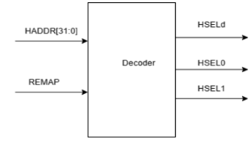
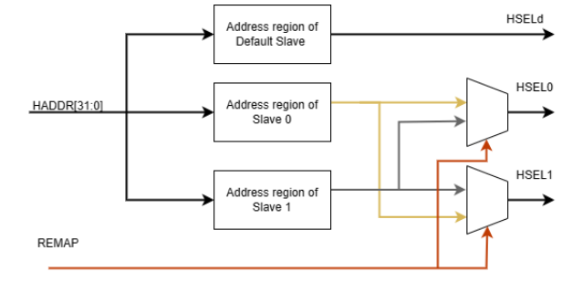
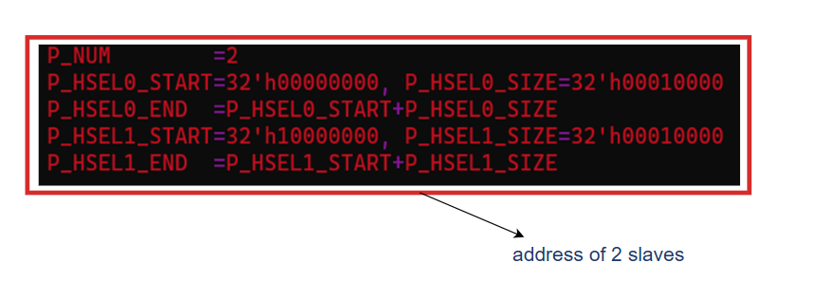
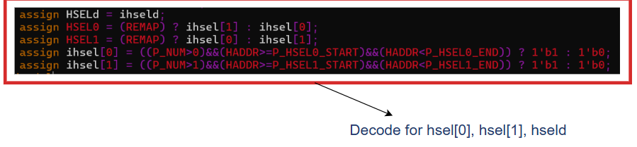
AHB Decode
The AHB Decoder is responsible for interpreting the address sent by the AHB master and determining which slave device should respond to the current transaction.
It essentially "decodes" the address and enables the corresponding slave by generating select signals.

Slide 9

AHB – Lite 2 Slave
AHB Slave to Master
HREADY0
001
010
100
df
HRDATA0
001
010
100
df
HRESETn
HREADY1
HRDATA1
HREADY
HRDATA
HREADY
HREADYd
HRDATAd
_hsel[2:0]
1’b1
32’b0
1
0
HRESP0
001
010
100
df
HSEL_FF
HRESP1
HRESP
_hsel_reg [2:0]
HRESPd
2’b01
HCLK

Slide 10
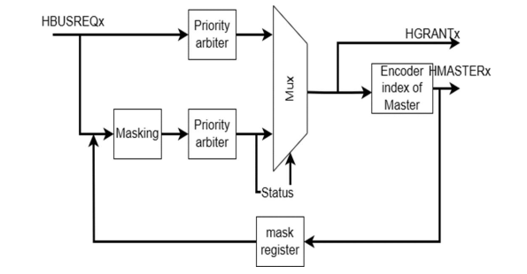
AHB Arbiter
The Arbiter block in the AMBA AHB Interconnect model functions to manage access requests to the AHB bus from various Masters.
The Arbiter handles these requests based on several criteria, such as the priority level of each Master, the waiting time of access requests, and other factors. After processing, the Arbiter will send a signal to the Master that is granted permission to access the AHB bus.

Slide 11
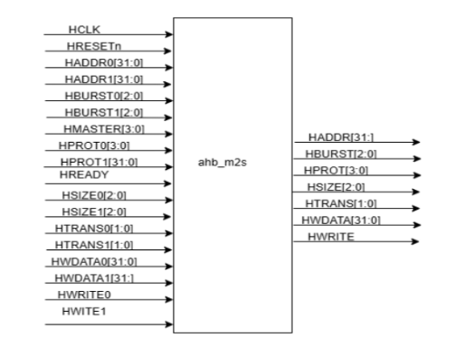
AHB Master to Slave
When the selection signal of master (HMASTER = 0) is actived, the signals from Master 0 (HADDR0, HPROT0, HTRANS0, HWRITE0, HSIZE0, HBURST0, HWDATA0) are selected to transmit data.
Similarly, when HMASTER=1 is actived, the signals from Master 1 (HADDR1, HPROT1, HTRANS1, HWRITE1, HSIZE1, HBURST1, HWDATA1) are selected to transmit data.

Slide 12


Overview Gen RTL Design with Python Scripting
Using WSL (Windows Subsystem for Linux) with the Ubuntu 22.04 or 20.04 kernel, or other applications running a Linux operating system.
Using Python Scripting to execute system commands.

Slide 13
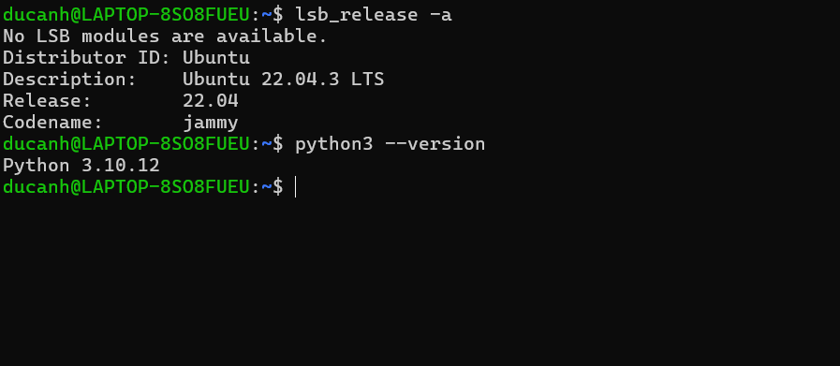
Overview Gen RTL Design with Python Scripting
More features that WSL (Windows Subsystem for Linux) offers:
Direct Access to Linux Functionality: It allows administrators and developers to use all the functions and tools of Linux directly .
Optimized Performance: Most Linux commands, including apt, dpkg, and others, operate normally on the Windows system due to the optimization of WSL.
Efficient Development and Management: Users and developers can effectively use WSL to develop cross-platform applications and manage IT infrastructure directly on Windows.
Cross-Platform Command Execution: You can run Linux commands and applications from the Windows interface and vice versa.
Support for Various Tools and Languages: It supports running tools and programming languages such as NodeJS, vim, JavaScript, C/C++, and more.

Slide 14
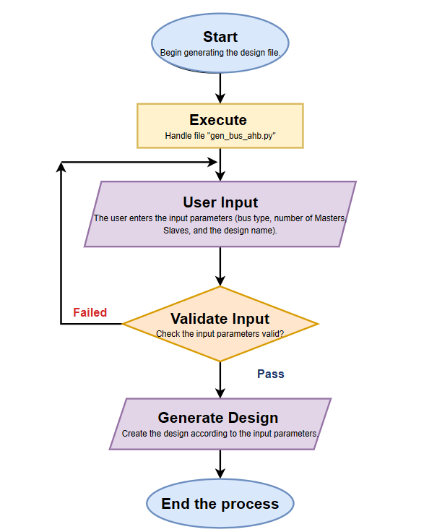
Overview Gen RTL Design with Python Scripting
The AHB Bus Auto-Design system is an automated tool
designed to generate AHB bus configurations based on user-provided input.
The process begins when the user initiates the system by running a script, typically named gen_bus_ahb.py.
Description of the AHB Bus Auto-Design System

Slide 15
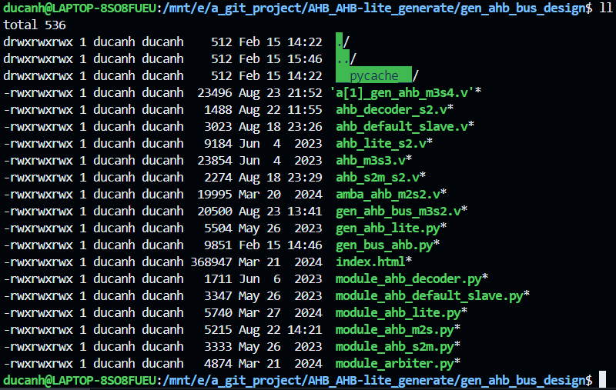
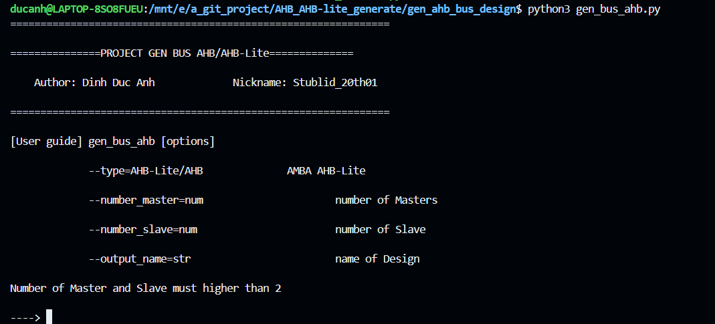
Result Gen RTL Design with Python Scripting
The system window interface after displaying the result

Slide 16
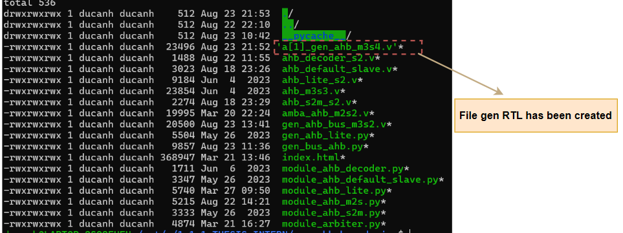
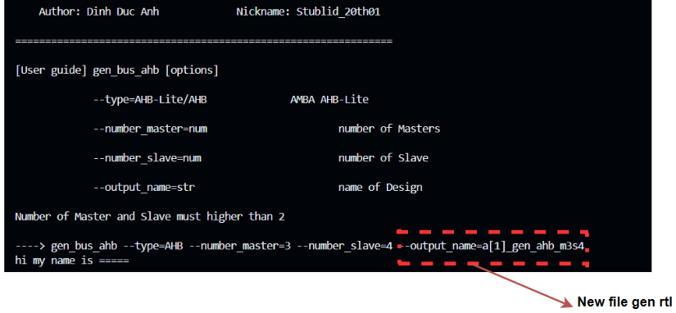
Result Gen RTL Design with Python Scripting

Slide 17
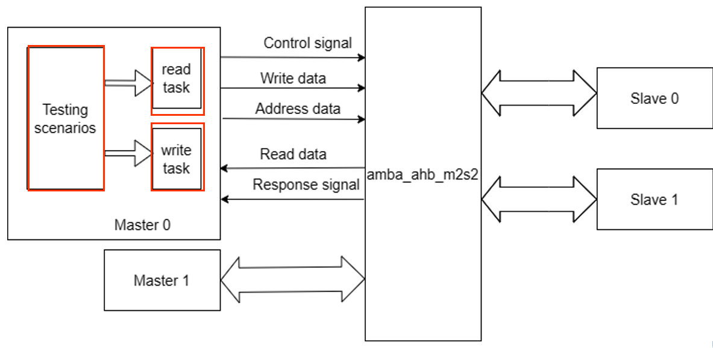
Verification Guidance And Checklist
Overview Verification Environment

Slide 18
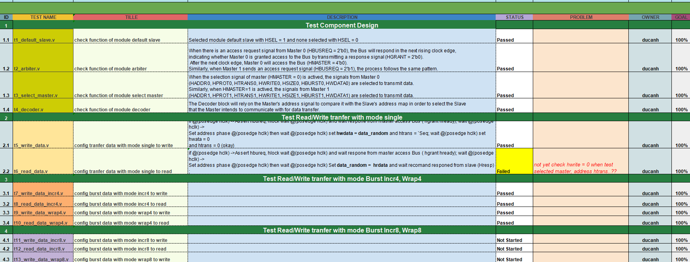
Verification Guidance And Checklist
Overview Verification Environment

Slide 19
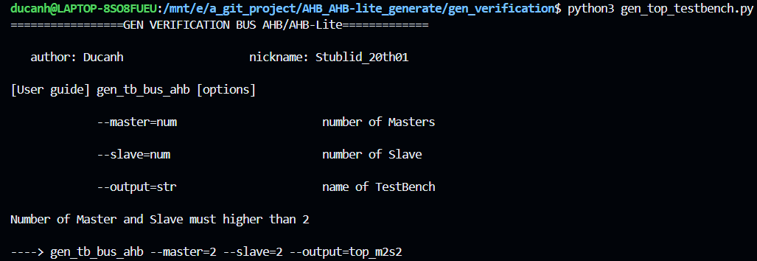
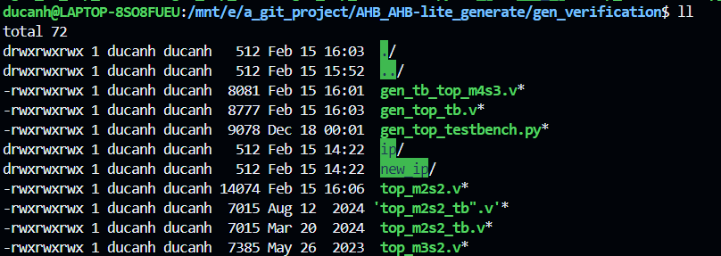
Verification Guidance And Checklist
Gen Top Verification

Slide 20
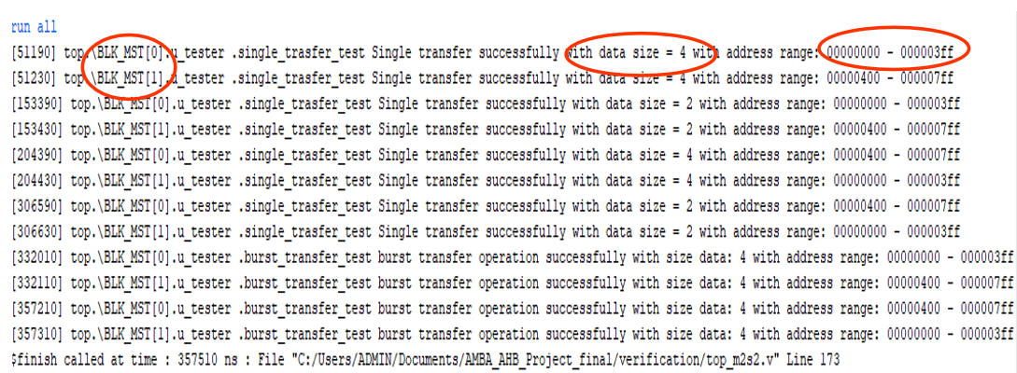
Verification Guidance And Checklist

