Slide 1




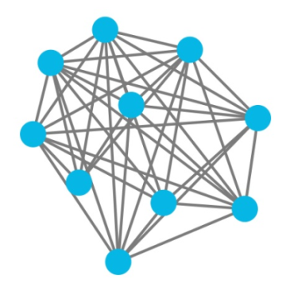
Storyline – Participants (roles)
Ceramic – save favourite real estate
ALICE – User search price
Chainlink - ProspectNow

Slide 2
Underlying Concept of Smart Real Estate
A user want to search a price from zipstate by giving the location of he/she want. Thanks to ProspectNow, users can enter zipstate code and ProspectNow returns a current price based on that zipstate.
Chainlink
SmartZip
(data feed)
Ceramic
(Save real estate)
address
city
Oracle
street
price
Users can store real estate information they find (including price, location, date) thanks to decentralized technologies for authentication and data storage (Ceramic).

Slide 3
ProspectNow feature
ProspectNow offers detailed information for every property on record in the United States, including over 100 million residential properties and 42 million commercial properties across all 50 states.
Reference: https://market.link/data-providers/c8fc4b66-66a5-4e24-8d11-85d19553c03c/integrations

Slide 4
List real estate
People can list their real estate with location, name, price.

Slide 5
Ceramic feature (future feature)
Ceramic is a decentralized, open source platform for creating, hosting, and sharing streams of data. With Ceramic's permissionless data streaming network, you can store streams of information and ever-changing files directly on the decentralized web – and share updates with anyone in the world. This page describes the most important features of the protocol.
Reference: https://developers.ceramic.network/learn/features/
*This one not finish

