Slide 1



BJC Specialties Company Limited
PARTNERING WITH CJ BIO IN VIETNAM
TasteNrich® HYBIND & Food-Grade Amino Acids (FGAA)
Introduction meeting with CJ BIO Vietnam | MS Teams | 15 October 2026
Present by: Nguyen Ducc Duy Anh
15 Oct 2026
Notes:
Thank Tram Anh and Daniel for their time. Purpose today: (1) introduce BJC Specialties and our Vietnam platform, (2) share market and regulatory insights for HYBIND and FGAA in Vietnam as requested, (3) show where and how we would grow these products, and (4) agree next steps. For a 60-minute call, focus on slides 2, 5-7, 9-13, 14, 21-25 and 27-28; account detail slides can be shown on request.

Slide 2







Executive Summary
BJCS Vietnam is ready to grow TasteNrich® HYBIND & FGAA in Vietnam — building on BJC's existing CJ BIO partnership in Thailand
Proven CJ BIO partnership
The right customers, today
BJC already distributes HYBIND & FGAA for CJ BIO in Thailand — one regional partner, aligned positioning and shared know-how.
~90 customer accounts incl. Masan, CJ Cầu Tre, Ajinomoto, Unilever, Navico, Seapimex, Hoa Linh and Merap.
Technical & regulatory selling
Supply chain ready
Food, Cosmetic and NPD teams, BJCS Application Lab (Bangkok) and in-house handling of import & declaration dossiers.
Ex-stock (local warehouse, VND invoicing, door-to-door) and Indent (CIF HCMC / Hai Phong); offices in HCMC & Hanoi.
OUR PROPOSAL
Appoint BJCS Vietnam as distributor of HYBIND & FGAA → 90-day onboarding → customer trials from Q1 2027 with ~20 priority accounts across North, Central & South Vietnam
Source: BJC Vietnam experience (Customer 360, 2026 YTD); CJ BIO Vietnam e-mail, 7 Oct 2026 (BJC Thailand = CJ distributor for Hybind & FGAA).
Notes:
Key message: we are not starting from zero. BJC is already CJ BIO's partner for the same portfolio in Thailand, and in Vietnam we already sell daily to processors and brand owners who are natural users of HYBIND and FGAA. Our ask: appointment as distributor, then a structured trial programme with ~20 priority accounts.

Slide 3



Agenda
1. Who we are
Slides 4 – 8
BJC Specialties, our CJ BIO link and the BJCS Vietnam platform
2. Market & regulatory landscape
Slides 9 – 13
Food industry, market size for HYBIND & FGAA, rules that apply today
3. Opportunity map
Slides 14 – 20
Applications, target accounts by segment and by North / Central / South
4. How we win
Slides 21 – 26
Value proposition, customer pain points, account approach, competition
5. Roadmap & partnership
Slides 27 – 28
Go-to-market milestones, proposal and next steps
Notes:
Five parts. If time is short, go quickly through part 1 and spend most time on parts 2-4.

Slide 4



















Key Partners
World-leading manufacturers we represent
Notes:
BJC Specialties represents global leaders across food, cosmetic, industrial and lab chemicals. CJ BIO would join a portfolio managed with the same discipline as these principals.

Slide 5



BJC × CJ BIO: Thailand to Vietnam
THAILAND — TODAY
VIETNAM — PROPOSED
CJ BIO Bangkok
BJC Thailand
CJ BIO Vietnam
BJCS Vietnam
BJC is CJ BIO's distributor for TasteNrich® HYBIND & FGAA
Same portfolio · same partner · dedicated local team
What CJ BIO gains
One regional partner
Faster ramp-up
Shared technical resources
Regional sponsorship
Consistent positioning, pricing discipline and key-account approach across Thailand and Vietnam.
Product know-how, application learnings and references shared from BJC Thailand with the Vietnam team.
BJCS Application Lab in Bangkok for meat trials, demos and customer training.
BJC regional management oversight, with a dedicated local team executing in Vietnam.
Source: CJ BIO Vietnam e-mail, 7 Oct 2026; BJC Vietnam experience.
Notes:
CJ BIO Vietnam manages the same portfolio as CJ BIO Bangkok, and BJC Thailand already serves CJ there. Extending the partnership to Vietnam gives CJ one regional partner, consistent positioning, and faster ramp-up. Be transparent: the Vietnam team is new to these two products, so we ask for product training and will learn from BJC Thailand.

Slide 6

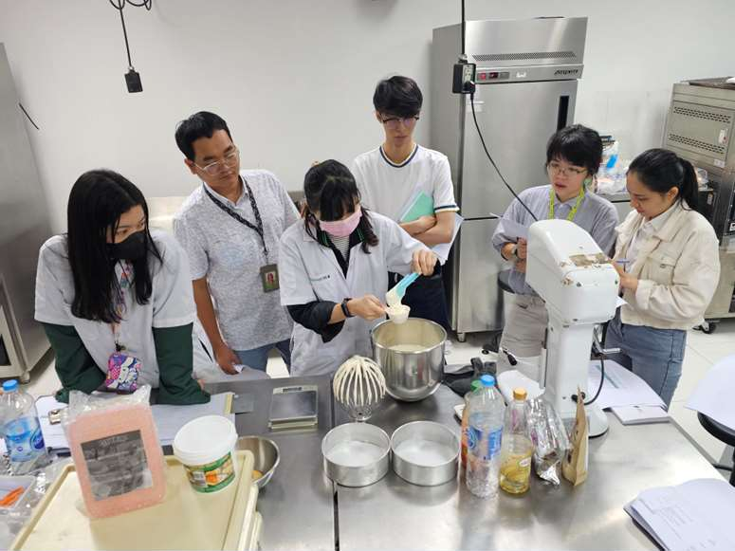
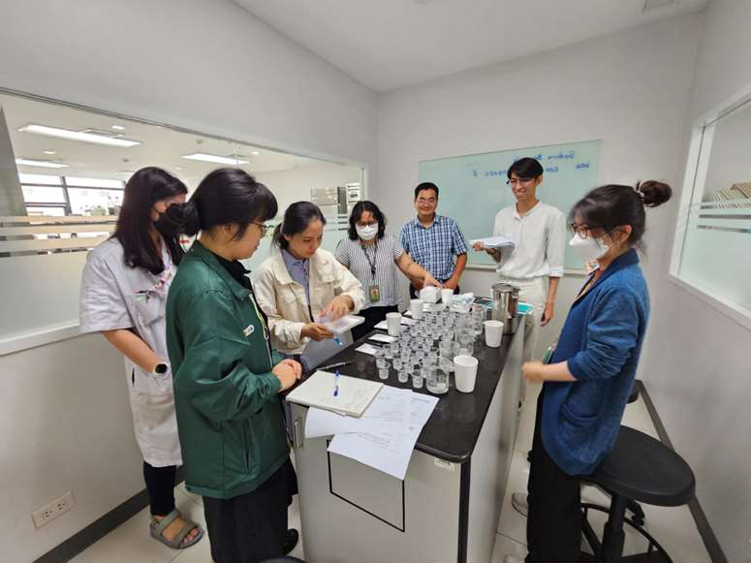
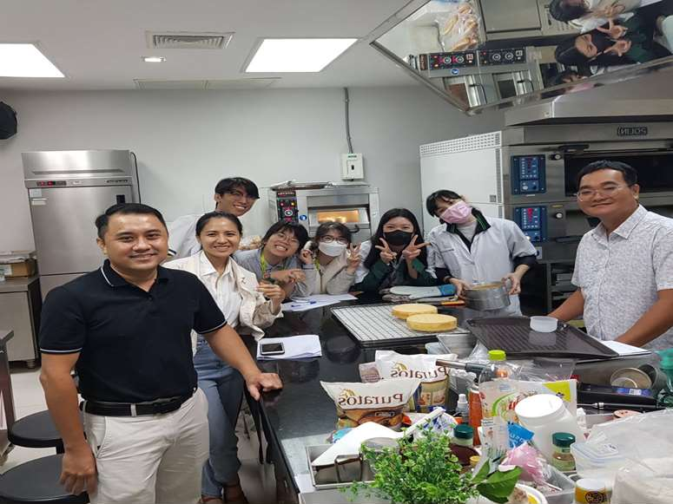
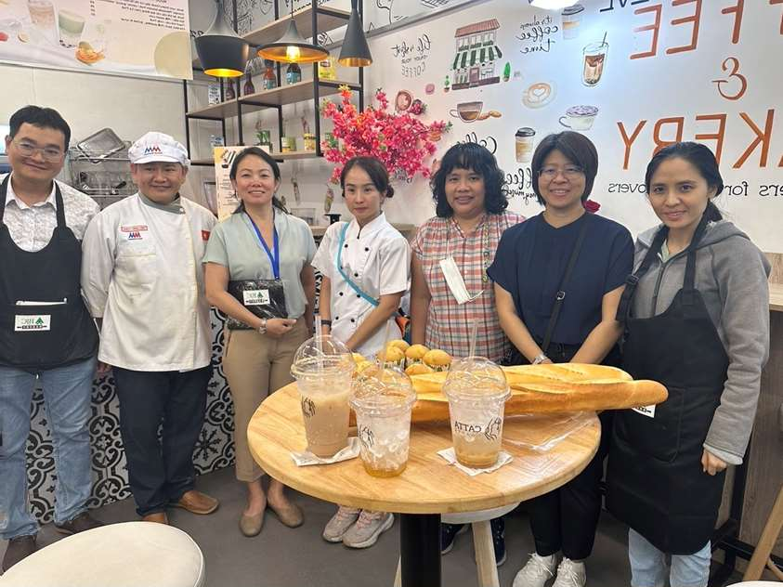
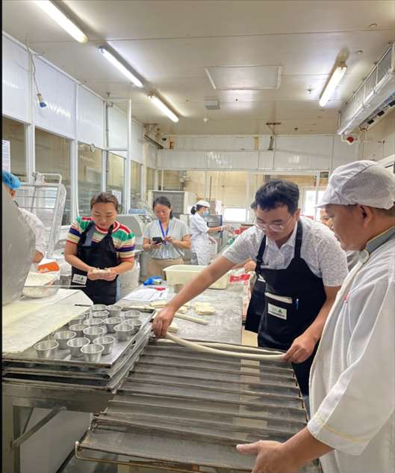
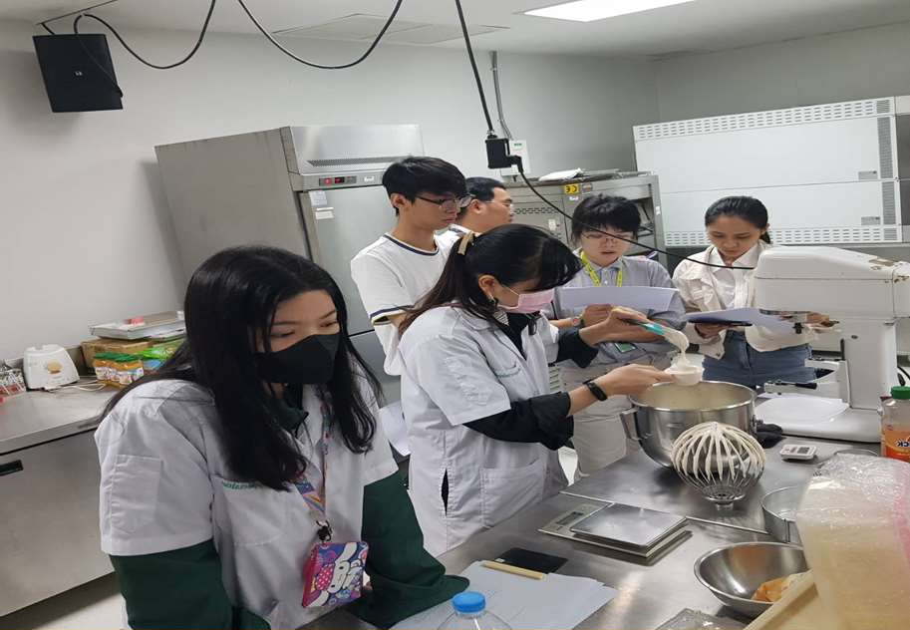
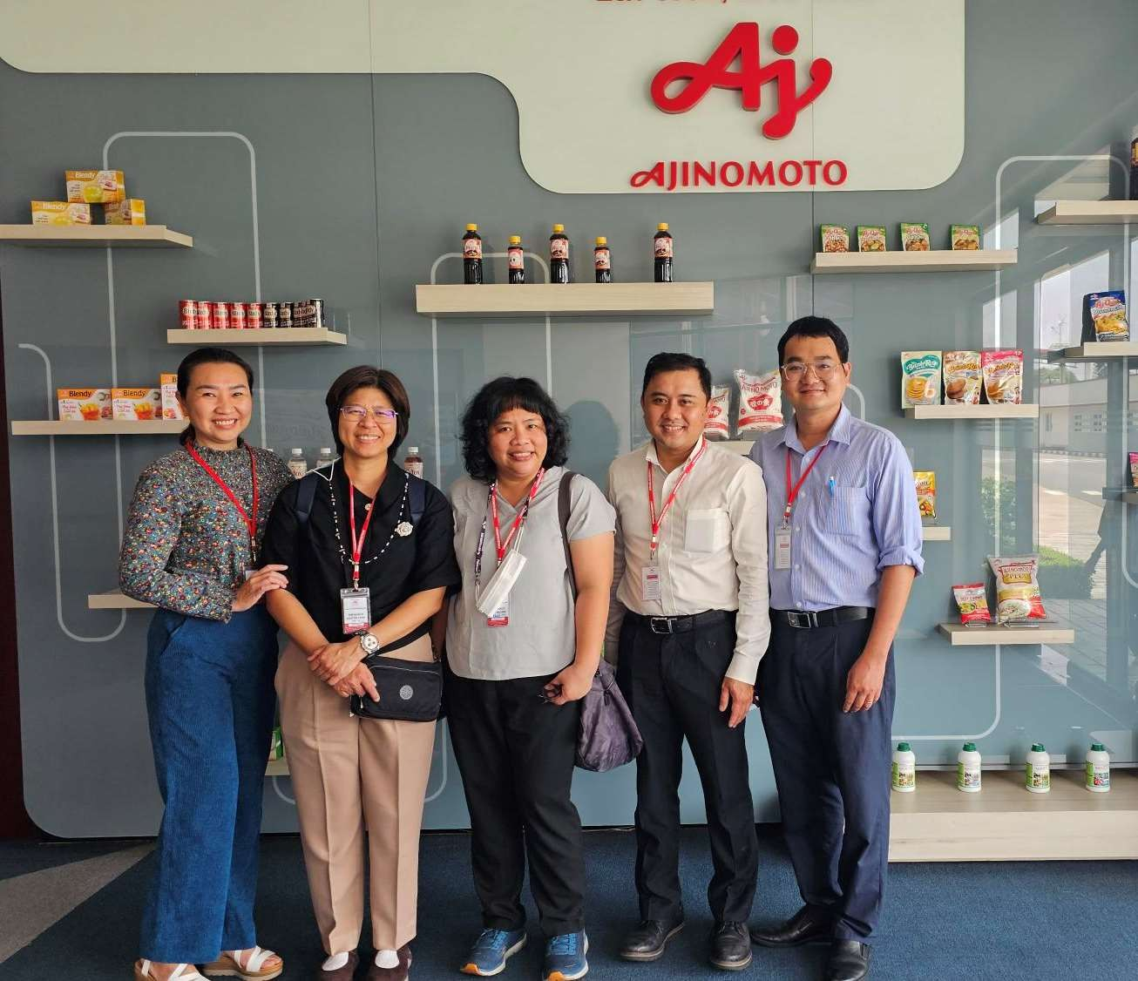
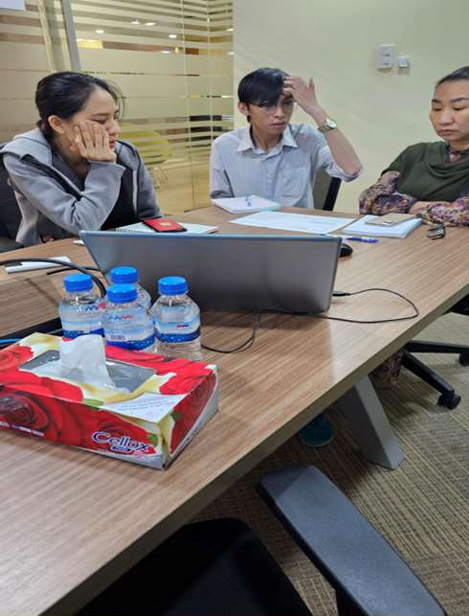
BJCS Vietnam – Platform Today
Presence
Route to market
Team & leadership
In Vietnam since 2007
Offices in Ho Chi Minh City & Hanoi
~90 customer accounts North – Central – South (2026 YTD)
Ex-stock: local warehouse, VND invoicing, door-to-door delivery
Indent: direct shipments CIF HCMC / Hai Phong
Import & declaration dossiers handled in-house
5 account owners (Food, Cosmetic, Non-food) + NPD manager
Led by Nguyen Duc Duy Anh – 21+ years in Vietnam's food & chemical ingredients industry
Customer 360 account plans & opportunity pipeline
Principals & categories we manage in Vietnam today
Preservatives
LANXESS · Wuhan Youji (Sodium Benzoate)
Yeast extracts
Lallemand (previously Lesaffre & DSM)
Flavors
dsm-firmenich
Cosmetic actives
Lipoid Kosmetik
Rheology & hydrocolloids
Vanderbilt · HPMC · Guar gum
Source: BJC Vietnam (Customer 360 workbook, Jan–Sep 2026).
Notes:
Our platform: 19 years in Vietnam, HCMC and Hanoi offices, both ex-stock and indent models, and a structured team with account owners by division plus an NPD manager. We manage import and product-declaration dossiers in-house. Current principals show we can manage global brands with strict compliance requirements.

Slide 7
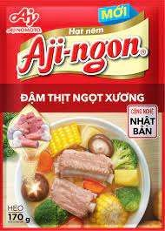
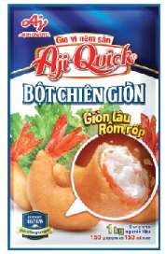
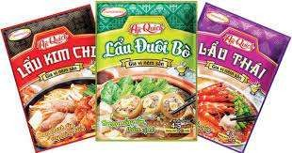
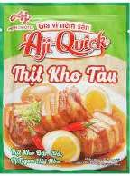
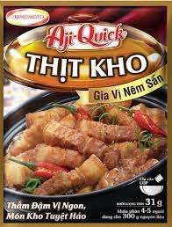
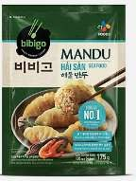
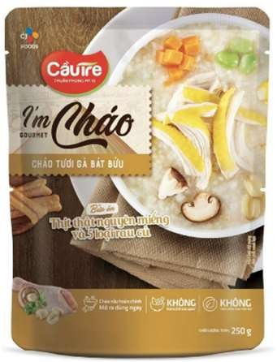
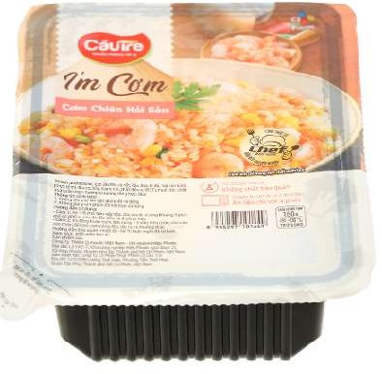
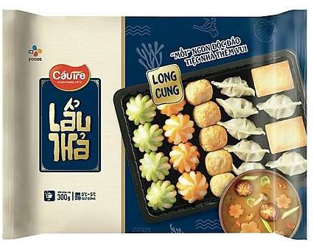
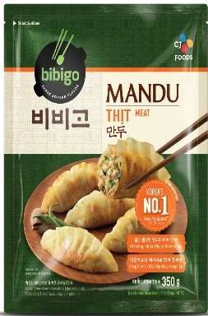
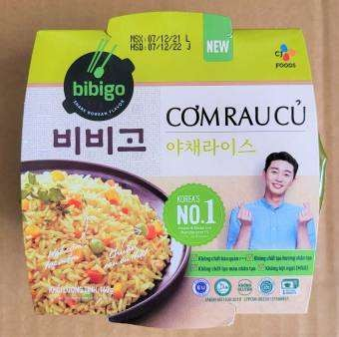
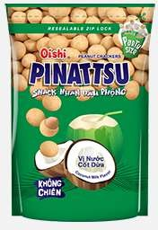
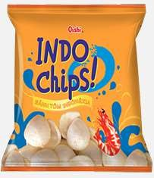
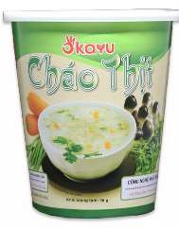
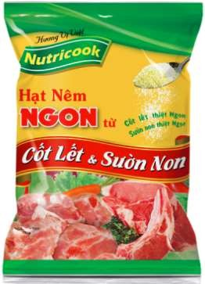
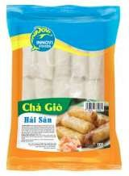
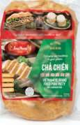
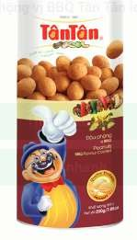
Trusted by Leading Manufacturers
Meat, seafood & convenience food
Masan Group · CJ Cầu Tre · LC Foods · Seapimex · Navico
Seasoning, savory & flavors
Ajinomoto · Givaudan · Đại Vân · Hoàng Anh · Ban Mai Xanh · Hưng Việt · Nitto Fuji
Beverages, snacks & nutrition
Masan Consumer · Tribeco · Yến Việt · Liwayway (Oishi) · Thế Hệ Mới
Pharma & personal care
Unilever Vietnam · Hoa Linh · Merap Group · Dược–TBYT Đà Nẵng
Products of selected BJCS customers. Source: BJC Vietnam
What we supply today
Preservatives · Yeast extracts · Flavors · Cosmetic actives · Rheology modifiers & hydrocolloids
Relevance for CJ BIO
We already work daily with R&D, QA and purchasing teams at natural users of HYBIND & FGAA — including CJ Foods Vietnam (Cầu Tre / bibigo).
Notes:
These are products of customers we supply today. Note that we already serve CJ Foods Vietnam (Cau Tre / bibigo). Do not mention prices or volumes of any customer.

Slide 8
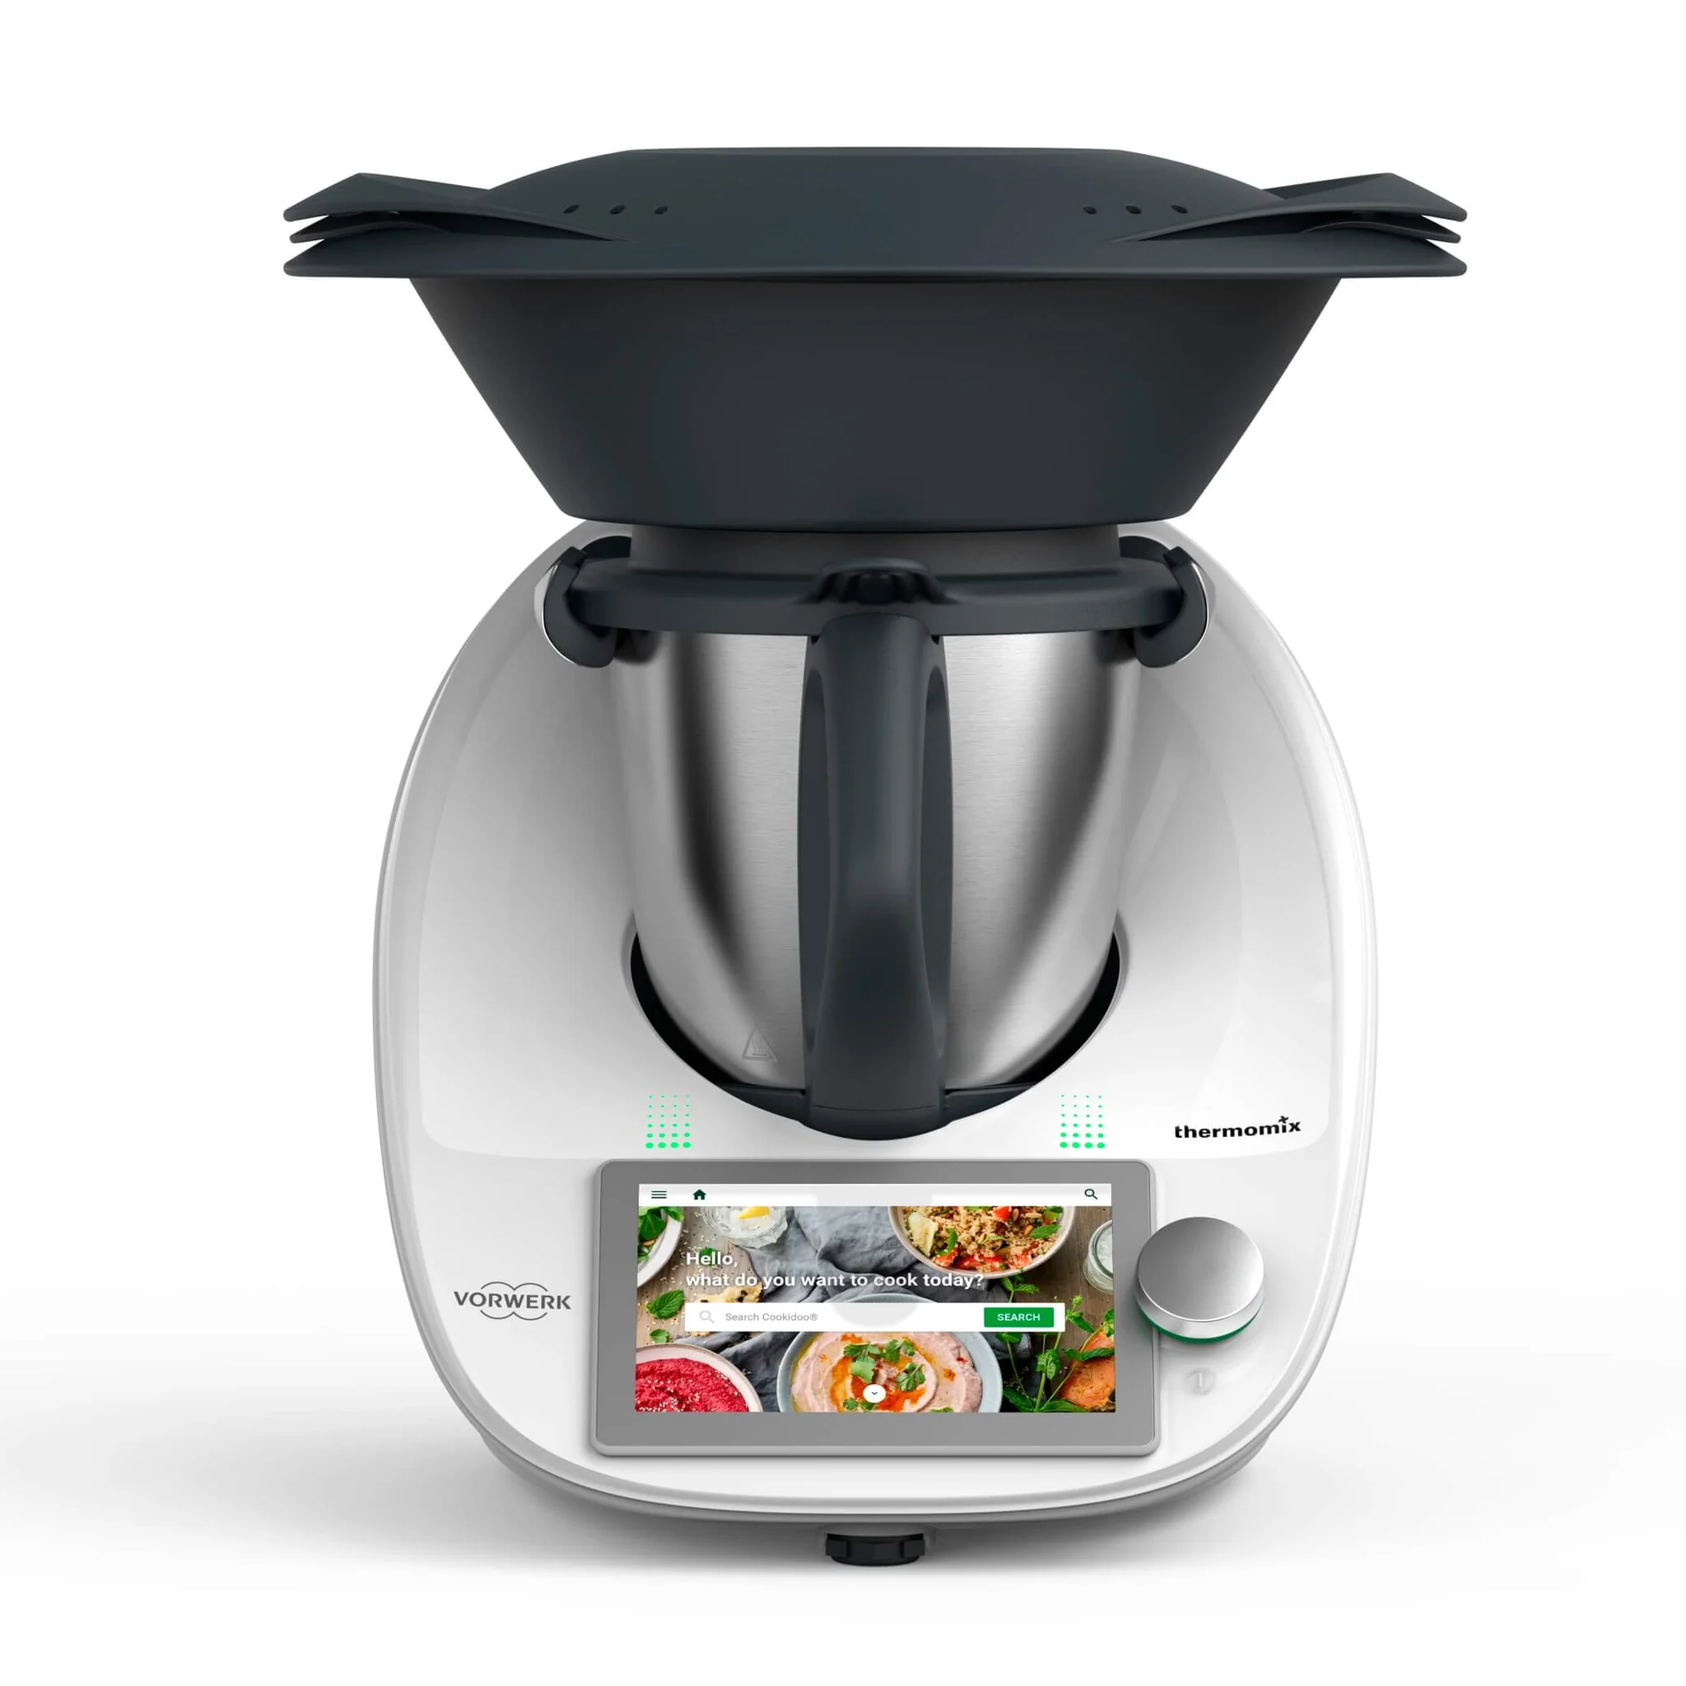
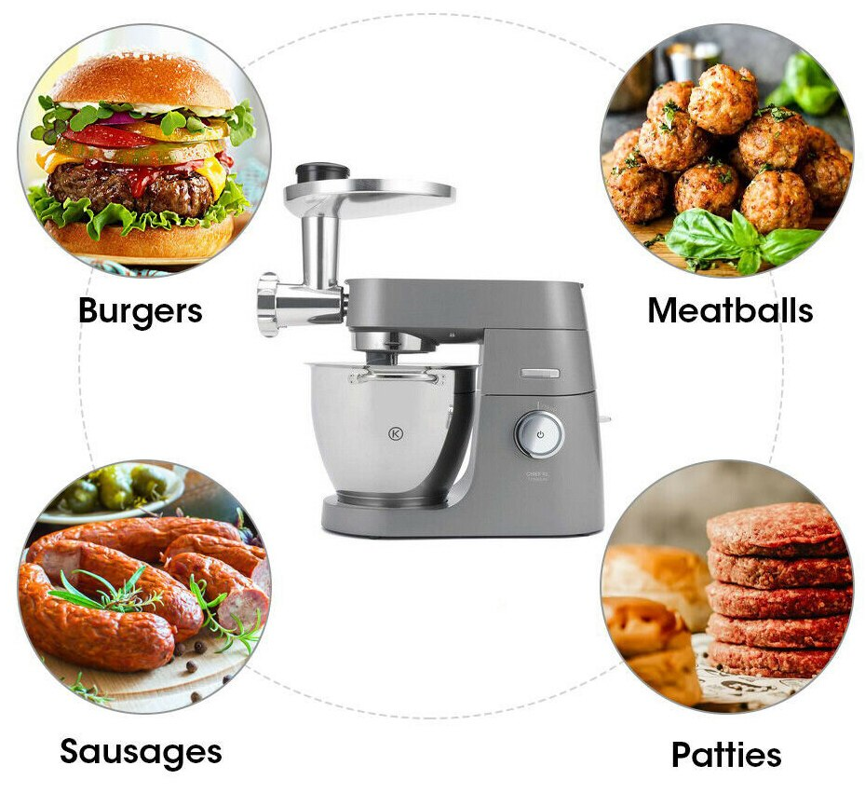
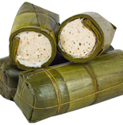
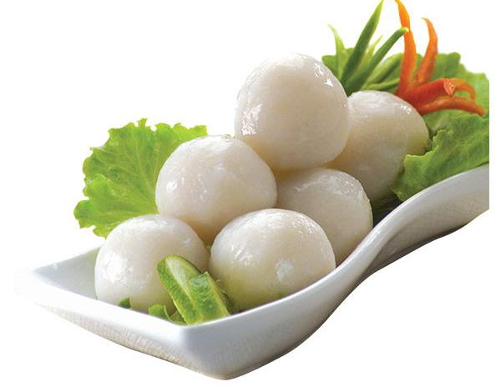
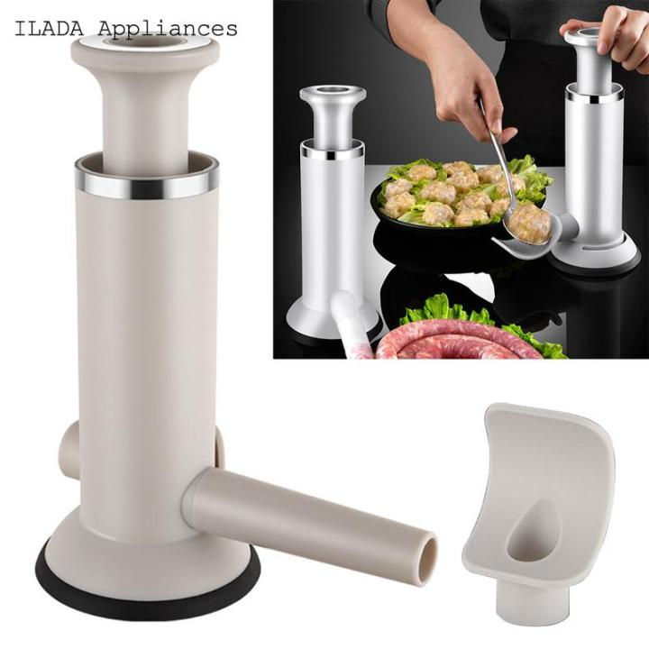
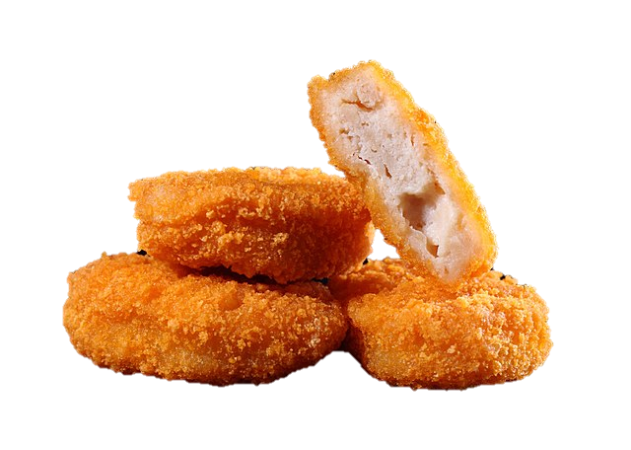
Application & Technical Support
Equipment for Savory & Meat Application:
BJCS Application Lab, Bangkok (~350 sqm): Food (sweet & savory) · Bakery · Cosmetic & Fragrance · Testing — ready for HYBIND trials on Vietnamese meat products and joint demos with CJ BIO
Mincer&Mixing
Thermomix
Vietnamese
Sausage
Fish ball
Hand Stuffing
Nugget
Source: BJC Specialties
Notes:
Vietnam has no lab today, so we will use the BJCS Application Lab in Bangkok, which already has savory and meat equipment (mincer, Thermomix, stuffing) for sausages, meatballs, nuggets and Vietnamese sausage, plus trials directly at customer plants.

Slide 9



Vietnam Food Industry at a Glance
US$88 bn
US$9.5 bn
101.9 M
+8.0%
food processing industry 2025 (+11%)
beverage manufacturing 2025
consumers; GDP US$514 bn
GDP growth 2025
Key trends that matter for HYBIND & FGAA
Food safety first
Convenience & branded meat
Recent scandals in canned meat and nutritional beverages push manufacturers toward safe, high-quality, documented ingredients.
Ready-to-cook and convenience foods grow with the middle class; MEATDeli, C.P. and Ba Huân run their own retail.
Domestic brands rising
Health & functional
Processors shift from export dependence to the home market and build their own brands — more formulation work.
Rising demand for functional and health-oriented beverages, low-sugar and nutrition products.
Sources: USDA FAS GAIN 'Food Processing Ingredients Annual – Vietnam' VM2026-0004 (Apr 2026); World Food 'Vietnam Country Profile' 2025.
Notes:
Context from USDA's April 2026 ingredients report: an US$88 bn food processing industry growing 11%, with food safety, convenience, domestic brands and functional products as the main shifts. All four favour HYBIND and FGAA.

Slide 10

HYBIND – Market Size & Drivers
~39 kg
5.4 Mt
7.4 Mt
US$11.3 bn
pork per capita 2025 (≈30 kg in 2021); pork >63% of livestock-product consumption
pork produced 2025 — Vietnam is #4 globally in pork consumption
frozen aquatic products 2025 (3.0 Mt in 2021)
seafood exports 2025 (+12.4%): shrimp US$4.6 bn, pangasius US$2.2 bn
Where HYBIND plays
Growth drivers
Processed meat: sausage, ham, giò lụa / chả, meatballs, canned meat
Poultry: marinated / injected, coated & fried chicken
Frozen convenience food: dumplings, spring rolls, ready meals
Seafood*: shrimp, pangasius, squid — phosphate-based water-retention agents widely used
Industrial, branded meat is scaling up — e.g., MEATDeli Long An planned 15,000 t/yr processed products (phase 1)
Meat & meat-product imports US$1.78 bn in 2024 (+18%) — room for local processing
Clean-label pressure from modern retail and export buyers (Japan, EU, Korea, US)
Yield = margin under raw-material cost pressure
Sizing next step: phosphate-replacement volume to be sized jointly with CJ BIO from phosphate import data and plant audits at priority accounts
Sources: MOIT Domestic Market Dept. (via VNA, Feb 2026); GSO via USDA GAIN VM2026-0004; VASEP 2025; World Food Vietnam Profile 2025; VnBusiness (Oct 2020). *Seafood subject to CJ validation.
Notes:
Base for HYBIND: a pork-centred meat market of ~39 kg per capita, a fast-growing frozen seafood sector and record seafood exports. We have not invented a phosphate volume: we propose to size it with CJ using import data and plant audits.

Slide 11

FGAA – Market Size & Drivers
US$888 M
US$1.3 bn
>12%
~10%
dietary supplements 2024 → US$1.95 bn by 2033 (CAGR 8.2%)
energy drinks 2025 → US$1.88 bn by 2030 (CAGR 7.8%)
CAGR of the functional / fitness-oriented drink segment
share of Wake-up 247 (Masan Consumer – BJCS customer) in energy drinks, 2024
Where FGAA plays
Growth drivers
Health supplements (TPBVSK): vitality, liver support, men's health, recovery
Energy & functional drinks: energy, endurance, bird's-nest drinks
Sports, adult & medical nutrition: powders, RTD, clinical formulas
Personal & oral care: pH adjuster, conditioning, sensitive-teeth care
Health consciousness and active lifestyles among young urban consumers
GMP-certified supplement manufacturing and a large OEM / ODM base
Premiumization: vegan, fermentation-derived, clean-label actives
Brand owners tightening supplier audits after food-safety incidents
Sizing next step: amino-acid volumes are not published — to be built bottom-up from customer formulations and import data with CJ BIO
Sources: IMARC Vietnam Dietary Supplements Market (2025); Mordor Intelligence, The Report Cube & Frost & Sullivan (via Masan Consumer AR 2024), compiled by B-Company (2025).
Notes:
FGAA rides on supplements (~US$0.9 bn, growing ~8%) and energy/functional drinks (~US$1.3 bn). Our customer Masan Consumer already holds ~10% of energy drinks with Wake-up 247. Amino-acid-specific volumes are not public; we will size bottom-up with CJ.

Slide 12

Regulatory Status Today
02/2018
26/01/2026
04/02/2026
06/04/2026
Oct 2026 →
Decree 15/2018/ND-CP
Decree 46/2026/ND-CP
Resolution 09/2026/NQ-CP
Resolution 15/2026/NQ-CP
Amended Food Safety Law
Current basis for food safety rules
+ Resolution 66.13/2026: stricter declaration & import inspection
Decree 46 suspended
Suspension extended until amended Food Safety Law takes effect
1st reading Oct 2026; adoption targeted May 2027
What applies today
What is coming
Decree 15/2018: self-declaration for packaged food, additives & processing aids; registration for health supplements, medical / special-diet foods and new-use mixed additives
Circular 24/2019/TT-BYT (amended by Circular 17/2023/TT-BYT): permitted additives, uses & maximum levels
Circular 18/2019/TT-BYT: GMP mandatory for health-supplement manufacturing
Decree 46 direction: registration instead of self-declaration; tighter sampling & testing of imported food
Draft amended Law: clearer validity periods, re-registration only for core changes, digital data system
Transition rules still open — watch the 2027 effective date
BJCS approach: file under the regime in force, but build every dossier to the stricter standard from day one
Sources: Decree 15/2018/ND-CP; Decree 46/2026/ND-CP; Resolutions 09/2026 & 15/2026/NQ-CP; MOH Submission 238/TTr-BYT; NA Standing Committee (Báo Quốc tế, 25 Sep 2026).
Notes:
Important update: Decree 46/2026 is suspended. Resolution 15/2026/NQ-CP (6 April 2026) keeps it suspended until the amended Food Safety Law and its decree take effect, so Decree 15/2018 still applies. The amended law had its first reading in October 2026 and is targeted for adoption in May 2027.

Slide 13
Regulatory Pathway & Checklist
Topic | Requirement today (Decree 15/2018 regime) | Owner | Watch-out
HYBIND classification First decision | Confirm VN status: food ingredient vs. food additive (INS) under Circular 24/2019 & 17/2023 | CJ BIO + BJCS | If a mixed additive with new use → MOH registration; drives ingredient name on customer labels
Ingredient import HYBIND & FGAA | Self-declaration by importer; test report ≤12 months (designated / ISO 17025 lab); Vietnamese sub-label (Decree 43/2017, 111/2021) | BJCS | Manufacturers importing for own production are exempt from self-declaration
Import inspection Each shipment | Reduced / ordinary / strict methods (Decree 15/2018); reduced inspection for GMP, HACCP, ISO 22000, FSSC 22000 plants | BJCS (CJ certificates) | Plant certificates from CJ BIO shorten clearance
FGAA in health supplements TPBVSK | Product registration with VFA (MOH); GMP-certified manufacturing; advertising content pre-approval | Brand owner (BJCS supports) | Evidence for claims & dosage; ingredient specs must match dossier
FGAA in drinks & foods Conventional food | Finished-product self-declaration; labeling & claims compliance | Brand owner | Functional claims must not imply disease treatment
Personal & oral care Arginine | Cosmetic product notification by brand owner (Circular 06/2011/TT-BYT; ASEAN Cosmetic Directive) | Brand owner | Cosmetic-grade documents (INCI, safety data) needed
Halal / Kosher / Vegan Voluntary | Required by export & multinational customers | CJ BIO | Confirm certificate scope per SKU and plant
Sources: Decree 15/2018/ND-CP; Circulars 24/2019, 17/2023, 18/2019, 06/2011/TT-BYT; Decrees 43/2017 & 111/2021/ND-CP; BJC Vietnam experience. Planning summary, not legal advice.
Notes:
The first regulatory decision is HYBIND's classification in Vietnam, because it determines self-declaration versus MOH registration and how customers name it on labels. BJCS handles import dossiers; CJ's plant certificates help us get reduced inspection.

Slide 14
CJ BIO Portfolio – Applications
CJ BIO product | Key functions | Target segments in Vietnam | Typical end products
TasteNrich® HYBIND Natural phosphate alternative | Cooking yield & moisture retention · Less purge loss · Texture & taste · Clean label, E-number free | Processed meat · Poultry · Frozen & convenience food · Seafood* | Whole muscle, emulsion & coarse products: ham, sausage, giò lụa / chả, meatballs, cold cuts, frozen fillings; seafood*
L-Arginine FGAA – AMINATURE® | Protein building & nitric-oxide release: blood flow, performance, recovery · Skin & hair moisture (personal care) | Health supplements & pharma · Energy & sports drinks · Medical / adult nutrition · Oral & skin care | Vitality & liver-support supplements, pre-workout, energy drinks, sensitive-teeth toothpaste, creams
L-Citrulline FGAA – AMINATURE® | Urea-cycle amino acid; raises arginine levels (NO pathway): endurance & recovery | Sports nutrition · Functional beverages · Supplements | Pre-workout powders, energy shots, men's-health capsules, bird's-nest & functional drinks
L-Histidine FGAA – AMINATURE® | Essential amino acid: muscle & brain metabolism; carnosine & histamine precursor | Supplements · Medical & adult nutrition · Fortified foods | Amino-acid complexes, recovery & elderly nutrition, fortified beverages
Sources: cjbio.net product pages (HYBIND, AMINATURE®, Oct 2026); Food Business News (Jul 2023); applications: BJC Vietnam experience. *Seafood use subject to CJ BIO validation.
Notes:
Where the products fit. HYBIND: processed meat, poultry, frozen convenience food, and potentially seafood (to be validated with CJ). FGAA: arginine is the broadest (supplements, energy drinks, nutrition, personal care); citrulline is sports/energy; histidine is supplements and medical nutrition.

Slide 15
HYBIND – Meat & Poultry Map
BJCS customer
Potential
NORTH
Hanoi · Hung Yen · Ha Nam · Hai Phong · Bac Ninh
CENTRAL
Thanh Hoa · Nghe An · Hue · Da Nang · Khanh Hoa
SOUTH
HCMC · Long An · Dong Nai · Binh Duong
Masan MEATLife – Hà Nam
MEATDeli giò lụa, sausages · Masan Group account
Regional giò chả, nem & chả bò makers
SME cluster: Thanh Hóa · Nghệ An · Huế · Đà Nẵng
Masan MEATLife – Long An
MEATDeli giò lụa, sausages; 3F Việt chicken
Daesang Đức Việt (Hưng Yên)
Fresh & sterilized sausage, meatballs
Fragmented SME base
Phase-2 target, served from our Hanoi & HCMC offices once reference cases are established
CJ Cầu Tre (CJ Foods Vietnam)
Dumplings, spring rolls, meatballs
Hạ Long Canfoods (Hải Phòng)
Canned meat, pâté
LC Foods
Sterilized sausage, ready meals
DABACO Food (Bắc Ninh)
Sausage, smoked meat, canned
Nitto Fuji
Batter & breading – co-development partner
Mavin Foods
Processed pork products
Vissan
Ham, sausage, canned meat
C.P. Vietnam (Đồng Nai)
Sausage, meatballs, chicken
Koyu & Unitek
Processed chicken for Japan
San Hà
Processed poultry
Sài Gòn Food
Dumplings & frozen ready meals
Sources: BJC Vietnam (customer status); company public information (products, locations). Dark = BJCS customer (Masan at group level); outlined = potential.
Notes:
Target map by region. The South is the core: we already serve Masan Group, CJ Cau Tre, LC Foods and Nitto Fuji, and can add Vissan, C.P., Koyu & Unitek, San Ha and Saigon Food. In the North: Masan's Ha Nam plant plus Duc Viet, Ha Long Canfoods, DABACO, Mavin. Central is a fragmented SME base for phase 2.

Slide 16
HYBIND – Priority Meat Accounts
Account | Status | Pain point / need* | HYBIND value | Key success factor
Masan MEATLife MEATDeli · 3F Việt chicken | BJCS customer Masan Group · N & S | Premium 'safe meat' brand needs cleaner labels without losing yield and bite | Phosphate replacement with comparable cooking yield & texture | R&D trials on giò lụa & sausage; cost-in-use vs. current phosphate blend
CJ Cầu Tre Dumplings, spring rolls, meatballs | BJCS customer South | Juicy fillings and stable texture through freezing and steaming | Better water retention, less purge in frozen fillings | CJ group synergy – first Vietnam reference case
LC Foods Sterilized sausage, ready meals | BJCS customer South | Yield and texture loss under retort sterilization | Higher cooking yield, less purge over shelf life | Validate performance under retort conditions
Nitto Fuji Batter, breading, premixes | BJCS customer South | Processors asking for phosphate-free marinade & coating systems | HYBIND-based marinade / premix co-development | Joint development; Nitto Fuji as channel to processors
Vissan Ham, sausage, canned meat | Potential South | Mass-market cost pressure; consistent yield at large scale | Yield parity with cleaner label → premium SKUs | Start with one premium SKU; joint trial with CJ
C.P. Vietnam Sausage, meatballs, chicken | Potential South | Integrated cost optimization; export chicken specifications | Yield gain in marinated / injected chicken | Cost-in-use model; multi-plant roll-out
Koyu & Unitek Processed chicken for Japan | Potential South | Strict Japanese buyer specs on additives & labeling | Clean-label yield solution for export programs | Complete documentation for Japanese buyer approval
Daesang Đức Việt German-style sausages | Potential North | Premium bite & juiciness; clean-label trend | Juiciness & texture with a 'no added phosphate' option | Align with CJ first (Daesang is a CJ competitor in Korea)
*Source: BJC Vietnam experience & company public information – hypotheses to be validated in customer meetings.
Notes:
Priority accounts with the pain point we expect, the value HYBIND brings, and what it takes to win. The first four are existing BJCS relationships, so access is immediate. CJ Cau Tre can become the first reference case inside the CJ group. Duc Viet is owned by Daesang, a CJ competitor in Korea, so we will align with CJ before approaching.

Slide 17
HYBIND – Seafood Opportunity
US$11.3 bn seafood exports in 2025. Phosphate-based water-retention agents are common in shrimp, squid and pangasius processing, while export buyers increasingly ask for non-phosphate (NP) / 'untreated' products.
Subject to CJ BIO application validation
BJCS customer
Potential
NORTH
Quang Ninh · Hai Phong
CENTRAL
Da Nang · Khanh Hoa
SOUTH
HCMC · Mekong Delta
Limited
Export seafood processing is concentrated in Central & South Vietnam
Thuận Phước (Đà Nẵng)
Shrimp
Seapimex (HCMC)
Shrimp
Thọ Quang (Đà Nẵng)
Squid, octopus
Navico (An Giang)
Pangasius
Nha Trang Seafoods F17 (Khánh Hòa)
Shrimp
LC Foods – Cadovina, Hoàng Long
Pangasius
Japan / Korea programs
Shrimp, squid & octopus exporters with strict non-phosphate (NP) specifications
Minh Phú (Cà Mau)
Shrimp
Sao Ta (Sóc Trăng)
Shrimp
Stapimex (Sóc Trăng)
Shrimp
Vĩnh Hoàn (Đồng Tháp)
Pangasius
Sources: VASEP 2025; BJC Vietnam experience (customer status, industry practice); company public information. Dark = BJCS customer.
Notes:
Seafood is potentially the largest volume opportunity in Vietnam, but CJ positions HYBIND for processed meat. We propose to validate seafood with CJ R&D first, using our existing customers Seapimex, Navico and LC Foods as pilot partners.

Slide 18
HYBIND – Seafood Accounts
Account | Status | Pain point / need* | HYBIND value* | Key success factor
Seapimex Shrimp | BJCS customer South | Buyer non-phosphate (NP) specs; yield loss when phosphate is removed | Non-phosphate yield & texture support | Shrimp soaking trials; buyer approval
Navico Pangasius (An Giang) | BJCS customer South | Fillet yield vs. buyer specs on added water & phosphate | Clean-label yield option for fillets | Trial on one fillet line; existing relationship
LC Foods Pangasius, value-added items | BJCS customer South | Yield economics vs. demand for 'untreated' fillets | Clean-label yield for fillets & breaded items | Trials on fillets & breaded items
Minh Phú Shrimp | Potential South | Premium Japan / US programs with tight additive specs | Clean-label, non-phosphate positioning | CJ global data; pilot on one program
Vĩnh Hoàn Pangasius | Potential South | Premium 'untreated' fillet positioning | Supports yield without added phosphate | Joint validation with CJ R&D
Thuận Phước · Thọ Quang Shrimp, squid, octopus | Potential Central | NP soaking required by Japan / Korea buyers | Alternative to current NP soaking agents | Lab trials; cost-in-use
1 Validate with CJ R&D
Confirm seafood performance & dosage
2 Pilot with BJCS customers
Seapimex, Navico & LC Foods
3 Extend to export leaders
Minh Phú, Vĩnh Hoàn, Sao Ta, Central exporters
*Source: BJC Vietnam experience & company public information – to be validated; seafood performance to be confirmed with CJ BIO.
Notes:
For each seafood account: expected pain point, potential HYBIND value and how to win. Proposed sequence: validate with CJ R&D, pilot with our three existing seafood customers, then extend to the large exporters.

Slide 19



FGAA – Segment & Region Map
BJCS customer
Potential
Segment & product
NORTH
CENTRAL
SOUTH
Health supplements & pharma
Merap Group
Dược–TBYT Đà Nẵng
DHG Pharma
Hoa Linh (Hà Nam)
Danapha (Đà Nẵng)
Imexpharm
Arg · Cit · His
Traphaco
Bidiphar (Bình Định)
OPC
Nam Dược
Energy & functional drinks
Masan – Wake-up 247
Thế Hệ Mới (Phú Thọ)
Yến Việt (Khánh Hòa)
Tribeco
Arg · Cit
Tribeco – North
Yến sào Khánh Hòa – Sanest
Tân Hiệp Phát – Number 1
Suntory PepsiCo – Sting
Dairy, sports & medical nutrition
Vinamilk
Nutricare
TH Group (Nghệ An)
Nutifood
Arg · His
Nestlé Vietnam
Personal & oral care
No major target identified yet
Unilever Vietnam
Hoa Linh – Ngọc Châu, Dạ Hương
LG Vina Cosmetics
Arg
Sao Thái Dương
Thorakao
Sources: BJC Vietnam (customer status); company public information. Arg/Cit/His = L-Arginine/L-Citrulline/L-Histidine. Dark = BJCS customer.
Notes:
FGAA target map. We already supply pharma and personal-care players in the North (Merap, Hoa Linh), a pharma customer in Da Nang, and beverage brands across all regions (Masan Consumer, Tribeco, Yen Viet in Khanh Hoa, The He Moi in Phu Tho). Dairy and medical nutrition are new accounts for us.

Slide 20
FGAA – Priority Accounts
Account | Status | Pain point / need* | FGAA value | Key success factor
Masan Consumer Wake-up 247 energy drink | BJCS customer South | Crowded energy-drink market; need new functional claims | L-Arginine / L-Citrulline for 'energy & endurance' variants | Concept prototype + cost per serving
Tribeco Soft & functional drinks | BJCS customer South & North | Portfolio upgrade vs. energy-drink leaders | Amino-acid functional variants; vegan, fermented | Flavor + amino-acid co-development (BJCS flavors)
Yến Việt Bird's-nest functional drinks | BJCS customer Central | Premiumization; added functional benefit | Amino-acid fortification for vitality positioning | Taste & solubility trials; formulation support
Merap Group OTC & supplement brands | BJCS customer North | Documented, consistent actives for registrations | Fermented, vegan, food-grade with full dossier | Dossier support; existing supply relationship
Hoa Linh Ngọc Châu oral care, supplements | BJCS customer North | Differentiation in oral care & supplements | Arginine for sensitive-teeth / mild formulas | Formulation data; small-lot supply
Unilever Vietnam Oral & skin care | BJCS customer South | Global specs; natural, mild functional ingredients | L-Arginine as pH adjuster & oral-care active | Global approval route; existing relationship
DHG Pharma Supplements & OTC | Potential South | Reliable raw materials for supplement registration | Global producer quality & documentation | Full dossier (COA, specs, certificates); stable supply
Tân Hiệp Phát Number 1 energy drink | Potential South | Frequent new variants to defend share | Functional actives for new SKUs | Speed-to-market; regulatory dossier ready
*Source: BJC Vietnam experience & company public information – hypotheses to be validated. Cosmetic use requires cosmetic-grade documents.
Notes:
FGAA priority accounts: six are existing BJCS customers, so we can prototype fast. Then new accounts such as DHG Pharma and Tan Hiep Phat where documentation and speed-to-market win.

Slide 21
HYBIND – Value Proposition
USP checklist
Gain creators
Confirmed by CJ BIO public data
Clean-label & premium SKUs at higher price points
Export readiness for demanding buyers
Brand differentiation in modern retail
✓
Natural phosphate alternative, clean label
✓
E-number free & allergen-free
✓
High cooking yield, less purge loss
✓
Moisture retention, texture & taste
Pain relievers
✓
Whole muscle, emulsion, coarse, cold cut, frozen
Keeps yield & bite when phosphate is removed
Controls purge in vacuum packs & freeze–thaw
Avoids soapy / metallic notes of phosphate overdose
✓
Supplied from Indonesia (ASEAN)
To confirm with CJ BIO
?
Composition → VN classification & label name
?
Halal / Kosher / Non-GMO certificates
Products & services
?
Dosage & cost-in-use benchmarks
TasteNrich® HYBIND
BJCS application support & trial protocol
Regulatory dossier & label-naming guidance
?
Poultry & seafood performance data
?
Shelf life & storage conditions
TCO logic: net cost per kg finished product = ingredient cost difference − value of extra cooking yield − premium / export uplift
Sell cost-in-use, not price per kg
Sources: cjbio.net – TasteNrich® HYBIND product page (Oct 2026); Ingredients Network; canvas & TCO: BJC Vietnam experience.
Notes:
Left: what CJ already states publicly versus what we need CJ to confirm before we claim it in Vietnam. Right: the value proposition canvas we will use with processors. Bottom: we sell total cost of ownership, not price per kg.

Slide 22

HYBIND – Customer Pain Points
Cost & economics
Technical performance
CUSTOMER PAIN
OUR RESPONSE
CUSTOMER PAIN
OUR RESPONSE
Higher cost per kg than phosphate
Margin pressure
ROI uncertainty
Cost-in-use model per kg finished product
Yield gain offsets price gap
Target premium & export SKUs first
Water-holding gap vs. phosphate
Purge in vacuum packs, freeze–thaw
Texture: bite & elasticity
Process changes (chopping, pH)
Lab trial → pilot plant trial
Dosage optimization with CJ data
Meat equipment at BJCS lab
Sensory
Operations & regulatory
CUSTOMER PAIN
OUR RESPONSE
CUSTOMER PAIN
OUR RESPONSE
Fermented off-note or aftertaste
Colour change (pink tone)
Masking of meat flavour
Blind sensory test vs. current formula
Flavor fine-tuning with BJCS flavor partner (dsm-firmenich)
R&D workload for reformulation
Ingredient naming on labels
Import supply continuity
Turn-key trial protocol with customer R&D
Regulatory & label guidance
Ex-stock inventory in Vietnam
Source: BJC Vietnam experience with meat & seafood processors.
Notes:
The four families of objections we expect from meat processors, and how BJCS with CJ answers each. This is our playbook; we will refine it with CJ Thailand's experience.

Slide 23
FGAA – Value Proposition
USP checklist
Gain creators
Confirmed by CJ BIO public data
Clean-label, vegan claims for premium & export lines
Easier audits by MNC & modern-retail buyers
Synergistic Arg + Cit concepts for energy / pre-workout
✓
Fermented from non-GMO plant material
✓
Vegan · Non-GMO · non-animal origin
✓
Arginine: protein building & NO release
✓
Histidine: muscle & brain metabolism, carnosine
Pain relievers
✓
Sports, metabolic, beauty & food uses
Removes doubts on purity, residues & origin
Full COA / TDS dossier for product registration
Global supply reliability
To confirm with CJ BIO
?
Halal / Kosher certificates per SKU
?
Purity & heavy-metal specifications
?
Production plant & certificate of origin (FTA)
Products & services
?
API (pharma) & cosmetic-grade documents
L-Arginine · L-Citrulline · L-Histidine
Formulation & taste-masking support (BJCS flavors)
Regulatory support for customers' dossiers
?
Recommended dosages & claim support
Risk-adjusted value: documented, premium actives protect brand owners from audit failures, rejections and recalls
Sell a formulation solution, not a commodity
Sources: cjbio.net – AMINATURE® product page (Oct 2026); SupplySide Global 2026 listings; canvas: BJC Vietnam experience.
Notes:
Same logic for FGAA: claim only what CJ confirms, and sell formulation solutions (for example arginine plus citrulline for energy drinks, with taste masking from our flavor partner) rather than commodity amino acids.

Slide 24
FGAA – Customer Pain Points
Taste & sensory
Stability & formulation
CUSTOMER PAIN
OUR RESPONSE
CUSTOMER PAIN
OUR RESPONSE
Bitter / metallic notes (Arg, His)
Interference with fruit or dairy flavors
Taste-masking: pH buffers, natural sweeteners, masking flavors
BJCS flavor partner (dsm-firmenich)
Solubility at high dose in RTD
Maillard browning in heat treatment
Hygroscopicity & caking in dry blends
Dissolution protocol (temperature, order of addition)
Stability trials with customer R&D
Storage & handling guidance
Regulatory & quality
Cost & commercial
CUSTOMER PAIN
OUR RESPONSE
CUSTOMER PAIN
OUR RESPONSE
Supplement registration hurdles
Purity, residues, traceability
Brand-owner audits (Halal, Kosher, Vegan)
Full COA / TDS / spec dossier from CJ
Certificates per SKU
BJCS support for customer dossiers
Higher price than low-grade sources
Effective dose vs. retail price
Value positioning: fermented, vegan, clean label
Dose-efficient Arg + Cit combinations
Focus on premium SKUs
Source: BJC Vietnam experience with supplement, beverage & personal-care manufacturers.
Notes:
FGAA objections are mostly technical (taste, solubility, stability) and documentary (registration and audits). Our flavor portfolio and in-house regulatory handling are direct answers.

Slide 25
Account Approach & Trials
Decision map at each account
HYBIND trial protocol
Economic buyer · Plant director / owner
1
2
3
Cost per kg finished product, yield, payback
Lab-scale trial
Solubility, pH, water-holding with customer R&D
Pilot / plant trial
Dosage optimization; texture & yield on the real line
Blind sensory test
Prove consumers cannot tell the difference
User buyer · R&D / product development
Water holding, texture, freeze–thaw, taste, solubility
FGAA co-development
1
2
3
Technical buyer · QA / QC & regulatory
Concept & ingredient matching
Format, claim, target dose
Taste & stability optimization
Masking, buffers, dissolution, shelf life
Commercial scale-up
Technical support from lab to full production
Legal status, microbiology, Halal / Kosher / Non-GMO documents
SPIN discovery – example need-payoff question
"If a natural solution matched your current phosphate yield and removed additive codes from your label, how would that change your premium and export lines?"
Source: BJC Vietnam sales methodology (strategic account management, SPIN, structured trials).
Notes:
How we sell: we map the three buyers in each account, then run structured trial protocols. For HYBIND: lab, pilot, blind test. For FGAA: concept, taste and stability, scale-up. We open with SPIN questions such as the one shown.

Slide 26
Competition & CJ Positioning
Phosphate replacement – HYBIND
Amino acids – FGAA
Conventional phosphates (STPP & blends)
Japanese premium producers
+ Proven yield, lowest cost per kg
– Labeled additives (INS 450–452); clean-label & buyer pressure
+ High quality & brand trust
– Premium price
Other phosphate-free systems
Chinese commodity producers
+ Clean label (fibers, starches, proteins, carbonate blends)
– Often partial functionality; may affect texture / taste or need reformulation
+ Price-competitive
– Variable consistency; supply-continuity risk
TasteNrich® HYBIND – CJ BIO
AMINATURE® – CJ BIO
+ Natural, E-number-free & allergen-free; high cooking yield, low purge, better texture & taste; ASEAN supply
→ Win on cost-in-use & label benefit
+ Fermented from non-GMO plant material; vegan; global scale & consistent quality
→ Win on quality, reliability & clean-label story
Our selling approach: sell value (cost-in-use, label, claims) and prove it with application trials — not price per kg
Sources: BJC Vietnam experience; cjbio.net product pages (Oct 2026); Nutrition Insight (Apr 2018) on China supply risk.
Notes:
General positioning only. HYBIND competes with low-cost phosphates and with other clean-label systems; we will win on cost-in-use and label benefits proven by trials. For FGAA, CJ sits between premium Japanese and low-cost Chinese supply: quality, reliability and the fermented, vegan story.

Slide 27

Go-to-Market Roadmap
1 ONBOARD
Oct – Dec 2026
2 SEED
Q1 2027
3 VALIDATE
Q2 2027
4 SCALE
H2 2027
Distribution agreement & NDA
CJ product training for BJCS team
Confirm HYBIND classification & certificates
Declaration dossiers, sub-labels
Price, MOQ, lead time
Present & sample ~20 priority accounts
Joint visits CJ BIO VN + BJCS
Lab trials (customer labs / BJCS Application Lab)
Plant trials & blind sensory tests
Cost-in-use & shelf-life validation
Customer approvals & first orders
Ex-stock inventory for fast delivery
Expand to second-tier & Central-region accounts
Quarterly business review with CJ BIO
What we report to CJ BIO every month
Accounts presented
Samples delivered
Lab & plant trials
Customer approvals
Pipeline value
Source: BJC Vietnam plan. Volume targets to be set jointly with CJ BIO once trial results are available.
Notes:
A four-phase plan. We commit to activities and milestones, not volumes, until trials give real data. Monthly reporting on accounts, samples, trials, approvals and pipeline keeps CJ fully informed.

Slide 28

Partnership & Next Steps
Our proposal
Support from CJ BIO
Next steps
Appoint BJCS Vietnam as exclusive distributor of TasteNrich® HYBIND & FGAA in Vietnam
Joint business plan with quarterly reviews; targets set after trials
Open to explore the wider CJ BIO portfolio (e.g., nucleotides I+G, TasteNrich® range) at a later stage
Samples & documents: TDS, SDS, COA, specs, certificates (Halal, Kosher, Vegan, plant GMP / FSSC)
HYBIND regulatory classification & label wording
Price indication, MOQ, lead time, Incoterms
Application data, product training & joint customer visits
15 Oct 2026
Introduction meeting
By 30 Oct
NDA, documents & samples
Nov 2026
Product training; agree priority account list
Dec 2026
Distribution agreement; first customer presentations
Our commitment: a dedicated team, structured trials and transparent monthly reporting to CJ BIO Vietnam
Notes:
Close with the ask: exclusive appointment for HYBIND and FGAA, a joint plan with targets set after trials, and openness to the wider CJ BIO portfolio later, without commitment today. Agree concrete next steps and dates before ending the call.

Slide 29
Thank You
For more information
BJC Specialties Vietnam | Nguyen Duc Duy Anh
HCMC: MM Mega Market Office Complex, Lot B, An Phu – An Khanh New Urban Area, Binh Trung Ward, Ho Chi Minh City
Hanoi: 3rd Floor, Lobby A, Geleximco Building, 897 Giai Phong Street, Hoang Mai Ward, Hanoi
Mobile: (+84) 908 095 693 | Email: duyanh@bjc.co.th
Notes:
Thank you. Confirm next steps and the owner of each action on both sides.

