Slide 1

BEHAVIOuR TREE & A* ALGORITHM
Group 2
Nguyen Viet Hoang, Nguyen Ngoc Hai, Albertus Agung

Slide 2
BEHAVIOuR TREE
Move
When there is no pil
Ambush pil
Eat pil
Hide from monsters
Get bonus
Hunt scared
Ambush bonus
Run away from 2 closest monsters
Run away from closest monster

Slide 3
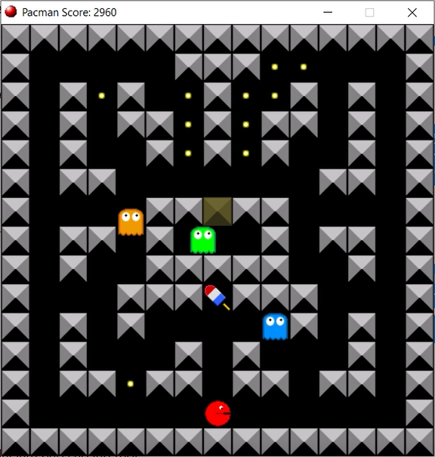
A* algorithm
A* pathfinding algorithm is used to find a shortest way to an object
Current node
(G) The distance beetween current node and start node
(H) The distance from the current node to the end node
F (total cost) = G + H

Slide 4
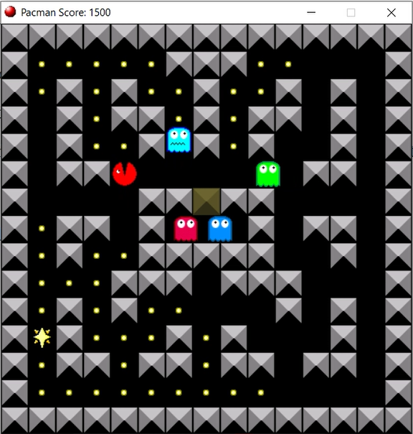

A* algorithm
Calculate the distance to 5 objects
Closest monster
2nd closest monster
Closest scared
Closest pill
Closest bonus

Slide 5
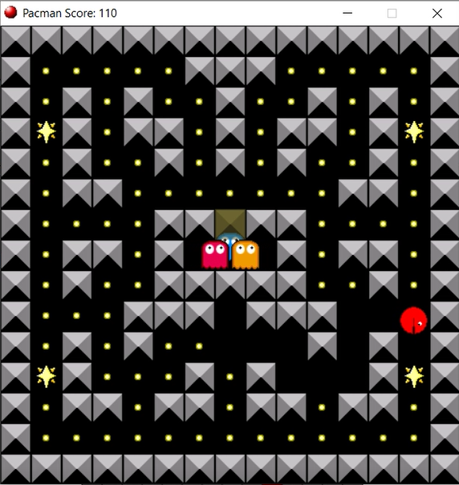
Ambush & EaT PIL
Do the following step
Go to closest pill as soon as posible
Do not eat the pil immediately
Move around the pill and wait for monster to come closer
Eat pil when distance to monster ≤ threshold
This strategy helps increase the score when hunting scareds

Slide 6
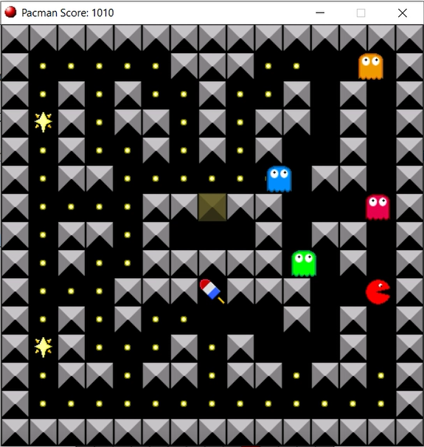
Hide FROM MONSTERS
When distance to closest monster less than or equal a threshold → Control Pacman to hide from monsters
Direction to closest monster
Direction to second closest monster
Other direction
Try to run aways from 2 closest monster
If there is no way to avoid both of them → Hide from closest one

Slide 7
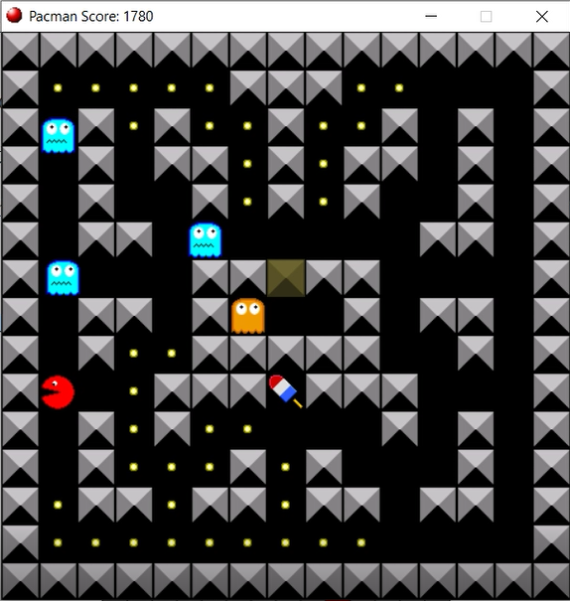
GET BONUS & HUNT SCARED
Getting bonus and hunting scared share the same priority
Eat closest scared or bonus when they are available

Slide 8
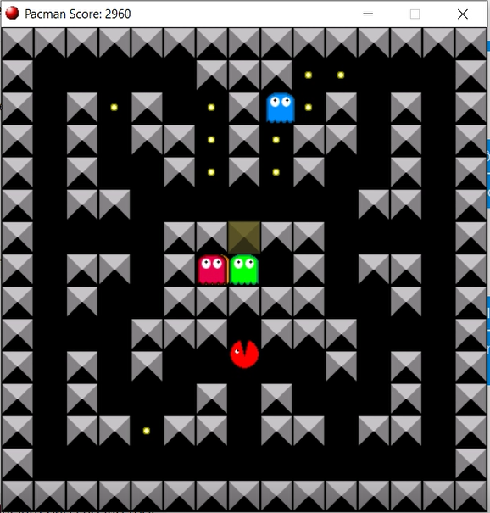
AMBUSH BONUS
When there is no any bonus the ways is:
Ambush bonus: move around bonus area (yellow arrow)
Chasing the point: try to eat more point
In our algorithm, we choose ambush bonus strategy

Slide 9
SCORES (in PetitAdvRTPacmanAI SCRIPT)
Point | Albertus Agung | Nguyen N. Hai | Nguyen V. Hoang | Chasing point | Ambushing bonus
Highest | 1130 | 2280 | 3030 | 2870 | 3720
2nd | 1060 | 2190 | 2750 | 2860 | 3260
3rd | 970 | 2190 | 2700 | 2680 | 3220
4th | 860 | 2060 | 2640 | 2670 | 3060
5th | 740 | 1850 | 2630 | 2540 | 3050
6th | 710 | 1790 | 2370 | 2400 | 2700
7th | 710 | 1760 | 2340 | 2310 | 2230
8th | 580 | 1760 | 2310 | 2210 | 2220
9th | 500 | 1650 | 2240 | 2070 | 2210
10th | 330 | 1600 | 2150 | 1970 | 2030
Average | 759 | 1913 | 2516 | 2458 | 2770

Slide 10
SCORES (in 1minLimitMultipleGames.... SCRIPT)
The results is lower than previous (especially chasing point and abushing bonus) because:
Our Pacman usually lives longer than 1 minutes. It was counted as a game over, though it never died
Chasing point and abushing bonus only work after run out of pill. In this case we have never reached that state → The scores here is just based on luck.
Point | Albertus Agung | Nguyen N. Hai | Nguyen V. Hoang | Chasing point | Ambushing bonus
Highest | 1140 | 2130 | 2730 | 2670 | 2370
2nd | 1010 | 2120 | 2540 | 2510 | 2260
3rd | 900 | 2100 | 2370 | 2200 | 2200
4th | 840 | 1890 | 2320 | 2150 | 2180
5th | 780 | 1840 | 2230 | 1980 | 2150
6th | 740 | 1790 | 2080 | 1820 | 2110
7th | 650 | 1770 | 2080 | 1790 | 2040
8th | 520 | 1740 | 2020 | 1710 | 2010
9th | 490 | 1670 | 1990 | 1690 | 1850
10th | 410 | 1640 | 1970 | 1670 | 1770
Average | 748 | 1869 | 2233 | 2019 | 2094

Slide 11
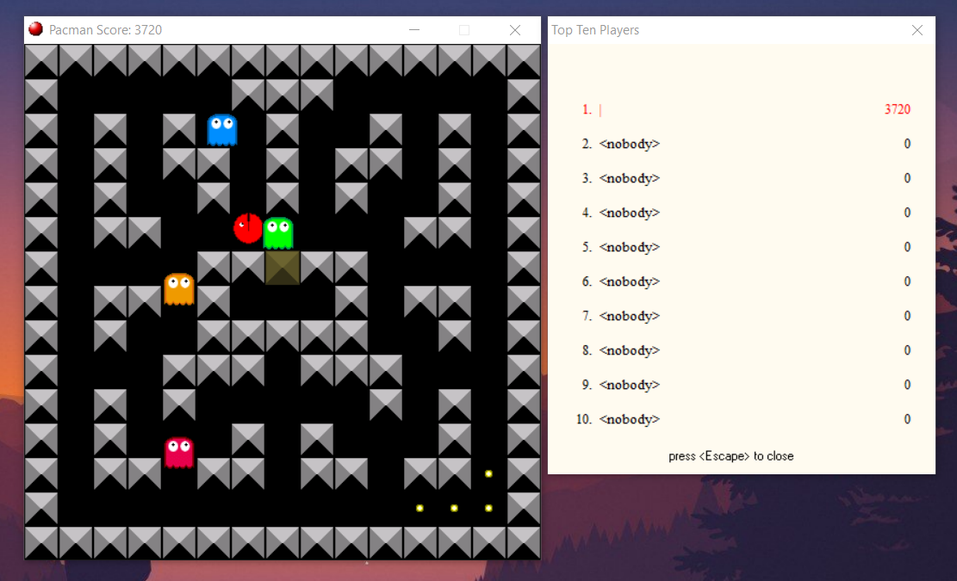
HIGHEST SCORE SCREENSHOT

Slide 12
member's contributions
Member | Contribution percentage
Nguyen Viet Hoang | 40%
Nguyen Ngoc Hai | 30%
Albertus Agung | 30%

