Slide 1
Stream Control Transmission Protocol (SCTP)

Slide 2
RFCs
RFC 2960 – Stream Control Transmission Protocol (obsolete)
RFC 4960 – Stream Control Transmission Protocol

Slide 3
Agenda
Service provided by SCTP
SCTP packets
SCTP Association State diagram
Association Initialization
Association Termination
User Data Transfer
Congestion Control
Interface with Upper Layer

Slide 4
Service provided by SCTP
Service provided by SCTP
SCTP packets
SCTP Association State diagram
Association Initialization
Association Termination
User Data Transfer
Congestion Control
Interface with Upper Layer

Slide 5
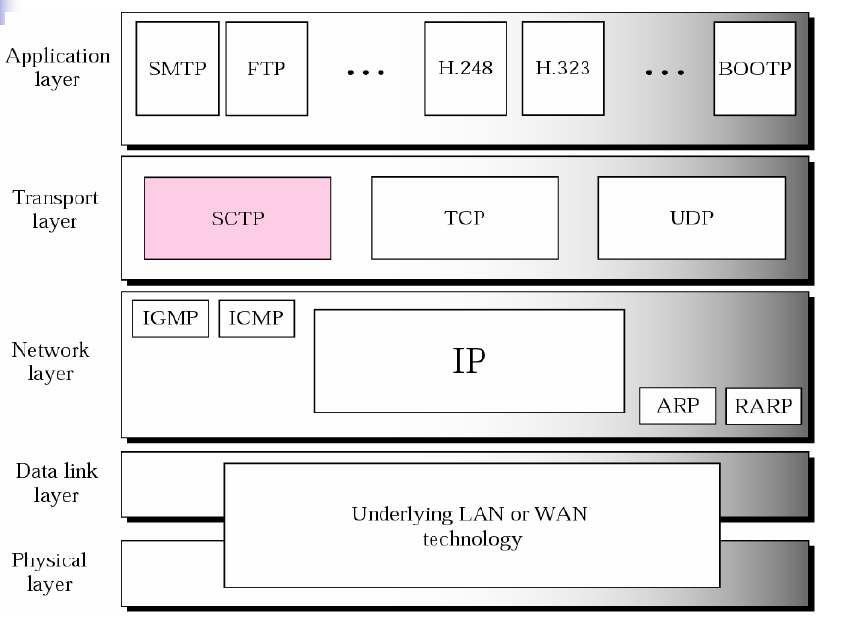
Where’s SCTP in protocol stack?

Slide 6
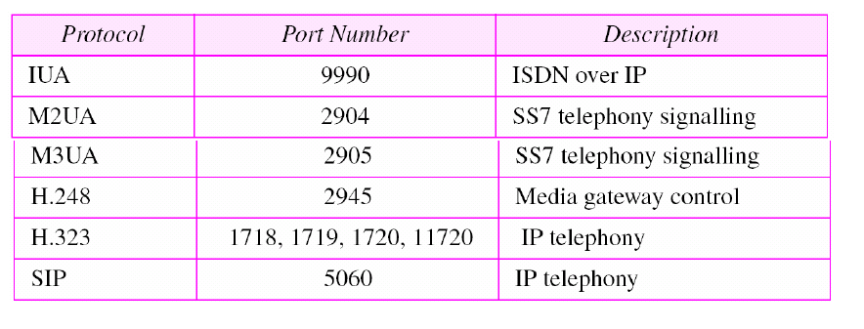
Some SCTP applications of signaling transport

Slide 7
Service provided by SCTP
- comparing with TCP…
The same as TCP:
reliable (retransmissions)
congestion controlled
connection oriented
More advanced than TCP:
4-way handshake
Framing
Multi-streaming
Multi-homing

Slide 8
Comparing with TCP – 4 way handshake
TCP Connection Setup
A
B
closed
t=0
SYN
listen
SYN sent
1RTT
SYN-ACK
SYN recd
(TCB created)
ACK
established
data
estab’d

Slide 9
Comparing with TCP – 4 way handshake
SYN Flooding Attack
attackers
victim
Flooded!!
130.2.4.15
128.3.4.5
SYN
TCB
228.3.14.5
TCB
192.10.2.8
SYN
TCB
TCB
190.13.4.1
221.3.5.10
SYN
TCB
Unavailable, reserved resources
There is no ACK in response to the SYN-ACK, hence connection
remains half-open
Other genuine clients cannot open connections to the victim
The victim is unable to provide service

Slide 10
Comparing with TCP – 4 way handshake
SCTP Association Setup
closed
V: Verification tag
I: Initiate tag
A
B
t=0
INIT (V=0) (I=TagA)
cookie
wait
INIT–ACK (V=TagA) (I=TagB) (StateCookie)
closed
1RTT
COOKIE–ECHO (V=TagB) (StateCookie)
cookie
echoed
COOKIE–ACK (V=TagA)
2RTT
estab’d
data (V=TagB)
established

Slide 11
Comparing with TCP – 4 way handshake
What’s in a cookie?
Information from original INIT
Information from current INIT-ACK
Timestamp
Life span of cookie (Time to live)
Signature for authentication (SHA-1, MD5, etc.)

Slide 12
Comparing with TCP – framing
Message Boundaries
UDP honors message boundaries
  Each app message becomes a datagram
TCP does not honor message boundaries
  App messages become part of a byte stream
SCTP maintains message boundaries
  Each app message is maintained as one or more data chunks

Slide 13
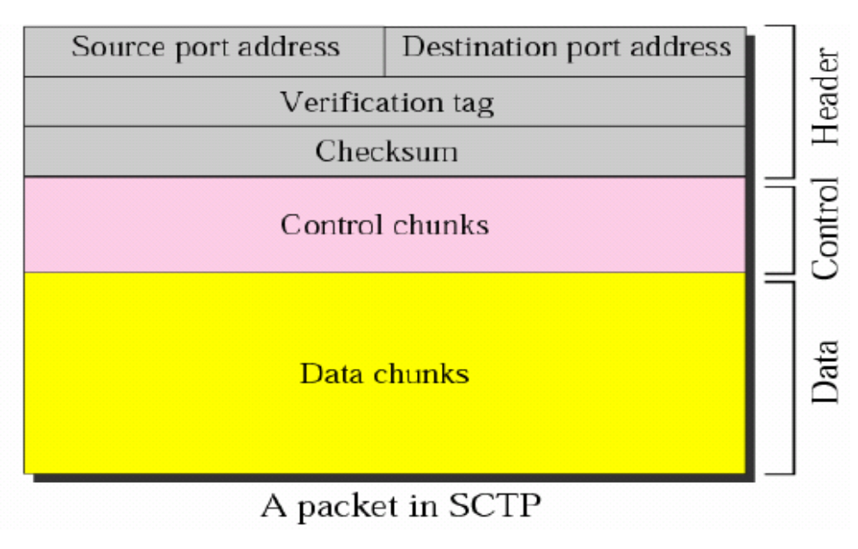
Comparing with TCP – framing
An SCTP Packet

Slide 14
Comparing with TCP – Multi-streaming
Head-of-Line Blocking in TCP
S
R
R’s App
1
2
3
ACK 2
1
4
ACK 3
2
5
ACK 3
6
ACK 3
ACK 3
PDU 3 is blocking the head of the line.

Slide 15
Comparing with TCP – Multi-streaming
Head-of-line Blocking
TCP provides a single data stream
When a segment is lost, subsequent segments must wait to be processed.
Problem for some applications (telephony)
SCTP provides multiple independent streams per association

Slide 16
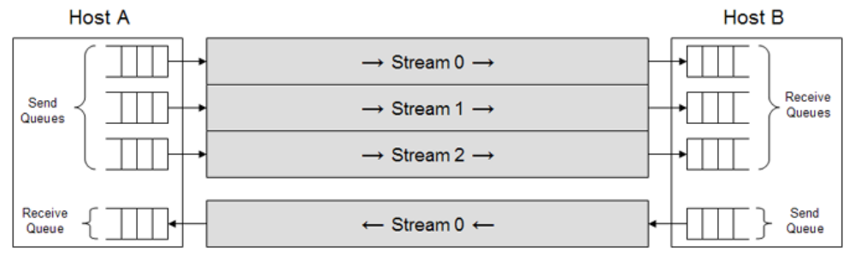
Comparing with TCP – Multi-streaming
SCTP Multi-streaming
Logical separation of data within an assoc
Designed to prevent head-of-line blocking
Can be used to deliver multiple objects belonging to the same assoc
  Eg: objects on a webpage, multimedia streams (audio/video/text), files in an FTP mget

Slide 17
Comparing with TCP – Multi-streaming
Head-of-Line Blocking in SCTP
S
(all ordered streams)
R
App Layer
Transport Layer
App Layer
SID :SSN
TSNs
SID :SSN
1:1
3:1
1,2
1:1, 3:1
ACK 2
1:2
1:1, 3:1
3
1:2
undelivered
3:2
1:3
2:1
3:2, 1:3, 2:1
ACK 2
3:2, 2:1
4,5,6
1:4
2:2
3:3
1:4, 2:2, 3:3
7,8,9
ACK 2
2:2, 3:3
NOTE: An SCTP ACK a cum ack based onTSN.

Slide 18
Comparing with TCP – Multi-streaming
Head-of-Line Blocking in SCTP
S
(stream 1 unordered)
R
App Layer
Transport Layer
App Layer
SID :SSN
TSNs
1:a
SID :SSN
3:1
1,2
3:1, 1:a
ACK 2
1:b
3:1, 1:a
3
1:b
1:c
Only blocked message
3:2
2:1
3:2, 2:1, 1:c
4,5,6
ACK 2
3:2, 2:1, 1:c
1:d
2:2
3:3
2:2, 3:4, 1:d
7,8,9
ACK 2
2:2, 3:3, 1:d
Letters show unordered chunks w/in a stream. U bit is set & SSN is ignored.

Slide 19


Comparing with TCP – multi-homing
What is SCTP Multihoming?
A₁
ISP
Internet
ISP
B₁
A₂
ISP
ISP
B₂
Host A
Host B
Hosts pick 1 of 4 possible TCP connections:
  {(A₁, B₁), (A₁, B₂), (A₂, B₁), (A₂, B₂)}
Hosts use 1 SCTP association:
  ({A₁,A₂}, {B₁,B₂})
  Selectable “primary” dest: Host A → B₁ ; Host B → A₁
  New data sent only to primary destination
  Path status and reachability monitored (hearbeats)

Slide 20
SCTP Multihoming
Why important?
  multihoming is now happening on wide scale
  wired + wireless, multiple ISPs, etc.

Slide 21
Service provided by SCTP
- summary
What’s new for SCTP:
4-way handshake
Framing
Multi-streaming
Multi-homing
→ SCTP is designed to transport Public Switched Telephone Network (PSTN) signaling messages over IP networks, but is capable of broader applications.

Slide 22
SCTP packets
Service provided by SCTP
SCTP packets
SCTP Association State diagram
Association Initialization
Association Termination
User Data Transfer
Congestion Control
Interface with Upper Layer

Slide 24
Chunk Bundling in SCTP
Source Port | Destination Port
Verification Tag
Checksum
Chunk 1
Chunk N
Common Header
SCTP
PDU
Bundling
Multiple chunks in one SCTP PDU
Control chunks bundled before data chunks
Chunk boundary cannot cross SCTP PDU boundary
Optional at sender, but receiver has to support

Slide 25
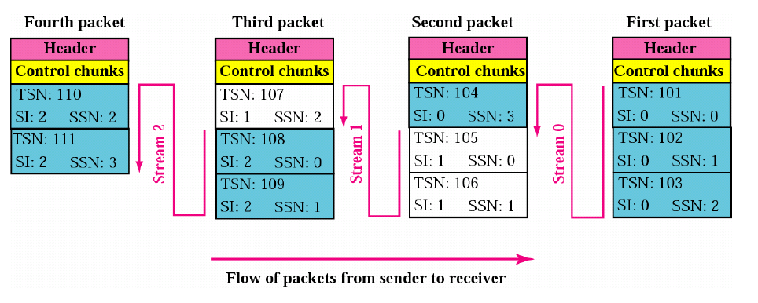

Slide 26
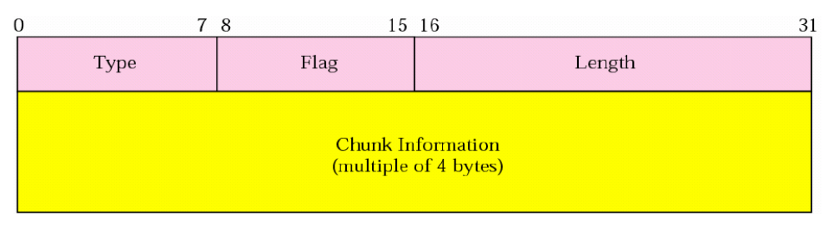
Format of a chunk

Slide 27
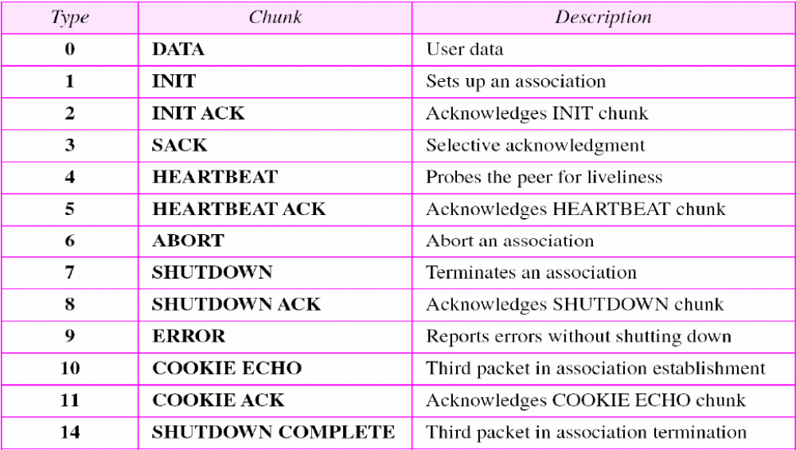
Chunk types

Slide 28
SCTP Association State diagram
Service provided by SCTP
SCTP packets
SCTP Association State diagram
Association Initialization
Association Termination
User Data Transfer
Congestion Control
Interface with Upper Layer

Slide 29
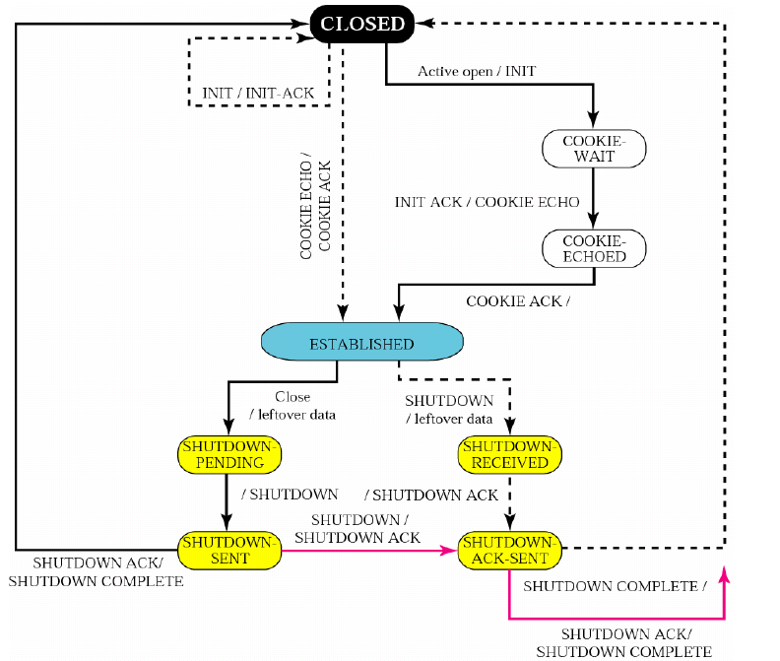

Slide 30
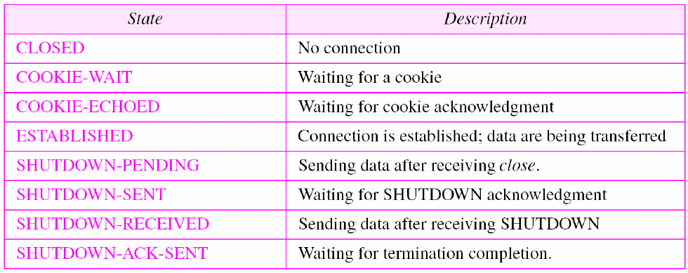
SCTP association states

Slide 31
Association Initialization
Service provided by SCTP
SCTP packets
SCTP Association State diagram
Association Initialization
Association Termination
User Data Transfer
Congestion Control
Interface with Upper Layer

Slide 32
SCTP Association Setup
closed
V: Verification tag
I: Initiate tag
A
B
t=0
INIT (V=0) (I=TagA)
cookie
wait
INIT–ACK (V=TagA) (I=TagB) (StateCookie)
closed
1RTT
COOKIE–ECHO (V=TagB) (StateCookie)
cookie
echoed
COOKIE–ACK (V=TagA)
2RTT
estab’d
data (V=TagB)
established

Slide 33
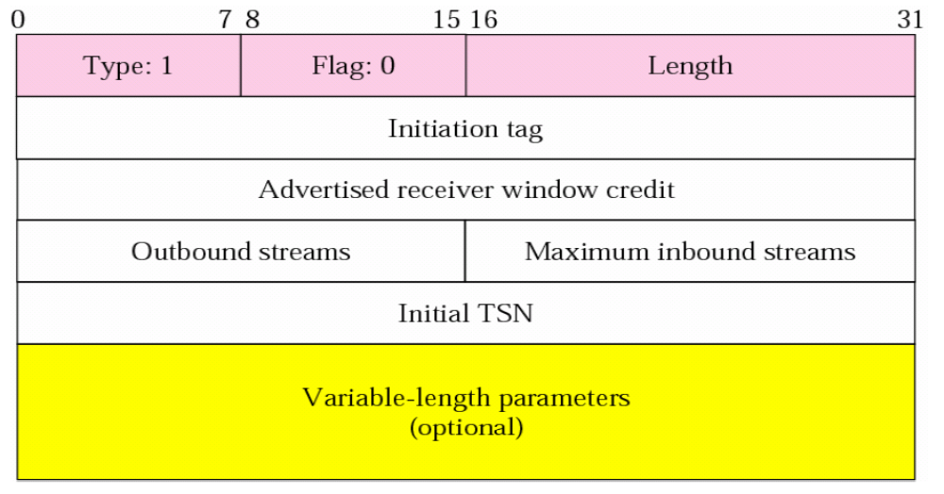
INIT chunk
Note: No other chunk can be carried in the packet carries INIT chunk.

Slide 34
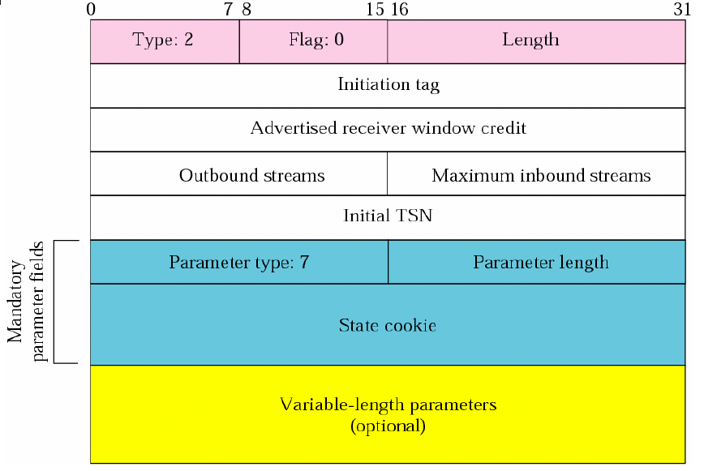
INIT ACK chunk
Note: No other chunk can be carried in the packet carries INIT ACK chunk.

Slide 35
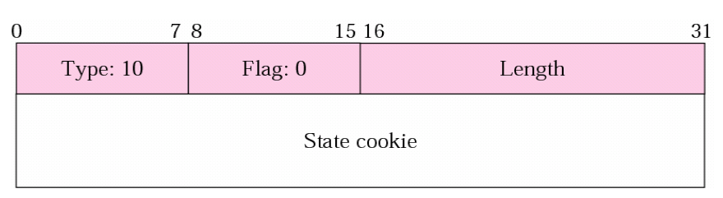
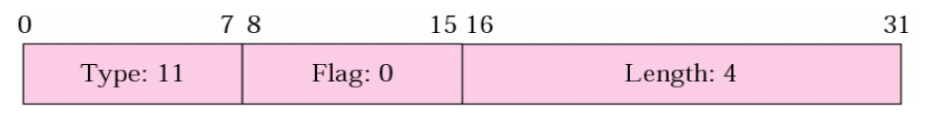
COOKIE ECHO
COOKIE ECHO ACK

Slide 36
SCTP Association Setup
closed
V: Verification tag
I: Initiate tag
A
B
t=0
INIT (V=0) (I=TagA)
cookie
wait
INIT–ACK (V=TagA) (I=TagB) (StateCookie)
closed
1RTT
COOKIE–ECHO (V=TagB) (StateCookie)
cookie
echoed
COOKIE–ACK (V=TagA)
2RTT
estab’d
data (V=TagB)
established

Slide 37
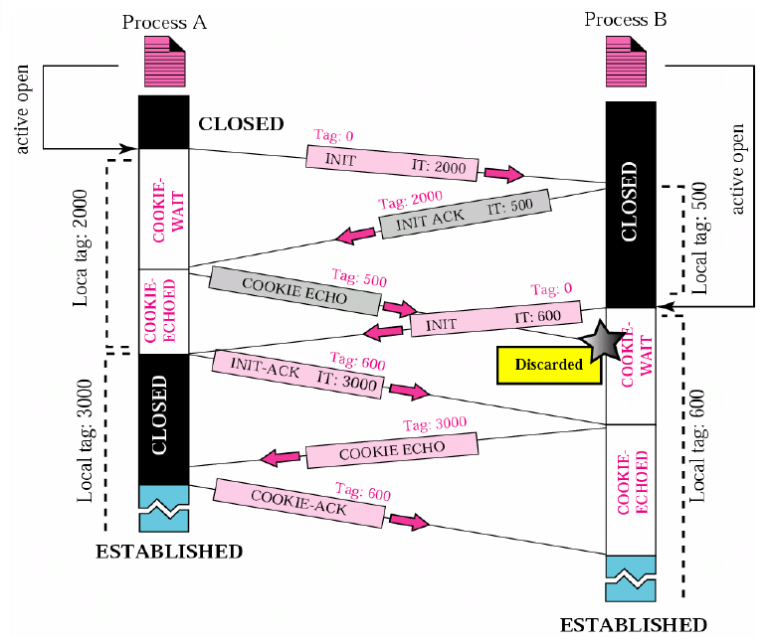
initialization collision
- Handle a COOKIE ECHO when a TCB Exists

Slide 38
Handle a COOKIE ECHO when a TCB Exists
Refer to RFC4960:
- 5.2.4. Handle a COOKIE ECHO when a TCB Exists

Slide 39
Multihoming Operation
Both the INIT and INIT ACK chunks contain lists of IP addresses, which are exchanged during INITIATION of association
The Source IP Address in the INIT chunk is used as the destination address for the INIT ACK response
INIT
IP address A1
1
IP address B1
INIT ACK
SCTP
Endpoint A
SCTP
Endpoint B
IP address A2
2
IP address B2

Slide 40
Association Termination
Service provided by SCTP
SCTP packets
SCTP Association State diagram
Association Initialization
Association Termination
User Data Transfer
Congestion Control
Interface with Upper Layer

Slide 41
Graceful Shutdown
A
B
App signals shutdown
Shutdown pending
(pending data)
SHUTDOWN
Shutdown received
Shutdown sent
(pending data)
SHUTDOWN-ACK
Shutdown-Ack sent
SHUTDOWN-COMPLETE
Closed
Closed

Slide 42
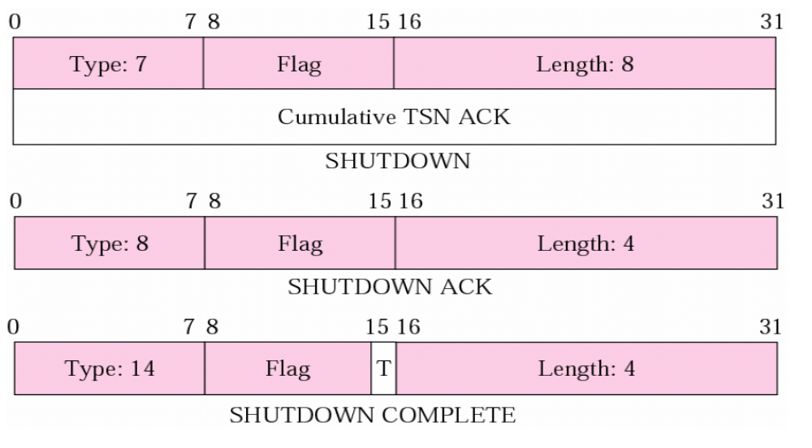

Slide 43
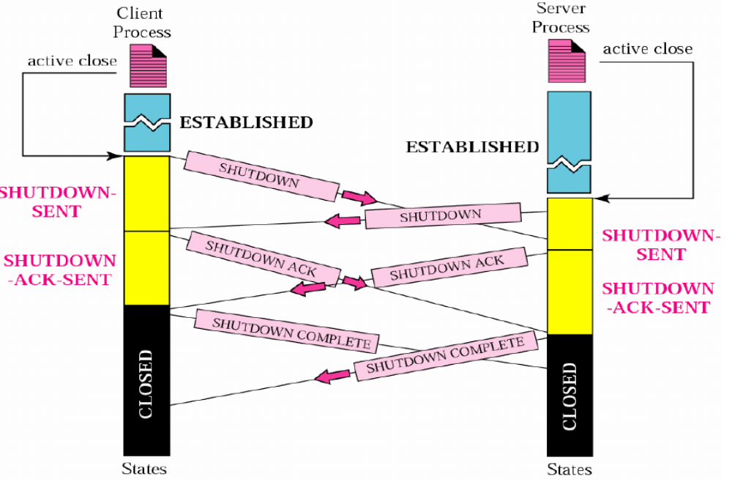
Shutdown on both sides

Slide 44
User Data Transfer
Service provided by SCTP
SCTP packets
SCTP Association State diagram
Association Initialization
Association Termination
User Data Transfer
Congestion Control
Interface with Upper Layer

Slide 45
Data Transmission
SCTP
Endpoint A
SCTP
Endpoint B
ESTABLISHED
STATE
DATA chunk(s)
ESTABLISHED
STATE

Slide 46
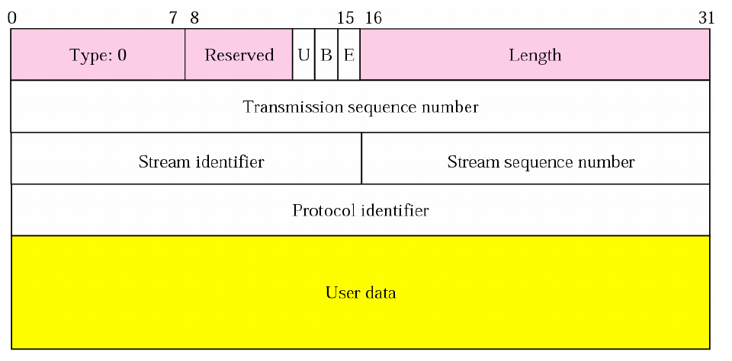
Data Chunk

Slide 47
Fragmentation/Reassembly in SCTP
Large messages are fragmented and encapsulated into several data chunks
Reassembled before delivery to receiving app
U | B | E | Description
* | 1 | 0 | (Begin) First Piece of fragmented message
* | 0 | 0 | Middle piece of fragmented message
* | 0 | 1 | (End) Last piece of fragmented message
* | 1 | 1 | Non-fragmented message
U set to 1 specifies unordered message
Note: Fragmentation req. – sequential TSN’s

Slide 48
Data Chunk
A Data chunk cannot carry data belonging to more than one message, but a message can be split into several chunks.
The data field of the DATA chunk must carry at least one byte of data, which means the value of length field cannot be less than 17.

Slide 49
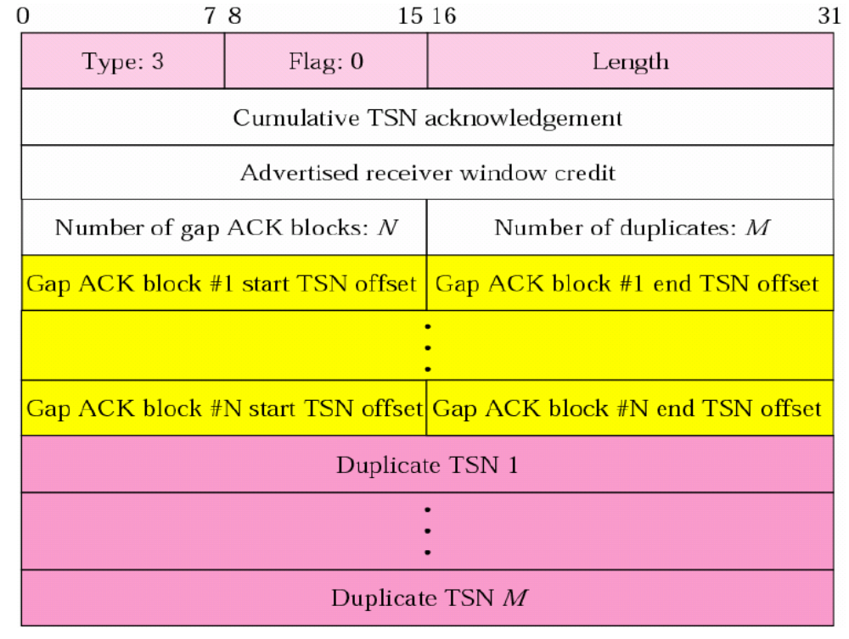
Sack chunk

Slide 50
Data Transmission
SCTP
Endpoint A
SCTP
Endpoint B
ESTABLISHED
STATE
DATA chunk
ESTABLISHED
STATE
SACK chunk
The Selective Acknowledgement Chunk is used to acknowledge received Data Chunks, and to inform of gaps in the sequence of Data Chunks

Slide 51
Acknowledging DATA Chunks
SCTP
Endpoint A
SCTP
Endpoint B
DATA chunk TSN=100
DATA chunk TSN=101
DATA chunk TSN=102
DATA chunk TSN=103
DATA chunk TSN=104
DATA chunk TSN=105
DATA chunk TSN=106
DATA chunk TSN=107
DATA chunk TSN=108
SACK chunk Cumulative TSN=108

Slide 52
Acknowledging DATA Chunks
DATA chunk TSN=109
DATA chunk TSN=110
DATA chunk TSN=111
DATA chunk TSN=112
DATA chunk TSN=113
DATA chunk TSN=114
X
DATA chunk TSN=115
X
DATA chunk TSN=116
DATA chunk TSN=117
DATA chunk TSN=118
DATA chunk TSN=119
DATA chunk TSN=120
DATA chunk TSN=121
DATA chunk TSN=122
DATA chunk TSN=123
X
DATA chunk TSN=124
DATA chunk TSN=125
DATA chunk TSN=126
SACK chunk Cumulative TSN=113
Gap Ack Block #1 Start = +3 End = +9
Gap Ack Block #2 Start = +11 End = +13

Slide 53
Unordered delivery
Streams by definition are ordered
Unordered data may be sent in a stream (U bit = 1)
SSN is ignored for U = 1
Unordered messages should be processed first

Slide 54
Comparing with TCP – Multi-streaming
Head-of-Line Blocking in SCTP
S
(all ordered streams)
R
App Layer
Transport Layer
App Layer
SID :SSN
TSNs
SID :SSN
1:1
3:1
1,2
1:1, 3:1
ACK 2
1:2
1:1, 3:1
3
1:2
undelivered
3:2
1:3
2:1
3:2, 1:3, 2:1
ACK 2
3:2, 2:1
4,5,6
1:4
2:2
3:3
1:4, 2:2, 3:3
7,8,9
ACK 2
2:2, 3:3
NOTE: An SCTP ACK a cum ack based onTSN.

Slide 55
Comparing with TCP – Multi-streaming
Head-of-Line Blocking in SCTP
S
(stream 1 unordered)
R
App Layer
Transport Layer
App Layer
SID :SSN
TSNs
1:a
SID :SSN
3:1
1,2
3:1, 1:a
ACK 2
1:b
3:1, 1:a
3
1:b
1:c
Only blocked message
3:2
2:1
3:2, 2:1, 1:c
4,5,6
ACK 2
3:2, 2:1, 1:c
1:d
2:2
3:3
2:2, 3:4, 1:d
7,8,9
ACK 2
2:2, 3:3, 1:d
Letters show unordered chunks w/in a stream. U bit is set & SSN is ignored.

Slide 56
Multihoming Operation
Endpoints will monitor data timeouts and the number of retransmissions to determine the suitability of the path
DATA
DATA
DATA
DATA
DATA
DATA
IP address A1
1
IP address B1
SACK
SCTP
Endpoint A
SCTP
Endpoint B
IP address A2
2
IP address B2

Slide 57
Multihoming Operation
Retransmitted Data chunks will be sent over both paths if the status of one path is suspect
DATA
IP address A1
1
IP address B1
SCTP
Endpoint A
SCTP
Endpoint B
DATA
IP address A2
2
IP address B2
SACK

Slide 58
Multihoming Operation
All faulty paths will be marked as “Out of Service”
Out of Service
X
1
IP address A1
IP address B1
SCTP
Endpoint A
SCTP
Endpoint B
DATA
DATA
DATA
DATA
DATA
DATA
IP address A2
2
IP address B2
SACK

Slide 59
Multihoming Operation
Heartbeat chunks are sent periodically to all inactive IP addresses
Non responding IP addresses will be marked as Out of Service
Heartbeat
Heartbeat
Heartbeat
Heartbeat
Heartbeat
Heartbeat
Heartbeat
Heartbeat
Heartbeat
Heartbeat
Heartbeat
Heartbeat
IP address A1
1
IP address B1
Heartbeat Ack
Heartbeat Ack
Heartbeat Ack
Heartbeat Ack
Heartbeat Ack
Heartbeat Ack
Heartbeat Ack
Heartbeat Ack
Heartbeat Ack
Heartbeat Ack
Heartbeat Ack
Heartbeat Ack
SCTP
Endpoint A
SCTP
Endpoint B
Heartbeat
Heartbeat
Heartbeat
Heartbeat
Heartbeat
Heartbeat
Heartbeat
Heartbeat
Heartbeat
Heartbeat
Heartbeat
Heartbeat
IP address A2
2
IP address B2
Heartbeat Ack
Heartbeat Ack
Heartbeat Ack
Heartbeat Ack
Heartbeat Ack
Heartbeat Ack
Heartbeat Ack
Heartbeat Ack
Heartbeat Ack
Heartbeat Ack
Heartbeat Ack
Heartbeat Ack

Slide 60
Congestion control
Service provided by SCTP
SCTP packets
SCTP Association State diagram
Association Initialization
Association Termination
User Data Transfer
Congestion Control
Interface with Upper Layer

Slide 61
Congestion Control
Basically congestion is controlled by observing the number of packets lost and modifying the transmission rate accordingly
Congestion Control Window
Represents the senders view of network conditions
Dynamically changed to suit network conditions
Receiver Window Size
Represents the senders view of the receivers incoming buffer space
Updated by the receiver in SACK chunks (Advertised Receiver Window Credit)

Slide 62
Congestion Control
Congestion Control Window
Slow Start
Threshold
The Congestion Control Window dictates how many Data Chunks can be transmitted before you must wait for an Acknowledgement
DATA
DATA
DATA
DATA
SCTP
Endpoint A
SCTP
Endpoint B
SACK
SACK
SACK

Slide 63
Congestion Control
Congestion Control Window
Slow Start
Threshold
If packets are being successfully delivered and acknowledged. The Congestion Control Window will be increased.
DATA
DATA
DATA
DATA
DATA
DATA
DATA
DATA
DATA
DATA
DATA
DATA
DATA
DATA
DATA
DATA
DATA
DATA
DATA
DATA
DATA
DATA
DATA
DATA
SCTP
Endpoint A
SCTP
Endpoint B
SACK
SACK
SACK

Slide 64
Congestion Control
Congestion Control Window
Slow Start
Threshold
If lost packets are being experienced, the Congestion Control Window will be reset, and the Slow Start Threshold may be lowered.
Slow Start
Threshold
DATA
DATA
DATA
DATA
SCTP
Endpoint A
SCTP
Endpoint B
SACK
SACK
SACK

Slide 65
Congestion Control
Congestion Control Window
Receiver Buffer Window
Slow Start
Threshold
DATA
DATA
DATA
DATA
DATA
DATA
DATA
DATA
DATA
DATA
DATA
DATA
SCTP
Endpoint A
SCTP
Endpoint B
SACK
SACK
SACK

Slide 66
Fast retransmit and fast recovery
Fast retransmit: 3 duplicated SACK with the same TSN from endpoint. Retransmit the UNACK data with bundling packet.
Fast recovery: CWND is not changed after fast retransmit is triggered to cut the time of slow start.

Slide 67
Interface with Upper Layer
Service provided by SCTP
SCTP packets
SCTP Association State diagram
Association Initialization
Association Termination
User Data Transfer
Congestion Control
Interface with Upper Layer

Slide 68
ULP-to-SCTP
Interface from Upper layer protocol to SCTP layer:
Eg.
Associate
Initialize
Shutdown
…

Slide 69
SCTP-to-ULP
Callback function provided by ULP:
Eg.
DATA ARRIVE notification
SEND FAILURE notification
COMMUNICATION UP notification
…

Slide 70
Others
Service provided by SCTP
SCTP packets
SCTP Association State diagram
Association Initialization
Association Termination
User Data Transfer
Congestion Control
Interface with Upper Layer

Slide 71
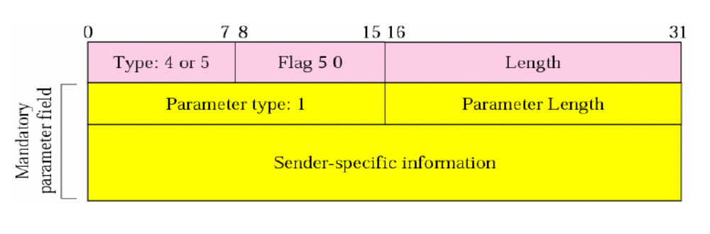
Heart beat Chunk

Slide 72
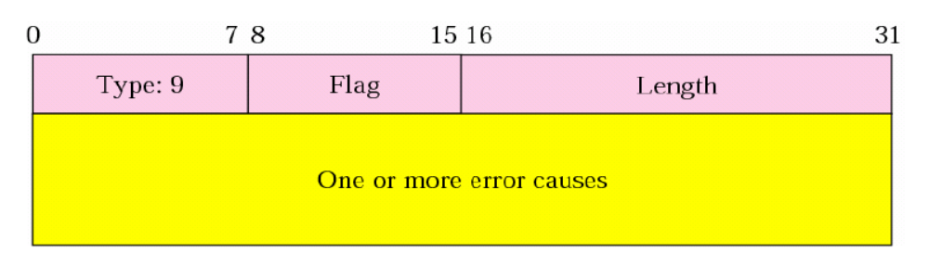
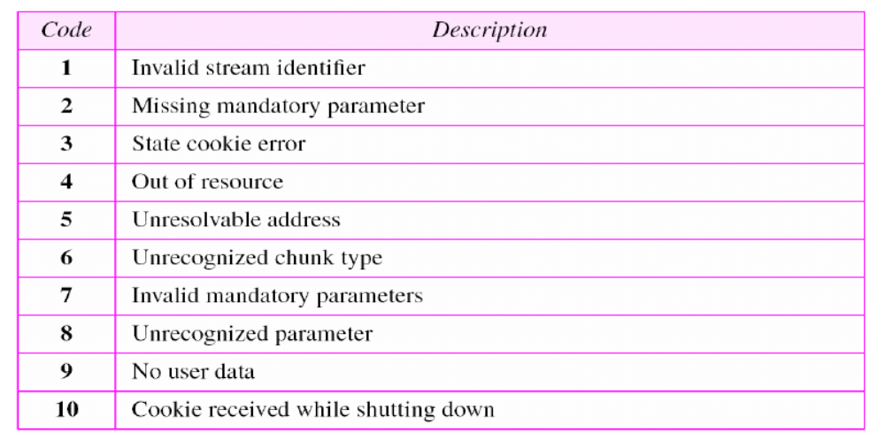
Error Chunk

Slide 73
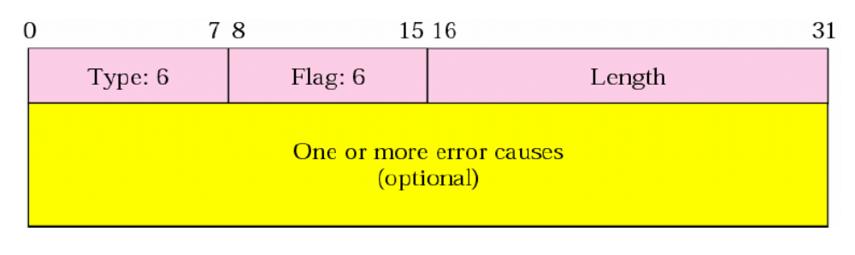
Abort Chunk

Slide 74
- End -
Thank you very much!

