Slide 1
Networking Basic

Slide 2
Contents
1. Introduction to Networking
2. OSI Model
3. TCP/IP Protocol
4. LAN
5. WAN
6. Other Concepts

Slide 3
What is networking?
In the world of computers, networking is the practice of linking two or more computing devices together for the purpose of sharing data. Networks are built with a mix of computer hardware and computer software.

Slide 4
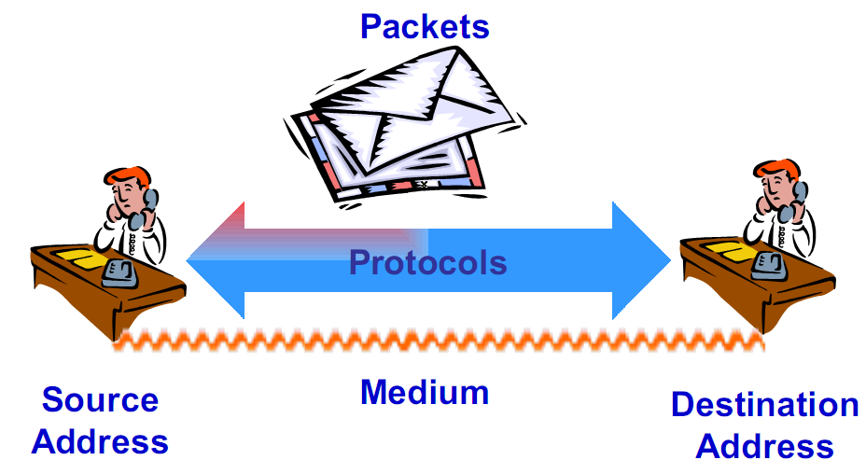
Communication Process

Slide 5
2. OSI MODEL

Slide 6
OSI Model
Researched and developed by the ISO - (International Organization for Standardizations) and ITU-T (International Telecommunication Union- Telecommunications Standards Sector).
1977: establish a subcommittee to develop a
communications architecture.
1984: publish ISO-7498, the Open System Interconnection (OSI) reference model.

Slide 7
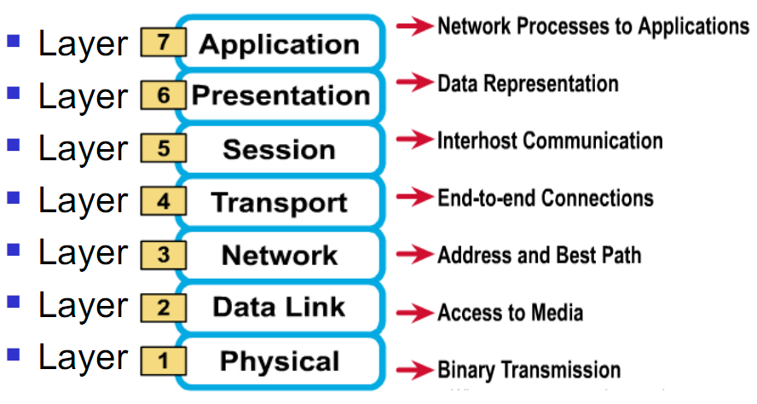
7 layers of the OSI reference model

Slide 8
Why a layered model?
Reduces complexity.
Standardizes interfaces.
Facilitates modular engineering.
Ensures interoperable technology.
Accelerates evolution.
Simplifies teaching and learning.

Slide 9
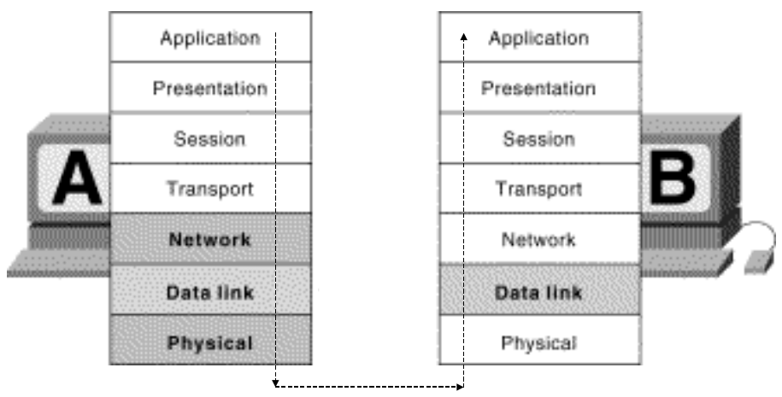
OSI Model and Communication between Systems

Slide 10
The physical layer
The physical layer defines the electrical, mechanical, procedural, and functional specifications for activating, maintaining, and deactivating the physical link between communicating network systems
Physical layer specifications define characteristics such as voltage levels, timing of voltage changes, physical data rates, maximum transmission distances, and physical connectors.
Physical connector : Twisted Pair, Baseband Coaxial Cable, Broadband Coaxial Cable, Fiber Optical, Line-of-Sight Transmission, Communication Satellites.

Slide 11
The data-link layer
The data link layer provides for the reliable transfer of data cross a physical link.
Data link layer specifications define different network and protocol characteristics, including physical addressing, network topology, error notification, sequencing of frames, and flow control
Data link layer is subdivided into two sublayers
  Logical Link Control (LLC) - manages communications between devices over a single link of a network
  Media Access Control (MAC) - manages protocol access to the physical network medium

Slide 12
The network layer
Provides connectivity and path selection between two host system that may be located on geographically separated networks.
  Virtual circuits used for connection services
  Datagram services - is used for connectionless services
  Route, routing table, routing protocol
  Logical address - Network Service Access Point Addresses
Two network layer protocols:
  X25 (packet layer protocol)
  IP (Internet Protocol)

Slide 13
The transport layer
The transport layer accepts data from the session layer and segments the data for transport across the network
Provides reliable, transparent transfer of data over networks:
  End-to-end flow control
  Error detection and recovery
  Segmentation & reassembly
Transport Layer Services
  Quality of Service
  Services Provided to the Session Layer
Transport Layer protocol
  TCP (Transmission Control Protocol)
  UDP (User Datagram Protocol

Slide 14
The session layer
The session layer establishes, manages, and terminates sessions between two communicating hosts.

Slide 15
The presentation layer
Ensures that information sent from the application layer of one system would be readable by the application layer of another system by using common data representation formats
  Data structure – depending on the application
  Format of data – define all the data structure types needed by each application in ASN.1 and package them together in a module
  Data conversion
  Data compression
  Data encryption

Slide 16
The application layer
Is the OSI layer that is closest to the end user; it provides network services to the user’s applications.
  File transfer
  Electronic mail
  Terminal access
  Word processing
  Intended communication partners

Slide 17
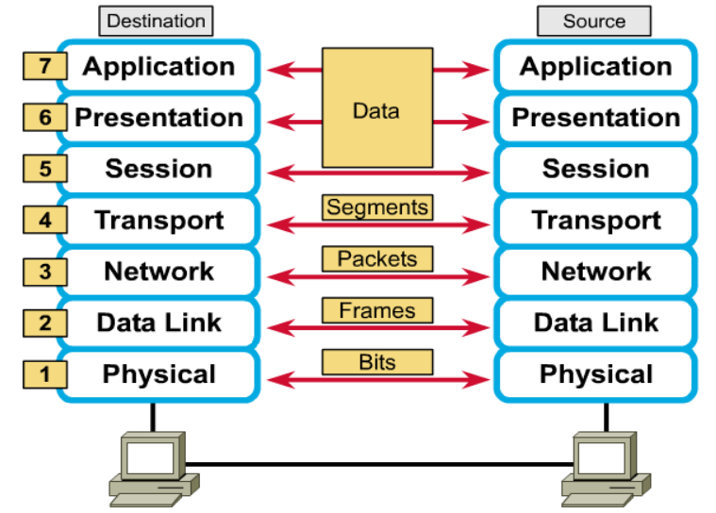
Peer-to-peer communications

Slide 18
Protocols implemented in OSI model
Protocol is a formal set of rules and conventions that governs how computers exchange information over a network medium.
Protocol implements the functions of one or more of the OSI layers.
A communication protocol is concerned with exchanging data between two peer layers.
Protocols in
  Data link layer – PPP, MLPPP, PAP (Password Authentication Protocol), L2F, L2TP, PPTP, SDCP (Serial Data Control Protocol), VLAN …
  Network layer –BGP, IS-IS, OSPF, ICMP, RIP, MPLS, IP, IPSEC, VRPN, VoIP, ….
  Transport layer – TCP, UDP, …
  Session layer – ZIP, SCP, …
  Application layer – File Transfer Protocol (FTP), and Simple Mail Transfer
  Protocol (SMTP), Telnet, SNMP, …

Slide 19
TCP/IP MODEL

Slide 20
TCP/IP Protocol
Transmission Control Protocol/Internet Protocol
The suite of communication protocols used to connect hosts on the Internet
TCP/IP uses several protocols, the two main ones being TCP and IP
TCP (Transmission Control Protocol)
  Enables two hosts to establish a connection and exchange streams of data
  Guarantees delivery of data and also guarantees that packets will be delivered in the same order in which they were sent
UDP (User Datagram Protocol)
  Connectionless protocol
  Used primarily for broadcasting messages over a network
IP (Internet Protocol)
  Specifies the format of packet and the addressing scheme

Slide 21
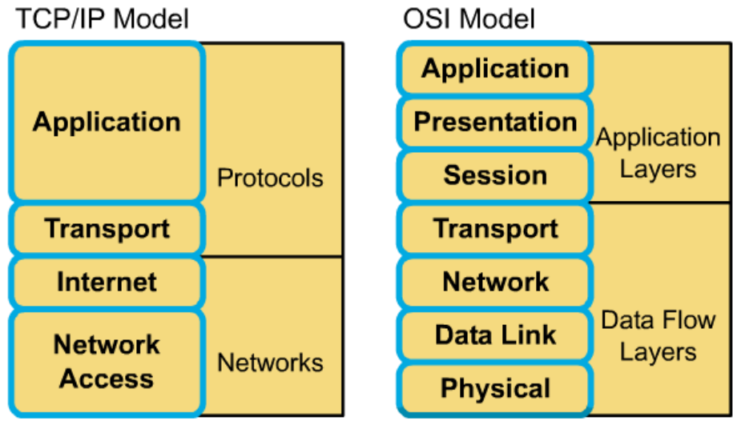
Mapping TCP/IP into OSI model

Slide 22
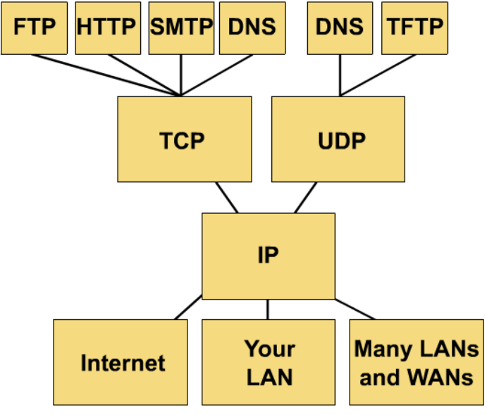
TCP/IP protocol stack

Slide 23
4. Local Area Networks

Slide 24
What is a LAN?
A LAN is a high-speed data network that covers a relatively small geographic area
It connects workstations, personal computers, printers, and other devices
LANs offers computer users
  Shared access to devices and applications
  File exchange between connected users
  Communication between users via electronic mail and other applications

Slide 25
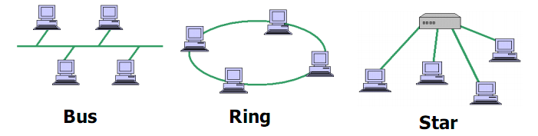
Topologies
LAN topologies define the manner in which network devices are organized.
Four common LAN topologies : bus, ring, star, and tree.
These topologies are logical architectures, but the actual devices need not be physically organized in these configurations

Slide 26
Topologies Comparison
Topology | Pros | Cons
Bus | Ease of initial set-up | Cable breaks affect the entire LAN
 | Low implementation costs
Ring | Uses less cabling | Cable breaks between devices affect the entire LAN (only in the Token Ring Standard).
 |  | Higher implementation costs.
Star | Cable break usually affects only one workstation | Uses excessive cabling due to physical distance factors
 | Workstations can be added easily, without affecting the entire network

Slide 27
Access method
The set of rules that enable data from one workstation to successfully reach its destination
LAN protocols typically use one of two methods to access the physical network medium
  CSMA/CD (Carrier-Sense Multiple Access with Collision Detection)
  CSMA/CA (Carrier-Sense Multiple Access with Collision Avoidance)
  Token passing
  Switch-based, connection-oriented

Slide 28
LAN Transmission Methods
LAN data transmissions fall into three classifications:
  Unicast: a single packet is sent from the source to a destination on a network
  Multicast: a single data packet that is copied and sent to a specific group of nodes on the network.
  Broadcast: a single data packet that is copied and sent to all nodes on the network.

Slide 29
LAN Devices
Repeaters
LAN extenders
Bridges
LAN switches
Routers
Gateway

Slide 30
Popular Types of LANs
Ethernet
Fast Ethernet
FDDI

Slide 31
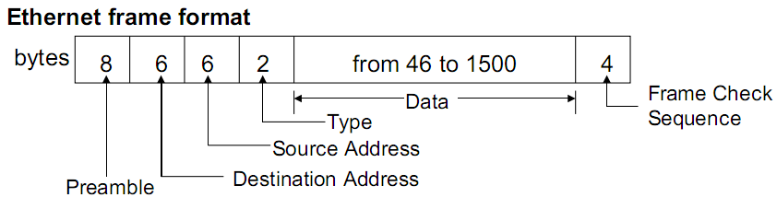
Ethernet LAN
Uses the CSMA/CD access protocol on a bus structure

Slide 32
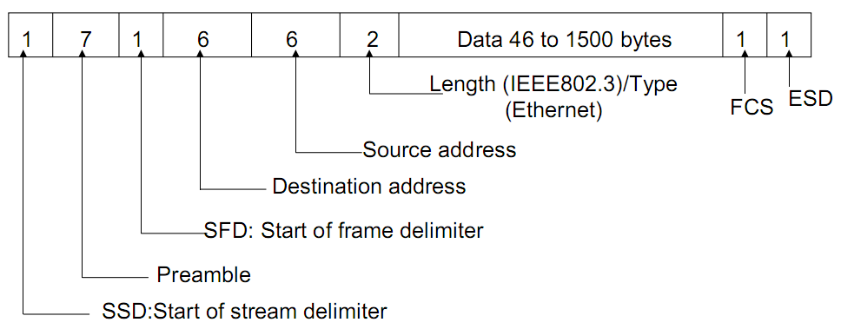
Fast Ethernet
A term commonly used to reference a series of three 100 Mbps physical layer LAN specifications

Slide 33
FDDI
Fiber Distributed Data Interface (FDDI) is a local networking standard which provides a 100 Mbps operating rate.
FDDI incorporate counter-rotating rings
Advantages
  Operating rate
  Reliability

Slide 34
LAN Protocols
PPP
  The Point-to-Point Protocol (PPP) originally emerged as an encapsulation protocol for transporting IP traffic over point-to-point links
PPPoE
  The Point-to-Point Protocol over Ethernet (PPPoE) is a specification for connecting multiple computer users on an Ethernet local area network to a remote site through common customer premises equipment

Slide 35
5. Wide Area Networks

Slide 36
What is a WAN?
A WAN is a data communications network that covers a relatively broad geographic area.
WAN technologies operate at the three lowest levels of the OSI model.
Respect to the flow of information on a transmission, WANs can be grouped into three basic types:
  Circuit switching
  Packet switching
  Leased line

Slide 37
Point-to-Point Links
A point-to-point link provides a single, pre-established WAN communications path from the customer premises through a carrier network
It is also known as a leased line
These links accommodate two types of transmissions: datagram transmissions and data-stream transmissions

Slide 38
Circuit Switching
Circuit switching is a WAN switching method in which a dedicated physical circuit (path) is established, maintained, and terminated through a carrier network for each communication session
This connection in which a call is established by switching equipment over a temporary path is known as a switched virtual call (SVC)

Slide 39
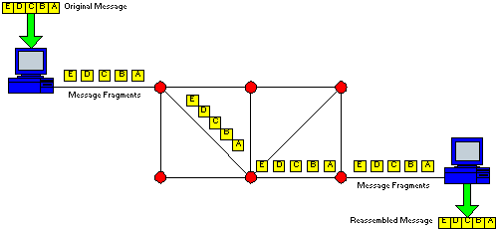
Circuit Switching (cont)

Slide 40
WAN Virtual Circuits
A virtual circuit is a logical circuit created to ensure reliable communication between two network devices.
There are two types:
  SVCs (switched virtual circuits): SVCs are virtual circuits that are dynamically established on demand and terminated when transmission is complete.
  PVCs (permanent virtual circuits): PVC is a permanently established virtual circuit.

Slide 41
Packet Switching
Packet switching is a WAN switching method in which network devices share a single point-to-point link to transport packets from a source to a destination across a carrier network
Transmitted data is divided into the packets, that have addressing, sequencing, and error control information
The flow of packets between nodes in a packet network is intermixed with respect to the originator and destination of packets => many users can share large portions of the transmission facilities

Slide 42
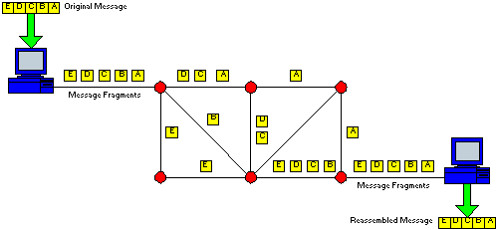
Packet Switching (cont)

Slide 43
Leased line networks
Leased line is used to reduce the number of physical lines required to connect telephone company offices to one another, communications carriers implemented a technique called multiplexing
A physical line can be shared for many users at time.
Two types of multiplexing:
  Frequency division multiplexing (FDM)
  Time division multiplexing (TDM)

Slide 44
WAN Devices
WANs use many types of devices :
WAN switches
Access servers
Modems
CSU/DSUs
ISDN terminal adapters

Slide 45
6. Some Concepts

Slide 46
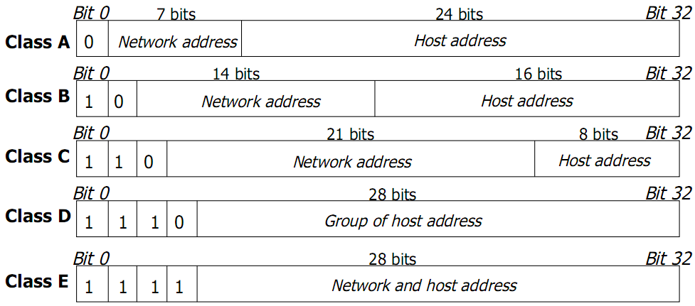
IP Addresses
Identifies the location to where the packet can be sent
Uses a 32 bit address which is divided into an assigned network number and a host number
The ranges of IP addresses

Slide 47
IP Addresses (cont)
Private IP:
  10.0.0.0 với Subnet mask là 255.0.0.0
  172.16.0.0 với Subnet mask là 255.255.0.0
  192.168.0.0 với Subnet mask là 255.255.255.0
Loopback IP: 127.0.0.0

Slide 48
Subnet Mask
Subnets is used to separate groups of hosts for security reasons, for traffic control purposes, or other reasons
A subnet mask is an IP address feature that serves as a sort of template to indicate which bits in the IP address define the network and which bits define the host
All devices on the same IP network must use the same subnet mask.
The standard subnet masks used for the class A, B, and C networks are
  Class A 255.0.0.0 – 11111111 00000000 00000000 00000000
  Class B 255.255.0.0 – 11111111 11111111 00000000 00000000
  Class C 255.255.255.0 – 11111111 11111111 11111111 00000000

Slide 49
IP Routing
IP routing defines the way packet get from A to B in internet.
Have 2 concepts:
  Static route: is simply the process of manually entering routes into a device's routing table via a configuration file that is loaded when the routing device starts up.
  Dynamic route: are supported by software applications running on the routing device (the router) which dynamically learn network destinations and how to get to them and also advertise those destinations to other routers.

Slide 50
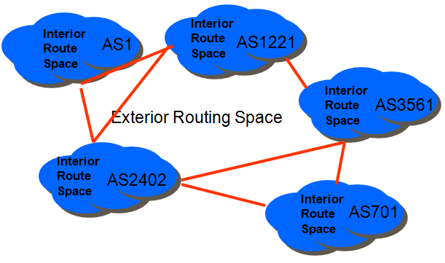
Interior and Exterior Routing Protocols

Slide 51
Interior Routing Protocols
Describe the current network topology
Routing protocols distribute how to reach address prefix groups
Methods of operation:
  Distance Vector Protocol
  Link state Protocol

Slide 52
Distance Vector Routing Protocols
Distance vector protocols use a distance calculation plus an outgoing network interface to choose the best path to a destination network.
  Each node sends its routing table (dest, distance) to all neighbors periodically.
Common distance vector routing protocols include:
  RIPv1
  RIPv2
  IGRP

Slide 53
Link State Routing Protocols
  Each link, the connected nodes and the metric is flooded to all routers
  Each link up/down status change is incrementally flooded
  Each router re-computes the routing table in parallel using the common link state database
Common link state routing protocols include:
  OSPF
  IS-IS

Slide 54
Exterior Routing Protocols
Border Gateway Protocol version 4 (BGP4)

Slide 55
Question & Answer

Slide 56
Thank You

