Slide 1
Data mining – python for trading

Slide 2
Business Understanding
The Meme Stock hype
In Jan 2021, a user on WallStreetBets SubReddit happened to know GameStop stocks were heavily shorted by hedge fund managers, and many users on Reddit decided to buy in the stock. Within a few days at the end of January 2021, millions of shares of GME were bought after this social media frenzy, and GME price went from just 40 USD on Jan 20th to the peak of 483 USD on Jan 28th (12x gain). The same phenomenon happened with other stocks such as AMC later in the year.
This rapid price bump and dump driven by social media activities and not by company's performance or business values is dubbed as "meme stocks", and later applied to DodgeCoin/ShibaInu as "meme coins" in cryptocurrency market.
Project Scope
In the scope of this project, I will analyze the stock price of any tickers that observed irregularities in prices (such as AMC, GME, ect.) in the past year when Covid hit in light of technical analysis.
I will compare these stock performance to that of market tickers such as SPY (S&P index), VTI (Total Stock Index) and other companies with strong stock performance such as Tesla, Apple, MSFT; as well stocks in the same sectors as GME and AMC.
After that, I will compare the returns of these stocks using a few technical trading techniques based on stock price movements.

Slide 3
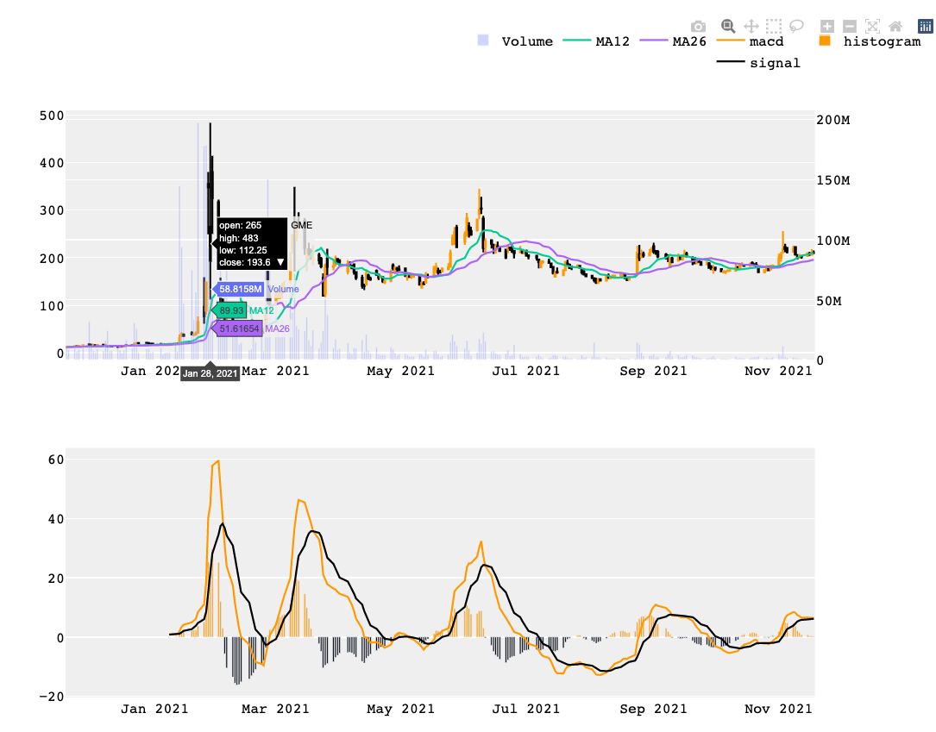
GME stock price ride Nov 2020 – Nov 2021
Before the hype, GME was traded below $20 prior to Jan’21, now the stock is in $100 - $200 range

Slide 4
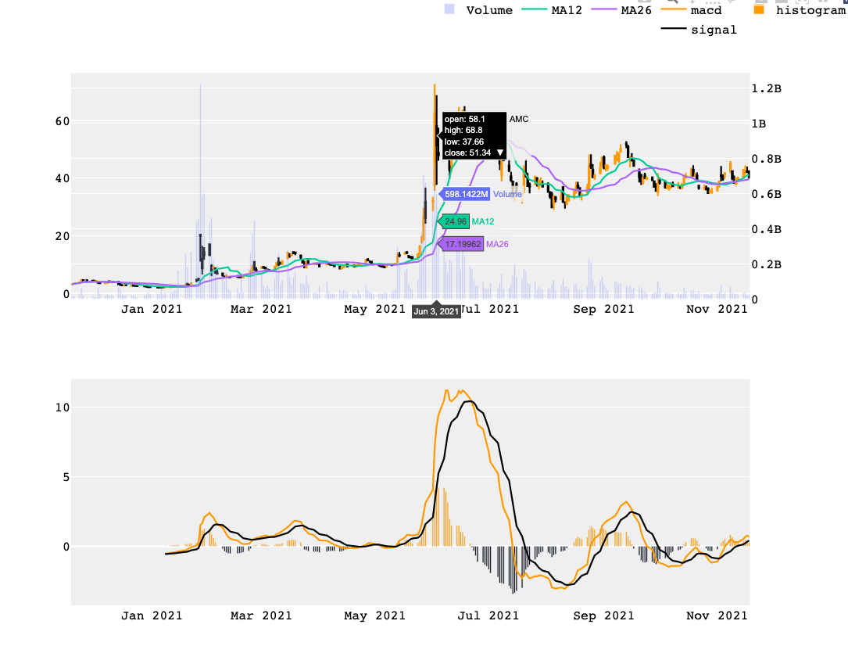
AMC stock price ride Nov 2020 – Nov 2021
After GME success in Jan, AMC had a surge in Feb 2021, but the biggest hype was in June 2021

Slide 5
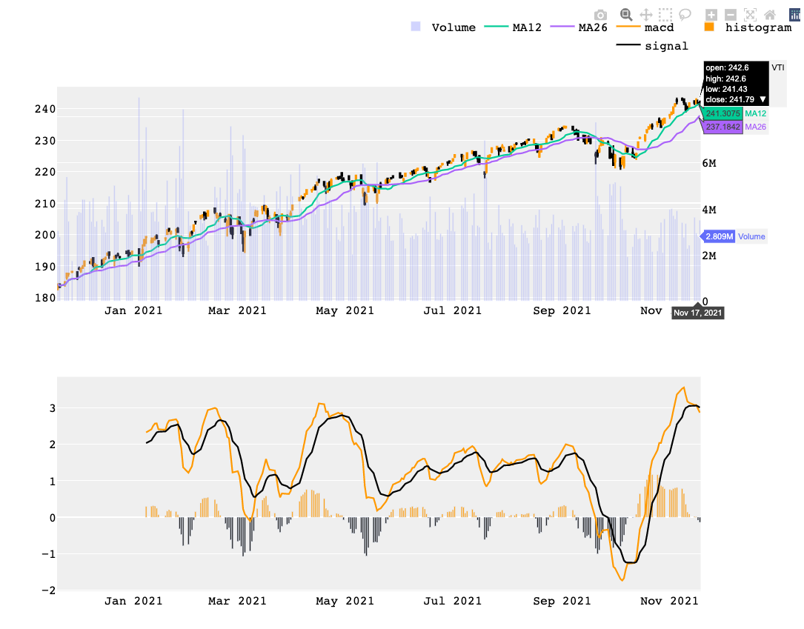
In the meantime, the entire equity market is also increasing steadily …
Vanguard Total Stock Market Index Fund (VTI) gained 1.3x...

Slide 6
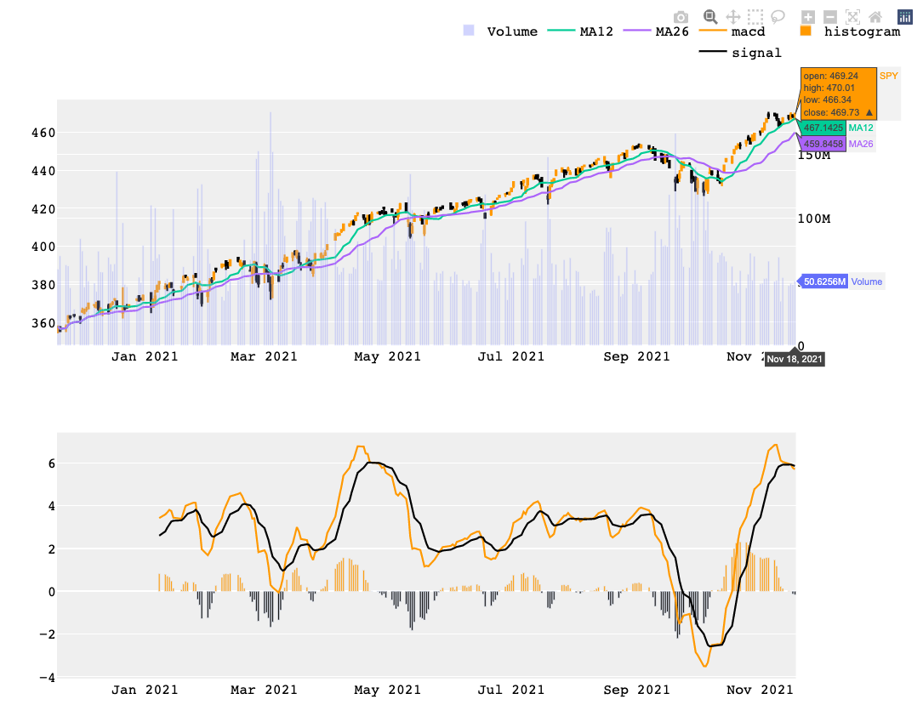
…a similar gain in S&P500 index

Slide 7
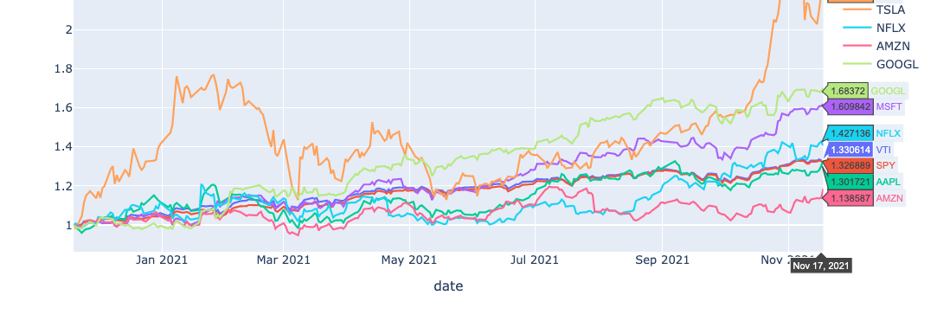
2021 was a good year for many stock tickers, especially tech sector, TSLA went up 2x; msft & googl gained > 1.5x; aapl & amzn was trailing the market indexes …

Slide 8
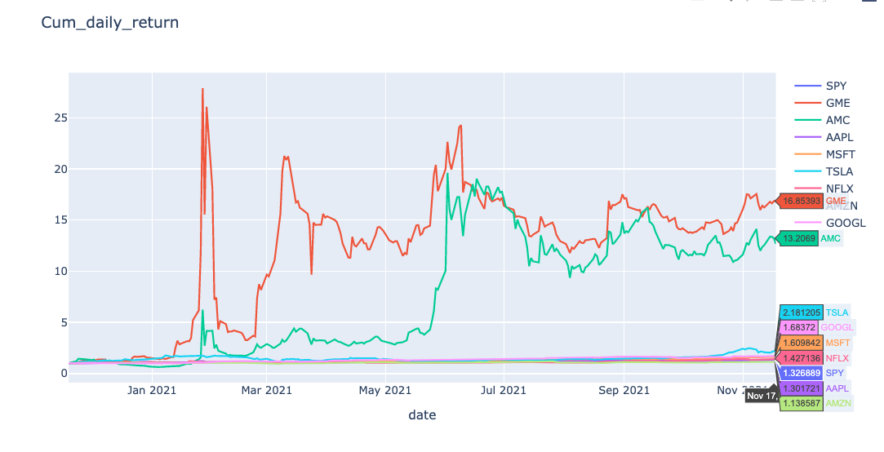
…but none compared to gme and Amc in term of gains from last November (AmC 13x, GME 16x)

Slide 9
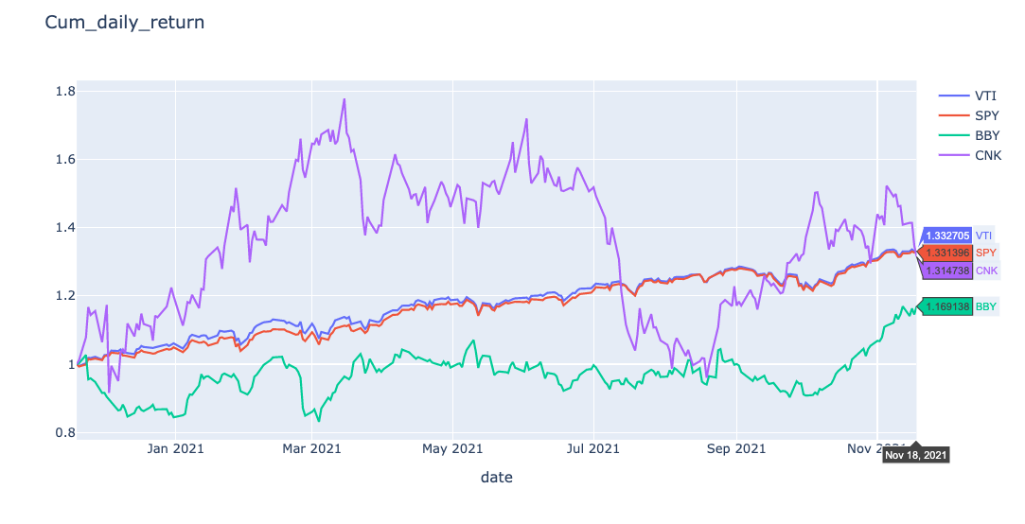
…while Cinemark (CNK) and Best Buy (bby), the 2 direct competitors of GME and AMC weren’t received similar attention

Slide 10
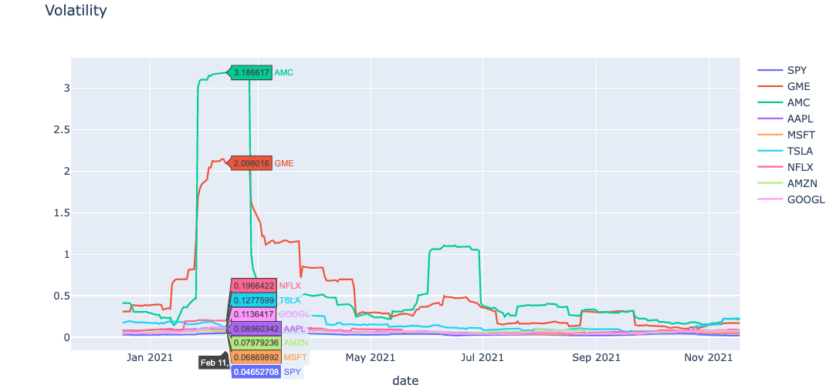
Unsurprisingly, AMC and GME were the 2 most volatile tickers in Jan and Feb 2021
The volatility of a stock is a measurement of the change in variance in the returns of a stock over a specific period of time.
Volatility is often seen as a representative of risk in investments, with low volatility signaling safety and positive results, and high volatility indicating more risks.
In this analysis, I calculate volatility by taking a rolling window standard deviation on the percentage change in returns of a stock over 20 trading window.

Slide 11
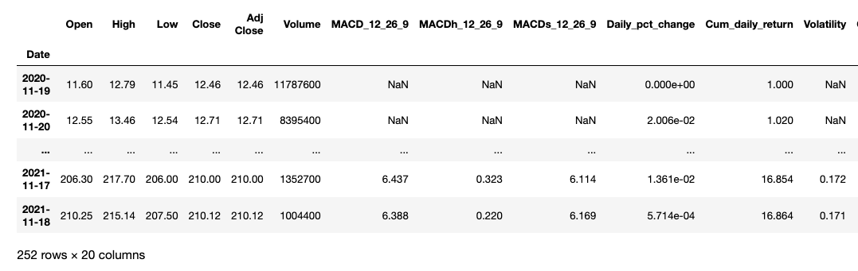
Data Understanding & Preparation
Data collection: yfinance
Data manipulation & representation: pandas, numpy
Data Visualization: plotly
Technical analysis: TA-lib
Notes:
Moving average convergence divergence (MACD) is a trend-following momentum indicator that shows the relationship between two moving averages of a security’s price. The MACD is calculated by subtracting the 26-period exponential moving average (EMA) from the 12-period EMA. An exponential moving average (EMA) is a type of moving average (MA) that places a greater weight and significance on the most recent data points.
When the EMA-9 crosses above the MACD(12,26), this is considered a bearish signal. It means the trend in the stock – its magnitude and/or momentum – is starting to shift course. When the MACD(12,26) crosses above the EMA-9, this is considered a bullish signal.

Slide 12
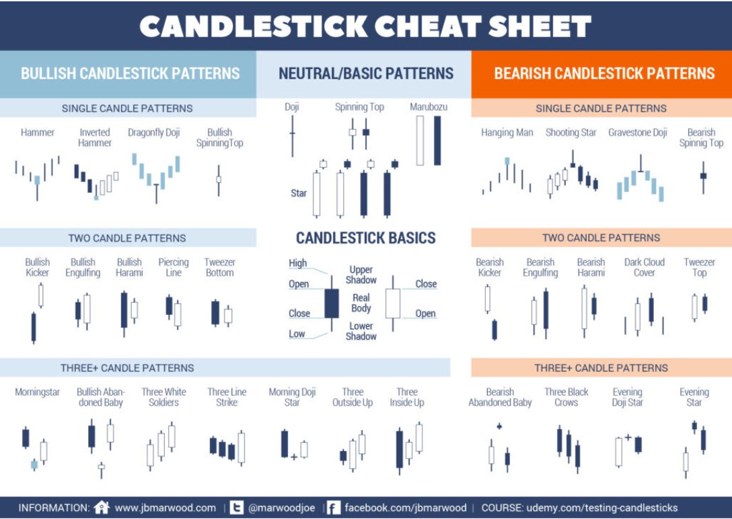
Technical Analysis – Candle Stick Pattern
In this section, I will use TA-lib to detect Candle Stick Pattern based on stock price

Slide 13
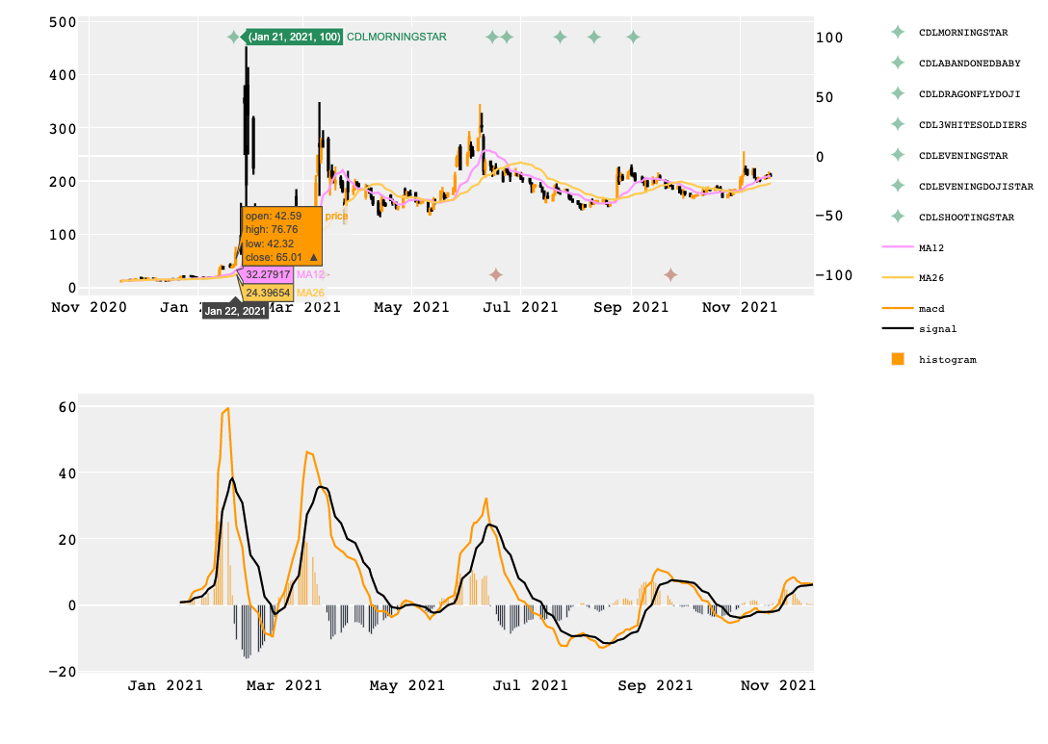
Candle Stick Pattern
Candlestick patterns does indicate bullish and bearish trend signal in some cases but they show very short-term trend reversal with a lot of noises.
We need to use additional patterns and information to confirm the signal when incorporating candlestick strategies.

Slide 14
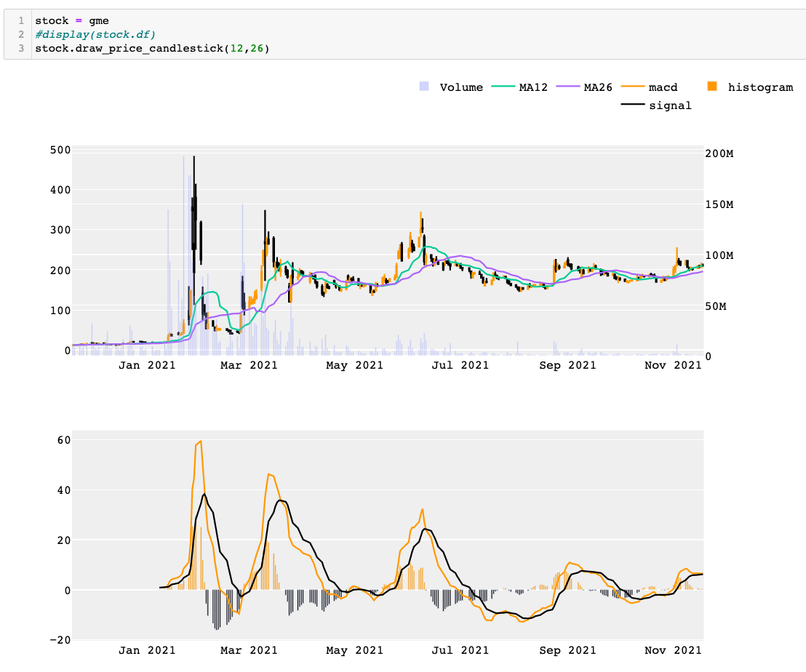
Technical Analysis
Simple Moving average (sma) Crossover & Moving average convergence divergence (MACD)
Simple Moving Average Crossover
If the shorter-period moving average exceeds the long moving average then bullish,
if the longer-period moving average exceeds the short moving average then bearish.
2. MACD
Bullish: If the MACD crosses above its signal line following a brief correction within a longer-term uptrend
Bearish: If the MACD crosses below its signal line following a brief move higher within a longer-term downtrend
Based on the graph, we can see clear longer-term bullish and bearish trend with SMA cross-over and MACD signal.

Slide 15
Data Modelling and Evaluation
In this section, I will build 2 technical trading strategies with Simple Moving Average crossover and MACD.
I will also back-test these 2 strategies and compare them with Buy-and-Hold strategy using a basket of stocks and $10k initial investment in each

Slide 16
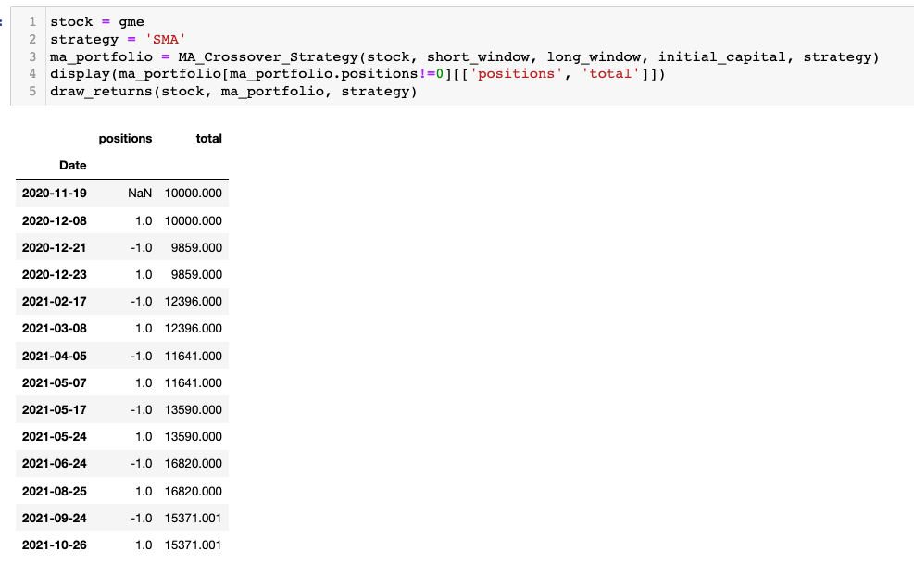
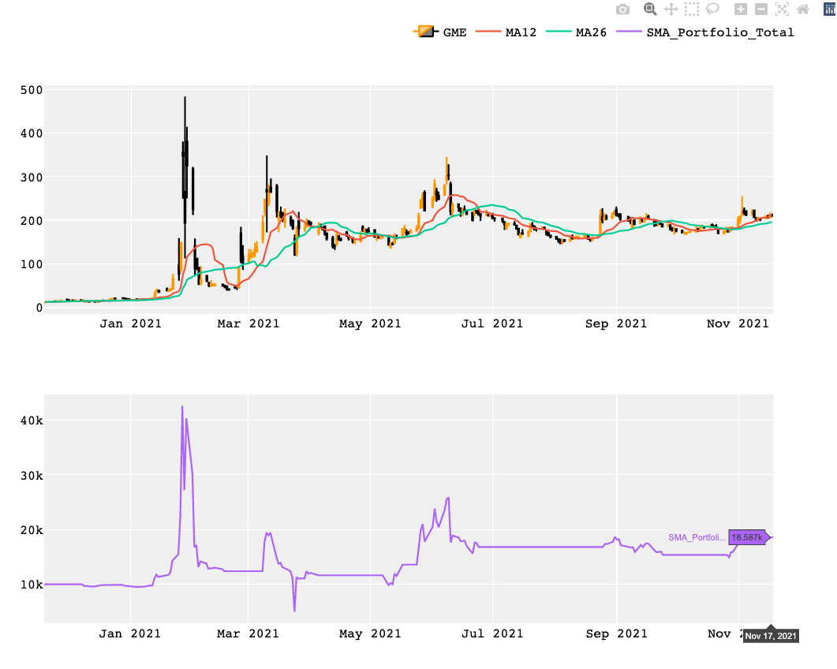
GME Returns with SMA CrossOver Strategy
Initial Investment: $10k
GME returns Nov 17 – SMA: $18.6k

Slide 17
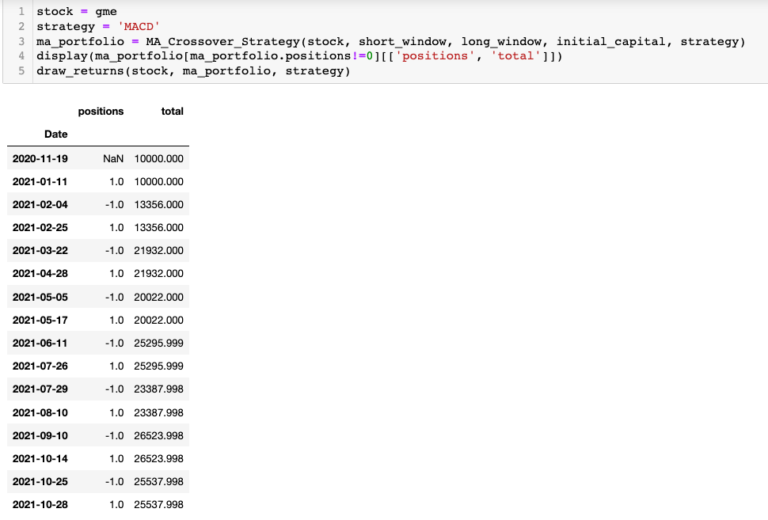
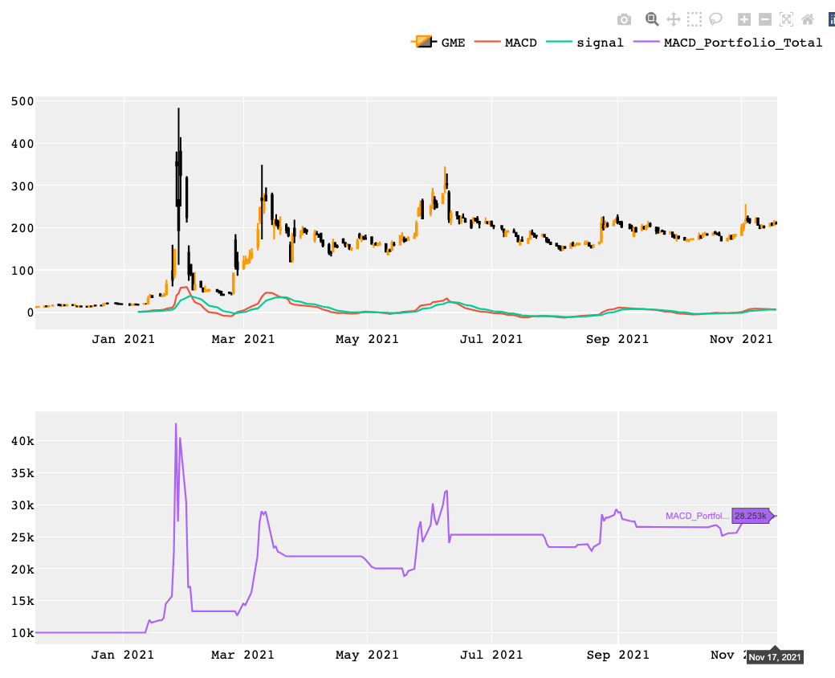
GME Returns with SMA CrossOver Strategy
Initial Investment: $10k
GME returns as of Nov 17– MACD: $28.2k

Slide 18
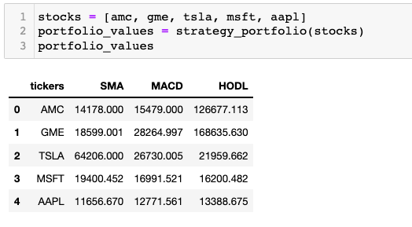
Back-test SMA and MACD Strategy
If we don't take into account trading fees and capital gain tax on short-term gains, we can see higher portfolios values at the end of 1 trading year for TSLA, MSFT using SMA and MACD strategies. SMA works really well for Tesla stock this year as the return is 3 times higher than HODL strategy and 2 times higher than MACD strategy.
For AMC and GME, one would see tremendous returns if bought the stocks in November last year. However, given that many people heard about the meme tickers after they hyped and entered right after the peak or bought at around $100 or $200, the returns would not be as pretty.

Slide 19
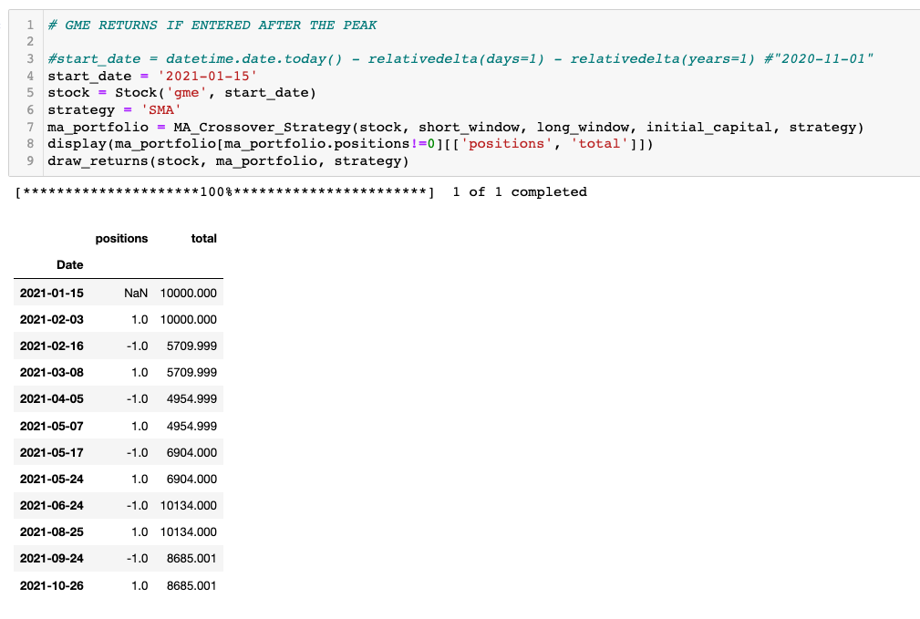
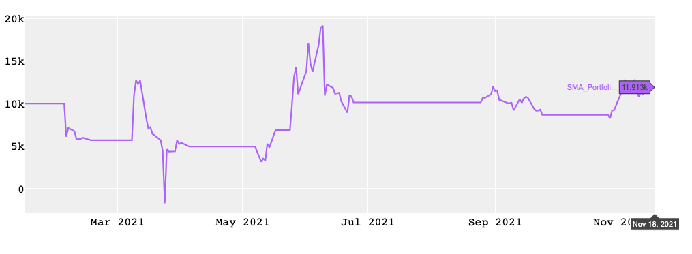

Slide 20
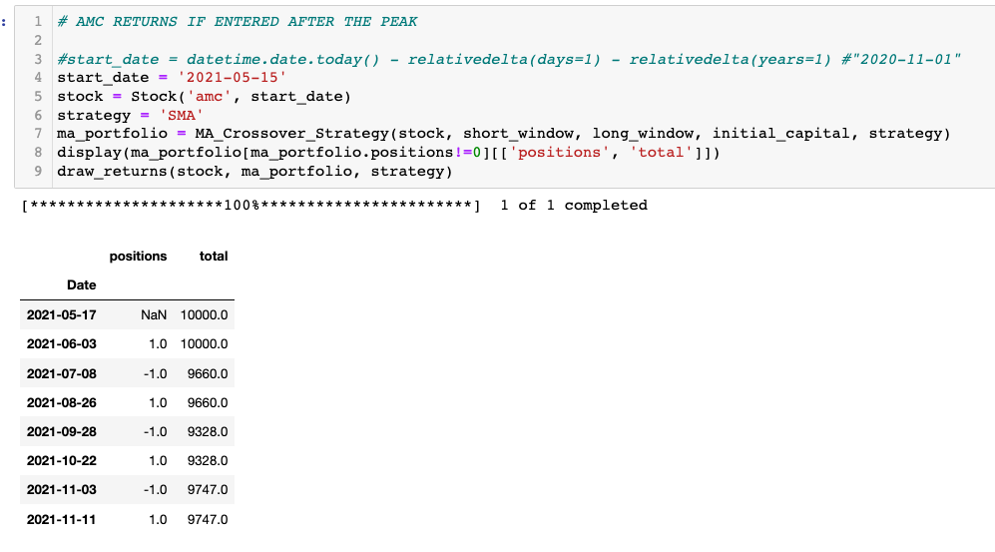
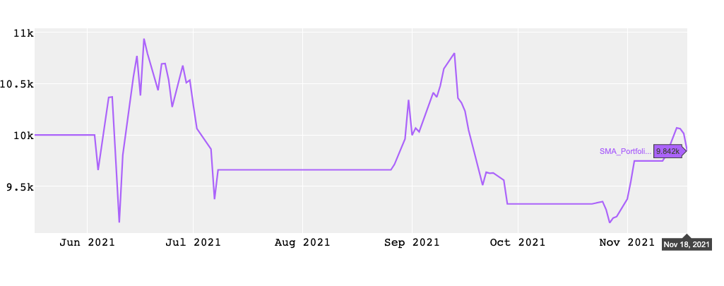

Slide 21
Conclusion
Technical Analysis Techniques can give signal on when to enter and exit a stock position but the result of each technique vary wildly between stocks
Meme stock hype became very well-known in 2021 as for the first time we see the power of public in moving the stock price
However, like gambling, entering and exiting meme stocks become very tricky as there’re no ways to know when the stock will peak and when it will crash
As Financial data weren’t available (Quandl API was deprecated) when preparing this presentation, I didn’t incorporate fundamental analysis in this presentation yet
Next step, performing fundamental analysis and Machine Learning in formulating stock investing and trading strategy

