Slide 1
HORIZON AUTO INSURANCE · SOLUTION AND DEMO
Catch driving risk before it becomes a claim.
Proactive prevention and human-approved renewal decisions on one governed platform.
BUSINESS → WORKFLOW → TECHNICAL DEEP DIVE
Horizon Auto Insurance
Databricks solution narrative

Slide 2
THE BUSINESS PROBLEM
Risk changes between portfolio reviews.
Horizon often learns about worsening behavior after the loss signal becomes a claim.
“
01
Late signal
My underwriters can explain yesterday’s book. They cannot see which drivers became riskier this week — or intervene before renewal.
Periodic review reveals unsafe trends after exposure has accumulated.
02
Fragmented evidence
Maya Chen · Regional Underwriting Manager
Telemetry, claims, guidelines, and policy state sit in separate workflows.
03
Hard to defend
Manual recommendations lack a consistent explanation and audit trail.
HORIZON AUTO INSURANCE
02

Slide 3
THE QUANTIFIED STAKES
The cost of waiting is operational and financial.
Prototype targets shown here are modeled outcomes, not realized customer results.
LESS REVIEW TIME
INTERVENED IN ONE DAY
PREVENTABLE CLAIMS
LOSS-RATIO IMPROVEMENT
40%
80%
−5%
+2 pts
Prioritize the policies that need judgment.
Reach high-risk policies while action can still matter.
Modeled reduction through earlier intervention.
Modeled portfolio impact from better timing.
THE DECISION WINDOW
Unsafe behavior rises
→
Risk is scored
→
Underwriter intervenes
→
Renewal is decided
The platform compresses the path from signal to governed action.
HORIZON AUTO INSURANCE
03

Slide 4
THE OUTCOME
Detect → explain → recommend → decide → audit.
The solution changes the underwriter’s workflow without automating the final decision.
01
Detect
02
Explain
03
Recommend
04
Decide
05
Audit
Hourly telemetry updates expose worsening driving patterns.
The model and Genie surface the factors and governed evidence.
Rules translate risk into an intervention and renewal action.
The underwriter approves or overrides with a required reason.
Every question, recommendation, and decision is recorded.
→
→
→
→
CONTROL POINT
The model scores risk. Deterministic rules recommend. A human underwriter decides.
HORIZON AUTO INSURANCE
04

Slide 5
BUSINESS VALUE
Four levers connect the workflow to business value.
LEVER
WHAT CHANGES
MODELED OUTCOME
CONTROL
Loss
Intervene before renewal
5% fewer preventable claims
Human approval
Speed
One prioritized evidence view
40% less review time
Same governed facts
Retention
Reward sustained safe behavior
3% modeled lift
Approved program terms
Risk
Explain and record every action
100% audited decisions
Identity-aware access
HORIZON AUTO INSURANCE
05

Slide 6
WHY DATABRICKS
One platform keeps data, intelligence, action, and audit aligned.
No separate analytics copy, app database workflow, or AI control plane to reconcile.
01
One governed definition
02
Operational speed
03
Built-in controls
Delta tables, a metric view, Genie, and the application resolve against the same policy-risk contract.
Lakebase sync serves policy queues and decisions in milliseconds while Delta remains the analytical source of truth.
Unity Catalog, AI Gateway, MLflow, lineage, and app identity make access and model use observable.
The architecture is simpler because governance is shared, not copied.
HORIZON AUTO INSURANCE
06

Slide 7
SOLUTION JOURNEY
Three milestones turn data into a governed decision.
①
GOVERNED DATA
②
UNDERWRITER ACTION
③
AUDITABLE CONTROL
Ingest policy and telematics files
Build trusted features
Score claim risk
Prioritize the review queue
Investigate with Genie
Approve or override
Apply user-level entitlements
Trace model and agent calls
Persist decisions
→
→
Lakeflow · Delta · MLflow
Databricks App · Genie · Lakebase
Unity Catalog · AI Gateway · Lakebase
HORIZON AUTO INSURANCE
07

Slide 8
LIVE DEMO
Watch one policy move from signal to decision.
01
02
03
04
05
See the queue
→
Inspect evidence
→
Ask why
→
Make the call
→
Prove it
Open the West-region review queue and portfolio KPIs.
Open the policy, risk factors, trend, and expected loss.
Genie queries governed data and cites underwriting guidelines.
Approve the recommendation or override with a reason.
Decision history and audit events update immediately.
Demo question
“Why is policy POL-004217 becoming riskier, and what should we do before renewal?”
08

Slide 9
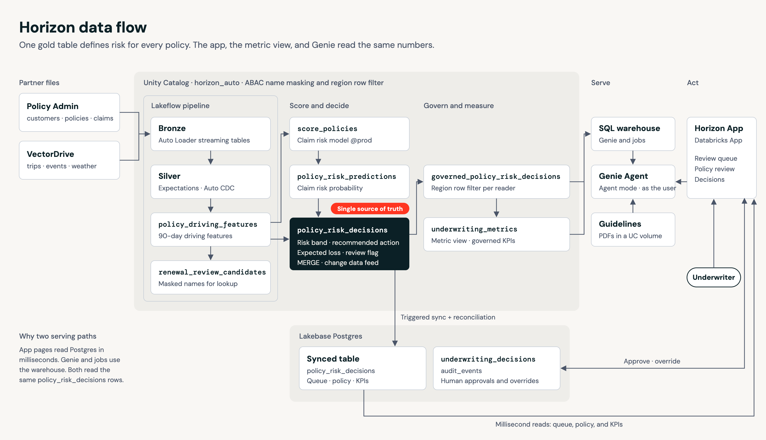
TECHNICAL ARCHITECTURE
One decision contract connects analytics and operations.
The app, metric view, and Genie show the same risk band, action, and expected loss.
HORIZON AUTO INSURANCE
09

Slide 10
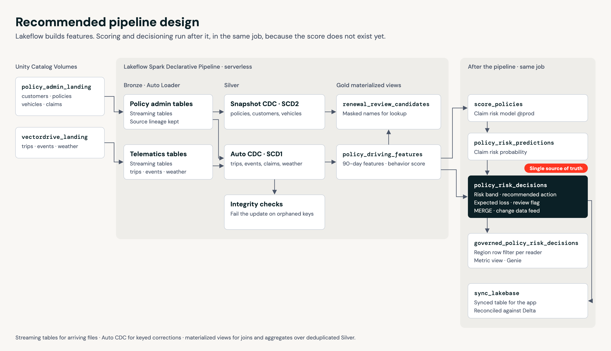
DATA ENGINEERING DEEP DIVE
Incremental by design, reconciled by contract.
Lakeflow handles continuous files and keyed corrections without rebuilding the entire portfolio.
01
Bronze
Auto Loader preserves lineage, manifests, rescued data, and event time.
02
Silver
Auto CDC applies snapshots and keyed corrections with data-quality expectations.
03
Gold
Materialized views produce stable policy features and review candidates.
04
After pipeline
Score → decide → sync to Lakebase.
HORIZON AUTO INSURANCE
10

Slide 11
ML AND DECISIONING DEEP DIVE
Separate prediction, business rules, and human judgment.
Each layer has a distinct purpose, owner, and audit boundary.
MODEL
RULES
HUMAN
Predict claim risk
Recommend an action
Record the decision
Interpretable features
Probability and drivers
MLflow registry + aliases
→
Risk band thresholds
Expected loss
Approved intervention logic
→
Approve or override
Required rationale
Reviewer identity + timestamp
No autonomous premium change. The platform supports a governed underwriting decision.
HORIZON AUTO INSURANCE
11

Slide 12
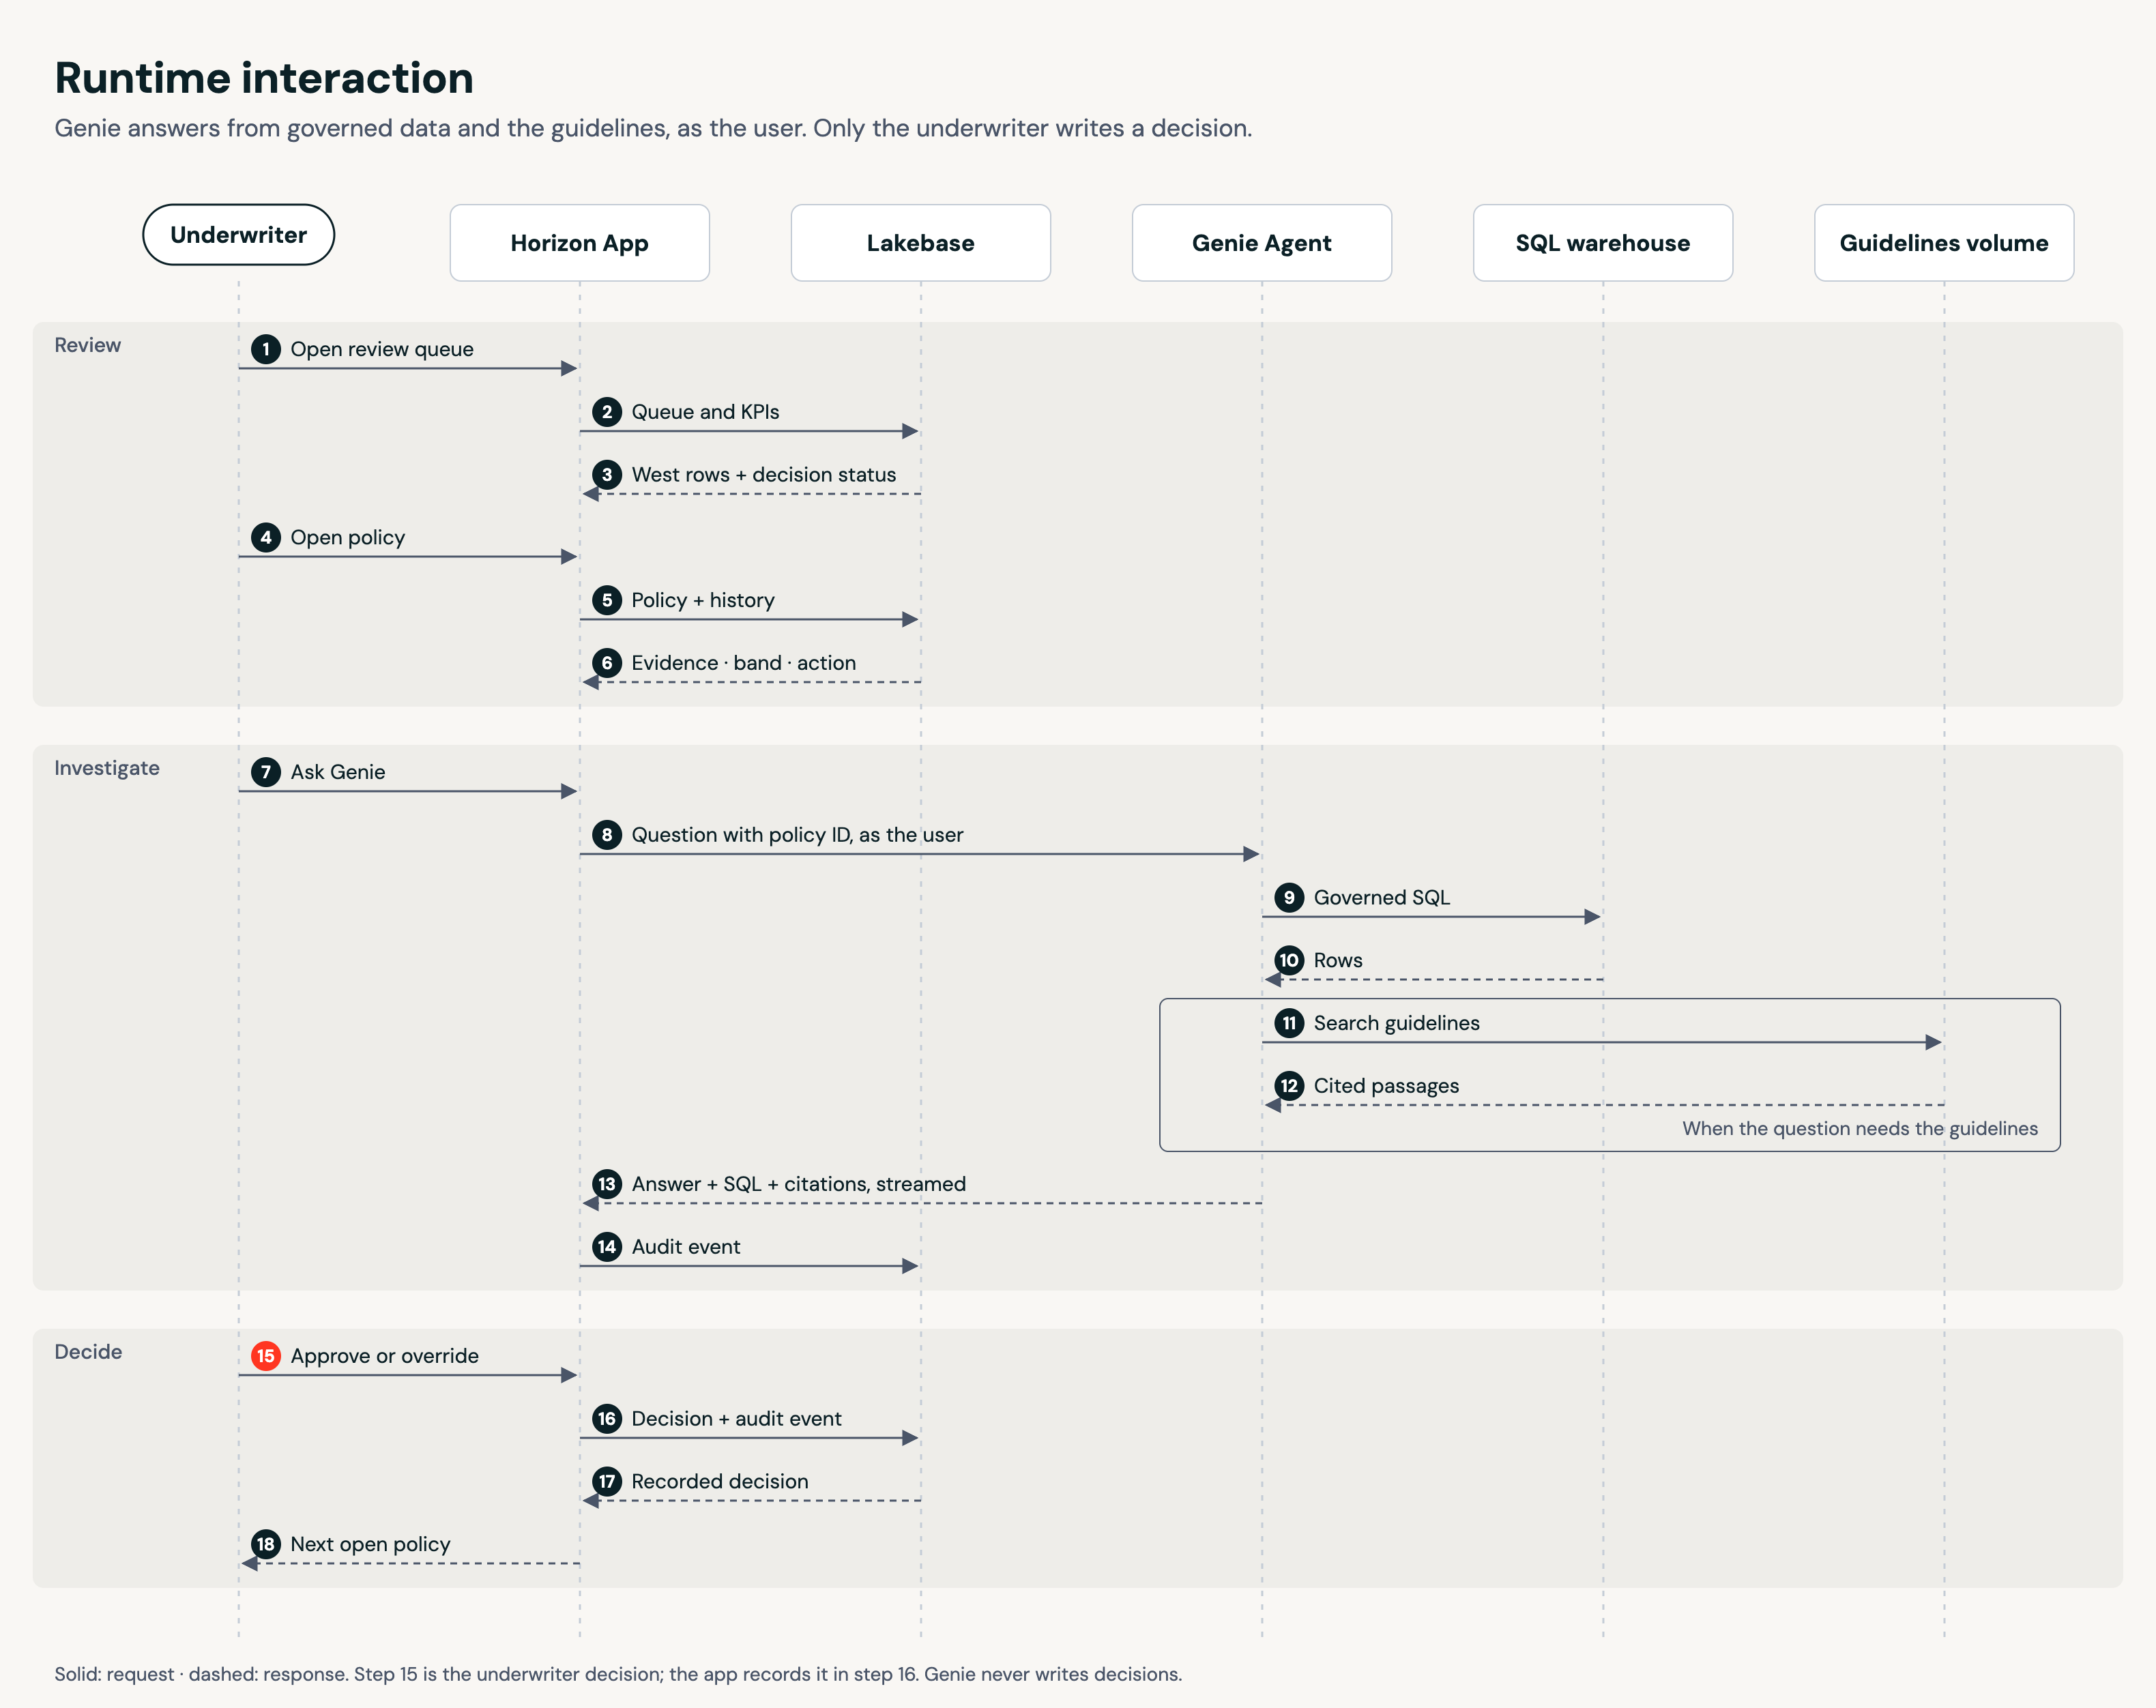
APPLICATION DEEP DIVE
Fast reads, governed investigation, human-only writes.
The signed-in user’s identity travels through the application and analytics layers.
01
Review
Lakebase serves queues, evidence, and history in milliseconds.
02
Investigate
Genie runs governed SQL and searches approved guidelines with citations.
03
Decide
Only the underwriter writes a decision; every action emits an audit event.
HORIZON AUTO INSURANCE
12

Slide 13
GOVERNANCE AND RESPONSIBLE USE
Governance follows the user from table to decision.
01
Access
02
Lineage
03
AI
Unity Catalog ABAC masks customer names and filters policies by assigned region.
Raw telemetry, features, scores, recommendations, and metrics remain traceable.
Unity AI Gateway governs model access; Genie cites SQL and guideline sources.
04
Audit
05
Quality
06
Fairness
Lakebase stores review state, decisions, overrides, and question history.
Pipeline expectations fail on orphaned keys and quarantine malformed events.
The model excludes direct PII and supports monitored comparison-group analysis.
HORIZON AUTO INSURANCE
13

Slide 14
TECHNOLOGY MAP
Each Databricks service has one clear job.
Lakeflow
Ingest files, apply CDC, enforce quality, build features
Delta Lake + Unity Catalog
Store governed data, permissions, lineage, and model assets
MLflow
Track training, register the model, manage production aliases
Metric views + Genie
Define shared KPIs and answer governed natural-language questions
Lakebase
Serve low-latency app reads and persist operational decisions
Databricks Apps
Deliver the underwriter workflow with user identity
Unity AI Gateway
Control and observe model endpoint access
Declarative Automation Bundles
Deploy jobs, pipelines, warehouse, app, and permissions as code
HORIZON AUTO INSURANCE
14

Slide 15
PILOT PLAN
Pilot the workflow before scaling the book.
Use the synthetic prototype to validate operations, controls, and value measurement.
01
Validate
02
Pilot
03
Scale
One region
One renewal cohort
Shadow decisions
Named underwriters
Daily review queue
Weekly control review
More regions
Champion/challenger model
Outcome feedback loop
2 WEEKS
4–6 WEEKS
AFTER GATES
Exit gates
Data quality holds · recommendations are explainable · entitlements match policy · underwriters trust the workflow · outcome metrics are measurable
HORIZON AUTO INSURANCE
15

Slide 16
THE ASK
Put earlier risk signals in the hands of underwriters.
01
Choose the cohort
02
Agree on controls
03
Measure the pilot
Select one region and renewal window where earlier intervention can be observed.
Confirm rating boundaries, program terms, entitlements, and audit requirements.
Track review time, intervention coverage, overrides, retention, and modeled loss impact.
One governed platform. One shared decision contract. One human accountable for the outcome.
Horizon Auto Insurance · Databricks solution narrative

