Slide 1

Video Game Sales analysis and prediction
Team member:
Anh Dao
Kai Qian
Zheng Fang

Slide 2
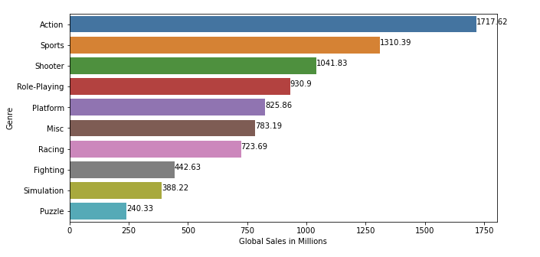
Use Cases
Game studio user requests analysis: system responds with graph display which analysed by user specified features(Graph A)
Retail user requests prediction: system responds with number of game sales based on user’s game info and R square, P value as precision variables which can decide the quality of the result
Input: most popular game genre
Input: game name, genre, company name …...
Output:
Output: 1.1 million sales
Area: globalwise
P: 0.2
R^2: 85%
Retail use case
Graph A
Notes:
Game Studios: (analysis)
Based on analyzing the most popular game category, it can recommend game designers to design relatively profitable.
Retailers: (prediction)
Retailers can use this application to analyze upcoming games. They can do inventory control based on the predicted sales result.

Slide 3
Game Studio Use Case Design
Dataset
Take inputs and analyse dataset
UI
Input: Features wants to be analyzed
Analysed Result
User
Visualized data, such as plot and graph
Display the result back to User

Slide 4
Retail Use Case Design
Dataset
Take inputs and analyse dataset
UI
User
Set up linear regression model to do prediction on given result
Input: game info
Return the number of predicted game sales, Area, R^2 and P value back to user

Slide 5
Data Source
Dataset from kaggle.com
Video Game Sales with Ratings
https://www.kaggle.com/rush4ratio/video-game-sales-with-ratings
16 different features, some of features has huge percentage of null values
11563 rows of data
Planning on using Name, Platform, Year of release, genre, publisher, global sales, critic score, critic count for analysis, 8 features in total

Slide 6

Framework and languages
Data processing and main functionalities:
Scala and Spark for main functionalities(data analysis)
Will make use of Spark’s components like MLlib, SparkSQL…
Will set up linear regression models to analyse data
Multiprocessing for analysing mixed features
UI and framework:
Use Play to design the user interface
Code repository:
https://github.com/tkkai-1011/Video-Games-Sales-Analaysis-Prediction

Slide 7
MileStone
Searching appropriate scala library for the project. Getting familiar with Spark.
Debugging and testing for the main functionality (Mostly scala part) and start implementing UI
March 27th
April 10th
April 3rd
April 17th
Implement scala data processing with Spark, using unit tests to verify the right output
Finish UI, integrate Spark with UI and test the entire application

Slide 8
Acceptance criteria
Game Studio use case:
Return the desired output within 1s
Able to analyse and display the desired result (Ex. The most popular game category, most popular game company)
Be able to process data with 3 or more features together(Ex. The best sale game category, company and platform)
Retail use case:
Return the result within 2s
Using R^2 and P value to decide if the result is good or bad, which R^2>=0.8 P <=0.25 to be determined as a good result

Slide 9
Goal of the Project
Game studios
Base on result of prediction or analysis to set up new game development
Games publisher
Base on result of prediction or analysis to arrange for publicity resources
VG sales analysis and prediction
Game retail
Base on result of prediction or analysis to do inventory control

