Slide 1
Introduction to Algorithms Greedy Algorithms
CSE 680
Prof. Roger Crawfis

Slide 2
Optimization Problems
For most optimization problems you want to find, not just a solution, but the best solution.
A greedy algorithm sometimes works well for optimization problems. It works in phases. At each phase:
You take the best you can get right now, without regard for future consequences.
You hope that by choosing a local optimum at each step, you will end up at a global optimum.
Notes:
2

Slide 3
Example: Counting Money
Suppose you want to count out a certain amount of money, using the fewest possible bills and coins
A greedy algorithm to do this would be: At each step, take the largest possible bill or coin that does not overshoot
Example: To make $6.39, you can choose:
a $5 bill
a $1 bill, to make $6
a 25¢ coin, to make $6.25
A 10¢ coin, to make $6.35
four 1¢ coins, to make $6.39
For US money, the greedy algorithm always gives the optimum solution
Notes:
3

Slide 4
Greedy Algorithm Failure
In some (fictional) monetary system, “krons” come in 1 kron, 7 kron, and 10 kron coins
Using a greedy algorithm to count out 15 krons, you would get
A 10 kron piece
Five 1 kron pieces, for a total of 15 krons
This requires six coins
A better solution would be to use two 7 kron pieces and one 1 kron piece
This only requires three coins
The greedy algorithm results in a solution, but not in an optimal solution
Notes:
4

Slide 5
A Scheduling Problem
You have to run nine jobs, with running times of 3, 5, 6, 10, 11, 14, 15, 18, and 20 minutes.
You have three processors on which you can run these jobs.
You decide to do the longest-running jobs first, on whatever processor is available.
P1
P2
P3
20
10
3
18
11
6
15
14
5
Time to completion: 18 + 11 + 6 = 35 minutes
This solution isn’t bad, but we might be able to do better
Notes:
5

Slide 6
Another Approach
What would be the result if you ran the shortest job first?
Again, the running times are 3, 5, 6, 10, 11, 14, 15, 18, and 20 minutes
P1
P2
P3
3
10
15
5
11
18
6
14
20
That wasn’t such a good idea; time to completion is now 6 + 14 + 20 = 40 minutes
Note, however, that the greedy algorithm itself is fast
All we had to do at each stage was pick the minimum or maximum
Notes:
6

Slide 7
An Optimum Solution
Better solutions do exist:
P1
P2
P3
20
14
18
11
5
15
10
6
3
This solution is clearly optimal (why?)
Clearly, there are other optimal solutions (why?)
How do we find such a solution?
One way: Try all possible assignments of jobs to processors
Unfortunately, this approach can take exponential time
Notes:
7

Slide 8
Huffman encoding
The Huffman encoding algorithm is a greedy algorithm
Given the percentage the each character appears in a corpus, determine a variable-bit pattern for each char.
You always pick the two smallest percentages to combine.
100%
54%
27%
46%
15%
22% 12% 24% 6% 27% 9% A B C D E F
Notes:
8

Slide 9
Huffman Encoding
100%
100%
54%
0
1
A=00 B=100 C=01 D=1010 E=11 F=1011
54%
27%
46%
0
1
27%
E
46%
15%
A
C
B
15%
A B C D E F
D
F
Average bits/char: 0.22*2 + 0.12*3 + 0.24*2 + 0.06*4 + 0.27*2 + 0.09*4 = 2.42
The solution found doing this is an optimal solution.
The resulting binary tree is a full tree.

Slide 10
Analysis
A greedy algorithm typically makes (approximately) n choices for a problem of size n
(The first or last choice may be forced)
Hence the expected running time is: O(n * O(choice(n))), where choice(n) is making a choice among n objects
Counting: Must find largest useable coin from among k sizes of coin (k is a constant), an O(k)=O(1) operation;
Therefore, coin counting is (n)
Huffman: Must sort n values before making n choices
Therefore, Huffman is O(n log n) + O(n) = O(n log n)
Notes:
11

Slide 11
Other Greedy Algorithms
Dijkstra’s algorithm for finding the shortest path in a graph
Always takes the shortest edge connecting a known node to an unknown node
Kruskal’s algorithm for finding a minimum-cost spanning tree
Always tries the lowest-cost remaining edge
Prim’s algorithm for finding a minimum-cost spanning tree
Always takes the lowest-cost edge between nodes in the spanning tree and nodes not yet in the spanning tree

Slide 12
Connecting Wires
There are n white dots and n black dots, equally spaced, in a line
You want to connect each white dot with some one black dot, with a minimum total length of “wire”
Example:
Total wire length above is 1 + 1 + 1 + 5 = 8
Do you see a greedy algorithm for doing this?
Does the algorithm guarantee an optimal solution?
Can you prove it?
Can you find a counterexample?

Slide 13
Collecting Coins
A checkerboard has a certain number of coins on it
A robot starts in the upper-left corner, and walks to the bottom left-hand corner
The robot can only move in two directions: right and down
The robot collects coins as it goes
You want to collect all the coins using the minimum number of robots
Example:
Do you see a greedy algorithm for doing this?
Does the algorithm guarantee an optimal solution?
Can you prove it?
Can you find a counterexample?

Slide 14
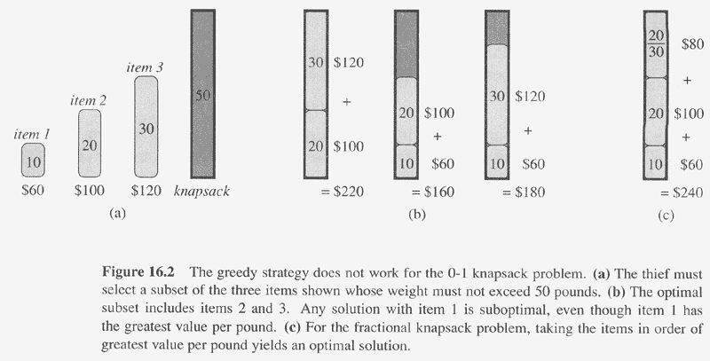
0-1 Knapsack

Slide 15
Other Algorithm Categories
Brute Force
Selection Sort
Divide-and-Conquer
Quicksort
Decrease-and-Conquer
Insertion Sort
Transform-and-Conquer
Heapsort
Dynamic Programming
Greedy Algorithms
Iterative Improvement
Simplex Method, Maximum Flow
From The Design & Analysis of Algorithms, Levitin

