Slide 1
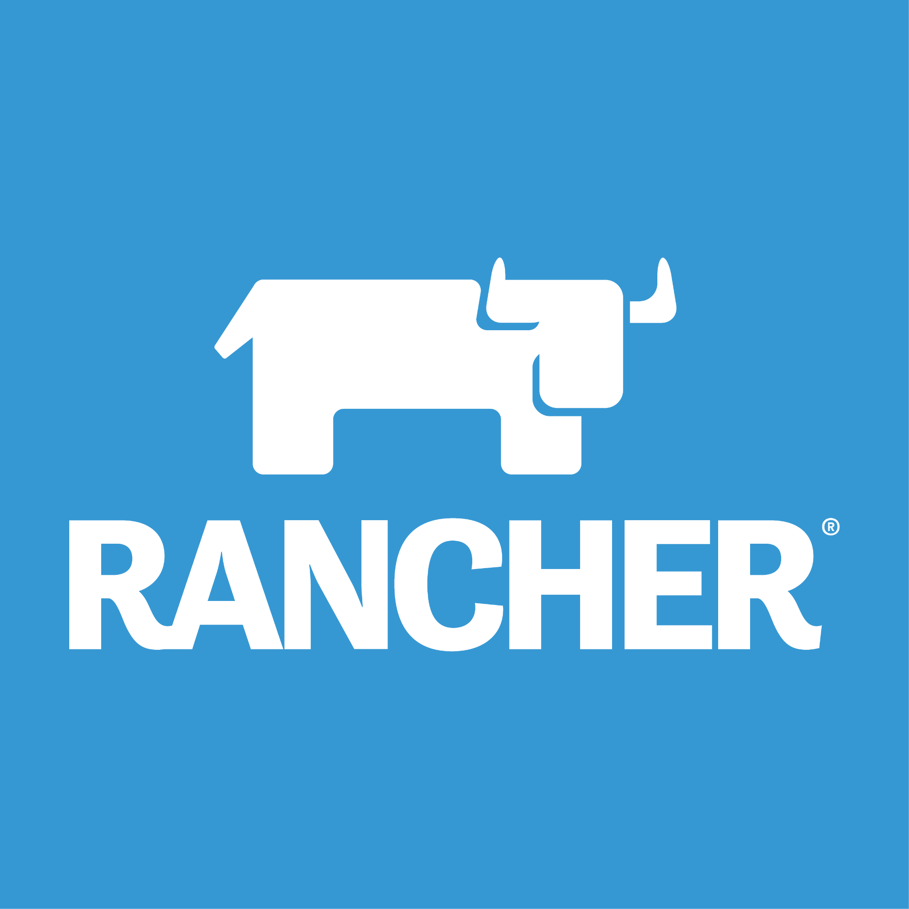
Backup and Restore Rancher
Team: 7
Nguyễn Bùi Kim Ngân - 20520648
Nguyễn Bình Thục Trâm - 20520815
Võ Anh Kiệt - 20520605

Slide 2
OVERVIEW
01
02
03
Set up
Backup
Restore

Slide 3
01
Setup

Slide 4
Install
Update and upgrade OS:
+) sudo apt update && sudo apt upgrade
Install curl:
+) sudo apt install curl
Install rancher:
+) curl https://releases.rancher.com/install-docker/20.10.sh | sh

Slide 5
Rancher
Add user to Docker user group:
+) sudo usermod -aG docker $USER && newgrp docker
Pull Rancher Docker Container:
+) sudo docker run --privileged -d --restart=unless-stopped -p 80:80 -p 443:443 rancher/rancher

Slide 6
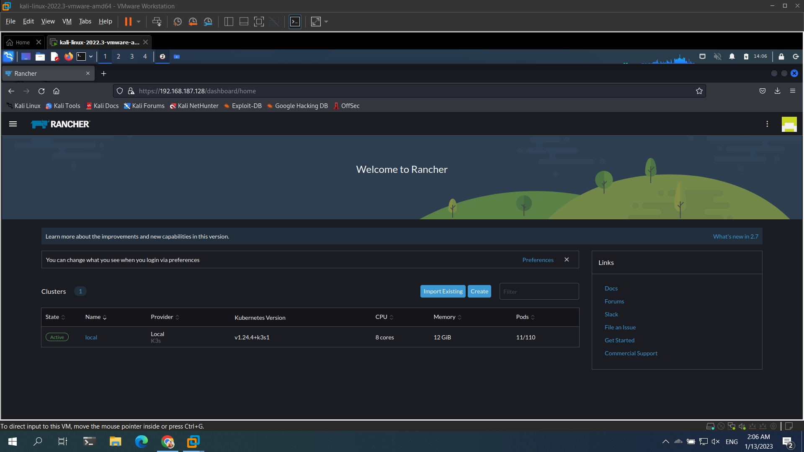
Rancher

Slide 7
02
Backup

Slide 8
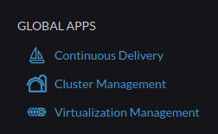
Backup
Click Cluster Management

Slide 9
Backup
Click Explore

Slide 10
Backup
Click Explore

Slide 11
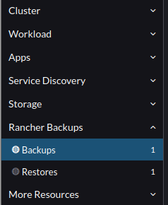
Backup
Click Rancher Backups -> Backups

Slide 12
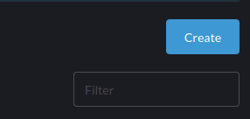
Backup
Click Create

Slide 13
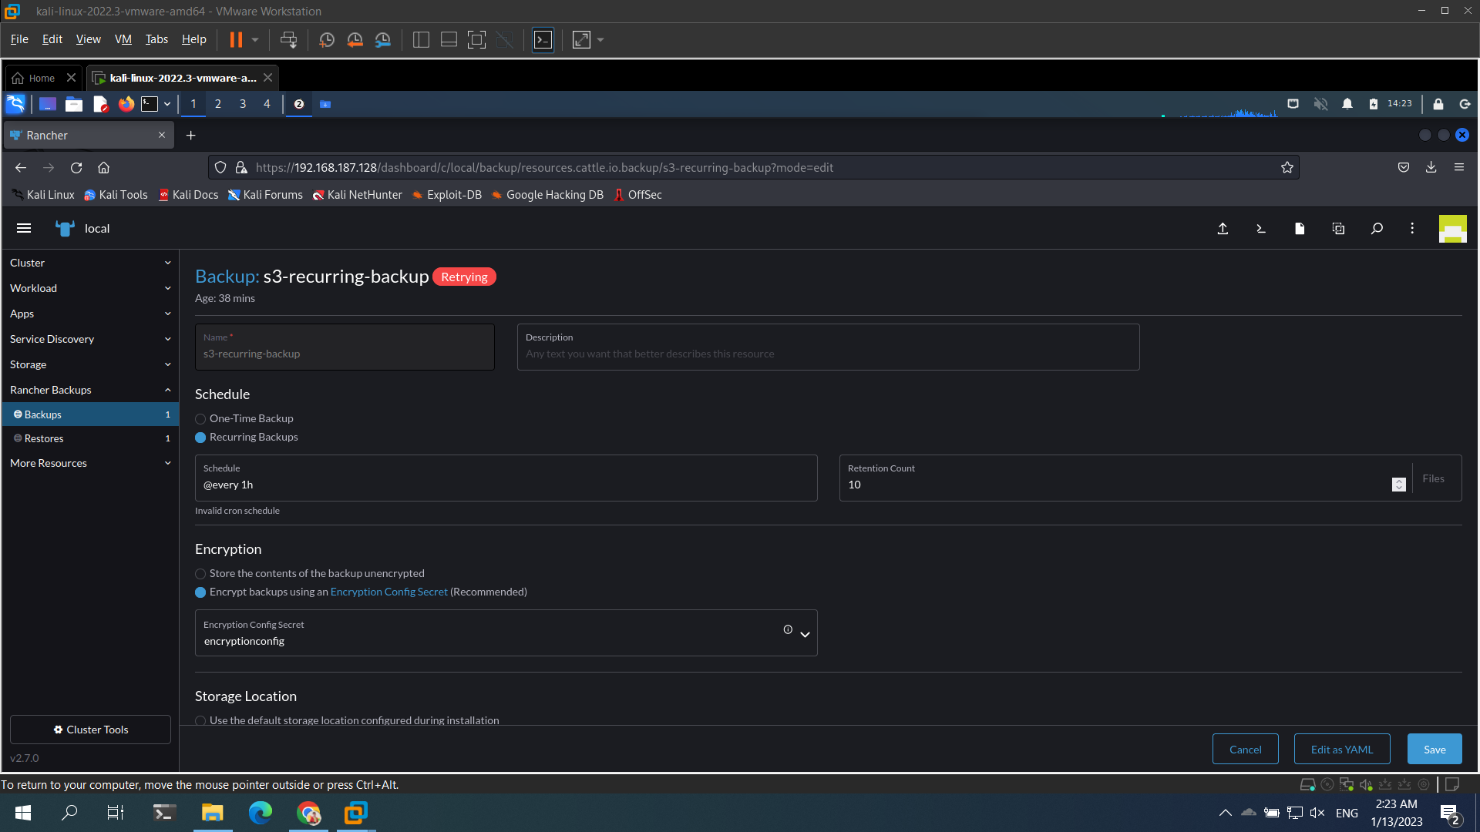
Backup
Config with interface

Slide 14
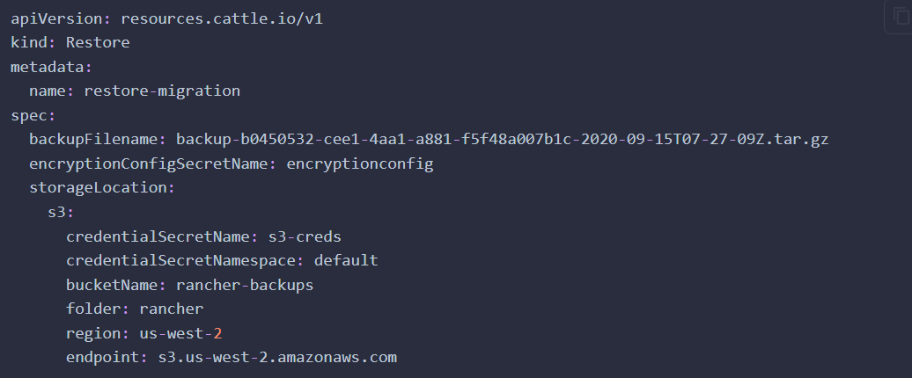
Backup
Config with YAML

Slide 15
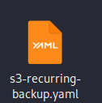
Backup
Result: get the file YAML

Slide 16
03
Restore

Slide 17
Restore
Click Cluster Management

Slide 18
Restore
Click Explore

Slide 19
Restore
Click Explore

Slide 20
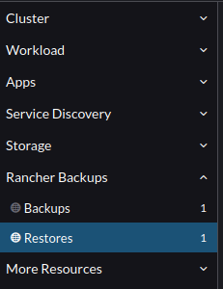
Restore
Click Rancher Backups -> Backups

Slide 21
Restore
Click Create

Slide 22
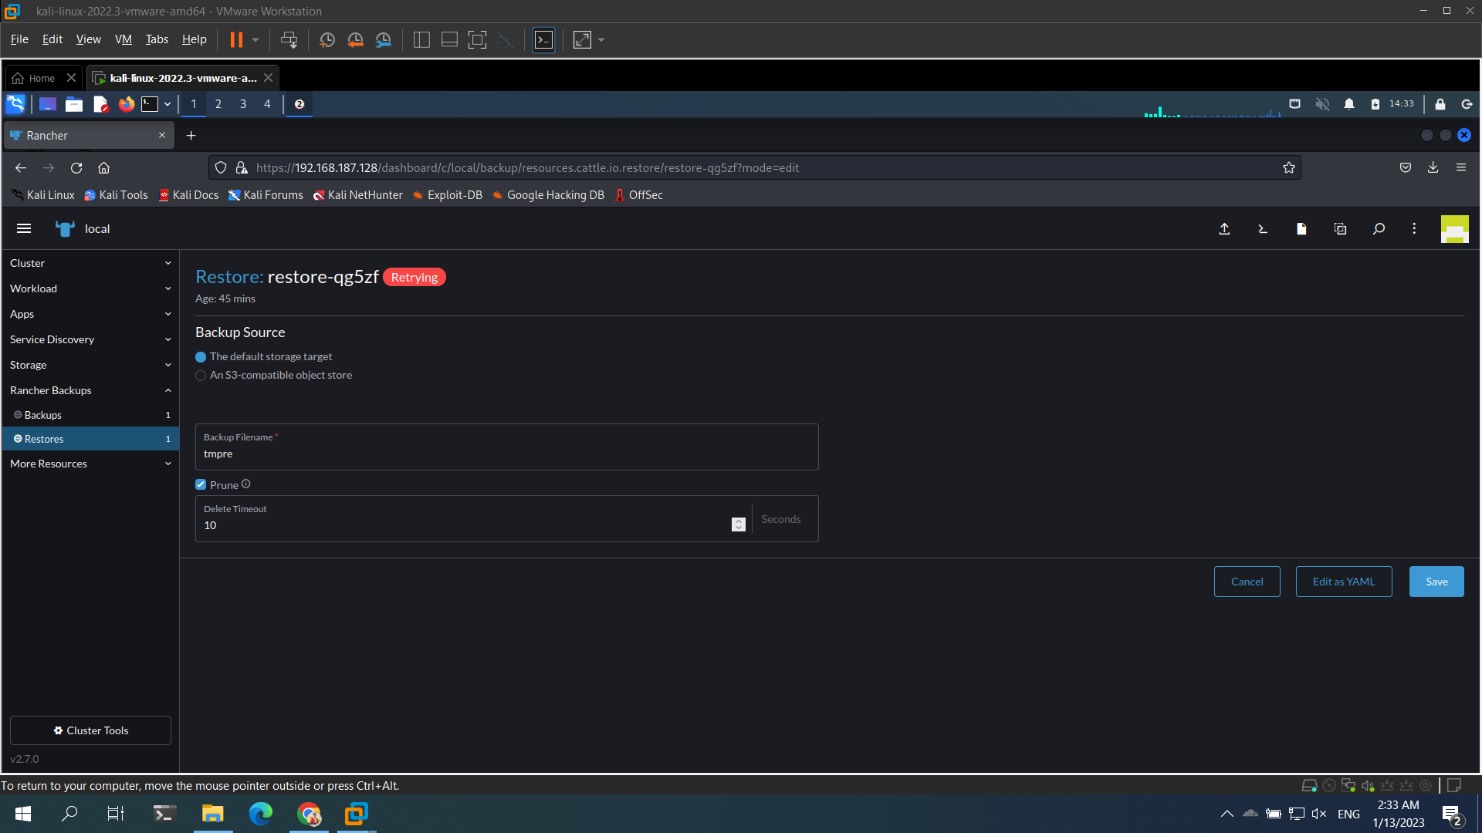
Restore
Config with interface

Slide 23
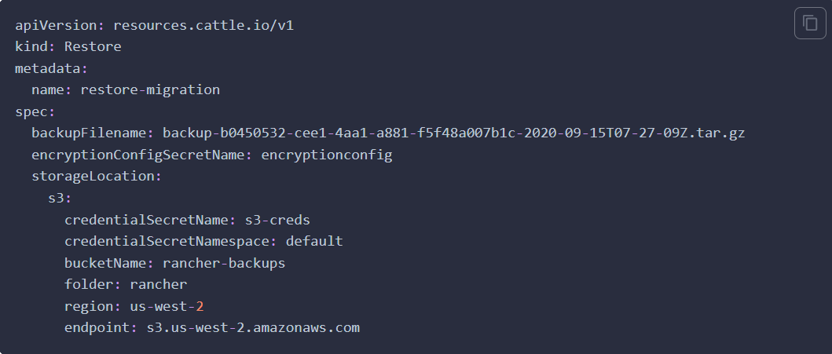
Restore
Config with YAML

Slide 24
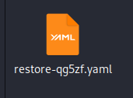
Restore
Result: get the file YAML

Slide 25
Restore
The rancher-operator scales down the rancher deployment during restore, and scales it back up once the restore completes.
The resources are restored in this order:
Custom Resource Definitions (CRDs)
Cluster-scoped resources
Namespaced resources

Slide 26
Restore
Check log:
+) kubectl logs -n cattle-resources-system -l app.kubernetes.io/name=rancher-backup -f

Slide 27
THANKS!

