Slide 1
Project Cryptography Protect the privacy for the smart device using face authentication
University of Information Technology
Faculty of Computer Network and Communication
Lecturer: Nguyễn Ngọc Tự
Võ Anh Kiệt – 20520605
Nguyễn Bảo Phương – 20520704

Slide 2
Introduction Background Design and Code Implement and Test Conclusion and Future work

Slide 3
Part 1: Introduction

Slide 4
Jong-Hyuk Im , Seong-Yun Jeon, & Mun-Kyu Lee (2020). Practical PrivacyPreserving Face Authentication for Smartphones Secure Against Malicious Clients. IEEE TRANSACTIONS ON INFORMATION FORENSICS AND SECURITY, VOL. 15, 2020 (2386-2401) Adrian Rosebrock, Face detection with OpenCV and deep learning, 2018, https://www.pyimagesearch.com/2018/02/26/face-detection-with-opencv-anddeep-learning/

Slide 5
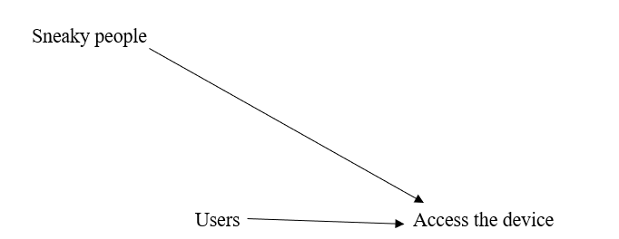
1.1. Problem Statement

Slide 6
1.2. Face recognize overview
Offer several advantages over other biometric
Required none explicit action
Can operate from a distance
Easy to collect data

Slide 7
1.3. Scope & Objective
Scope:
Face recognize
Users
Sneaky people
Objective:
Understand the core concepts and algorithm using face recognition
Build a simple face authentication mechanism to verify the identity quickly and protect the privacy of the users.

Slide 8
Part 2: Background

Slide 9
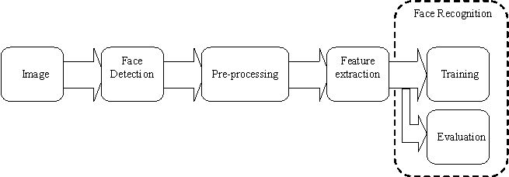
2.1. Fundamental of face recognize
Face detection: detect human face in image
Pre-processing: minimize effect of factor can influence in algorithm
Feature Extraction: compute feature from algorithm
Training: Extracted feature from image and store in database
Evaluation: Compare extracted feature to database

Slide 10
2.2. OpenCV
A library of programming functions primarily for real-time computer vision.
Free and cross-platform library under the open-source BSD license.
Support TensorFlow, Torch/PyTorch, and Caffe deep learning frameworks.
Launch with a pre-trained engine that can be used for face detection.

Slide 11
2.3. HaarCascade
HaarCascade is an efficient object detection method proposed by Paul Viola and Michael Jones in their paper, "Object Detection rapidly using simple feature enhancement cascaders" in 2001
It is a machine learning-based approach in which a cascade function is formed from a large number of positive and negative images.
It is then used to detect objects in other images.

Slide 12
2.4. Single Shot Detector base ResNet Network
OpenCV's deep learning face detector is based on the Single Shot Detector (SSD) framework with the ResNet base framework.
ResNet, the so-called Residual Neural Network by Kaiming He et al., introduced a new architecture with "jump connections" and provided heavy batch normalization at ILSVRC 2015.
Thanks to this technique, they were able to generate a NN with 152 layers while having less complexity than VGGNet

Slide 13
Part 3: Design and Code

Slide 14
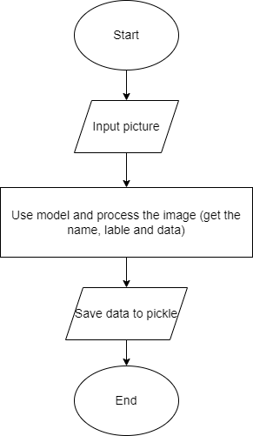
3.1. Design register

Slide 15
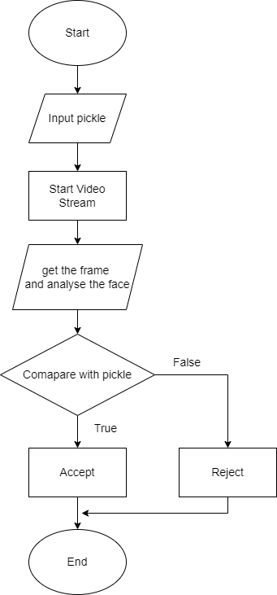
3.2. Design Recognize and Verify

Slide 16
Part 4: Implement and Test

Slide 17
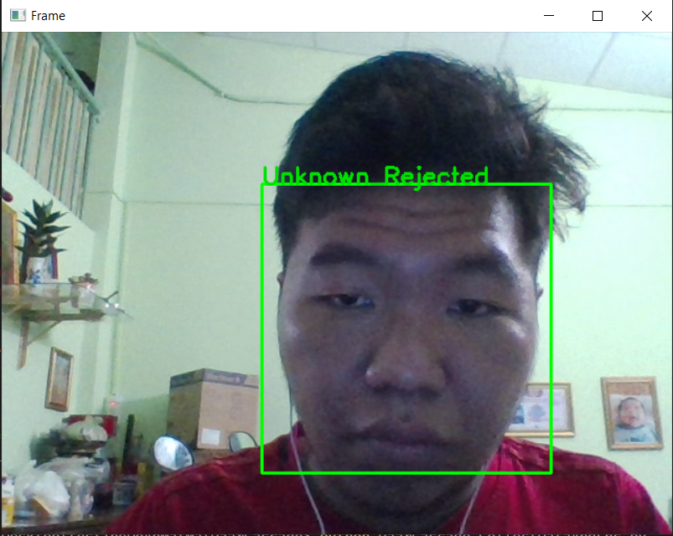
4.1. HaarCascade
Before register

Slide 18
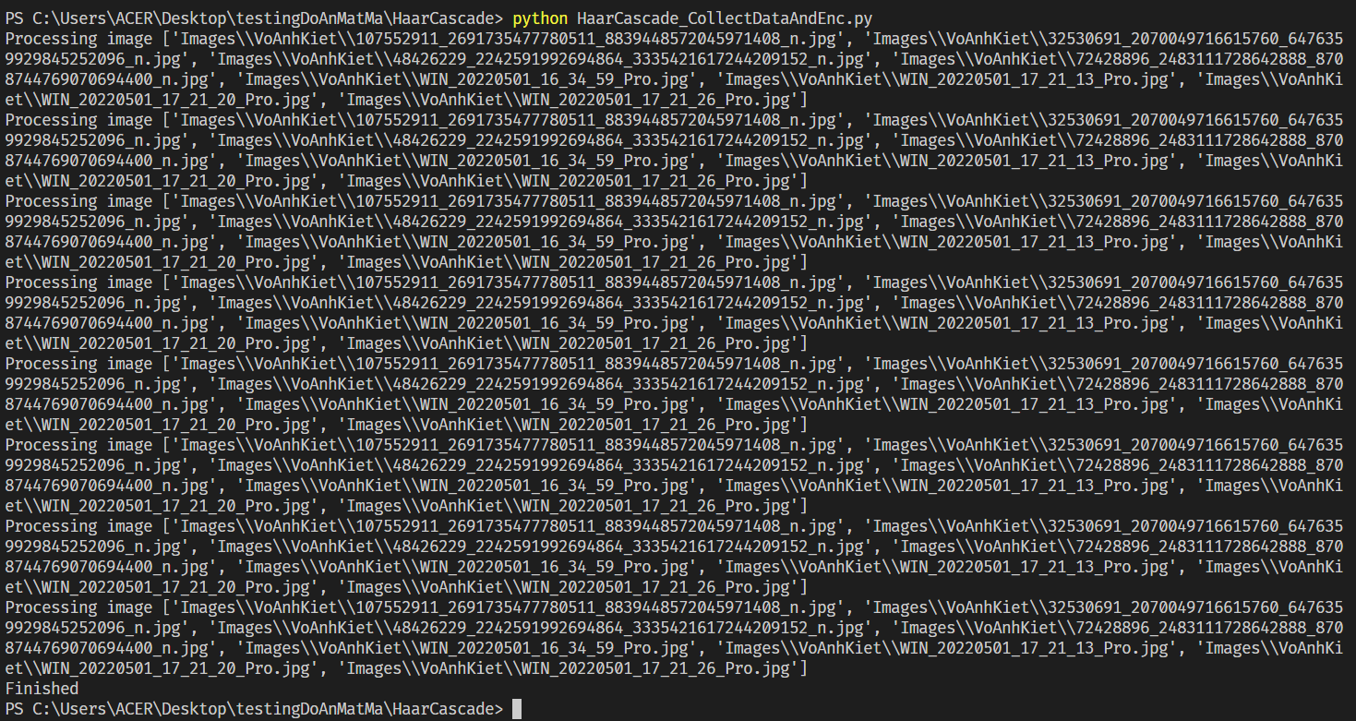
4.1. HaarCascade
Register

Slide 19
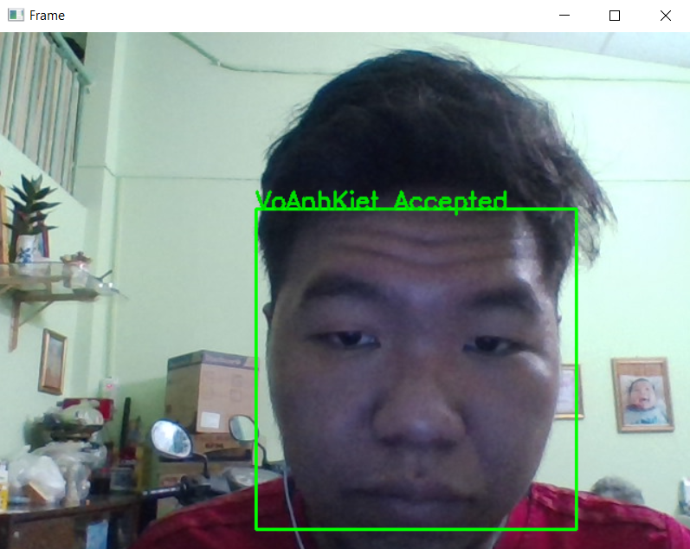
4.1. HaarCascade
Verify

Slide 20
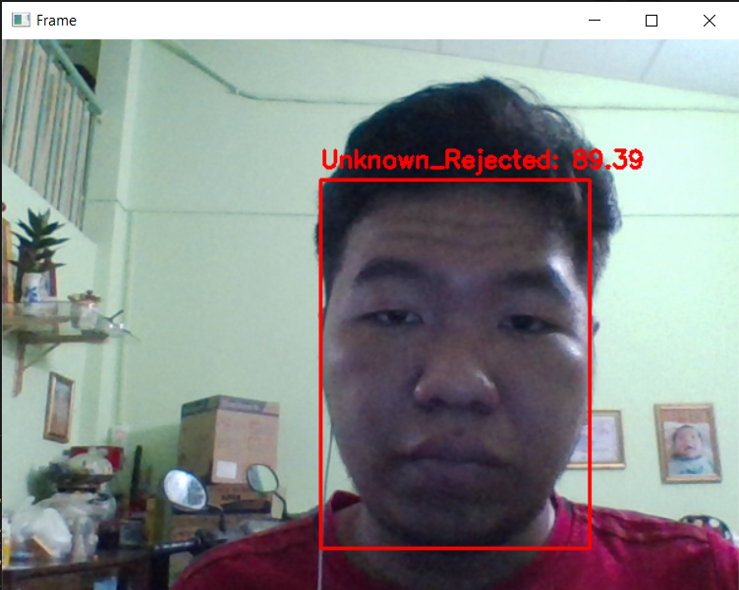
4.2. Caffe
Before register

Slide 21
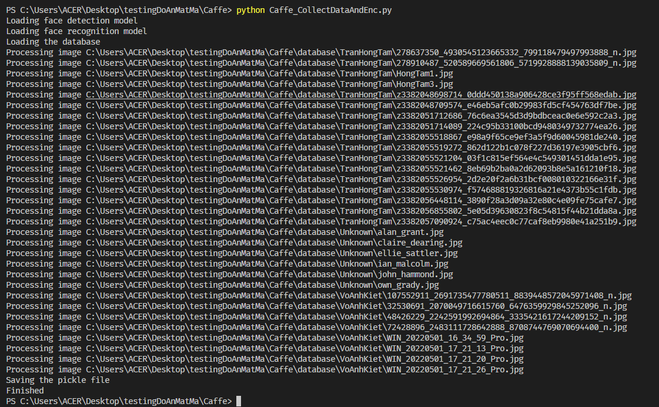
4.2. Caffe
Register

Slide 22

4.2. Caffe
Verify

Slide 23
4.3. Testing
 | HaarCascade | Caffe | Paper1
Recognize in normal light | Pass | Pass | Pass
Recognize a part of face | Pass | Pass | Not mentioned
Detect fake face | Not Pass | Not Pass | Pass
Recognize in low light | Not Pass | Not Pass | Not mentioned
Respone time counter | 2.0052 second | 2.2138 second | 0.3496 second
Accuracy | 46.8547% | 71.8954% | 99.95%

Slide 24
Part 5: Conclusion and Future work

Slide 25
Conclusion and Future work
Conclusion
Complete basic feature
Register and verify complete
Future work
Develop the mobile app and web app allowing user to have more methods in registering and verifying
Implement the program in the IOT device such as Raspberry Pi
Build the training data system using the larger data to improve the register and verify system
Improve the register and verify system algorithm to pop up the accuracy of the system

Slide 26
Thank you for listening

