Slide 1
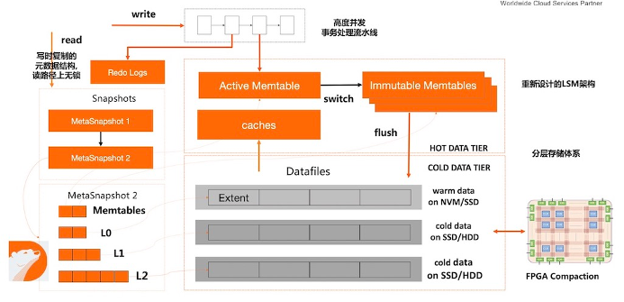
High Level of Concurrency
Transaction Processing Pipeline
Copy-on-Write Metadata Index
No Lock in the Path
Redesigned LSM Architecture
Tired Storage Architecture

