Slide 1
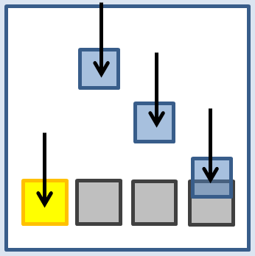

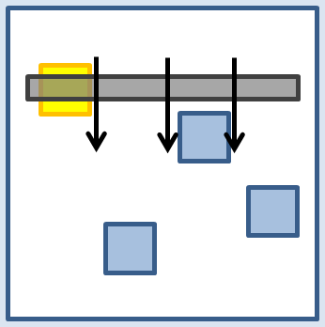

Designing Rhythm Game Interfaces for Touchscreen Devices
Philip Peng <pengp@stwing>
Stephen H. Lane <shlane@cis>
University of Pennsylvania
SEAS Senior Design Project Competition, 2012
Department of Computer and Information Science
Notes:
Hello all and thank you for coming to this presentation. My name is Philip Peng and today I will be presenting to you my senior design project, titled “Designing Rhythm Game Interfaces for Touchscreen Devices”

Slide 2
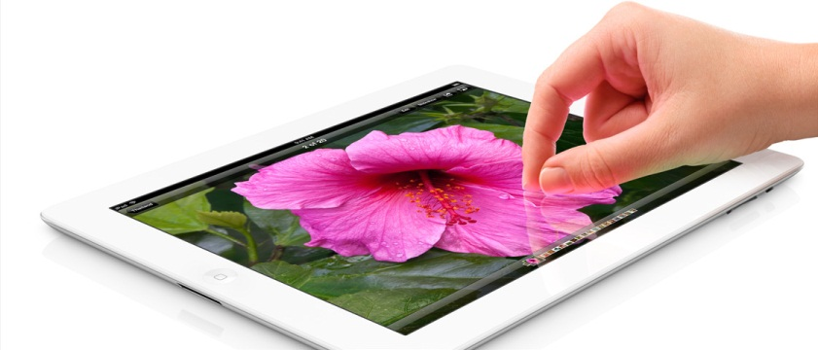
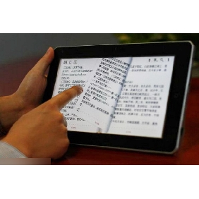
Touchscreens
Touchscreen devices on the rise
iPod Touch/iPad
Android phones/tablets
Windows 8 slates
New input paradigm
No mouse/keyboard
New interface designs!
Notes:
- So first off, some background information.
- Over the past few years, we’ve seen a drastic rise in touchscreen devices on the consumer market.
- According to a report by Information Display, consumer-device manufacturers are rapidly adopting touch-input technologies, with revenues increasing 10x and unit production 3x faster than the display industry.
- We see this directly, with Apple’s iPads and iPod Touches, and Android devices become commonplace, and Windows 8 slates expected to become mainstream in a few years.
- All these modern personal devices feature touchscreen displays, forcing users to adopt a new device interaction approach different from the old mouse-keyboard combination we’ve gotten used to.
- With this new input paradigm shift comes the need for new user interface designs when developing software applications for touchscreens.

Slide 3
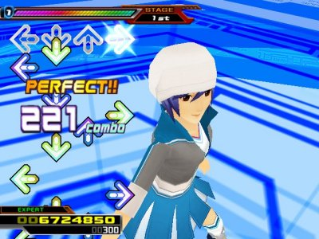
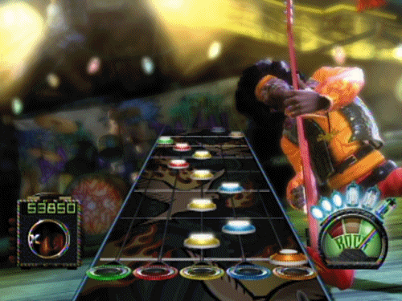
Rhythm Games
Rhythm Games
Timing-critical music games
Measure player’s sense of rhythm
Popular examples:
Dance Dance Revolution
Guitar Hero
Beatmania IIDX
etc.
Notes:
- The application studied in this project are rhythm games.
- For those unfamiliar to the genre, rhythm games are timing-critical music games that measure the player’s sense of rhythm.
- Popular rhythm games include Konami’s Dance Dance Revolution, Harmonix’s Guitar Hero, and more

Slide 4
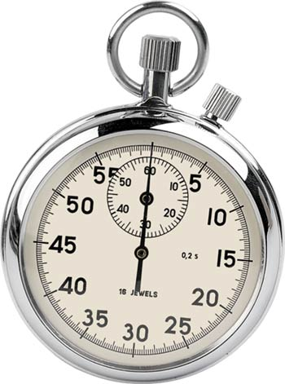
Rhythm Games + Touch
Gameplay
Action performed in response to note patterns
Better timing = higher score
Design Factors
User Responsiveness
Gameplay Experience
Visual-recognition/physical input relation
Perfect for touchscreen UI study!
Notes:
Rhythm game gameplay often involve performing a specific action in response to note patterns whose timings are indicated by the background music and on-screen visual cues.
Better timing accuracy results in a higher score
When designing a successful rhythm games, there are two main factors to take into consideration
1) the user’s ability to respond to notes during gameplay, and
2) the gameplay experience as a whole, the enjoyment factor
Both of these factors are closely determined by the game’s user interface design
Because of the close relationship between the visual-recognition and physical input components, rhythm games are a perfect vessel for studying user interfaces on touchscreen devices.

Slide 5
Project - Focus
The study focus:
The comparison of different user interface designs for the future development of rhythm games on touchscreen devices.
Notes:
Combine rhythm games and touchscreens and the result is this study, which focuses on
The comparison of different user interface designs for the future development of rhythm games on touchscreen devices

Slide 6
Project - Solution
How?
Make a prototype rhythm game and collect data!
Notes:
- So how can we accomplish this goal? Straightforward: Make a prototype rhythm game and collect data!

Slide 7
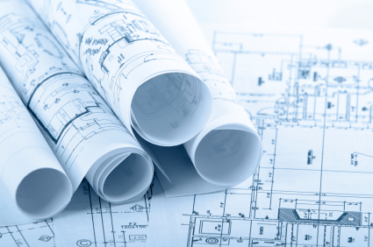
Project – Three Stages
Three stages
Design
Prototype
Evaluation
Notes:
This study was divided into three stages: Design, Prototype, and Evaluation

Slide 8
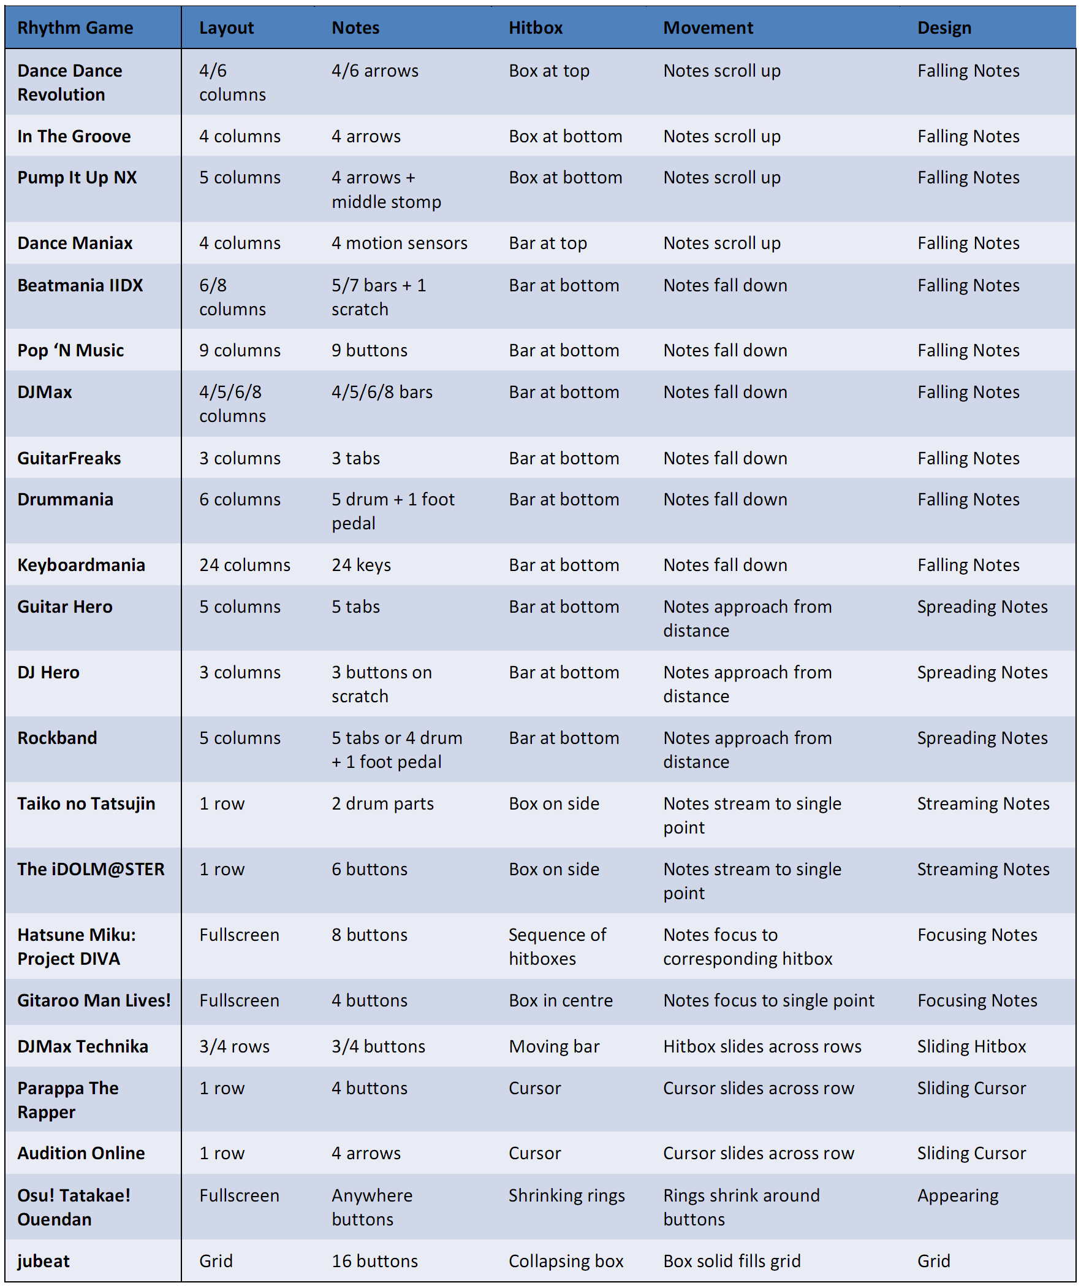
Design – Analyzing Existing Games
Analyze and categorize existing rhythm games
22 analyzed
Layout, Notes, Hitbox, Movement, Design
Notes:
The first part of the design stage was to look at currently existing commercial rhythm games
A total of 22 of the most popular rhythm games were researched, then categorized

Slide 9
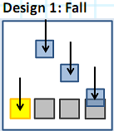
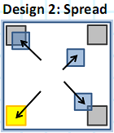
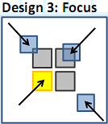
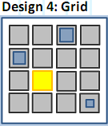
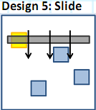
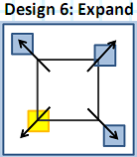
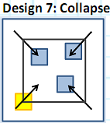
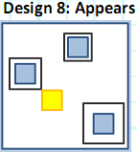
Design - Interfaces
Eight different rhythm game interface designs
Notes:
Based on the analysis, eight different rhythm game user interfaces were designed.

Slide 10
Design - Interfaces
Eight different rhythm game interface designs
Element Mobility:
Moving notes, fixed hitboxes
Notes:
For element mobility, Designs #1-3 feature moving notes and fixed hitboxes

Slide 11
Design - Interfaces
Eight different rhythm game interface designs
Element Mobility:
Fixed notes, moving hitboxes
Notes:
Designs #5-7 feature fixed notes and moving hitboxes

Slide 12
Design - Interfaces
Eight different rhythm game interface designs
Element Mobility:
Fixed notes, fixed hitboxes
Notes:
Designs #4 and 8 feature fixed notes and fixed hitboxes

Slide 13
Design - Interfaces
Eight different rhythm game interface designs
Movement Behaviour:
Top to bottom
Notes:
For movement behaviour, Designs #1 and #5 feature top to bottom

Slide 14
Design - Interfaces
Eight different rhythm game interface designs
Movement Behaviour:
Centre to Corners
Notes:
Designs #2 and #6 feature centre to corners

Slide 15
Design - Interfaces
Eight different rhythm game interface designs
Movement Behaviour:
Corners to centre
Notes:
Designs #3 and #7 feature corners to centre

Slide 16
Design - Interfaces
Eight different rhythm game interface designs
Movement Behaviour:
Fixed grid points
Notes:
Designs #4 and #8 feature fixed grid points

Slide 17
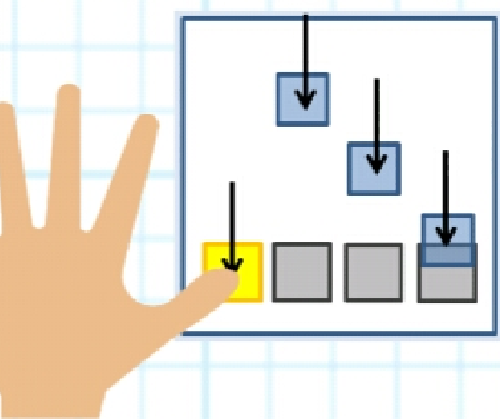
Implementation - Development
Prototype game developed
“Beats2 Prototypes”
http://git.to/beats2protot
Simple game for study
4 notes of same colour
Tap action
Featured 8 design as modes
Use same backend and game data
Notes:
After the design stage came the implementation stage
In this stage, the actual prototype game was created, named “Beats2 Prototypes”
The graphics and general gameplay itself was extremely simplified ,
With only four notes of the same colour were used and the user action to be performed were simple screen taps, the most basic touchscreen interaction
The 8 user interfaces designed earlier were featured as 8 different game modes in the game
To try to match the gameplay modes as closely as possible, the exact same timing backend and game data was used for all 8 modes.

Slide 18
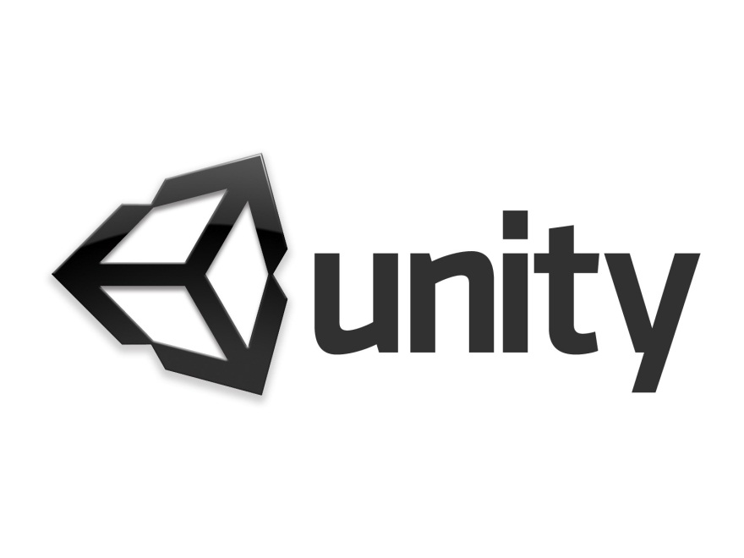
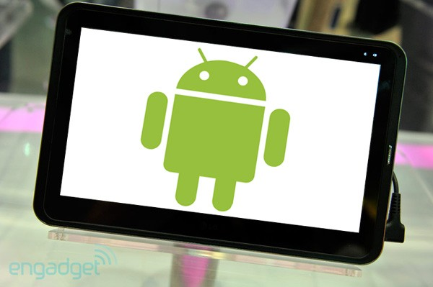
Implementation - Technical
Developed for Unity3
C#, Cross-platform
Target device
Android tablets
Test device: Samsung Galaxy Tab 10.1
Could run on iPad (but don’t have one)
Notes:
The actual game itself was developed for the Unity3 game engine in C#. Unity3 was chosen due to its extremely useful cross-platform support.
With minimal code modification, Unity3 would allow the same game to run on your iPad, your Android phone, directly on your web browser, natively on your Windows computer, and much more.
This flexibility is very important as more and more platforms supporting touch input are released in the future, such as Windows 8
The target platform for this study were Android tablets. This was mainly because the touchscreen device that I own for which I could test my game on was the Samsung Galaxy Tab 10.1 (which you can see here), a 10-inch Android tablet.
While it was completely possible to also target iPads, I did not own one nor have the Macbook and development license needed for building for that target.

Slide 19
Demo Video
http://www.youtube.com/watch?v=n-pFAVSPj10
Notes:
Now of course being a game, the best way to understand how it works is to watch it in action!
Here is a demo video I took showing each of the eight game modes.
You can see it in its full high-definition glory on YouTube, but for your convenience, I’ve embedded it here

Slide 20
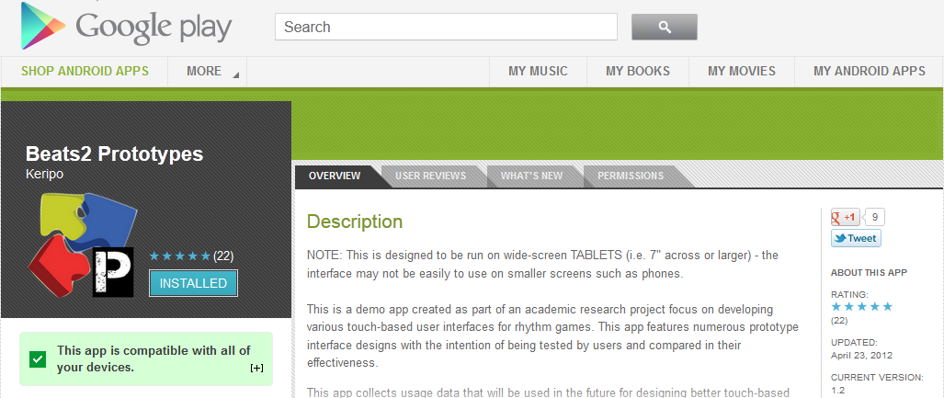
Evaluation – App Release
Android app released publically
Google Play: http://git.to/beats2protot
Website: http://beatsportable.com/2012/04/beats2-prototypes/
Total of 100+ players, 30 tablet users
Notes:
In the final Evaluation stage, the app was released publically on the official Google Play app-store as well as my personal website.
By the end of the study, there were over 100 players in total, 30 of which were tablet users whose data was analyzed

Slide 21
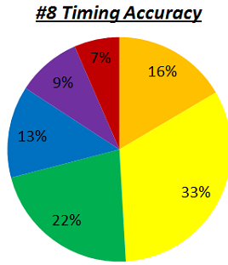
Evaluation – User Responsiveness
To obtain data, built-in tracker implemented
Timing Accuracy (quantitative measure of user responsiveness)
MARVELOUS
PERFECT
GREAT
GOOD
ALMOST
MISS
Notes:
To compare the interface designs of this study, a tracker was added to track gameplay statistics and user feedback.
Timing accuracy was used as a quantitatively measure of user responsiveness

Slide 22
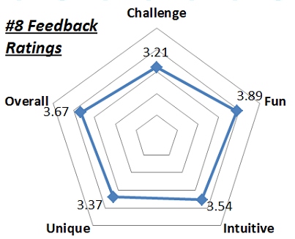
Evaluation – Gameplay Experience
Feedback Ratings (qualitative measure of gameplay experience, loosely based on Swetser & Wyeth’s Gameflow model)
Challenge
Intuitive
Fun
Unique
Overall
Rated on 1-5 scale, normalized for comparison
Notes:
Feedback ratings were used as a qualitative measure of gameplay experience.
The rating categories requested of were loosely based on Swetser and Wyeth’s Gameflow model of evaluating player enjoyment in games.
These categories were
All categories rated on a 1-5 star scale and normalized for relative comparison purposes.

Slide 23
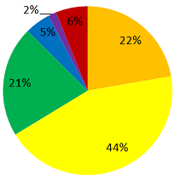
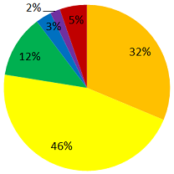
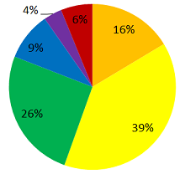
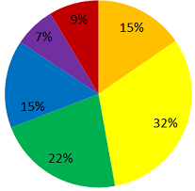
Results – Timing Accuracy
Notes:
So finally, here are the results, to be interpreted relative to each other
Shown here are the timing accuracy charts for Designs #1-4, with the highest two accuracy values being represented in gold and yellow.
Design #1 showed a good accuracy as expected due to its commonality in current rhythm game designs.
Design #2 showed an exceedingly strong accuracy rate, most likely due to the fact that placement of fingers during gameplay allowed for independent tap actions as well as a large visual space.
Design #3 showed far less accuracy compared to Design #2, most likely due to more screen space being covered.
Design #4 showed the least accuracy of the four, most likely due to the user having to focus on 16 possible note locations instead of 4.

Slide 24
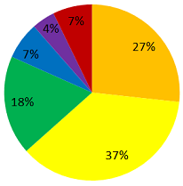
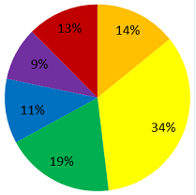
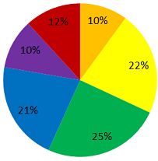
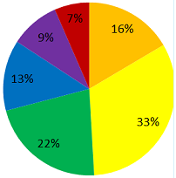
Results – Timing Accuracy
Notes:
For Designs #5-7, the hitboxes changed instead of notes.
This change seemingly resulted in drastically lower accuracy rates than their counterparts in Designs #1-3
Design #8, which was similar to #4, had almost the exact same accuracy chart, indicating the two designs being on equal footing.

Slide 25
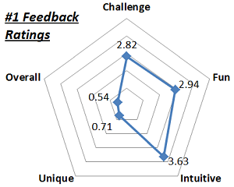
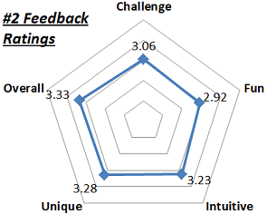
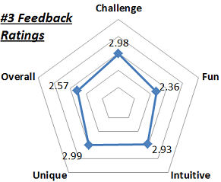
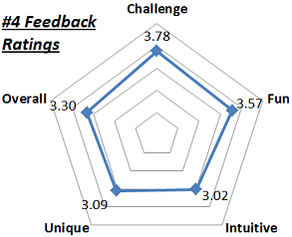
Results – Feedback Ratings
Notes:
For feedback ratings, we had very different results
Design #1 was received quite poorly, rated extremely low for Unique and Overall
Designs #2 and #4 were well received, receiving a normalized 3 or higher rating in all categories

Slide 26
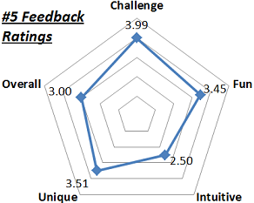
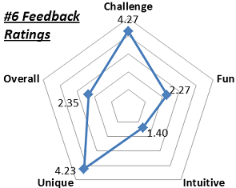
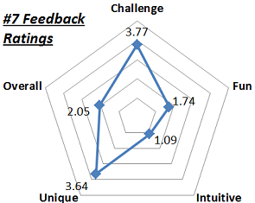
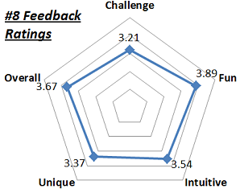
Results – Feedback Ratings
Notes:
For Designs #5-7, all Challenge ratings were significantly higher and Intuitive ratings significantly lower than their #1-3 counterparts
Designs #6 and #7 shared the same shape in results, receiving very low ratings for Fun, Intuitive, and Overall.
Design #8 received roughly the same feedback ratings as #4 – high all around

Slide 27
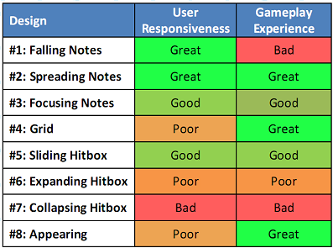
Results – Overall
Overall results:
User Responsiveness and Gameplay Experience not correlated but both important (e.g. #1 and #4/#8
Moving Notes, Fixed Hitboxes > Fixed Notes, Moving Hitboxes
Notes:
Finally, here is the overall charts of the results, with each mode ranked Great, Good, Poor or Bad relative to each other in User Responsiveness and Gameplay Experience
Note that the two categories were not correlated; for example, Design #1 is great for time-critical applications, but does not make for an interesting rhythm game.
Alternatively, Designs #4 and #8 aren’t may provide some hinderance in user responsiveness, but they provided a great gameplay experience.
One general trend was that moving notes with fixed hitboxes lead to better user responsiveness than fixed notes with moving hitboxes.
Overall, however, the focus of this study was achieved, with Design #2 shown to be great in both user responsiveness and gameplay experience, making it the best candidate for future rhythm game development.

Slide 28
Results – Conclusion
Focus: The comparison of different user interface designs for the future development of rhythm games on touchscreen devices.
Answer: Design #2 is the best candidate for future rhythm game development
Notes:
Lets take a look at the original project focus:
The comparison of different user interface designs for the future development of rhythm games on touchscreen devices
Based on the comparison results, the focus of this study was achieved:
Design #2 shown to be great in both user responsiveness and gameplay experience, making it the best candidate for future rhythm game development.

Slide 29
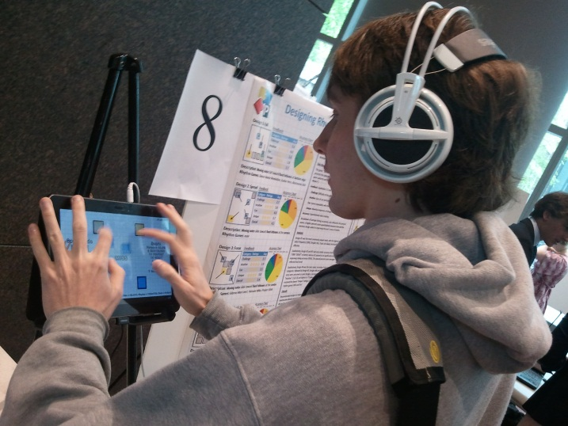

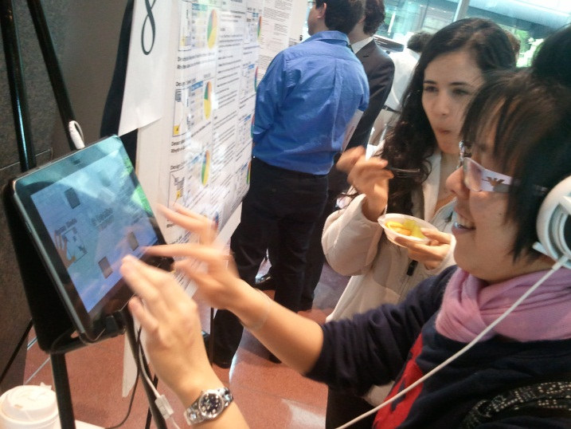
Thanks
Faculty Advisor:
Stephen H. Lane
CIS 401 Professor and TAs:
Insup Lee
Andrew G. West
Alex Roederer
Prototype Testers
STWingers
Anonymous internet testers
You (in advance if you download and try it out)
Notes:
Lets take a look at the original project focus:
The comparison of different user interface designs for the future development of rhythm games on touchscreen devices
Based on the comparison results, the focus of this study was achieved:
Design #2 shown to be great in both user responsiveness and gameplay experience, making it the best candidate for future rhythm game development.

