Slide 1
REPORT SOFTWARE ENGINEERING GROUP 03 PROJECT: SHARING FORUM
MEMBERS
Lê Đỗ Tân(leader)
Nguyễn Hồng Sơn
Lê Tuấn Anh

Slide 2
Wiki
Welcome to the G03_ wiki! Our project is a forum of telling and listening. In the 21th century, human being's life is very fast. There are a lot of things which affect our life such as studying, working .. So we decide to create a forum where people can open their heart, can tell everything happened during there working day..
The forum's name "goc chia se". The language used in our project is PHP and html. Our forum, for now, has two parts: the forum and the "discussion" part.
The forum is the main part of our project. The forum has 6 parts, which are 6 main problem in human's life: . In each problem, user could add a topic, which could be seen by guess and other users. Other users could also mark "like", "dislike" for each topic, or post a comment on each one. We will also allow to post a video or picture attract with each topic.
The "discussion" part will open a new page (page 1), which allow users make a question and some options in it. When users click on the button "post" (on the page 1), they will be given a link to a other page of questions and options (page 2), if they want to invite other users to discussion and vote, they will send them this link. To see the result, anyone who has the link could click on the button "result" (on the page 2), and see the result at the end of the page 2. To end of the discussion, the user who post the question could click on the button "finish" (on the page 2). Anyone who has the link still could see the result, but couldn't vote anymore.

Slide 3
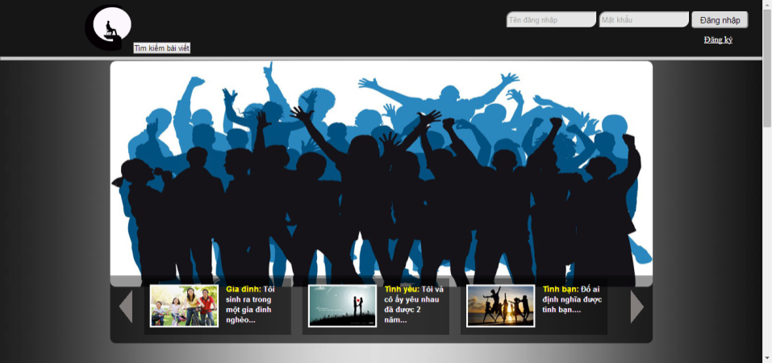

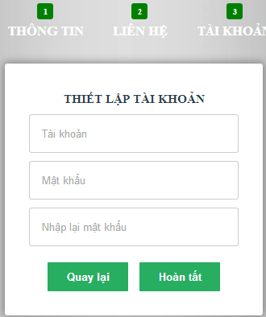
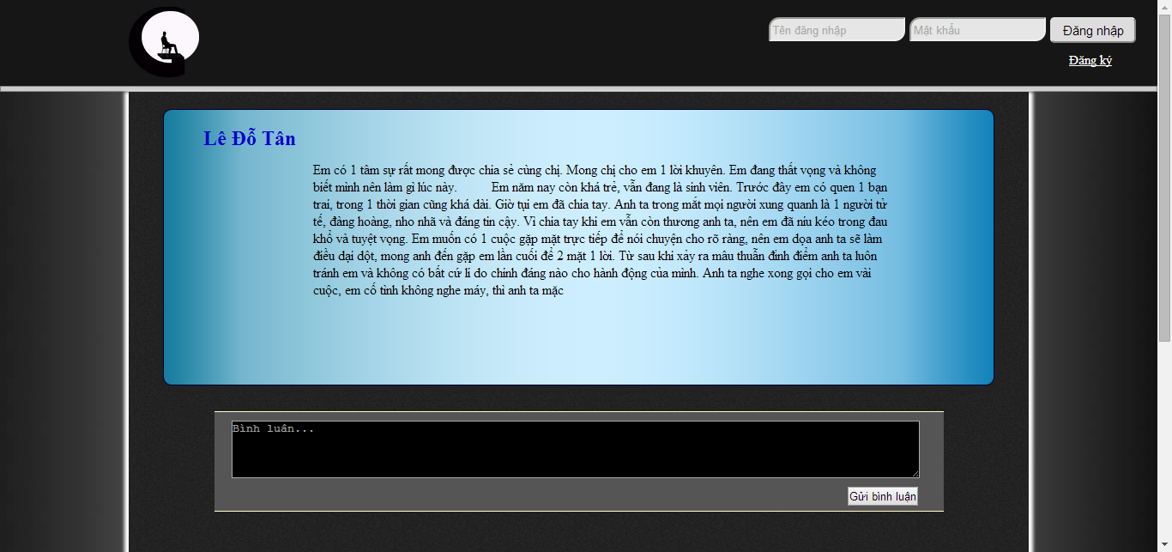
Some image about website

Slide 4
Programming language
HTML
CSS/Bootstrap (Css framework)
JavaScript/Jquery (JavaScript framework)
PHP/MySQL

Slide 5
Support tools
Skype
Facebook
Gmail
Pivotaltracker
Github

Slide 6
What did we do?
Week 1+2: Learning languages
Week 3: Interface demo and define features
Week 4: Building homepage
Week 5: Log in/out – sign up – change account info
Week 6: Posting
Week 7: Comment
Week 8: Building admin page
Week 9: Search
Week 10: Optimize features
Week 11: Optimize interface

Slide 7
What did we do?
Week 1+2: Learning languages
Week 3: Interface demo and define features

Slide 8
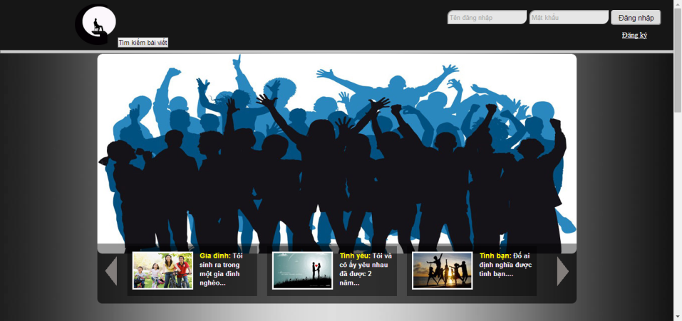
What did we do?
Week 4: Building homepage

Slide 9
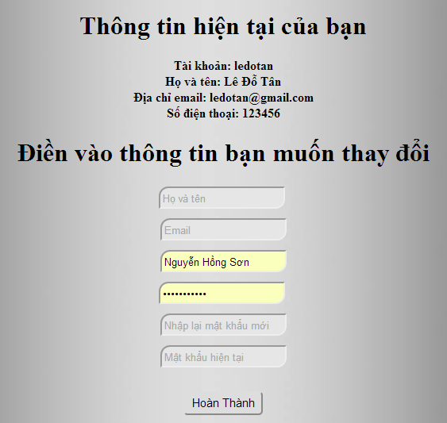

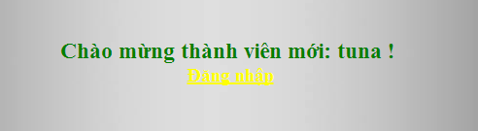
What did we do?
Week 5: Log in/out – sign up – change account info

Slide 10
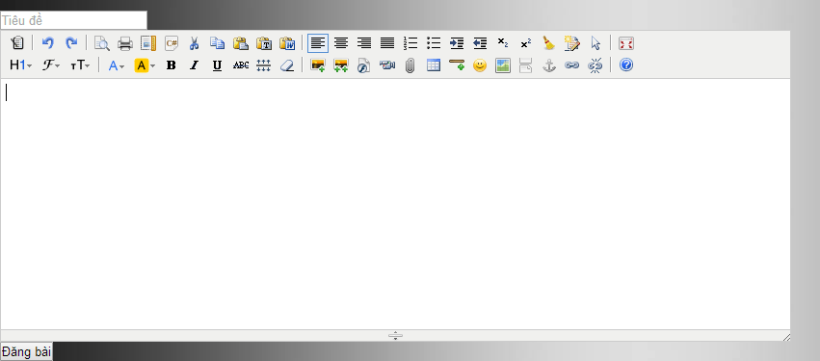
What did we do?
Week 6: Posting

Slide 11
What did we do?

Slide 12
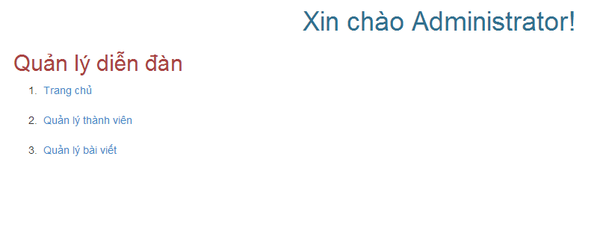
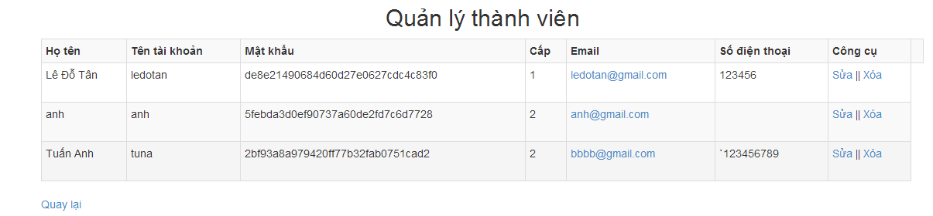
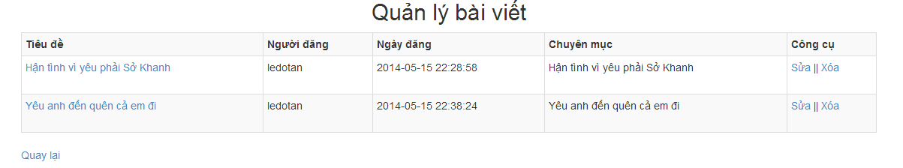
What did we do?
Week 8: Building admin page

Slide 13
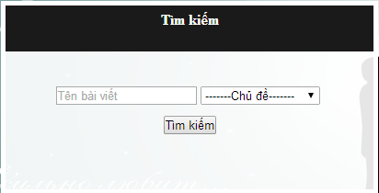
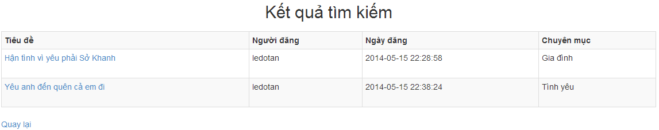
What did we do?
Week 9: Search

Slide 14
What did we do?
Week 10: Optimize features
Week 11: Optimize interface

Slide 15
Problems
At the beginning, there are 6 members in our group. However,3 people gave up without announcing to us. Therefore we had to waste 3 weeks for waiting them.
Github also had some problems. Sometimes,it did not update codes.So we had to re-build our functions.

Slide 16
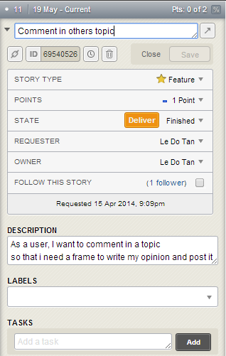
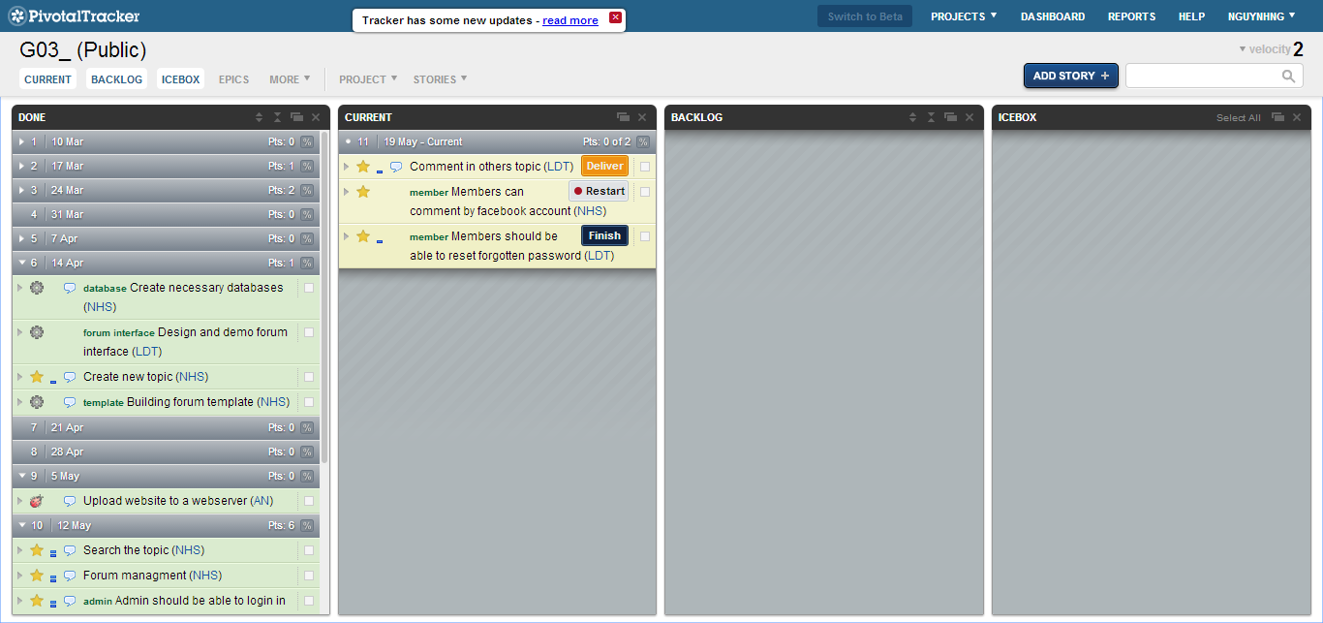
User story

Slide 17
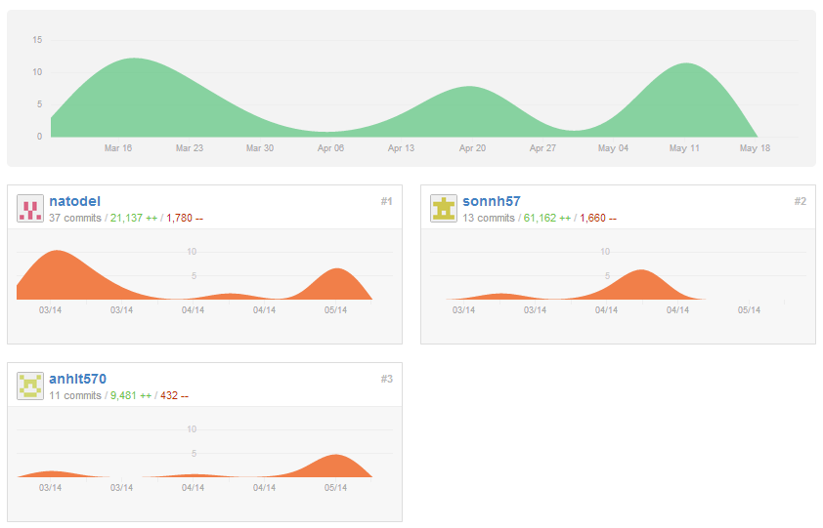
Github

Slide 18
UML

Slide 19
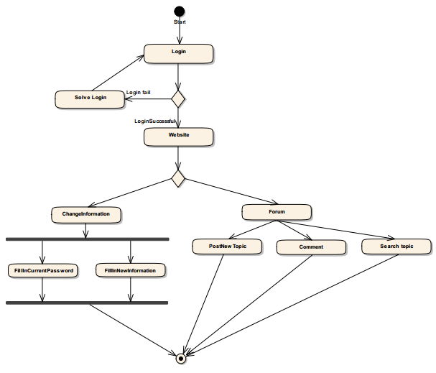
Logical use

Slide 20
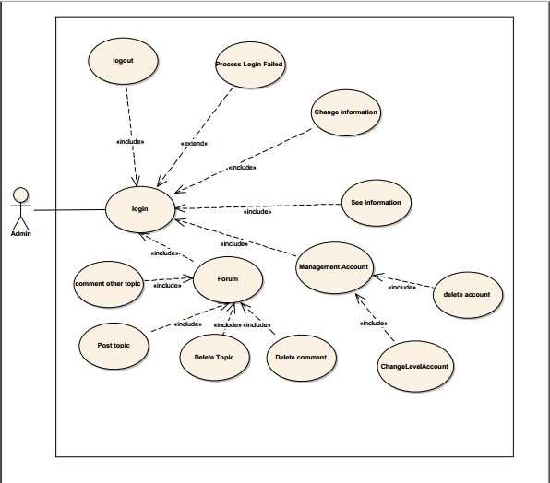
User case for admin

Slide 21
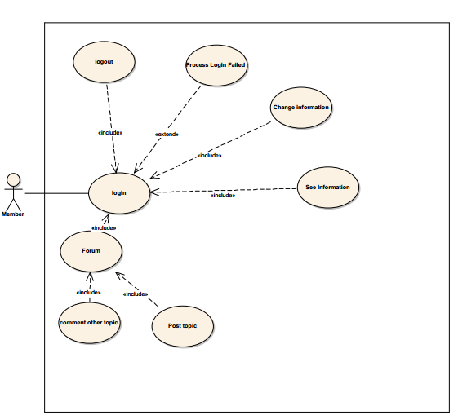
User case for member

Slide 22
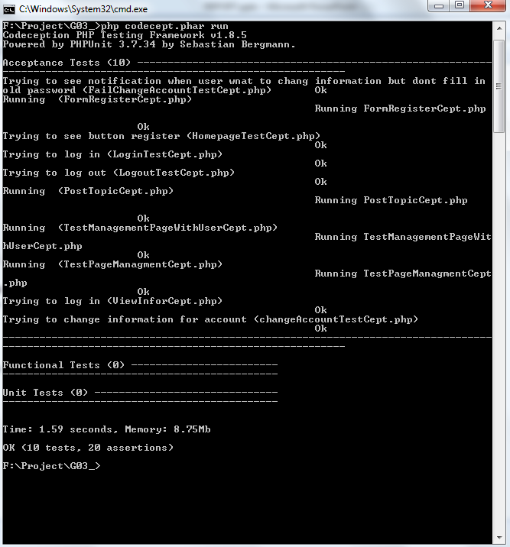
Test Result

