Slide 1
Microbiome of Type 2 Diabetes Patients
Anh-Minh Nguyen

Slide 2
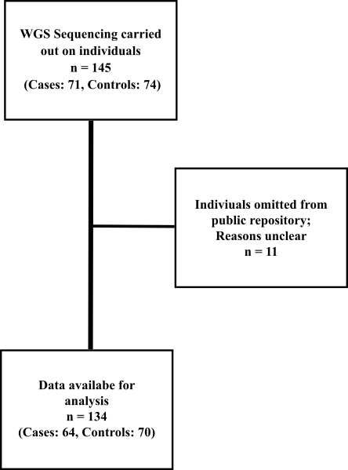
Introduction - Dataset
“A metagenome-wide association study of gut microbiota in type 2 diabetes” By Qin et al. (2012)
metagenome-wide association study
whole-genome shotgun (WGS) sequencing
Chinese individuals living in the south of China

Slide 3
Rationale
Realistic implementation: Blood sugar test vs stool
Definition of healthy biome
Limitations of sequencing and identifying microbiota (Fresh faecal samples were obtained at home, used the 85% identity as the threshold for genus assignment, as well as another threshold of 80% of the alignment coverage, etc.)
Age and sex are two important variables
Questions
For each OTU, is it associated with hba1c (blood sugar) adjusting for age and sex? (Linear regression model for each OTU) Provide inference for significant OTUs
For each OTU, is it associated with T2D status, adjusting for age and sex?

Slide 4
Methods
Build a trivariate linear regression model for each OTU, so the outcomes is hba1c (blood sugar) and the predictors are age, sex, and the specified OTU
Build a trivariate logistic regression model for each OTU, so the outcome is T2D status, and the predictors are age, sex, and the specified OTU.
Additional notes:
Log transform (after pseudo +1) all OTUs because a small difference could be non-significant
Converted hba1c from % to nmol
Hypothesis testing: α = 0.01 Importance of strict significance level
Bonferroni Correction

Slide 5
Data Preparation
Filter for complete genome/sequence OTUs only. (limited on the amount of expertise on how to deal with non-complete genome sequences)
Filter OTUs for those with counts higher than the total number of OTUs. (common standard as it helps reduce possible errors from sequencing)
Filter for OTUs with less zeros than the total number of samples (patients). (Possibly reduce the errors from sequencing)
Around 11,000 → 127

Slide 6
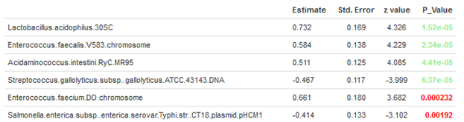
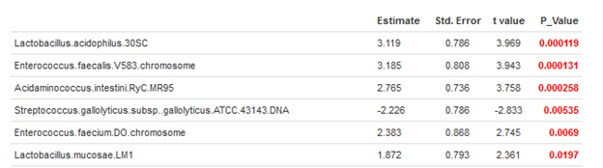
Results
No significant OTUs associated with hba1c
4 significant OTUs associated with Type 2 Diabetes

Slide 7
Discussion
Lactobacillus acidophilus (PROBIOTIC: It does this by producing an enzyme called lactase. Lactase breaks down lactose, a sugar found in milk, into lactic acid)
Enterococcus faecalis (BAD BIOTIC: sepsis, endocarditis, and meningitis)
Acidaminococcus intestini (BAD BIOTIC: phylum Firmicutes)
Streptococcus gallolyticus (BAD BIOTIC: main causative agent of septicemia and infective endocarditis)
Limitations/Potential Problems
Did not account for interactions between OTUs
3 main sources of error in my opinion (stool, sequencing, classification)
Directionality
Inexperience

Slide 8

References
https://www.healthline.com/health/enterococcus-faecalis
https://www.healthline.com/nutrition/lactobacillus-acidophilus
https://www.ncbi.nlm.nih.gov/pmc/articles/PMC5891635/

