Slide 1

CRIMINAL MINDS
Anh-Minh Nguyen
Hank Flury
Monica Wisdom
Stephen White

Slide 2
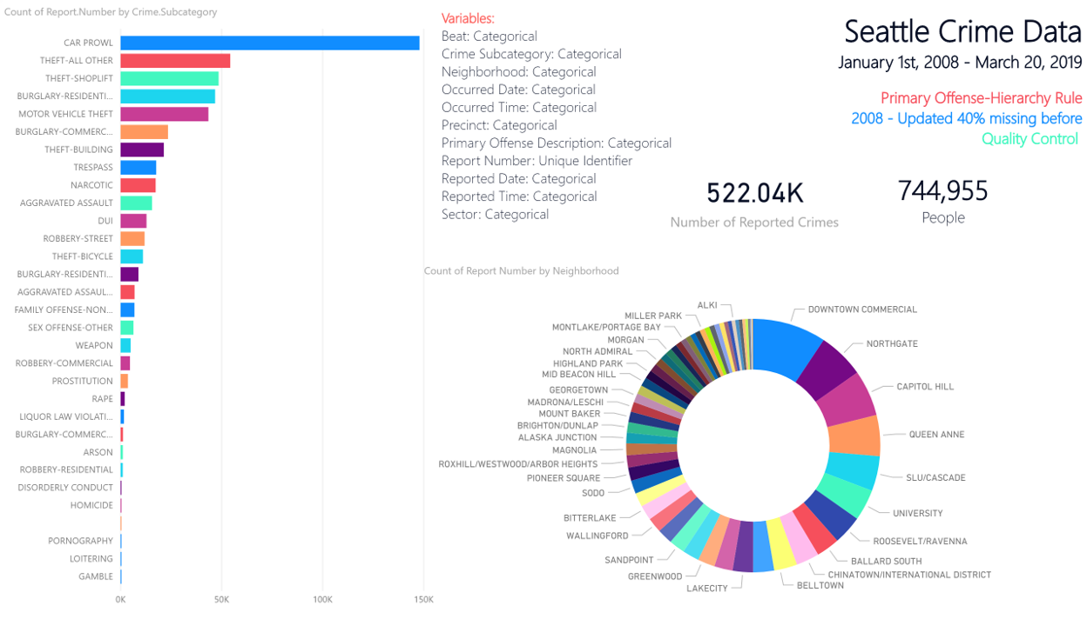

Slide 3
Questions:
Does the proportions of different crimes in U-District differ from the whole of Seattle?
Does the average number of days between the date the crime occurred and the date the crime was reported in U-District differ from the whole of Seattle, particularly in the cases of rape, other sexual offenses, and nonviolent family offenses?
Where we study, live, and congregate
To put life into perspective
Proactivity vs. Reactivity

Slide 4
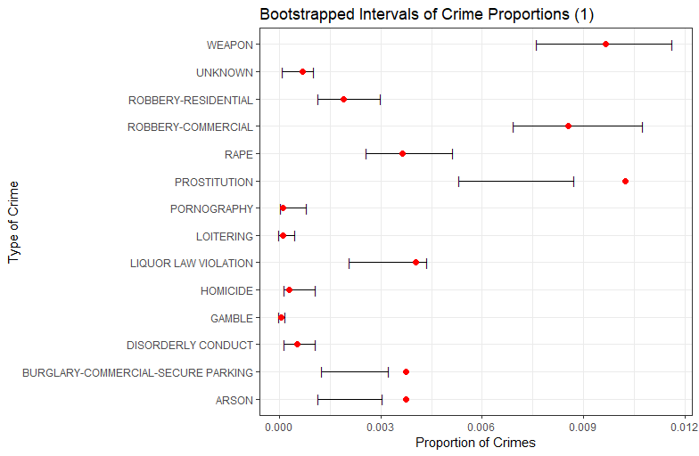
Does the proportions of different crimes in U-District differ from the whole of Seattle?

Slide 5
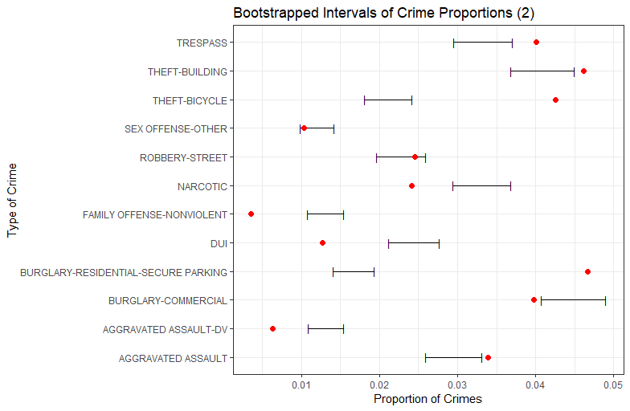
Does the proportions of different crimes in U-District differ from the whole of Seattle?

Slide 6
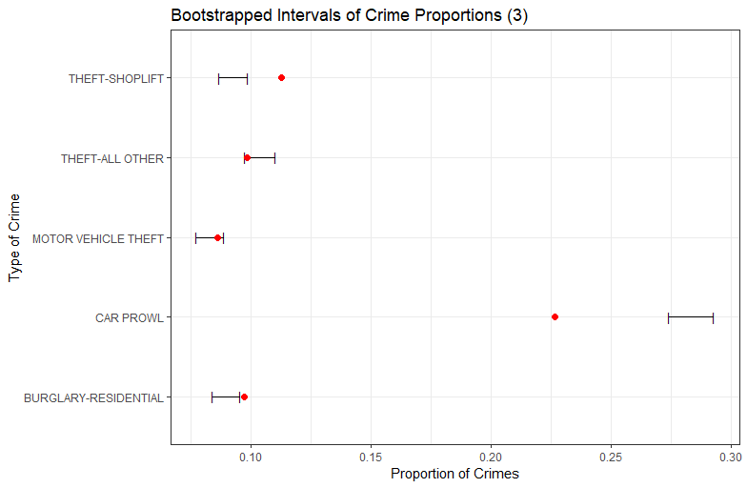
Does the proportions of different crimes in U-District differ from the whole of Seattle?

Slide 7
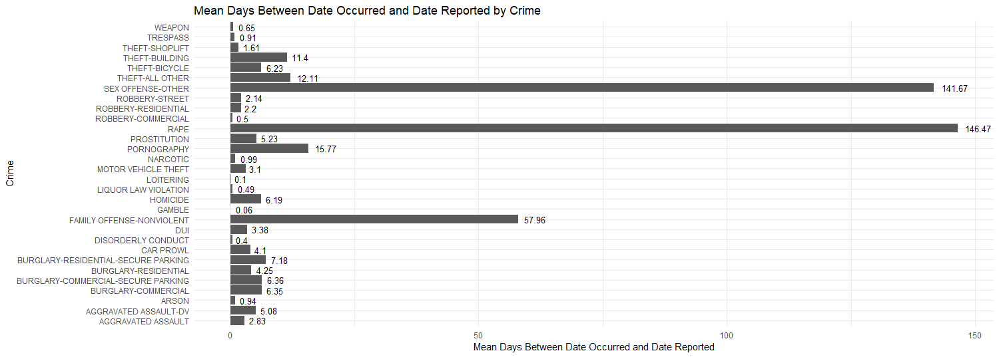
Does the average number of days between the date the crime occurred and the date the crime was reported in U-District differ from the whole of Seattle?

Slide 8
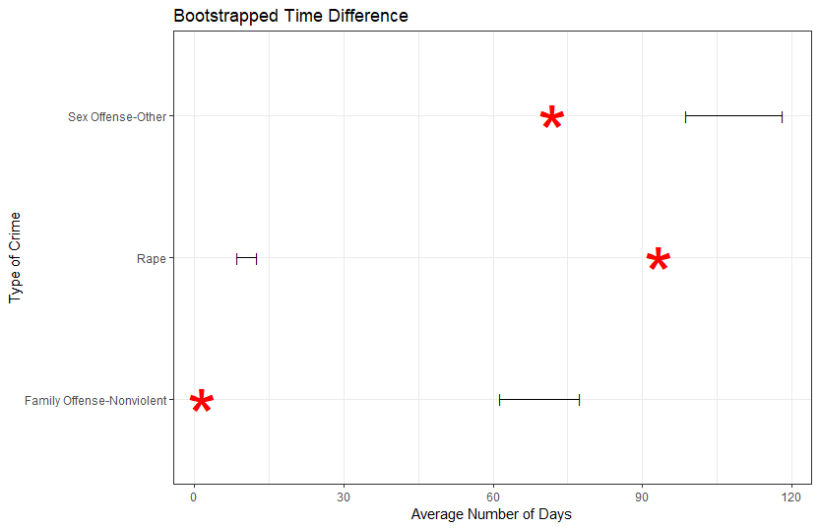
Does the average number of days between the date the crime occurred and the date the crime was reported in U-District differ from the whole of Seattle?

Slide 9
Conclusion

