Slide 1
Chapter 5 – Introduction to Object oriented programming
Anh Nguyen-Duc
Tho Quan Thanh

Slide 2
Agenda
History
Key OOP Concepts
Object, Class
Instantiation, Constructors
Encapsulation
Inheritance and Subclasses
Abstraction
Reuse
Polymorphism, Dynamic Binding
Object-Oriented Design and Modeling

Slide 3

Agenda
There are different approaches to writing computer programs.
Procedural programming
Object oriented programming
They all involve decomposing your programs into parts.
“And so, from Europe, we get things such ... object-oriented analysis and design (a clever way of breaking up software programming instructions and data into small, reusable objects, based on certain abstraction principles and design hierarchies.)”
-Michael A. Cusumano, The Business Of Software

Slide 4
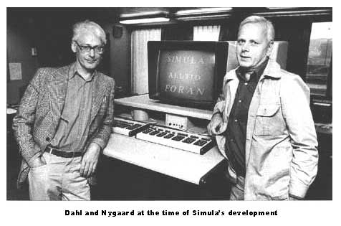
OOP … since 1962
Simula 1 (1962 - 1965) and Simula 67 (1967) Norwegian Computing Center, Oslo, Norway by Ole-Johan Dahl and Kristen Nygaard.
Turing Award Winners - 2001

Slide 5


OOP … since 1962
Smalltalk (1970s), Alan Kay's group at Xerox PARC
C++ (early 1980s), Bjarne Stroustrup, Bell Labs

Slide 6
OOP Languages
Modula – 3, Oberon, Eiffel, Java, C#, Python
many languages have some Object Oriented version or capability
One of the dominant styles for implementing complex programs with large numbers of interacting components
… but not the only programming paradigm and there are variations on object oriented programming

Slide 7
Definition – OOP, Class
Object-oriented programming is a method of programming based on a hierarchy of classes, and well-defined and cooperating objects
A class is a structure that defines the data and the methods to work on that data. When you write programs in the Java language, all program data is wrapped in a class, whether it is a class you write or a class you use from the Java platform API libraries

Slide 8
Definition – Class, Object
Class: a collection of data (fields/ variables) and methods that operate on that data
define the contents/capabilities of the instances (objects) of the class
a class can be viewed as a factory for objects
a class defines a recipe for its objects

Slide 9
Example of a class (Java)
class Customer {
// Fields/ variables/ Data
private String name; //Can get but not change
private double salary; // Cannot get or set // Constructor
Customer(String n, double s) { name = n; order = s; } // Methods
void pay () {
System.out.println("Pay to the order of " +
name + " $" + order);
} public String getName() { return name; } // getter
}
Customer a = new Customer(«Anh», 500);
a.pay();
Customer b = new Customer(«Tho», 600);
String anh_name = a.getName();
b.pay();

Slide 10
Definition – Class, Object
Object creation: memory is allocated for the object’s fields as defined in the class
Initialization is specified through a constructor
A special method invoked when objects are created
Different objects have the same attributes but the values of those attributes can vary
Reminder: The class definition specifies the attributes and methods for all objects
The current value of an object’s attribute’s determines it’s state.

Slide 11
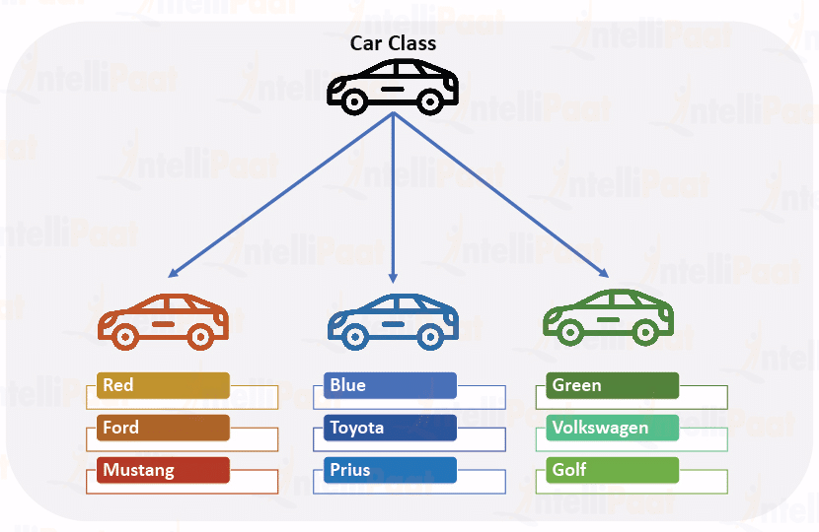
Concept: Classes describe objects

Slide 12
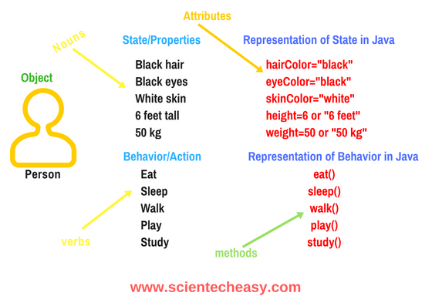
Concept: Classes describe objects
Class Person {
private String hairColor;
….
}

Slide 13
Notation: How to declare and create objects
Employee secretary; // declares secretary
secretary = new Employee (); // allocates space
Employee secretary = new Employee(); // does both
But the secretary is still "blank" (null)
secretary.name = "Adele"; // dot notation
secretary.birthday (); // sends a message

Slide 14
Notation: How to reference a field or method
Inside a class, no dots are necessary
class Person { ... age = age + 1; ...}
Outside a class, you need to say which object you are talking to
if (john.age < 75) john.birthday ();
If you don't have an object, you cannot use its fields or methods!

Slide 15
Inheritance
Inheritance:
programming language feature that allows for the implicit definition of variables/methods for a class through an existing class
An object also inherits:
the fields described in the class's superclasses
the methods described in the class's superclasses
A class is not a complete description of its objects!

Slide 16
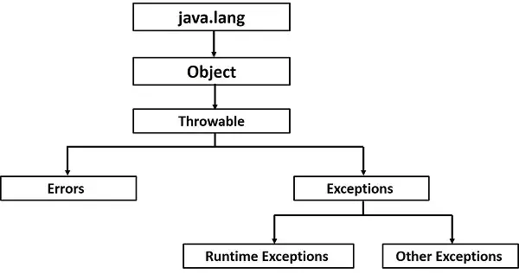
Concept: Classes form a hierarchy
Classes are arranged in a treelike structure called a hierarchy
The class at the root is named Object
Every class, except Object, has a superclass
When you define a class, you specify its superclass
If you don’t specify a superclass, Object is assumed

Slide 17
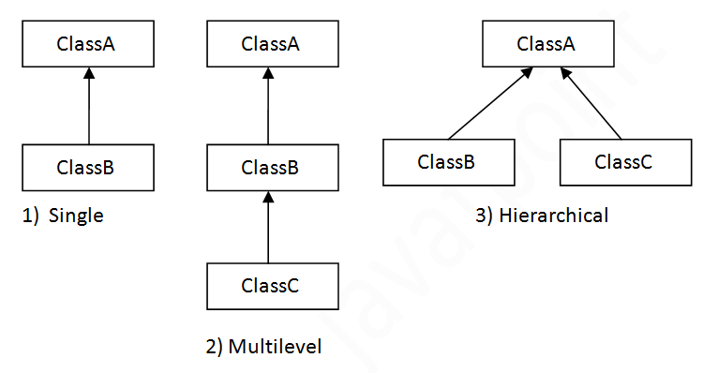
Concept: Classes form a hierarchy
Subclass relationship
B is a subclass of A
B inherits all definitions (variables/methods) in A
A class may have several ancestors, up to Object
Every class may have one or more subclasses

Slide 18
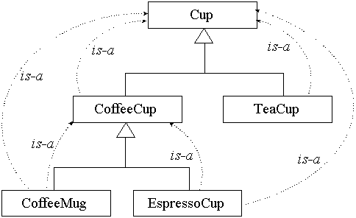
Example of (part of) a hierarchy

Slide 19
Example of inheritance
class Person {
private String name;
private int age;
public void birthday () {
age = age + 1;
}
}
class Employee
extends Person {
private double salary;
public void pay () { ...}
}
…
Employee ee = new Employee();
ee.birthday()
Every Employee has name and age fields and birthday method as well as a salary field and a pay method.

Slide 20
Example: Assignment of subclasses
class Dog { ... }
class Poodle extends Dog { ... }
Dog myDog; Dog rover = new Dog ();
Poodle yourPoodle; Poodle fifi = new Poodle ();
myDog = rover; // ok
yourPoodle = fifi; // ok
myDog = fifi; //ok
yourPoodle = rover; // illegal
yourPoodle = (Poodle) rover; //runtime check

Slide 21
Encapsulation
Also know as separation of concerns and information hiding
When creating new data types (classes) the details of the actual data and the way operations work is hidden from the other programmers who will use those new data types
So they don't have to worry about them
So they can be changed without any ill effects (loose coupling)
Encapsulation makes it easier to be able to use something
microwave, radio, ipod, the Java String class

Slide 22
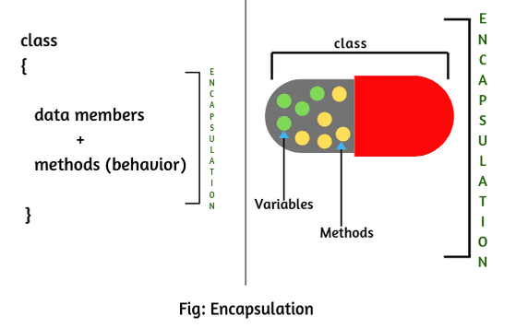
Encapsulation (A capsule)

Slide 23
Kinds of access in Java
Java provides four levels of access:
public: available everywhere
protected: available within the package (in the same subdirectory) and to all subclasses
[default]: available within the package
private: only available within the class itself
The default is called package visibility
In small programs this isn't important...right?

Slide 24
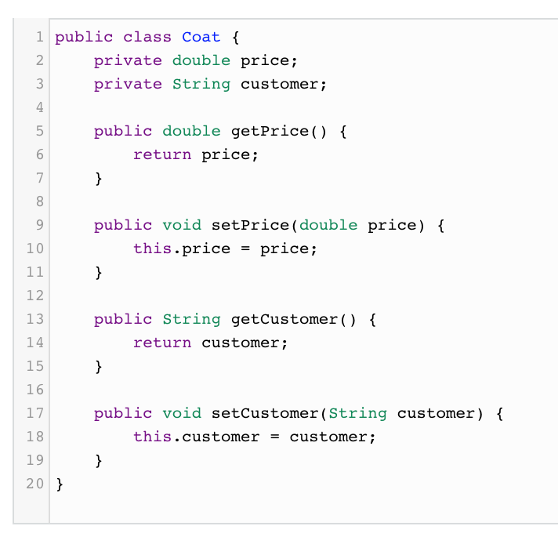
Encapsulation

Slide 25
Abstraction
OOP is about abstraction
Abstraction is a method of hiding the implementation detail and only show the functionalities
Encapsulation and Inheritance are examples of abstraction

Slide 26
Polymorphism
Polymorphism means many (poly) shapes (morph)
In Java, polymorphism refers to the fact that you can have multiple methods with the same name in the same class
There are two kinds of polymorphism:
Overloading
Two or more methods with different signatures
Overriding
Replacing an inherited method with another having the same signature

Slide 27
Polymorphism
two methods have to differ in their names or in the number or types of their parameters
foo(int i) and foo(int i, int j) are different
foo(int i) and foo(int k) are the same
foo(int i, double d) and foo(double d, int i) are different

Slide 28
Overloading
class Test { public static void main(String args[]) { myPrint(5); myPrint(5.0); }
static void myPrint(int i) { System.out.println("int i = " + i); }
static void myPrint(double d) { // same name, different parameters System.out.println("double d = " + d); } }
int i = 5 double d = 5.0

Slide 29
Overriding
class Animal { public static void main(String args[]) { Animal animal = new Animal(); Dog dog = new Dog(); animal.print(); dog.print(); } void print() { System.out.println("Superclass Animal"); } }
public class Dog extends Animal { void print() { System.out.println("Subclass Dog"); } }
This is called overriding a method
Method print in Dog overrides method print in Animal
A subclass variable can shadow a superclass variable, but a subclass method can override a superclass method
Superclass Animal Subclass Dog

Slide 30
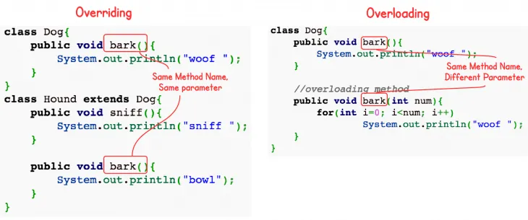
Another examples

Slide 31
When to do?
You should overload a method when you want to do essentially the same thing, but with different parameters
You should override an inherited method if you want to do something slightly different than in the superclass
It’s almost always a good idea to override public void toString() -- it’s handy for debugging, and for many other reasons
To test your own objects for equality, override public void equals(Object o)
There are special methods (in java.util.Arrays) that you can use for testing array equality

Slide 32
Reuse
Inheritance encourages software reuse
Existing code need not be rewritten
Successful reuse occurs only through careful planning and design
when defining classes, anticipate future modifications and extensions

Slide 33
Building Complex Systems
From Software Engineering: complex systems are difficult to manage
Proper use of OOP aids in managing this complexity
The analysis and design of OO systems require corresponding modeling techniques

Slide 34
Object-Oriented Modeling
UML: Unified Modeling Language
OO Modeling Standard
Booch, Jacobson, Rumbaugh
What is depicted?
Class details and static relationships
System functionality
Object interaction
State transition within an object

Slide 35
Some UML Modeling Techniques
Class Diagrams
Use Cases/Use Case Diagrams
Interaction Diagrams
State Diagrams

Slide 36
Object-Oriented Design Models
Static Model
Class Diagrams
Dynamic Model
Use Cases, Interaction Diagrams, State Diagrams, others

