Slide 1
continuous integration and delivery (CI/CD)
Anh Nguyen-Duc
Tho Quan-Thanh
WEEK 11

Slide 2
Outline
Challenges of modern code development
Code integration
Continuous integration
Continuous delivery
DevOps
Notes:
Course outline:
This is an introductory course to the field of software engineering. The goal of this course is to provide undergraduate students with techniques, methods and processes for the development of software-intensive systems. They will get familiar with various engineering activities for software development including requirements elicitation, software specification, architectural & detailed design using design patterns, implementation, and software testing. The UML modeling language is extensively used in the course.

Slide 3
The challenge: complexity and size
As the project grows, complexity grows:
Physical code size
Dependencies
Number of developers
Package versions
Examples of well-known open source projects
Notes:
Course outline:
This is an introductory course to the field of software engineering. The goal of this course is to provide undergraduate students with techniques, methods and processes for the development of software-intensive systems. They will get familiar with various engineering activities for software development including requirements elicitation, software specification, architectural & detailed design using design patterns, implementation, and software testing. The UML modeling language is extensively used in the course.

Slide 4
The challenge: complexity and size
Some notably large codebases include:
Google: monolithic, 1 billion files, 9 million source code files, 2 billion lines of source code, 35 million commits in total, 86 TB total size (January 2015)
Facebook: monolithic, 8 GB (repo 54 GB including history, 2014),[6] hundreds of thousands of files (2014)
Linux kernel: distributed, over 15 million lines of code (as of 2013 and kernel version 3.10)
Notes:
Course outline:
This is an introductory course to the field of software engineering. The goal of this course is to provide undergraduate students with techniques, methods and processes for the development of software-intensive systems. They will get familiar with various engineering activities for software development including requirements elicitation, software specification, architectural & detailed design using design patterns, implementation, and software testing. The UML modeling language is extensively used in the course.

Slide 5
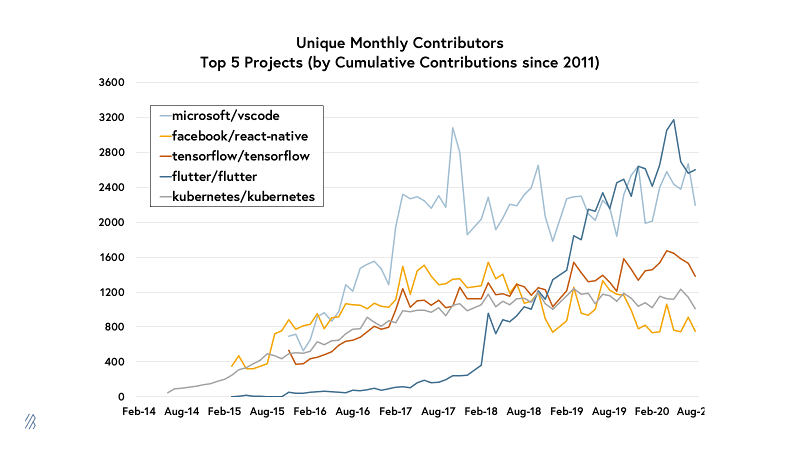

Slide 6
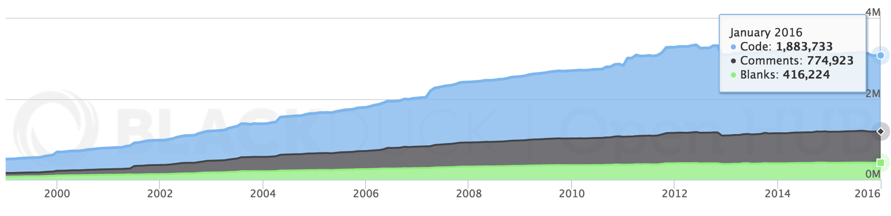
Example - Geant4
A framework for the simulation of the passage of particles through matter.
Used in HEP, medical and space physics
Just under 2 million lines of code
Mostly C++
LOC

Slide 7
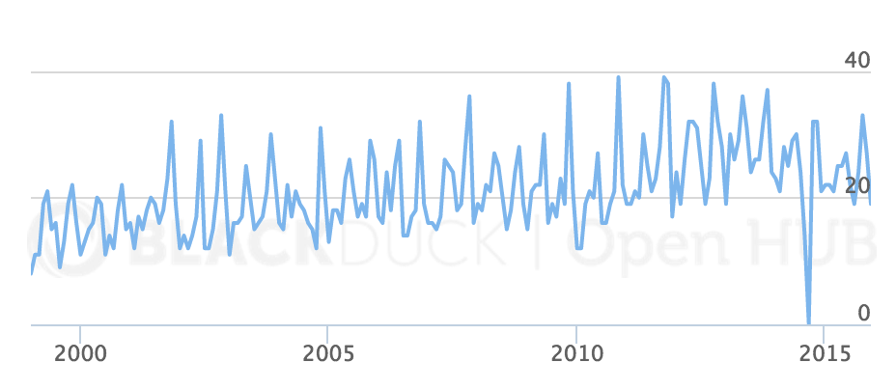
Example - Geant4
# of contributors
537 person-years
Estimated cost: ~ €29 million
58,683 commits from 160 developers

Slide 8
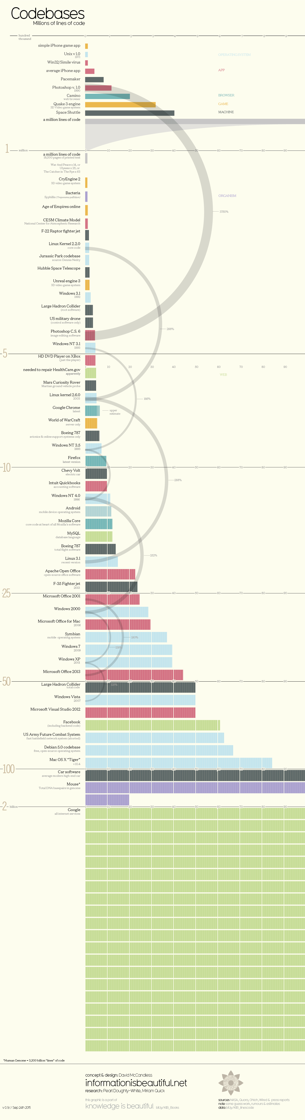

Slide 9
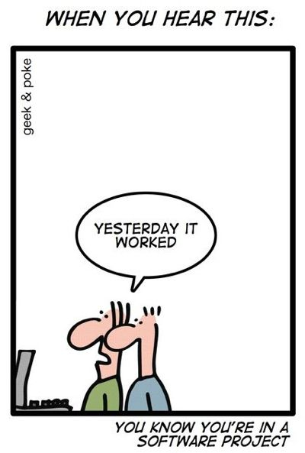
The challenge
How do we handle increasing code-base sizes?
How do we handle an increasing number of developers?
How can developers interact with each other?
How do we build across multiple platforms?
How do we build multiple versions?
How can we make sure we don’t break things!
Notes:
Course outline:
This is an introductory course to the field of software engineering. The goal of this course is to provide undergraduate students with techniques, methods and processes for the development of software-intensive systems. They will get familiar with various engineering activities for software development including requirements elicitation, software specification, architectural & detailed design using design patterns, implementation, and software testing. The UML modeling language is extensively used in the course.

Slide 10
What is integration?
Software teams often have multiple developers working on the same codebase at the same time(independently):
E.g. Developer A works on feature 1 while developer B works on feature 2.
E.g. Developer A works on class 123.java while developer B works on class 456.java
Once they have finished, they needs to integrate their work into the main codebase.
“I can't compile the program if you're in the middle of typing a variable name”
https://martinfowler.com/articles/branching-patterns.html#integration-patterns
Notes:
Course outline:
This is an introductory course to the field of software engineering. The goal of this course is to provide undergraduate students with techniques, methods and processes for the development of software-intensive systems. They will get familiar with various engineering activities for software development including requirements elicitation, software specification, architectural & detailed design using design patterns, implementation, and software testing. The UML modeling language is extensively used in the course.

Slide 11
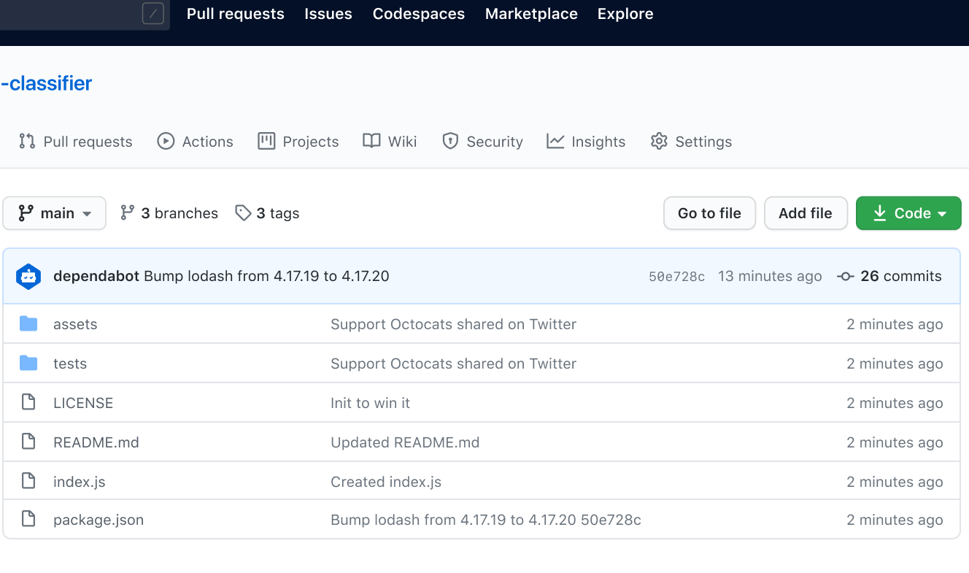
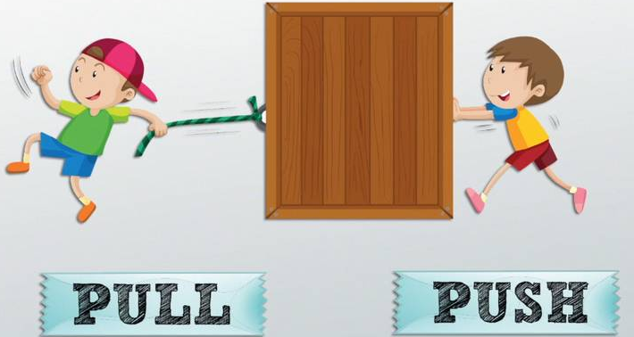
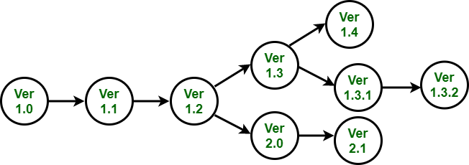
Terminology
Integration
Repository
Pull vs. push
Software Version
Notes:
Course outline:
This is an introductory course to the field of software engineering. The goal of this course is to provide undergraduate students with techniques, methods and processes for the development of software-intensive systems. They will get familiar with various engineering activities for software development including requirements elicitation, software specification, architectural & detailed design using design patterns, implementation, and software testing. The UML modeling language is extensively used in the course.

Slide 12
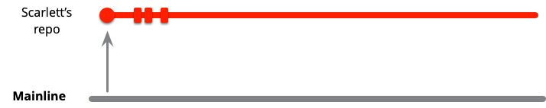
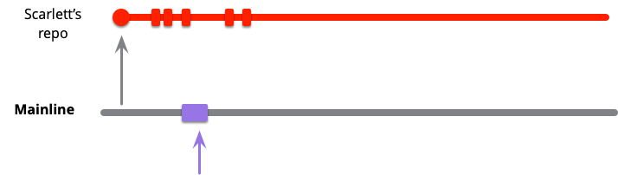
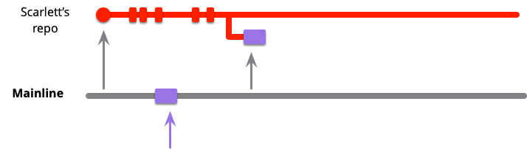
Mainline integration:Developers integrate their work by pulling from mainline, merging, and - if healthy - pushing back into mainline
Viollet makes some changes!
Notes:
While she's working, her colleague Violet pushes some changes onto mainline. As she's working in her own codeline, Scarlett can be oblivious to those changes while she works on her own task.
At some point, she reaches a point where she wants to integrate. The first part of this is to fetch the current state of mainline into her local master branch, this will pull in Violet's changes. As she's working on local master, the commits will show on origin/master as a separate codeline.

Slide 13
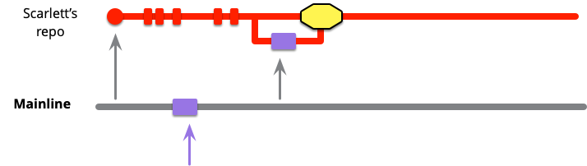
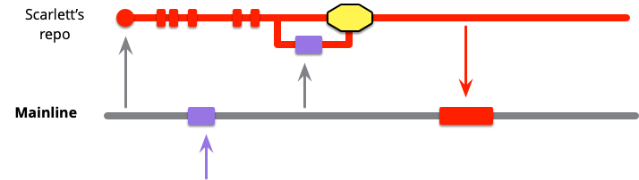
Mainline integration:Developers integrate their work by pulling from mainline, merging, and - if healthy - pushing back into mainline
A successful merge
Notes:
If Scarlett is fortunate, merging in Violet's code will be a clean merge, if not she'll have some conflicts to deal with. These may be textual conflicts, most of which the source control system can handle automatically.
At this point, Scarlett needs to verify that the merged code satisfies the health standards of the mainline (assuming mainline is a Healthy Branch). This usually means building the code and running whatever tests form the commit suite for mainline.
To finish integrating she must push her changes into the mainline

Slide 14
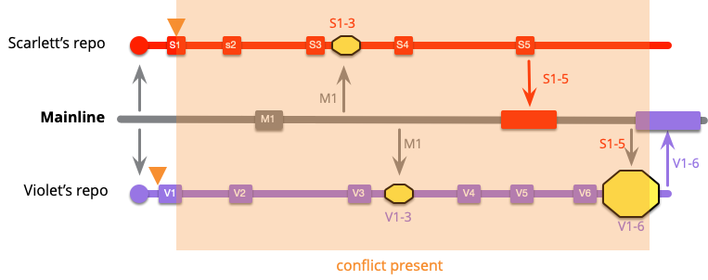
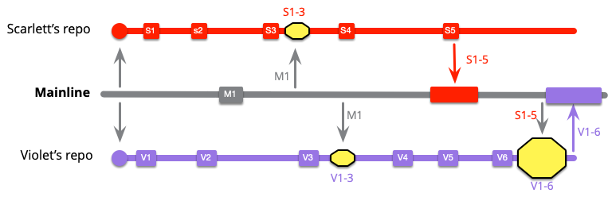
Integration frequency
Elite development teams integrate notably more often than low performers
Low-Frequency Integration
https://martinfowler.com/articles/branching-patterns.html#integration-patterns
Notes:
This team works by keeping a healthy branch and pulling from mainline after each commit. Scarlett didn't have anything to pull with her first two commits as mainline was unchanged, but now needs to pull M1.
I've marked the merge with the yellow box. This one merges commits S1..3 with M1. Soon Violet needs to do the same thing.
At this point both developers are up to date with mainline, but they haven't integrated since they are both isolated from each other. Scarlett is unaware of any changes Violet has made in V1..3.
Scarlett makes a couple more local commits then is ready to do mainline integration. This is an easy push for her, since she pulled M1 earlier.
Violet, however has a more complicated exercise. When she does mainline integration she now has to integrate S1..5 with V1..6.

Slide 15
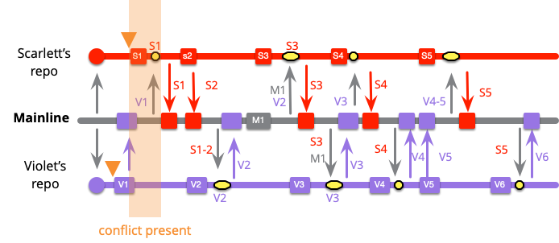
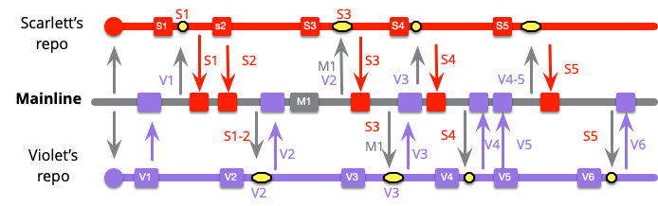
Integration frequency
Elite development teams integrate notably more often than low performers
High-Frequency Integration
https://martinfowler.com/articles/branching-patterns.html#integration-patterns
Notes:
Scarlett's first commit also has mainline integration, but because Violet got there first, she needs do a merge. But since she's only merging V1 with S1, the merge is small.
Scarlett's next integration is a simple push which means Violet's next commit will also require merging with Scarlett's latest two commits. However it's still a pretty small merge, one of Violet's and two of Scarlett's.
The developers continue with their remaining work, integrating with each commit.

Slide 16
What is continous integration?
Continuous integration (CI) is a software development practice where developers in a team integrate their work frequently
Developers usually integrates several times a day.
Each integration is verified by anautomated build: compile the code and also run automated tests?
Question: Why are automated tests run?

Slide 17
Why is continous integration?
Early/rapid feedback!
Do all components/projects compile?
Coding standards?
Are tests successful?
Performance requirements?
Problems archiving or deploying?
Better project visibility
Possible to notice trends
What features are needed/being added
Insures clean environments
Manual tasks automated
Speedup of working software turnover
No large integration steps
Much less likely to break something
A full working/deployable version at ANY POINT IN TIME
Complete documentation of who did what

Slide 18
How is continous integration?
In order for CI to work, individual developers should:
Commit frequently
Many small commits
Run local build first (if possible)
Huge code repos may make this difficult
Only commit working code
Fix broken builds immediately
Write automated tests
Use various existing tools to:
Combine changes often
Build often
Test often
Deploy often

Slide 19
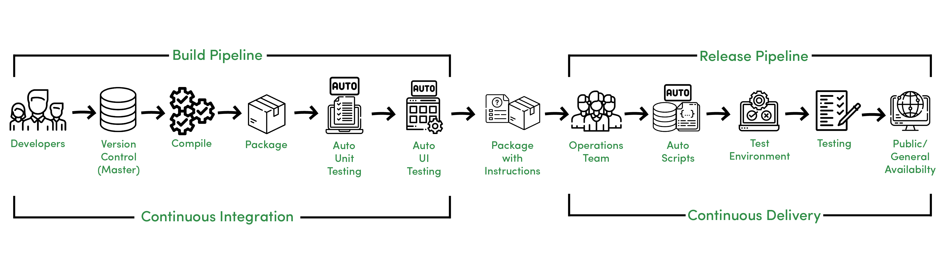
Continuous integration model
Version control software
Dependency management
Automated testing software
Continuous integration framework
Infrastructure management
Build automation

Slide 20
Continuous integration tools
Code repositories
Github, Bitbucket, Mercurial, BitKeeper, Bzr, CVS, Darcs, Gerrit, Monotone, P4, SVN ...
Test frameworks
CppUnit, Valgrind, JUnit, Unittest, TestNg ...
Continuous Integration
Bamboo, Buildbot, CruiseControl, Jenkins, Gitlab CI …
Wikipedia has a great comparison table: https://en.wikipedia.org/wiki/Comparison_of_continuous_integration_software

Slide 21

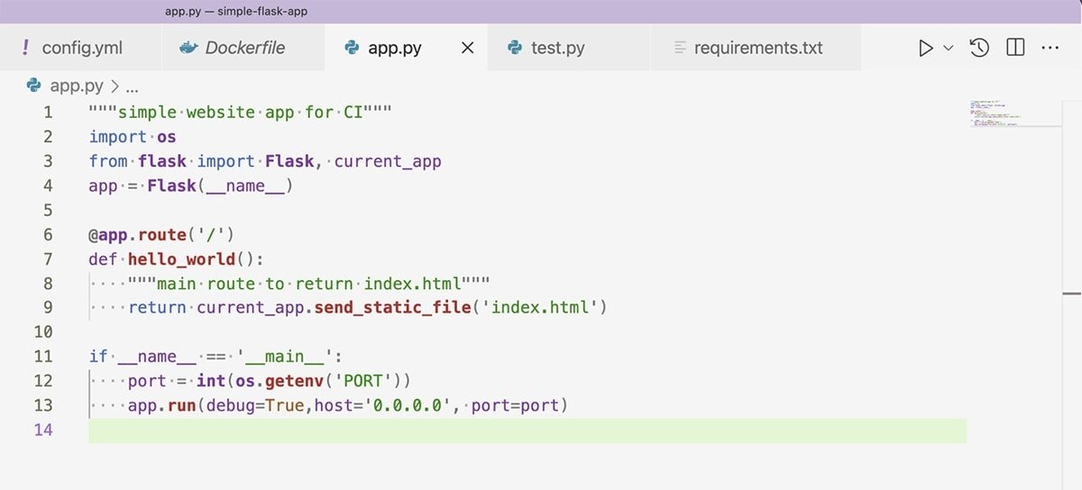
Setting up a CI pipeline
A simple example of a Flask web appliation
Notes:
On line 11, the application starts with app.run, a basic Flask call. The port is set on line 12, using an environment variable set outside of our application. The function os.getenv reaches out to the system running the Python application and finds the environment variable's value for the argument specified. In this case, it is PORT.
The system running the Python application in this CI/CD tutorial is a Heroku server. The Heroku server sets the PORT environment variable to the proper port to run the Docker container on Heroku's web server.

Slide 22
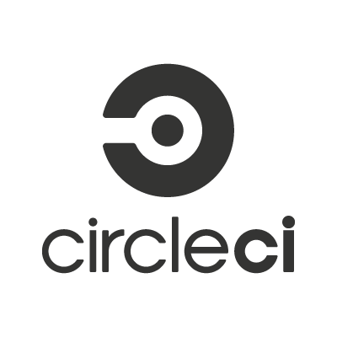
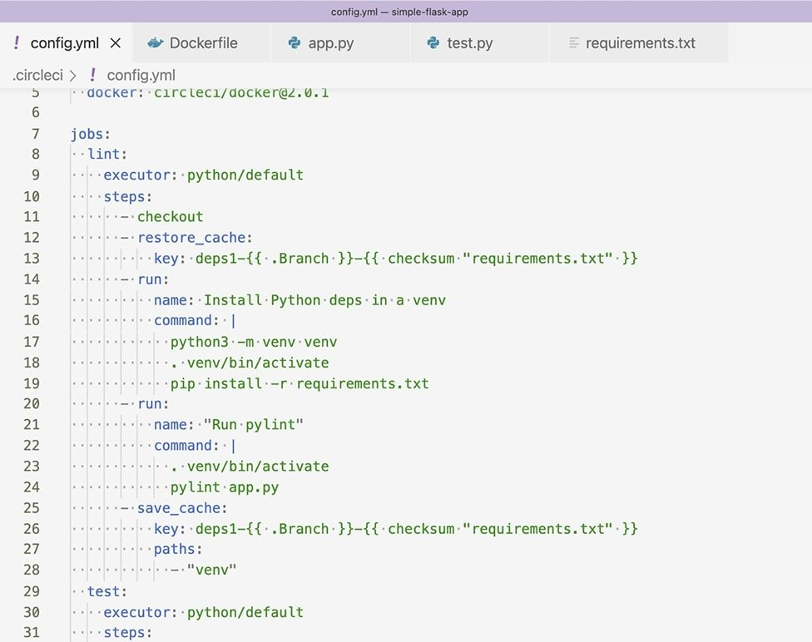
Our YAML file defines four different processes to run: lint, test, build and deploy.
Notes:
CircleCI is a free tool that enables projects to run different commands and processes on each commit to a Git repository. To define the commands and processes, use a YAML file. Our YAML file defines four different processes to run: lint, test, build and deploy.

Slide 23
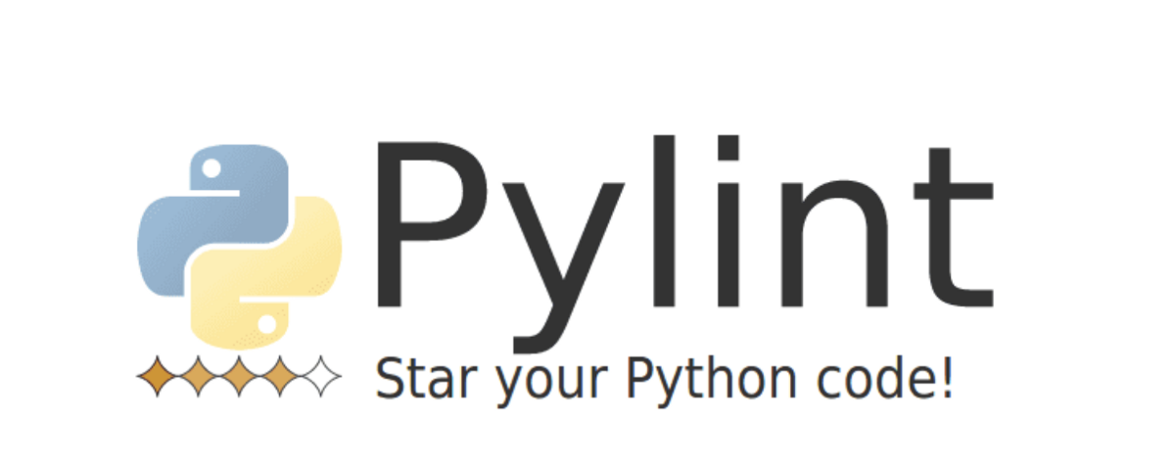
The lint stage checks for possible errors and formatting issues without running the code. The linting program used in this case is a popular tool called Pylint.
Notes:
CircleCI is a free tool that enables projects to run different commands and processes on each commit to a Git repository. To define the commands and processes, use a YAML file. Our YAML file defines four different processes to run: lint, test, build and deploy.
Pylint reports the lines that need changes along with the issue type found. From there, a developer can fix issues and improve code quality.

Slide 24
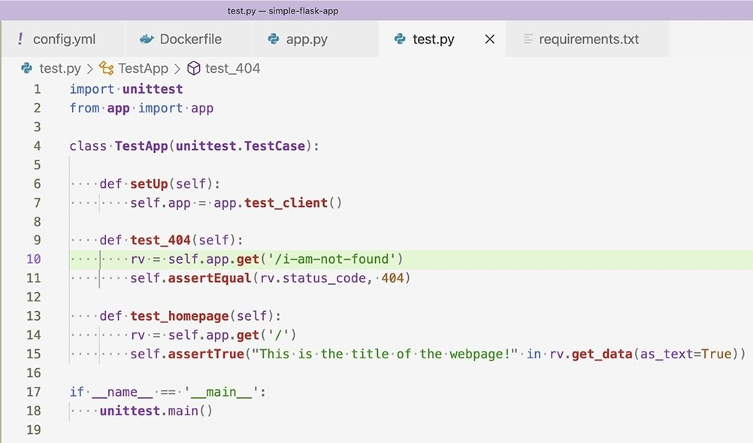
The next step in our CI/CD pipeline tutorial is testing. Our tests in this project are run with the unit test framework
Notes:
CircleCI is a free tool that enables projects to run different commands and processes on each commit to a Git repository. To define the commands and processes, use a YAML file. Our YAML file defines four different processes to run: lint, test, build and deploy.
Pylint reports the lines that need changes along with the issue type found. From there, a developer can fix issues and improve code quality.

Slide 25
Automated testing
Automated testing is the application of software tools to automate a human-driven manual process of reviewing and validating a software product
Different levels:
Unit test
Integration test: mocking these 3rd party dependencies and asserting the code interfacing with them behaves as expected
Performance test: i.e. speed and responsiveness

Slide 26
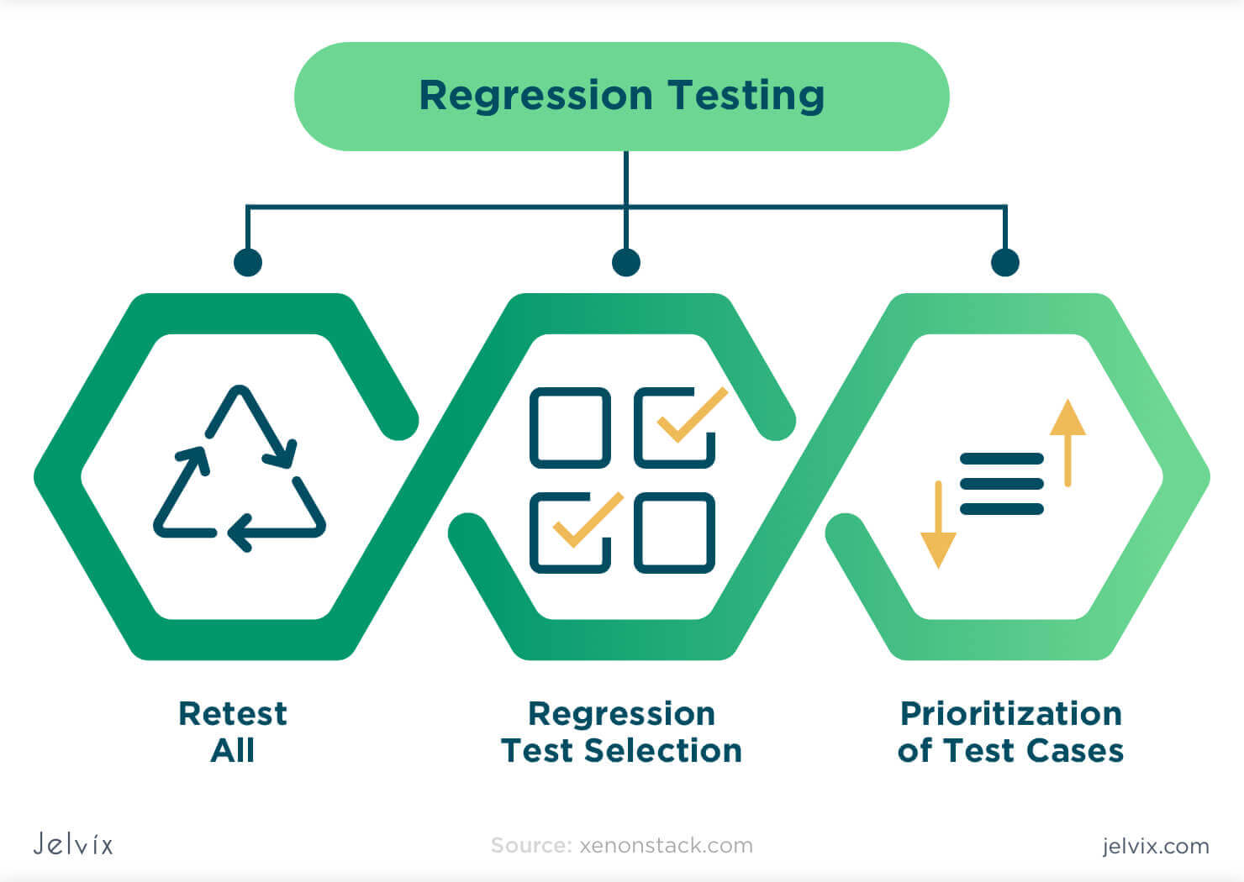
Regression testing
Re-running functional and non-functional tests to ensure that previously developed and tested software still performs after a change
Three types
Notes:
Retest All
It is one of the methods of this Testing in which all tests in an existing test bucket or suite re-executed. It is costly as it requires enormous time as well as resources.Regression Test Selection
Instead of re-executing an entire test suite, it is better to select a part of the test suite to run - Test chosen cases categorized asReusable Test cases
Obsolete Test cases
Reusable Test cases used in succeeding Regression cycles. Obsolete Test cases not used in succeeding cycles.Prioritization of Test cases
To prioritize test cases depending on a business impact, critical and frequency used functionalists. The selection of test cases based on priority will significantly reduce the regression test suite.

Slide 27
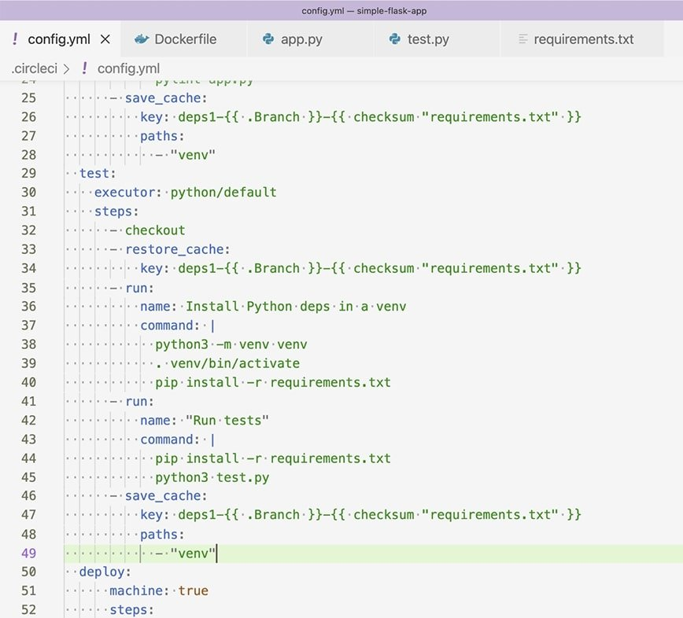
The next step in our CI/CD pipeline tutorial is testing. Our tests in this project are run with the unit test framework
Running tests on every commit is crucial to a project's success
Notes:
The tests check that our application returns a 404 response code and the root domain returns our HTML properly. The steps to run the tests in our CircleCI configuration YAML file are shown in Figure 6.

Slide 28
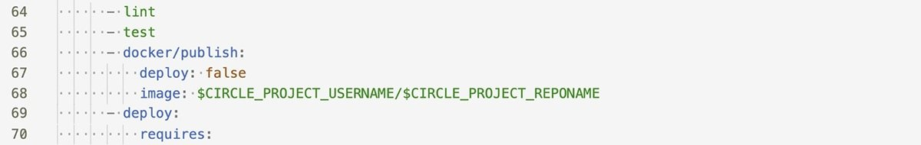
Build steP:
Lines 66-68 reference the Docker orb and define how the Docker job will run. Set the deploy attribute to false to instruct the Docker/publish job to build the image without pushing it to a repository. By default, the Docker/publish job finds the Dockerfile by name and builds it. It will also fail the job if the Docker build fails.
Notes:
The Dockerfile builds our Python application inside a Docker image and provides the command to run the application on container start. Docker provides a CircleCI orb, which is an abstraction of CircleCI commands contained within an importable job. For this reason, the steps to build the Dockerfile are as shown in Figure 8.

Slide 29
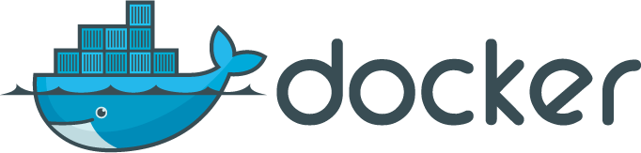
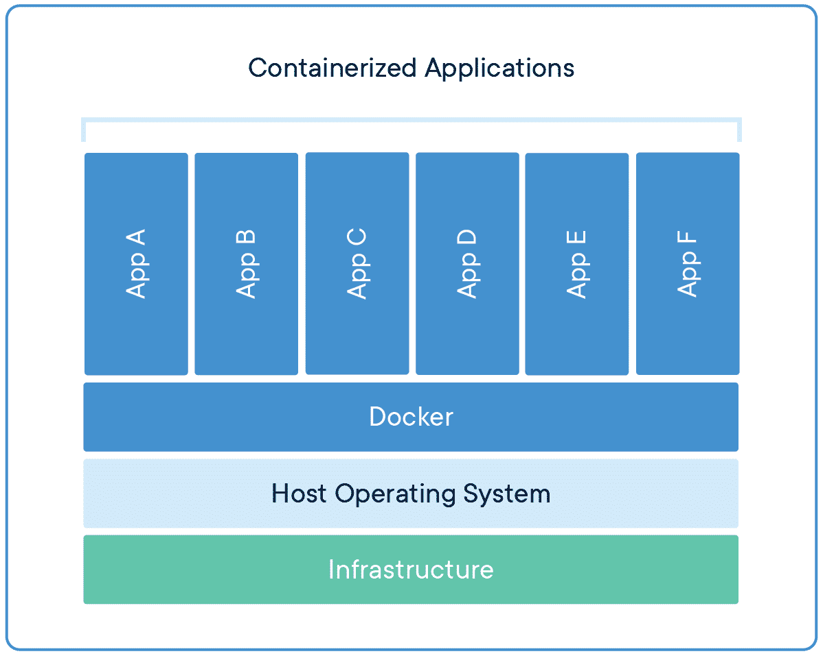
Docker
an open platform for developing, shipping, and running applications
separate your applications from your infrastructure
significantly reduce the delay between writing code and running it in production
container

Slide 30
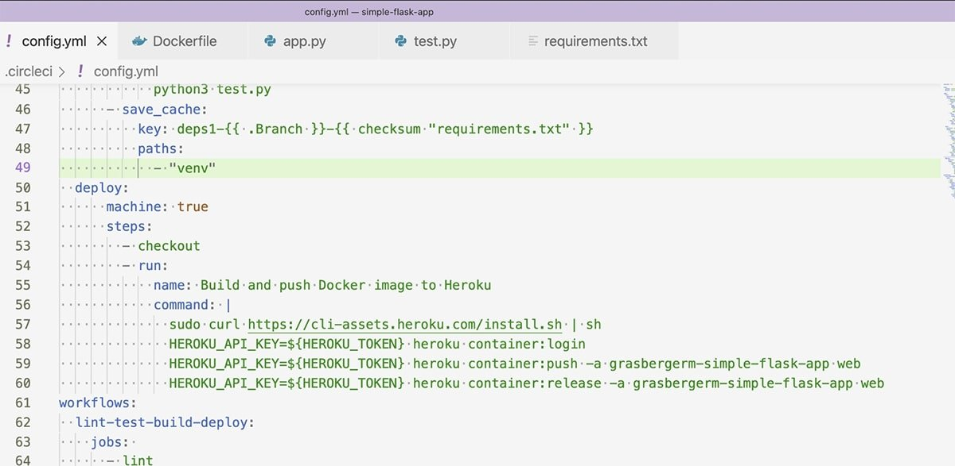
Deploy step:
https://www.techtarget.com/searchitoperations/tip/CI-CD-tutorial-How-to-set-up-a-pipeline
Notes:
After the three stages -- lint, test and build -- have succeeded, we can deploy our application. For this project, I used Heroku, which is an easy-to-set-up application hosting service. Heroku offers a command-line interface (CLI) that integrates with GitHub and supports different deployment methods. For our CI/CD tutorial, we're using the Heroku CLI to deploy a container to build and push our Docker image to Heroku. Heroku will then run the image as a container. The job to deploy our image to Heroku is seen in Figure 9.
On line 57, the Heroku CLI is installed. Then it runs the commands to build and release the container. The environment variable HEROKU_TOKEN is required to authenticate our Heroku credentials to push up our image. The value for HEROKU_TOKEN is found in the Heroku account settings and can be provided to CircleCI through the project's environment variables.
This project's CI/CD pipeline evaluates the application constantly for proper formatting and correctness. When those requirements are satisfied, a Docker image deploys automatically to Heroku, where the application runs. To further explore this example, you can examine the application and pipeline used.

Slide 31
Continuous delivery

Slide 32
Continuous delivery
Teams produce software in short cycles, ensuring that the software can be reliably released at any time and, when releasing the software, without doing so manually.
Continuous delivery is an extension of continuous integration since it automatically deploys all code changes to a testing and/or production environment after the build stage.

Slide 33
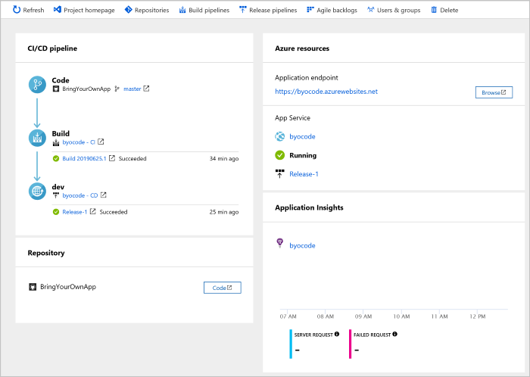
Other solutions for ci/Cd ….

Slide 34
Common pitfall of ci/cd
Wrong processes may be automated first
Confusion between Continuous Deployment and Continuous Delivery
Inadequate coordination between continuous integration and continuous delivery
Meaningful dashboards and metrics may be absent
Requires new skillset
Maintenance is not easy
Notes:
https://medium.com/@xenonstack/a-quick-guide-to-continuous-integration-and-continuous-delivery-4df594ae281

Slide 35
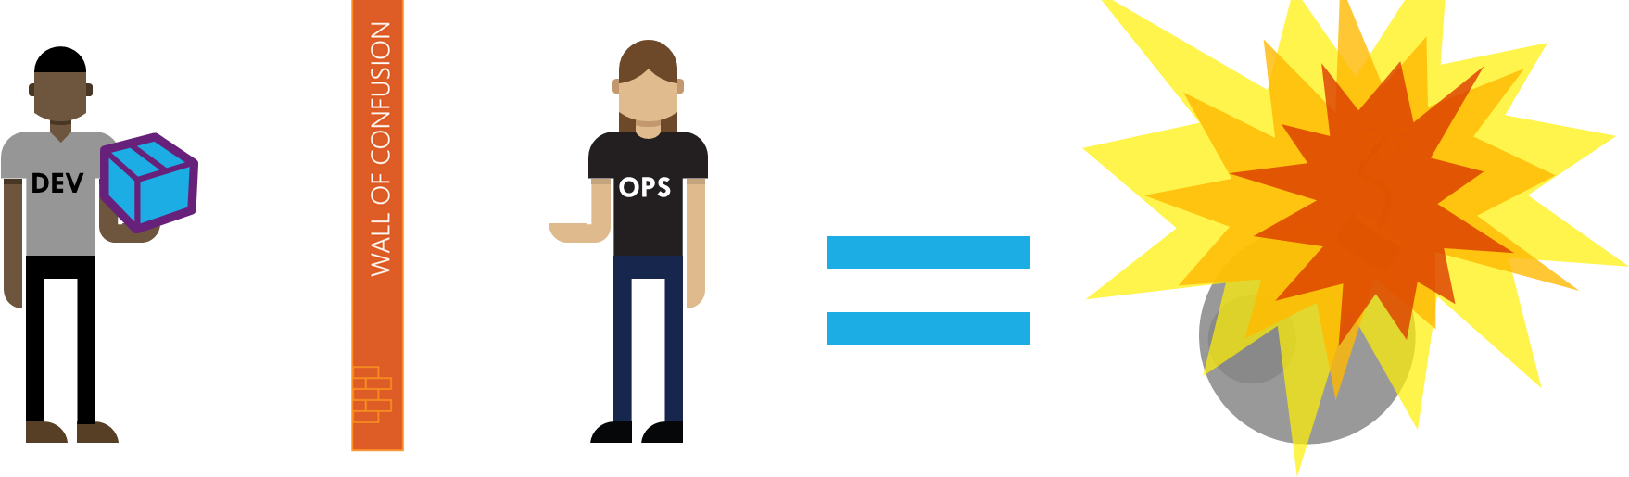
devops
a set of practices that combines software development (Dev) and IT operations (Ops)

Slide 36
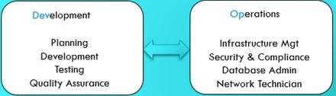
devops
a set of practices that combines software development (Dev) and IT operations (Ops)

Slide 37
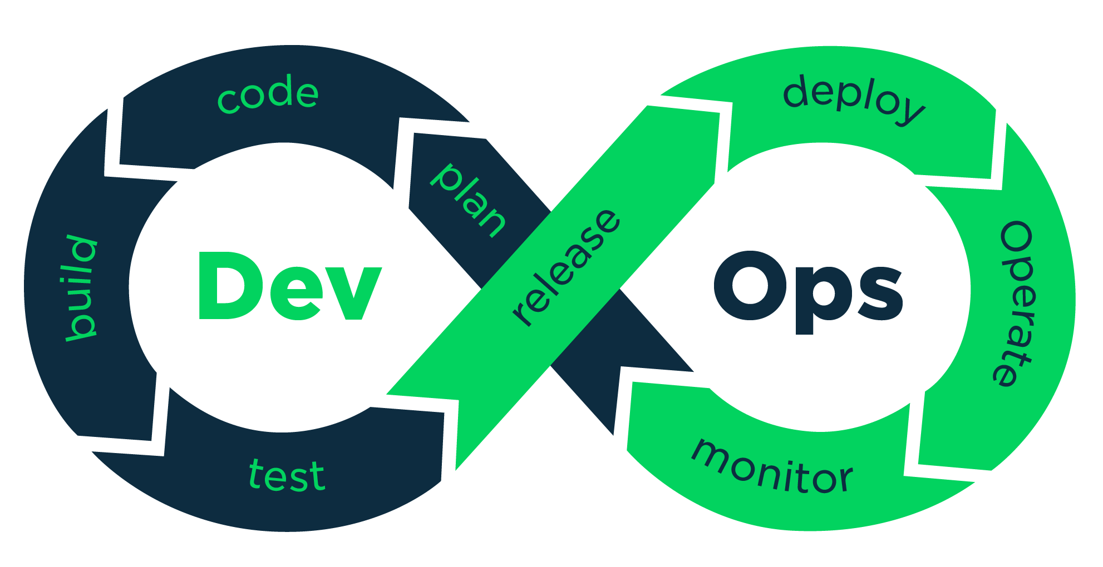
devops
a set of practices that combines software development (Dev) and IT operations (Ops)
Breaking the Silos: Dev and Ops
aims to shorten the systems development life cycle and provide continuous delivery with high software quality

Slide 38
Devs and ops working together
Create feedback loops between inventors and mechanics
Expose real-time metrics from ops enabling dev to learn from the system running under real world conditions
Expose real-time metrics from dev enabling ops to anticipate production needs and provide early input
Cross-functional teams collaborate to deliver whole working systems including all infrastructure, software code, and configurations

Slide 39

“DevOps is development and operations collaboration”
“DevOps is treating your infrastructure as code”
It’s DevOps!
It’s DevOps!
“DevOps is using automation”
It’s DevOps!
“DevOps is feature switches”
It’s DevOps!
“DevOps is small deployments”
“Kanban for Ops?”

Slide 40

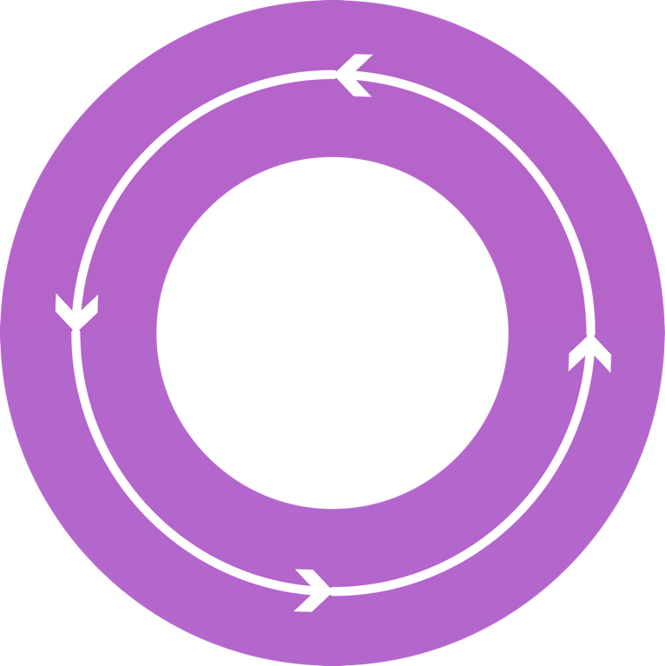



DevOps: the three stage conversation
DEV
OPS
1
People
2
Process
3
Products

Slide 41
List of DevOps Practices
Infrastructure as Code (IaC)
Continuous Integration
Automated Testing
Continuous Deployment
Release Management
App Performance Monitoring
Load Testing & Auto-Scale
Availability Monitoring
Change/Configuration Management
Feature Flags
Automated Environment De-Provisioning
Self Service Environments
Automated Recovery (Rollback & Roll-Forward)
Hypothesis Driven Development
Testing in Production
Fault Injection
Usage Monitoring/User Telemetry
http://www.itproguy.com/devops-practices/

Slide 42


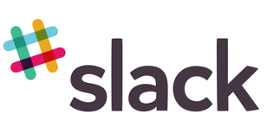































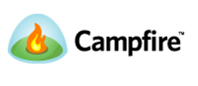



Visual Studio Partners and Extensions
65
Visual Studio Code Extensions
5,910
Visual Studio Gallery Extensions
90
Visual Studio Sim-Ship Partners
48
VS Team Services Extensions

Slide 43
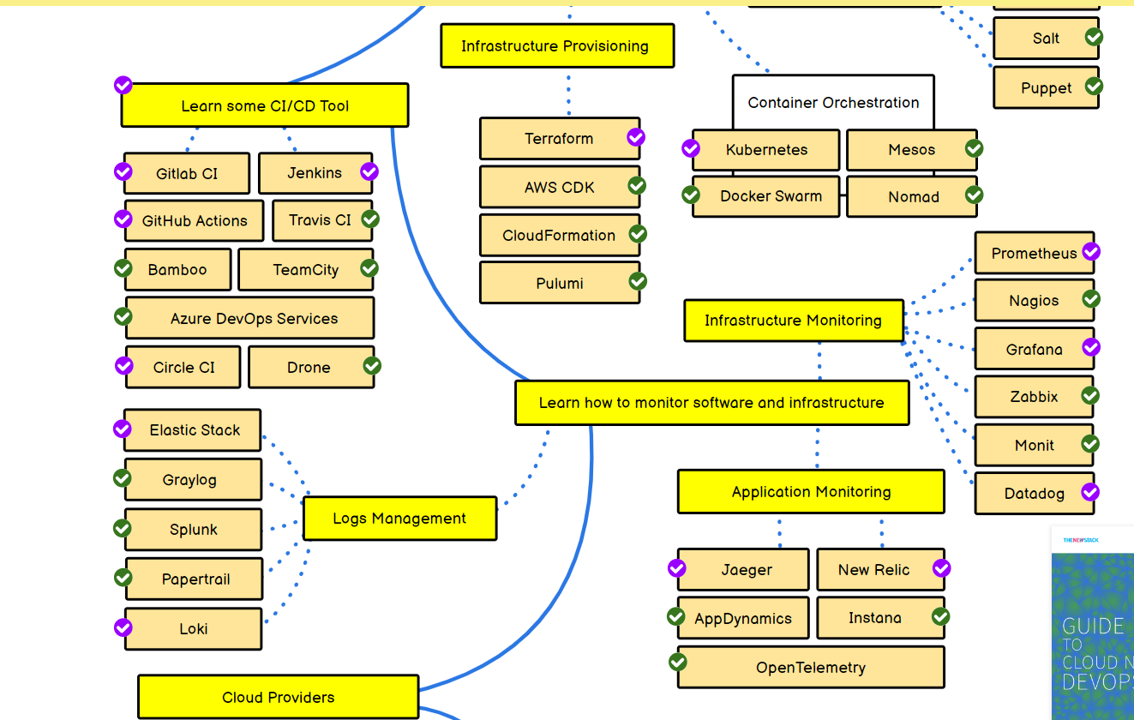
A better view
Step by step guide for DevOps, SRE or any other Operations Role in 2022
Notes:
https://roadmap.sh/devops

Slide 44
Q&A

