Slide 1
IT5427 • FINAL PRESENTATION
HANOI APARTMENT
RENTAL DATA INTEGRATION
A locally runnable PySpark prototype with city-grain context
26 OCT 2026 • VERIFIED RUN: public-20261026T084534Z
1 listing source
2 context sources
City-level join
Kaggle rental-oriented rows
OSM + WorldPop
No listing-level enrichment
Exploratory prototype • not a market-wide estimate • no streaming

Slide 2
01 / SCOPE
A clear integration problem with explicit limits
Listing titles and prices are inconsistent; only reliable shared keys are used.
Input problem
Implemented
Interpretation
• Apartment and transaction type are not structured
• Most amounts have no time basis
• Listing geography is free text
• Separate synthetic and public paths
• PySpark cleaning, review labels and Parquet
• OSM + WorldPop city context
• 102 title-reviewed likely rentals with usable amount and area
• Monthly statistics use verified records only
• No neighborhood or market-wide claims
Public prototype = one rental-oriented listing dataset + OSM and WorldPop context.
The context datasets are not independent rental-listing sources.
IT5427 • Hanoi • Local exploratory prototype
02 / 11

Slide 3
02 / DATA SOURCES
Three datasets, three roles
Only one source contains rental-oriented listings; public context joins at city grain.
Kaggle listings
OpenStreetMap
WorldPop
Vietnam House Rent Dataset
13,785 source rows; 3,284 Hanoi rows
Uploader declares CC0. Original platforms and third-party rights remain unresolved.
Geofabrik Vietnam PBF, snapshot 2026-09-30
ODbL 1.0; attribute OpenStreetMap contributors
Prepared into one Hanoi context row.
Vietnam population count, reference year 2020
CC BY 4.0; WorldPop / University of Southampton
408,151 valid Hanoi raster cells.
TiniX is excluded: rental-versus-sale status is not validated. The three-record Batdongsan pilot is not in the public manifest.
IT5427 • Hanoi • Local exploratory prototype
03 / 11

Slide 4
03 / 3V EVIDENCE
Volume and variety are demonstrated; listing Velocity is open
Counts include separate context inputs and must not be presented as rental listings.
Volume
Variety
Velocity
13,785 listing rows
3,284 Hanoi rows
102 curated numeric rows
408,151 WorldPop cells
1 integrated city row
Kaggle CSV
OSM PBF, prepared JSON and batch diff
WorldPop GeoTIFF and CSV.gz
Spark Parquet
Different formats and grains
OSM seq. 4926: 9,555 / 6,385 / 1,969
OSM seq. 4927: 14,572 / 5,901 / 2,284
(create / modify / delete)
Batch evidence only; no rental feed or repeat listing snapshot.
OSM batch changes do not establish streaming or rental-listing Velocity.
IT5427 • Hanoi • Local exploratory prototype
04 / 11

Slide 5
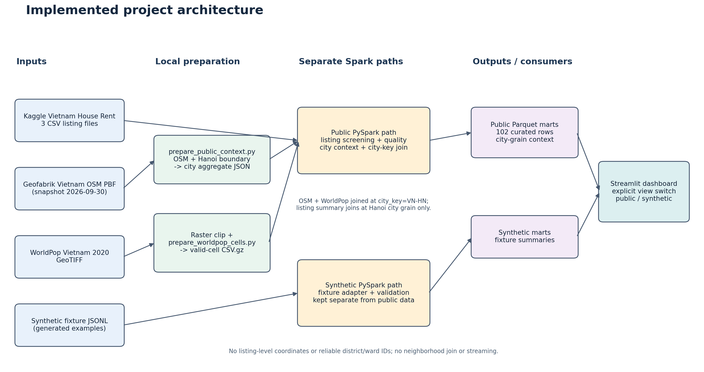
04 / ARCHITECTURE
Two separate data paths, one explicitly labelled dashboard
The public path joins OSM, WorldPop and the listing summary only at Hanoi city grain.
IT5427 • Hanoi • Local exploratory prototype
05 / 11

Slide 6
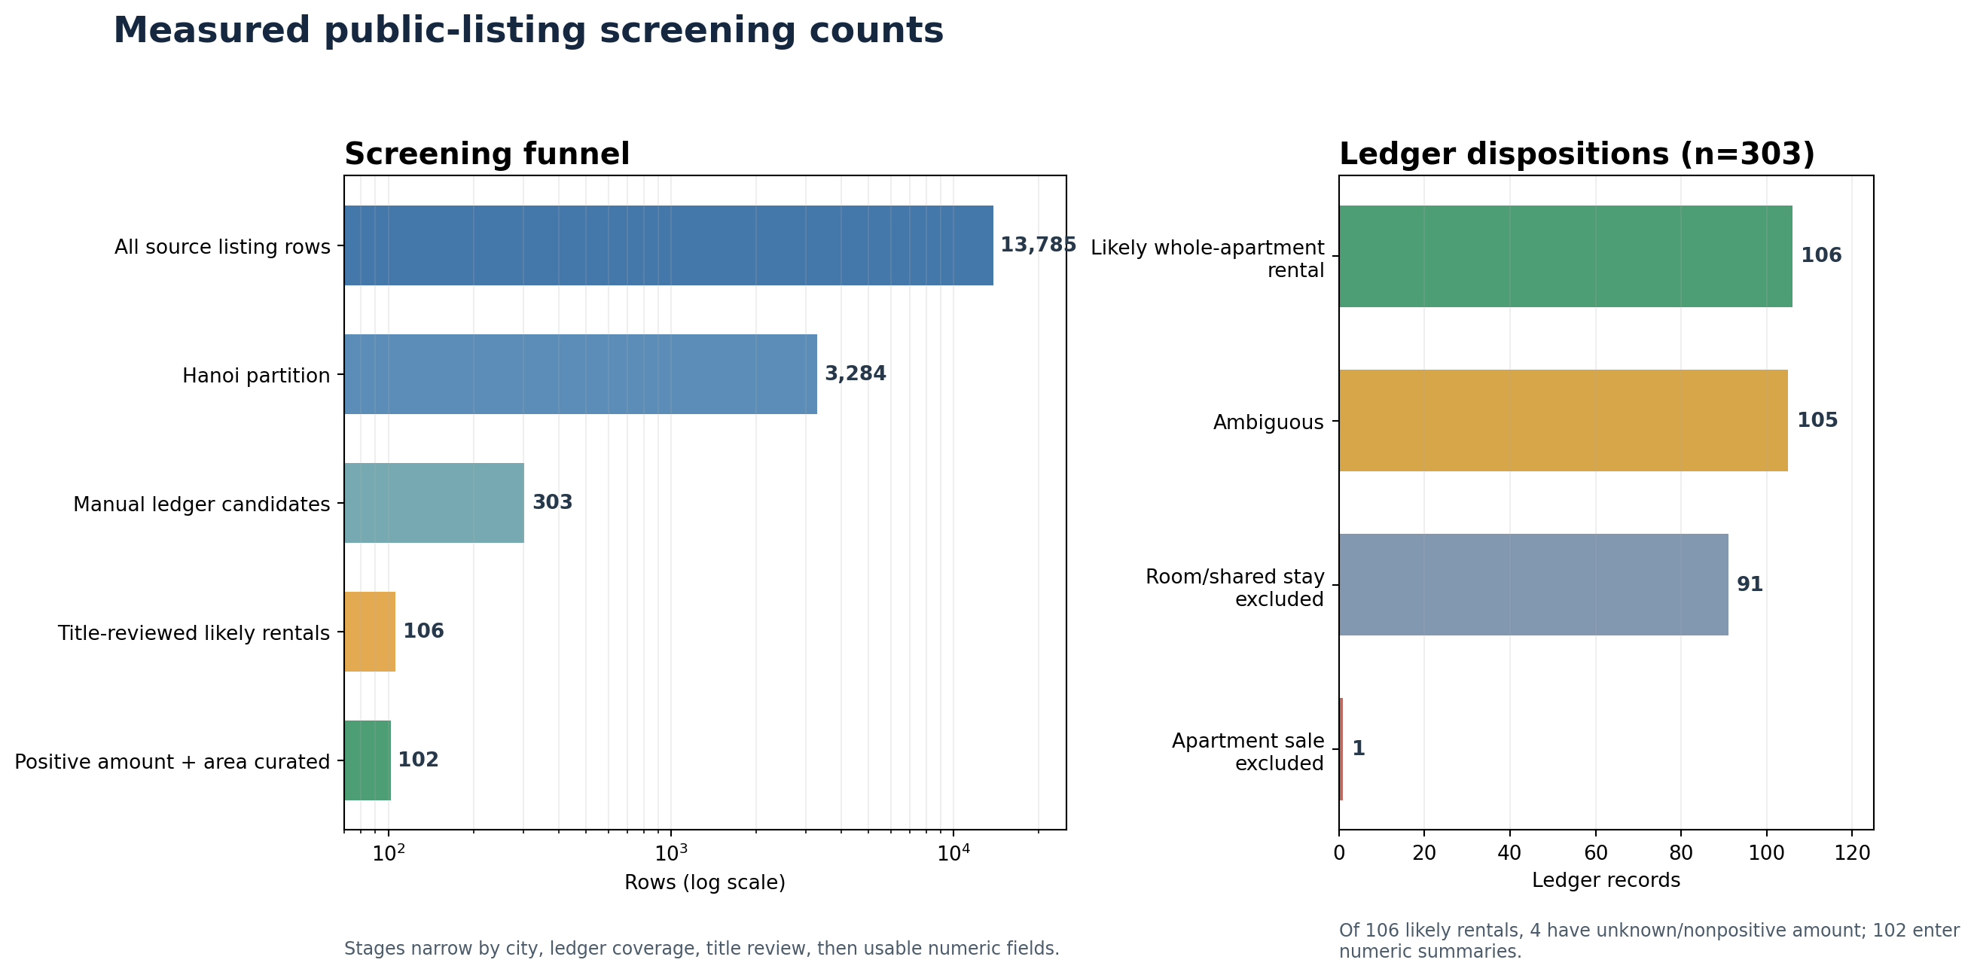
05 / DATA QUALITY
Screening counts show where review narrows the dataset
Manual review covers 303 apartment-cue candidates, not the full Hanoi partition.
IT5427 • Hanoi • Local exploratory prototype
06 / 11

Slide 7
06 / SPARK AND STORAGE
Latest run: 107.996 s Spark time; 140.8 s wall time
Manifest public-20261026T084534Z • PySpark 3.5.9 • local[2] • two shuffle partitions
Kaggle listings
OSM context
68.820 s
1.495 s
13,785 input rows → 102 curated rows
2,491,539 source bytes • 13,883 Parquet bytes
1 prepared Hanoi JSON row → 1 city row
PBF processed before Spark • 7,034 Parquet bytes
WorldPop
City integration
6.383 s
30.150 s
408,151 valid raster cells
3,410,996 Parquet bytes • city aggregate: 1 row
OSM + WorldPop + listing summary
city_key=VN-HN • integrated output: 1 row
Spark total 107.996 s • public command wall time 140.8 s • one local run, not a benchmark
IT5427 • Hanoi • Local exploratory prototype
07 / 11

Slide 8
07 / ENTITY HANDLING
Deduplication claims are limited to what the data supports
A public fingerprint links review rows; it is not a stable listing ID or a deduplication key.
Synthetic fixtures
Public Kaggle path
• Drop duplicates by (source, source_listing_id)
• Fixture IDs are generated for pipeline demonstration
• Pilot Batdongsan check is only three records
• No stable listing ID is present
• SHA-256 fingerprint links titles to the review ledger
• Fingerprint is not used to deduplicate
• No cross-platform entity resolution
No listing is matched across Kaggle, Batdongsan or TiniX.
IT5427 • Hanoi • Local exploratory prototype
08 / 11

Slide 9
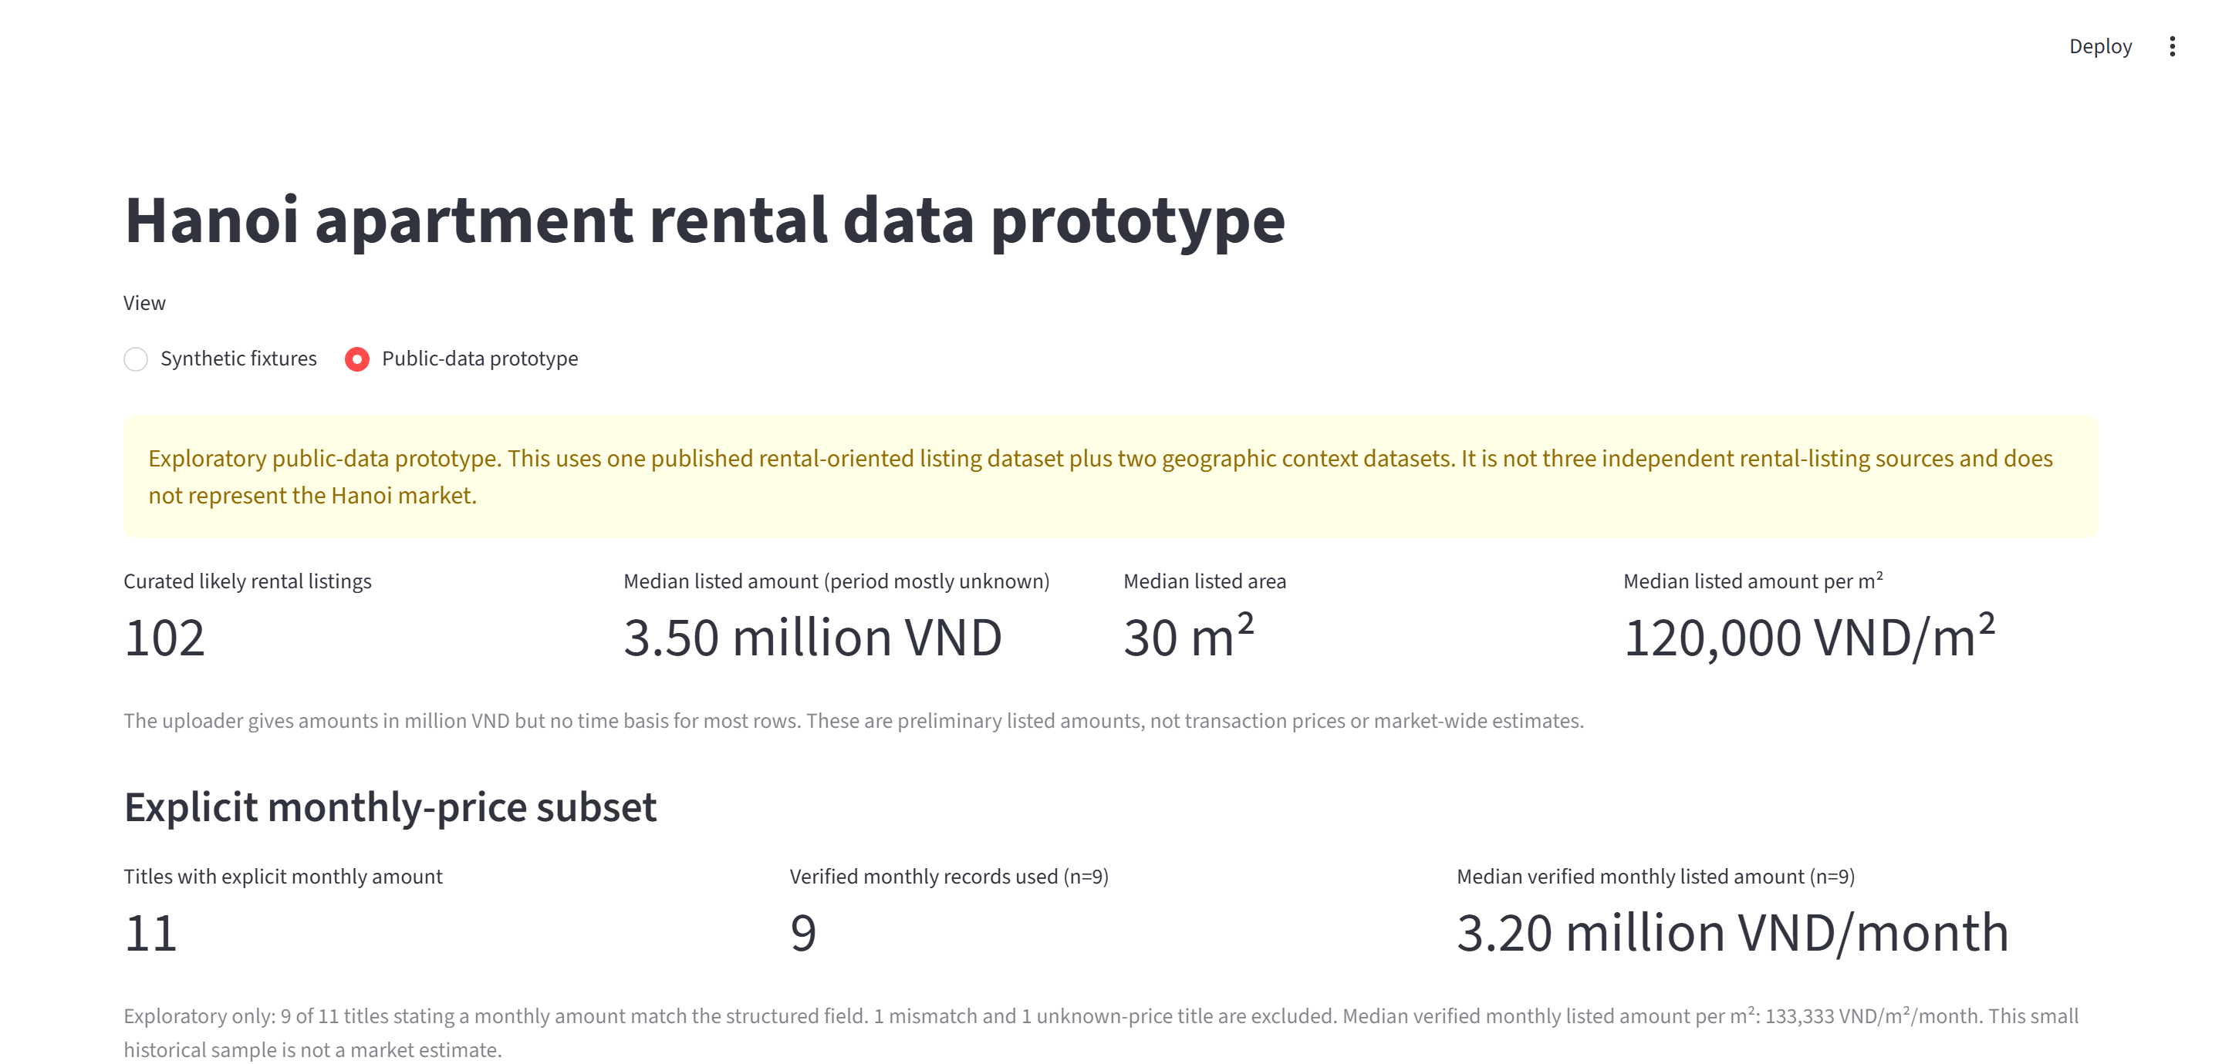
08 / DASHBOARD
Dashboard separates listed amounts from verified monthly prices
The screenshot is from the running local Streamlit public-data view.
IT5427 • Hanoi • Local exploratory prototype
09 / 11

Slide 10
09 / VERIFICATION
Both pipelines and both dashboard views passed local checks
All checks listed below were run against the moved project folder on 2026-10-26.
Pipeline and dashboard
Recorded OSM update
Synthetic: 7 raw / 7 active / 5 valid / 4 unique
Public: 13,785 raw / 3,284 Hanoi / 102 curated / 408,151 WorldPop cells / 1 integrated city row
Streamlit AppTest: both views pass • HTTP 200
Seq. 4926 → 4927
14,572 creates
5,901 modifies
2,284 deletes
22,757 unique operations; no duplicates
This is Vietnam-wide OSM batch evidence.
No streaming • no repeated rental snapshot • no evidence of rental-listing Velocity
IT5427 • Hanoi • Local exploratory prototype
10 / 11

Slide 11
10 / CONCLUSION
A runnable prototype with city-level joins and known limits
The verified work supports a cautious demonstration, not a market estimate.
What works
What remains unresolved
Next decision
• Reproducible local Spark paths
• Saved quality dispositions and lineage
• Separate synthetic and public dashboard views
• OSM / WorldPop joined at city grain
• Upstream Kaggle platform and rights
• Most listed amounts have unknown time basis
• No reliable listing coordinates
• Rental-listing Velocity
Confirm whether one listing dataset plus two context sources meets the course definition of multi-source.
If more listing sources are required, obtain a permitted source with documented provenance.
Conclusion: a locally demoable data integration prototype, not a three-source rental platform.
IT5427 • Hanoi • Local exploratory prototype
11 / 11

