Slide 1
IT5427 • FINAL PRESENTATION
HANOI APARTMENT
RENTAL DATA INTEGRATION
A locally runnable PySpark prototype with city-grain context
29 OCT 2026 • VERIFIED RUN: public-20261029T083945Z
1 listing source
1 aggregate source
2 context sources
Kaggle rental-oriented rows
NEST • optional, separate
OSM + WorldPop • city grain
Exploratory prototype • not a market-wide estimate • no streaming

Slide 2
01 / SCOPE
A clear integration problem with explicit limits
Listing titles and prices are inconsistent; only reliable shared keys are used.
Input problem
Implemented
Interpretation
• Apartment and transaction type are not structured
• Most amounts have no time basis
• Listing geography is free text
• Separate synthetic, public and optional NEST paths
• PySpark validation, review labels and Parquet
• OSM + WorldPop city context
• 102 title-reviewed likely rentals with usable amount and area
• Monthly statistics use verified records only
• No neighborhood or market-wide claims
Kaggle is one listing dataset; NEST is an independent aggregate rental source.
OSM and WorldPop are geographic context. NEST is not joined to listing rows or the Kaggle city mart.
IT5427 • Hanoi • Local exploratory prototype
02 / 11

Slide 3
02 / DATA SOURCES
Four sources, three distinct roles
Kaggle listings • NEST rental aggregates • OSM and WorldPop geographic context.
Kaggle listings
NEST aggregates
OpenStreetMap
WorldPop
Vietnam House Rent Dataset
13,785 source rows; 3,284 Hanoi rows
One rental-oriented listing dataset. Uploader declares CC0; upstream rights remain unresolved.
Hanoi Rent Index CSV
45 cells; 28 published; 17 suppressed
NEST's own monthly asking rents. Terms state no open reuse license; optional local input.
Geofabrik Vietnam PBF
Snapshot 2026-09-30
ODbL 1.0; attribute contributors. One prepared Hanoi context aggregate.
Vietnam population count
Reference year 2020; 408,151 valid cells
CC BY 4.0; University of Southampton.
NEST aggregate rows are not listing records. TiniX is excluded because rental-versus-sale status is unvalidated; the three-record Batdongsan pilot is not in the public manifest.
IT5427 • Hanoi • Local exploratory prototype
03 / 11

Slide 4
03 / 3V EVIDENCE
Volume and variety are demonstrated; listing Velocity is open
Counts include separate context inputs and must not be presented as rental listings.
Volume
Variety
Velocity
13,785 Kaggle source rows
3,284 Hanoi rows
102 curated listing rows
45 NEST aggregate cells
408,151 WorldPop cells
Kaggle listing CSV
NEST aggregate CSV
OSM PBF, prepared JSON and batch diff
WorldPop GeoTIFF and CSV.gz
Separate Spark Parquet marts
OSM seq. 4926: 9,555 / 6,385 / 1,969
OSM seq. 4927: 14,572 / 5,901 / 2,284
(create / modify / delete)
Batch evidence only; no rental feed or repeat listing snapshot.
NEST has one genuine aggregate capture (17 small-sample cells suppressed); no aggregate change comparison is available yet.
OSM batch changes do not establish streaming or rental-listing Velocity.
IT5427 • Hanoi • Local exploratory prototype
04 / 11

Slide 5
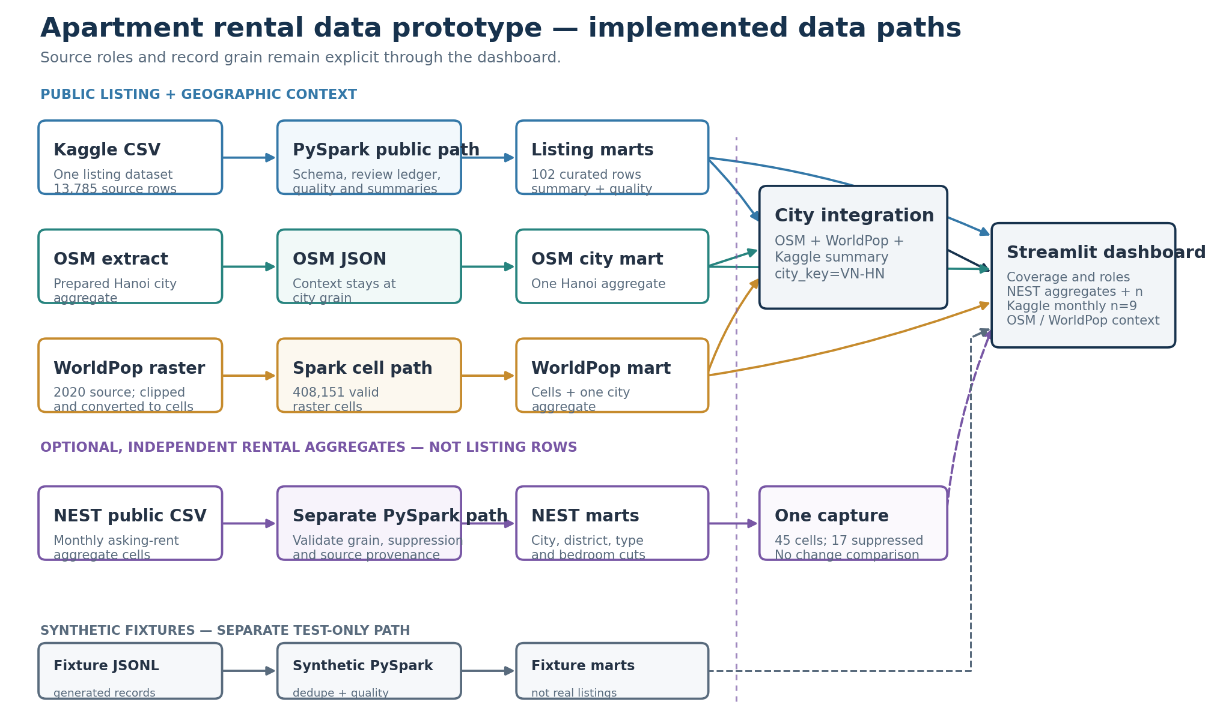
04 / ARCHITECTURE
Separate source grains through to the dashboard
Only OSM, WorldPop and the Kaggle summary join at Hanoi city grain; NEST stays separate.
IT5427 • Hanoi • Local exploratory prototype
05 / 11

Slide 6
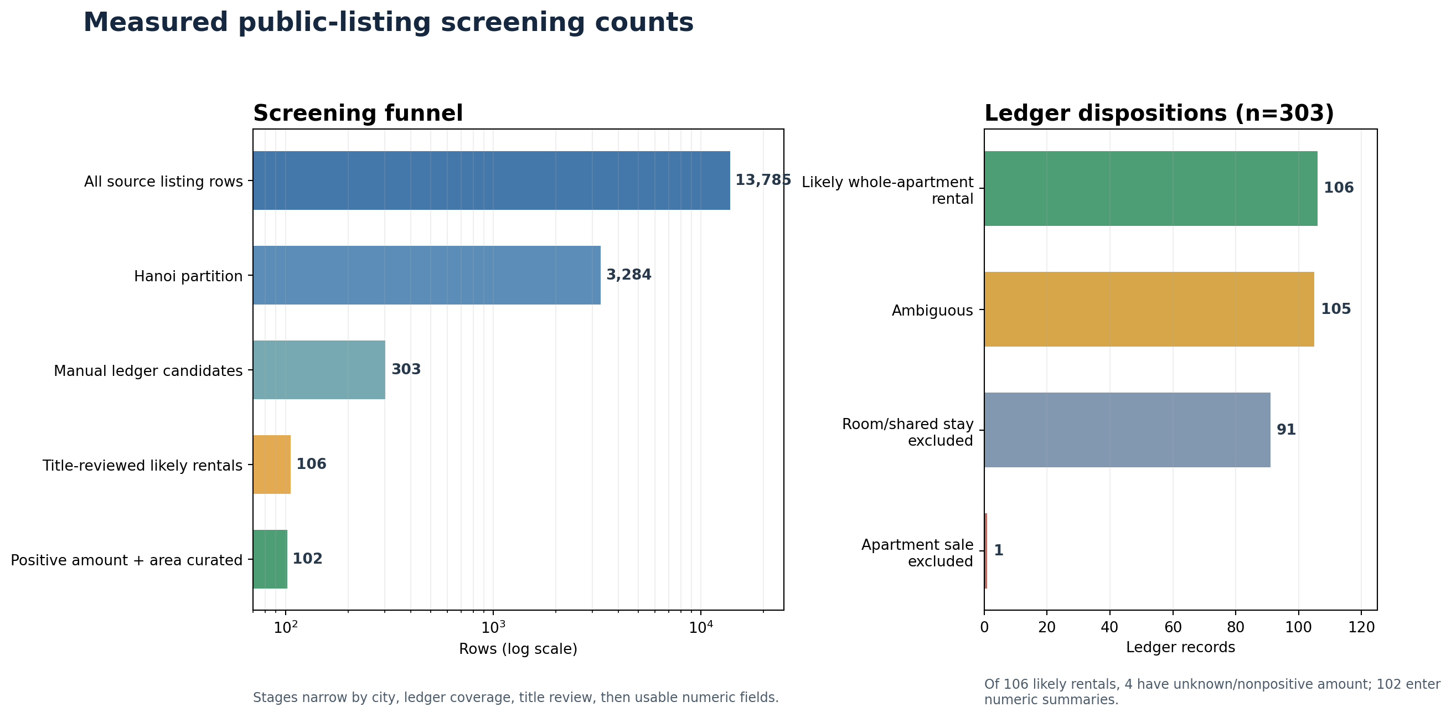
05 / DATA QUALITY
Screening counts show where review narrows the dataset
Manual review covers 303 apartment-cue candidates, not the full Hanoi partition.
IT5427 • Hanoi • Local exploratory prototype
06 / 11

Slide 7
06 / SPARK AND STORAGE
Latest public run: 109.395 s Spark time; 119.97 s elapsed
Manifest public-20261029T083945Z • PySpark 3.5.9 • local[2] • two shuffle partitions
Kaggle listings
OSM context
73.635 s
1.545 s
13,785 input rows → 102 curated rows
2,491,539 source bytes • 13,883 Parquet bytes
1 prepared Hanoi JSON row → 1 city row
PBF processed before Spark • 7,034 Parquet bytes
WorldPop
City integration
6.391 s
26.073 s
408,151 valid raster cells
3,410,996 Parquet bytes • city aggregate: 1 row
OSM + WorldPop + listing summary
city_key=VN-HN • integrated output: 1 row
Spark total 109.395 s • manifest elapsed 119.97 s • one local run, not a benchmark
IT5427 • Hanoi • Local exploratory prototype
07 / 11

Slide 8
07 / ENTITY HANDLING
Deduplication claims are limited to what the data supports
A public fingerprint links review rows; it is not a stable listing ID or a deduplication key.
Synthetic fixtures
Public Kaggle path
• Drop duplicates by (source, source_listing_id)
• Fixture IDs are generated for pipeline demonstration
• Pilot Batdongsan check is only three records
• No stable listing ID is present
• SHA-256 fingerprint links titles to the review ledger
• Fingerprint is not used to deduplicate
• No cross-platform entity resolution
No listing is matched across Kaggle, Batdongsan or TiniX.
IT5427 • Hanoi • Local exploratory prototype
08 / 11

Slide 9
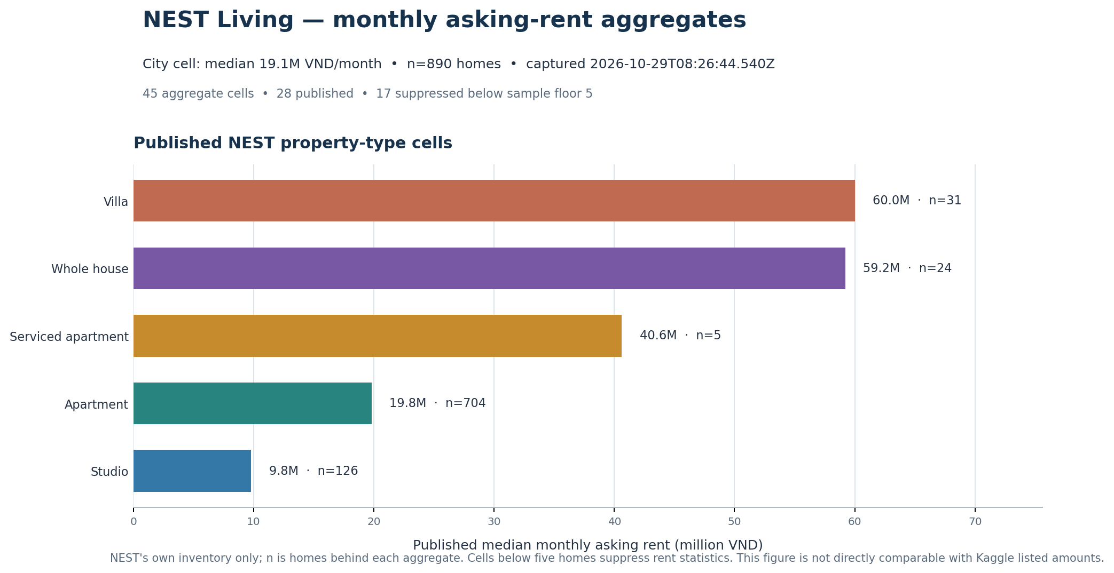
08 / DASHBOARD
NEST monthly aggregates show coverage and sample sizes
Data-derived from the 2026-10-29 CSV capture; Kaggle's n=9 monthly subset remains separate.
IT5427 • Hanoi • Local exploratory prototype
09 / 11

Slide 10
09 / VERIFICATION
Spark paths and both dashboard views passed local checks
Pipelines and AppTest rerun on 2026-10-29; the NEST comparison correctly reports one capture.
Pipeline and dashboard
Recorded OSM update
Synthetic: 7 raw / 7 active / 5 valid / 4 unique
Public: 13,785 raw / 3,284 Hanoi / 102 curated / 408,151 WorldPop cells / 1 integrated city row
NEST: 45 cells / 28 published / 17 suppressed
AppTest: both views pass
Seq. 4926 → 4927
14,572 creates
5,901 modifies
2,284 deletes
22,757 unique operations; no duplicates
This is Vietnam-wide OSM batch evidence.
NEST: one aggregate snapshot, no change counts • OSM batch changes remain separate from rental-listing Velocity
IT5427 • Hanoi • Local exploratory prototype
10 / 11

Slide 11
10 / CONCLUSION
A runnable prototype with city-level joins and known limits
The verified work supports a cautious demonstration, not a market estimate.
What works
What remains unresolved
Next decision
• Reproducible local Spark paths
• Saved quality dispositions and lineage
• Separate NEST aggregate marts
• OSM / WorldPop joined at city grain
• Kaggle upstream rights
• NEST CSV reuse grant is unstated
• Most Kaggle amounts have unknown time basis
• Only one NEST capture; no listing Velocity
Confirm the course definition of multi-source.
If another listing source is required, obtain permitted listing rows with documented provenance; NEST is aggregate-only.
Conclusion: one listing dataset + one independent aggregate rental source + geographic context; no three-platform claim.
IT5427 • Hanoi • Local exploratory prototype
11 / 11

