Slide 1
How to use Git and Github
Sara Taheri

Slide 2
Why using Git and Github

Slide 3
Situation 1:
You have written a paper. You name it “final”.
After a while, changing it again. → Name it “final_new”.
Making new changes. → Name it “final_really”!
Someone asks you a year later that if he can view your paper to learn from it. You open your folder and cannot remember which file was actually the final version of the paper!!

Slide 4
Situation 2:
Your project is now in a good state.
You want to add new codes and change some parts of the project.
The project gets so messy with lots of errors that you don’t know how to solve them
You wish to go back to the previous state of the project
Solution:
always save a copy of the good state project
Disadvantage:
You have to do this process many times with different names.

Slide 5
Situation 3:
You and your teammate are working on the same project.
You and Your teammate make some changes to the project separately.
You will notify your teammate of your changes. She will notify you of her changes.
Both of you have to manually find the changes and add them to your codes. This is frustrating!
What is the solution to avoid these situations?

Slide 6
What is Git, Version control and repository?
Git is a software that you install locally on your computer and you can handle version control of your files easily.
Version control:
Version control means to take a snapshot of your files every time you edit them.
Your files will be updated to the latest version while you always have access to previous versions whenever you need them.
This solves the problems in situation 1 and 2.
Repository:
When you start a Git project on your computer, you are going to store the entire history of the project locally. The storage of your project and its history is called a repository.

Slide 7
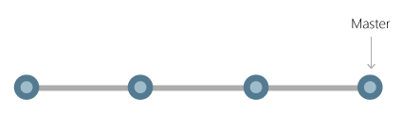
What is commit?
Every time you save your work, you can commit your changes to Git.
Commit : a snapshot of all your files at a point in time.
If a file has not changed from one commit to the next, Git uses the previously stored file.
Commits create links to other commits, forming a graph of your development history .
You can revert your code to a previous commit, inspect how files changed from one commit to the next, and review information such as where and when changes were made.

Slide 8
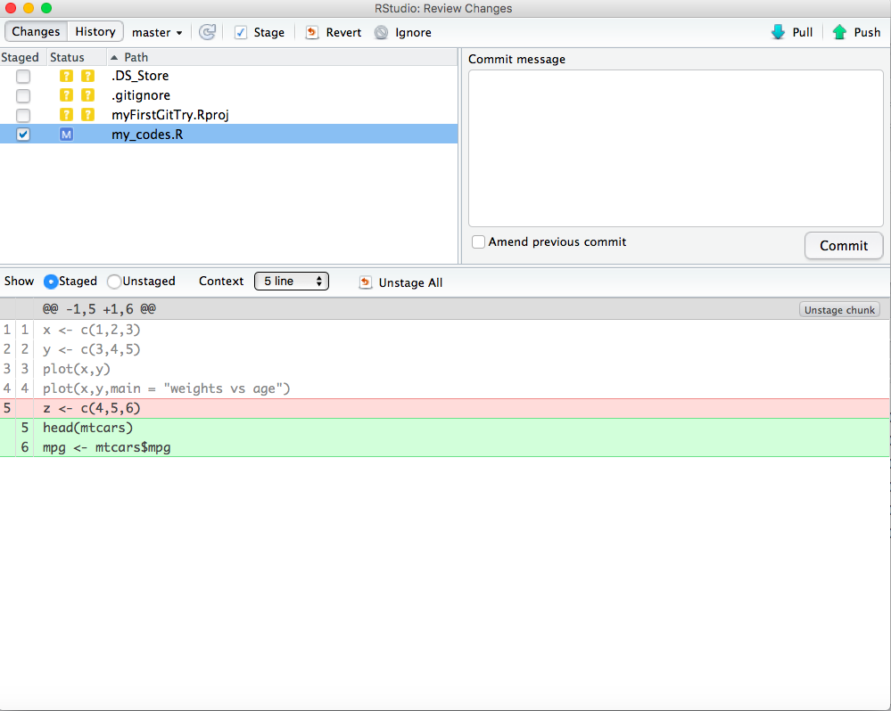
Inspect how files changes from one commit to the next
This line of code was
removed
These two lines were
added to the code

Slide 9
What is Github and Push?
Github is a remote server
You can save your project and all the history of changes that Git has made for you in your local history.
Once you commit something to repository, you can push them to Github.
Advantages:
If something happens to your computer you will not loose your data.
It lets you to work with a team easily.

Slide 10
What is Pull?
Your teammate: -make changes to the project. - -Commits the changes on her local repository. - -Pushes the changes to Github server.
You: -pull new changes from Github. - -update your project to the latest changes - -make your own changes. - -commit them on your local repository. - -push your commit to Github server.

Slide 11
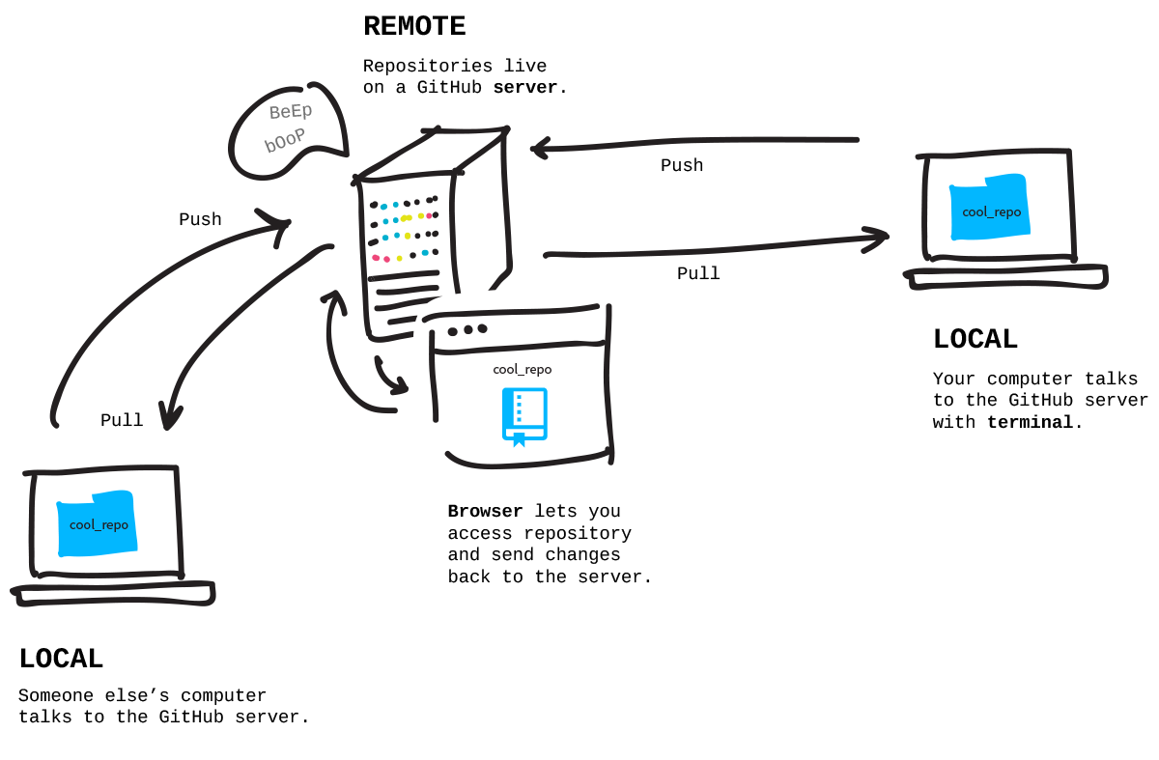
How push and pull works

Slide 12
Install and set up Git
Mac users:
Download Git from (https://git-scm.com/download/mac)
Windows users:
Download Git from (https://git-scm.com/download/win)

Slide 13
How to start using Github
- Register for a free Github account : https://github.com
- Creat a new repository. Name it "myFirstGitTry".
- Write a brief description (For example : "I am trying to learn git.")
- Choose "public”
- Check the box "Initialize this repository with a README”
- Click "create repository”
- Click on "clone and download"- Copy the "web URL"

Slide 14
Cloning the repository through R Studio
- Go to RStudio- File -> new project
- Click on "version control"”
- Click on "Git"(Clone a project from a repository)
- Paste the web URL in "Repository URL".
- Browse the "Create as a subdirectory of" and create a new folder called "May_Short_Course_NEU_2017”
- Choose "open in new session”
- Click on "create project"

Slide 15
Commit a change, push to Github
- Click on "README.md”
- Write another line of message (For example : "I cloned my project.")
- Save it (command+s in mac or Ctrl+s in windows)
- Click on the small GIT icon and choose "Commit”
- Check the icon "README" on left.
- Write a short message of what you have done so far. Click on "commit". Close the window.
- Again click on the small GIT icon and choose "Push Branch". Then close the window that appears.
- Go to the github website <https://github.com>, sign in and choose "myFirstGitTry" repository from bottom right.
- Your first commit is there!
- Click on README.md. You can see that your changes are successfully pushed to Github server.

Slide 16
Creat a new R script
- Creat a new R script and save it as "my_codes" in the "myFirstGitTry" folder.
- Try writting some simple codes.
- Click on the small GIT icon and choose "Commit”
- Check the icon "my_codes" on left.
- On the right, write some comments.
- Click on the commit button.
- Close the 2 windows related to committing.
- Click on the small GIT icon and choose "Push Branch". Then close the window that appears.
- Go to the github website <https://github.com>, and choose "myFirstGitTry" repository from bottom right.
- Your second commit ("I added plot1 to the project") is there!
- Click on "my_codes.R". You can see that your changes are successfully pushed to Github server.
- Try adding more lines to your code and then practice to committ your changes and push them to github server. Do this several times.

Slide 17
Working in a team and using Git
- Go to github [website](https://github.com/), log in, and choose your project "myFirstGitTry”
- Click on "Setting".
- In the Options column at the left, click on "Collaborators".
- It may ask you to confirm your password to continue adding a collaborator.
- Write down the github username (usually email address) of your collaborator to add him/her to this project.
- Click on "Add collaborator".
- An invitation will be emailed to your collaborator. Ask him/her to check his/her inbox and accept the invitation.

Slide 18
When conflicts happen
Your collaborator changes part of the project, then commited and pushed the changes to Github.
You make changes at the same place and when you try to commit and push your changes to Github you will receive an error.
A "conflict" has happened!

Slide 19
Solving conflicts
- On Github website <https://github.com>, choose your repository (myFirstGitTry), then click on "my_codes.R".
-Click on the icon that looks like a pen to edit your code.
-Add a line of code (like z <- c(3,4,5,6)).
- Go to the bottom of the page. Write your comments and then click on "commit changes" button.
- In R Studio, also edit "my_codes.R" and write a line of different code exactly in the same line number that you wrote a message in "my_codes.R" on github website.
- Commit your changes.
- Try to push.
-You will receive an error!
- Now try pulling. Again an error!

Slide 20
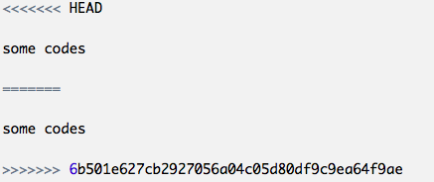
Solving conflicts
You will see a signs like this in your my_codes.R:
lines between these signs are the cause of conflict.
You can decide whether to keep the both lines or to delete one of them.
Delete all those signs and commit that you have solved the conflicts and then push it to server.

Slide 21
Useful references for further readings:
https://guides.github.com/
http://blog.udacity.com/2015/06/a-beginners-git-github-tutorial.html
http://kbroman.org/github_tutorial/

Slide 22
References:
https://www2.stat.duke.edu/courses/Fall15/sta112.01/post/slides/deck2.html#22
https://jahya.net/blog/git-vs-github/
http://r-bio.github.io/intro-git-rstudio/

