Slide 1
IV Examples
Yuta Toyama
May 24th, 2019

Slide 2











$$p_{}$$
$$S_{1}$$
$$S_{2}$$
$$S_{3}$$
$$(q_{1},p_{1})$$
$$(q_{2},p_{2})$$
$$(q_{2},p_{2})$$
$$D_{2}$$
$$D_{3}$$
$$D_{1}$$
$$q_{}$$

Slide 3

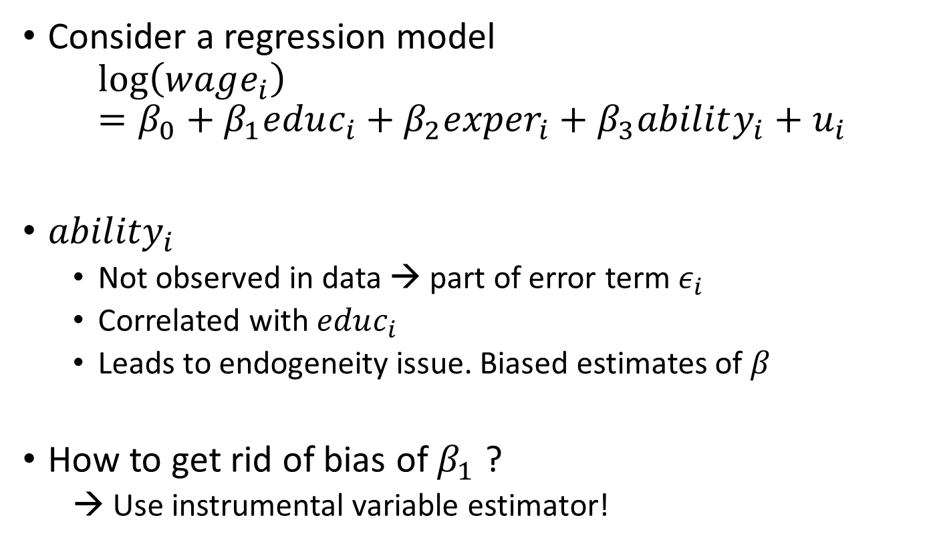
Example 1: Wage regression
Consider a regression model
$$\log\left(wage_{i}\right)=β_{0}+β_{1}educ_{i}+β_{2}{exper}_{i}+β_{3}ability_{i}+u_{i}$$
${ability}_{i}$
Not observed in data → part of error term $ε_{i}$
Correlated with $educ_{i}$
Leads to endogeneity issue. Biased estimates of $β_{}$
How to get rid of bias of $β_{1}$ ?
→ Use instrumental variable estimator!
$${≡ε}_{i}$$

Slide 4




Idea of Instrumental Variable (IV)
Consider $y_{i}=β_{0}+β_{1}x_{i}+ε_{i}$
$x_{i}$ : endogenous variable. $Cor\left(x_{i},ε_{i}\right)≠0$
Instrumental variable (IV) $z_{i}$
$Cor\left(z_{i},ε_{i}\right)=0$ and $Cor\left(z_{i},x_{i}\right)≠0$
indirect effect (bias)
Idea:
Pick variation of $x_{i}$ that is explained by $z_{i}.$
Use this variation to explain $y_{i}$ and estimate $β_{1}$.
$$ε$$
correlation
X
Y
$$β_{1}$$
causal effect
Z
Instrumental variable

Slide 5
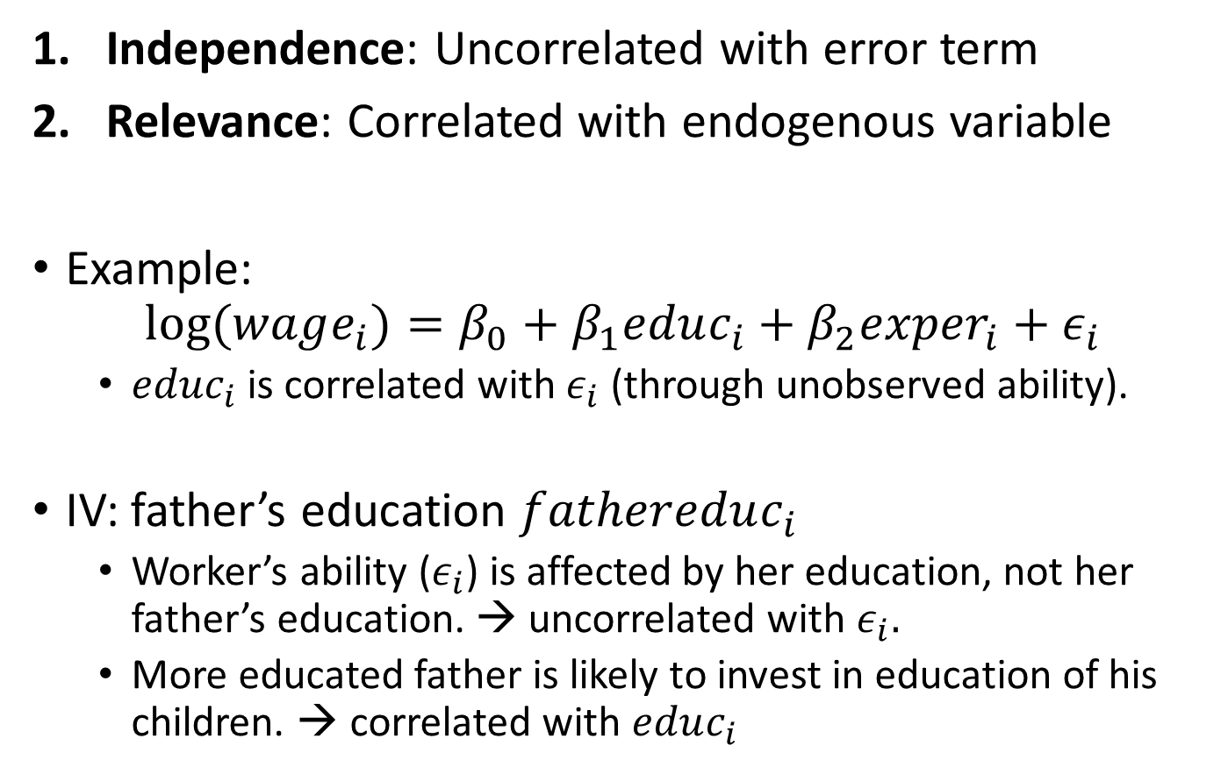
Two Conditions for IV and Example
Independence: Uncorrelated with error term
Relevance: Correlated with endogenous variable
Example:
$$log⁡(wage_{i})=β_{0}+β_{1}educ_{i}+β_{2}{exper}_{i}+ε_{i}$$
$educ_{i}$ is correlated with $ε_{i}$ (through unobserved ability).
IV: father’s education $fathereduc_{i}$
Worker’s ability ($ε_{i}$) is affected by her education, not her father’s education. → uncorrelated with $ε_{i}.$
More educated father is likely to invest in education of his children. → correlated with $educ_{i}$

Slide 6
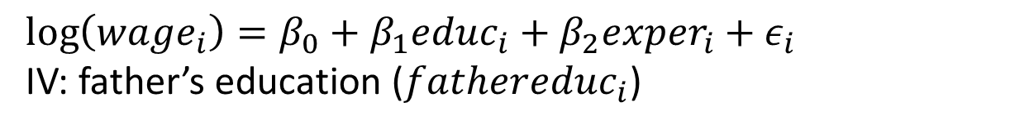
Example: Wage regressions (MROZ.dta)
$$\log\left(wage_{i}\right)=β_{0}+β_{1}educ_{i}+β_{2}{exper}_{i}+ε_{i}$$
IV: father’s education ($fathereduc_{i}$)
OLS might have an upward bias:
Education level is positively correlated with ability.
OLS: 1 additional year of schooling → 11% increase in wage.
IV: 7.5% increase in wage. IV helps to eliminate the upward bias.

Slide 7
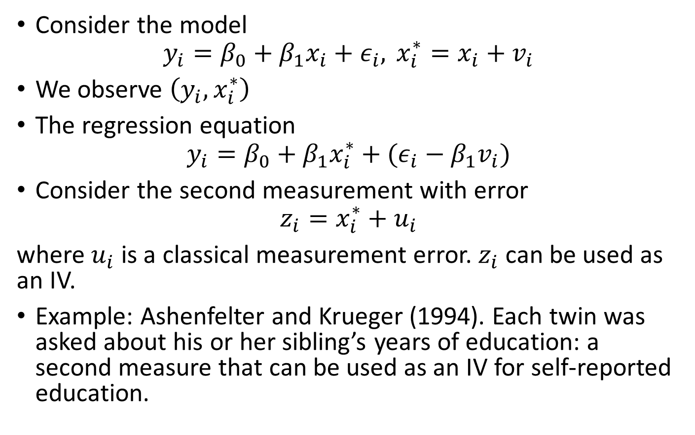
Example 2: Measurement Error
Consider the model
$$y_{i}=β_{0}+β_{1}x_{i}+ε_{i}, x_{i}^{∗}=x_{i}+v_{i}$$
We observe $\left(y_{i},x_{i}^{∗}\right)$
The regression equation
$$y_{i}=β_{0}+β_{1}x_{i}^{∗}+(ε_{i}−β_{1}v_{i})$$
Consider the second measurement with error
$$z_{i}=x_{i}^{∗}+u_{i}$$
where $u_{i}$ is a classical measurement error. $z_{i}$ can be used as an IV.
Example: Ashenfelter and Krueger (1994). Each twin was asked about his or her sibling’s years of education: a second measure that can be used as an IV for self-reported education.

Slide 8
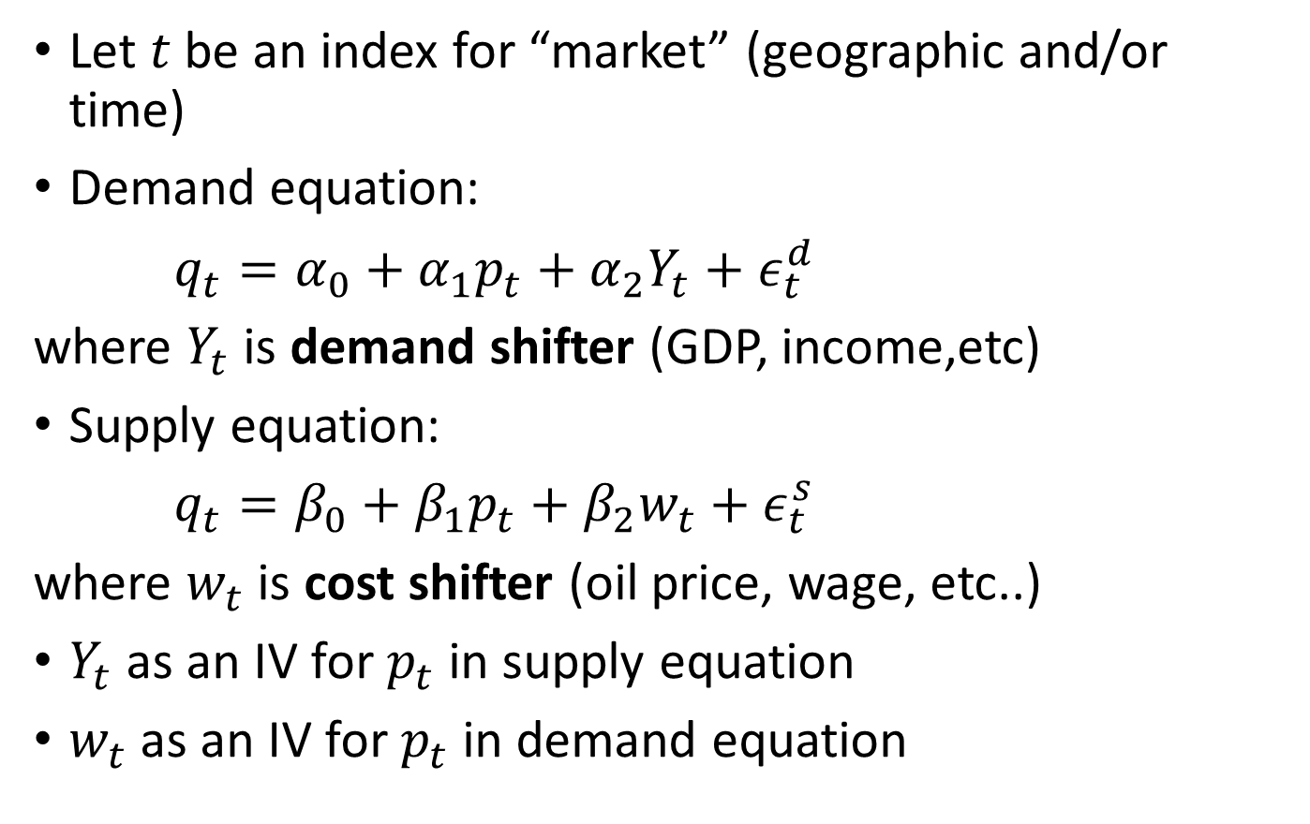
Example 3: Demand and Supply (Simultaneous equation)
Let $t$ be an index for “market” (geographic and/or time)
Demand equation:
$q_{t}=α_{0}+α_{1}p_{t}+α_{2}Y_{t}+ε_{t}^{d}$
where $Y_{t}$ is demand shifter (GDP, income,etc)
Supply equation:
$q_{t}=β_{0}+β_{1}p_{t}+β_{2}w_{t}+ε_{t}^{s}$
where $w_{t}$ is cost shifter (oil price, wage, etc..)
$Y_{t}$ as an IV for $p_{t}$in supply equation
$w_{t}$ as an IV for $p_{t}$in demand equation

Slide 9

Demand estimation from Ryan (2012, Econometrica)
Estimate the demand for cement in market j in year t
$$log\left(Q_{jt}\right)=α_{0}+α_{1}\log\left(P_{jt}\right)+α_{3}X_{jt}+ε_{jt}$$
Panel data!
IV: wage, electricity price, coal price, gas price
Elasticity is under-estimated in OLS.

Slide 10
1st stage regression
Regress endogenous variable on IV and exogenous variables.

