Slide 1
STA6206 - Bayesian Data Analysis - Practical 5 (Solutions)
Marc Henrion

Slide 2
Practical 5

Slide 3
Notation
$X,Y,Z$ - random variables
$x,y,z$ - measured / observed values
$\overline{X}$, $\overline{Y},\overline{Z}$ - sample mean estimators for X, Y, Z
$\overline{x}$, $\overline{y},\overline{z}$ - sample mean estimates of X, Y, Z
$\hat{T}$, $\hat{t}$ - given a statistic T, estimator and estimate of T
$P(A)$ - probability of an event A occuring
$f_{X}(.)$, $f_{Y}(.),f_{Z}(.)$ - probability mass / density functions of X, Y, Z; sometimes $p_{X}(.)$ etc. rather than $f_{X}(.)$
p(.) - used as a shorthand notation for pmfs / pdfs if the use of this is unambiguous (i.e. it is clear which is the random variable)
$X∼F$ - X distributed according to distribution function F
$E[X]$, $E[Y]$, $E[Z]$, $E[T]$ - the expectation of X, Y, Z, T respectively

Slide 4
Exercise 1
Fit the model from Practical 3, Exercise 3 using JAGS and the rjags package. Use this as the data from the sampling model:
$$y=(1,3,2,3,0,2,6,4,4,1,1,3,2,3,1,1,3,0)$$
Inspect the trace plot and plot the posterior distribution.
Compute the posterior mean and the quantile-based 95% Bayesian confidence interval.

Slide 5
Exercise 1 (Solution)
Write the following JAGS model into a file called jagsP5ex1.jags:
model{ # sampling model for(i in 1:N){ y[i]~dpois(lambda) } # prior lambda~dgamma(5,2) }
This specifies the model. Now we need to fit this model using MCMC.
For this we use R and the rjags library.

Slide 6
Exercise 1 (Solution)
library(rjags) ## Loading required package: coda ## Linked to JAGS 4.3.0 ## Loaded modules: basemod,bugs set.seed(123) dat<-list(N=18,y=c(1,3,2,3,0,2,6,4,4,1,1,3,2,3,1,1,3,0)) # 25 observations, 16 of which are 1 jagsMod<-jags.model("jagsP5ex1.jags",data=dat,n.chains=4,n.adapt=1000) ## Compiling model graph ## Resolving undeclared variables ## Allocating nodes ## Graph information: ## Observed stochastic nodes: 18 ## Unobserved stochastic nodes: 1 ## Total graph size: 22 ## ## Initializing model

Slide 7
Exercise 1 (Solution)
update(jagsMod,1000) parsPosterior<-coda.samples(model=jagsMod,variable.names=c("lambda"),n.iter=1e4) # check trace plot and empirical posterior distribution plot(parsPosterior)

Slide 8
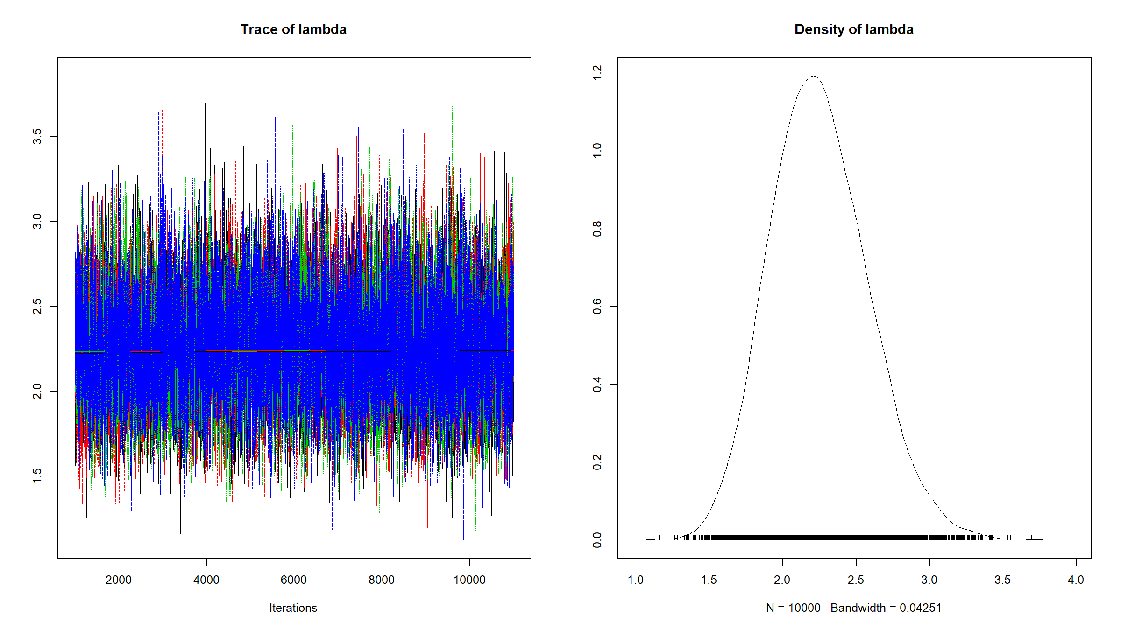

Slide 9
# posterior mean estimate summary(parsPosterior)$statistics["Mean"] ## Mean ## 2.248801 # posterior quantile based 95% credible interval summary(parsPosterior)$quantiles[c("2.5%","97.5%")] ## 2.5% 97.5% ## 1.641754 2.949591

Slide 10
Exercise 2
Generate the following data
N<-100 x<-rnorm(N) z<-2-4*x p<-1/(1+exp(-z)) y<-rbinom(n=N,size=1,prob=p) dat<-list(N=N,x=x,y=y)
Use R and JAGS to fit a Bayesian logistic regression model to this data:
$$g(E[Y|X])=β_{0}+β_{1}X$$
where $g(π)=log(π/(1−π))$

Slide 11
Exercise 2 (Solution)
JAGS model file (save as jagsP5ex2.jags):
model{ # logistic regression model for(i in 1:N){ y[i]~dbern(p[i]) p[i]<-1/(1+exp(-z[i])) z[i]<-b0+b1*x[i] } # priors b0~dnorm(0,0.0001) b1~dnorm(0,0.0001) }

Slide 12
Exercise 2 (Solution)
library(rjags) set.seed(123) jagsMod<-jags.model("jagsP5ex2.jags",data=dat,n.chains=4,n.adapt=1000) ## Compiling model graph ## Resolving undeclared variables ## Allocating nodes ## Graph information: ## Observed stochastic nodes: 100 ## Unobserved stochastic nodes: 2 ## Total graph size: 806 ## ## Initializing model
update(jagsMod,1000) parsPosterior<-coda.samples(model=jagsMod,variable.names=c("b0","b1"),n.iter=1e4) # check trace plot and empirical posterior distribution plot(parsPosterior)

Slide 13
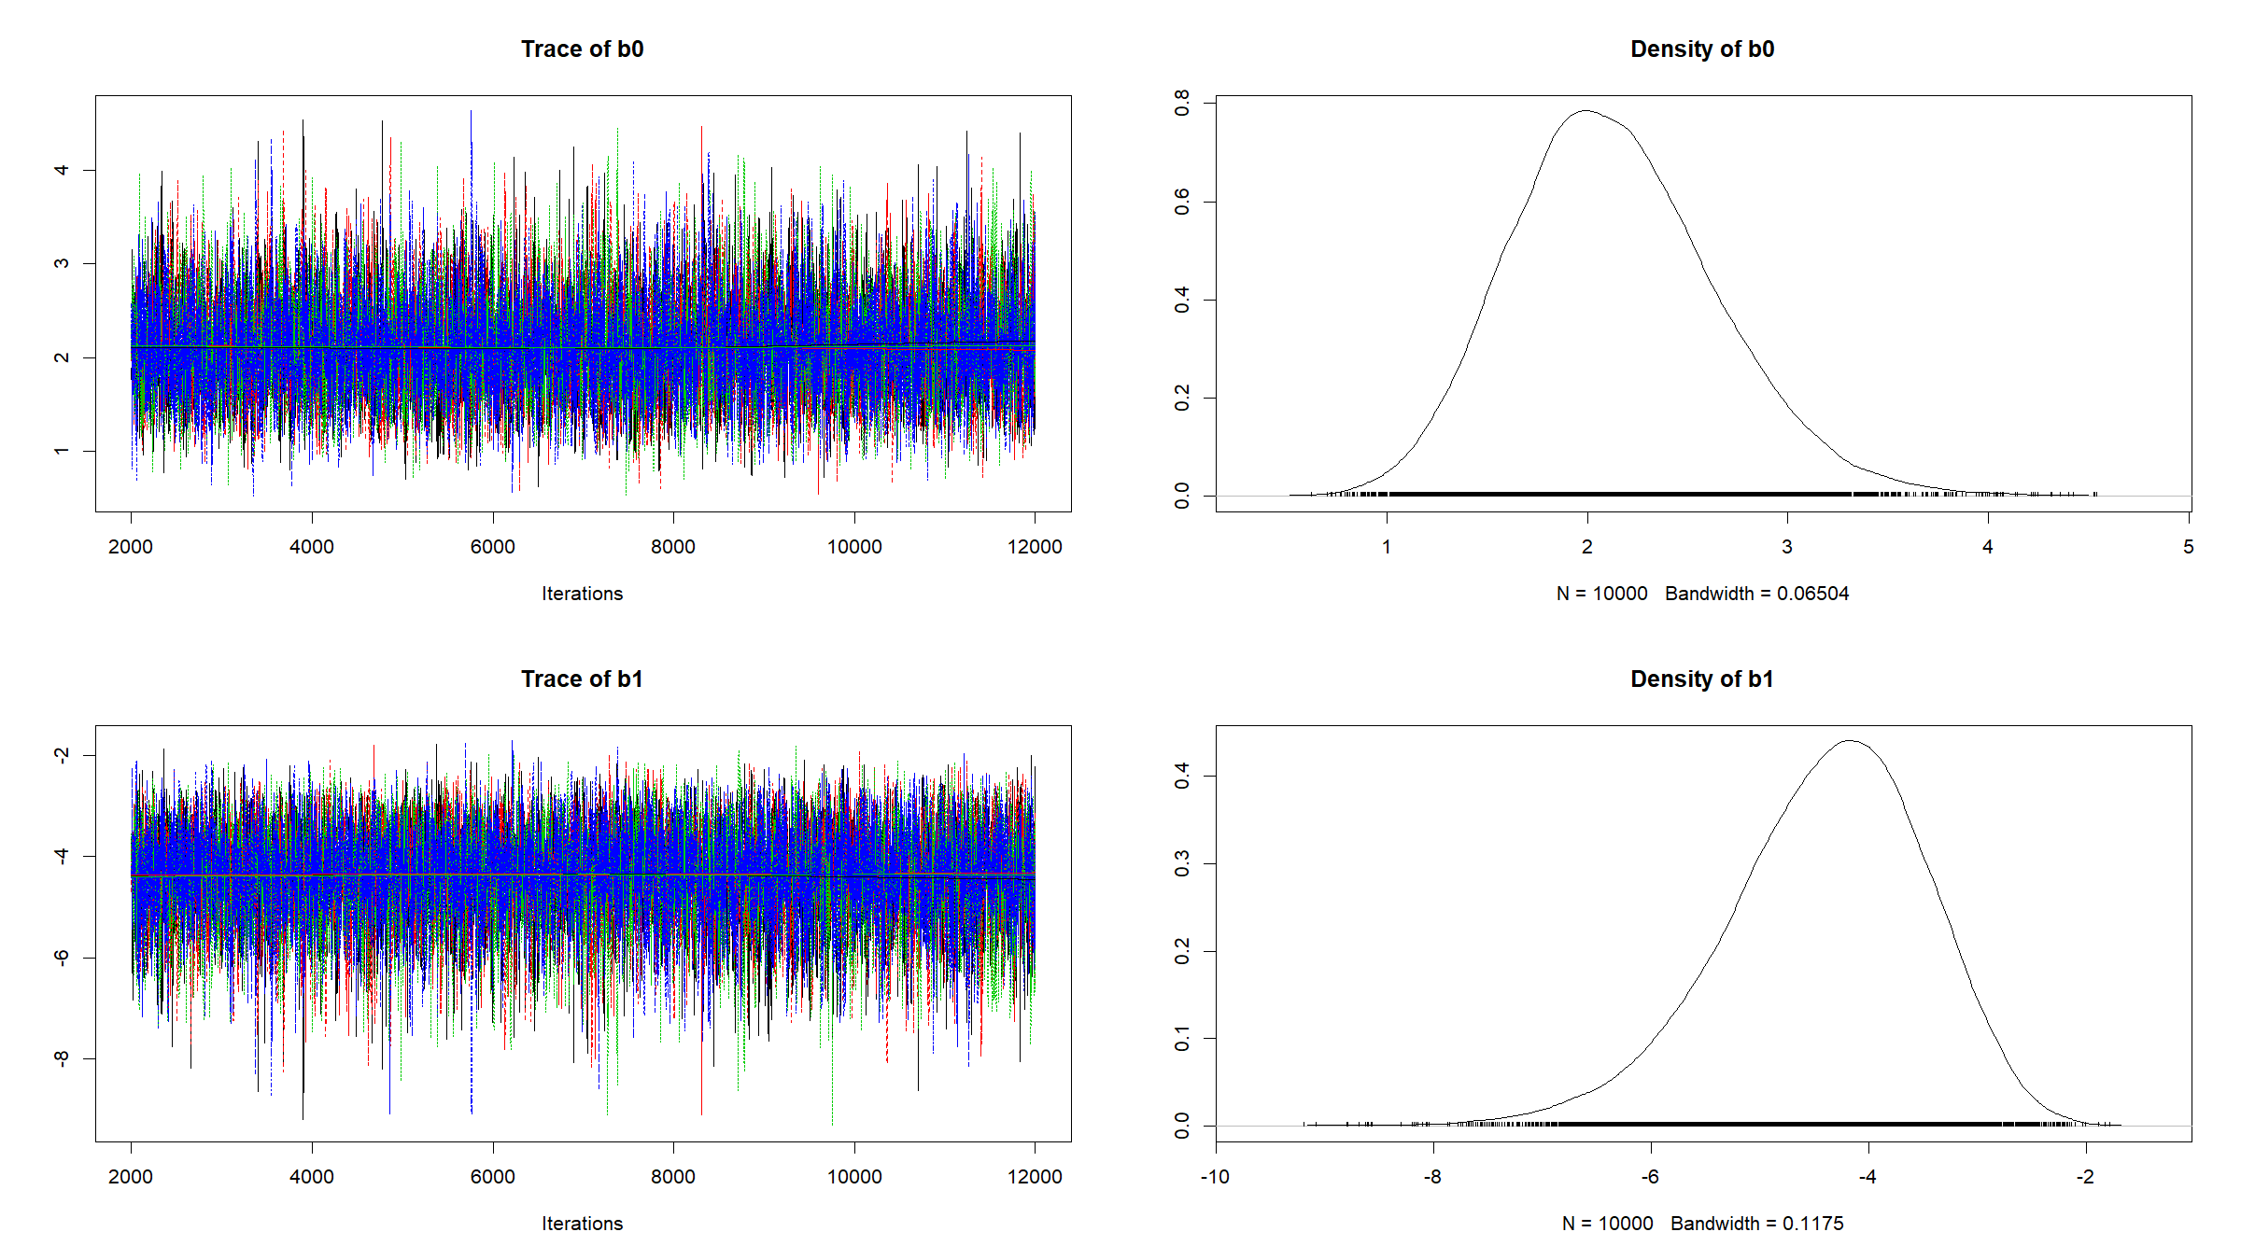

Slide 14
# posterior mean estimate summary(parsPosterior)$statistics[,"Mean"] ## b0 b1 ## 2.133407 -4.409281 # posterior quantile based 95% credible interval summary(parsPosterior)$quantiles[,c("2.5%","97.5%")] ## 2.5% 97.5% ## b0 1.216744 3.234703 ## b1 -6.478732 -2.809139

Slide 15
[end of STA6206 BDA Practical 5]

