Slide 1
STA6206 - Bayesian Data Analysis - Session 5
Marc Henrion

Slide 2
Preliminaries
These notes were written in R markdown.
All examples / code in these notes is R and a combination of STAN / JAGS / BUGS for Bayesian model specification.
GitHub repository - will contain all course materials by the end of the week:
https://github.com/gitMarcH/Chanco_STA6206

Slide 3
Session 5: Markov Chain Monte Carlo (cont’d)
Some references for Bayesian statistics / data analysis are:
Hoff, P.D. (2009). “A First Course in Bayesian Statistical Methods.” Springer.
Gelman, A., Carlin, J.B., Stern, H.S., Dunson, D.B., Vehtari, A., Rubin, D.B. (2014). “Bayesian Data Analysis”. 3rd ed. CRC Press.
Ramoni, M., Sebastiani, P. (2007), ‘Bayesian Methods’, in Berthold, M., Hand, D.J. (eds.). “Intelligent Data Analysis”, 2nd ed., Springer, pp.131-168
Stone, J.V. (2013). “Bayes’ Rule: A Tutorial Introduction to Bayesian Analysis”. Sebtel Press.

Slide 4
Notation
$X,Y,Z$ - random variables
$x,y,z$ - measured / observed values
$\overline{X}$, $\overline{Y},\overline{Z}$ - sample mean estimators for X, Y, Z
$\overline{x}$, $\overline{y},\overline{z}$ - sample mean estimates of X, Y, Z
$\hat{T}$, $\hat{t}$ - given a statistic T, estimator and estimate of T
$P(A)$ - probability of an event A occuring
$f_{X}(.)$, $f_{Y}(.),f_{Z}(.)$ - probability mass / density functions of X, Y, Z; sometimes $p_{X}(.)$ etc. rather than $f_{X}(.)$
p(.) - used as a shorthand notation for pmfs / pdfs if the use of this is unambiguous (i.e. it is clear which is the random variable)
$X∼F$ - X distributed according to distribution function F
$E[X]$, $E[Y]$, $E[Z]$, $E[T]$ - the expectation of X, Y, Z, T respectively

Slide 5
MARKOV CHAIN MONTE CARLO (cont’d)

Slide 6
MCMC: JAGS
Just another Gibbs sampler (JAGS) is a program to simulate from Bayesian models using MCMC.
It was devloped by Martyn Plummer, a biostatistician at WHO / IARC. JAGS is based on Bayesian inference using Gibbs sampling (BUGS) developed by the MRC Biostatistics Unit at Cambridge University and uses largely the same syntax.
Unlike BUGS, JAGS is platform independent. It provides no user interface and has to be interacted with via other software such as R or Python.
Common R libraries for this are rjags (developed by Plummer) and R2jags. The coda library is also needed.

Slide 7
MCMC: JAGS
JAGS can be downloaded from http://mcmc-jags.sourceforge.net/.
The user manual is (highly) recommended reading.
https://sourceforge.net/projects/mcmc-jags/files/Manuals/4.x/jags_user_manual.pdf/download
Note that JAGS coding syntax is very similar to R syntax but with some differences, particularly for specifying distribution functions (e.g. normal distribution takes mean and precision not mean and standard deviation).
While JAGS mostly relies on the Gibbs sampler, it will actually try to figure out what is the best sampler to use for your problem. It will also use other samplers such as Metropolis-Hastings or Slicer…

Slide 8
MCMC: JAGS
Fitting a JAGS model in R requires 3 things:
Dataset.
JAGS model file.
R script to pre-process the data, call JAGS, process the resulting samples from the posterior density.

Slide 9
MCMC: JAGS
Example
Fit the model from Practical 3, Exercise 2 using JAGS and the rjags package.
Inspect the trace plot and plot the posterior distribution.
Compute the posterior mean and the quantile-based 95% Bayesian confidence interval.

Slide 10
MCMC: JAGS
Write the following JAGS model into a file called jagsS5ex1.jags:
model{ # sampling model for(i in 1:N){ y[i]~dbern(pi) } # prior pi~dbeta(2,3) }
This specifies the model. Now we need to fit this model using MCMC.
For this we use R and the rjags library.

Slide 11
MCMC: JAGS
library(rjags) set.seed(123) dat<-list(N=25,y=c(rep(1,16),rep(0,25-16))) # 25 observations, 16 of which are 1 # specify the model jagsMod<-jags.model("jagsS5ex1.jags",data=dat,n.chains=4,n.adapt=1000) ## Compiling model graph ## Resolving undeclared variables ## Allocating nodes ## Graph information: ## Observed stochastic nodes: 25 ## Unobserved stochastic nodes: 1 ## Total graph size: 29 ## ## Initializing model

Slide 12
MCMC: JAGS
# run some 'burn-in' samples update(jagsMod,1000) # extract samples from the posterior parsPosterior<-coda.samples(model=jagsMod,variable.names=c("pi"),n.iter=1e4,thin=10) # this chain is thinned just as an example # avoid thinning in practice # check trace plot, empirical posterior distribution, potential scale reduction factor plot(parsPosterior)

Slide 13
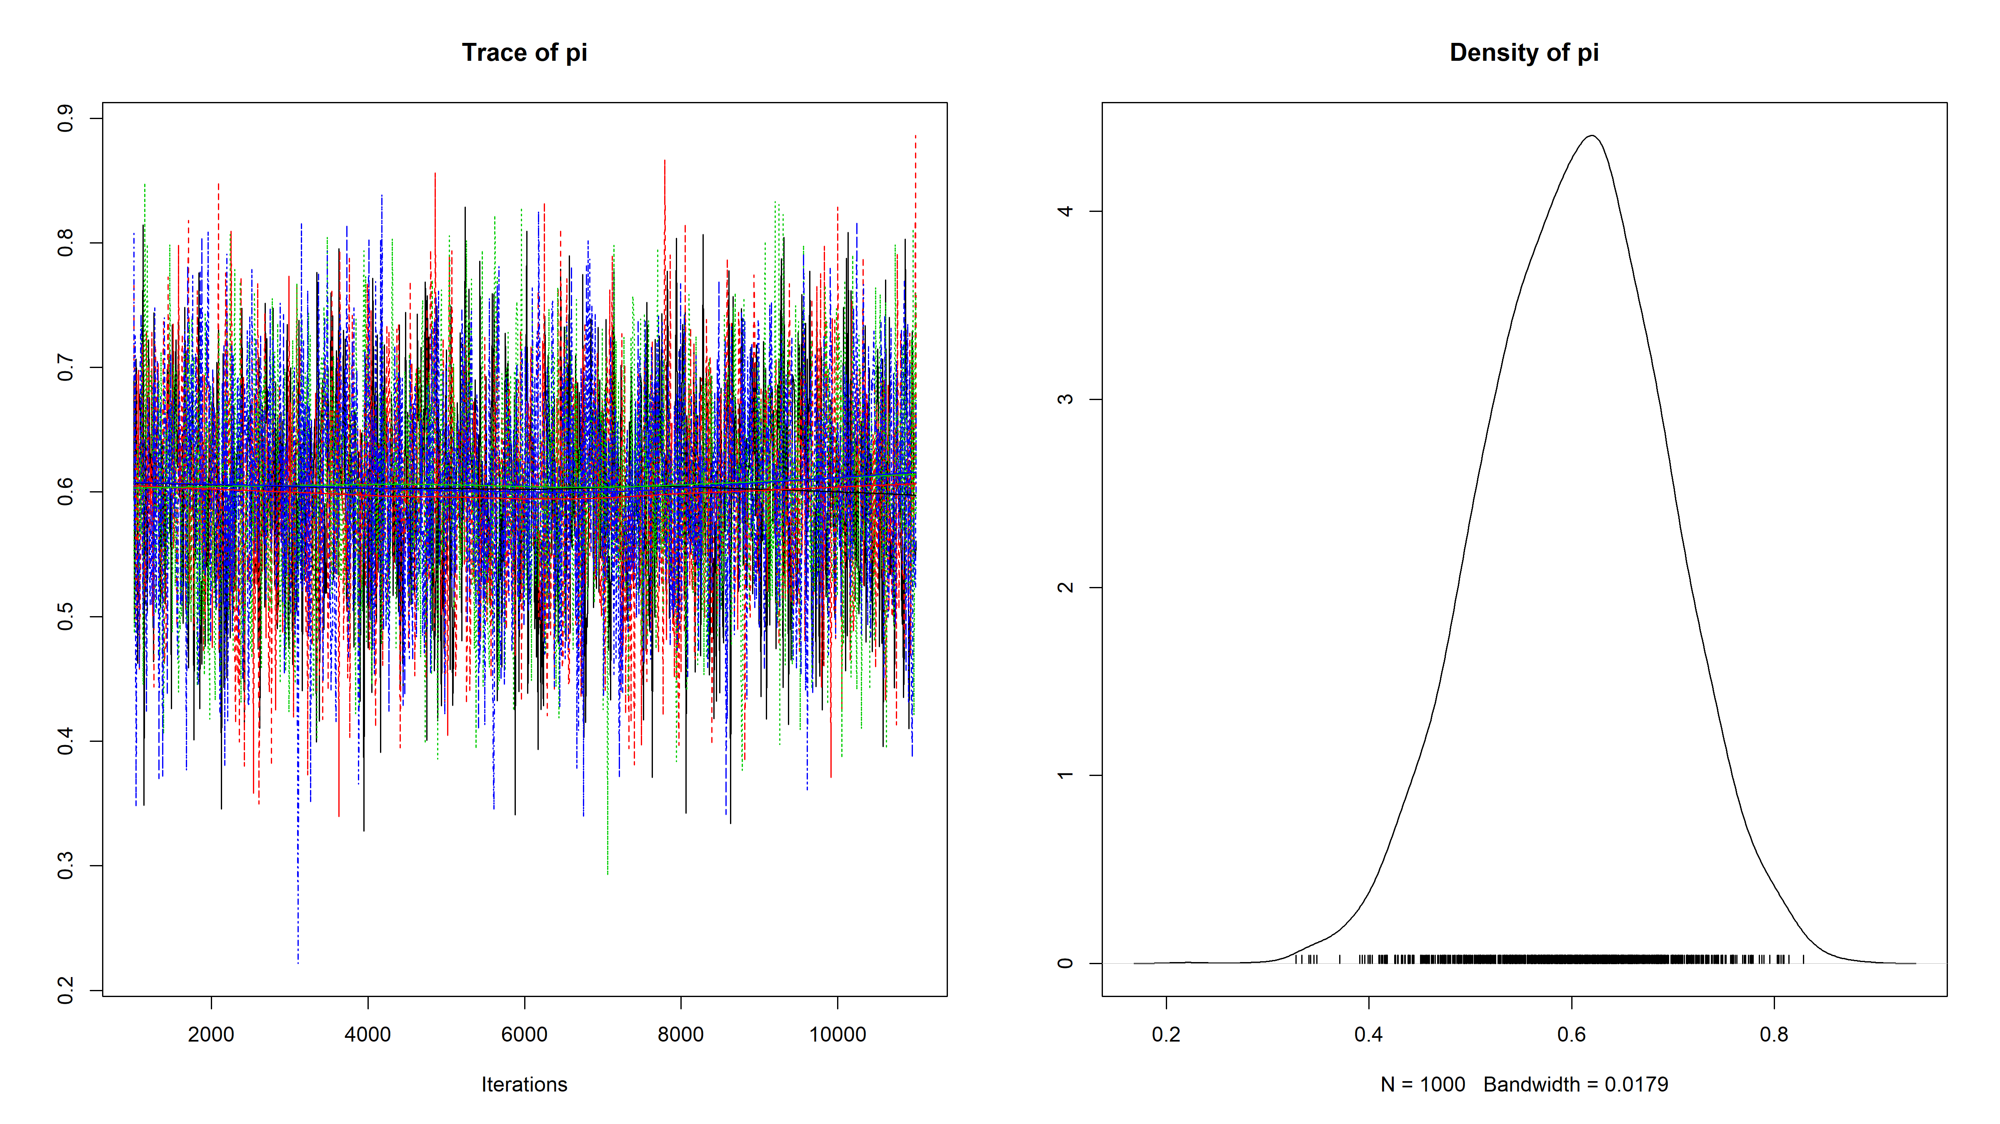

Slide 14
gelman.diag(parsPosterior) ## Potential scale reduction factors: ## ## Point est. Upper C.I. ## pi 1 1 # posterior mean estimate summary(parsPosterior)$statistics["Mean"] ## Mean ## 0.6020501 # posterior quantile based 95% credible interval summary(parsPosterior)$quantiles[c("2.5%","97.5%")] ## 2.5% 97.5% ## 0.4252976 0.7709103

Slide 15
MCMC: burn-in
MCMC algorithms usually take a few iterations (how many?) to move into the support region for a parameter.
We have seen that the Gibbs sampler is guaranteed to converge to the target distributions, but we said nothing about how long this would take.
For this reason, the initial iterations (the ‘’burn-in’’) are generally discarded as they are not samples from the target distribution.
How many to discard: depends on model, sampler, initial value…
A trace plot can help to check if a longer burn-in is required.

Slide 16
MCMC: mixing
It is important that the MCMC sampler explores the parameter space efficiently. We want to avoid iterations where the MCMC samples stay ‘flat’ in one region and also we want to avoid many steps in the same direction.
To avoid that a single chain gets stuck in one part of the parameter space, we should run multiple chains and check that they all explore similar regions of the parameter space.

Slide 17
MCMC: auto-correlations / thinning
We saw that MCMC chains are dependent sequences of samples – there will be autocorrelations between samples. Autocorrelations should drop off rapidly with increasing lag.
If not, a chain can be thinned: e.g. keep only every 10th sample in the chain.
Generally thinning only makes sense for storage requirements: a long chain will average out autocorrelations and this results in higher-precision estimates than when the chain is thinned.

Slide 18
MCMC: Diagnostics
trace plot - should look like a hairy caterpillar if the posterior has converged to the stationary distribution
empirical posterior distributions of parameters in the model (and compare to prior) - should look sensible
potential scale reduction factor (Gelman-Rubin’s convergence diagnostic) - should be close to 1

Slide 19
MCMC: Alternatives to JAGS and alternatives to MCMC
Alternatives to JAGS
Stan
Bayes-X
BUGS
…
Alternatives to MCMC
integrated nested Laplace approximation (INLA)

Slide 20
EXAMPLE

Slide 21
Example: Bayesian linear regression model
Simulate the following data:
set.seed(1309) N<-50 x1<-rexp(N,rate=2) x2<-rnorm(N,mean=-2,sd=0.5) x3<-rpois(N,lambda=20) eps<-rnorm(N,mean=0,sd=0.75) y<-5+x1+0.1*x3+eps dat<-list(N=N,y=y,x1=x1,x2=x2,x3=x3)

Slide 22
Example: Bayesian linear regression model
Fit the following regression model using JAGS:
$$Y=β_{0}+β_{1}X_{1}+β_{2}X_{2}+β_{3}X_{3}+ϵ$$
where $ϵ∼N(0,σ^{2})$

Slide 23
Example: Bayesian linear regression model
JAGS model file (jagsS5ex2.jags):
model{ for(i in 1:N){ y[i]~dnorm(yhat[i],tau) yhat[i]<-b0+b1*x1[i]+b2*x2[i]+b3*x3[i] } b0~dnorm(0,0.0001) b1~dnorm(0,0.0001) b2~dnorm(0,0.0001) b3~dnorm(0,0.0001) tau<-pow(sigma,-2) sigma~dunif(0,100) }

Slide 24
Example: Bayesian linear regression model
set.seed(123) jagsMod<-jags.model("jagsS5ex2.jags",data=dat,n.chains=4,n.adapt=1000) ## Compiling model graph ## Resolving undeclared variables ## Allocating nodes ## Graph information: ## Observed stochastic nodes: 50 ## Unobserved stochastic nodes: 5 ## Total graph size: 380 ## ## Initializing model

Slide 25
Example: Bayesian linear regression model
# run some 'burn-in' samples update(jagsMod,1000) # extract samples from the posterior parsPosterior<-coda.samples(model=jagsMod,variable.names=c("b0","b1","b2","b3","sigma"),n.iter=1e4) # this chain is thinned just as an example # avoid thinning in practice # check trace plot, empirical posterior distribution, potential scale reduction factor par(mfrow=c(2,5)) traceplot(parsPosterior) densplot(parsPosterior)

Slide 26
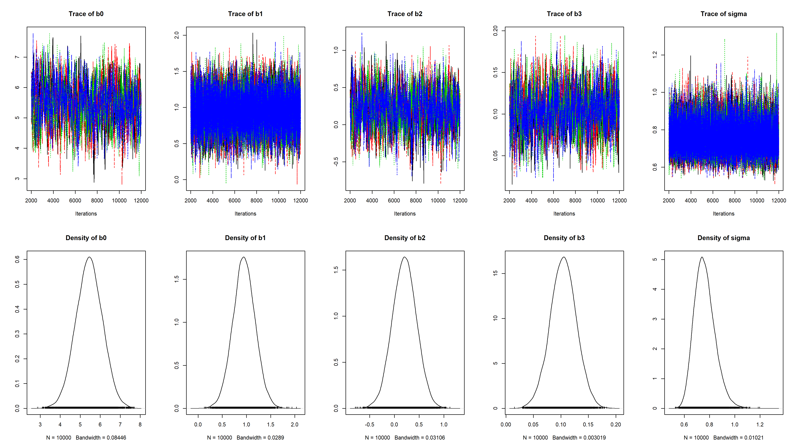

Slide 27
gelman.diag(parsPosterior) ## Potential scale reduction factors: ## ## Point est. Upper C.I. ## b0 1.00 1.01 ## b1 1.00 1.00 ## b2 1.01 1.02 ## b3 1.00 1.01 ## sigma 1.00 1.00 ## ## Multivariate psrf ## ## 1.01

Slide 28
Example: Bayesian linear regression model
# posterior mean estimate summary(parsPosterior)$statistics[,"Mean"] ## b0 b1 b2 b3 sigma ## 5.4501749 0.9494212 0.2025153 0.1043726 0.7611629 # posterior quantile based 95% credible interval summary(parsPosterior)$quantiles[,c("2.5%","97.5%")] ## 2.5% 97.5% ## b0 4.14175028 6.7462748 ## b1 0.49445006 1.4106124 ## b2 -0.27474222 0.6791361 ## b3 0.05687712 0.1512666 ## sigma 0.62168563 0.9419024

Slide 29
Example: Bayesian linear regression model
Note that you can access all the individuals MCMC samples: parsPosterior is a list with 4 elements, 1 for each chain. Each element is simply a data frame with a column for every variable in the variable.names argument and the number of rows corresponds to n.iter/thin.
Use this to produce your own trace and histogram plots, compute various statistics of the parameters etc!
parsPosterior[[1]][1:10,] ## b0 b1 b2 b3 sigma ## [1,] 5.961974 1.0490390 0.36194545 0.09785028 0.7744259 ## [2,] 5.714157 1.0376339 0.37920063 0.11114082 0.6438101 ## [3,] 5.698880 1.0882954 0.47389859 0.11082279 0.6332962 ## [4,] 5.772259 1.0194163 0.45574826 0.10812163 0.6446068 ## [5,] 5.901129 0.8575897 0.43329293 0.11055065 0.8680574 ## [6,] 5.563649 0.9688162 0.26249450 0.10445311 0.7702695 ## [7,] 5.599686 0.9398171 0.22691076 0.09489215 0.7812817 ## [8,] 5.692168 1.0989779 0.13773830 0.08124577 0.7466728 ## [9,] 5.708121 0.9683713 0.14117908 0.08107579 0.7304950 ## [10,] 5.829481 0.8961371 0.09907612 0.08264892 0.7750295

Slide 30
[end of STA6206 Bayesian Data analysis Session 5]

