Slide 1
STA6206 - Bayesian Data Analysis - Practical 3 (Solutions)
Marc Henrion

Slide 2
Practical 3

Slide 3
Notation
$X,Y,Z$ - random variables
$x,y,z$ - measured / observed values
$\overline{X}$, $\overline{Y},\overline{Z}$ - sample mean estimators for X, Y, Z
$\overline{x}$, $\overline{y},\overline{z}$ - sample mean estimates of X, Y, Z
$\hat{T}$, $\hat{t}$ - given a statistic T, estimator and estimate of T
$P(A)$ - probability of an event A occuring
$f_{X}(.)$, $f_{Y}(.),f_{Z}(.)$ - probability mass / density functions of X, Y, Z; sometimes $p_{X}(.)$ etc. rather than $f_{X}(.)$
p(.) - used as a shorthand notation for pmfs / pdfs if the use of this is unambiguous (i.e. it is clear which is the random variable)
$X∼F$ - X distributed according to distribution function F
$E[X]$, $E[Y]$, $E[Z]$, $E[T]$ - the expectation of X, Y, Z, T respectively

Slide 4
Exercise 1
Show that the Bayes estimator ${\hat{θ}}_{B}$ for the quadratic loss function $C(θ−\hat{θ})=(θ−\hat{θ})^{2}$ is given by the posterior mean. In other words, show that:
E[θ|y]=argminθY​Θ​C(θ−θ)p(θ,y)dθdy

Slide 5
Exercise 1 (Solution)
We saw in lectures that we can use the multiplication rule and then optimise the inner integral only:
$$\begin{matrix}{\hat{θ}}_{B} & = & arg\min_{\hat{θ}}∫C(θ−\hat{θ})p(θ|y)dθ \\ & = & arg\min_{\hat{θ}}∫(θ−\hat{θ})^{2}p(θ|y)dθ\end{matrix}$$
To find the minimum, we solve
$$\begin{matrix} & \frac{d}{d\hat{θ}}∫(θ−\hat{θ})^{2}p(θ|y)dθ=0 \\ ⇔ & ∫2(θ−\hat{θ})(−1)p(θ|y)dθ=0 \\ ⇔ & ∫(θ−\hat{θ})p(θ|y)dθ=0 \\ ⇔ & ∫θp(θ|y)dθ=∫\hat{θ}p(θ|y)dθ\end{matrix}$$

Slide 6
Exercise 1 (Solution)
Note that $∫\hat{θ}p(θ|y)dθ=\hat{θ}∫p(θ|y)dθ=\hat{θ}$ since the posterior distribution for $θ$ is a probability distribution and needs to integrate to 1.
Therefore we see that
$${\hat{θ}}_{B}=∫θp(θ|y)dθ$$
This is the posterior mean $E[θ|y]=∫θp(θ|y)dθ$.

Slide 7
Exercise 2
Suppose $π∼Beta(2,3)$ and $Y_{1},…,Y_{n}∼_{iid}Bernoulli(π)$. Further suppose we observe data $y_{1},…,y_{n}$ with n=25,k=i​yi=16.
Find the following:
posterior distribution $p(π|k)$ and plot it, comparing it to the prior distribution
posterior predictive distribution $p(\tilde{y}|y_{1},…,y_{n})$
the 95% quantile-based Bayesian confidence interval for $π$
the 95% HPD interval
Further, compute:
$P(π>0.5|k)$
For the following 2 hypotheses: $H_{1}:π∈[0.3,0.5],H_{2}:π∈[0.5,0.7]$, compute the prior and posterior odds and calculate the Bayes factor.

Slide 8
Exercise 2 (Solution)
Posterior distribution
$$p(π|k=16)∝π^{2−1}(1−π)^{3−1}π^{16}(1−π)^{25−16}=π^{17}(1−π)^{11}$$
$$⇒Π|k∼Beta(18,12)$$
xx<-seq(0,1,length=100) yyPr<-dbeta(xx,2,3) yyPo<-dbeta(xx,18,12) plot(type="l",xx,yyPo,lwd=3,col="mediumorchid",xlab=expression(pi),ylab="density",cex.lab=2,cex.axis=2) lines(xx,yyPr,lwd=3,lty=2,col="steelblue") legend(x="topleft",bty="n",lwd=2,col=c("steelblue","mediumorchid"),lty=c(2,1),legend=c("prior","posterior"),cex=2)

Slide 9
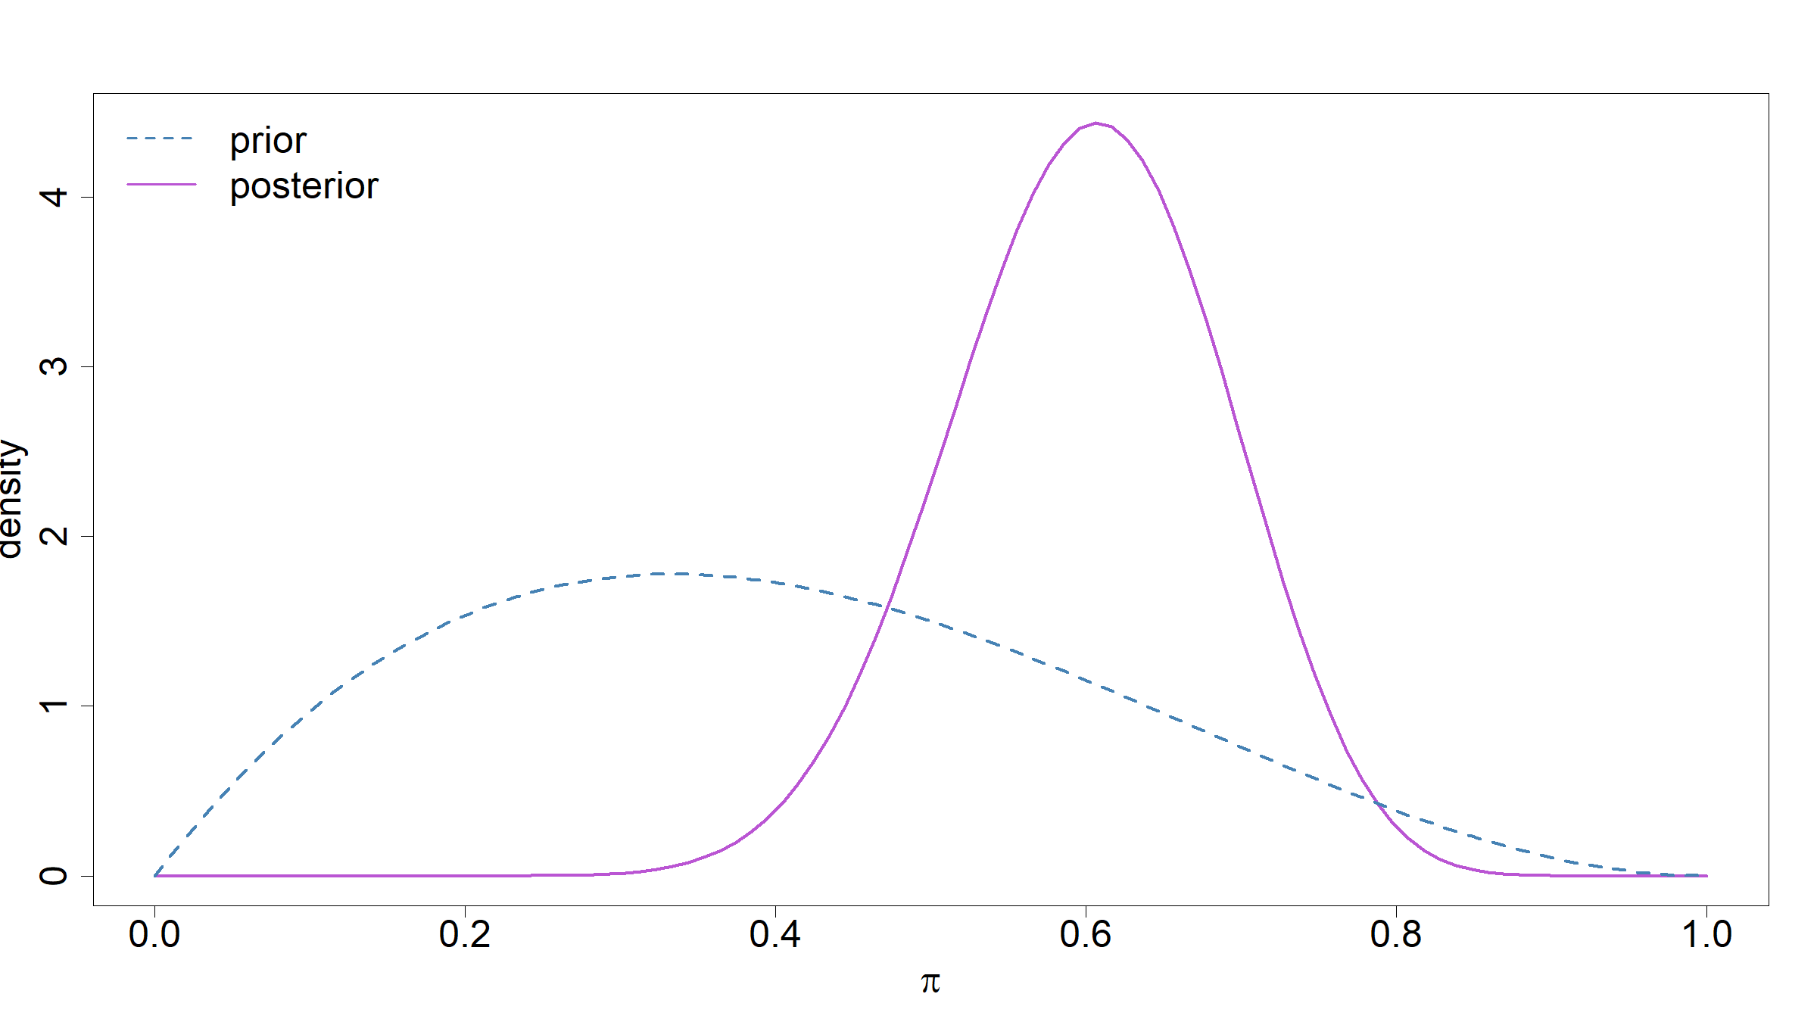

Slide 10
Exercise 2 (Solution)
Posterior predictive distribution
$$\begin{matrix}p(\tilde{Y}=1|y_{1},…,y_{n}) & = & ∫p(\tilde{y},π|y_{1},…,y_{n})dπ \\ & = & ∫p(\tilde{y}|pi,y_{1},…,y_{n})p(π|y_{1},…,y_{n})dπ \\ & = & ∫π\frac{Γ(30)}{Γ(18)Γ(12)}π^{17}(1−π)^{11}dπ \\ & = & \frac{Γ(30)Γ(19)}{Γ(18)Γ(31)}∫\frac{Γ(31)}{Γ(19)Γ(12)}π^{18}(1−π)^{11}dπ \\ & = & \frac{Γ(30)Γ(19)}{Γ(18)Γ(31)}=\frac{18}{30}=3/5=0.6\end{matrix}$$
From this it follows that $p(\tilde{Y}=0|y_{1},…,y_{n})=1−\frac{3}{5}=\frac{2}{5}=0.4$.

Slide 11
Exercise 2 (Solution)
We have:
$q_{0.025;Beta(18,12)}=$ 0.4226
$q_{0.975;Beta(18,12)}=$ 0.7648
Therefore the 95% quantile based Bayesian confidence interval for $π$ is given by $[$0.42,0.76$]$
qbeta(c(0.025,0.975),18,12)
## [1] 0.4226046 0.7647598

Slide 12
Exercise 2 (Solution)
For the HPD we are going to use the function hdi() from the R package HDInterval:
library(HDInterval) hdp<-hdi(qbeta,0.95,shape1=18,shape2=12) print(hdp)
## lower upper ## 0.4273464 0.7690367 ## attr(,"credMass") ## [1] 0.95
From this we find that the 95% HDP interval for $π$ is given by $[$0.43,0.77$]$

Slide 13
Exercise 2 (Solution)
We have
$$\begin{matrix}P(π>0.5|Y=k) & = & \int_{0.5}^{1}{p}(π|k)dπ \\ & = & \int_{0.5}^{1}{\frac{Γ(30)}{Γ(18)Γ(12)}}π^{17}(1−π)^{11}dπ \\ & = & ≈0.87\end{matrix}$$
integrate(dbeta,lower=0.5,upper=1,shape1=18,shape2=12)
## 0.8675346 with absolute error < 2.8e-09
Alternatively we could have worked with the posterior cdf:
1-pbeta(0.5,18,12)
## [1] 0.8675346

Slide 14
Exercise 2 (Solution)
Prior odds
$$\frac{P(H_{1})}{P(H_{2})}=\frac{\int_{0.3}^{0.5}{p_{β(3,2)}}(π)dπ}{\int_{0.5}^{0.7}{p_{β(3,2)}}(π)dπ}=1.48$$
Prosterior odds
$$\frac{P(H_{1}|k)}{P(H_{2}|k)}=\frac{\int_{0.3}^{0.5}{p_{β(18,12)}}(π)dπ}{\int_{0.5}^{0.7}{p_{β(18,12)}}(π)dπ}=0.18$$

Slide 15
Exercise 2 (Solution)
priorOdds<-integrate(dbeta,0.3,0.5,shape1=2,shape2=3)$value/integrate(dbeta,0.5,0.7,shape1=2,shape2=3)$value #priorOdds<-(pbeta(0.5,2,3)-pbeta(0.3,2,3))/(pbeta(0.7,2,3)-pbeta(0.5,2,3)) # alternative way of doing this priorOdds
## [1] 1.482517
posteriorOdds<-integrate(dbeta,0.3,0.5,shape1=18,shape2=12)$value/integrate(dbeta,0.5,0.7,shape1=18,shape2=12)$value posteriorOdds
## [1] 0.1789838

Slide 16
Exercise 2 (Solution)
Bayes Factor
$BF=\frac{posterior odds}{prior odds}=0.18/1.48=0.12$
bayesFactor<-posteriorOdds/priorOdds bayesFactor
## [1] 0.1207296

Slide 17
Exercise 3
Suppose $π∼Gamma(5,2)$ and $Y_{1},…,Y_{n}∼_{iid}Poisson(λ)$. Further suppose we observe data $y_{1},…,y_{n}$ with n=18,k=i​yi=40.
Find the following:
posterior distribution $p(λ|y_{1},…,y_{n}$ and plot it, comparing it to the prior distribution
posterior predictive distribution $p(\tilde{y}|y_{1},…,y_{n})$
the 95% quantile-based Bayesian confidence interval for $λ$
the 95% HPD interval
Further, compute:
$P(λ≤1|y_{1},…,n)$
For the following 2 hypotheses: $H_{1}:λ∈[0.75,1.25],H_{2}:λ∈[1.75,2.25]$, compute the prior and posterior odds and calculate the Bayes factor.

Slide 18
Exercise 3 (Solution)
Posterior distribution
p(λ|y1,…,yn)∝λ5−1e−2λλi​yie−nλ∝λ5+40−1e−(2+18)λ⇒Λ|y1,…,yn∼Γ(45,20)
xx<-seq(0,8,length=100) yyPr<-dgamma(xx,shape=5,rate=2) yyPo<-dgamma(xx,shape=45,rate=20) plot(type="l",xx,yyPo,lwd=3,col="mediumorchid",xlab=expression(pi),ylab="density",cex.lab=2,cex.axis=2) lines(xx,yyPr,lwd=3,lty=2,col="steelblue") legend(x="topleft",bty="n",lwd=2,col=c("steelblue","mediumorchid"),lty=c(2,1),legend=c("prior","posterior"),cex=2)

Slide 19
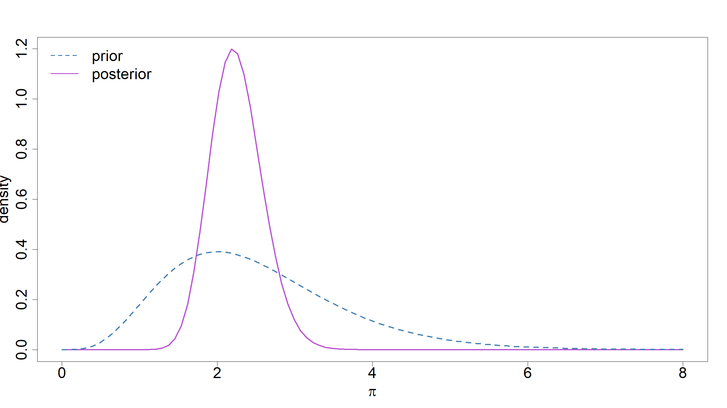

Slide 20
Exercise 3 (Solution)
Posterior predictive distribution
From Practical 1&2, Exercise 4, we know:
$$\tilde{Y}|y_{1},…,y_{n}∼NegBin(45,20/21)$$

Slide 21
Exercise 3 (Solution)
We have:
$q_{0.025;Γ(45,20)}=$ 1.6412
$q_{0.975;Γ(45,20)}=$ 2.9534
Therefore the 95% quantile based Bayesian confidence interval for $π$ is given by $[$1.64,2.95$]$
qgamma(c(0.025,0.975),shape=45,rate=20)
## [1] 1.641165 2.953397

Slide 22
Exercise 3 (Solution)
For the HPD we are going to use the function hdi() from the R package HDInterval:
library(HDInterval) hdp<-hdi(qgamma,0.95,shape=45,rate=20) print(hdp)
## lower upper ## 1.611342 2.917067 ## attr(,"credMass") ## [1] 0.95
From this we find that the 95% HDP interval for $λ$ is given by $[$1.61,2.92$]$

Slide 23
Exercise 3 (Solution)
We have
$$\begin{matrix}P(λ≤1|y_{1},…,y_{n}) & = & \int_{0}^{1}{p}(λ|y_{1},…,y_{n})dλ \\ & = & \int_{0}^{1}{\frac{{20}^{45}}{Γ(45)}}λ^{44}e^{−20λ}dλ \\ & = & 1.06⋅{10}^{−6}\end{matrix}$$
integrate(dgamma,lower=0,upper=1,shape=45,rate=20)
## 1.060263e-06 with absolute error < 4.4e-13

Slide 24
Exercise 3 (Solution)
Prior odds
$$\frac{P(H_{1})}{P(H_{2})}=\frac{\int_{0.75}^{1.25}{p_{γ(5,2)}}(λ)dλ}{\int_{1.75}^{2.25}{p_{Γ(5,2)}}(λ)dλ}=0.2513$$
Prosterior odds
$$\frac{P(H_{1}|y_{1},…,y_{n})}{P(H_{2}|y_{1},…,y_{n})}=\frac{\int_{0.75}^{1.25}{p_{γ(45,20)}}(λ)dλ}{\int_{1.75}^{2.25}{p_{Γ(45,20)}}(λ)dλ}=0.0004$$

Slide 25
Exercise 3 (Solution)
priorOdds<-integrate(dgamma,0.75,1.25,shape=5,rate=2)$value/integrate(dgamma,1.25,2.25,shape=5,rate=2)$value priorOdds
## [1] 0.2513296
posteriorOdds<-integrate(dgamma,0.75,1.25,shape=45,rate=20)$value/integrate(dgamma,1.25,2.25,shape=45,rate=20)$value posteriorOdds
## [1] 0.0003851655

Slide 26
Exercise 3 (Solution)
Bayes Factor
$BF=\frac{posterior odds}{prior odds}=0.004/0.2513=0.0015$
bayesFactor<-posteriorOdds/priorOdds bayesFactor
## [1] 0.001532511

Slide 27
[end of STA6206 BDA Practical 3]

