Slide 1
STA6206 - Bayesian Data Analysis - Practical 4 (Solutions)
Marc Henrion

Slide 2
Practical 4

Slide 3
Notation
$X,Y,Z$ - random variables
$x,y,z$ - measured / observed values
$\overline{X}$, $\overline{Y},\overline{Z}$ - sample mean estimators for X, Y, Z
$\overline{x}$, $\overline{y},\overline{z}$ - sample mean estimates of X, Y, Z
$\hat{T}$, $\hat{t}$ - given a statistic T, estimator and estimate of T
$P(A)$ - probability of an event A occuring
$f_{X}(.)$, $f_{Y}(.),f_{Z}(.)$ - probability mass / density functions of X, Y, Z; sometimes $p_{X}(.)$ etc. rather than $f_{X}(.)$
p(.) - used as a shorthand notation for pmfs / pdfs if the use of this is unambiguous (i.e. it is clear which is the random variable)
$X∼F$ - X distributed according to distribution function F
$E[X]$, $E[Y]$, $E[Z]$, $E[T]$ - the expectation of X, Y, Z, T respectively

Slide 4
Exercise 1
Let’s revisit Exercise 5 from Practical 1&2.
We had 2 groups of women and we compared the number of children born to each women in the 2 groups. For each group we assumed a Poisson sampling model: $Y_{i,j}∼Pois(θ_{i}),i=1,…,n_{j},j=1,2$ and we found that the posterior distributions were:
Women without college degree: $θ_{1}∼Γ(219,112)$
Women with college degree: $θ_{2}∼Γ(68,45)$
We had computed P(θ1>θ2|n1,n2,i​yi,1,i​yi,2)=0.97.
Use the Monte Carlo method to compute
P(Y1>Y2|n1,n2,i​yi,1,i​yi,2)

Slide 5
Exercise 1 (cont’d)
For the group of women without college degree, remember that we found that the posterior predictive distribution was a negative binomial:
Y1|n1,i​yi,1∼NegBin(219,112/113)
Compare this distribution with the empirical distribution of the raw data (given on next slide).
Let $y=(y_{1,1},…,y_{n_{1},1})$. Define $t(y)$ as the ratio of 2’s in $y$ to the number of $1′s$. In this dataset we observe $t(y)=38/19=2$. Use the posterior predictive distribution for Y1|n1,i​yi,1 and the Monte Carlo method to compute P(t(Y)≥2|n1,i​yi,1). What is your conclusion?

Slide 6
Exercise 1 (cont’d)
no. children per mother | number of mothers
0 | 20
1 | 19
2 | 38
3 | 20
4 | 10
5 | 2
6 | 2

Slide 7
Exercise 1 (Solution)
In this exercise we had:
a=2,b=1,n1=111,i​yi,1=217,n2=44,i​yi,2=66
We found that the posterior distributions for $θ_{1}$ and $θ_{2}$ were Γ(a+i​yi,j,b+nj),j=1,2 respectively.

Slide 8
Exercise 1 (Solution)
To compute $P({\tilde{Y}}_{1}>{\tilde{Y}}_{2}|...)$ we need to, for $j=1,2$
sample θj(1)∼Γ(a+i​yi,j,b+nj), sample yj(1)∼Poisθj(1)sample θj(2)∼Γ(a+i​yi,j,b+nj), sample yj(2)∼Poisθj(2)…sample θj(S)∼Γ(a+i​yi,j,b+nj), sample yj(S)∼Poisθj(S)

Slide 9
Exercise 1 (Solution)
The R code for this is quite short:
a<-2; b<-1 n1<-111; sy1<-217 n2<-44; sy2<-66 S<-1e4 s.theta1<-rgamma(n=S,a+sy1,b+n1) s.theta2<-rgamma(n=S,a+sy2,b+n2) s.y1<-rpois(n=S,lambda=s.theta1) s.y2<-rpois(n=S,lambda=s.theta2)

Slide 10
Exercise 1 (Solution)
Finally we need to compute 1Ss​I(y1(s)>y2(s)), where $I(.)$ is the indicator function, to approximate $P({\tilde{Y}}_{1}>{\tilde{Y}}_{2}|...)$.
($I(TRUE)=1,I(FALSE)=0$)
sum(s.y1>s.y2)/S ## [1] 0.4897
While we have a lot of evidence that the parameters satisfy $θ_{1}>θ_{2}$, the overlap between the distributions is significant, and only about 47% of the time, a random woman in the first group has more children than a random woman in the second group.

Slide 11
Exercise 1 (Solution)
We now focus only on the first group, the women without a college degree.
Let’s compare the empirical (i.e. observed) and the posterior predictive distributions.
First we need to code up the data:
freqMatObs<-data.frame(numChild=0:6,propMother=c(20,19,38,20,10,2,2)/111,dist=rep("observed",7)) freqMatPred<-data.frame(numChild=0:6,propMother=NA,dist=rep("predicted",7)) for(i in 1:nrow(freqMatPred)){ freqMatPred$propMother[i]<-sum(s.y1==freqMatPred$numChild[i])/S } freqMat<-rbind(freqMatObs,freqMatPred)

Slide 12
Exercise 1 (Solution)
Then we can compare these distributions:
library(ggplot2) ggplot(data=freqMat,mapping=aes(x=numChild,y=propMother,fill=dist),col=c("steelblue","greenyellow"),cex.lab=2.3,cex.axis=2.3) + geom_bar(position=position_dodge(width=0.3),stat="identity",width=0.2) + scale_fill_manual(values=c("steelblue","orange")) + xlab("number of children") + ylab(expression(paste(sep="","P(",Y[j],"=",y[j],")"))) + theme(axis.text=element_text(size=24), axis.title=element_text(size=24), title=element_text(size=36), legend.text=element_text(size=24)) + ggtitle("Comparison of the empirical and the posterior predictive distribution for the 1st group of women")

Slide 13
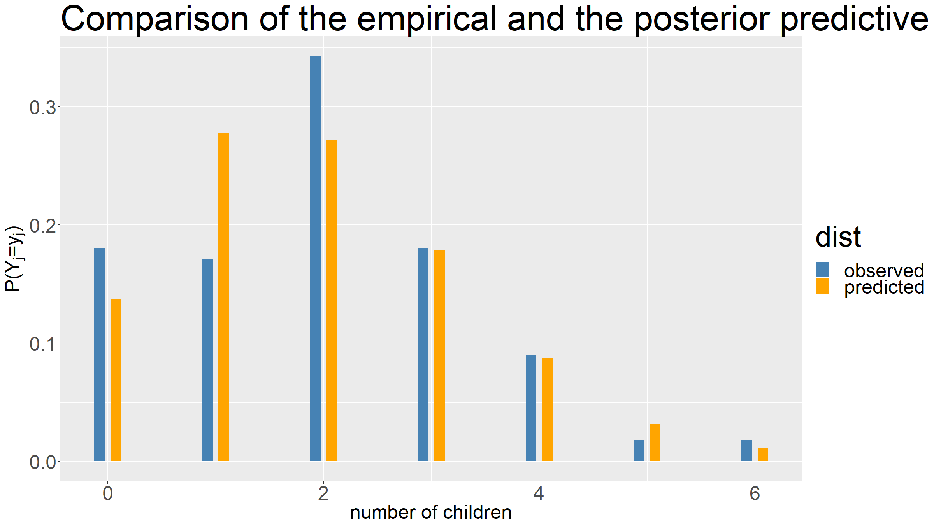

Slide 14
Exercise 1 (Solution)
We see that for $Y_{1}=2$, the empirical and the posterior predictive distributions are quite different: while in the observed data, twice as many women had 2 children than had 1 child, according to the posterior predictive distribution, we would expect slighly more women to have 1 child than women who have 2.
Let $t(y)$ be the ratio of the number of women with 2 children to the number of women with 1 child.
We see that $t(y_{obs}=38/19=2)$.

Slide 15
Exercise 1 (Solution)
Let’s compute $P(t(\tilde{Y})>2|y_{1,1},…,y_{n_{1},1})$. For this we need to, for $s=1,…,S$:
sample $θ_{1}^{(s)}∼p(θ_{1}|y_{1,1},…,y_{n_{1},1})=Γ(219,112)$
sample ${\tilde{Y}}_{1}^{(s)}=({\tilde{y}}_{1,1}^{(s)},…,{\tilde{y}}_{n_{1},1}^{(s)})∼_{iid}Pois\left({\tilde{y}}_{1}|θ_{1}^{(s)}\right)$
compute $t^{(s)}=t\left({\tilde{Y}}_{1}^{(s)}\right)$

Slide 16
Exercise 1 (Solution)
In R this becomes:
tVect<-rep(NA,S) for(s in 1:S){ theta1<-rgamma(n=1,a+sy1,b+n1) s.y1<-rpois(n1,lambda=theta1) tVect[s]<-sum(s.y1==2)/sum(s.y1==1) } sum(tVect>=2)/S
## [1] 0.0063
We conclude it is very unlikely to observe this ratio of 2’s to 1’s under the assumed Poisson sampling model. Our sampling model is likely wrong and we should try to identify a more suitable model.

Slide 17
[end of STA6206 BDA Practical 4]

