Slide 1
An Introduction to Computational Statistics
Workshop by Brian Spiering, Professor of CS/DS at University of San Francisco
(March 10, 2019)
Two Perspectives: Analytical and Computational
Analytical Methods | Computational Methods
Based on Mathematics (Statistics, Probability) Use domain and theoretical knowledge Made sense when data collection and computing power were expensive Main tool: probability, statistical tests | Based on Computer science (software engineering) Use fundamental computing (i.e. looping and random number generator) Make sense because data collection and computing is cheaper Using computers we can also solve novel problems Main tool: simulation

Slide 2
Computational Statistics by Example
An Introduction to Computational Statistics
Example 1: Simulating outcomes
Efficient simulation of probabilities of common events and statistics
Example 2: Permutation testing
Hypothesis (A/B) testing
More in the workshop Jupyter notebooks
Computational approach to linear regression
Permutation tests for median differences
Inspection paradox
Additional resources

Slide 3
Simulating Outcomes
An Introduction to Computational Statistics
Question: If you roll two 6-sided dice,
how likely is it that the sum is greater than 7?

Slide 4
Analytical Method
If you roll two 6-sided dice, how likely is it that the sum is greater than 7?
We have 6^2 potential outcomes (variations with repetition)
In total 36 pairs of (result of first roll, result of second roll)
(1, 1), (1, 2), (1, 3), …, (6, 6) -> how many with the sum greater then 7?
(2, 6) -> 1
(3, 5), (3, 6) -> 2
(4, 4), (4, 5), (4, 6) -> 3 15 pairs with sum > 7, so the probability is 15/36 = 0.4166(6)
(5, 3), …, (5, 6) -> 4
(6, 2), …, (6, 6) -> 5
What about: If you roll seven 6-sided dice, how likely is it that the sum is greater than 35?
6^7 = 279936 (variations)
Notes:
… to the power of …

Slide 5
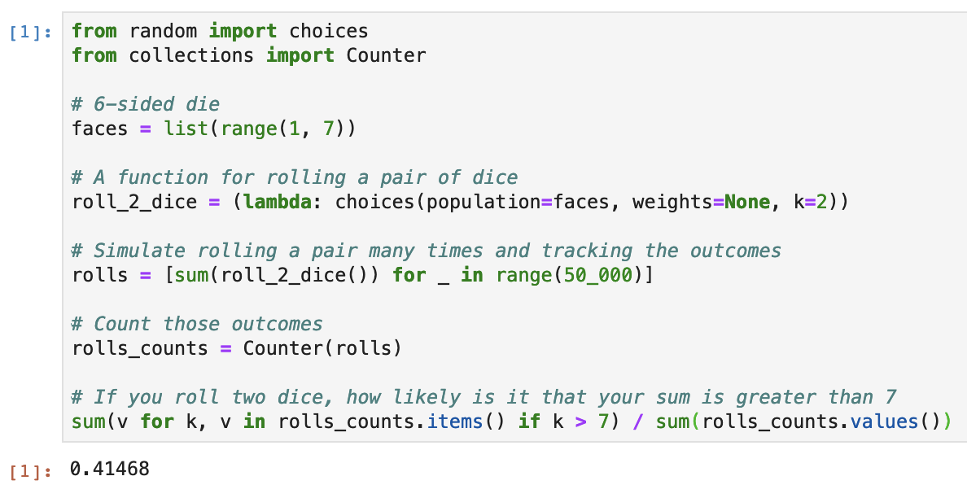
Computational Method
If you roll two 6-sided dice, how likely is it that the sum is greater than 7?

Slide 6
Analytical vs. Computational
Simulating outcomes approach comparison
Analytical approach
Think about all possible outcomes
Enumerate outcomes which meet the condition (>7)
Count the outcomes which meet the condition and calculate the likelihood
Have problem with the same approach for more complex scenario
Computational approach
Define 6-sided die
Simulate rolling a pair of dice (many times) -> how many times should suffice?
Count and calculate the likelihood
Bonus: I can count, sort, visualize easily
No problem with more complex scenario

Slide 7
Permutation Testing
An Introduction to Computational Statistics
Question: Is a drug effective or not?
drug = [54, 73, 53, 70, 73, 68, 52, 65, 65]
placebo = [54, 51, 58, 44, 55, 52, 42, 47, 58, 46]

Slide 8
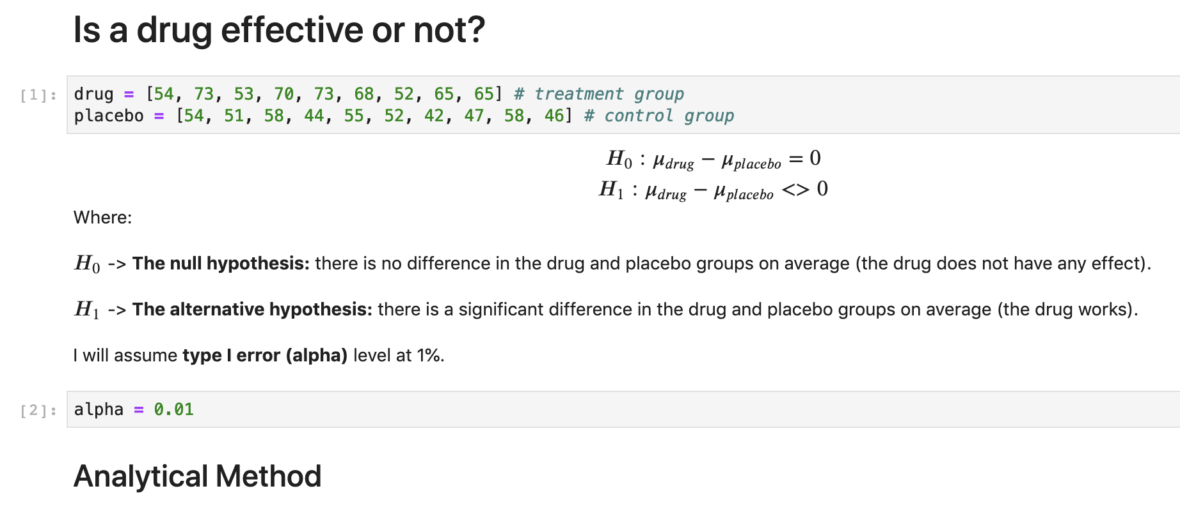
Analytical Method
Is a drug effective or not?
https://github.com/ksatola/Computational-Statistics/blob/master/Example2.html

Slide 9
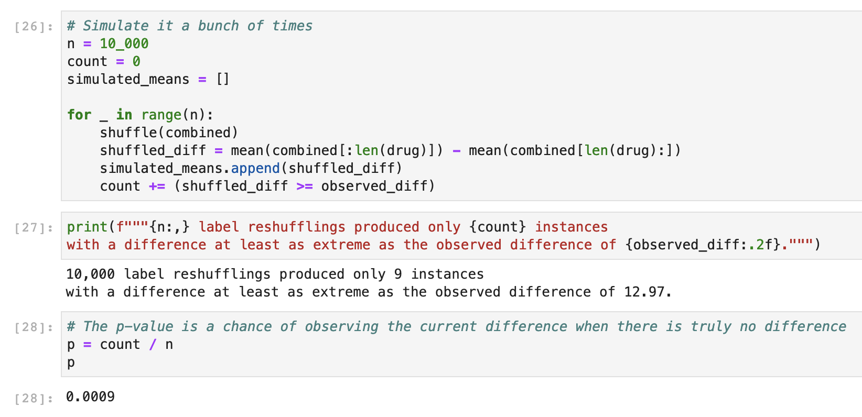
Computational Method
Is a drug effective or not?
https://github.com/ksatola/Computational-Statistics/blob/master/Example2.html

Slide 10
Analytical vs. Computational
Hypothesis Testing approach comparison
Analytical approach
Setup testing framework
Define null and alternative hypothesis
Set alpha (the threshold for rejecting differences)
Collect data
Pick a sampling distribution, calculate a test statistic, remember about assumptions
Calculate p-value
Draw conclusion
Computational approach
Setup testing framework
Define null and alternative hypothesis
Set alpha (the threshold for rejecting differences)
Collect data
Iterate while shuffling data to simulate null effect and create a sampling distribution
Calculate p-value
Draw conclusion

Slide 11
Advantages of Computational Approach
Hypothesis Testing approach comparison
Analysis | Simulation
Often dictates the test statistic, and tests have assumptions If you have issues like: censored data, non-independence, and long-tailed distributions, you won’t find an off-the-shelf test Unless you are a mathematical statistician, you won’t be able to make it by yourself | There are no test assumptions to satisfy These are not issues when simulating

