Slide 1
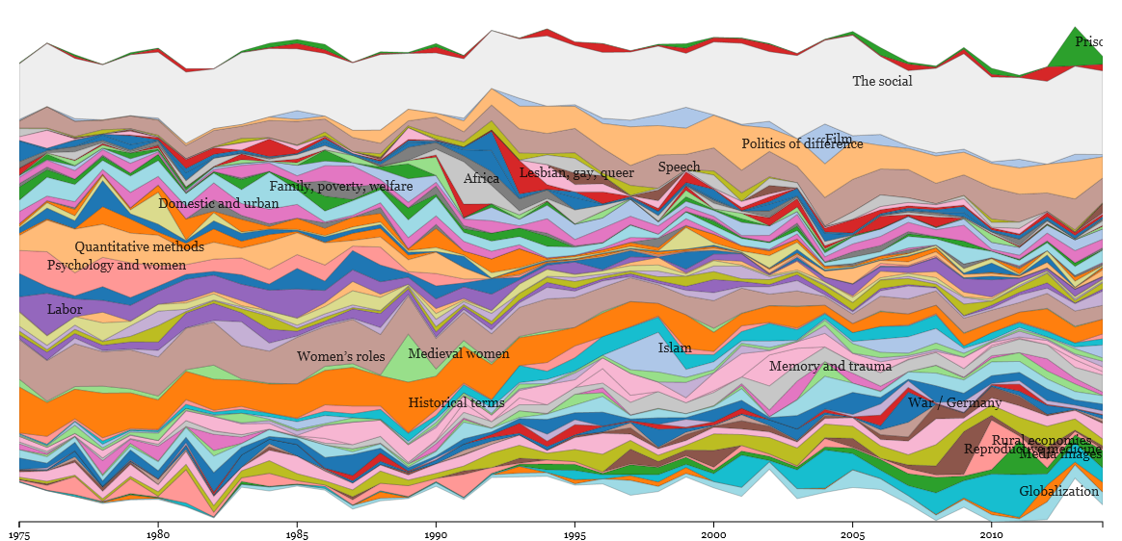
Imagine the Possibilities

Slide 2
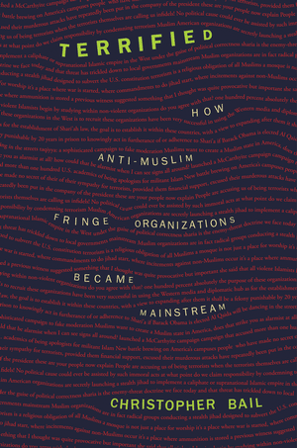
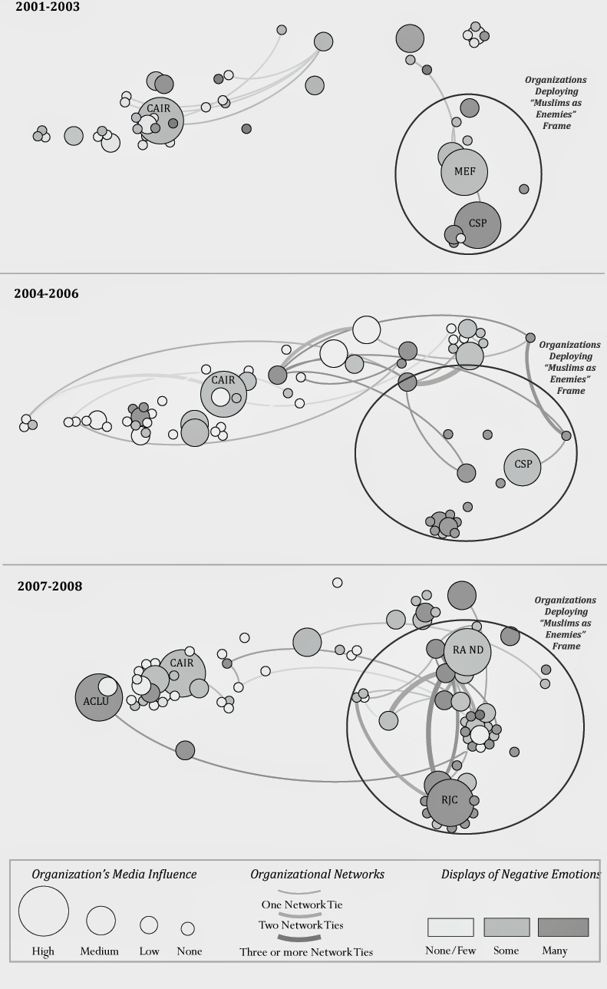
Chris Bail (Duke University, Soc)

Slide 3
Justin Grimmer (Stanford, Poli Sci)
Uncovered fourth political speech category: partisan taunting
Shows how and why “aligned” representatives dominate policy debates, and how this leads to artificial ideological extremity

Slide 4
Nick Beauchamp (Northeastern, Poli Sci)
Combined text analysis and online experiments
Varied individual sentences in an ad about Obamacare, to determine, experimentally, what sentences are more or less influential in producing the desired response

Slide 5
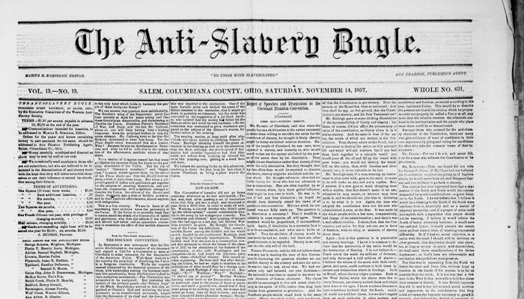
NULab
Viral Text Project

Slide 6
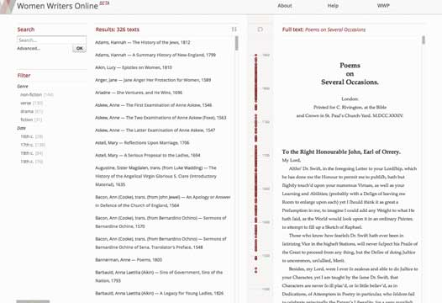
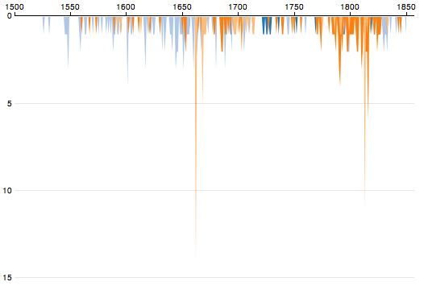
NULab
Women Writers Project

Slide 7
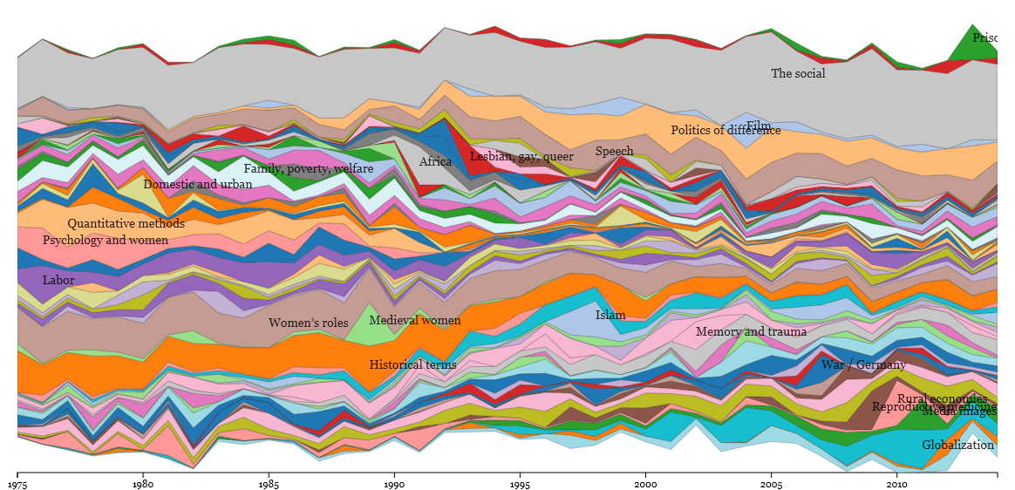
Signs
Signs at 40 project

Slide 8
Other People to Follow
Benjamin Schmidt (Northeastern English)
Gendered teacher evaluations
Rejecting the gender binary: a vector-space operation
Wonder with images
David Bamman (Berkeley I-School)
Detect sarcasm on Twitter
Nuance in gender and language on social media

Slide 9
The Future
Combine text analysis with other methods
Experiments
Network analysis
Use computational methods to enhance close reading
Combine qualitative/quantitative methods
Targeted close reading
Computational inductive analysis
The best projects start with a good question, research design, and motivated by theory

