Slide 1
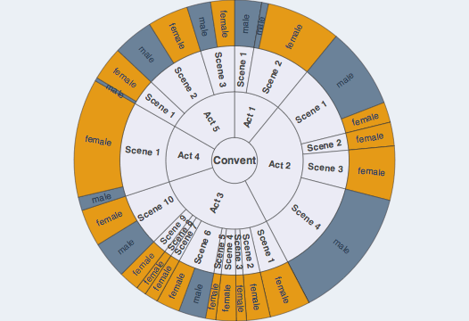
Workshop Overview

Slide 2
Goals
This course will introduce students to cutting edge ways of structuring and analyzing digitized text-as-data, and will do so by exploring questions fundamental to the humanities.
Topics Covered
Principles of Natural Language Processing
Introduction to Python for NLP
Discriminating Words
Dictionary Methods
Textual Classification
Topic Modeling
Give time for you to apply what your learn to your own corpus.

Slide 3
Two Goals
Intuition about what computational text analysis entails
What types of questions can you answer?
What types of evidence does it produce?
Range of techniques available
Practical tools for implementing techniques
Understanding Python
Working scripts for specific techniques
How to learn on your own

Slide 4
Introduction: Text Formats
To analyze text, we need to move away from word processing and pdfs. What does this mean?

Slide 5
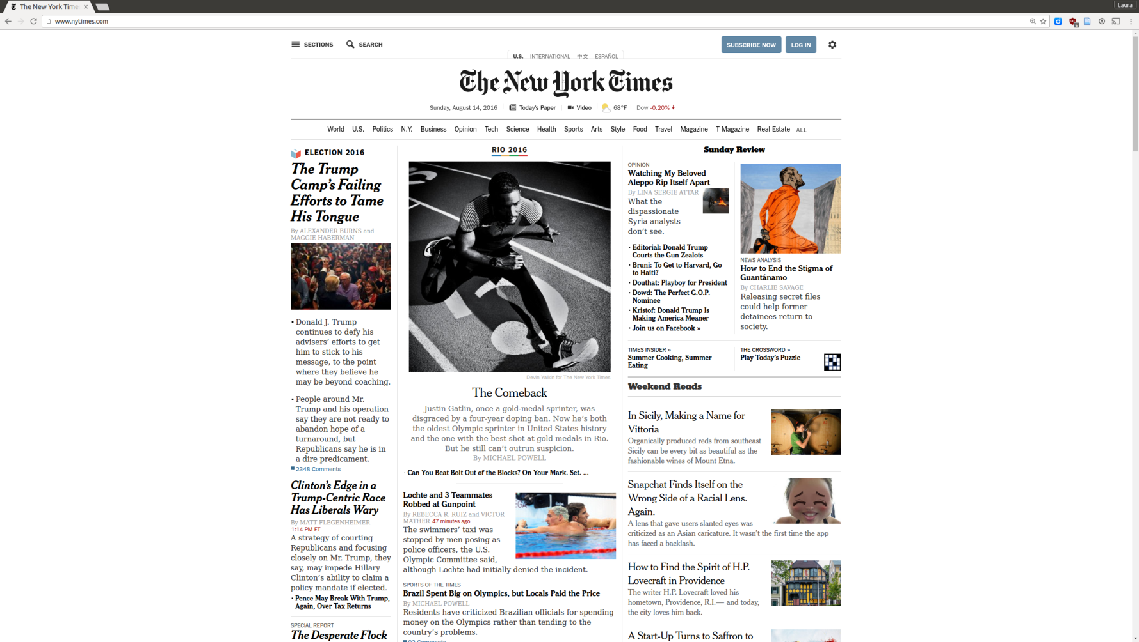
Text Formats
The way we read text: easy on the eyes
Notes:
Everything that makes text really nice for humans to reads, makes it very difficult for computers to read. So, when collecting or formatting data with an eye toward computational analysis, avoid these formats.

Slide 6
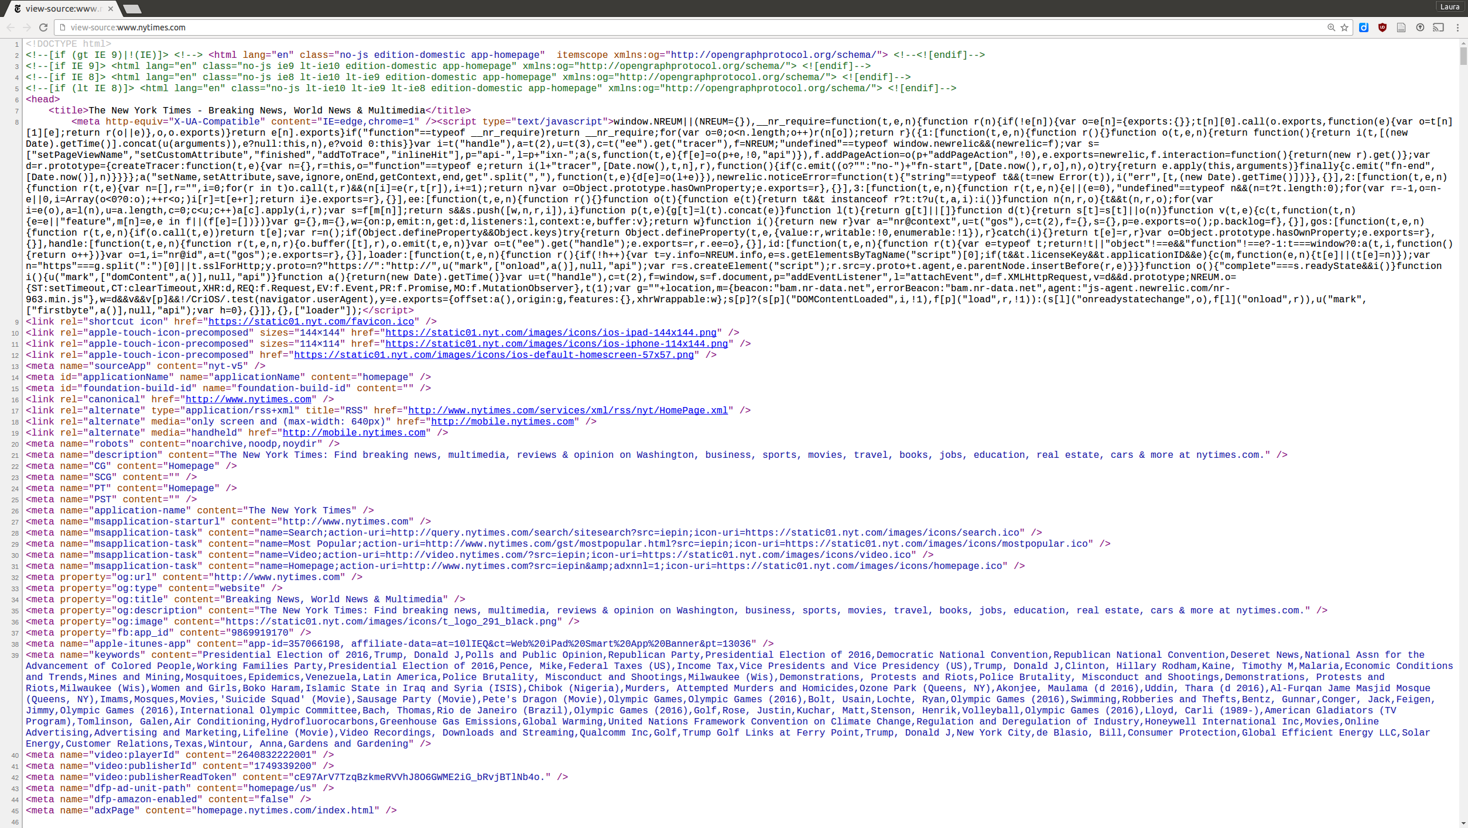
Text Formats
The way computers read text: everything must be uniquely identified (e.g. html).

Slide 7
Text Formats
This week we’ll cover two text formats:
Raw text, or .txt
Delimiter-separated files, or .csv

Slide 8
Word (Processed) Text
A Highbrow Essay on Woman:
A Dissertation on the Economic Function of Woman with the part played therein by scientific bulletins and deep thinkers.
By Eugene Wood
If there is any one thing in the reading line that I dote upon more than another, it is a bulletin, a real scientific bulletin, whether it be on the Stomach Contents of Arctomys Miurus or The Method of Procedure in Making Salt-rising Bread. Those fellows go at it so thoroughly. Right up to the handle. They don't have to worry whether the editor will like it or not. They don't care whether it will hit the public or not. If anything, they'd a little rather it didn't. It can't be very scientific if people read it and enjoy it. They aren't like literary folks, who when they take hold of a subject must not do more than pull out a few of the prettiest tail-feathers.
They pluck the subject as bare as a teacup. And then they take the hide off it. And then they cut it open and have a look at its insides, and dissect away every muscle from every bone, so that when they get all through, and washed up, that subject hasn't one secret left. They know it backwards and forwards, lengthwise and crosswise, up and down, and outside and inside.

Slide 9
Raw Text (.txt)
A Highbrow Essay on Woman:\n A Dissertation on the Economic Function of Woman with the part played therein by scientific bulletins and deep thinkers. \nIf there is any one thing in the reading line that I dote upon more than another, it is a bulletin, a real scientific bulletin, whether it be on the Stomach Contents of Arctomys Miurus or The Method of Procedure in Making Salt-rising Bread. Those fellows go at it so thoroughly. Right up to the handle. They don't have to worry whether the editor will like it or not. They don't care whether it will hit the public or not. If anything, they'd a little rather it didn't. It can't be very scientific if people read it and enjoy it. They aren't like literary folks, who when they take hold of a subject must not do more than pull out a few of the prettiest tail-feathers.\n\tThey pluck the subject as bare as a teacup. And then they take the hide off it. And then they cut it open and have a look at its insides, and dissect away every muscle from every bone, so that when they get all through, and washed up, that subject hasn't one secret left. They know it backwards and forwards, lengthwise and crosswise, up and down, and outside and inside.\nSo when I received a few days ago a Teachers' College Bulletin on "The Economic Function of Woman," by Edward T. Devine, PhD, Professor of Social Economy of Columbia University, I just knocked off work on that hurry job I had, part of the pay for which is going to reward the insurance company for my not dying this year, and settled myself to a really enjoyable intellectual sozzle. Here was something that nobody else could ever read clear through unless he was paid for it or had to read it in order to get a term-standing. And I'm interested in Woman. Most men are, if you'll notice. More or less. It is a subject that is brought to the male attention so often, so very often when you consider the whole period from the cradle to the grave. And then, again, this seemed a particularly promising viewpoint from which to consider Woman, what, if any account, is she?\nThere is not an extended piece of writing, however foolish it may seem, from which it is entirely impossible to get one good idea. And I will say for Dr. Devine that he sets forth some very sound and sensible things. I am sure of this because they're exactly what I think. When he says that students of the economic processes haven't paid as much attention to Consuming as they have to Producing, I think he's quite right. (I want the printer and the editor to let these capital letters stand as they are because I want to give the impression that I am a Deep Thinker. Nobody can be a Deep Thinker without capital letters sticking up through his copy like bristles on a cucumber. If I can't have any other symptoms of a Deep Thinker than Capital Letters, I must have them.)

Slide 10
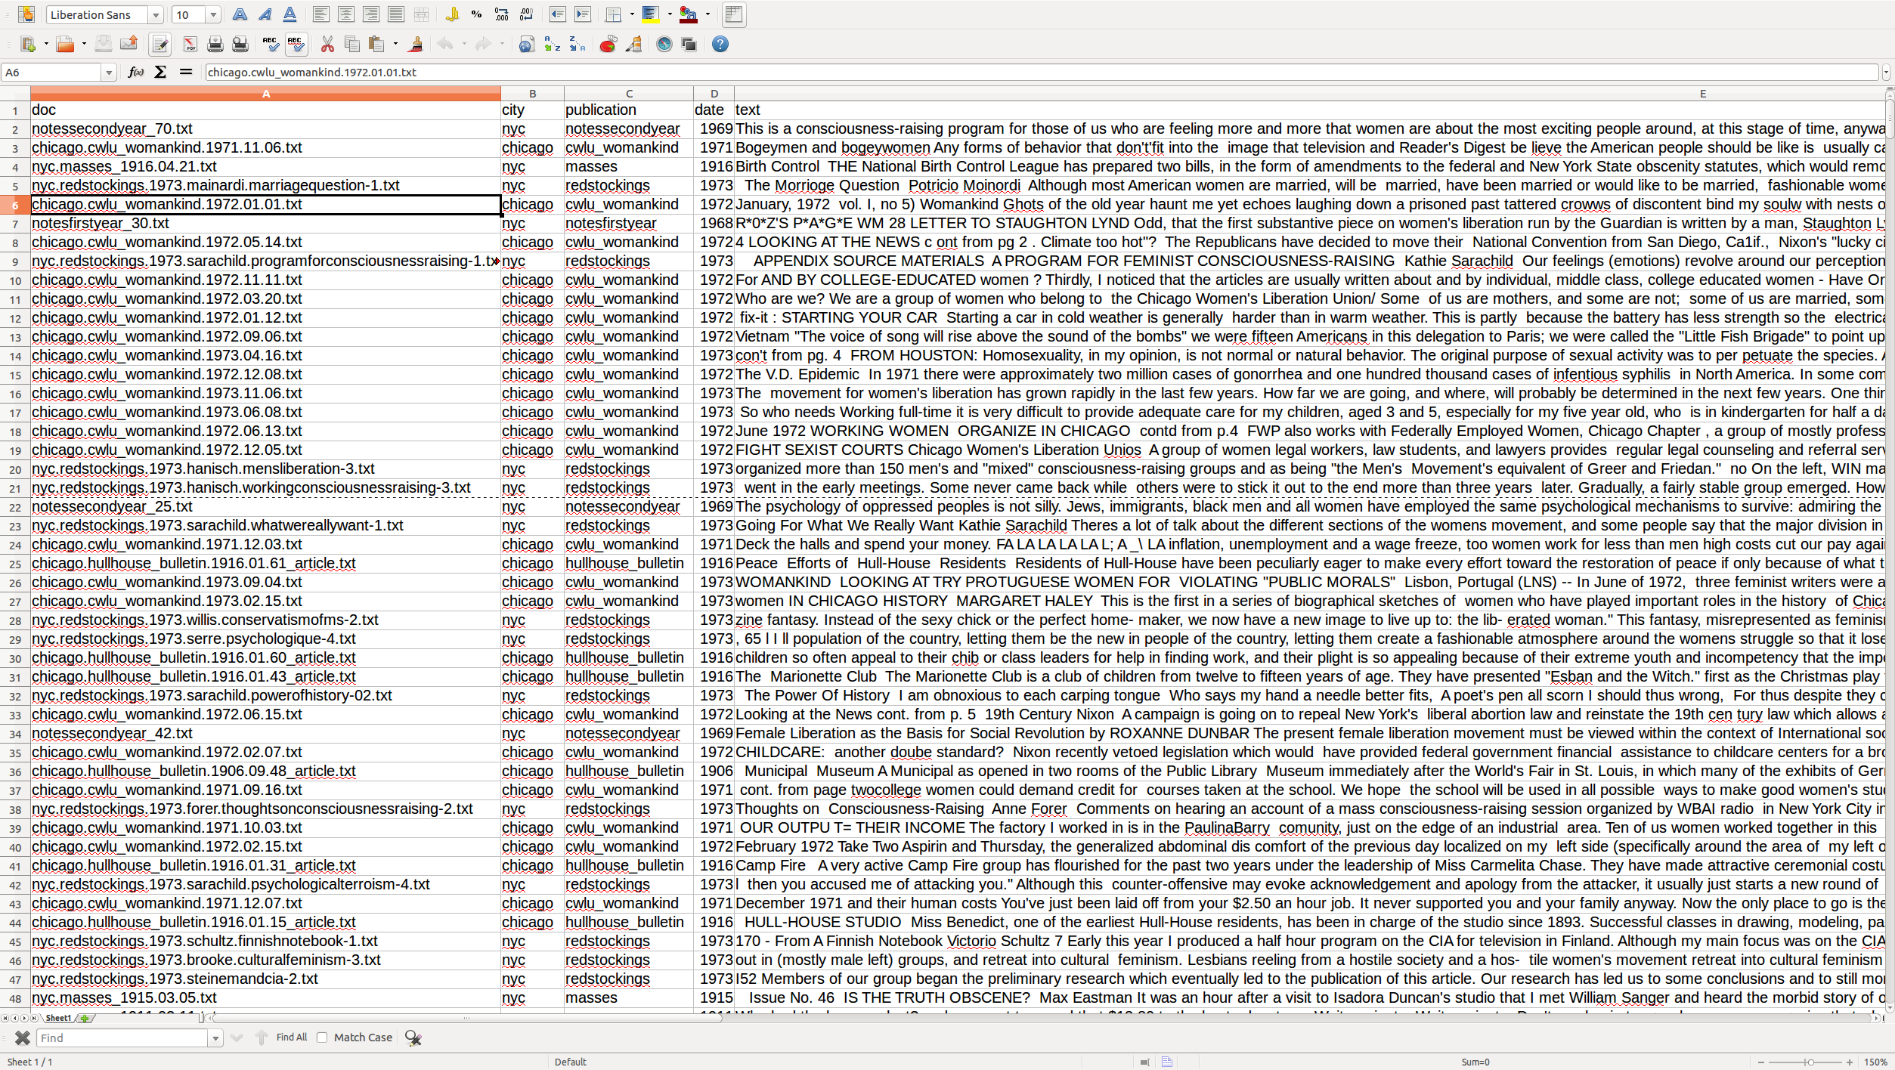
Excel (Processed) File

Slide 11
.csv
doc city publication date text word_count org identifier wave
notessecondyear_70.txt nyc notessecondyear 1969 "This is a consciousness-raising program for those of us who are feeling more and more that women are about the most exciting people around, at this stage of time, anyway, and that the seeds of a new and beautiful world' society lie buried in the consciousness of this very class which has been abused and oppressed since the beginning of human history. It is a program planned on the assumption that a mass liberation movement will develop as more and more women begin to perceive their situation correctly and that, therefore, our primary task right now is to awaken '.class"" consciousness in ourselves and others on a mass scale. The following outline is just one hunch of what a theory of mass consciousness-raising would look like in skeleton form. I. The ""bitch session"" cell group A. Ongoing consciousness expansion 1. Personal recognition and testimony a. Recalling and sharing our bitter experiences b. Expressing our feelings about our experiences both at the time they occurred and at present c. Expressing our feelings about ourselves, men, other women d. Evaluating our feelings 2. Personal testimony - methods of group practice a. Going around the room with key questions on key topics b. Speaking our experience - at random c. Cross examination 3. Relating and generalizing individual testimony a. Finding the common root when different women have opposite feelings and experiences b. Examining the negative and positive aspects of each woman's feelings and her way of dealing with her situation as a woman B. Classic forms of resisting consciousness, or: How to avoid facing the awful truth 1. Anti-womanism 2. Glorification of the oppressor 3. Excusing the oppressor (and feeling sorry for him) 4. False identification with the oppressor and other socially privileged groups 5. Shunning identification with one's own oppressed group and other oppressed groups 6. Romantic fantasies, utopian thinking and other forrns of confusing present reality with what one wishes reality to be 7. Thinking one has power in the traditional role-can ""get what one wants,"" has power behind the throne. etc. 8. Belief that one has found an adequate personal solution or will be able to find one without large social changes 9. Self-cultivation, rugged individualism, seclusion, and other forms of go-it-alonism 10. Self-blame!! 11. Ultra-militancy; and others?? C. Recognizing the survival reasons for resisting consciousness D. ""Starting to Stop"" - overcoming repressions and delusions 1. Daring to see, or: Taking off the rose-colored glasses a.. Reasons for repressing one's own consciousness 1) Fear of feeling the full weight of one's painful situation 2) Fear of feeling one's past wasted and meaningless (plus wanting others to go through the same obstacles) 3) Fear of despair for the future b. Analyzing which fears are valid and which invalid 1) Examining the objective conditions in one's own past and in the lives of most women throughout History 2) Examining objective conditions for thepresent " 553 redstockings 1 2

Slide 12
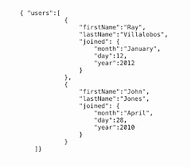
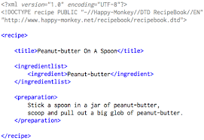
Other formats (we won’t cover)
html, json, xml, pickel

Slide 13


Warning!
When creating your own corpus:
Do not save text in .doc, .docx, .rtf, .xls, or pdf formats

Slide 14
Provided Corpuses (aka: Corpora)
Literary:
txtLab 450: a novel per year for 150 years in 3 languages
Underwood/Sellers: 750 volumes of C19 poetry, canon/archive
Music Reviews:
From metacritic.com, 1990-2015
First paragraph from professional reviews (versus user reviews)
Random sample of 5000 reviews from ~171,000 reviews
Includes metadata on release date, artist, album, reviewer, and genre
Stored in .csv format
If you have one, we hope you can try these lessons on your own corpus!

Slide 15
Workshop Schedule
Monday Afternoon: Jump Right In with an introduction to NLTK
Introduction to the way computers “read” text
Text tokens and counting words (bag of words)
Part-of-Speech tagging and counting tagged words
What you’ll learn:
Basic things you can do with Natural Language Processing
Starting thinking in a computational/ distance reading framework
Illustration: Can you identify a novel from only the most frequent nouns and verbs?
Corpus: Two mystery novels
Notes:
We’re not just hear to teach technical skils, although we will do that. But it takes a paradigm shift in how to think about questions, types of evidence, types of answers, and what you’re looking for, how you read.

Slide 16
Workshop Schedule
Tuesday: Back to Basics – Working with Texts in Python
Morning: Python basics – lists, strings, and all the important things
Afternoon: The Pandas Dataframe
What you’ll learn:
How to use python to do what you already do, but faster
Understand the Python version of Excel (called Pandas), and learn why it’s 1000x better than Excel
Illustration: graphing the character space using Pandas
Corpus: Literary novels

Slide 17
Workshop Schedule
Wednesday: Document Term Matrix (DTM) and Word Scores
Morning: scikit-learn and word scores
What you’ll learn:
What is a Document Term Matrix and why do we <3 it
How to identify important or interesting words, not just frequent words
Illustration: What words distinguishe reviews from different genres
Corpus: Music Reviews
Afternoon: Sandbox!
You do you

Slide 18
Workshop Schedule
Thursday: Thematic Frequencies, or the Frequency of Themes
Morning: Dictionary Method
Counting groups of words to measure presence of themes
Corpus: Music Reviews
Afternoon: Text Classification
Classify text into different categories to measure presence of themes
Corpus: Literary texts
Sandbox!
You do you
What you’ll learn:
Two different methods to use computers to “code” or “categorize” text into pre-determined themes. Can it replace human coding?

Slide 19
Workshop Schedule
Friday: Computational Inductive Analysis
Morning:
Topic Modeling (users, beware!)
Unsupervised machine learning
Corpus: Literary texts
Wrap-Up
What you’ll learn:
How to use computational methods to inductively identify themes in your text
A look back at how far you’ve come in a week
A look toward the future
Afternoon:
Lightening Talks (all workshops together)

Slide 20
Cheesy (but genuine) Thoughts
You can learn to program!
Programming is a creative endeavor
There is no one right solution, no one way to code
Requires problems solving skills, artistic thinking
You will get frustrated, you will hate your computer, and you will want to give up
Nothing will work the first time you try. Doesn’t matter, try again
No matter what problem you have, 100 other people have had the same problem, 100 others have the answer (check StackOverflow, Google)
Look to each other (and StackOverflow) for help
Once it works, it is beautiful
Notes:
And I mean whatever problem you have. You saved a file on your computer and can’t get to the folder you saved it in. You don’t know the admin password on your computer (or don’t even know there is an admin password)
You will work for hours, find that you have a stray semi colon where it’s not supposed to be, but when it works those frustrations melt away and you move on in a flurry of glory.

Slide 21
Cheesy (but genuine) Thoughts
This Workshop only works if it is active, not passive
We know the scripts work on our computer. Get them working on your computer
Modify them, tie them up with a bow, and take them home with you
This is a new and developing field, so now more than ever: question everything and push boundaries. You are the future of this field.

Slide 22
Our Goals
Theoretical
General understanding of the past, present, future of text analysis
Overview of computational text-analysis, how it fits into traditional, or close reading
Intuition about programming/scripting and how computers read text
Technical
Basic technical understanding of programming/scripting in Python
Deeper understanding of some key techniques
Knowledge of how to learn on your own
First reproduce, then modify
Use Stack Overflow
Practical
How to translate these techniques to your own corpus/research
Go home with completed scripts you can modify/use in your own research
Ideas and a plan of action for how to advance your own research, contribute to this field

