Slide 1
AFS Credit Products: Effects of Economic and Demographic Differences on Household Use
Isaiah K. Okiemen
Ph.D. Student in Economics
Howard University, Washington, DC.
Presented at
Federal Reserve Board of Governors
Division of Research and Statistics
October 21, 2016

Slide 2
Economic Research Statement
Question: What effects does economic and demographic differences have on household use of credit products (payday pawnshop, refund anticipation, automobile and rent-to-own loans?
Importance: According to current population survey supplement, “7.7 percent (1 in 13) of households in the United States were unbanked in 2013. Also, 20 percent of U.S. households (24.8 million) were underbanked in 2013, meaning that they had a bank account but also used alternative financial services (AFS) outside of the banking system” https://www.fdic.gov/householdsurvey. These results pose serious concern for policy-makers.
Hypothesis: The hypothesis in the model is that household economic and demographic differences have no effect on the use of AFS credit products.
Rule of Thumb: Rejecting the null hypothesis would mean the coefficients of each predictor variables in the model are statistically different from 0; hence household economic and demographic differences have effect on household use of AFS credit products.

Slide 3
Data Description
In June 2013, the FDIC sponsored the third National Survey of Unbanked and Underbanked Households to collect data on the number of U.S households that are unbanked and underbanked, their demographic characteristics, and their reasons for being unbanked and underbanked.
CPS survey was conducted by the U.S. Census Bureau, with a nationally representative sample of 53,405.
The dataset is cross-sectional. The unit of observation is household.
Dependent variables: payday loans, pawnshop loans and automobile title loans.
Independent variables: unbanked, income group, age group, homeowner, unmarried female headed household and household levels of education.

Slide 4
Data Cleaning Preparation Method~using R Programming
Created the following dummy variables using an ifelse statement in R
Created indicator variable “unbanked” =1 if do not have checking and or savings account, otherwise 0.
Created indicator variables for each credit products (payday, pawnshop, rent-to-own, tax refund anticipation and automobile title loans and set values equals 1 if used in the past 12 months, otherwise 0.
Created indicator variable for income group, age group and levels of education and set values equals, otherwise 0.
Created indicator variable if unmarried and female headed household and set values equals 1, otherwise 0.

Slide 5
Description of AFS Credit Products
Payday loans
short term cash loans based on the borrower’s personal check held for the future deposit or on electronic access to the borrower’s bank account.
Payday loan range in size from $100 to $1,000, depending on state legal maximum
The cost of payday loan can range from $10 to $30 for every $100 borrowed
APR of payday loan can go as high 400%
Pawnshop loans
Non-recursive, short-term collateral loans
Customers repay loans and redeem their collateral at a high average national redemption rate of 85%

Slide 6
Description of AFS Credit Products Cont..
Tax refund anticipation loan (RAL)
Aggressively marketed by income tax preparation companies, such as H&R Block
RAL companies facilitate loans through banks
According to Consumer Federation of America, the fee for a typical RAL of $1,500 is $61.22, which translates into an APR of 149%
Automobile title loan
Short-term loan secured by borrower’s title to a vehicle
States typically determine the terms of the loan, maximum amount and repossession in the case of default.

Slide 7
Analysis of the Research Question~Logit Model
From a consumer choice theoretical framework, I model the consumer’s choice of whether to use AFS products with a multivariate logit model.
The logit model is more appropriate in this case given that the dependent and predictor variables are categorical in nature.
These predictor variables are statistically significant in previous literature.
Three equations are presented. First is payday loan usage. Second, is pawnshop loan usage and third, is auto title loan usage.

Slide 8
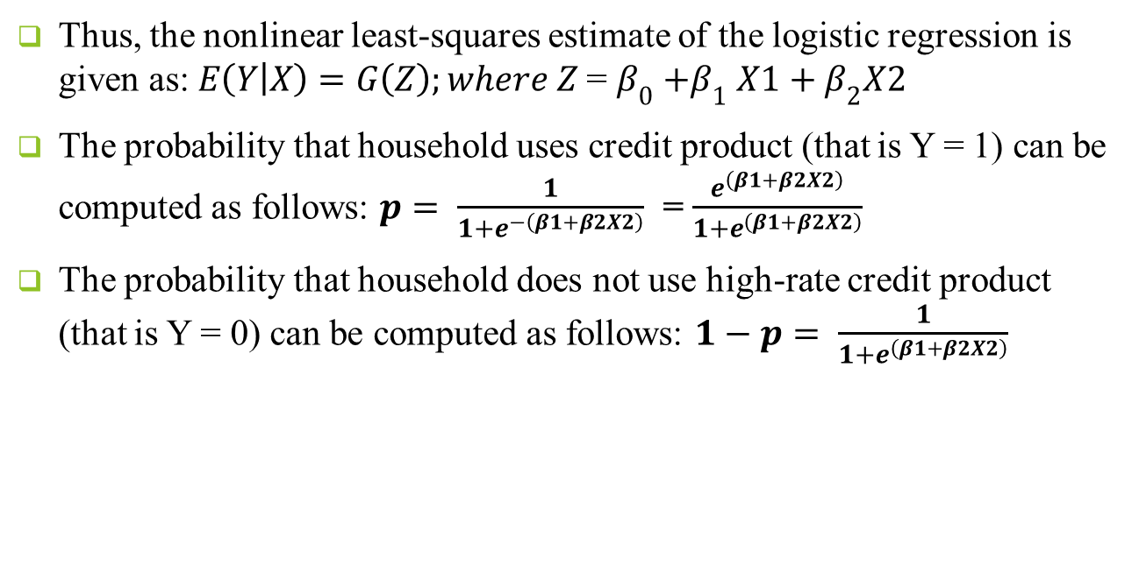
Analysis Cont.
Thus, the nonlinear least-squares estimate of the logistic regression is given as: $E\left(Y | X\right)=G\left(Z\right);where Z$ = $β_{0}{+β}_{1}X1+β_{2}X2$
The probability that household uses credit product (that is Y = 1) can be computed as follows: $p= \frac{1}{1+e^{−\left(β1+β2X2\right)}}$ = $\frac{e^{\left(β1+β2X2\right)}}{1+e^{\left(β1+β2X2\right)}}$
The probability that household does not use high-rate credit product (that is Y = 0) can be computed as follows: $1−p= \frac{1}{1+e^{\left(β1+β2X2\right)}}$

Slide 9
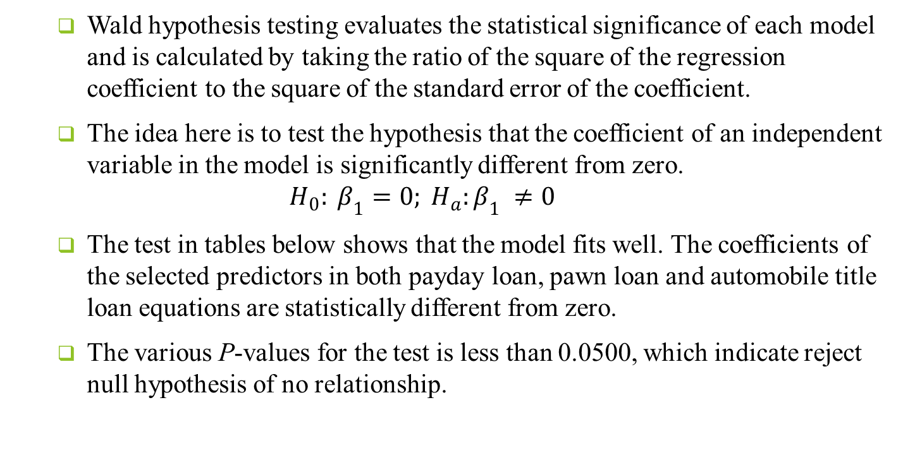
Model Testing: Wald Statistical Test for Predictor Variables
Wald hypothesis testing evaluates the statistical significance of each model and is calculated by taking the ratio of the square of the regression coefficient to the square of the standard error of the coefficient.
The idea here is to test the hypothesis that the coefficient of an independent variable in the model is significantly different from zero.
$$H_{0}: β_{1}=0; H_{a}:β_{1} ≠0$$
The test in tables below shows that the model fits well. The coefficients of the selected predictors in both payday loan, pawn loan and automobile title loan equations are statistically different from zero.
The various P-values for the test is less than 0.0500, which indicate reject null hypothesis of no relationship.

Slide 10
Household Income of Borrowers (Percentage Distribution-National Data)
Income (in thousand) | Payday loan | Pawn loan | Rent-to-Own | Auto-title loan | RAL | No high-rate credit
Less than $15 | 17 | 35 | 28 | 21 | 15 | 11
$15-$30 | 27 | 28 | 27 | 22 | 30 | 15
$30-$50 | 27 | 19 | 26 | 24 | 24 | 19
$50-$75 | 18 | 11 | 11 | 18 | 18 | 19
$75 or more | 11 | 7 | 8 | 15 | 13 | 36
Total | 100 | 100 | 100 | 100 | 100 | 100

Slide 11
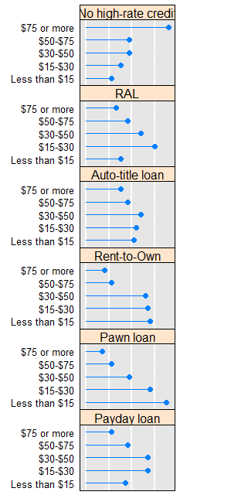
Household Income of Borrowers (Percentage Distribution-National Data)

Slide 12
Household Income of Borrowers (Percentage Distribution-MSA-DMV)
Income (in thousand) | Payday loan | Pawn loan | Rent-to-Own | Auto-title loan | RAL | No high-rate credit
Less than $15 | 0 | 14 | 40 | 0 | 15 | 8
$15-$30 | 17 | 50 | 20 | 25 | 0 | 5
$30-$50 | 33 | 0 | 20 | 0 | 8 | 13
$50-$75 | 8 | 29 | 0 | 25 | 54 | 14
$75 or more | 42 | 7 | 20 | 50 | 23 | 60
Total | 100 | 100 | 100 | 100 | 100 | 100

Slide 13
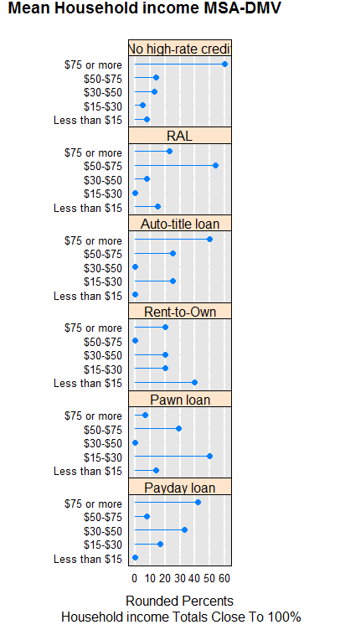
Household Income of Borrowers (Percentage Distribution-MSA-DMV)

Slide 14
Household Age of Borrowers (Percentage Distribution-National Data
Age group | Payday loan | Pawn loan | Rent-to-Own | Auto-title loan | RAL | No high-rate credit
15 to 24 | 6 | 9 | 9 | 6 | 8 | 3
25 to 34 | 25 | 23 | 27 | 28 | 25 | 14
35 to 44 | 22 | 21 | 25 | 26 | 27 | 15
45 to 54 | 25 | 27 | 21 | 22 | 23 | 19
55 to 64 | 14 | 15 | 12 | 10 | 12 | 20
65 or more | 8 | 5 | 6 | 8 | 6 | 28
Total | 100 | 100 | 100 | 100 | 100 | 100

Slide 15
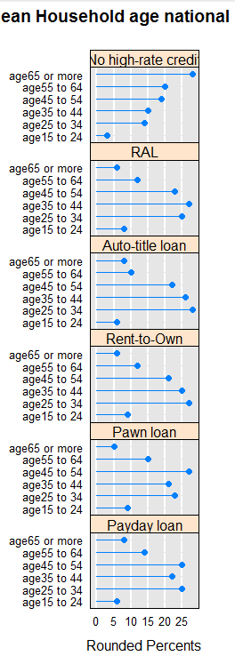
Household Age of Borrowers (Percentage Distribution-National Data

Slide 16
Household Age of Borrowers (Percentage Distribution-MSA-DMV
Age group | Payday loan | Pawn loan | Rent-to-Own | Auto-title loan | RAL | No high-rate credit
15 to 24 | 5 | 5 | 5 | 5 | 5 | 5
25 to 34 | 20 | 21 | 20 | 20 | 20 | 19
35 to 44 | 19 | 20 | 20 | 19 | 20 | 18
45 to 54 | 19 | 19 | 20 | 20 | 19 | 20
55 to 64 | 16 | 16 | 16 | 16 | 16 | 16
65 or more | 20 | 20 | 20 | 20 | 20 | 21
Total | 100 | 100 | 100 | 100 | 100 | 100

Slide 17
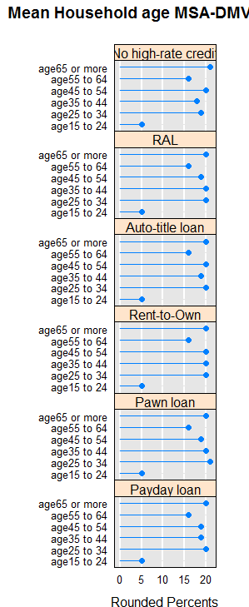
Household Age of Borrowers (Percentage Distribution-MSA-DMV

Slide 18
Logit Regression Results for Households Who Use Payday Loan

Slide 19
Logit Regression Results for Households Who Use Pawnshop Loan

Slide 20
Logit Regression Results for Households Who Use Automobile Loan

Slide 21
Wald Hypothesis Testing: Statistical Test for Individual Predictors

Slide 22
Next Step.
Look at the CPS supplement multi-year data set to see how changes in household income over time affect the demand for the AFS credit products.
2009-2013 CPS supplement.

Slide 23
References
Elliehausen, G (2011). Assessment of Consumer’s Use of High-Rate Credit Products
Division of Research and Statistics, Board of Governors of the Federal Reserve System
Sherrie, L., Rhine, W; Toussaint, M. (2006). The Importance of Check-Cashing Businesses to the Unbanked: Racial and Ethnic Differences
The Review of Economics and Statistics, Vol. 88, No. 1. Pp. 146-157
Robert, B., Avery. (2011). Payday Loans versus Pawnshops: The Effects of Loan Fee Limits on Household Use
Board of Governors of the Federal Reserve System
Miller, T (2015). Differences in Consumer Credit Choices Made by Banked and Unbanked Mississippians.
Journal of Law, Economics and Policy
Bhutta, N; Paige, S; Jeremy T. (2015). Payday Loan Choices and Consequences
Journal of Money, Credit and Banking, Vol. 47, No. 2-3

Slide 24
References
Kurban, H; Diagne, A. (2014). Demographics of Payday Lending in Oklahoma
Howard University Center on Race and Wealth
Consumer Financial Protection Bureau (2016). Consumer Guide to Selecting a Low-Risk Account. Retrieved April 13, 2016 from
http://files.consumerfinance.gov/f/201602_cfpb_consumer-guide-to-selecting-a-lower-risk-account.pdf
Meltzer, B. (2011). The Real Cost of Credit Access: Evidence from the Payday Lending Market
The Quarterly Journal of Economics, Vol. 126. Pp 517-555

