Slide 1
Boko Haram and its effects on schooling decisions in Nigeria
Midterm Project
Expository Data Analysis with R
Candy Martinez

Slide 2
Research Question & Challenges
What effects, if any, does Boko Haram’s presence have on an individual’s decision regarding school?
Hypothesis: Domestic terrorism perpetrated by Boko Haram adversely affects education in the country.
Data cleaning issues:
Survey data included many NAs, limiting operations that could be conducted on the data set.
Placing age restrictions on the data set required me to reformat the entire dataframe.

Slide 3
Background
Nigeria is home to one of the most dangerous terrorist organizations in the world, a group known as Boko Haram. Founded in 2002, the Boko Haram insurgency has rapidly become Nigeria’s biggest threat to national stability
Boko Haram is commonly translated to “western education is forbidden.” Thus, their ideology discourages participation in modern schooling and may adversely impact education decisions made by the youth.
Historically, Boko Haram has been concentrated in the North, where poverty is generally high and educational attainment is low, compared to the South.
Part of the success Boko Haram has had in the north can be attributed to their ability to gather regional support through spreading belief that state governments abuse their power (Gaffey 2016).
Boko Haram received widespread international attention in 2014 with the kidnapping of 276 school girls from Chibok. Although the sect regularly targets women, those tactics are being reciprocated by the Nigerian government. Boko Haram has also begun to incorporate women into their ranks (Zenn and Pearson 2014). As a result, women on both sides of the conflict have been adversely affected by the violence.

Slide 4
Literature Review
The gap between the north and south that existed at the time of independence has not been narrowed despite several major efforts by the federal government to achieve universal primary education (Lincove 2009, Antoninis 2014).
According to Forest (2012), conditions in Nigeria are particularly conducive to religious terrorism and the Boko Haram ideology due to corruption, weak institutions and a roughly equal split between Muslims and Christians in the country.
The inability of a country to provide its people with basic resources like adequate healthcare and education creates a “demand” for a militia or religious group to step in and fill the gap (Berman 2003).
Many of Boko Haram’s members come from the Kanuri tribe; historically, the Kanuri tribe was based in northeastern Nigeria thus explaining Boko Haram’s concentration in the region. Kanuri living across the borders in several neighboring countries have further enabled Boko Haram by providing easy access to small weapons trade (Forest 2012).

Slide 5
Data description
The Living Standards Measurement Survey is conducted by the World Bank and represents 5,000 households across Nigeria.
Wave 1: 2010
Wave 2: 2012
Collected on the individual level
Data from the survey contains information on age, gender, religion, education, household expenditure, media access and geographic conditions.
Time series data on the media-reported attacks attributed to Boko Haram comes from the Council on Foreign Relations’ Nigeria Security Tracker.

Slide 6
Descriptive Statistics
 | N | Mean | Standard Deviation | Median | Min | Max | Standard Error
Expected Education to be completed upon the completion of studies | 20515 | 10.24 | 5.05 | 12 | 0 | 18 | 0.04
Household Size | 55472 | 6.74 | 3.31 | 6 | 1 | 31 | 0.01
Number of dependents | 55472 | 3.05 | 2.22 | 3 | 0 | 16 | 0.01
Rainfall (mm) | 56716 | 1392.65 | 644.67 | 1258 | 324 | 3788 | 2.71
Slope (%) | 56716 | 3.05 | 2.46 | 2.25 | 0 | 30.59 | 0.01
Elevation (M) | 56716 | 292.91 | 220.40 | 271 | 1 | 1427 | 0.93
LGA10killings | 55999 | 3.49 | 49.92 | 0 | 0 | 780 | 0.21
LGA12killings | 55999 | 5.23 | 44.45 | 0 | 0 | 628 | 0.19
LGA10attacks | 55999 | 0.02 | 0.16 | 0 | 0 | 2 | 0.00
LGA12attacks | 55999 | 1.12 | 11.03 | 0 | 0 | 171 | 0.05
Education Expenditure (log) | 55472 | 11.31 | 0.69 | 11.31 | 8.49 | 14.74 | 0.003

Slide 7
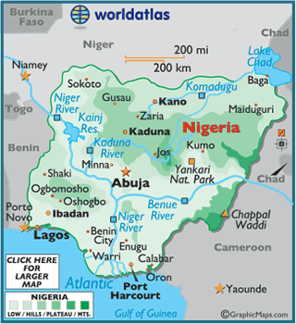
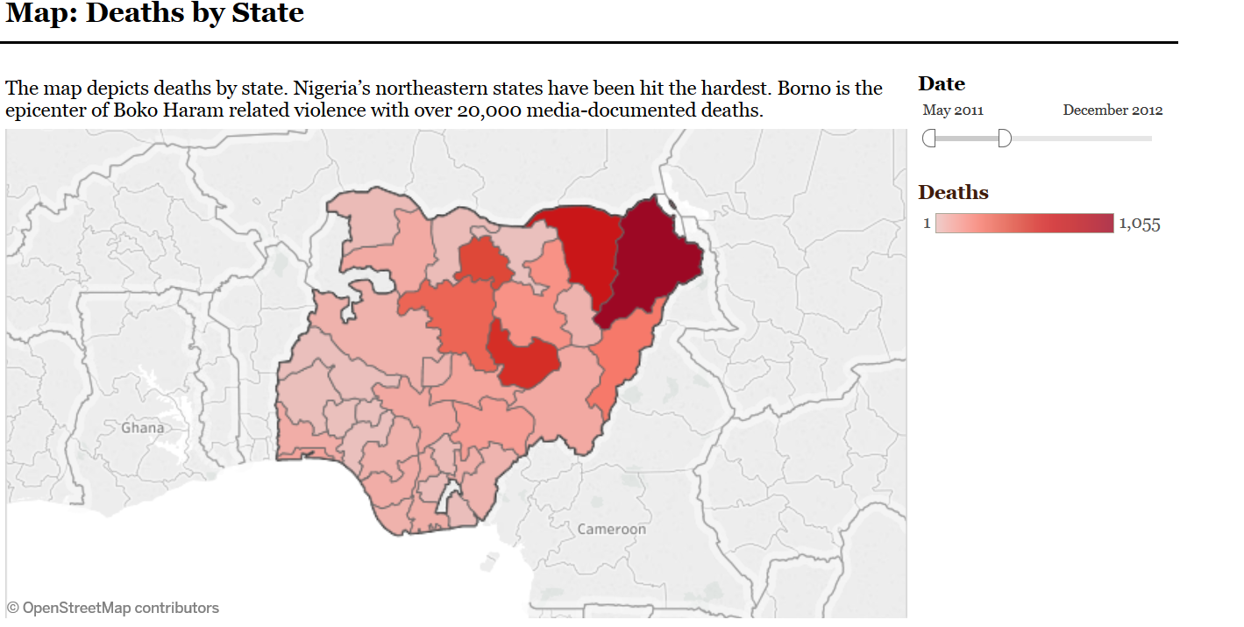
Elevation & Boko Haram
http://www.cfr.org/nigeria/nigeria-security-tracker/p29483
http://www.worldatlas.com/webimage/countrys/africa/nigeria/nglatlog.htm

Slide 8
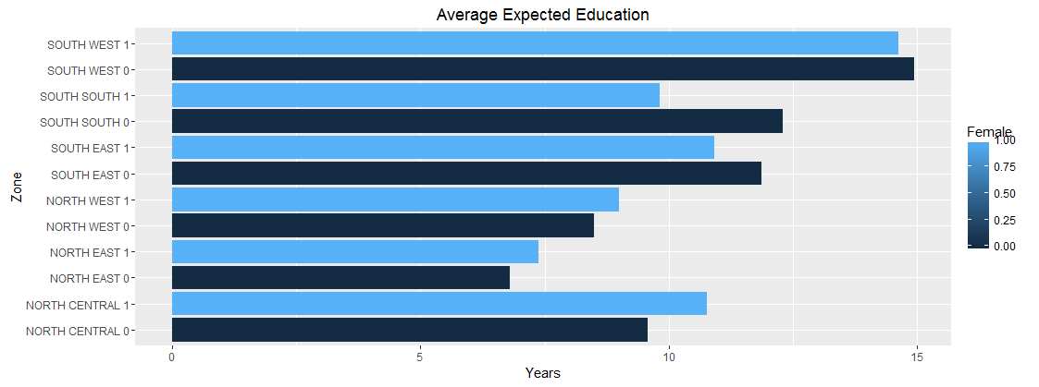
The sample size depicted in the graph is limited to individuals between the ages of 6-14.

Slide 9
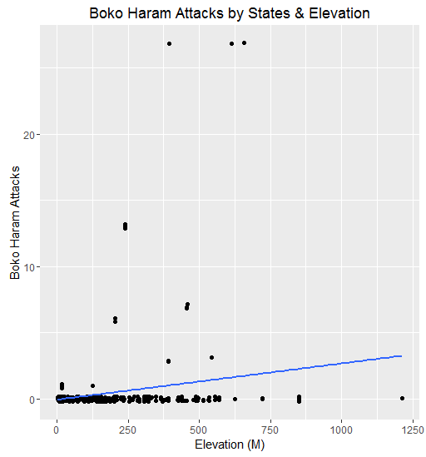
ρ=.23
P-value: 1.769e-05

Slide 10
Next Steps
Due to factors that are correlated with both Boko Haram and Education, endogeneity is a concern in the OLS model. Utilization of an instrument that is correlated with the independent variable but not the dependent variable can correct for the concern.
Econometric model:
Elevation Boko Haram killings Schooling Decisions
Poverty, etc.
LGAkillings = γ₀ + γ₁(Elevation) ) + γ₂(Female) + γ₃(age) + γ₄(log(expenditure)) + γ₅(dependents) + γ₆(Islam) + γ₇(school distance) + γ₈ (radio) + γ₉ (tv) + γ₁₀ (rainfall) + γ₁₁ (state*) + u
Expected Education = β₀ + β₁(LGAkillings) + β₂(Female) + β₃(age) + β₄(log(expenditure)) + β₅(dependents) + β₆ (Islam) + β₇(school distance) + β₈(radio) + β₉(tv) + β₁₀(rainfall) + β₁₁(state*) + ε

Slide 11
Next Steps (cont’d)
Additional data work includes running regressions using the distance from households to nearest northern border as an instrument for Boko Haram killings, because the existing literature says proximity to northern national borders enables Boko Haram through facilitation of small weapons trade.

Slide 12
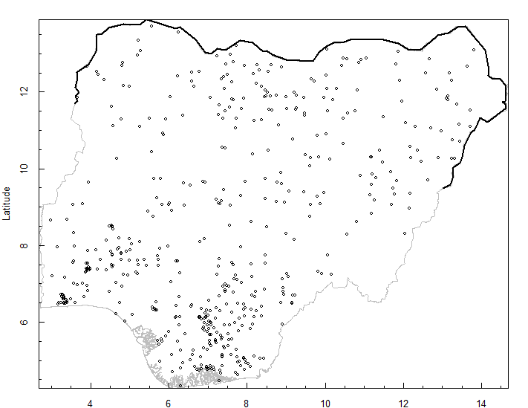
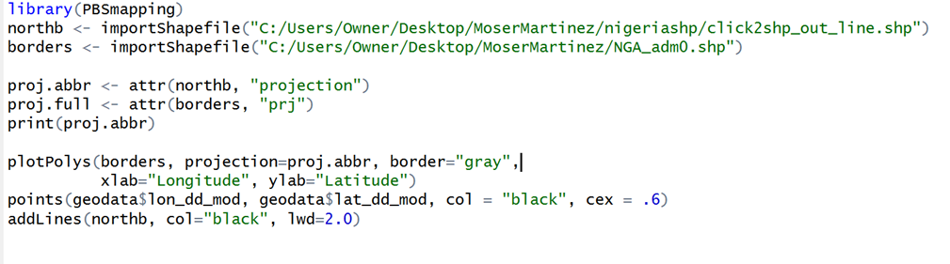
Households sampled by the LSMS survey
The northern border is highlighted and distance from each household to the border would be used as an instrument for attacks

Slide 13
References
Antoninis, Manos. "Tackling the Largest Global Education Challenge? Secular and Religious Education in Northern Nigeria." World Development (2014): 82-92.
Berman, Eli. "Hamas, Taliban And The Jewish Underground: An Economist's View Of Radical Religious Militias." NBER Working Paper Series (2003). National Bureau of Economic Research.
Forest, James. “Confronting the Terrorism of Boko Haram in Nigeria.” JSOU Report, The JSOU Press (2012).
Gaffey, Conor. "Nigerian state government 'acting like Boko Haram,' says Shiite spokesman." Newsweek 11 10 2016.
Lincove, Jane Arnold. "Determinants of schooling for boys and girls in Nigeria under a policy of free primary education." Economics of Education Review 28.4 (2009): 474-484.
Zenn, Jacob and Elizabeth Pearson. "Women, Gender and the evolving tactics of Boko Haram." Journal of Terrorism Research (2014).

