Slide 1

Skilled Emigration of Caribbean Nationals to the United States
Presenter: Marcy Jagdeo
PhD Candidate, Economics
Howard University

Slide 2
Research Question ?
Has the pattern of skilled migration to Caribbean nationals to the United States changed since the removal of work-permit restriction among Caribbean member states ?

Slide 3
Context
This study will look specifically at countries which are members of CARICOM
What is CARICOM?
Caribbean Community (CARICOM) is aimed a promoting economic integration between its 15 member sates
What is CSME?
The CARICOM Single Market and Economy (CSME) is an enlarged market which aims to provide a foundation for growth and development through the creation of a single economic space for the production of competitive goods and services.
In this single market space, there is free movement of skilled labor for certain occupational categories removing work permit restrictions

Slide 4
Why is this Question Important?
Migration affects both sending and receiving countries
Many countries in the Caribbean have lost more than 70 percent of their labor force , which is amongst the highest rates of brain drain in the world (Mishra, 2006)
CSME was implemented to provide full employment of labor and to curb the loss of its skilled labor force
Notes:
- It is important to clarify which country is experiencing the highest rate of brain drain. For example, if Haiti is experiencing the highest rate of brain drain, this may be detrimental to the overall economic recovery of a country which in recent years have experienced intense weather-related devastations. Something to be mindful about as well when you want to think about the “why?”

Slide 5
Findings from Previous Studies
Thirteen (13) Caribbean countries were ranked among the 20 countries with the highest skilled migration rates and seven occupy the first positions with Guyana, Grenada, Jamaica, St. Vincent and Haiti (Castellani, 2007)
While all socioeconomic groups in the Caribbean participate in the exodus, Caribbean migrants comprise of a select population. Caribbean migrants strongly over-represent young adults from the age s of 20 and 39 with women more than men choosing to migrate. (Thomas-Hope, 2002)
On average, Caribbean migrants had better-paying and more skilled occupations than non-migrants in their country of origin. Accordingly, the Caribbean has exported a large share of its skilled labor force. As many as 4,000 Caribbean professionals including doctors, engineers, teachers, and nurses form part of this annual “brain drain” from the region. (Duany,1994).
There is greater movement between island nations in the Caribbean with Trinidad and Barbados becoming virtual hubs for migrants from other islands Mazza and Sohnen (2011)

Slide 6
Hypothesis
The free movement of labor within the Caribbean has had a negative effect on skilled emigration from the Caribbean to the United States after the implementation of the policy in 2008

Slide 7
Data Sources
This study will use the dataset from the American Community Survey
It is repeated cross sectional dataset with years ranging from 2000-2014. The study will incorporate the following variables: age, sex, birthplace, occupation, immigration status, educational attainment and English as a native language The unit of observation is at individual level.
Notes:
Other data sets worth exploring:
labor statistics: http://www.bls.gov/spotlight/2013/foreign-born/)
Visa data from State Dept: https://travel.state.gov/content/visas/en/law-and-policy/statistics/graphs.html
MPI also has some information on their website for you to explore: http://www.migrationpolicy.org/article/caribbean-immigrants-united-states

Slide 8
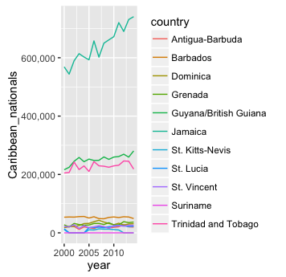
Caribbean Immigrants in the United States
Notes:
The current graph is hard to read because of all the color schemes. In order to make this readable, a good way to display the data is through a table. For example:
Country Year # of Immigrants to U.S.
Antigua-Barbuda 2000 200,000
2005 210,000

Slide 9
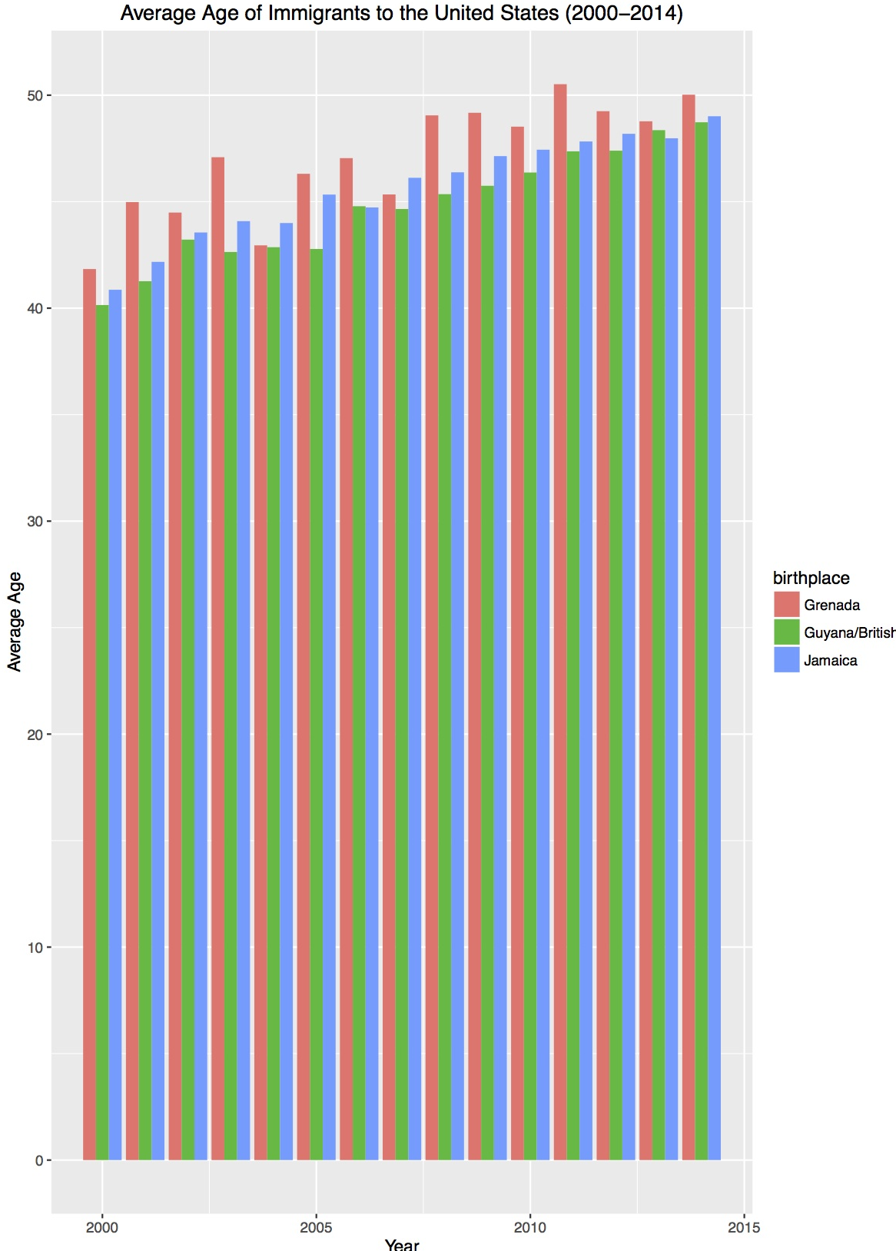
Decomposition of Migrant Population
Notes:
- The labels on the graphs are very small. To make this more readable, you can turn this into a year-on-year comparison. For example, have the legend sets as year, and the x-axis as the sample countries. That way, people can see if there has been a drop or increase as the years go by. It would also be useful if you can just pull out the average age overall from 2000-2014. It will also be useful to note that the migrant population may include people coming over with family visas and so forth; otherwise, the audience will assume the data is for workers only.

Slide 10
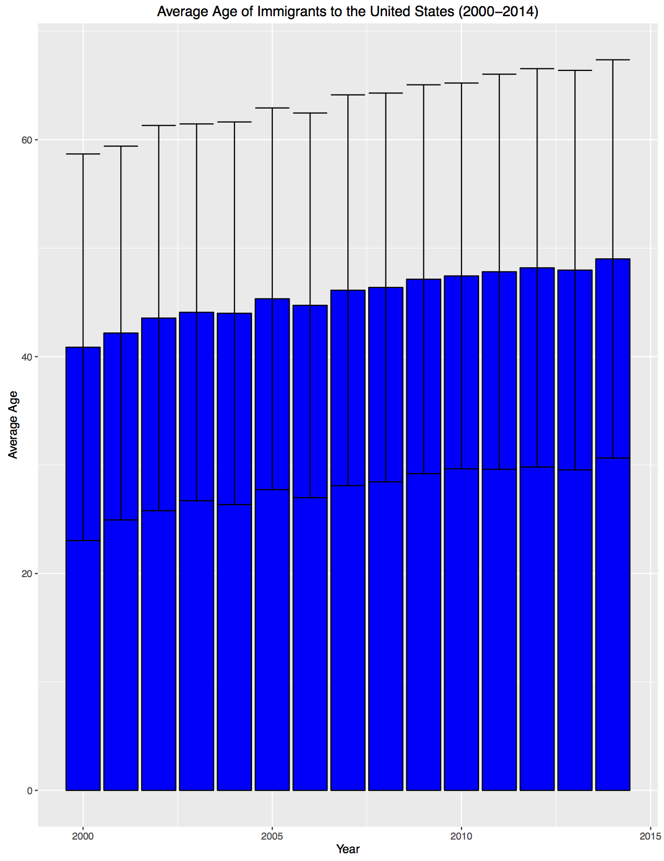
Notes:
The labels are small; please make them bigger.
A more useful graph would be a pie chart where you break down the different sectors that Caribbean migrant workers work in: such as hospitality, health care, and so forth.

Slide 11
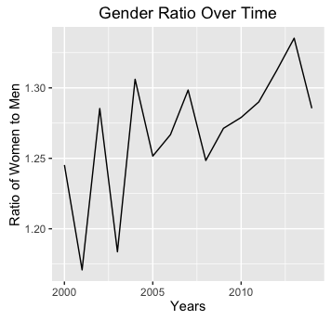
Notes:
- This would be more useful if there’s another comparison component. Is the Caribbean exporting more women to work in certain industries than men? Like nursing? Another way to look at this is analyze the economic impact this will have on the Caribbean countries when certain genders are not in the labor force.

Slide 12
Tertiary Level Education amongst Caribbean born immigrants
Notes:
-Labels are hard to read, please make them bigger. Another way useful way to display the data is to look at what field migrant workers studied in. For example, is there a higher rate of engineers majors than others?

Slide 13
Summary Statistics
Variables | mean | SD | median | min | max | range | skew | kurtois | se
PERWT | 109.34 | 123.64 | 75 | 0 | 1902 | 1902 | 3.49 | 18.19 | 0.29
SEX | 1.57 | 0.5 | 2 | 1 | 2 | 1 | -0.27 | -1.93 | 0
AGE | 44.97 | 17.78 | 45 | 0 | 95 | 95 | 0.08 | -0.39 | 0.04
BPL | 267.84 | 15.88 | 260 | 260 | 300 | 40 | 1.53 | 0.34 | 0.04
BPLD | 26824.3 | 1588.05 | 26042 | 26030 | 30040 | 4010 | 1.53 | 0.34 | 3.76
CITIZEN | 2.35 | 0.53 | 2 | 1 | 3 | 2 | 0.1 | -0.94 | 0
YRNATUR | 4857.21 | 3835.99 | 2005 | 1925 | 9999 | 8074 | 0.59 | -1.65 | 13.32
YRIMMIG | 1986.03 | 12.61 | 1987 | 1910 | 2014 | 104 | -0.46 | 0.48 | 0.03
YRSUSA1 | 20.4 | 12.67 | 19 | 0 | 93 | 93 | 0.62 | 0.33 | 0.03
EDUC | 6.42 | 2.61 | 6 | 0 | 11 | 11 | -0.27 | 0.03 | 0.01
OCC | 2454.98 | 2743.59 | 814 | 0 | 9920 | 9920 | 0.94 | -0.12 | 6.5
OCC2010 | 5760.22 | 3108.32 | 5110 | 10 | 9920 | 9910 | 0.05 | -1.18 | 7.37
Notes:
- While this is useful, some of the variables are difficult to decipher. What does PERWT mean? Also, you may want to code the program so that it does not read missing data, such as the 9999 value in YRNATUR.

Slide 14
Econometric Model
OLS Regression
ϒ_{it} = β0_{i} +β₁X₁+ β₂X₂+β₃X₃ … +ε_{i}
Where :
ϒ_{it} – share of immigrant population (Caribbean nationality)
β₁X₁ – time dummy for the year of CSME implementation
β₂X_{2 …} - dummies for each country

Slide 15
ϒ_{it} = β0_{i} +β₁X₁+ β₂X₂+β₃X₃ +β₄X₄ +β₅X₅+β₆X₆ +ε_{i}
Where:
ϒ_{it} – share of immigrant population (Caribbean nationality)
β₁X₁ – educational attainment
β₂X₂ – age
β₃X₃ - sex
β₄X₄ – occupation
β₅X₅ – Immigration status
β₆X₆ - English as a native language

Slide 16
Challenges
The main challenge is finding a model which can answer the question using the available data

