Slide 1
EPI 809: Multiple Linear Regression
OUTLINE
Review of simple linear regression with a quantitative and a binary predictor.
Linear models for factors with multiple levels
Types of contrasts and parameter interpretation
Multiple Linear regression with categorical and continuous predictors
Interpretation of parameters associated to dummy variables and to quantitative predictors
OLS estimation in multiple linear regression
Analysis of variance in multiple linear regression
Degrees of freedom
Variance decomposition
Multiple R-sq.
F-test
Partition of the model variance into sub-components
Type-I error control and sequential testing

Slide 2
Linear Regression When X is Quantitative
Model:
Response
Residual
Intercept
Predictor
Regression Coef.
Interpretation:
=> : Linear rate of change of y with respect to X
=> : Prediction equation (linear approx. to the conditional expectation)
What if X is Categorical, How do We Handle This?

Slide 3
Case 1: Categorical Variable With 2 Levels
(e.g., Male/Female or South/North)
1st We recode X into a Dummy Variable e.g., M_{i}={ 1 if X_{i}=Male ; 0 if X_{i}=Female }
Then we fit a linear model using M_{i} as predictor:
How do we interpret regression coefficients here?
We look at the prediction equations both for male and female.
Therefore, the regression coefficient represent the difference between the expected value of Male and Female.
NOTE: The interpretation of the regression coefficient depends on what level was used as reference category.

Slide 4
What if Our Predictor Has More than Two Levels (e.g., Ethnicity: Black/White/Hispanic)?

Slide 5
What if our categorical variable has more than two levels?
Suppose our categorical variable can get on 3 possible values (White, Black, Hispanic). Then one possibility is to create 2 dummy variables:
W B
----------------------------------
White 1 0
Black 0 1
Hispanic 0 0
----------------------------------
How are these regression coef. Interpreted?

Slide 6
Example in R
https://github.com/gdlc/EPI809/blob/master/MULTIPLE_LINEAR_REGRESSION.md

Slide 7
Multiple Linear Regression Model
So far we have discussed cases where we have only one predictor (e.g., regression of weight on height or wage on sex).
However, in most cases, more than one predictor affect the response.
For example, one may think that weight is not only affected by height but also by sex, age, etc.
A multiple regression model is a regression model that includes more than one predictor.
For example, let’s consider regressing wages on education and ethnicity (W/B/H).

Slide 8
Model Definition & Interpretation
Let:
- ED= Years of Education
- W={ 1 if White; 0 0therwise } B={ 1 if Black; 0 0therwise }
Interpretation:
Therefore:
- For continuous predictors the reg. coefficients represent the slope of the line.
- For dummy variables, reg. coefficients represent differences.

Slide 9
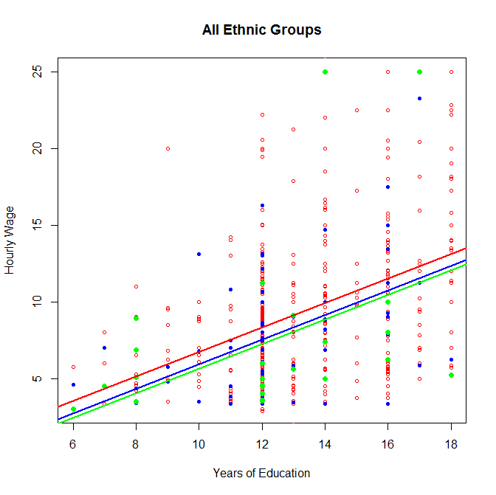
Graphical Representation
The Slope is the same for all groups.
The dummy variables induce group-specific intercepts.

Slide 10
Estimation (OLS)
Stationary point: set all partial derivatives equal to zero.

Slide 11
Estimation (OLS)
- First Order Conditions: set all these derivatives equal to zero.
- This gives as many equation as coefficients.
OLS estimates are then obtained by solving all these equations.
- JMP, SAS, R, etc. will give us OLS estiamtes.

Slide 12
Example
(Regression of Wages on Education and Ethnicity)
https://github.com/gdlc/EPI809/blob/master/MULTIPLE_LINEAR_REGRESSION.md

Slide 13
ANOVA in the Multiple Regression Model

Slide 14
ANOVA in the Multiple Regression Model
Model equation…
Predictions:
Residuals:
Variance partition:

Slide 15
Summary
1. How do we include categorical predictors in a linear model
- we code our predictor variables (e.g., ethnicity) using dummy variables and include these dummy variables into the model.
- the regression coefficients associated to these dummy variables are interpretable as difference between the mean of the category that the dummy variable represent and the reference group.
2. Multiple Linear Regression Model
(a) Def. A regression model that includes more than one predictor.
(b) Parameters. The interpretation of regression coefficients depend on whether the associated covariate (predictor) is continuous or a dummy variable.
(c) Estimation. The regression coefficients of the multiple linear regression can be jointly estimated using Ordinary Least Squares.
(d) Model assessment. We can asses goodness of fit of the model based on the ANOVA table from where we can compute R-squared.

