Slide 1
Testing in Linear Models

Slide 2
Multiple Regression Model
Regression of, Wages (y) on Region, Sex, Experience and Education.
Model
Dummy:
South (1) ; North(0)
Dummy:
Female (1) ; Male (0)
Years of Education
Years of Experience
Examples of tests of hypothesis that we can do once we fit the model
Type of Test
Example/Description
Set of Hypothesis
Stat. Test
Single-parameter
Are there differences between South & North?
t-test (Parameter Estimates Table)
Model as a whole
Do Region, Sex, Experience and Education together have any effect on wages?
F-test
(ANOVA table)
F-test (we will calculate it)
Do Experience and Education together have any effect on wages?
Groups of predictors

Slide 3
Single-Effect Test

Slide 4
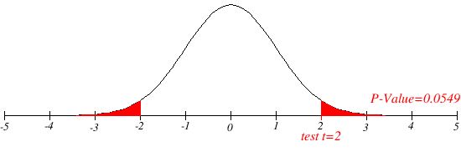
Standard Errors & t-statistic
Standard Error of Estimates
Standardized Estimates
(t-statistic)
pValue: We compare the t-statistic against a reference distribution (the distribution of the t-statistic under the null hypothesis (H0: b1=0). If the observed statistic is ‘unusual’ for this reference distribution that provides evidence against H0.
Specifically, the p-value is the probability of observing a t-statistic at least as extreme as the one observed if the null hypothesis holds.
Let’s discuss this from the JMP output

Slide 5
Testing the Model as a Whole (All effects together)
If the NULL Hypothesis holds…
Mean of Y
To test the model as a whole we will use the ANOVA Table…

Slide 6
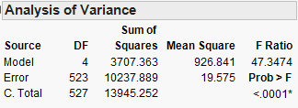
ANOVA and F-test
Mean Square=Sum Sq. / DF
F-statistic:
MS.Model/MS.Error
Note:
The F-statistic is directly related to the R-squared of the model.
The larger the R-sq. the larger the F-stat.
SS Under H0
SS Under Ha
Is the F-ratio large enough to reject the NULL (see H0 above)?

Slide 7
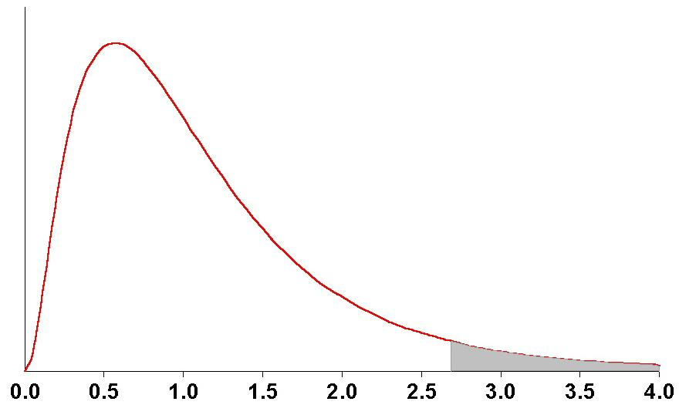
ANOVA and F-test
F Distribution ( the distribution of the F-statistic under H0)
P-value: Probability of observing a value of the F statistic greater or equal than the one observed under H0
The observed value of the F-statistic
(from the ANOVA table)

Slide 8
Testing Groups of Predictors
(e.g., Do Education and Experience Have Any Effect on Wages?)

Slide 9
Null and Alternative
Short Regression
Long Regression
Implementing the above test boils down to comparing the short and long regressions.

Slide 10
The R-squared of the Long Regression will always be > than that of the Short Regression
How can we test whether the reduction in R² we observed is large enough to reject the null hypothesis?
F-test

Slide 11
F Test for the Long Vs Short Regression
Long Regression
Short Regression (H₀)
ANOVA Table of the Short Regression (k=3)
Source DF SS MS R² f
-------------------------------------------------------------------
Model 2 SSR₀ MSR₀ SSR₀ /SST MSR_{0 /} MSE₀
Error N-3 SSE₀ MSE₀
Total N-1 SST MST
-------------------------------------------------------------------
ANOVA Table of Long Regression (k=5)
Source DF SS MS R² f
-------------------------------------------------------------------
Model 4 SSR_{A} MSR_{A} SSR_{A} /SST MSR_{A /} MSE_{A}
Error N-5 SSE_{A} MSE_{A}
Total N-1 SST MST
-------------------------------------------------------------------
F-Test
Source DF SS MS R² F
-----------------------------------------------------------------------------------------------------------
Model (Ha) 2
Error N-5
Total (H₀ ) N-3
-----------------------------------------------------------------------------------------------------------

Slide 12
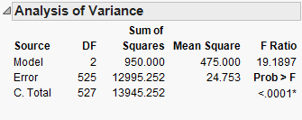
F Test for the Long Vs Short Regression
Long Regression
Short Regression (H₀)
ANOVA Short Regression (H₀)
ANOVA Long Regression (H_{A})

Slide 13
Summary
Once we fitted a model there are various test we may want to do.
First we assess whether the model as a whole have any merit. For this we look at the R-sq. and at the F-test (both from the ANOVA table). In this case we are comparing our model against an intercept-only (or mean) model.
Then we can test:
Either individual predictors (we do this with a t-test, from the parameter estimates table)
Or groups of predictors. We do this by fitting and comparing the short and long regressions.

