Slide 1
Employed for Higher Pay? How Medicare Payment Rules Affect Hospital Employment of Physicians
Xin Hu, MSPH
Econ 771 Presentation 1, Sep 1st 2020

Slide 2
CONTENT
Background
Conceptual Framework
Data
Method
Results
Conclusion & Implication

Slide 3
Background
Hospitals Employ More Physicians/Hospital Integration
Efficiencies (Besanko et al. 2016)
Market power (Dafny, Ho & Lee 2018)
Competition (Baker, Bundorf & Kessler 2016)
Bargaining power with insurers (Burns et al. 2000, Cuellar and Gertler 2006)
Payment models/Reimbursement rules (Neprash, Chernew, & McWilliams 2017)
Medicare Price Shock (2010) → Vertical Integration & Billing Behaviors

Slide 4
Background
Medicare Payment Rule
Physician Fee Schedule (PFS) | Outpatient Prospective Payment System (OPPS)
Both Office Visits & Outpatient Visits | Only for Outpatient Visits
1. Physician time 2. Malpractice insurance costs 3. Practice expenses Direct expenses Indirect expenses Indirect practice expense per hour of physician time (PE/HR) Survey Based
2007
Based on “Old” Survey
2010
Based on “New Survey”
2013

Slide 5
Background
Office Visit
Outpatient Visit
Office Visit
Outpatient Visit
PFS
PFS
PFS
PFS
OPPS
OPPS
2007
2010
2013
Medicare 2010 Price Shock

Slide 6
Conceptual Framework
Physician Vertical Integration
Physician Facility Share
Physician-Level
Medicare 2010 Price Shock
Procedure Facility Share
Procedure-Level

Slide 7
Data
Data source : Medicare Data (Not Claim-level) and Private Claims Data in 2007-2013
Procedure selection:
Site-neutral procedures;
Separately billable (no bundle procedures);
Performed across study period (2007-2013);
No large quantity changes
Physician selection:
Those performed the select procedures in 2007-2013 and in Medicare data

Slide 8
METHOD
Medicare Data
Price shock (procedure level)
Medicare Facility Share (procedure level)
Private Claims
Physician Integration
Price shock (Physician Level)
Private facility share (Procedure Level)
Private facility share (physician level)

Slide 9
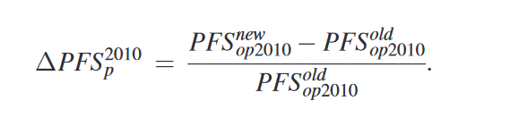
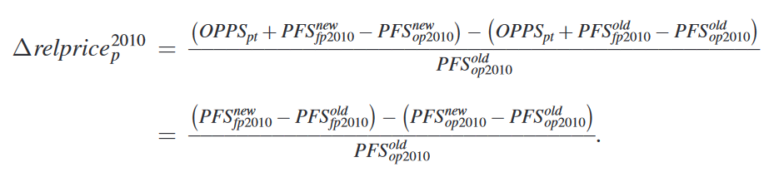
MEASURES - Medicare Data Price shock (procedure level) Medicare Facility Share (procedure level) - Private Claims Physician Integration Price shock (Physician Level) Private facility share (Procedure Level) Private facility share (physician level)

Slide 10
MEASURES - Medicare Data Price shock (procedure level) Medicare Facility Share (procedure level) - Private Claims Physician Integration Price shock (Physician Level) Private facility share (Procedure Level) Private facility share (physician level)
Proportion of procedure performed in a facility cite

Slide 11
MEASURES - Medicare Data Price shock (procedure level) Medicare Facility Share (procedure level) - Private Claims Physician Integration Price shock (Physician Level) Private facility share (Procedure Level) Private facility share (physician level)
Physician bills under a hospital system’s Tax Identification Number (TIN)

Slide 12
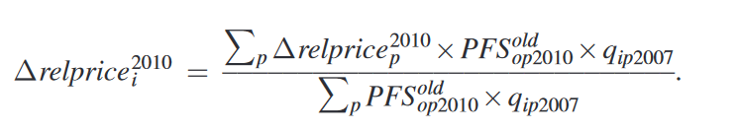
MEASURES - Medicare Data Price shock (procedure level) Medicare Facility Share (procedure level) - Private Claims Physician Integration Price shock (Physician Level) Private facility share (Procedure Level) Private facility share (physician level)

Slide 13
MEASURES - Medicare Data Price shock (procedure level) Medicare Facility Share (procedure level) - Private Claims Physician Integration Price shock (Physician Level) Private facility share (Procedure Level) Private facility share (physician level)
Relative Value Units (RVUs) = quantity * PFS
Proportion of RVUs that are performed in facilities for each procedure

Slide 14
MEASURES - Medicare Data Price shock (procedure level) Medicare Facility Share (procedure level) - Private Claims Physician Integration Price shock (Physician Level) Private facility share (Procedure Level) Private facility share (physician level)
Relative Value Units (RVUs) = quantity * PFS
Proportion of RVUs that are performed in facilities for each physician

Slide 15
Summary of aims
Aim 1: 2010 Price shock affects observed Medicare price and Private price
Aim 2: Price shock affects VI (physician-level)
Aim 3: Price shock affects facility share in Medicare and Private market (procedure-level)
Aim 4: VI after price shock affects facility share in Private market (physician-level), i.e. physician more likely to bill for procedures in facilities after integration.
*NOTE: No physician-level quantity available in Medicare data

Slide 16
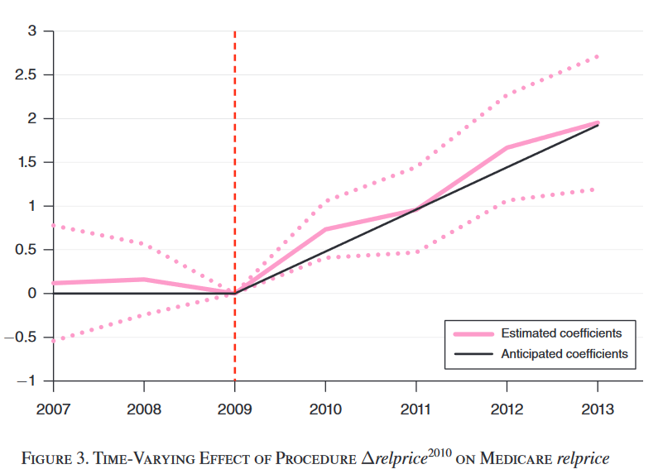
Result
I. 2010 Price shock & Medicare price and Private price
Notes:
Anticipated increase matched almost perfectly with the estimated increase using the Medicare data. Suggesting no other exogenous shock beyond the 2010 Medicare payment rules that affect the price increase in 2010-2013.

Slide 17

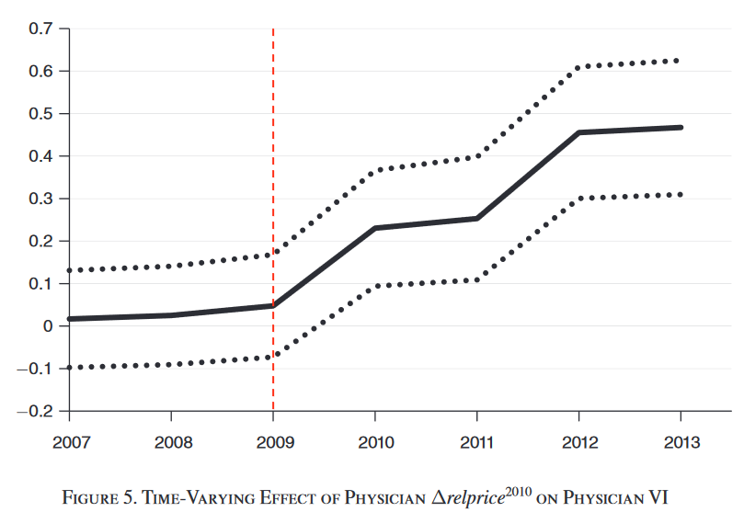
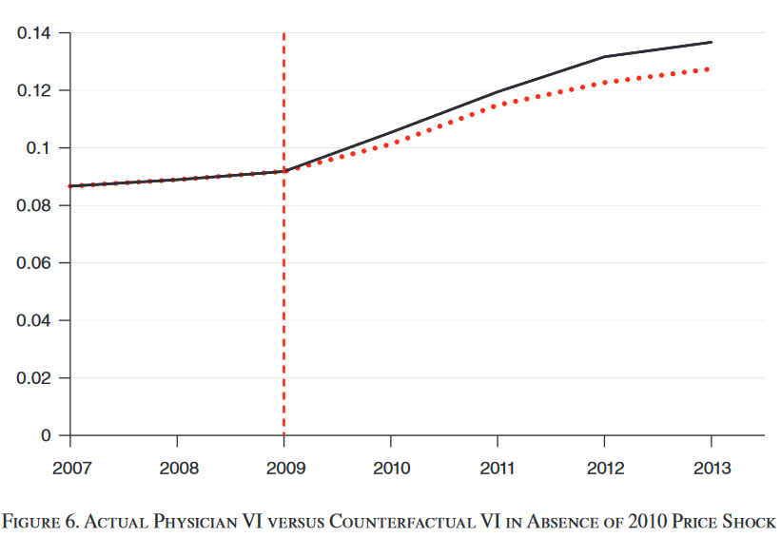
Result
II. Price shock & VI (physician-level)
20% of total increase in VI
Notes:
Physician-level analysis. VI increases from 2010-2013. The price shocks explained 20% of total increase in VI in 2010-2013.

Slide 18
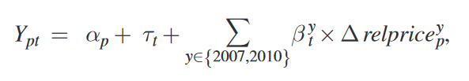


Result
III. Price shock affects facility share in Medicare and Private market (procedure-level)
Time-varying effect:
Pooled effect:
Notes:
Procedure-level analysis. Both time-vary effect (beta for each year) and pooled effect (averaged beta for year 2010-2013).

Slide 19
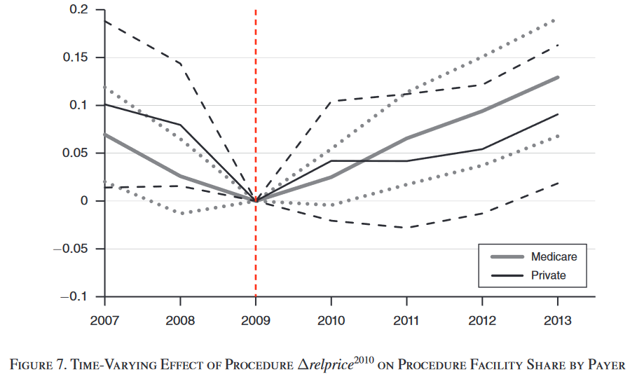
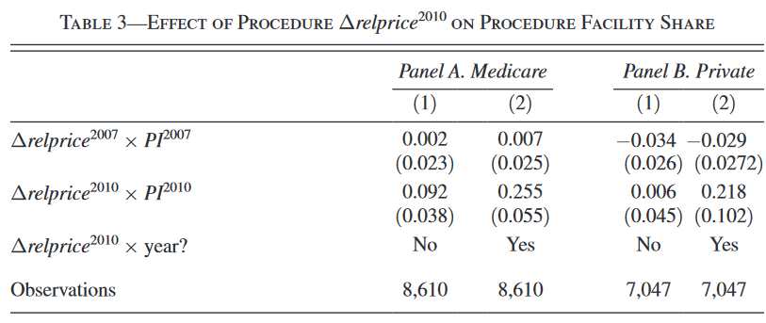
Result
III. Price shock affects facility share in Medicare and Private market (procedure-level)
Medicare:
0.88 percentage point increase;
75% of total increase in facility share
Private:
0.77 percentage point increase
Notes:
Both increases in facility share in Medicare and Private market. Changes in private market is nosier. Pooled effect suggested that in Medicare market, when the relative price increase by 100% (one-unit), the facility share increased by 9.2 percentage point. After controlling for pre-shock trend, such effect is even larger (25.5 percentage point). This explained 75% of total increase in facility share in 2010-2013

Slide 20

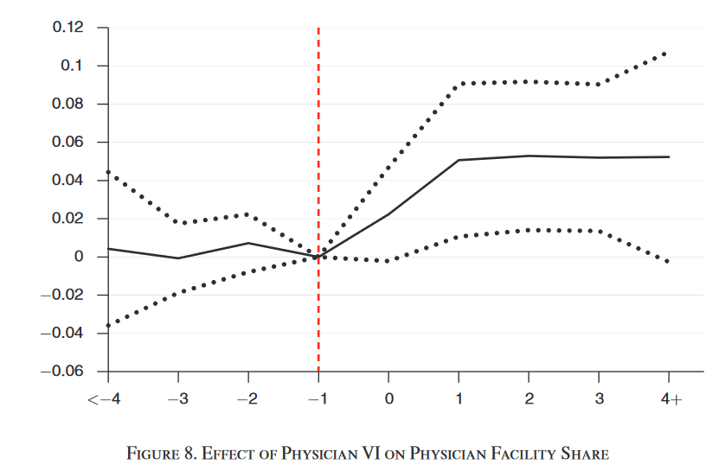
Result
IV. VI after price shock & facility share in Private market (physician-level)
4.9 percentage point increase

Slide 21
cONCLUSION
I. Observed Price increase in 2010-2013 almost perfectly matched the estimated increase from the 2010 Medicare Price Shock – Other exogenous shock to Medicare price is unlikely
II. Price shock explained about 20% of the increase in VI in 2010-2013
III. Price shock explained about 75% of increase in facility share in Medicare market; spill-over effect also observed in Private market.
IV. Physician were more likely (4.9 percentage point increase) to bill under facility after integration.

Slide 22
IMPLICATION
Reimbursement based on procedure average cost (FFS) leads to no incentive for physician to choose lower cost procedure.
Site-neutral reimbursement and restrictions for hospital-employed office-based physician to bill under facility may present such behaviors.
Motivation of vertical integration may not be quality and efficiency improvement, but rather a response to payment reform.

Slide 23
QUESTIONS

