Slide 1

Practical 1: Understanding the posterior distribution
GMS-MT2019
Wellcome Centre for Human Genetics
Instructor: Dr Andre Python

Slide 2
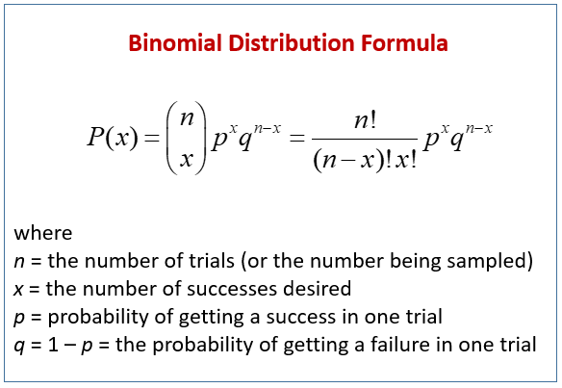

Slide 3
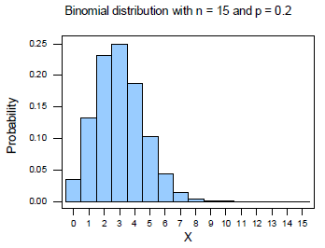
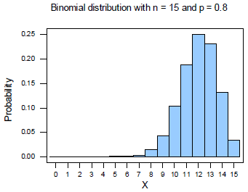

Slide 4
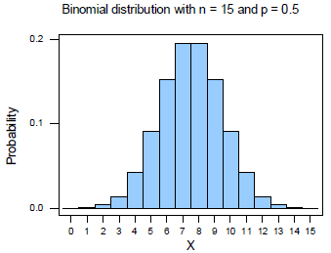
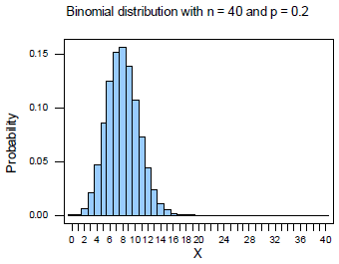

Slide 5
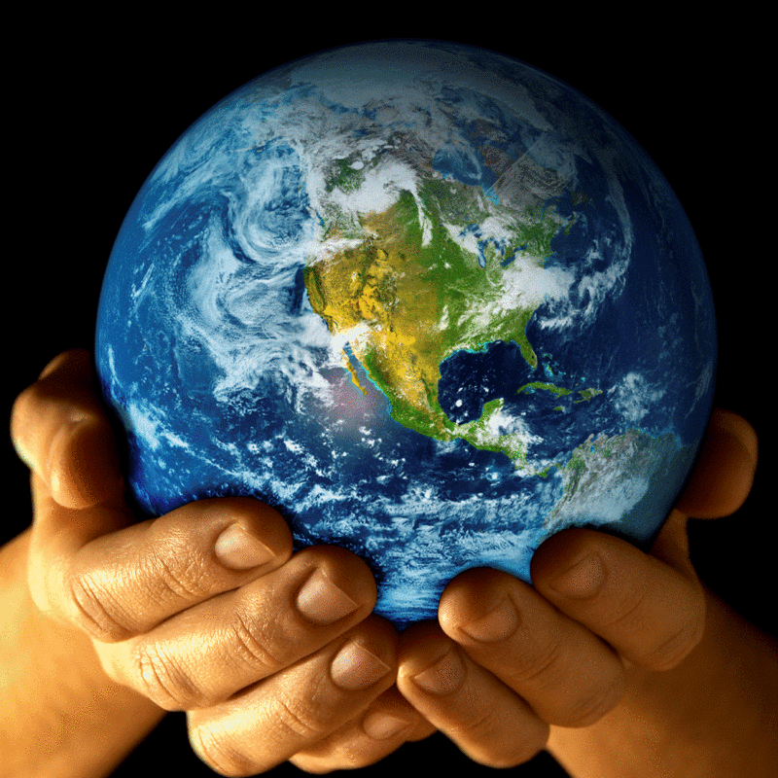
A thought experiment
Source: Statistical rethinking, R. MacElreath (book "SR")
Context: how much water covers the earth? imagine a version of the globe small enough to hold in your hands.
Experience: you toss the globe up in the air, when you catch it you record whether or not the surface under your right finger is water or land. You repeat the procedure n times.
Statements:
The true proportion of water is p
A single toss of the globe has probability p of producing water and 1-p of producing land
Each toss is independent

Slide 6
Number tosses
Count of (“water”) follows a Binomial distribution
Prob (“water”)
Prob (“land”)

Slide 7
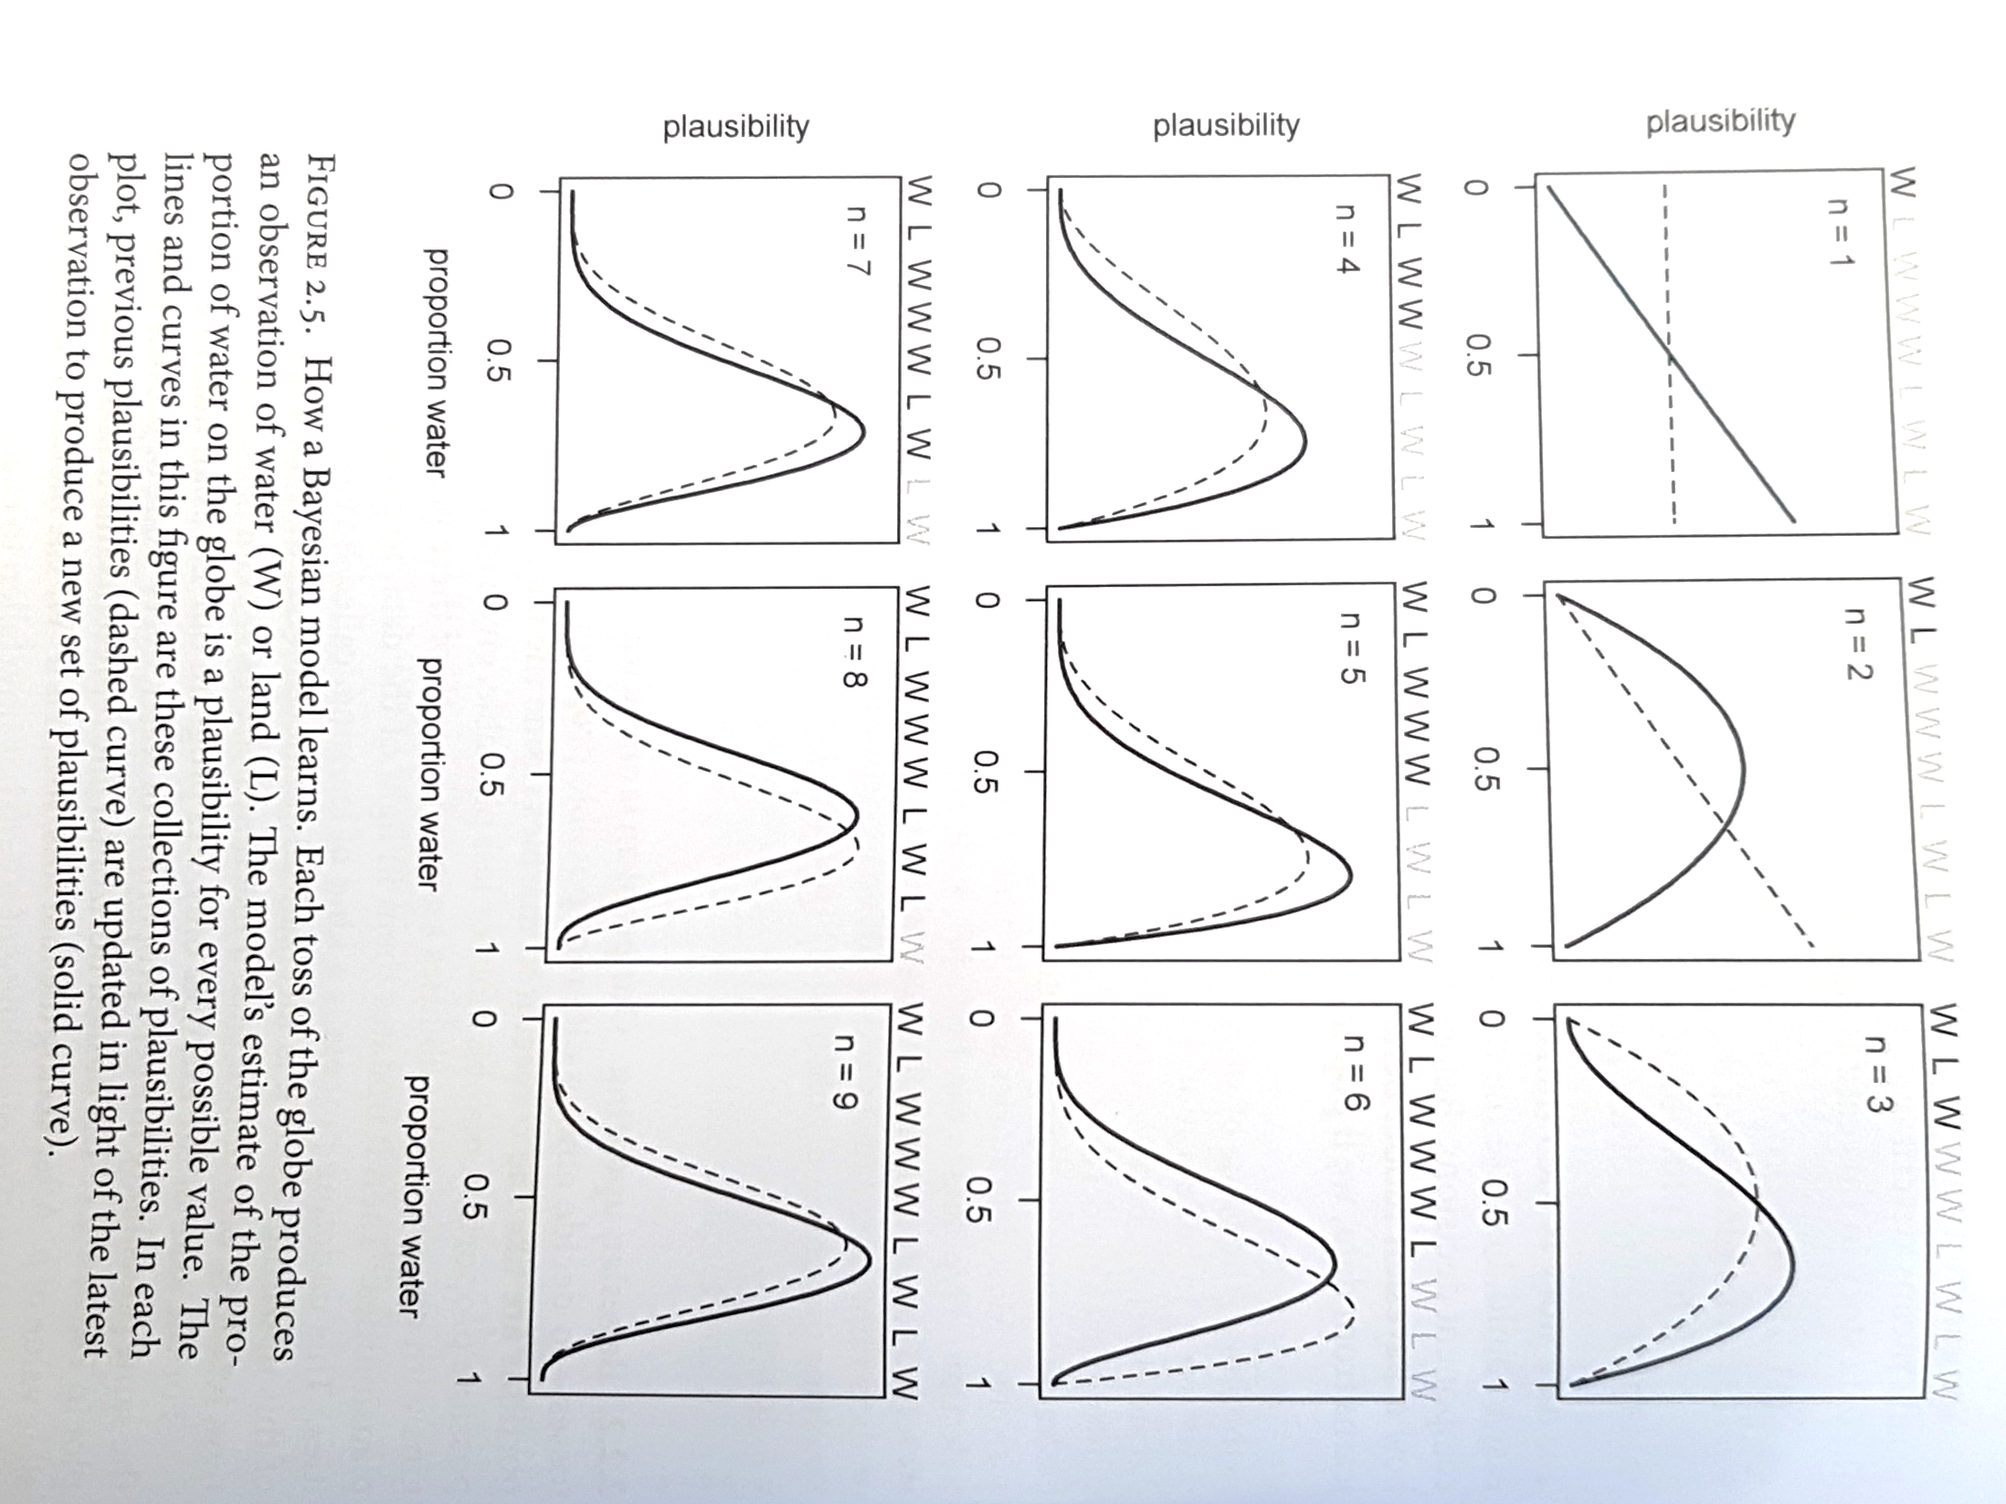

Slide 9
Practical
Start and complete the first R practical

