Slide 1
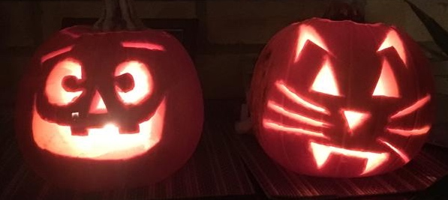
Introduction to Statistics – Day 1
GMS Statistics Programme
Justin Whalley

Slide 2

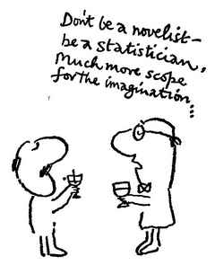
Notes:
“The average Yaleman, Class of 1924, makes $25,111* a year!” said Time magazine, half a century ago. (1959?)
*$215,800 (2018 US dollars) (based on Consumer Price Index)

Slide 3
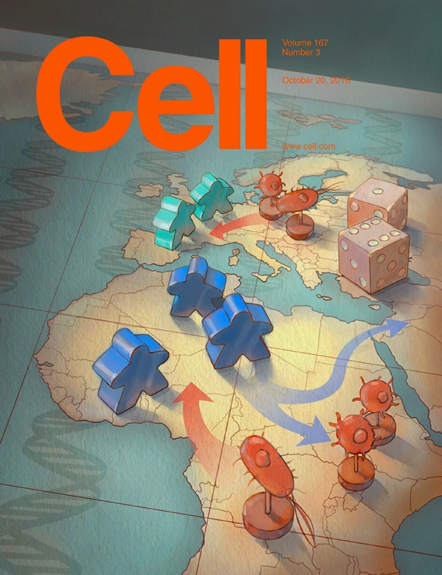
Notes:
The October 20th 2016 Cell cover image shows a board game illustrating the continuous evolutionary battle between host and pathogens in different parts of the world.
Two papers in here: how that genetic ancestry and natural selection are key determinants of population differences in the transcriptional response of macrophages to bacterial pathogens &
uncover differences between Europeans and Africans in the monocyte response to bacteria and viruses.

Slide 4
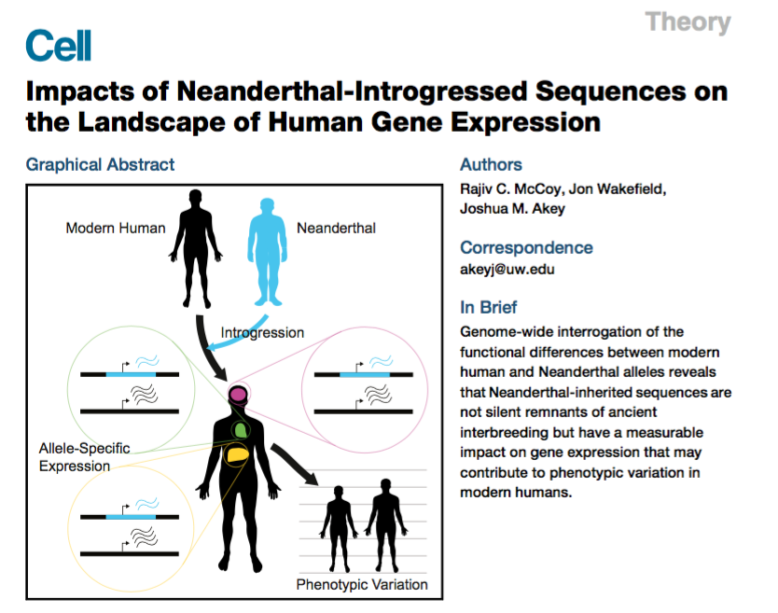
Notes:
Many Neanderthal sequences survive in modern humans due to ancient hybridization.
Which populations of modern humans?

Slide 5
https://github.com/jpwhalley/GMS_Stats_Course
Notes:
Implementation time!

Slide 6
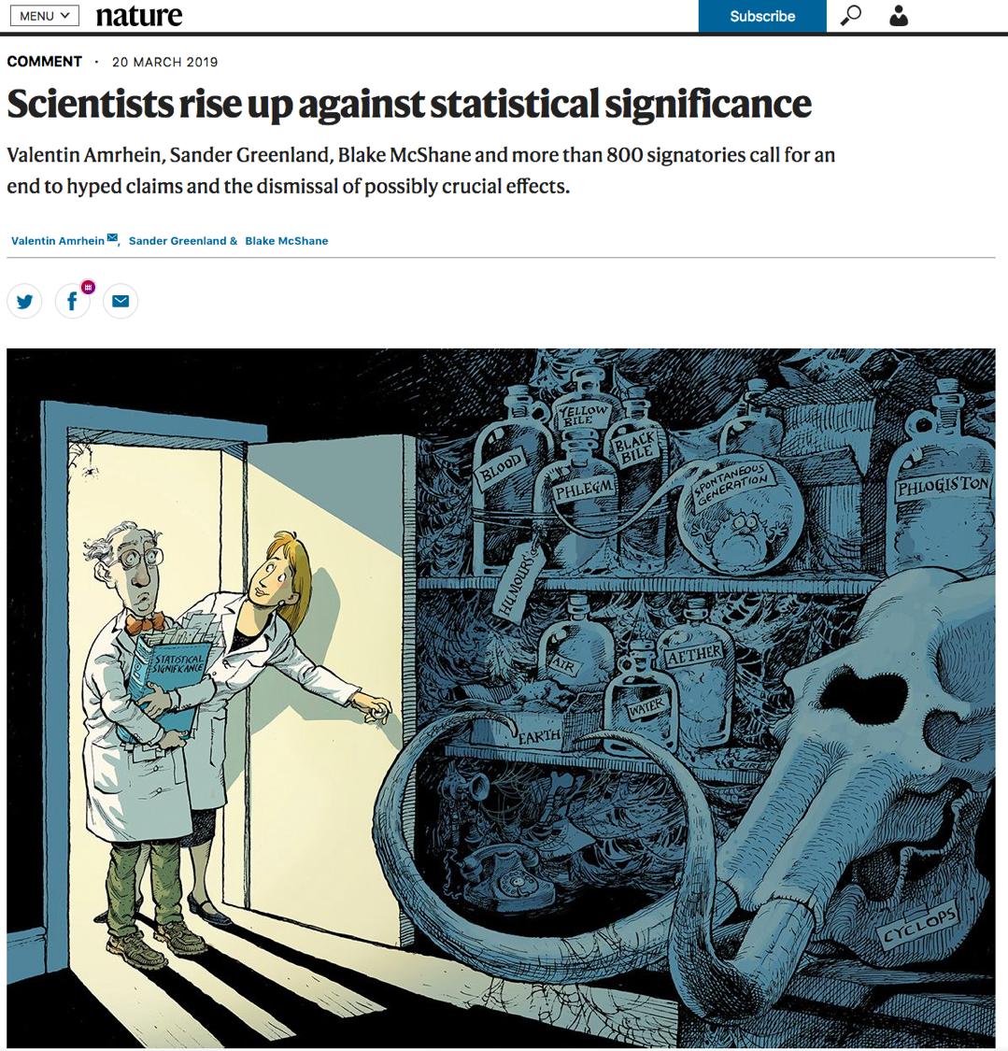
Link
Notes:
https://www.nature.com/articles/d41586-019-00857-9
Bullet points:
Difference is not significant ≠ there is no difference; “We should never conclude there is ‘no difference’ or ‘no association’ just because a P value is larger than a threshold such as 0.05 or, equivalently, because a confidence interval includes zero.”
“We agree, and call for the entire concept of statistical significance to be abandoned.”

Slide 7
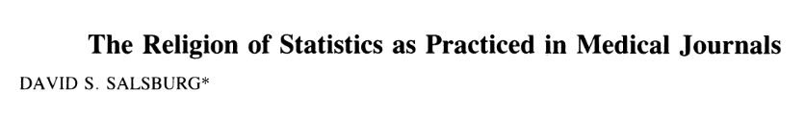
After 17 years of interacting with physicians, I have come to realize that many of them are adherents of a religion they call Statistics. It bears some resemblance to the mathematical theories and practices of statistics as described in journals like this one, using many of the same words, but it reflects activity in only a small portion of the statistical world-the use of hypothesis tests.
Link
Notes:
https://statmodeling.stat.columbia.edu/wp-content/uploads/2019/03/salzburg_religion_stat.pdf

Slide 8
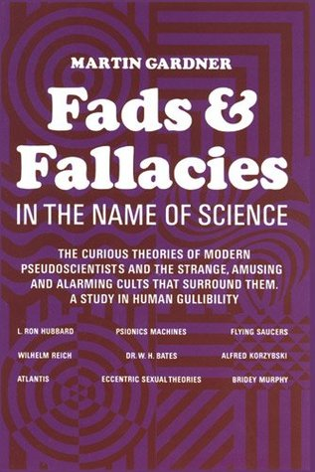
Notes:
Published in the 1950s.

Slide 9
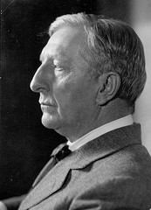
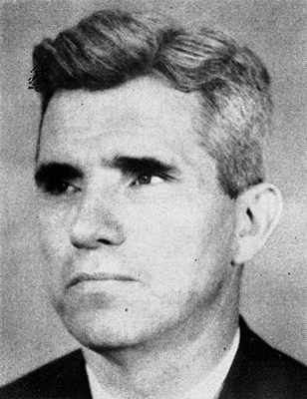



Notes:
Dr Joseph Banks Rhine of Duke University working under Prof William McDougall formerly of Oxford and Harvard.
Published articles and books on Extra Sensory Perception – proven beyond all reasonable doubt by means of several million tests.
Cards with 5 x 5 symbols- guess what is coming next.
Concentrate on face of the dice, better than chance of that coming up.
How do we test these experimentally? What

Slide 10
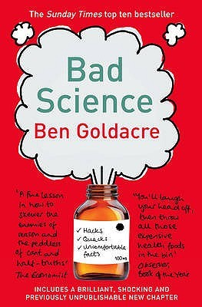

Notes:
Talks about drug companies – trials to test drugs much more likely to be positive than independent studies.
Can we test this?
https://www.ted.com/talks/ben_goldacre_battling_bad_science/transcript#t-668972

