Slide 1

Introduction to Statistics – Day 1
GMS Statistics Programme
Justin Whalley

Slide 2

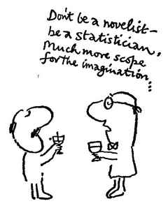
Notes:
“The average Yaleman, Class of 1924, makes $25,111* a year!” said Time magazine, half a century ago. (1959?)
*$215,800 (2018 US dollars) (based on Consumer Price Index)

Slide 3

Notes:
The October 20th 2016 Cell cover image shows a board game illustrating the continuous evolutionary battle between host and pathogens in different parts of the world.
Two papers in here: how that genetic ancestry and natural selection are key determinants of population differences in the transcriptional response of macrophages to bacterial pathogens &
uncover differences between Europeans and Africans in the monocyte response to bacteria and viruses.

Slide 4
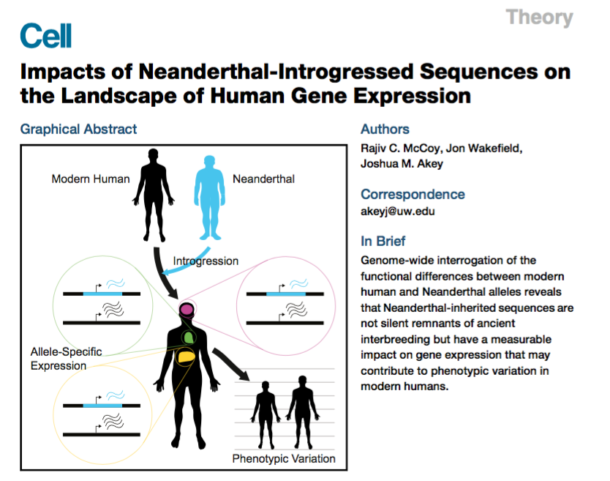
Notes:
Many Neanderthal sequences survive in modern humans due to ancient hybridization.
Which populations of modern humans?

Slide 5
https://github.com/jpwhalley/GMS_Stats_Course
Notes:
Implementation time!

Slide 6

Notes:
Published in the 1950s.

Slide 7
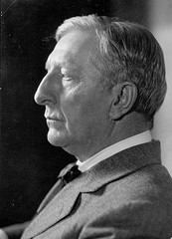
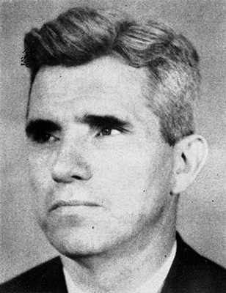



Notes:
Dr Joseph Banks Rhine of Duke University working under Prof William McDougall formerly of Oxford and Harvard.
Published articles and books on Extra Sensory Perception – proven beyond all reasonable doubt by means of several million tests.
Cards with 5 x 5 symbols- guess what is coming next.
Concentrate on face of the dice, better than chance of that coming up.
How do we test these experimentally? What

Slide 8


Notes:
Talks about drug companies – trials to test drugs much more likely to be positive than independent studies.
Can we test this?
https://www.ted.com/talks/ben_goldacre_battling_bad_science/transcript#t-668972

