Slide 1
Workforce Planning

Slide 2
Agenda
Start | End | Item
 |  | Basics
 |  | (limited) results

Slide 3

Workforce planning
Workforce planning is the science of identifying the amount of work to be done & the expected number of people, robots, material needed to perform the task.

Slide 4

Forecast the demand.
Using the forecasting methods in this class and more sophisticated methods, a forecast is built at a specific period to understand the demand put onto the system.
How many cars do we need to build in an 8hr shift to make the weekly, monthly and quarterly inventory?
How many phone calls do we need to answer in this 30m window?
How many customers will order a drink in this 15min period?

Slide 5
Given a forecasted demand, then understand your workforce productivity
Avg Cycle time the amount of time needed to complete one unit of work/operation
Cycle time is not lead time (which is the moment a customer initiates an order to receiving it)
In a call center this may be:
Answer/Greeting
Summarize problem
Research resolution
Put on hold
Articulate resolution
Hang up & record notes in customer act.
On Average this may take 7min among all agents.

Slide 6

Who should get the bonus?
Barista A
Barista B
Can complete a drink order in 1 min:
Avg Cycle Time = 1min
Can complete a drink order in 5 min:
Avg Cycle Time = 5min
Very fast!
Much slower ☹

Slide 7
Who should get the bonus?
Barista A
Barista B
Can complete a drink order in 1 min:
Avg Cycle Time = 1min
Can complete a drink order in 5 min:
Avg Cycle Time = 5min
Helps 4 customers in 1 hour.
Helps 5 customers in 1 hour.
Helps 4 customers
Helps 5 customers

Slide 8
Average cycle time is not enough!
Also need to measure the throughput of a person doing the work.
throughput is the rate at which items are passing through the system.
One Cycle
One Cycle
One Cycle
One Cycle
One Cycle
One Cycle
One Cycle
In one hour, on average a call center agent may complete 7 calls per hour.

Slide 9
Who should get the bonus?
Barista A
Barista B
Can complete a drink order in 1 min:
Avg Cycle Time = 1min
Can complete a drink order in 5 min:
Avg Cycle Time = 5min
Helps 4 customers in 1 hour.
Helps 5 customers in 1 hour.
1 in 20 drinks is made improperly
2 in 5 drinks are made improperly
1Min cycle time
Helps 4 customers per hour
1 in 40 drinks needs to be reworked
Therefore in an hour 3.95 (1/20th of a drink defect per hr) drinks are being made correctly
5Min cycle time
Helps 5 customers per hour
2 in 5 drinks needs to be reworked
Therefore in an hour 3 drinks (2/5 of drinks are defective per hr) are being made correctly.
In 5hrs, barista A makes 20 drinks with 1 defect.
In 5hrs, barista B makes 25 drinks with 10 defects.

Slide 10
Avg Cycle time & Throughput are not enough!
First Pass Yield the number of units coming out of a process divided by the number of units going into that process over a specified period of time. Only good units with no rework or scrap are counted as coming out of an individual process.
One Cycle
One Cycle
One Cycle
One Cycle
One Cycle
One Cycle
One Cycle
In one hour, on average a call center agent makes 1 mistake and the customer needs to call back.

Slide 11
What does the data say to coach on?
Barista A
Barista B
1Min cycle time
Helps 4 customers per hour
1 in 40 drinks needs to be reworked
Therefore in an hour 3.95 (1/20th of a drink defect per hr) drinks are being made correctly
5Min cycle time
Helps 5 customers per hour
2 in 5 drinks needs to be reworked
Therefore in an hour 3 drinks (2/5 of drinks are defective per hr) are being made correctly.
In 5hrs, barista A makes 20 drinks with 1 defect.
In 5hrs, barista B makes 25 drinks with 10 defects.
Good cycle time
Decent throughput but given the cycle time, better utilization of time, they are spending only 4min/hr actually working.
Good defect rate.
Decent cycle time
Decent throughput
Terrible defect rate. Improve quality of result while maintaining cycle & throughput.

Slide 12

These principles can be applied to other queues
Manufacturing example
Jenny puts wheels on Ford Trucks, with each wheel taking 6 min – cycle time
Jenny averages 9 wheels an hour – throughput
1 in 100 wheels is put on with a loose lug nut – 99% first pass yield

Slide 13
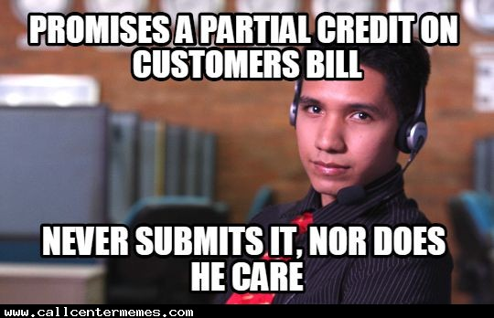
These principles can be applied to other queues
Call center example
On average Chris, a call center agent, takes 8min to complete a call – cycle time
Chris completes 6 calls per hour, - throughput
1 in 1000 calls, the person calls back (missed “first contact resolution”) – 99.9% first pass yield

Slide 14

These principles can be applied to other queues
Data scientist example
Dale completes 500 lines of production data science code in 48 hours of work – cycle time
Dale completes 2.6 blocks of 500 line code per month - throughput
1 in 3 chunks of codes submitted require a correction 67% first pass yield – first pass yield

Slide 15

These principles can be applied to other queues
Professor example
It takes 16hrs of prep to create a 1hr lesson plan so 17hrs/lesson total– cycle time
48 students take the course per session and learn something (TAs aid the throughput w/grading & knowledge support)- throughput
2 in 24 students don’t learn anything from the course, leave a bad survey and decide to take it with another teacher. – first pass yield (notice that its not actual grades, its knowledge, success is individualized and limited by student effort, cognition, personal life obligations & professor effectiveness etc)

Slide 16
The last piece of the puzzle is an erlang-c
If you assume a customer is willing to wait a certain amount of time once their “order” has been placed but “before” work starts, you can save money by allowing the work queue to back up and in doing so reduce the total number of workers needed.
At Starbucks a customer places an order and you immediately expect work to start on it…except when you place an online order for pickup. This is done for Starbuck to make orders when they are convenient as much as for you!
In a call center a Service Level Agreement (SLA) is chosen…”our call center will pick up 80% of calls each half hour within 60 seconds” or “our call center will pick up 60% of calls in 120 seconds”. Letting people wait, means less agents are needed. When you call in, expect to wait, they built models expecting you to.

Slide 17
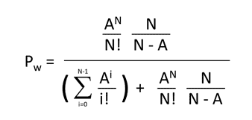
An Erlang-C calculates the probability work will have to wait.
Or just use an R Function!
https://github.com/phubers/erlang

Slide 18

Workload Intensity
workload <- intensity(arrival_rate = 200, #200calls/30min
avg_handle_time = 180, 3min cycle time
interval_length = 30) #30min periods
“20 erlangs”

Slide 19
What is the probability of waiting any amount of time in the interval (30min period)?
waiting <- erlang_c(number_of_agents = 25, intensity = 20)

Slide 20
What is the expected Service Level compared to the stated SLA of 80% in 60 seconds?
sl <- service_level(number_of_agents = 25, #number of agents available
arrival_rate = 200, #forecast calls/period
avg_handle_time = 180,#cycle time
interval_length = 30, #period length
wait_time = 60) #max seconds we want someone to wait

Slide 21

Rearranging the formula you can calculate the number of agents needed.
agents <- number_of_agents_for_sl(arrival_rate = 200,
avg_handle_time = 180,
interval_length = 30,
wait_time = 60,
service_level_goal = 0.8)
To meet this service level you need 23 agents (plus time needed for breaks, sickness etc).
If an agent is paid $50k/yr you need a budget of $1.15m without managers, time off, etc.

Slide 22

Rearranging the formula you can calculate the number of agents needed.
agents <- number_of_agents_for_sl(arrival_rate = 200,
avg_handle_time = 180,
interval_length = 30,
wait_time = 120,
service_level_goal = 0.8)
One way to save money is to let customers wait longer (2min).
Saved $50K

Slide 23

Rearranging the formula you can calculate the number of agents needed.
agents <- number_of_agents_for_sl(arrival_rate = 200,
avg_handle_time = 180,
interval_length = 30,
wait_time = 120,
service_level_goal = 0.5)
One way to save money is to let customers wait longer (2min).
You can also relax the % of calls to be answered in the 120 seconds.
Saved $50K & another $50K

Slide 24

Rearranging the formula you can calculate the number of agents needed.
agents <- number_of_agents_for_sl(arrival_rate = 200,
avg_handle_time = 160,
interval_length = 30,
wait_time = 120,
service_level_goal = 0.5)
One way to save money is to let customers wait longer (2min).
You can also relax the % of calls to be answered in the 120 seconds.
Now let’s create a tool to let agents have a better cycle time (150 seconds)
Saved $50K & another $50K & another $100K

Slide 25
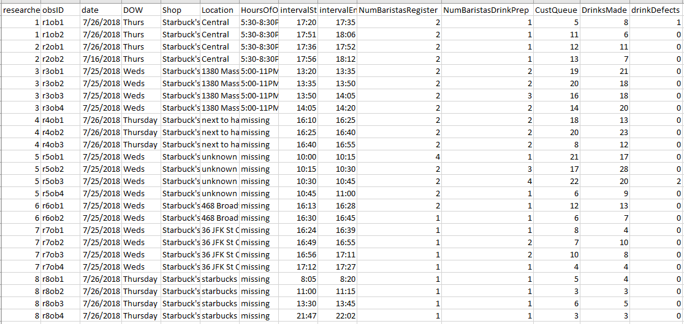
Limited Example of Starbuck’s

Slide 26
Cycle Time of a Barista
For each 15min interval:
AVG Number of Customers in Queue / (Number of Baristas working register *15min) =
AVG =.43 orders taken per minute
For example, 2 baristas took orders from 20 customers in queue during 15min, they averaged .667 orders/minutes per order
For each 15min interval:
AVG Number of Drinks made / (Number of Baristas making drinks*15min) =
AVG = 0.49 drinks made per minute
For example, 1 barista served 13 drinks in a 15min period meaning they average .8667 drinks/min

Slide 27
Throughput of a Barista
For each 15min interval:
AVG Number of Customers in Queue / Number of Baristas working register =
6.55 orders taken in 15m
For each 15min interval:
AVG Number of Drinks made / Number of Baristas making drinks =
7.35 drinks made in 15m

Slide 28
Not surprisingly, Starbuck’s Looks balanced.
AVG Cycle time =.43 orders taken per minute
AVG Cycle Time = 0.49 drinks made per minute
AVG Throughput = 6.55 orders taken in 15m
AVG Throughput = 7.35 drinks made in 15m
In this limited data set across 6.25hrs:
~2min 20sec to stand in line & place an order
~2min get a drink.
Total time was ~4.5min with no large outliers across stores or 15min intervals
Starbuck’s accepts you waiting in both parts of the process. So expect that on average your roundtrip visit will be ~5min. Their service level is likely 80% of patrons served in 300seconds.

