Slide 1

Intro to Stata
Clay Ford, StatLab
September 10, 2014
Notes:
• Title should be in Garamond or Times New Roman
• Subtitle should be in Trade Gothic or Helvetica
• Change the size and case of the type as appropriate
• Change alignment of the text as you like (i.e. center it, right align, et cetera)
• Insert the ribbon appropriate to your library, department, or unit. Size it appropriately according to its length. It should only be on this first slide.

Slide 2
About this workshop
Assumptions
No prior knowledge of Stata
Access to Stata
Teach you how to…
Load data into Stata
Do basic data manipulation and statistical analyses
Save Stata syntax for reproducibility
Notes:
• Slide title should be Garamond or Times New Roman
• Subhead should be Helvetica or Trade Gothic.
• Text can be in Garamond, Times New Roman, Helvetica or Trade Gothic as you wish
• Captions, if used, should be in Trade Gothic or Helvetica
• Size of headings/subheads/text/captions should be consistent from one slide to the next
• Use bold or change case and formatting as appropriate
• Move text blocks around to accommodate images as appropriate
• Use Library Orange (RGB: 252/175/23) as an accent color if you wish

Slide 3
About Stata
Complete, integrated statistical software package
Has both a point-and-click interface and command syntax (aka, its own programming language)
Comes with fantastic documentation
For Windows, Mac, and Linux/Unix
Can purchase perpetual license or annual license
Can purchase different flavors:
Stata/MP: The fastest version of Stata (for dual-core and multicore/multiprocessor computers)
Stata/SE: Stata for large datasets
Stata/IC: Stata for moderate-sized datasets
Small Stata: A version of Stata that handles small datasets (for students only)
See the full sales pitch: http://www.stata.com/why-use-stata/
Notes:
• Slide title should be Garamond or Times New Roman
• Subhead should be Helvetica or Trade Gothic.
• Text can be in Garamond, Times New Roman, Helvetica or Trade Gothic as you wish
• Captions, if used, should be in Trade Gothic or Helvetica
• Size of headings/subheads/text/captions should be consistent from one slide to the next
• Use bold or change case and formatting as appropriate
• Move text blocks around to accommodate images as appropriate
• Use Library Orange (RGB: 252/175/23) as an accent color if you wish

Slide 4
Getting Stata at UVa
Three ways:
Stata GradPlan. Under this program Stata software is purchased (or rented) online and ships directly to you. See http://www.stata.com/order/new/edu/gradplans/
The Hive. Provides access to Stata/IC, version 13.
Computer labs: ITS computer lab in Clark Hall and the Scholars’ Lab in Alderman Library.
Note: The University owns 45 concurrent licenses. These apply to both computer labs and the Hive. You may have to wait for licenses to open if all are in use.
Notes:
• Slide title should be Garamond or Times New Roman
• Subhead should be Helvetica or Trade Gothic.
• Text can be in Garamond, Times New Roman, Helvetica or Trade Gothic as you wish
• Captions, if used, should be in Trade Gothic or Helvetica
• Size of headings/subheads/text/captions should be consistent from one slide to the next
• Use bold or change case and formatting as appropriate
• Move text blocks around to accommodate images as appropriate
• Use Library Orange (RGB: 252/175/23) as an accent color if you wish

Slide 5
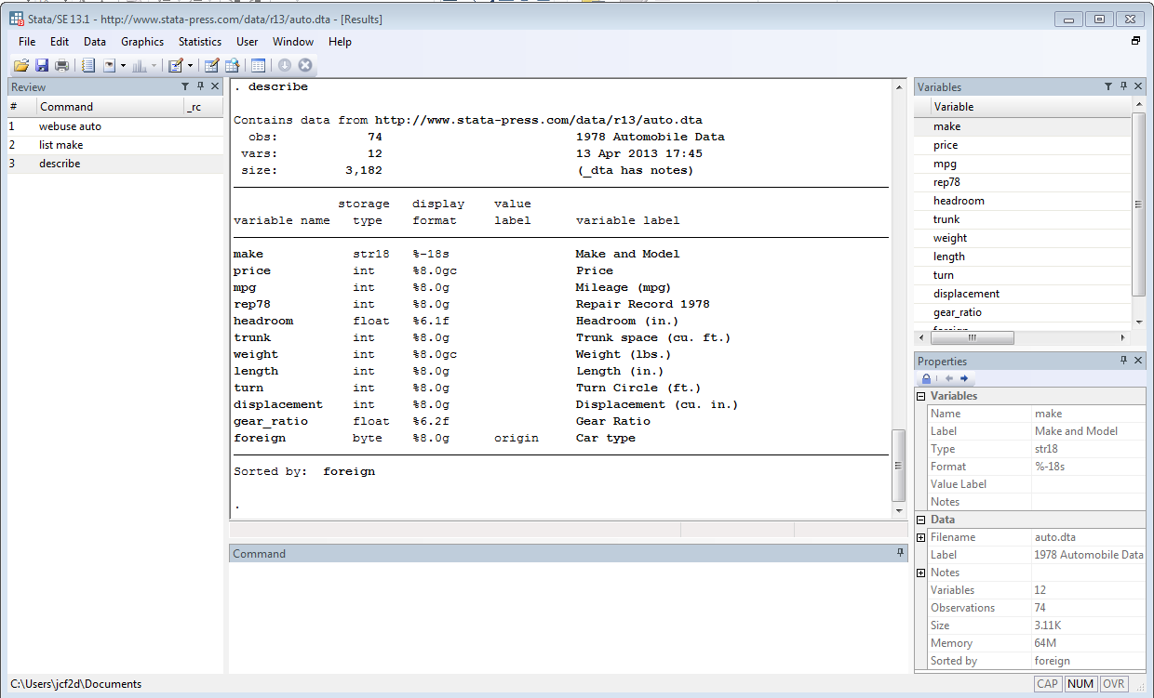
Navigating Stata
Results:
Output resulting from commands
Review:
List of commands you have used
Variables:
List of variables in dataset
Command:
Where you type in Stata syntax/code
Properties:
Information about your variables and dataset
Working Directory
Notes:
• Slide title should be Garamond or Times New Roman
• Subhead should be Helvetica or Trade Gothic.
• Text can be in Garamond, Times New Roman, Helvetica or Trade Gothic as you wish
• Captions, if used, should be in Trade Gothic or Helvetica
• Size of headings/subheads/text/captions should be consistent from one slide to the next
• Use bold or change case and formatting as appropriate
• Move text blocks around to accommodate images as appropriate
• Use Library Orange (RGB: 252/175/23) as an accent color if you wish

Slide 6
Using Stata syntax
Stata provides point-and-click interface but highly recommended to use syntax. Why?
Syntax can be saved and reused, making it easier to reproduce results and collaborate with others
When you Google for Stata help, the results will almost always be syntax
The Stata help manuals present all examples using syntax
Syntax can be entered interactively or submitted in batch from a “do” file (ie, a text file of Stata commands)
Example of Stata syntax (set working directory and load CSV file):
cd "C:\Users\jcf2d\IntroToStata\"
import delimited "scores.csv"
Notes:
• Slide title should be Garamond or Times New Roman
• Subhead should be Helvetica or Trade Gothic.
• Text can be in Garamond, Times New Roman, Helvetica or Trade Gothic as you wish
• Captions, if used, should be in Trade Gothic or Helvetica
• Size of headings/subheads/text/captions should be consistent from one slide to the next
• Use bold or change case and formatting as appropriate
• Move text blocks around to accommodate images as appropriate
• Use Library Orange (RGB: 252/175/23) as an accent color if you wish

Slide 7
Stata syntax tips
Stata is case-sensitive
Commands are lower case
Most Stata commands have the following structure: command variables, options
Many commands can be abbreviated (example, “reg” for “regress”, “gen” for “generate”, “sum” for “summary”)
In interactive mode, previous commands can be recalled with PageUp and PageDown buttons
Comments are preceded with an asterisk (*) or placed between /* */
Submit help command to get help on a command
Submit search topic to find commands
Notes:
• Slide title should be Garamond or Times New Roman
• Subhead should be Helvetica or Trade Gothic.
• Text can be in Garamond, Times New Roman, Helvetica or Trade Gothic as you wish
• Captions, if used, should be in Trade Gothic or Helvetica
• Size of headings/subheads/text/captions should be consistent from one slide to the next
• Use bold or change case and formatting as appropriate
• Move text blocks around to accommodate images as appropriate
• Use Library Orange (RGB: 252/175/23) as an accent color if you wish

Slide 8
Do files and Log files
Do file: a text file of Stata commands; today we will work from a do file prepared in advance
In the do file, highlight line(s) and hit Ctrl + D to submit commands, or click the Execute Selection button:
Use * or // to add comments
Use /// to break commands across lines
Log file: record of results; captures text printed in the Results window
When doing sustained work in Stata, it is recommended to record commands in a do file and save output to a log file
Notes:
• Slide title should be Garamond or Times New Roman
• Subhead should be Helvetica or Trade Gothic.
• Text can be in Garamond, Times New Roman, Helvetica or Trade Gothic as you wish
• Captions, if used, should be in Trade Gothic or Helvetica
• Size of headings/subheads/text/captions should be consistent from one slide to the next
• Use bold or change case and formatting as appropriate
• Move text blocks around to accommodate images as appropriate
• Use Library Orange (RGB: 252/175/23) as an accent color if you wish

Slide 9
Getting started
When starting analysis in Stata:
Start a do file: doedit (or click New Do-file Editor button)
Set working directory: cd “<path>” (“C:/Users/jcf2d”) (or File…Change Working Directory)
Start a log: log using “filename” (or File…Log…Begin)
Proceed to type, submit and save commands from do file.
You can also type commands in the Command window if you’re not concerned about saving commands for future use.
Notes:
• Slide title should be Garamond or Times New Roman
• Subhead should be Helvetica or Trade Gothic.
• Text can be in Garamond, Times New Roman, Helvetica or Trade Gothic as you wish
• Captions, if used, should be in Trade Gothic or Helvetica
• Size of headings/subheads/text/captions should be consistent from one slide to the next
• Use bold or change case and formatting as appropriate
• Move text blocks around to accommodate images as appropriate
• Use Library Orange (RGB: 252/175/23) as an accent color if you wish

Slide 10
Let’s go to the do file
I have written a do file for today’s workshop. This allows you to reproduce what I have already done in Stata.
To follow along, simply highlight commands as we get to them and hit Ctrl + D (or click the submit button)
Feel free to add comments to the do file by preceding the text with an * or //
Let’s go to Stata!
Notes:
• Slide title should be Garamond or Times New Roman
• Subhead should be Helvetica or Trade Gothic.
• Text can be in Garamond, Times New Roman, Helvetica or Trade Gothic as you wish
• Captions, if used, should be in Trade Gothic or Helvetica
• Size of headings/subheads/text/captions should be consistent from one slide to the next
• Use bold or change case and formatting as appropriate
• Move text blocks around to accommodate images as appropriate
• Use Library Orange (RGB: 252/175/23) as an accent color if you wish

Slide 11
Getting Help/Going further
Web sites
Resources to help you learn and use Stata (IDRE UCLA)
http://www.ats.ucla.edu/stat/stata/
Germán Rodríguez’s Stata Tutorial
http://data.princeton.edu/stata/
Statlist: The Stata Forum
http://www.statalist.org/
Stata NetCourses: web-based courses for learning Stata
http://www.stata.com/netcourse/
SSCC Statistical Computing Articles
http://www.ssc.wisc.edu/sscc/pubs/stat.htm
Notes:
• Slide title should be Garamond or Times New Roman
• Subhead should be Helvetica or Trade Gothic.
• Text can be in Garamond, Times New Roman, Helvetica or Trade Gothic as you wish
• Captions, if used, should be in Trade Gothic or Helvetica
• Size of headings/subheads/text/captions should be consistent from one slide to the next
• Use bold or change case and formatting as appropriate
• Move text blocks around to accommodate images as appropriate
• Use Library Orange (RGB: 252/175/23) as an accent color if you wish

Slide 12
Getting Help/Going further
Books
Hamilton, L. 2012. Statistics with STATA: Version 12. Cengage Learning
Mitchell, M. 2010. Data Management Using Stata: A Practical Handbook. Stata Press.
Long, J.Scott. 2009. The Workflow of Data Analysis Using Stata. Stata Press.
Acock, Alan C. 2012. A Gentle Introduction to Stata, Revised 3rd ed. Stata Press.
Mitchell, Michael N. 2012. A Visual Guide to Stata Graphics. Stata Press.
Notes:
• Slide title should be Garamond or Times New Roman
• Subhead should be Helvetica or Trade Gothic.
• Text can be in Garamond, Times New Roman, Helvetica or Trade Gothic as you wish
• Captions, if used, should be in Trade Gothic or Helvetica
• Size of headings/subheads/text/captions should be consistent from one slide to the next
• Use bold or change case and formatting as appropriate
• Move text blocks around to accommodate images as appropriate
• Use Library Orange (RGB: 252/175/23) as an accent color if you wish

Slide 13
Useful commands
General
help or search : online help on a specific command
ssc : access routines from the SSC Archive
log : log output to an external file
tsset : define the time indicator for time series or panel data
compress : economize on space used by variables
cd : change the working directory
clear : clear memory
quietly : do not show the results of a command
Data manipulation
generate : create a new variable
replace : modify an existing variable
rename : rename variable
sort : change the sort order of the dataset
recode : recode categorical variable
drop : drop certain variables and/or observations
keep : keep only certain variables and/or observations
encode : generate numeric variable from categorical variable
destring : convert string variables to numeric
describe : describe a data set or current contents of memory
Notes:
• Slide title should be Garamond or Times New Roman
• Subhead should be Helvetica or Trade Gothic.
• Text can be in Garamond, Times New Roman, Helvetica or Trade Gothic as you wish
• Captions, if used, should be in Trade Gothic or Helvetica
• Size of headings/subheads/text/captions should be consistent from one slide to the next
• Use bold or change case and formatting as appropriate
• Move text blocks around to accommodate images as appropriate
• Use Library Orange (RGB: 252/175/23) as an accent color if you wish

Slide 14
Useful commands
More data manipulation
use : load a Stata data set
import delimited : load a text file in tab- or comma-delimited format
save : write the contents of memory to a Stata data set
export delimited : write a text file in tab- or comma-delimited format
append : combine datasets by stacking
merge : merge datasets (one-to-one or match merge)
contract : make a dataset of frequencies
collapse : make a dataset of summary statistics
Statistical commands
tab : abbreviation for tabulate: 1- and 2-way tables
table : tables of summary statistics
summarize : descriptive statistics
correlate : correlation matrices
ttest : perform 1-, 2-sample and paired t-tests
anova : 1-, 2-, n-way analysis of variance
regress : least squares regression
logit, logistic : logit model, logistic regression
probit : binomial probit model
predict : generate fitted values, residuals, etc.
test : test linear hypotheses on parameters
Notes:
• Slide title should be Garamond or Times New Roman
• Subhead should be Helvetica or Trade Gothic.
• Text can be in Garamond, Times New Roman, Helvetica or Trade Gothic as you wish
• Captions, if used, should be in Trade Gothic or Helvetica
• Size of headings/subheads/text/captions should be consistent from one slide to the next
• Use bold or change case and formatting as appropriate
• Move text blocks around to accommodate images as appropriate
• Use Library Orange (RGB: 252/175/23) as an accent color if you wish

Slide 15
Useful commands
More statistical commands
ivregress : instrumental variables regression
prais : regression with AR(1) errors
ologit, oprobit : ordered logit and probit models
mlogit : multinomial logit model
poisson : Poisson regression
heckman : selection model
arima : BoxJenkins models, regressions with ARMA errors
xtreg, (fe, re) : fixed or random effects estimator
xtlogit : panel-data logit models
xtmixed : linear mixed (multi-level) models
Graphical commands
histogram x: histogram of the x variable
twoway scatter y x: a Y vs X scatterplot
twoway line y x: a Y vs X line plot
tsline Y time: a Y vs time time-series plot
twoway area y x: a Y vs X area plot
twoway rline y x: a Y vs X range plot (hi-lo) with lines
twoway lfit y x: a Y vs X least-squares fit line
twoway lfitci y x: a Y vs X least-squares fit line with confidence intervals
twoway lowess y x: a Y vs X lowess (locally weighted smoothed) line
Notes:
• Slide title should be Garamond or Times New Roman
• Subhead should be Helvetica or Trade Gothic.
• Text can be in Garamond, Times New Roman, Helvetica or Trade Gothic as you wish
• Captions, if used, should be in Trade Gothic or Helvetica
• Size of headings/subheads/text/captions should be consistent from one slide to the next
• Use bold or change case and formatting as appropriate
• Move text blocks around to accommodate images as appropriate
• Use Library Orange (RGB: 252/175/23) as an accent color if you wish

Slide 16
StatLab
Thanks for coming today!
For help and advice with your data analysis, contact the StatLab to set up an appointment:
statlab@virginia.edu
Sign up for more workshops or see past workshops:
http://data.library.virginia.edu/statlab/
Register for the Research Data Services newsletter to stay up-to-date on StatLab events and resources:
http://data.library.virginia.edu/newsletters/
Notes:
• Slide title should be Garamond or Times New Roman
• Subhead should be Helvetica or Trade Gothic.
• Text can be in Garamond, Times New Roman, Helvetica or Trade Gothic as you wish
• Captions, if used, should be in Trade Gothic or Helvetica
• Size of headings/subheads/text/captions should be consistent from one slide to the next
• Use bold or change case and formatting as appropriate
• Move text blocks around to accommodate images as appropriate
• Use Library Orange (RGB: 252/175/23) as an accent color if you wish

