Slide 1
A Practical Introduction to Bayesian Regression Analysis
Woosub Shin
Research Scientist
eScience Institute

Slide 2
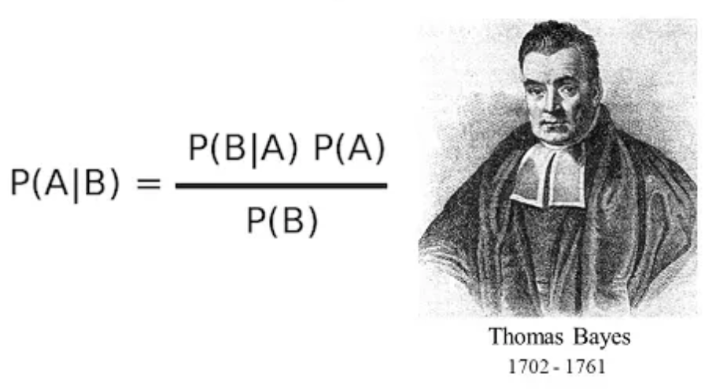
Motivation
Bayes Theorem, so what?
Notes:
Pictured retrieved from: https://scienceprog.com/simple-explanation-of-naive-bayes-classifier/ on May 2, 2019

Slide 3
Motivation
Bayes Theorem, so what?
Where can we go from Bayes Theorem?
Can we understand and use Bayesian regressions?

Slide 4
The Goal of This Seminar
Run a Bayesian regression
From Bayes Theorem to regression
Linear (& Logistic) regression(s)

Slide 5
The Goal of This Seminar
Run a Bayesian regression
From Bayes Theorem to regression
Linear (& Logistic) regression(s)
Compare with Frequentist methods
Model setup, parameter estimation, interpretation, prediction
We’ll start from Frequentist regression

Slide 6
We Need to Think About Assumptions
Assumptions DO matter
Main difference between Bayesian vs. Frequentist
Crucial to derive actual meaning of results

Slide 7
We Need to Think About Assumptions
Assumptions DO matter
Main difference between Bayesian vs. Frequentist
Crucial to derive actual meaning of results
Assumptions on:
Data
Randomness of parameters

Slide 8
Regression (Supervised Learning)
Modeling the relationship between variables

Slide 9
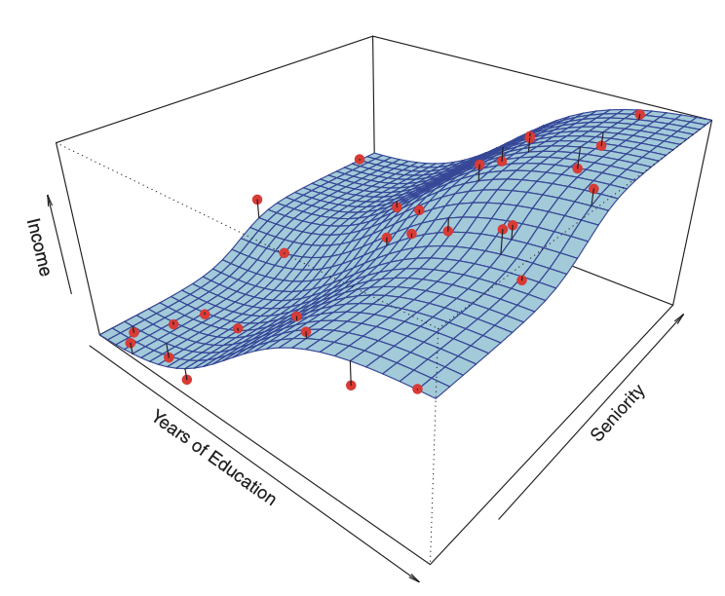
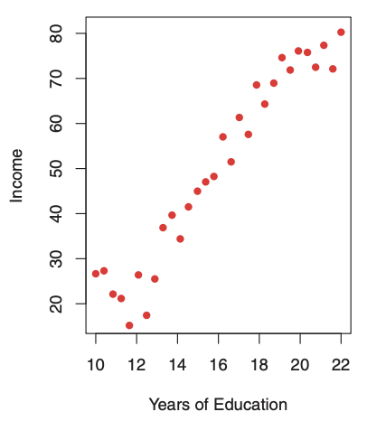
Regression (Supervised Learning)
Modeling the relationship between variables
- response variable(s) ← explanatory variables
Notes:
“Income” dataset, from the Introduction to Statistical Learning – with Applications in R, page 17, page 18
- So explanatory variables try to ‘explain’ response variables

Slide 10
Regression Analysis Framework
Model setup

Slide 11
Regression Analysis Framework
Model setup
Parameter estimation (fitting)
Notes:
Two kinds of estimation – point vs. interval

Slide 12
Regression Analysis Framework
Model setup
Parameter estimation (fitting)
Diagnostics (assumption checking)

Slide 13
Regression Analysis Framework
Model setup
Parameter estimation (fitting)
Diagnostics (assumption checking)
Interpretation / Prediction

Slide 14
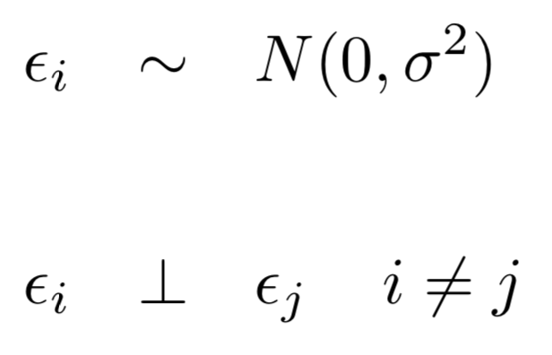
Linear Regression Model

Slide 15
Linear Regression Model
Explanatory variable #2, i^{th} observation value
i^{th} response
i^{th} residual
(Random Variable)

Slide 16
Linear Regression Model
Explanatory variable #2, i^{th} observation value
i^{th} response
i^{th} residual
(Random Variable)
Assumptions

Slide 17
Frequentist Linear Regression Model
Explanatory variable #2, i^{th} observation value
i^{th} response
‘Fixed’ coefficient for variable #1,
Independent of i
i^{th} residual
(Random Variable)
Assumptions
Notes:
Beta1 is basically the effect of X1 (for ith observation – meaning given the other variables’ values)

Slide 18
Frequentist Linear Regression Model
Explanatory variable #2, i^{th} observation value
i^{th} response
Expected value of Y (fixed), when all X_{i}’s are zero
i^{th} residual
(Random Variable)
Assumptions
Notes:
Beta0 is basically the average of Y, because you’re not using any other predictors.

Slide 19
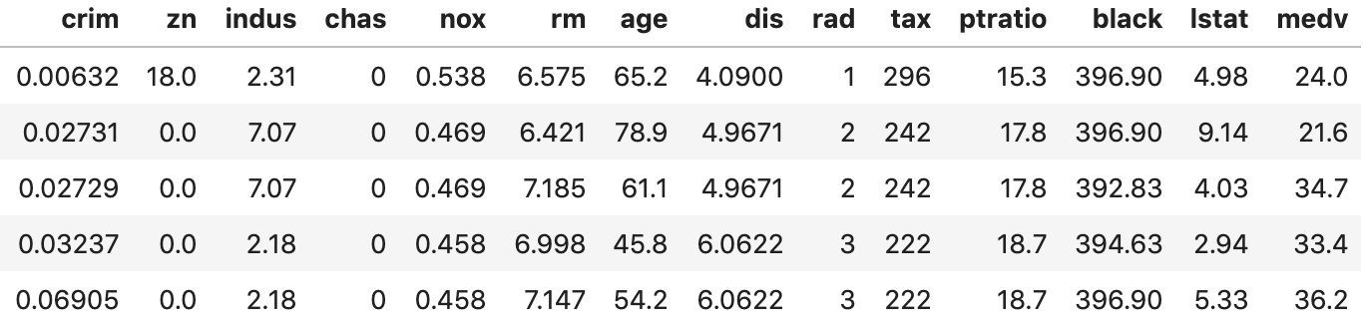
Linear Regression Using Boston Data
Housing data of Boston, MA (U.S. Census)
Included in R package ‘MASS’
Notes:
Should be on GitHub page as well
Information on MASS package: https://cran.r-project.org/web/packages/MASS/MASS.pdf

Slide 20
Linear Regression Using Boston Data
Housing data of Boston, MA (U.S. Census)
Included in R package ‘MASS’
Response: Median value of house (per $1,000)
Notes:
Should be on GitHub page as well
Information on MASS package: https://cran.r-project.org/web/packages/MASS/MASS.pdf

Slide 21
Linear Regression Using Boston Data
Housing data of Boston, MA (U.S. Census)
Included in R package ‘MASS’
Response: Median value of house (per $1,000)
Explain by: age, % of lower status pop.(lstat)
Notes:
Should be on GitHub page as well
Information on MASS package: https://cran.r-project.org/web/packages/MASS/MASS.pdf

Slide 22
Fitting the Model
The following is our model. Need to estimate parameters (β₀, β_{age}, β_{lstat})
Y_{i, medv} = β₀ + β_{age} ⋅ X_{i, age} + β_{lstat} ⋅ X_{i, lstat} + ε_{i}

Slide 23
Fitting the Model (Frequentist)
The following is our model. Need to estimate parameters (β₀, β_{age}, β_{lstat})
We need a Design matrix
Predictors & one column of 1’s (for intercept β₀)
Added by default except in statsmodels package
Y_{i, medv} = β₀ + β_{age} ⋅ X_{i, age} + β_{lstat} ⋅ X_{i, lstat} + ε_{i}

Slide 24
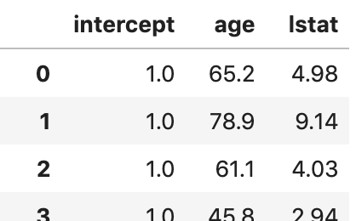
Design Matrix – Input Matrix
Y_{i, medv} = β₀ ⋅ 1 + β_{age}⋅ X_{i, age} + β_{lstat}⋅ X_{i, lstat} + ε_{i}
X =

Slide 25
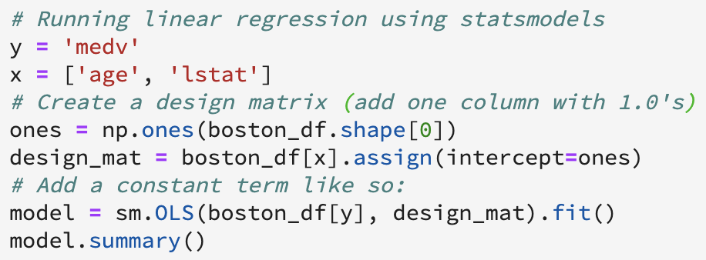
Let’s Fit the Model (Frequentist)
Once data are ready, fitting itself is quite easy
response variable vector (Y) & design matrix
We’re using statsmodels
Notes:
***Let’s go to Jupyter

Slide 26
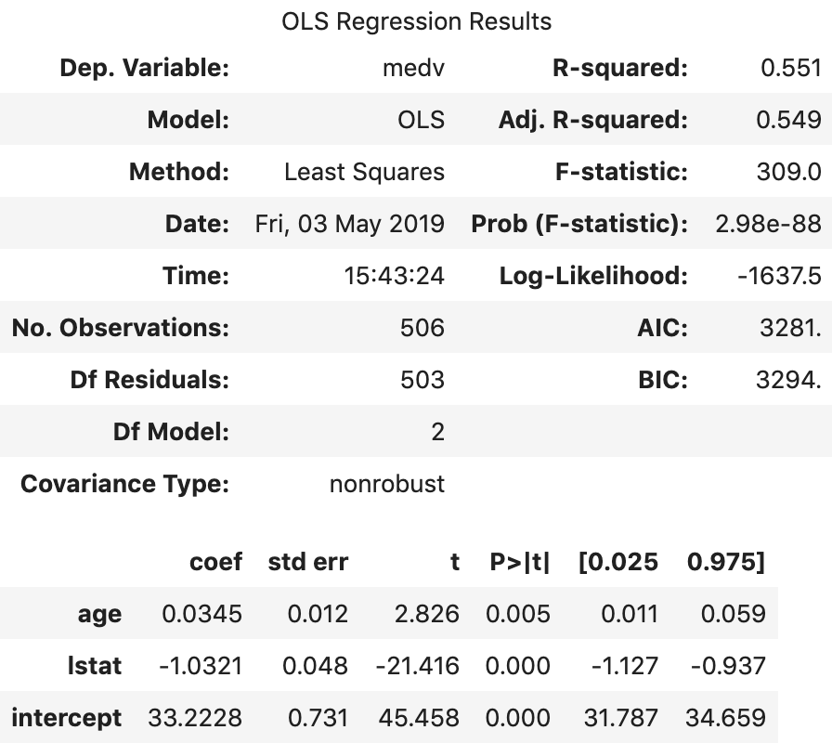
Interpreting Results (Frequentist)
Default estimation method

Slide 27
Interpreting Results (Frequentist)
'Variability’
explained

Slide 28
Interpreting Results (Frequentist)
‘Significance’ of your model
Notes:
Significance – compared to Y = beta0 + error_i model
Seems like it is much better than just using the values of Y
Probability – smaller the better!

Slide 29
Interpreting Results (Frequentist)
If want to compare with other predictor sets
Smaller
the merrier!!
Notes:
AIC/BIC – best ‘parsimonious’ fit

Slide 30
Interpreting Results (Frequentist)
Estimated ‘effect’ of predictors
95% confidence (frequency) interval
Y estimate when
age=lstat=0
Notes:
P-value of both predictors small

Slide 31
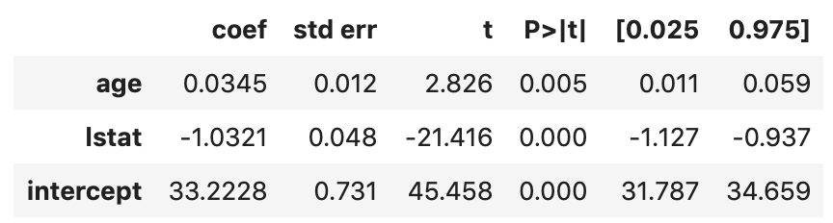
Prediction is Quite Easy
Just plug in the estimates
Y_{i, medv} = β₀ + β_{age} ⋅ X_{i, age} + β_{lstat} ⋅ X_{i, lstat} + ε_{i}

Slide 32
Prediction is Quite Easy
Also get 95% limits using confidence intervals
Y_{i, medv} = β₀ + β_{age} ⋅ X_{i, age} + β_{lstat} ⋅ X_{i, lstat} + ε_{i}

Slide 33
Diagnostics
Comparing assumptions to actual results
For example, does Y really follow Gaussian?

Slide 34
Diagnostics
Comparing assumptions to actual results
For example, does Y really follow Gaussian?
There are so many to check…
Linearity
Normality of error and Y
Multicollinearity (excessive correlation b/w preds)
Autocorrelation (independence b/w each ε_{i} /Y_{i})
etc.

Slide 35
Diagnostics Example
Functional form of predictors
Is it okay to just use age, lstat?
How about age², lstat²?
Y_{i, medv} = β₀ + β_{age} ⋅ X_{i, age} + β_{lstat} ⋅ X_{i, lstat} + ε_{i}

Slide 36
Diagnostics Example
Functional form of predictors
Is it okay to just use age, lstat?
How about age², lstat²?
We can draw predictor vs. residuals plot
Dots should be randomly scattered
Y_{i, medv} = β₀ + β_{age} ⋅ X_{i, age} + β_{lstat} ⋅ X_{i, lstat} + ε_{i}

Slide 37
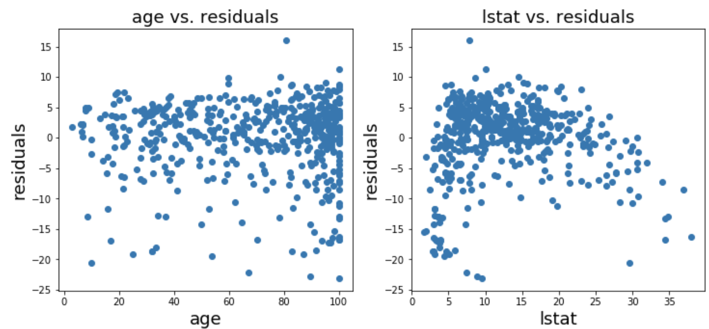
Predictor vs. Residuals

Slide 38
Predictor vs. Residuals
To fix lstat plot: add lstat²

Slide 39
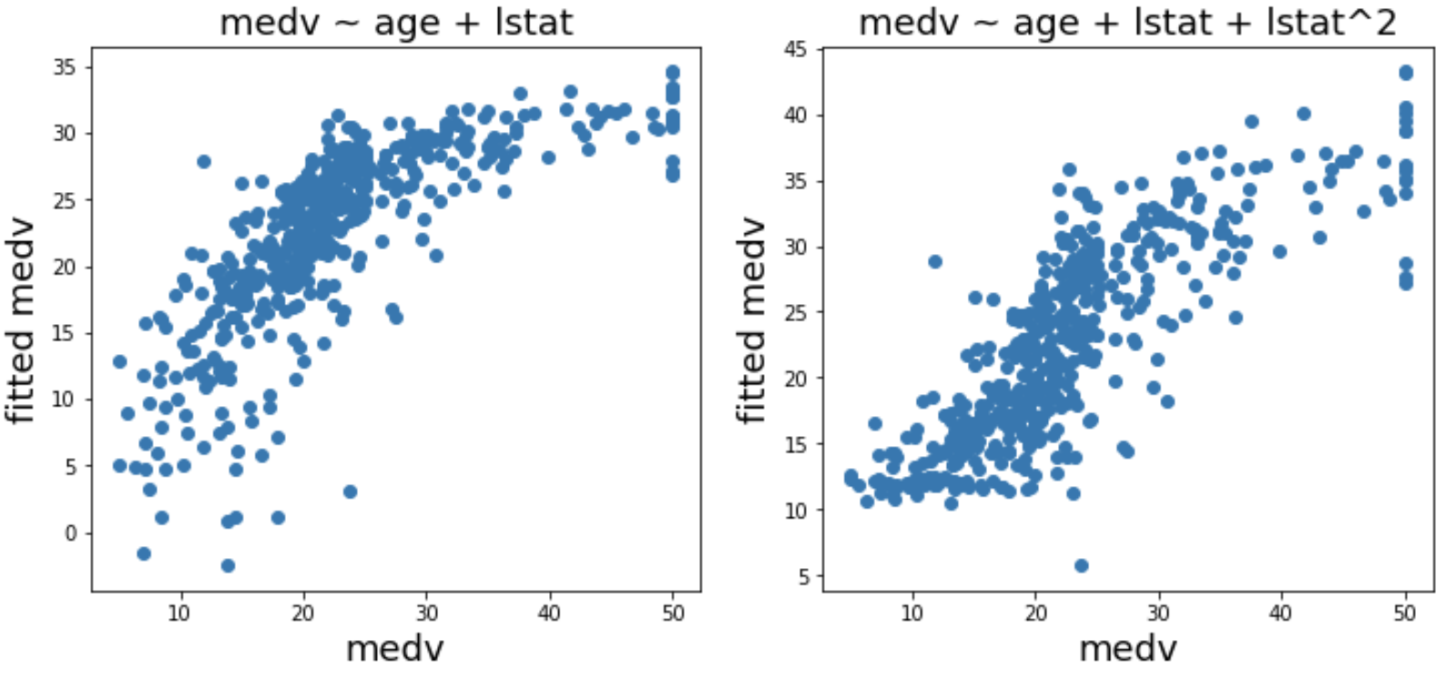
Added X_{i, lstat}² to the Model
R² = 0.551
R² = 0.668
So we can ‘improve’ the model

Slide 40
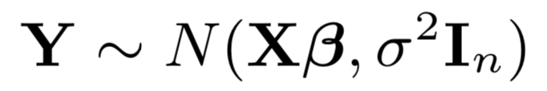
At This Point, I (We?) Tend to Forget…
That Y is a random variable following Normal Distribution

Slide 41
At This Point, I (We?) Tend to Forget…
That Y is a random variable following Normal Distribution
We estimated ‘fixed’ β and σ so that we can figure out the distribution of Y
Coefficients
Estimated along the way

Slide 42
Transition to Bayesian Regression
What if coefficients are random variables?
This means we have different assumptions
It will be much harder to estimate parameters analytically
All random variables, and we don’t know their distributions!

Slide 43
Transition to Bayesian Regression
What if coefficients are random variables?
This means we have different assumptions
It will be much harder to estimate parameters analytically
All random variables, and we don’t know their distributions!
Especially from ε_{i} ~ N(0, σ²), σ ² becomes a random variable

Slide 44
Bayesian Model – Updating Belief
σ ~ π (λ_{σ}, θ_{σ})
β₀ ~ π (λ₀, θ₀)
+ Data =
β₁ ~ π (λ₁, θ₁)
β₂ ~ π (λ₂, θ₂)
etc…
Y ~ π (βs, σ)
‘Prior’ distribution
Notes:
Actual mathematical notations are much more complicated

Slide 45
Bayesian Model – Updating Belief
σ ~ π (λ_{σ}, θ_{σ})
σ` ~ π (λ_{σ}, θ_{σ},Data)
β₀ ~ π (λ₀, θ₀)
β`₀ ~ π (λ₀, θ₀,Data)
+ Data =
β₁ ~ π (λ₁, θ₁)
β`₁ ~ π (λ₁, θ₁,Data)
β₂ ~ π (λ₂, θ₂)
β`₂ ~ π (λ₂, θ₂,Data)
etc…
Bayes Theorem used here to
‘update’ priors
etc…
Y ~ π (βs, σ)
Y ~ π (β`s, σ`, Data)
‘Prior’ distribution
Notes:
Actual mathematical notations are much more complicated

Slide 46
Bayesian Model – Updating Belief
σ ~ π (λ_{σ}, θ_{σ})
σ` ~ π (λ_{σ}, θ_{σ},Data)
β₀ ~ π (λ₀, θ₀)
β`₀ ~ π (λ₀, θ₀,Data)
+ Data =
β₁ ~ π (λ₁, θ₁)
β`₁ ~ π (λ₁, θ₁,Data)
β₂ ~ π (λ₂, θ₂)
β`₂ ~ π (λ₂, θ₂,Data)
etc…
Bayes Theorem used here to
‘update’ priors
etc…
Y ~ π (βs, σ)
Y ~ π (β`s, σ`, Data)
‘Prior’ distribution
‘Posterior’ distribution
Notes:
Actual mathematical notations are much more complicated

Slide 47
Sampling as an Estimation Tool
Now, Y is a combination of random variables
Often extremely difficult to find mathematical closed-form solution

Slide 48
Sampling as an Estimation Tool
Now, Y is a combination of random variables
Often extremely difficult to find mathematical closed-form solution
But if we can ‘sample’ the data and summarize them without knowing closed-form…
It will be great!

Slide 49
Markov Chain Monte Carlo (MCMC)
A sequential sampling scheme where the future only depends on the present step
Previous steps don’t matter

Slide 50
Markov Chain Monte Carlo (MCMC)
A sequential sampling scheme where the future only depends on the present step
Previous steps don’t matter
Under certain conditions, the distributions will stabilize (Ergodic Theorem)
Can sample from the stable posterior distributions
Notes:
And most cases it will converge

Slide 51
Markov Chain Monte Carlo (MCMC)
A sequential sampling scheme where the future only depends on the present step
Previous steps don’t matter
Under certain conditions, the distributions will stabilize (Ergodic Theorem)
Can sample from the stable posterior distributions
There are a few MCMC algorithms & tools:
Gibbs, Metropolis-Hastings, Hamiltonian-MC
JAGS, Stan, etc.

Slide 52
We Will Use Stan (PyStan)
Uses No U-Turn Sampler (NUTS) algorithm
A variant of HMM (Hamiltonian Monte Carlo)
You’ll see it when you run PyStan
Notes:
https://en.wikipedia.org/wiki/Stan_(software)

Slide 53
We Will Use Stan (PyStan)
Uses No U-Turn Sampler (NUTS) algorithm
A variant of HMM (Hamiltonian Monte Carlo)
You’ll see it when you run PyStan
Need a few steps to sample data
Code specification
Input data
Model
Sampling
Notes:
https://en.wikipedia.org/wiki/Stan_(software)

Slide 54
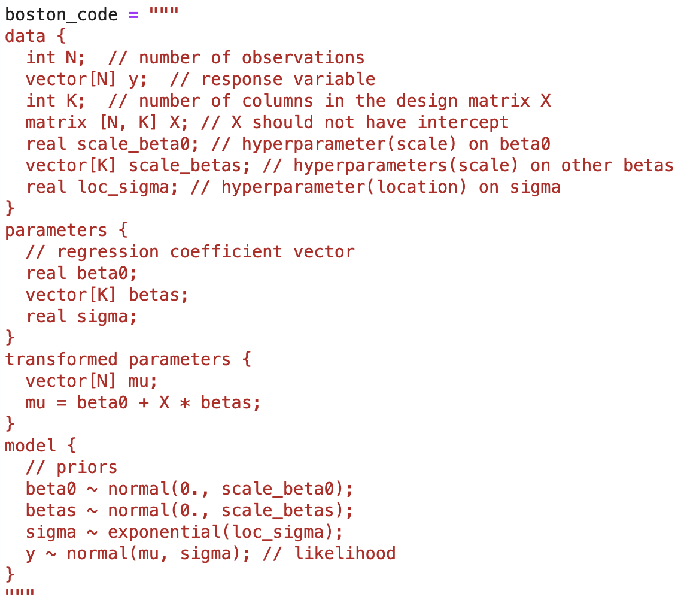
Stan Code Specification (Boston Data)
A string with several
sub-components:
Data
Parameters
Transformed parameters
Model
etc
Notes:
Code adapted from: https://jrnold.github.io/bayesian_notes/introduction-to-stan-and-linear-regression.html

Slide 55
Stan Code Components - Data
Information on input data:
All of them should be given/specified before sampling
Notes:
C++ style coding (end line with ;, comment with //)

Slide 56
Stan Code Components – Parameters1
The parameters will be sampled during MCMC, so distribution should be provided later

Slide 57
Stan Code Components – Parameters2
Simplifying formula for the model component
X*betas: dot product between matrix & vector

Slide 58
Stan Code Components – Model
Specification of distributions – priors and Y

Slide 59
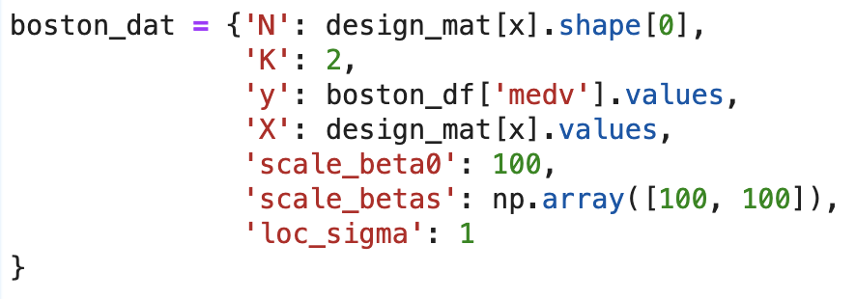
Stan Input Data Specification
A dictionary with specified components
Items should be a value or list/numpy.array
If you have pandas.DataFrame, .values method will retrieve them in proper data type

Slide 60
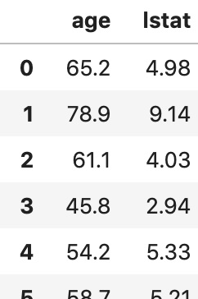
Stan Input Data Specification
A dictionary with specified components
Items should be a value or list/numpy.array
If you have pandas.DataFrame, .values attribute will retrieve them in proper data type

Slide 61
Stan Model Specification
Connecting Stan model class to the code specification
That’s it!

Slide 62
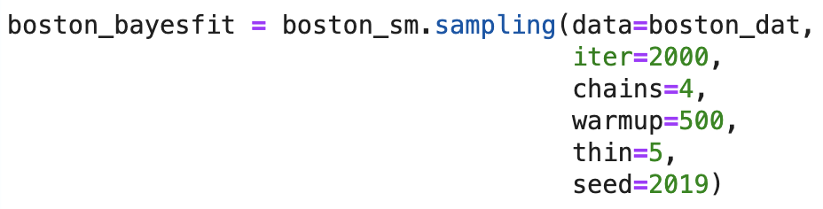
Stan Sampling
Finally, combine everything and start sampling
Need to specify a few more things

Slide 63
Stan Sampling
Finally, combine everything and start sampling
Need to specify a few more things
Model connected to code specification
Input data

Slide 64
Determine Size of the Result
To keep samples only from stable distribution, we throw away initial results (warmup)
Also called ‘burn-in’
Throwing away first samples until distributions converge
Notes:
Thinning is to reduce autocorrelation (adjacent samples might be too strongly correlated)

Slide 65
Determine Size of the Result
To keep samples only from stable distribution, we throw away initial results (warmup)
Also called ‘burn-in’
Size of samples kept:
[(iter – warmup) / thin] ⋅ chains = 1200
Iterations per chain
Only keep every 5 samples
Notes:
Thinning is to reduce autocorrelation (adjacent samples might be too strongly correlated)

Slide 66
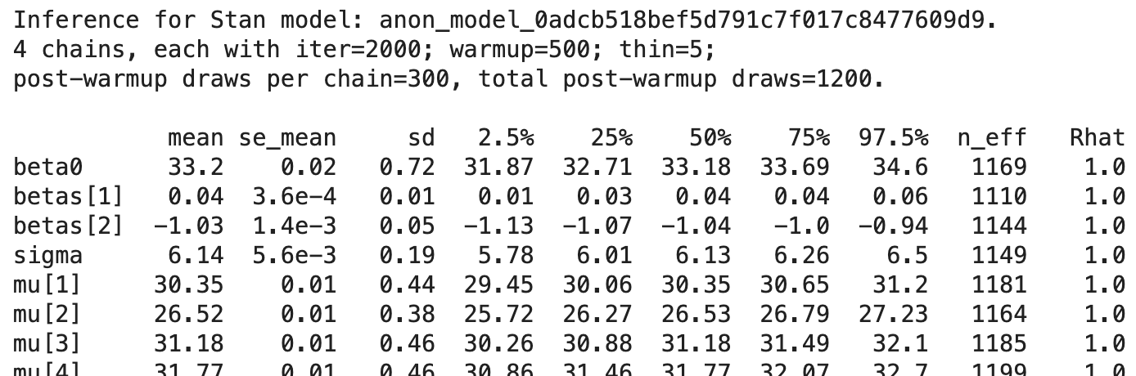
Sampling Result – Just a Large Dataset
The biggest practical difference between Freq/Bayes – you summarize samples
beta0, betas, sigma, mu (Y) all have distributions

Slide 67
Initial Diagnostics – Trace Plot
It is important to check first if the sampled data have actual stationary distributions

Slide 68
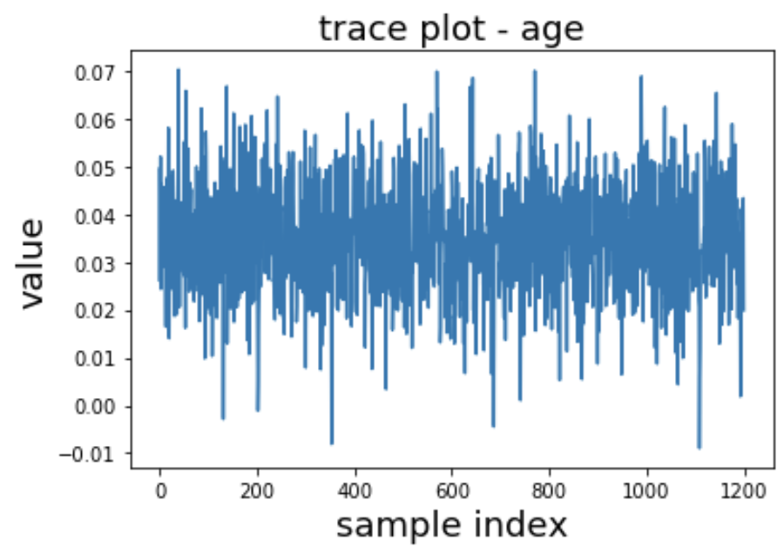
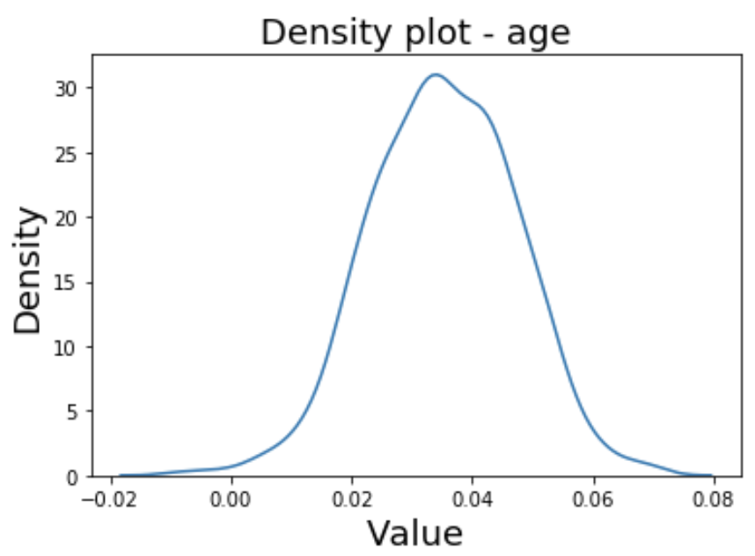
Initial Diagnostics – Trace Plot
It is important to check first if the sampled data have actual stationary distributions
Trace plot and density plot do this
Notes:
This looks fine!
Because of the chaining, you can just draw the traceplot using just one chain (300 samples)

Slide 69
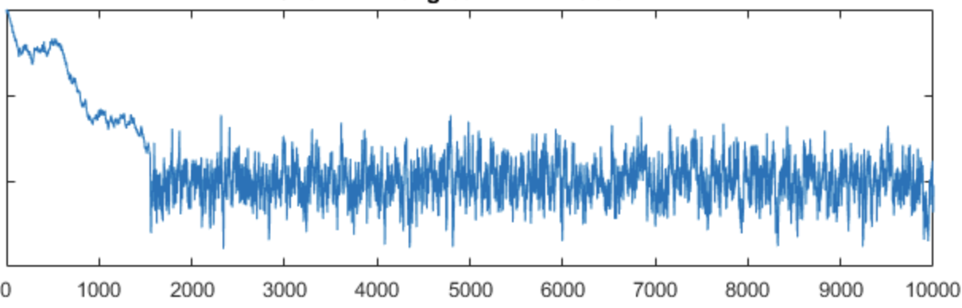
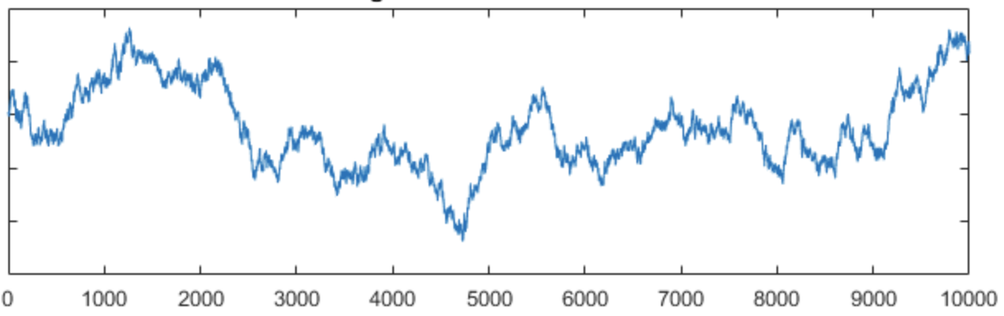
Problematic Trace Plot Examples
You don’t want to see these
Need longer warmup (burn-in)
Need thinning or larger sample
Notes:
Plots retrieved from (on May 6, 2019):
https://www.statlect.com/fundamentals-of-statistics/Markov-Chain-Monte-Carlo-diagnostics
issue 1: need time to converge
Cycle too slow because each observation is serially correlated

Slide 70
Summarizing the Result
Mean and SD
Notes:
Se_mean – Monte Carlo standard error of mean -> small so good!

Slide 71
Summarizing the Result
95% ‘Credible’ Bayesian interval
Notes:
“Given our observed data, there is a 95% probability that the true value of μ falls within CI”
http://jakevdp.github.io/blog/2014/06/12/frequentism-and-bayesianism-3-confidence-credibility/

Slide 72
Summarizing the Result
Comparison of individual variance vs. group variance => should be around 1.0
Notes:
You can consider it as a ratio!
N_eff effective sample size where (variance(mu) = sd/n*)

Slide 73
Posterior Predictive Distribution
How do we make predictions?
Note that Y is a random variable: has distribution
Idea 1. Use the means of parameter samples
Y ~ N(Xβ, σ²)
Plug in means of β, σ samples
Can get a closed-form distribution for Y, but cannot account for variability of β, σ
Consequently, you get smaller variance than real

Slide 74
Posterior Predictive Distribution
How do we make predictions?
Note that Y is a random variable: has distribution
Idea 2. Use sampled data
Sample values of Y directly from each β & σ sample, then summarize the information of Y
Considers variability of β, σ
Might not always get closed-form distribution easily
Will have larger variance than idea 1.

Slide 75
Priors and Hyperparameters
Compare with the Frequentist results

Slide 76
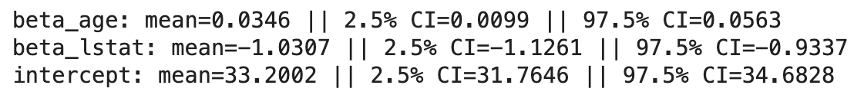
Priors and Hyperparameters
Compare with the Frequentist results
If age ~ N(0, 1²), lstat ~ N(0, 1²)
Notes:
But actually age mean 0, lstat mean 0 don’t make sense, because anyone is at least 0 years old, and lstat ranges from 0 - 100

Slide 77
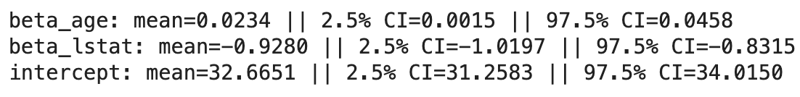
Priors and Hyperparameters
If you update hyperparameters
If age ~ N(50, 1²), lstat ~ N(50, 1²)
Similar means, slightly different intervals

Slide 78
Priors for Bayesian Linear Regression
Can try different hyperparameters
Your prior ‘knowledge’ might help
Notes:
Jeffrey’s priors: (π(β) ∝ 1, π(β, σ) ∝ 1/ σ²)
Bayesian Lasso: pi(beta) ) ∝ exp(-|beta|/(gamma^2))

Slide 79
Priors for Bayesian Linear Regression
Can try different hyperparameters
Your prior ‘knowledge’ might help
Can also try different prior distributions
Many options such that…
Jeffrey’s priors
Multivariate normal prior
Spike and Slab priors
More!
Notes:
Jeffrey’s priors: (π(β) ∝ 1, π(β, σ) ∝ 1/ σ²)
Bayesian Lasso: pi(beta) ) ∝ exp(-|beta|/(gamma^2))
Spike and Slab - Weighted mixture prior

Slide 80
Now, Logistic Regression
Just an extension of linear regression models
Y value is either 0 or 1
Bernoulli distribution: probability of Y=1
Need to transform Y in modeling
So, the response is a function of P(Y=1)
We use ‘logit’ function:
log(x / (1-x))
So, You have log(P(Y=1) / [1 – P(Y=1)])

Slide 81
Now, Logistic Regression
So, your model is:
log(P(Y=1) / [1 – P(Y=1)]) = beta0 + beta1*x1 + …
In statsmodels package, it will be as easy
statsmodels.discrete.discrete_model.Logit
In Bayesian, also easy:
Y ~ bernoulli_logit(linpred)
Notes:
Reference from here:
https://www.kaggle.com/gkoundry/bayesian-logistic-regression-with-pystan

Slide 82
‘Gambia’ Dataset
Information of children with malaria infection
Compared to Boston dataset, fewer covariates but longer observations
You can use logistic regression
Pos (malaria) ~ netuse (usage of bed-net)

Slide 83
Conclusion – It Will Become Easy
Once you know how to run a Bayesian Regression model, things will get easy
Be careful of data type/model coding

Slide 84
Conclusion – It Will Become Easy
Once you know how to run a Bayesian Regression model, things will get easy
Be careful of model coding/ input data
Further direction
Switching to different prior distributions
Incorporating prior knowledge into the model
Try different models (logistic regression etc.)

Slide 85

The End

