Slide 1
Introduction to Statistical Analysis (using Shiny Apps)
CRUK:- Monday 17th October 2016
Robert Nicholls & Edward Williams
www.tiny.cc/crukStats
Acknowledgements:- Sarah Vowler, Sarah Dawson, Liz Merrell, Deepak Parashar

Slide 2
Approximate Timetable
10.30 - 11.15 – Lecture: Introduction to Statistical analysis
11.15 - 11.30 – Quiz: Variables/Dependencies/Tests/Generalisability
11.30 - 12.00 – Lecture: Parametric Tests for Continuous Variables; t-tests
12.00 - 12.30 – Examples/Practicals (computer based)
12.30 - 13.30 – Lunch (not provided)
13.30 - 14.00 – Lecture: Non-parametric tests for continuous variable
14.00 - 14.30 – Examples/Practicals (computer based)
(14:30 COFFEE)
14.30 - 14.45 – Lecture: Tests for Categorical Variables
14.45 - 15.30 – Examples/Practicals/Solutions (computer based)
15.30 - 16.25 – Group based exercise: Choosing appropriate tests
16.25 - 16.30 – Summary

Slide 3
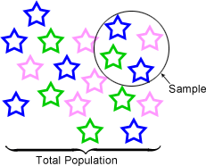
The point of statistics
Rarely feasible to study the whole population that we are interested in, so we take a sample instead
Assume that data collected represents a larger population
Use sample data to make conclusions about the overall population
Notes:
What is the point of statistics? Why do we need them?
Typically in any research we’re looking to make a finding which we can apply more universally.
We want to make inferences about the population we’re interested in. It’s usually time consuming, expensive and very difficult to get data for everyone in the population, so we take a sample from the population and record data for those in the sample in the hope that this will be representative of the population as a whole.
In other words we take a sample of individuals – which might be mice, cells or humans – find something interesting about that sample and generalise that finding to the overall population.
To convince others about our findings, we need a good study design, with a sample that is representative of the population we are interested in and an appropriate statistical test.

Slide 4
Beginning a study
Which samples to include?
Randomly selected?
Generalisability
Always think about the statistical analysis
Randomised comparisons, or biased?
Any dependency between measurements?
Data type?
Distribution of data?
Normally distributed? Skewed? Bimodal?
Notes:
Before beginning a study we should be thinking about the statistical analysis that we will do to answer our research question.
The statistical analysis that we carry out will depend on the data that we collect.
- firstly the type, there are 4 types
Categorical, nominal where data are in categories with no ordering, any observation can be assigned to only one category, boil down to a yes/no answer if there are two categories. Examples include gender, eye colour, surgical margin status.
Categorical with ordering or ordinal, this is similar to nominal, except that the categories have an implicit order to them, given the categories you should be able to put them in order, for ordinal data there are few categories, examples include tumour grade, tumour stage, age if it has been categorised.
Discrete: can take a finite range of set values, usually a larger number of values than for ordinal data, discrete data are often count data, e.g. shoe size, number of cells, number of tumours.
Continuous, this sort of data can take any value over an infinite range, although sometimes discrete data is over a large enough range to be considered continuous, examples are weight, height, temperature.
Different statistical methods will be used depending on the type of data, it is important to use the right test for the data you have collected and to ensure that the data meet all the assumptions of the test.
- most statistical approaches rely on the observations that we are studying to be independent, that is one measurement shouldn’t be more similar to another, but we’ll learn more about that shortly.
Any findings you make with your data can only be generalised back to the population from which your sample was drawn, you should not extrapolate beyond this population. So if you only collect animals from one mouse litter your findings only apply to that litter. If you only collect males then your findings only apply to males, or you study black 6 mice then your findings only apply to black 6 mice.
- and in addition the statistical approach we take can depend on the distribution of our data, many tests depend on a normality assumption so we need to know are the data normally distributed, skewed or bimodal but more about that shortly.

Slide 5
Generalisability
How samples are selected affects interpretation
What is the population that the results apply to?
How widely applicable will the study be?
Statistical methods assume random samples
Do not extrapolate beyond range of the data
i.e. don’t assume results apply to anything not represented in the data
Examples:
Males only, no idea about females
Adults only, no idea about children
1 litter of mice, no idea about other litters

Slide 6
Data types
Several different categorisations
Simplest:
Categorical (nominal)
Categorical with ordering (ordinal)
Discrete
Continuous

Slide 7
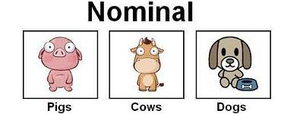
Most basic type of data
Three requirements:
Same value assigned to all the members of level
Same number not assigned to different levels
Each observation only assigned to one level
E.g. gender: 1 = female, 2 = male
Boils down to yes/no answer
Others: Surgery type, cancer type, eye colour, dead/alive, ethnicity.
Images:http://www.restore.ac.uk

Slide 8
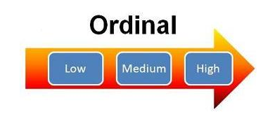
Next type of data
Mutually exclusive fixed categories
Implicit order
Can say one category higher than another
But not how much higher
Example: stress level 1 = low … 7 = high
Others: Grade, stage, treatment response, education level, pain level.

Slide 9

Discrete
Third level of measurement
Fixed categories, can only take certain values
Like ordinal but with well-defined distances
Can be treated as continuous if range is large
Anything counted (cardinal) is discrete
– how many?
Examples: number of tumours, shoe size, hospital admissions, number of side effects, medication dose, CD4 count, viral load, reads.

Slide 10
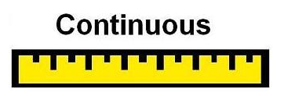
Final type of data
Anything that is measured, can take any value
May have finite or infinite range
Zero may be meaningful: ratios, differences
Care required with interpretation
Given any two observations, one fits between
Examples: Height, weight, blood pressure, temperature, operation time, blood loss, age.
Notes:
Interval How much more or less compared to something else, Distances between values not same meaning
Meaningful zero point so distances carry the same meaning at different points on the scale.

Slide 11
Data types
Several different categorisations
Simplest:
Categorical (nominal) – yes/no
Categorical with ordering (ordinal) – implicit order
Discrete – only takes certain values; counts (cardinal)
Continuous – measurements; finite/infinite range

Slide 12
Measurements:
Dependent / Independent?
Measurements of gene expression taken from each of 20 individuals
Are any measurements more closely related than others?
Siblings/littermates?
Same individual measured twice?
Batch effects?
If no reason, assume independent observations
Notes:
Now we are going to think about independent measurements as I said previously this is a common assumption of statistical tests.
Suppose we have measured gene expression on each of 20 individuals we need to think if there is any reason why any measurements may be more closely related to other measurements in the dataset. Are two of the subjects siblings or littermates? Is gene expression measured twice or more on the same subject, are there batch effects of DNA extraction, are the measurements taken on the same day different days, are the same reagent batches used in the experiment, are measurements carried out by different people? Are they are measured on the different genechips etc etc If there is any reason why some measurements are more alike than others, then it is important to take account of this in the analysis otherwise it will be biased.
If there is no obvious reason why two measurements should be more similar then it is safe to assume independent observations and use analysis that assumes independent observations.
Now we will move on to look at some examples.

Slide 13
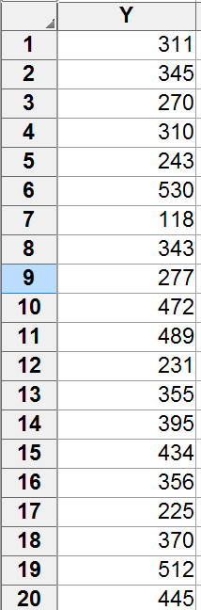
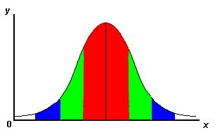
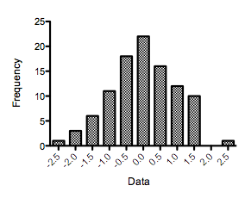
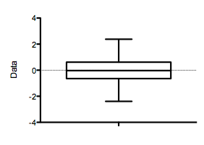
Continuous Data – Distribution
Notes:
If we have continuous data, or data across a sufficient range to be considered continuous, we need to assess the distribution of the data, to decide which tests are suitable for the analysis. Many statistical tests require a normal distribution of the data. A normal distribution is a bell shape curve and has 2/3 of the data within 1 SD of mean, 95% of the data within 2 SD and 99% within 3 SD, as illustrated here. We can assess normality by use of a histogram or boxplot. A histogram gives the frequency of values within a particular range. A histogram should give a nice bell shaped curve if the data are normally distributed. A boxplot should have the median in the centre of the box which shouldn’t be too wide, and the boxplot should be symmetric. You need to remember to plot separate plots for each group and in the case of paired data it is the differences that need to be normal.
More rigorous/objective methods of testing for Normality exist (Shapiro-Wilk test; Kolmogorov-Smirnov test), although naive test results may not be reliable - manual inspection & interpretation is important.
----- Meeting Notes (23/05/2012 09:43) -----
Take out second column in example
----- Meeting Notes (09/09/2014 09:42) -----
Replace graphs with R graphs

Slide 14
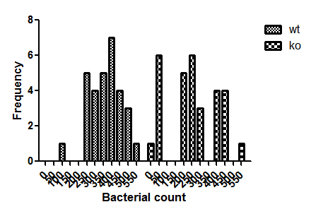
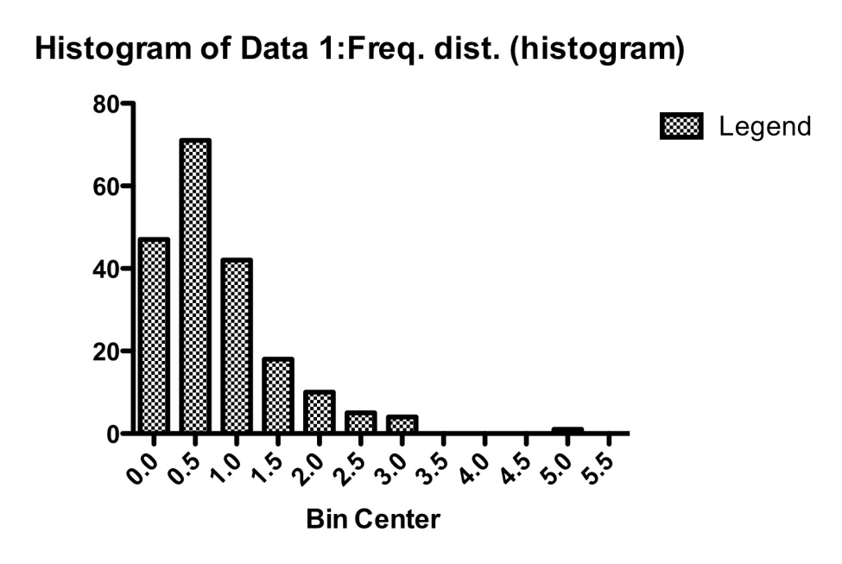

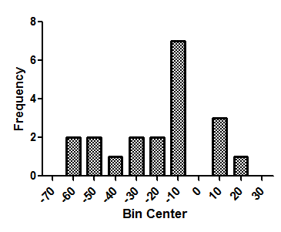

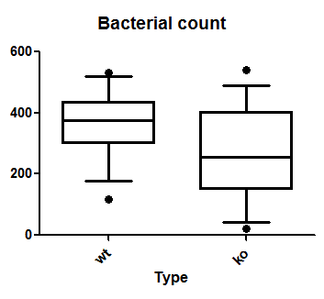

Continuous Data – Distribution?
Notes:
Now to look at some examples. Looking at the first two graphs on the left it is probably OK to assume that the data are normally distributed. For the third graph, the data are right skewed, that is the bulk of the data are on the left with a long tail out to the right. This is often the case for cost data, length of stay and survival data. A log-transformation might make this data normally distributed but care then needs to be taken with the interpretation as it is no longer on the original scale, so non-parametric methods, that don’t assume a normal distribution might be preferred. For the final plot, as the sample size is small it is unclear whether the population is normally distributed, but the data are not symmetric so methods assuming a normal distribution are probably best avoided. If the data are normally distributed or not is a subjective judgement, best to decide based on the graphs, rather that using a statistical test as these tend to be over-sensitive for large samples and say data aren’t normally distributed when they are sufficiently normally distributed for parametric tests, for small sample sizes they are likely to say that the data are sufficiently normally distributed when they are not. Also testing for normality adds to the multiple testing issue. As a rule of thumb: measurements taken on humans are often normally distributed, measurements on blood often require a log transformation and count data often need a sqrt transformation.
----- Meeting Notes (23/05/2012 09:43) -----
Change left hand plots so that they are more normal
Also question 2 of practical
----- Meeting Notes (09/09/2014 09:42) -----
Replace graphs with R graphs

Slide 15
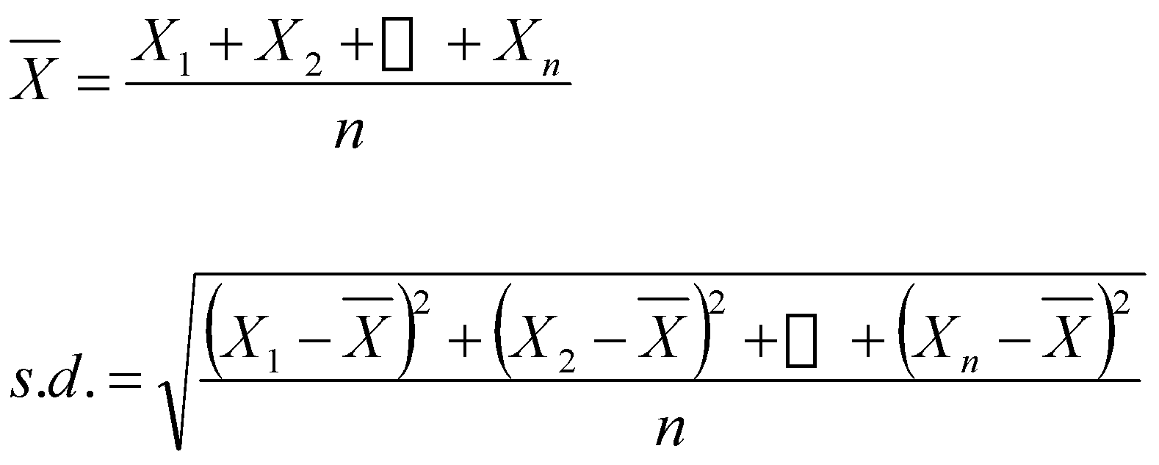
Continuous Data
Descriptive Statistics
Measures of location and spread
Mean and standard deviation
...
...
Notes:
We use summary statistics to give an initial impression of the data. For continuous data these are measures of location, i.e. where on the scale the data are and spread, how widely scattered our data are. For normally distributed data, the summary statistics are the mean value and the standard deviation. The mean or average is the sum of all the observations divided by the number of observations. The standard deviation is the average distance from the mean. The formulae are given here but they can be calculated in GraphPad its unusual to need to do by hand.
----- Meeting Notes (09/09/2014 09:42) -----
Replace with R graph

Slide 16
Continuous Data
Descriptive Statistics
Median: middle value
Lower quartile: median bottom half of data
Upper quartile: median top half of data
Notes:
If the data are skewed or have a distribution other than normal or contain outliers then the mean and sd might not be suitable summary statistics, the median and interquartile range may be more appropriate. If the data are arranged in numerical order then the median is the middle value of the data. The interquartile range is formed of the lower quartile which is the median of the bottom half of the data and the upper quartile which is the median of the top half of the data.
----- Meeting Notes (09/09/2014 09:42) -----
Replace with R graphs

Slide 17
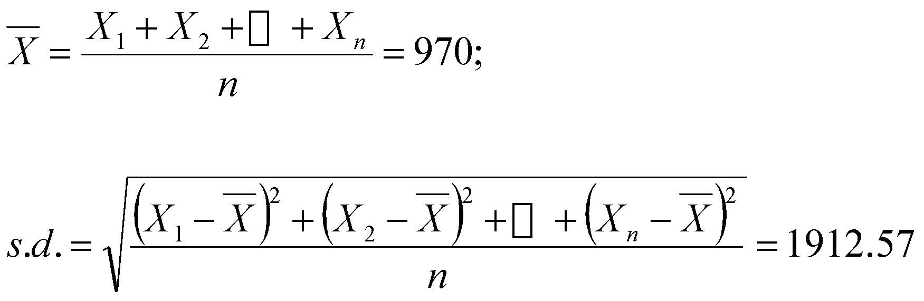
Continuous Data
Descriptive Statistics (Example)
E.g. No. of Facebook friends for 7 colleagues
311, 345, 270, 310, 243, 5300, 11
Measures of location and spread
Mean and standard deviation
Median and interquartile range
11, 243, 270, 310, 311, 345, 5300
...
...
Notes:
So for an example Suppose we have these data here that are numbers of facebook friends of 7 colleagues assuming the number of facebook friends is normally distributed we calculate the mean and sd.
So what the mean is telling us is that the observations are centred around 970.
And what the standard deviation is telling us is that the average distance between each observation and the mean is just over 1900.
And we expect almost all of our observations to be within 2 standard deviations of the mean.
If our data is skewed – and we might think this with these numbers as there is one very big 5300 compared with the other observations – we tend to look median and interquartile range, the median is the middle value 310, much lower than 970. IQR is 243-345. If we look at the raw data the median value of 310 is more representative of the data, than the mean value of 970. Similarly the interquartile range is more representative than the SD.

Slide 18
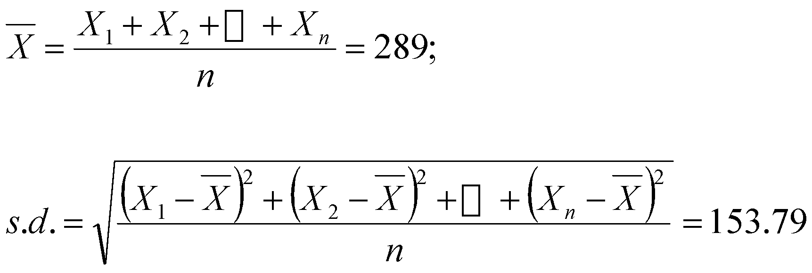
Continuous Data
Descriptive Statistics (Example)
E.g. No. of Facebook friends for 7 colleagues
311, 345, 270, 310, 243, 530, 11
Measures of location and spread
Mean and standard deviation
Median and interquartile range
11, 243, 270, 310, 311, 345, 530
...
...
Notes:
If we look at this data the value of 5300 is much bigger than expected from the rest of the data. It is an outlying value. We should never remove a value just because it is an outlier, but we should investigate outliers to see if they are real values. When we check we find that this value should have been 530.
Now we recalculate the mean and find that it drops from 970 to 289. The SD drops from just over 1900 to 153. We can see that the mean and sd are unduly influenced by this outlying value.
When we look at the median and interquartile range, however, we find that they haven’t changed, as the median and interquartile range are robust to outliers.
We can see with the outliers removed the mean and median are more similar and both reflect the data. The value of the SD is also more similar to the value of the IQR which is 102.
If the data contain outliers then the median and interquartile range might provide more reflective summary values.
As well as checking for outliers it is important to check the data for missing values, as missing values can bias the results.

Slide 19
Continuous Data
Descriptive Statistics (Example)
E.g. No. of Facebook friends for 7 colleagues
311, 345, 270, 310, 243, 530, 11
Measures of location and spread
Mean and standard deviation : low breakdown point
Median and interquartile range : robust to outliers
11, 243, 270, 310, 311, 345, 530
...
...
Notes:
If we look at this data the value of 5300 is much bigger than expected from the rest of the data. It is an outlying value. We should never remove a value just because it is an outlier, but we should investigate outliers to see if they are real values. When we check we find that this value should have been 530.
Now we recalculate the mean and find that it drops from 970 to 289. The SD drops from just over 1900 to 153. We can see that the mean and sd are unduly influenced by this outlying value.
When we look at the median and interquartile range, however, we find that they haven’t changed, as the median and interquartile range are robust to outliers.
We can see with the outliers removed the mean and median are more similar and both reflect the data. The value of the SD is also more similar to the value of the IQR which is 102.
If the data contain outliers then the median and interquartile range might provide more reflective summary values.
As well as checking for outliers it is important to check the data for missing values, as missing values can bias the results.

Slide 20
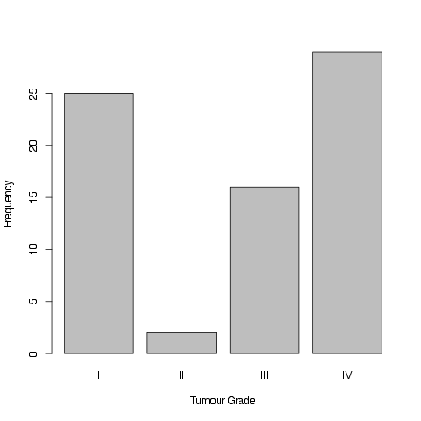
Categorical Data
Summarised by counts and percentages
Examples
19/82 (23%) subjects had Grade IV tumour
48/82 (58%) subjects had Diarrhoea as an Adverse Event.
Notes:
Mean, median etc. don’t apply.
Bar charts, pie charts, etc.
----- Meeting Notes (09/09/2014 09:42) -----
Represented by bar charts put some bar charts in

Slide 21
Standard Deviation and Standard Error
Commonly confused
Standard deviation (SD):
Measure of spread of the data
Standard error (SE):
Variability of the mean from repeated sampling
Precision of mean
Used to calculate confidence interval
SD: How widely scattered measurements are
SE: Uncertainty in estimate of sample mean
Notes:
The terms standard deviation and standard error are often confused. The difference between the two reflects the distinction between data description and statistical inference.
SD is a measure of variability or spread of the data. We use the sample SD to estimate the variability of the whole population. Standard deviation is used when we are describing a population.
When we have a normally distributed population if we took repeated samples from the population and calculated their means, then these means would be normally distributed. The standard error of the mean is the variability of the means from repeated sampling. The standard error can also be considered as a measure of precision of the sample mean.
So if we want to say how widely scattered some measurements are we use the standard deviation. If we want to indicate the uncertainty around the estimate of the mean measurement we quote the standard error of the mean.
If you have done nothing to your data use the SD, if you have carried out a statistical test use the se, or better still a confidence interval.
SE can be calculated for any statistic, not just the mean.

Slide 22
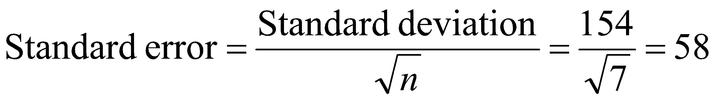
Confidence intervals for the mean
Confidence interval (CI) is a random interval
In repeated experiments…
95% of time CI covers the mean
The mean should be in the CI 95% of the time
Notes:
The confidence interval is a random interval. If we carried out an experiment a large number of times and calculated a confidence interval for the mean each time, then 95% of the time the confidence intervals would include the true value of the mean. A looser interpretation is 95% of the time the mean is within the confidence interval.
It is calculated by taking the mean +/- 1.96 * standard error. Where the standard error is the standard deviation divided by the square root of the number of observations. Going back to our facebook friends example the 95% CI for the mean number of facebook friends of 289 is 175, 402. So from repeated sampling we’d expect the average number of facebook friends to be between 175 and 402. Confidence intervals are usually reported as they give a range of values of the mean that are consistent with the data and are therefore more informative than merely giving a p-value.

Slide 23
Confidence intervals for the mean
Confidence interval (CI) is a random interval
In repeated experiments…
95% of time CI covers the mean
The mean should be in the CI 95% of the time
Facebook data: 11, 243, 270, 310, 311, 345, 530
Mean 289, 95% CI (175, 402)
Notes:
The confidence interval is a random interval. If we carried out an experiment a large number of times and calculated a confidence interval for the mean each time, then 95% of the time the confidence intervals would include the true value of the mean. A looser interpretation is 95% of the time the mean is within the confidence interval.
It is calculated by taking the mean +/- 1.96 * standard error. Where the standard error is the standard deviation divided by the square root of the number of observations. Going back to our facebook friends example the 95% CI for the mean number of facebook friends of 289 is 175, 402. So from repeated sampling we’d expect the average number of facebook friends to be between 175 and 402. Confidence intervals are usually reported as they give a range of values of the mean that are consistent with the data and are therefore more informative than merely giving a p-value.

Slide 24
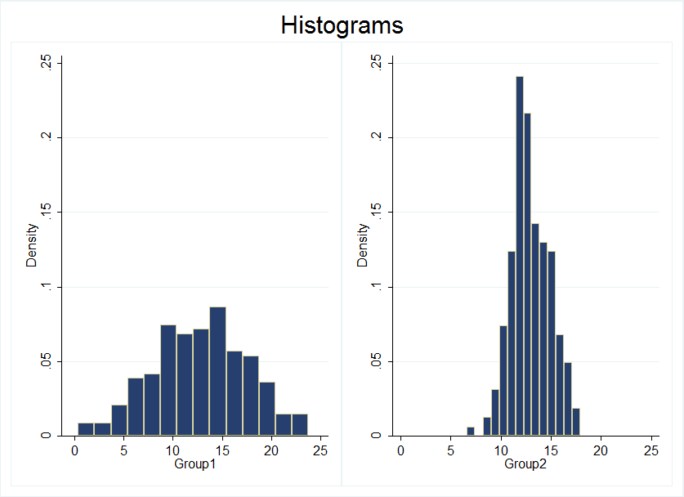
Confidence intervals
No. of observations
(samples)
Standard deviation
Standard error of mean
Group 1
Group 2
Notes:
If you continue to sample from the same population then increasing the number of samples does not change the standard deviation as the variability in the population does not change. However, the standard error of the mean will decrease, as sqrt n enters into the calculation. This is because with more observations you can be more sure of what the mean is. Smaller standard error will lead to tighter confidence intervals.

Slide 25
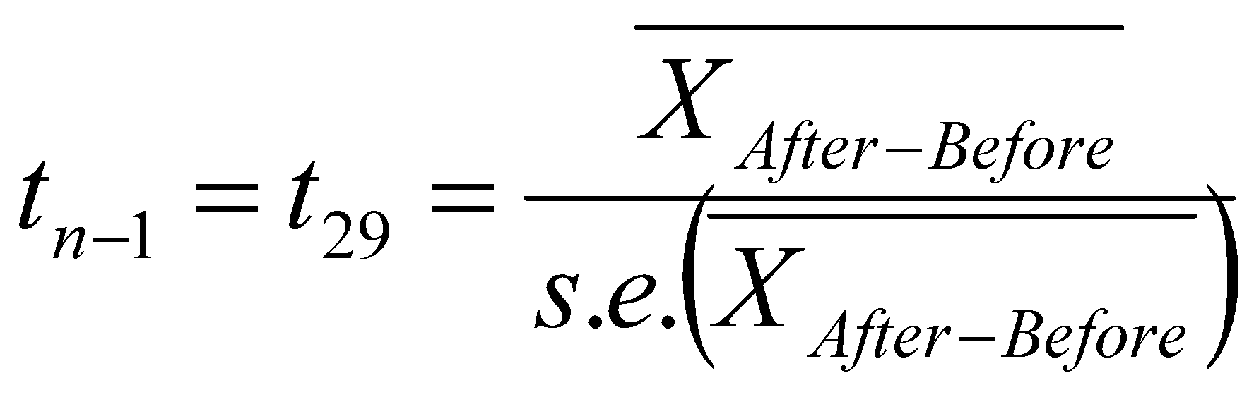
Hypothesis tests – basic set-up
Formulate a null hypothesis, H₀
Calculate a test statistic from the data under the null hypothesis
Example: the difference in gene expression before and after treatment = 0
Notes:
More observations -> SE reduces -> test statistic increases -> more chance of being able to reject null hypothesis (if appropriate to do so). If null hypothesis should not be rejected, then improvement in the estimate of the mean should counter the reduction in the standard error.
Statistical tests are all set up in a similar way. First formulate the null hypothesis, this is the working hypothesis that you wish to disprove with your test. For example the difference in gene expression before and after treatment is 0. Then having verified that all of the assumptions of the test hold for your data, you calculate the test statistic from the data under the null hypothesis such as the t statistic shown here. Determine if the test statistic is more extreme than expected under the null hypothesis, the p-value and compare the p-value to an arbitrary cut off such as 0.05. Then reject or don’t reject the null hypothesis. Remember that absence of evidence is not evidence of absence. So just because you have not seen a difference does not mean that one does not exist. Your sample size might be too small to detect the effect size of interest.
If you wish to show that there is no difference, you need to use formal statistical methods to show equivalence, you can’t just have a non-significant p-value and say that they are the same.
Using the conventional cut off of 0.05 1 in 20 tests will be significant by chance and you don’t know which, so if you are carrying out a lot of hypothesis tests, then corrections for multiple testing are important. See a statistician for advice.

Slide 26
Hypothesis tests – basic set-up
Formulate a null hypothesis, H₀
Calculate a test statistic from the data under the null hypothesis
Compare the test statistic to theoretical values Is it more extreme than expected? (p-value)
Either reject or do not reject the null hypothesis
Example: the difference in gene expression before and after treatment = 0
Absence of evidence is not evidence of absence
(Bland and Altman, 1995)
Notes:
More observations -> SE reduces -> test statistic increases -> more chance of being able to reject null hypothesis (if appropriate to do so). If null hypothesis should not be rejected, then improvement in the estimate of the mean should counter the reduction in the standard error.
Statistical tests are all set up in a similar way. First formulate the null hypothesis, this is the working hypothesis that you wish to disprove with your test. For example the difference in gene expression before and after treatment is 0. Then having verified that all of the assumptions of the test hold for your data, you calculate the test statistic from the data under the null hypothesis such as the t statistic shown here. Determine if the test statistic is more extreme than expected under the null hypothesis, the p-value and compare the p-value to an arbitrary cut off such as 0.05. Then reject or don’t reject the null hypothesis. Remember that absence of evidence is not evidence of absence. So just because you have not seen a difference does not mean that one does not exist. Your sample size might be too small to detect the effect size of interest.
If you wish to show that there is no difference, you need to use formal statistical methods to show equivalence, you can’t just have a non-significant p-value and say that they are the same.
Using the conventional cut off of 0.05 1 in 20 tests will be significant by chance and you don’t know which, so if you are carrying out a lot of hypothesis tests, then corrections for multiple testing are important. See a statistician for advice.

Slide 27
Hypothesis tests – basic set-up
Formulate a null hypothesis, H₀
Calculate a test statistic from the data under the null hypothesis
Compare the test statistic to theoretical values Is it more extreme than expected? (p-value)
Either reject or do not reject the null hypothesis
Correction for multiple testing
Example: the difference in gene expression before and after treatment = 0
Absence of evidence is not evidence of absence
(Bland and Altman, 1995)
Notes:
More observations -> SE reduces -> test statistic increases -> more chance of being able to reject null hypothesis (if appropriate to do so). If null hypothesis should not be rejected, then improvement in the estimate of the mean should counter the reduction in the standard error.
Statistical tests are all set up in a similar way. First formulate the null hypothesis, this is the working hypothesis that you wish to disprove with your test. For example the difference in gene expression before and after treatment is 0. Then having verified that all of the assumptions of the test hold for your data, you calculate the test statistic from the data under the null hypothesis such as the t statistic shown here. Determine if the test statistic is more extreme than expected under the null hypothesis, the p-value and compare the p-value to an arbitrary cut off such as 0.05. Then reject or don’t reject the null hypothesis. Remember that absence of evidence is not evidence of absence. So just because you have not seen a difference does not mean that one does not exist. Your sample size might be too small to detect the effect size of interest.
If you wish to show that there is no difference, you need to use formal statistical methods to show equivalence, you can’t just have a non-significant p-value and say that they are the same.
Using the conventional cut off of 0.05 1 in 20 tests will be significant by chance and you don’t know which, so if you are carrying out a lot of hypothesis tests, then corrections for multiple testing are important. See a statistician for advice.

Slide 28

Hypothesis tests – Example
Lady Tasting Tea
Randomised Experiment by Fisher
Randomly ordered 8 cups of tea
4 were prepared by first adding milk
4 were prepared by first adding tea
Task: Lady had to select the 4 cups of one particular method
H₀: Lady had no such ability
Test Statistic: number of successes in selecting the 4 cups.
Result: Lady got all 4 cups right!
Reject the null hypothesis
Notes:
Dr. Muriel Bristol

Slide 29
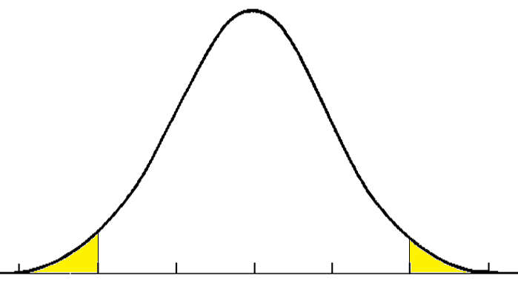
Hypothesis tests – Errors
 | Null hypothesis does not hold | Null hypothesis holds
Reject null hypothesis | Correct True positive | Wrong False positive
Do not reject null hypothesis | Wrong False negative | Correct True negative
significance level, sample size, difference of interest, variability of the observations.
Be aware of issues of multiple testing!
Notes:
When we carry out statistical tests, either the null hypothesis is true or the alternative hypothesis is true. When we carry out the statistical tests we either reject or do no reject the null hypothesis. We may correctly accept or reject the null hypothesis. Or we can make an error. When we wrongly reject the null hypothesis, a false positive result. This is the more serious error, known as a type I error, as we conclude that something is going on when it isn’t. This is our p-value and we try to restrict this error rate to 5%. However, if we carry out multiple hypothesis tests, then one in 20 of our hypotheses will be significant just by chance and we don’t know which. For this reason if we are carrying out many hypothesis tests, then we need to correct for multiple testing to control our overall false positive rate at 5%.
We can also make a false negative mistake, by not rejecting the null hypothesis when it is false. So we say that there is nothing happening when in fact there is. This is deemed a type II error as it is less serious and this rate is usually controlled at 10-20%. 1-false negative rate is the power of the study, i.e. the probability of detecting a particular effect of interest given that it exists. The power of a study depends on the significance level of the test, the size of the sample, the size of the difference of interest and most importantly the variability of the observations. Before carrying out any experiment, you should ensure that it has sufficient power, usually 80-90% to detect the effect of interest. Otherwise there is little point in carrying out the experiment in the first place as you are unlikely to detect the effect size of interest even if it exists.

Slide 30
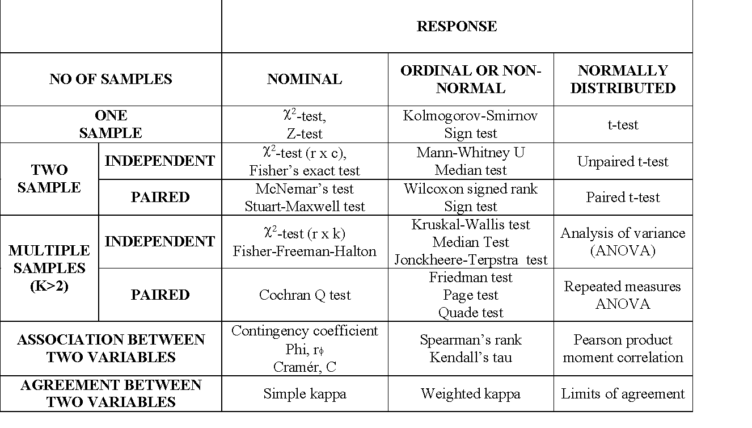
When to use which test
(see course site for “cheat sheet”)

Slide 31
Quiz…..
tinyurl.com/further-stats-prac

Slide 32
Tests for continuous variables T-tests
Notes:
This follows on very closely from what Deepak has just been talking about – I’ll be going through each of the different types of t-test and then you’ll have an opportunity to have a go yourself using the shiny apps

Slide 33
Statistical tests – continuous variables
T-test:
One-sample t-test
(e.g. H₀: mean = 5)
Independent two-sample t-test
(e.g. H₀: mean of sample 1 = mean of sample 2)
Paired two-sample t-test
(e.g. H₀: mean difference between pairs = 0)
Notes:
Most of you will have come across the t-test before.
T-tests are used for continuous data and there are three different types of t-test which we can use depending on the type of data we have, the one-sample t-test, independent two-sample t-test and the paired two-sample t-test.
However, a paired two-sample t-test equivalent to the one-sample t-test. We will see some more examples as we move on.

Slide 34
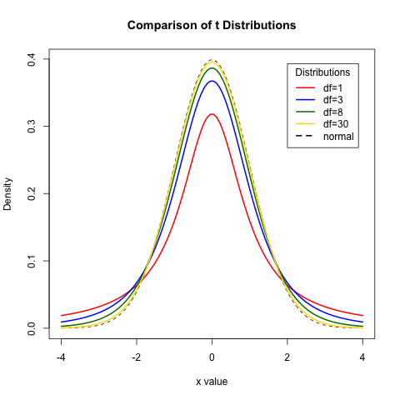
T-distributions
Notes:
This slide is a bit technical so don’t worry too much if you don’t understand it.
The t-test is based on the t-distribution. This is similar to the normal distribution which has the bell shaped curve which we’ve seen before. There is one standard normal distribution curve there are several curves for the t-distribution and which one we use depends on something called degrees of freedom. Loosely, as the sample size increases the number of degrees of freedom increases but the exact value will depend on what test you’re using to analyse your data and we will learn more about degrees of freedom later.
The main difference between the normal distribution and t-distribution is that the t-distribution has wider tails and a shorter peak this is because we have small samples and therefore the uncertainty around the extreme values is higher. As our sample size gets larger the t-distribution gets closer to the standard normal distribution, and once the sample size reaches 30 there is very little difference between the two.
This is all a bit theoretical, and it’s more useful for you to actually be able to apply these tests.

Slide 35

One-sample t-test: does mean = X?
E.g. Research question: Published data suggests that the microarray failure rate for a particular supplier is 2.1%.
Genomics Core want to know if this holds true in their own lab?
Notes:
So we’ll start with the one-sample t-test.
Suppose Illumina’s published microarray failure rate is 2.1%. Genomics want to know if this figure holds true in their lab, so they have been collecting data on the monthly microarray failure rate over the last 12 months.
What we want to test is whether the mean monthly failure rate of the microarrays could be 2.1% or not. We need to formulate this into a null and alternative hypothesis. So, slightly counter intuitively, our null hypothesis is that the mean monthly failure rate is 2.1%, in the Genomics core.
Our alternative hypothesis could take one of three different forms, depending on our research question. We could be looking for a failure rate of less than 2.1%, more than 2.1%, or maybe we just want to know if there is a difference in either direction. In this case, we haven’t specified an increase or decrease in the question, so our alternative hypothesis is looking for a change in either direction. This is what we refer to as a two-tailed test.

Slide 36
One-sample t-test: does mean = X?
Null hypothesis, H₀ :
Mean monthly failure rate = 2.1%.
Alternative hypothesis, H₁ :
Mean monthly failure rate ≠ 2.1%.
Tails: two-tailed.
Either reject or do not reject the null hypothesis – never accept the null hypothesis
Notes:
So our null hypothesis that we wish to disprove is that the mean monthly failure rate of microarrays in Genomics is 2.1% and we wish to disprove this in favour of the alternative that the mean monthly failure rate is not 2.1%, as we are looking for a a change in either direction this is a two-tailed test, and we will either reject or not reject the null hypothesis, we never say that we accept the alternative hypothesis.

Slide 37
One-sample t-test – the data
Month | Monthly failure rate
January | 2.90
February | 2.99
March | 2.48
April | 1.48
May | 2.71
June | 4.17
July | 3.74
August | 3.04
September | 1.23
October | 2.72
November | 3.23
December | 3.40
The mean is the sum of all observations divided by the number of observations.
Mean = (2.90 +...+ 3.40)/12 = 2.84
Standard deviation = 0.84
Test value: 2.1
Notes:
We can calculate some basic summary statistics from the data ourselves or we can get R commander to do it for us. In a one-sample t-test, we are testing the mean value, so it would be really useful to know what the mean of our sample is.
We can instantly see that 2.84 is higher than the 2.1% we specified in our null hypothesis, but we can’t tell yet whether it is significantly different.
We can also calculate the standard deviation, and in this case this is 0.84. This gives us an indication of the variability in our sample data, with a high number suggesting our data is highly variable and a low number meaning there is little variation in our data. The standard deviation tells us the average distance of the data from the mean.

Slide 38
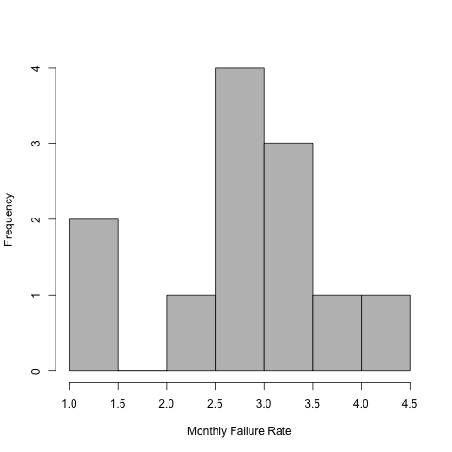
One-sample t-test – key assumptions
Observations are independent
Observations are normally distributed
Notes:
We can’t just go straight ahead and carry out the t-test as there are a few assumptions that we need to think about first.
The first assumption is independence of the observations – are the values genomics have collected each month independent of each other? In this case they probably are. Need to consider whether other factors such as temperature, season or ozone, for example, might influence the monthly results. Were the same people running the arrays, was the failure rate higher because the person who usually runs the arrays was away on holiday. Also, make sure that array failure is due to the array failing and not the experiment failing (include controls that we know should work).
The second assumption is that the observations are normally distributed. As Deepak mentioned earlier, we can assess this assumption by plotting a histogram of the data. In general, we want the histogram to be symmetrical with a rough bell shape to the bars. We want the bars in the middle to be tall (corresponding with the peak of the normal curve) and the tails at each end being the shortest (corresponding with the low tails of the normal curve).
It can be difficult to assess whether data from a small sample are normally distributed as a single observation can make the shape of the histogram look quite different. If we know from past data that the population that we are considering is known to be normal we can draw on that information and assume normality. Here normality seems like a reasonable assumption to make.
----- Meeting Notes (23/05/2012 09:50) -----
Add normal curves

Slide 39
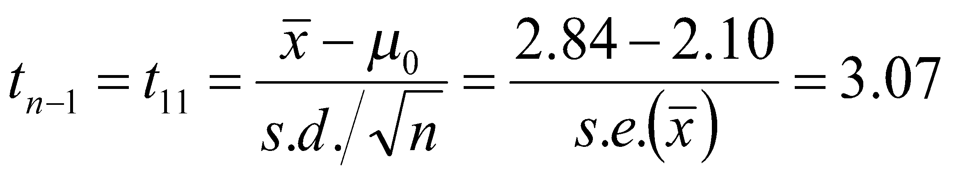
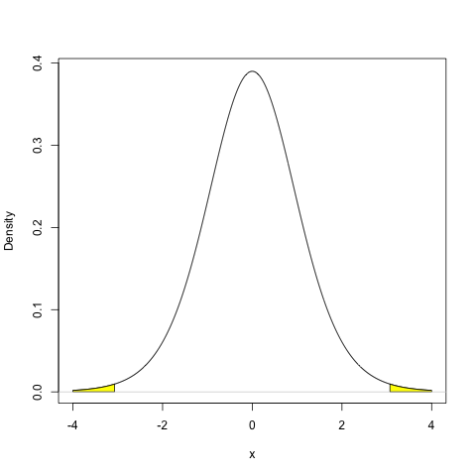
One-sample t-test - results
Test statistic:
Notes:
So now we’ve checked the assumptions hold, we can carry out the one-sample t-test.
There are two main values of interest that are calculated in a t-test: the t-statistic and the p-value.
The t-statistic is based on the sample mean, x bar, the value you want to test from your null hypothesis, mu 0, the standard deviation of your observed data and the sample size. The bottom part of this equation (the part with the standard deviation and sample size) is the same as the standard error. You won’t need to do this by hand, but it’s good to have an appreciation of how the t-statistic is calculated and where each of it’s components comes from.
We get a t-statistic from this formula and we then need to work out what this value means. To do this, we compare it to a t-distribution curve, like the ones that I introduced earlier. In this example, our t-distribution is based on 11 degrees of freedom because we have 12 observations (df=n-1 in a one sample test as we are estimating one parameter).
We look at the t-distribution and find out where our t-value lies. In this case, we can see 3.07 is right in the tails of the distribution. This is a two-tailed test so we look at values above 3.07 and below -3.07 (remember that the t-distribution is symmetrical), and this is shown by the yellow shading. We can then work out the probability of seeing a value in either of the two yellow shaded areas, and this gives us our p-value; in this case p=0.01.
We usually compare this to an arbitrary value of 0.05. Here 0.01 is less than 0.05 so we reject the null hypothesis and conclude that the mean monthly failure rate is not the same as the published microarray failure rate if this were a real experiment we may then want to investigate why this is the case.

Slide 40
One-sample t-test - results
Notes:
Our t statistic is 3.07, we compare this to our t distribution, as we are doing a two sided test we need to look in both tails of the t distribution, so we look at ±3.07 and we calculate the area under the curve in both tails and this gives us our p-value. Of course R commander will give us the test statistic, p-value and degrees of freedom so we don’t need to do this ourselves, but it is useful to know how the test is carried out.

Slide 41
One-sample t-test - results
Test statistic:
df = 11
P = 0.01
Reject H₀
(Evidence that mean monthly failure rate ≠ 2.1%.)
Notes:
So now we’ve checked the assumptions hold, we can carry out the one-sample t-test.
There are two main values of interest that are calculated in a t-test: the t-statistic and the p-value.
The t-statistic is based on the sample mean, x bar, the value you want to test from your null hypothesis, mu 0, the standard deviation of your observed data and the sample size. The bottom part of this equation (the part with the standard deviation and sample size) is the same as the standard error. You won’t need to do this by hand, but it’s good to have an appreciation of how the t-statistic is calculated and where each of it’s components comes from.
We get a t-statistic from this formula and we then need to work out what this value means. To do this, we compare it to a t-distribution curve, like the ones that I introduced earlier. In this example, our t-distribution is based on 11 degrees of freedom because we have 12 observations (df=n-1 in a one sample test as we are estimating one parameter).
We look at the t-distribution and find out where our t-value lies. In this case, we can see 3.07 is right in the tails of the distribution. This is a two-tailed test so we look at values above 3.07 and below -3.07 (remember that the t-distribution is symmetrical), and this is shown by the yellow shading. We can then work out the probability of seeing a value in either of the two yellow shaded areas, and this gives us our p-value; in this case p=0.01.
We usually compare this to an arbitrary value of 0.05. Here 0.01 is less than 0.05 so we reject the null hypothesis and conclude that the mean monthly failure rate is not the same as the published microarray failure rate if this were a real experiment we may then want to investigate why this is the case.

Slide 42
One-sample t-test results
The mean monthly failure rate of microarrays in the Genomics core is 2.84 (95% CI: 2.30, 3.37).
It is not equal to the hypothesized mean proposed by the company of 2.1.
t=3.07, df=11, p=0.01

Slide 43
Two-sample t-test
Two types of two-sample t-test:
Independent:
e.g. the weight of two different breeds of mice.
Paired:
e.g. a measurement of disease at two different parts of the body in the same patient/animal.
Notes:
We’ll now move on to looking a two-sample t-tests, which tend to be more common than a one sample test as we often want to compare two groups.
The rules are very similar to the one-sample t-test so hopefully you’ll be able to spot a few common themes as I go through the next few slides.

Slide 44


Independent two-sample t-test Does mean of group A = mean of group B?
E.g. Research question: 40 male mice (20 of breed A and 20 of breed B) were weighed at 4 weeks old.
Does the weight of 4 week old male mice depend on breed?
Notes:
So we’ll go on to look at the independent two-sample t-test. Often just called an independent sample t-test or a two-sample t-test.
Suppose a researcher has access to two different breeds of mice and they want to do an experiment where change in weight is one of the outcomes. It would be easier to use a mixture of the two breeds in the experiment but first we need to know weather the weight differs between the mice just because of breed. So we want to investigate whether the weight of 4 week old male mice depends on breed.
We have 20 mice from breed A and 20 from breed B.
As before, we need to formulate a null hypothesis from our research question. Does the average weight of breed A differ from the average weight of breed B in 4-week old male mice.
The alternative hypothesis can take one of three options, less than, greater than or different to. In this example, we are interested in a difference in any direction, so our alternative hypothesis is that the mean weight of breed A is different to the mean weight of breed B. So this is a two-tailed test.

Slide 45
Independent two-sample t-test Does mean of group A = mean of group B?
Null hypothesis, H₀ :
Mean weight of breed A = Mean weight of breed B.
Alternative hypothesis, H₁ :
Mean weight of breed A ≠ Mean weight of breed B.
Tails: two-tailed.
Either reject or do not reject the null hypothesis – never accept the null hypothesis
Notes:
So we’ll go on to look at the independent two-sample t-test.
Suppose a researcher has access to two different breeds of mice and they want to do an experiment where change in weight is one of the outcomes. It would be easier to use a mixture of the two breeds in the experiment but first we need to know weather the weight differs between the mice just because of breed. So we want to investigate whether the weight of 4 week old male mice depends on breed.
We have 20 mice from breed A and 20 from breed B.
As before, we need to formulate a null hypothesis from our research question. Does the average weight of breed A differ from the average weight of breed B in 4-week old male mice.
The alternative hypothesis can take one of three options, less than, greater than or different to. In this example, we are interested in a difference in any direction, so our alternative hypothesis is that the mean weight of breed A is different to the mean weight of breed B. So this is a two-tailed test.

Slide 46
Independent two-sample t-test – the data
Breed A |  | Breed B
Subject | Weight at 4 weeks (g) | Subject | Weight at 4 weeks (g)
1 | 20.77 | 21 | 15.51
2 | 9.08 | 22 | 12.93
3 | 9.80 | 23 | 11.50
4 | 8.13 | 24 | 16.07
5 | 16.54 | 25 | 15.51
6 | 11.36 | 26 | 17.66
7 | 11.47 | 27 | 11.25
8 | 12.10 | 28 | 13.65
9 | 14.04 | 29 | 14.28
10 | 16.82 | 30 | 13.21
11 | 6.32 | 31 | 10.28
12 | 17.51 | 32 | 12.41
13 | 9.87 | 33 | 9.63
14 | 12.41 | 34 | 14.75
15 | 7.39 | 35 | 9.81
16 | 9.23 | 36 | 13.02
17 | 4.06 | 37 | 12.33
18 | 8.26 | 38 | 11.90
19 | 10.24 | 39 | 8.98
20 | 14.64 | 40 | 11.29
Mean | 11.50 | Mean | 12.80
Standard deviation | 4.18 | Standard deviation | 2.33
Notes:
As with the one-sample t-test, it’s useful to calculate some basic summary statistics from the data ourselves.
In the independent two-sample t-test, we are again testing the mean values, so it would be really useful to know the mean in each of our groups.
We can see here that the two mean values are fairly similar.

Slide 47
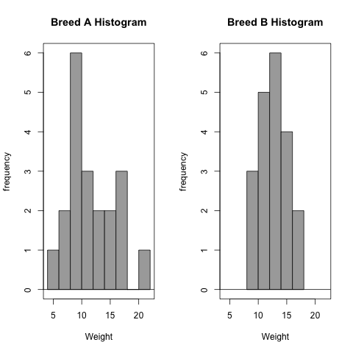
Independent two-sample t-test – key assumptions
Observations are independent
Observations are normally distributed
Notes:
Again, we need to check the assumptions.
Within each breed, are the observations independent? Here we particularly need to think about whether we have littermates in the sample, as mice will be more similar within a litter than between litters. Ideally, mice within each group would either all come from the same litter or all come from different litters.
The normality assumption is assessed with a histogram – plotted separately for each breed. The small sample size makes it quite difficult to judge. A looks fairly bell shaped and symmetrical, so is probably ok. There might be some slight skewing for breed B and the histogram isn’t very symmetrical so we might decide that actually normality is not reasonable here. For the purpose of this example we’ll say that the assumption is ok, but this might be something we need to consider in more detail when doing a ‘real’ analysis.

Slide 48
Independent two-sample t-test -More key assumptions...
Equal variance in the two comparison groups
Use Welch’s correction if variances are different
Alters the t-value and degrees of freedom
Standard deviation 4.18 2.33
Notes:
A third assumption, one that we didn’t need to consider in the one-sample t-test, is equal variance between the two groups we want to compare.
We can use the histogram to assess this. Look at the spread, you can see that the histogram for breed A is much wider than the histogram for breed B. This suggests that the variance is not equal between the two groups.
This isn’t a problem – we can apply a Welch’s correction if the variances are difference, which just means that the t-statistic is calculated in a slightly different way than if we did assume equal variance. However, care must be taken not to apply the Welch’s correction inappropriately (i.e. When variances are not dissimilar) because its use results in a large reduction in power. So if it is used inappropriately then we are less likely to see a difference should one exist.
There are also formal test to compare variances (Such as F-tests or Levene’s test, available within R), but this adds to the multiple testing problem that Deepak mentioned earlier, so we advise you to just use the plots if you can and use your own judgement rather than carrying out a formal test.

Slide 49
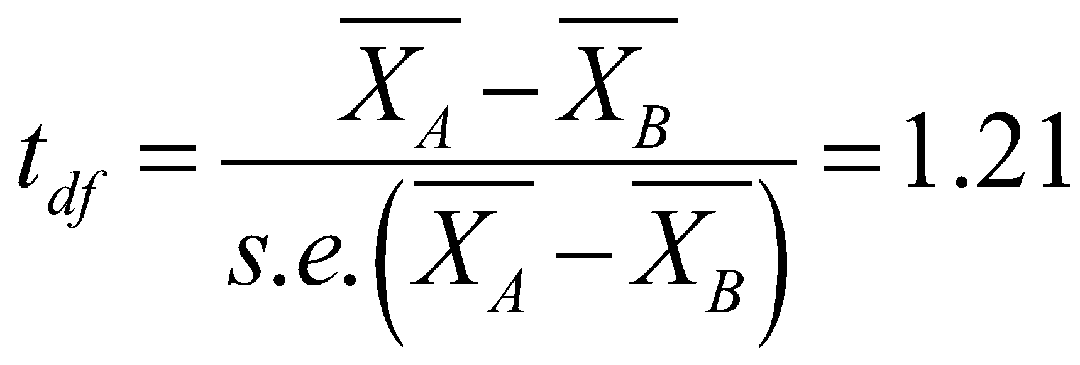
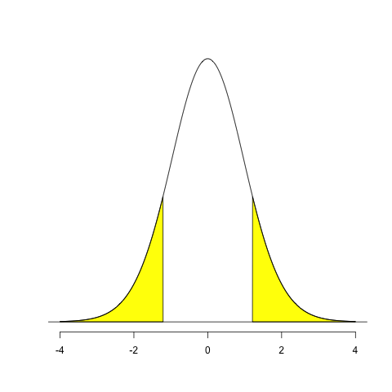
Independent two-sample t-test - results
Test statistic:
df = 29.78
(Welch’s correction)
P-value: 0.24
Do not reject H₀
(No evidence that mean weight of breed A ≠ mean weight of breed B)
Notes:
So now we’ve checked the assumptions hold, we can carry out the independent two-sample t-test.
As before, there are two main values of interest that are calculated in a t-test: the t-statistic and the p-value.
The t-statistic is based on the sample mean for each group and the standard deviation of your observed data and the sample size for each group. With the Welch’s correction, we treat the standard deviation for each group separately, without the correction we use a pooled value.
We get a t-statistic from this formula and we then need to work out what this value means. To do this, we compare it to a t-distribution curve, as before. In this example, our t-distribution is based on 23 degrees of freedom which comes from a complicated formula, that we won’t give the details of.
We look at the t-distribution and find out where our t-value lies. In this case, we can see 0.72 is in the middle part of the distribution. This is a two-tailed test so we look at values above 0.72 and below -0.72 (remember that the t-distribution is symmetrical), and this is shown by the yellow shading. We can then work out the probability of seeing a value in either of the two yellow shaded areas. In this case, the yellow area is quite large, so we expect a high probability. In this case our p-value is 0.48.
We usually compare this to an arbitrary value of 0.05. Here 0.48 is more than 0.05 so we can’t reject the null hypothesis and conclude that there is no evidence to suggest that the mean weight of breed A differs to the mean weight of breed B in 4 week old male mice.

Slide 50
Independent two-sample t-test - results
The difference in mean weight between the two breeds is -1.30 (95% CI: -3.48, 0.89)
[NB this is negative breed B weights tend to be bigger than breed A weights].
There is no evidence of a difference in weights between breed A and breed B.
t=1.21, df= 29.78 (Welch’s correction), p=0.24.

Slide 51
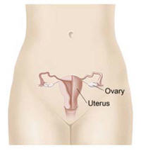
Paired two-sample t-test: Does the mean difference = 0?
E.g. Research question: 20 patients with ovarian cancer were studied using MRI imaging. Cellularity was measured for each patient at two sites of disease.
Does the cellularity differ
between two different sites
of disease?
Notes:
So my final example for this part of the lecture is on the paired two-sample t-test.
Suppose a researcher wants to know whether cellularity (the tumour content of cells) at the primary site of disease differs to that of another site of metastatic disease within the same patient.
As before, we need to formulate a null hypothesis from our research question. Does the cellularity at site A differ from cellularity at site B?
As before, the alternative hypothesis can take one of three options, less than, greater than or different to. In this example, we are interested in a difference in any direction, so our alternative hypothesis is that the cellularity at site A is different to the cellularity at site B. So this is a two-tailed test.

Slide 52
Paired two-sample t-test: Does the mean difference = 0?
Null hypothesis, H₀ :
Cellularity at site A = Cellularity at site B
Alternative hypothesis, H₁ :
Cellularity at site A ≠ Cellularity at site B
Tails: two-tailed.
Either reject or do not reject the null hypothesis – never accept the null hypothesis
Notes:
So my final example for this part of the lecture is on the paired two-sample t-test.
Suppose a researcher wants to know whether cellularity (the tumour content of cells) at the primary site of disease differs to that of another site of metastatic disease within the same patient.
As before, we need to formulate a null hypothesis from our research question. Does the cellularity at site A differ from cellularity at site B?
As before, the alternative hypothesis can take one of three options, less than, greater than or different to. In this example, we are interested in a difference in any direction, so our alternative hypothesis is that the cellularity at site A is different to the cellularity at site B. So this is a two-tailed test.

Slide 53
Paired two-sample t-test – Null hypothesis
H₀ : Cellularity at site A = Cellularity at site B
OR
H₀ : Cellularity at site A - Cellularity at site B = 0
Notes:
We can actually formulate our null hypothesis in a slightly different way.
Saying that the cellularity at site A = cellularity at site B is the same as saying that the cellularity at site A - cellularity at site B = 0.
This all boils down to doing a one-sample t-test on the differences.
We can calculate the mean difference as our summary statistic. Here the mean difference is 19.14, which is clearly larger than 0. Still, we don’t know if this mean difference is significant different from 0.

Slide 54
H₀ : Cellularity at site A - Cellularity at site B = 0
Subject | Cellularity
 | Site A: Primary ovarian mass | Site B: Peritoneal deposits | Difference
1 | 1201.33 | 1155.98 | -45.35
2 | 1029.64 | 1020.82 | -8.82
3 | 895.57 | 881.21 | -14.37
4 | 842.14 | 830.78 | -11.36
5 | 903.07 | 897.06 | -6.01
6 | 1311.57 | 1262.73 | -48.84
7 | 833.52 | 823.06 | -10.46
8 | 1007.66 | 951.01 | -56.65
9 | 1465.51 | 1450.98 | -14.53
10 | 967.82 | 978.15 | 10.33
11 | 812.72 | 778.26 | -34.46
12 | 884.08 | 823.57 | -60.51
13 | 1358.56 | 1335.78 | -22.78
14 | 1280.10 | 1293.91 | 13.80
15 | 942.38 | 925.75 | -16.63
16 | 884.33 | 891.34 | 7.01
17 | 930.09 | 892.02 | -38.07
18 | 1146.75 | 1132.80 | -13.95
19 | 881.50 | 847.78 | -33.72
20 | 1315.22 | 1337.80 | 22.58
Mean difference |  |  | 19.14
Standard deviation |  |  | 23.37
Notes:
We can actually formulate our null hypothesis in a slightly different way.
Saying that the cellularity at site A = cellularity at site B is the same as saying that the cellularity at site A - cellularity at site B = 0.
This all boils down to doing a one-sample t-test on the differences.
We can calculate the mean difference as our summary statistic. Here the mean difference is 19.14, which is clearly larger than 0. Still, we don’t know if this mean difference is significant different from 0.

Slide 55
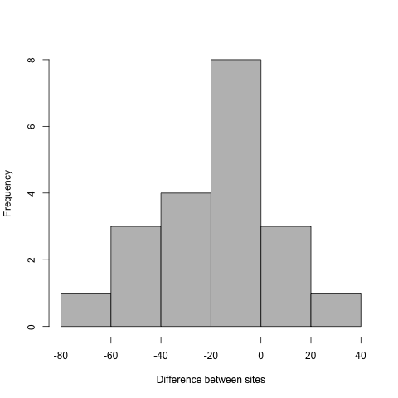
Paired two-sample t-test – key assumptions
Observations are independent
The paired differences are normally distributed
Notes:
Once again, we need to check the assumptions.
We know that the two measurements within a patient are not going to be independent. What we need to do here is take one measurement per patient, in this case the difference between the two sites, and ask if these values are independent. In this case this seems fine. One thing to consider is whether any of the patients in your sample may be related as this may mean that independence cannot be assumed.
The normality assumption is assessed with a histogram – again based on the difference between the two sites. Normality seems fine here, even with the small sample size we can see that the histogram is symmetrical and has a bell shape.

Slide 56
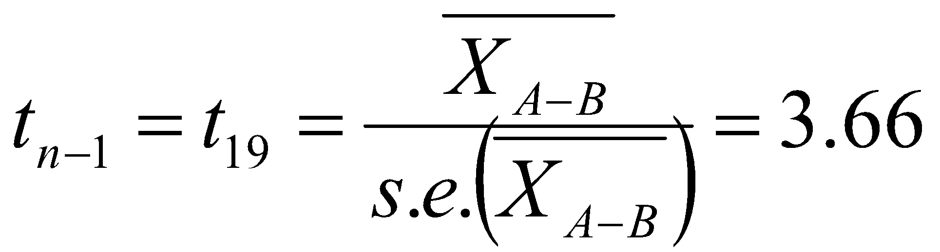
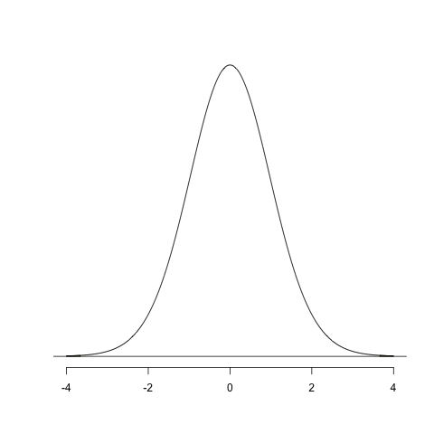
Paired two-sample t-test - results
Test statistic
df = 19
P-value: 0.002
Reject H₀
(Evidence that cellularity at site A ≠ Cellularity at site B)
Notes:
Now we’ve checked the assumptions hold, we can carry out the paired two-sample t-test.
As before, there are two main values of interest that are calculated in a t-test: the t-statistic and the p-value.
The t-statistic is based on the mean difference between paired observations and the standard deviation and the sample size of these differences.
We get a t-statistic from this formula and we then need to work out what this value means. To do this, we compare it to a t-distribution curve, as before. In this example, our t-distribution is based on 19 degrees of freedom because we have 20 paired observations (df=n-1).
We look at the t-distribution and find out where our t-value lies. In this case, we can see 3.66 is right in the tails of the distribution. This is a two-tailed test so we look at values above 3.66 and below -3.66 (remember that the t-distribution is symmetrical), and this is shown by the yellow shading – you can’t see it that well as the area is so small. We can work out the probability of seeing a value in either of the two yellow shaded areas. In this case, the yellow area is very small, so we expect a small probability. In this case our p-value is less than 0.01.
We usually compare this to an arbitrary value of 0.05. Here 0.01 is less than 0.05 so we reject the null hypothesis and conclude that there is evidence to suggest that the cellularity differs between site A and site B within the same patient.

Slide 57
Paired two-sample t-test - results
The difference in cellularity between the two sites is 19.14 (95% CI: 8.20, 30.08).
There is evidence of a difference in cellularity between the two sites.
t=3.66, df=19, p=0.0017.

Slide 58
What if normality is not reasonable?
Transform your data, e.g. Ln transformation
Non-parametric tests:
Parametric test | Non-parametric test
One-sample t-test | One-sample Wilcoxon signed rank test One-sample sign test
Independent two-sample t-test | Mann-Whitney U test/ Wilcoxon rank sum test
Paired two-sample t-test | Matched-pairs Wilcoxon signed rank test Two-sample sign test
Notes:
We’ve covered three different types of t-test now and you may have noticed that they all rely on the assumption of normality. If your data is normally distributed then that’s great, you should be able to carry out the relevant t-test.
But, there may be times when the normality assumption seems unreasonable and in those cases carrying out a t-test might give you unreliable results. You have a couple of options.
First, you could try a transformation of your data. A popular transformation is the log-transformation. If the log-transformed data is normally distributed, you can then perform the t-test on the transformed data. You need to be really careful when interpreting your results when using transformed data because the results won’t be on the original scale.
There’s also an alternative to each of the t-tests that doesn’t require the normality assumption. These are what we call non-parametric tests, which make less restrictive assumptions about the underlying shape of the data's distribution (dependent on test). You can carry out any of these tests within GraphPad Prism.

Slide 59
Summary – continuous variables
One-sample t-test
Use when we have one group.
Independent two-sample t-test
Use when we have two independent groups. A Welch correction may be needed if the two groups have different spread.
Paired two-sample t-test
Use when we have two non-independent groups.
Non-parametric tests or transformations
Use when we cannot assume normality.

Slide 60
Summary – t-test
Turn scientific question to null and alternative hypothesis
Think about test assumptions
Calculate summary statistics
Carry out t-test if appropriate

Slide 61

T-tests practical
Work through examples in the slides
Complete the t-test practical
Parametric Tests only
We will start the next lecture after lunch (13:30pm)
Feel free to take a short break if you want to
Notes:
Now you’ll get the opportunity to have a go at doing some t-tests yourself.
Start by going through the examples in the manual and try to replicate the results -these are the same examples that I’ve just shown you. Then there’s a practical sheet to go through as well.
We’ll be around to help if you get stuck and don’t worry if you can’t finish everything, we’ll have another practical session later for you to continue with this and to try some new analyses from the next lecture, and we’ll also stay for a little while after the lectures if anyone wants to continue then.

Slide 62
Tests for continuous variables non-parametric methods
Notes:
Feel free to interrupt if you have questions.

Slide 63
When to use which test

Slide 64

When to use which test

Slide 65
When to use which test

Slide 66
Sign Test
A very simple non-parametric test
based on the Binomial distribution
Uses directions of differences
One-sample case: compares to proposed value
Paired two-sample case: compares medians
Notes:
Uses directions of differences - looks to see whether observed values are smaller or larger than a reference value.

Slide 67
One-Sample Sign Test
Assumptions:
Order in coding system (minimally requires ordinal data)
Randomly selected observations (independent)
Hypotheses:
H₀: median is equal to a specific value
H_{A}: median is not equal to that specific value
Notes:
Minimally requires ordinal data, so that the comparisons “greater than”, “less than”, and “equal to” are meaningful.

Slide 68
One-Sample Sign Test
Method:
Compare values to a specific value:
+ : if bigger
– : if smaller
= : if equal
Count the number of +’s and -’s, and calculate:
x = smallest of the positives and negatives
n = number of non-ties
Compare to binomial tables
With p = 0.5 (binomial success probability, not p-value)

Slide 69
One-Sample Sign Test
General health section of SF-36 collected in a breast cancer study
Expected value in general population: 72
H₀ : median value in sample is different from 72

Slide 70

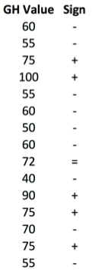
One-Sample Sign Test

Slide 71
One-Sample Sign Test
9 : observations <72
5 : observations >72
1 : observation =72

Slide 72
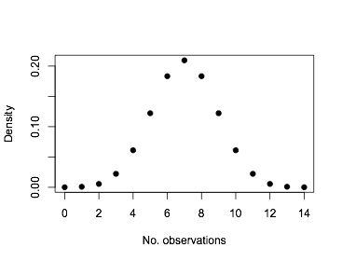
One-Sample Sign Test
9 : observations <72
5 : observations >72
1 : observation =72
Binomial tables: n=14, p=0.5, x=5

Slide 73
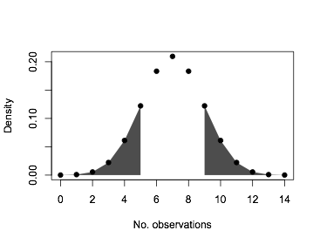
One-Sample Sign Test
9 : observations <72
5 : observations >72
1 : observation =72
Binomial tables: n=14, p=0.5, x=5
P-value = 0.42

Slide 74
One-Sample Sign Test
H₀ : median value in sample is different from 72
Sign test p-value = 0.42
Insufficient evidence to reject H₀
Conclusion: insufficient evidence to suggest that the median value is different from 72

Slide 75
When to use which test

Slide 76
Two-Sample Sign Test
Method:
Compare paired values between the two samples:
+ : if the value in sample 1 is bigger
– : if the value in sample 1 is smaller
= : if the value in the two samples is equal
Count the number of +’s and -’s, and calculate:
x = smallest of the positives and negatives
n = number of non-ties
Compare to binomial tables
With p = 0.5 (binomial success probability, not p-value)

Slide 77
Two-Sample Sign Test
General health section of SF-36 collected in a breast cancer study
Data collected at two time points
Is there a difference between the time points?
H₀ : medians of the two samples are different

Slide 78
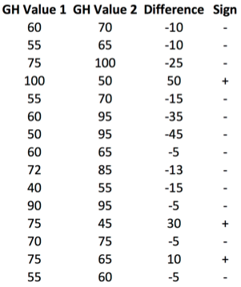

Two-Sample Sign Test
Data are paired

Slide 79
Two-Sample Sign Test
Data are paired

Slide 80
Two-Sample Sign Test
Data are paired
Negative signs : 12
Positive signs : 3

Slide 81
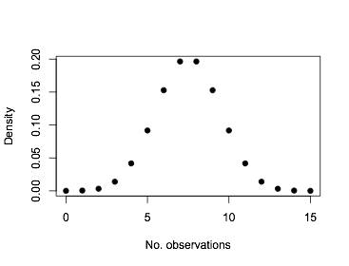
Two-Sample Sign Test
Data are paired
Negative signs : 12
Positive signs : 3
Binomial tables: n=15, p=0.5, x=3

Slide 82
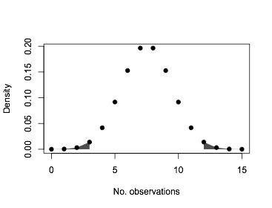
Two-Sample Sign Test
Data are paired
Negative signs : 12
Positive signs : 3
Binomial tables: n=15, p=0.5, x=3
P-value = 0.035

Slide 83
Two-Sample Sign Test
H₀ : medians of the two samples are different
Sign test p-value = 0.035
Reject the null hypothesis
Conclusion: there is a difference in general health between the two time points

Slide 84
Presentation of the Results
One-sample case:
“There is insufficient evidence to suggest a significant difference between the median general health value (60) observed in this sample and the value (72) observed in the general population (p=0.42, sign test).”
Two-sample case:
“The median general health value observed at the second time point (70) was found to be significantly higher than the median (60) observed at the first time point (p=0.035, sign test).”

Slide 85
Sign Test - Advantages & Limitations
Simple - few assumptions thus widely applicable
Significance threshold can be adjusted
Less powerful than other tests
Does not consider magnitude of differences
May fail to reject null hypothesis when other tests would achieve significance.
Can be used for quick assessment of direction

Slide 86
When to use which test

Slide 87
Wilcoxon Signed Rank Test
Alternative to sign test
Assumptions:
Paired data (e.g. matched samples, repeated measurements)
Each pair is independent
Continuous or ordinal data (Normality not assumed)
Symmetry of difference scores about true median difference (test by looking at histogram/boxplot)
Hypothesis:
H₀: sum of positive ranks equals sum of negative ranks
H_{A}: sum of positive ranks not equal to sum of negative ranks
Notes:
Symmetry of difference scores about true median difference required as an assumption, otherwise you’re testing whether the difference between the pairs follows a symmetric distribution around zero.

Slide 88
Wilcoxon Signed Rank Test
Method:
Calculate differences for each pair
Rank the paired differences by magnitude
Split the ranks into two groups:
positive and negative signed differences
Calculate sum of positive ranks: W⁺
Calculate sum of negative ranks: W⁻
Compare smaller of and W⁺ and W⁻ to the critical value from the tables

Slide 89
Wilcoxon Signed Rank Test
General health section of SF-36 collected in a breast cancer study
Data collected at two time points
Is there a difference between the time points?
H₀ : medians of the two samples are different

Slide 90
Wilcoxon Signed Rank Test
General health section of SF-36 collected in a breast cancer study
Data collected at two time points
Is there a difference between the time points?
H₀ : medians of the two samples are different
H₀ : distribution of paired differences is
symmetric about zero

Slide 91
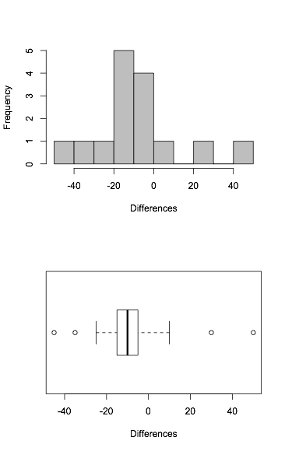
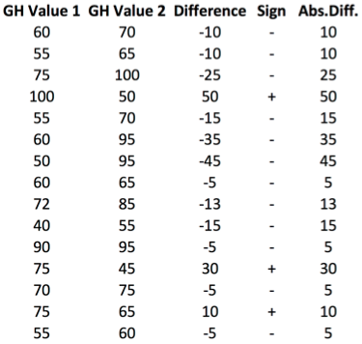

Wilcoxon Signed Rank Test

Slide 92
Wilcoxon Signed Rank Test

Slide 93
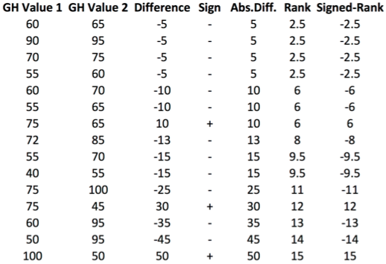
Wilcoxon Signed Rank Test

Slide 94
Wilcoxon Signed Rank Test

Slide 95
Wilcoxon Signed Rank Test

Slide 96
Wilcoxon Signed Rank Test
Rank-Sums:
W⁺ = 33
W⁻ = 87

Slide 97
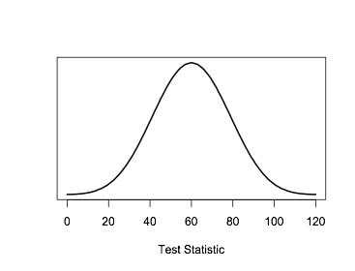
Wilcoxon Signed Rank Test
Rank-Sums:
W⁺ = 33
W⁻ = 87

Slide 98
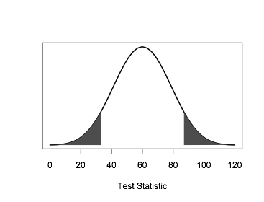
Wilcoxon Signed Rank Test
Rank-Sums:
W⁺ = 33
W⁻ = 87
P-value = 0.12

Slide 99
Wilcoxon Signed Rank Test
H₀ : distribution of paired differences is
symmetric about zero
Wilcoxon test p-value = 0.12
Insufficient evidence to reject the null hypothesis
Conclusion: Insufficient evidence to conclude that there is a difference in general health between the two time points

Slide 100
Wilcoxon Signed Rank Test
Note:
Validity of assumptions
may affect results.
H₀ : medians of the two samples are different
H₀ : distribution of paired differences is
symmetric about zero
Notes:
Whilst the Wilcoxon test is a stronger test, which utilises more information from the data, the sign test had a p-value low enough to reject the null hypothesis whilst the Wilcoxon test did not. This emphasises that these two tests actually test slightly different hypotheses, and that the validity of assumptions may affect results.

Slide 101
Advantages and Limitations
Easy to apply
Powerful
Utilises more information than the Sign test (but less than the paired t-test)
Sometimes misinterpreted
Assumes symmetry of difference scores about the true median difference
Notes:
Symmetry of difference scores about true median difference required as an assumption, otherwise you’re testing whether the difference between the pairs follows a symmetric distribution around zero.

Slide 102
When to use which test

Slide 103
Mann-Whitney U test
Also called the Wilcoxon Rank Sum test
Assumptions:
Two independent groups
At least ordinal dependent variable
Randomly selected observations
Population distributions same shape
Hypotheses:
H₀: populations have the same median
H₀: populations have the same spread and shape

Slide 104
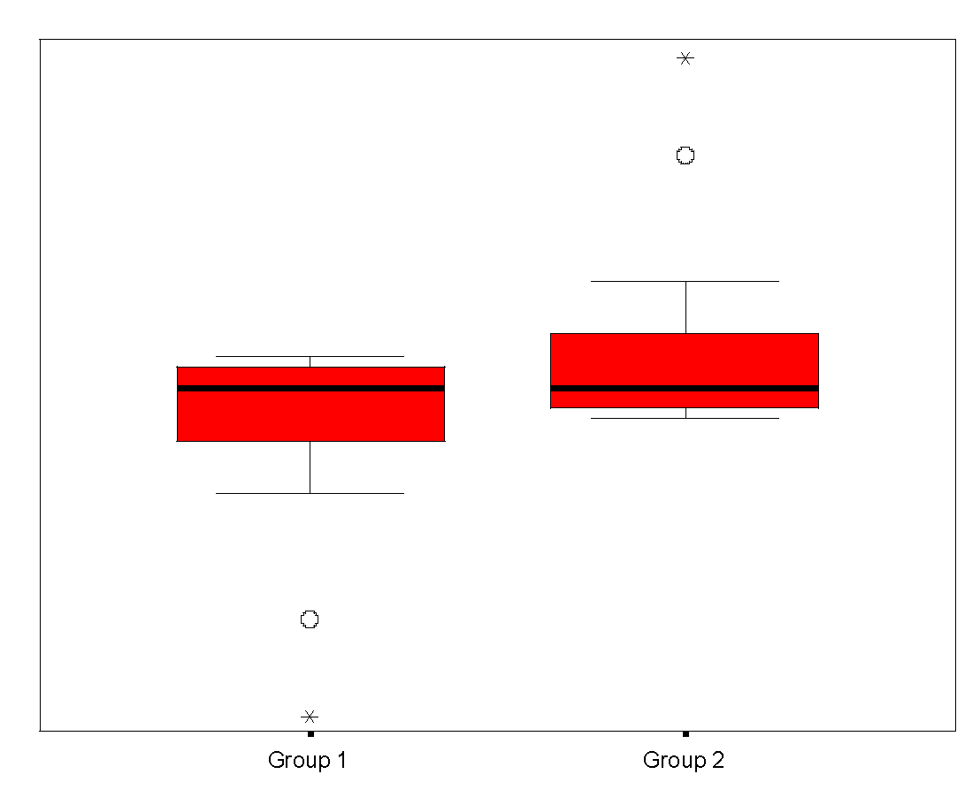
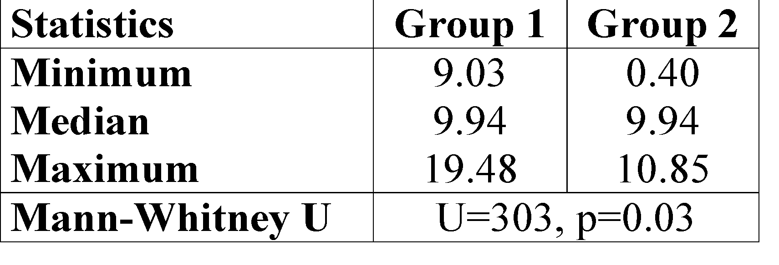
Misunderstood test

Slide 105
Mann-Whitney U Test
Method:
Pool the whole sample
Rank observations from smallest to largest
(assign average rank to ties)
Calculate sum of ranks for each group
Calculate U test statistic
Compare U to critical value in the tables

Slide 106
Mann-Whitney U Test
Coronary artery surgery study (Fisher’s book)
Exercise times in seconds for 2 groups:
Control and 3-Vessel Disease group
Is there a difference in exercise times between the two groups?
H₀ : distributions of both populations are equal

Slide 107
Mann-Whitney U Test

Slide 108
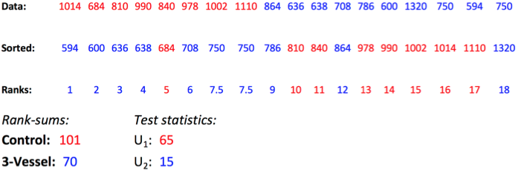

Mann-Whitney U Test

Slide 109
Mann-Whitney U Test

Slide 110
Mann-Whitney U Test

Slide 111
Mann-Whitney U Test

Slide 112
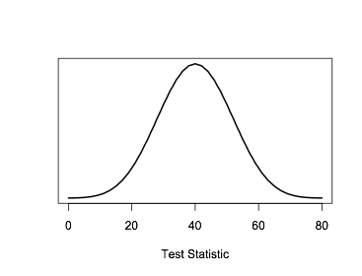
Mann-Whitney U Test

Slide 113
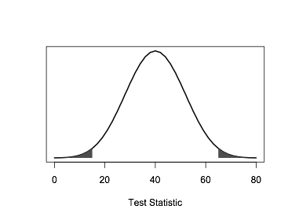
Mann-Whitney U Test
P-value = 0.026

Slide 114
Advantages and limitations
Almost as powerful as t-test
almost as likely as t-test to reject H₀ if false
Sensitive to central tendencies of scores
Often misinterpreted:
Difference in medians if same shape distributions
Otherwise tests for a combination of differences between the distributions, including spread and shape
Notes:
Therefore it does not test for the difference between medians.

Slide 115
Summary: One Sample
One-sample t-test:
Compares mean to a proposed value, providing the data can be assumed to be Normally distributed.
One-sample Sign test:
Compares the median to a proposed value.

Slide 116
Summary: Two Independent Samples
Two-sample t-test:
Compares means, providing the data can be assumed to be Normally distributed.
Mann-Whitney U test (Wilcoxon Rank Sum test):
Compares medians in two independent groups, without assuming Normality. However, does assume similarity of distributions. Otherwise, compares the shape and spread of the two groups, leading to potential misinterpretation of results.

Slide 117
Summary: Paired Groups
Paired t-test:
Compares means, providing paired differences can be assumed to be Normally distributed.
Wilcoxon Signed Rank test:
Compares means, providing the distribution of differences is symmetric.
Two-sample Sign test:
Compares the medians between matched pairs.

Slide 118
Tests for categorical variables
Notes:
We’re now moving on to looking at categorical data
We’re now moving on to looking at categorical data, and a fairly common statistical question is whether there is an association/relationship between two categorical variables.
2 categorical variables (factors), each with 2 or more levels.
Feel free to interrupt if you have questions.

Slide 119
Associations between categorical variables
All about frequencies!
Row x Column table (2 x 2 simplest)
Categorical data
Look for association (relationship) between row variable and column variable
Treatment group | Tumour shrinkage
 | No | Yes
Treatment | 44 | 40
Placebo | 24 | 16
2 x 2
Notes:
Start by making a frequency table – the cells in the table contain the number of times each combination of the two categorical variables is observed.
The simplest is 2 x 2.
In this kind of table, each patient (or what ever your sample is based on) contributes to only one cell in the table.

Slide 120
Pearson’s chi-square test
E.g. Research question: A trial to assess the effectiveness of a new treatment versus a placebo in reducing tumour size in patients with ovarian cancer.
Is there an association between treatment group and tumour shrinkage?
Null hypothesis, H₀ : No association
Alternative hypothesis, H₁ : Some association
Treatment group | Tumour shrinkage
 | No | Yes
Treatment | 44 | 40
Placebo | 24 | 16
Notes:
A fairly common statistical question is whether there is an association/relationship between two categorical variables. Each variable can have 2 or more levels,
Here we are going to look at the simples case where both variables have 2 levels.
Start by making a frequency table – the cells in the table contain the number of times each combination of the two categorical variables is observed. In this kind of table, each patient (or what ever your sample is based on) contributes to only one cell in the table.
So say we have the research question: A trial to assess the effectiveness of a new treatment versus a placebo in reducing tumour size in patients with ovarian cancer.
Start by formulating our null hypothesis. Which is that there is no association between tumor shrinkage and treatment group

Slide 121
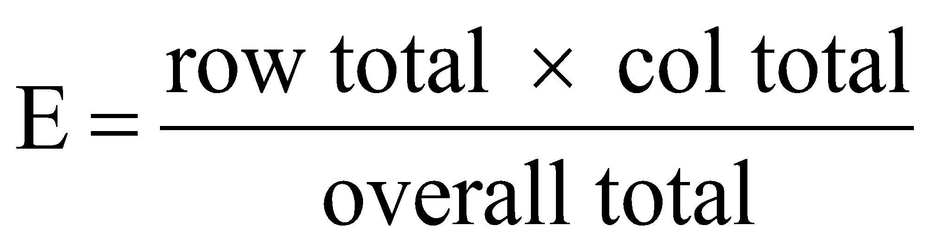
Chi-square test
Calculating expected frequencies under null hypothesis:
Treatment group | Tumour shrinkage |  | Total
 | No | Yes
Treatment | 44 46.1 | 40 37.9 | 84
Placebo | 24 21.9 | 16 18.1 | 40
Total | 68 | 56 | 124
e.g. 84 x 68 x 124 = 84 x 68 = 46.1
124 124 124
Notes:
To carry out a chi-square test, we need to carry out a few short steps.
The first step is to calculate the expected frequency for each cell in the contingency table under the null hypothesis of no association, shown in red. These are calculated as the probability being in row i and column j multiplied by the sample size.
e.g. Probability of being in row 1 = 84/124
Probability of being in column 1 = 68/124
Independent events so probability of being in row 1 and column 1 (scaled so total sample size is 124) = 84/124 * 68/124 *124 = (84*68)/124

Slide 122
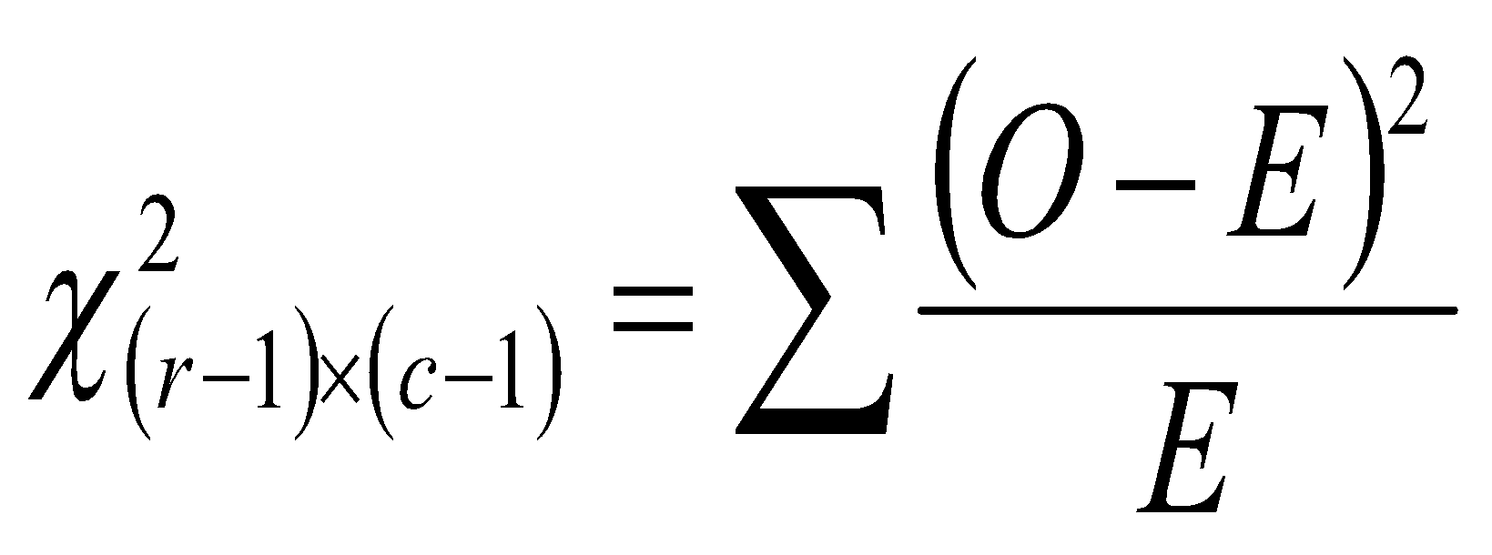
Chi-square test
Calculating the chi-square statistic:
Treatment group | Tumour shrinkage |  | Total
 | No | Yes
Treatment | 44 46.1 | 40 37.9 | 84
Placebo | 24 21.9 | 16 18.1 | 40
Total | 68 | 56 | 124
Notes:
The next step is to use the observed and expected frequencies to calculate the chi-squared statistic – either by hand (fairly easy for a small rxc table) or using a computer.
What we’re essentially doing is looking at the difference between the observed and expected frequencies and asking are they similar or not? Calculate the chi-square statistic – in this case the chi-square statistic is 0.64.
We compare test value to the Chi-squared distribution with degrees of freedom equal to (r-1)(c-1), so for this example it is 1.

Slide 123


Chi-square test
Test statistic:
df = 1
P-value: 0.43
Do not reject H₀ (No evidence of an association between treatment group and tumour shrinkage)
Notes:
So if we plot this value on the chi-squared distribution then the p-value is the area under the curve to the right of our test statistic.
If we then compare this p-value to the ‘standard’ 0.05. In this case, our p-value is larger than 0.05 so we don’t reject Ho and conclude that there’s no evidence or an association between the treatment group and tumour shrinkage.

Slide 124
Limitations of the chi-square test
In general, a Chi-square test is appropriate when:
at least 80% of the cells have an expected frequency of 5 or greater
none of the cells have an expected frequency less than 1
If these conditions aren’t met, Fisher’s exact test should be used.
Notes:
There are some assumptions which need to be met to use the Pearson’s chi-squared test :
Firstly at least 80% of the cells should have a expected frequency more than 5, so for a 2 by 2 table this means all the cells should have a expected frequency more than 5.
And secondly none of the cells should have an expected frequency less than 1
If these are not et then the test can overestimate of statistical significance (it will produce a smaller p value than it should).
If these assumptions are not met then you can use the Yate’s correction, however we wont discuss this here. Another possibility is to use the FIsher’s exact test instead which is what we will look at now.

Slide 125
Same question, smaller sample size
E.g. Research question: Is there an association between treatment group and tumour shrinkage?
Null hypothesis, H₀ : No association
Alternative hypothesis, H₁ : Some association
Treatment group | Tumour shrinkage |  | Total
 | No | Yes
Treatment | 8 | 3 | 11
Placebo | 9 | 4 | 13
Total | 17 | 7 | 24
Notes:
So now I’m going to introduce another example. Actually, the research question is exactly the same as in the previous example but the sample size is now just 24 (instead of 124).
If we carry out the same steps as before, starting with calculating the expected frequencies.

Slide 126

Expected frequencies
Treatment group | Tumour shrinkage |  | Total
 | No | Yes
Treatment | 8 7.8 | 3 3.2 | 11
Placebo | 9 9.2 | 4 3.8 | 13
Total | 17 | 7 | 24
Expected frequency less than 5
Only 50% of cells have an expected frequency greater than 5 → use Fisher’s exact test
e.g. 11 x 17 x 24 = 11 x 17 = 7.8
24 24 24
Notes:
So now we calculate the expected frequencies. As before we can calculate the expected frequency for each cell of the table by calculating row total times column total divided by overall total; these values are shown in red.
We could go ahead and perform the chi-square test as we did before, but actually in this case the chi-square test isn’t appropriate. We can see that there are two cells with an expected frequency less than 5 (i.e. less than 80% > 5) so we choose to carry out a Fisher's exact test rather than a Chi-square test.

Slide 127
Fisher's exact test - results
Treatment group | Tumour shrinkage |  | Total
 | No | Yes
Treatment | 8 7.8 | 3 3.2 | 11
Placebo | 9 9.2 | 4 3.8 | 13
Total | 17 | 7 | 24
Test statistic: N/A
P-value: 1.00
Interpretation: Do not reject H₀ (No evidence of an association between treatment group and tumour shrinkage).
Notes:
It is called an exact test as instead of calculating a test statistic and comparing this to a probability distribution, we instead calculate the p-value adding the probability of observing this combination of cell values or another that is more unlikely.
In this case this combination is the most likely so the p-value is equal to 1.
Although Fisher’s exact test can be calculated by hand it is very difficult, even for a very simple 2x2 table! The number of calculation inceases with the sample size and the number of levels of the categorical variables.
As I’ve already mentioned, you don’t get a test statistic with Fisher’s exact test as you do with the Chi-square test. However, you do get a p-value to tell you whether there may be an association between your two categorical variables or not. In this case the p-value is large (in fact it can’t be any bigger!) so we don’t reject our null hypothesis and conclude that there is no association between treatment group and tumour shrinkage.

Slide 128
Chi-square test for trend
E.g. Research question: Is there a linear association between tumour grade and the incidence of tumour shrinkage?
Null hypothesis, H₀: No linear association
Alternative hypothesis, H₁ : Some linear association
Tumour grade | Tumour shrinkage |  | Total
 | No | Yes
2 | 18 | 5 | 23
3 | 15 | 14 | 27
4 | 11 | 21 | 34
Total | 44 | 40 | 84
Notes:
The final test we will talk about is the Chi-squared test for trend, which is also called the Cochran–Armitage test for trend.
This test is used to assess the presence of an association between a variable with two categories and a variable with k categories. It is used instead of the normal Chi-squared test when we want to test for a specific trend in the variable with k categories.
The trend test will have higher power (probability of rejecting the Null hypothesis when the alternative hypothesis is true) than the chi-squared test when the suspected trend is correct, but the ability to detect unsuspected trends is sacrificed.
The example we will look at has 3 levels and we will test for a linear trend.

Slide 129
Expected frequencies
Tumour grade | Tumour shrinkage |  | Total
 | No | Yes
2 | 18 12.0 | 5 11.0 | 23
3 | 15 14.1 | 14 12.9 | 27
4 | 11 17.8 | 21 16.2 | 34
Total | 44 | 40 | 84
e.g. 44 x 23 x 84 = 44 x 23 = 12.0
84 84 84
Notes:
As before, we need to calculate the expected frequencies too make sure none of them are too small. They all look ok here. Again there is exact version of this test that can be used.

Slide 130

Chi-square test for trend
Notes:
The point here is if we were to draw a line through the proportions of patients with tumour shrinkage in each group for tumour grade, shown in blue, - the test for trend evaluates whether the gradient of that line is significantly different from 0 (i.e. the line is not flat – shown in red).
If we convert our expected frequencies into proportions, we expect exactly the same proprortion to fall into each of the three groups if there were no linear increasing or decreasing trend.
x1 <- 5/23
x2 <- 14/27
x3 <- 21/34
x <- 40/84
png("plot.png")
plot(c(2, 3, 4),c(x1, x2, x3), ylim=c(0, 1), xlim=c(1, 4.8), xlab="Tumour Grade", ylab="Proportion with tumour shrinkage", pch=4, col=4)
lines(c(1.8,4.2), c(x, x), col=2)
lines(c(1.8,4.2), c(0.21,0.69), col=4)
points(2, x, pch=4, col=2)
points(3, x, pch=4, col=2)
points(4, x, pch=4, col=2)
legend("topright", legend=c("H0", "HA"), lty=1, col=c(4,2))
dev.off()

Slide 131



Chi-square test for trend - results
Test statistic:
DF = 1
P-value: 0.001
Reject H₀ (evidence of a linear association between tumour grade and tumour shrinkage)
Notes:
I haven’t included the formula to calculate the test statistic here, but to be honest you won’t ever have to calculate it by hand, it isn’t that nice to calculate by hand either.
As with the standard chi-square test, we get a chi-square statistic and a p-value for the chi-square test for trend. We alway compare it to the chi squared distribution with 1 degrees of freedom. THe degrees of freedom is always equal to 1 for this test.
This has one degree of freedom because the linear scoring means that when one expected value is given all the others are fixed
We interpret the result as ‘evidence of a linear association between tumour grade and the incidence of tumour shrinkage’.

Slide 132
Summary – categorical variables
Chi-square test
Use when we have two categorical variables, each with two or more levels, and our expected frequencies are not too small.
Fishers exact test
Use when we have two categorical variables, each with two levels, and our expected frequencies are small.
Chi-square test for trend
Use when we have two categorical variables, where one or both are naturally ordered and the ordered variable has at least three levels, and our expected frequencies are not too small.
McNemar’s test
Use when we have two categorical paired variables.

Slide 133
Summary – contingency tables
Turn scientific question to null and alternative hypothesis
Calculate expected frequencies
Think about test assumptions
Carry out chi-square or Fishers test if appropriate

Slide 134
Contingency table practical
Work through examples in the slides
Complete contingency table practical
We will have solutions before moving to the group exercise
Notes:
If you didn’t manage to finish all of the exercises and are still feeling enthusiastic, we’ll be staying until about 1pm so if you want to carry on until then you can do. Otherwise, you’re more than welcome to e-mail us or come and find us to ask questions later on.

Slide 135
Small group exercise
In groups of 3 /4 you are going to explore several example datasets
Each dataset has a brief explanation
You have to decide what test is appropriate?
Parametric / Non-parametric?
Paired? Independent?
Two-sided?
Record your observations here:-
https://public.etherpad-mozilla.org/p/2016-10-17-intro-to-stats

Slide 136
Summary
For independent observations
For normally distributed continuous outcomes - T-tests
For categorical outcomes - Chi-squared tests
Confidence interval tell us more of story than p-value
Limitations
Confounding – can adjust for important factors by stratification or regression
Notes:
In summary most statistical tests are for independent observations. If your data aren’t independent then it is important to use an analysis that takes the pairing or nesting into account in the analysis, otherwise your results will be invalid.
For normally distributed continuous outcome the t-test can be used, making sure to use the paired t-test if the data are paired.
For categorical outcomes the chi-square test can be used.
Remember that confidence intervals give more information than just p-values as they give the range of values that are consistent with the data. Therefore, Cis should be reported wherever possible not just p-values.
The basic statistics tests covered here have some limitations, if there is confounding of variables, this can not be taken account of in these types of analyses.
Remember that we are here to help and if you are at all unsure of what you are doing please come and ask.

Slide 137
References
Essential Medical Statistics, Betty Kirkwood and Jonathan Sterne, Wiley-Blackwell, 2nd Edition 2003.
Practical Statistics for Medical Research, Douglas G. Altman, Chapman & Hall / CRC, 1999.
Ten Simple Rules for Effective Statistical Practice, Robert E. Kass, Brian S. Caffo, Marie Davidian, Xio-Li Meng, Bin Yu, Nancy Reid http://journals.plos.org/ploscompbiol/article?id=10.1371/journal.pcbi.1004961

Slide 138
Finally…
Course Materials:-
http://tiny.cc/crukStats
Course Feedback:-
http://tinyurl.com/stats-oct17

