Slide 1
Technology Fundamentals for Analytics
Jason Kuruzovich

Slide 2
Kaggle Assignment 1
Due Next Tuesday

Slide 3
Midterm
Next Tuesday
From labs and presentations
Multiple choice and short answer

Slide 4
Statistical Models
Provide explanations for things
What is the role of gender in school performance
Which groups perform better
What foods reduce your likelihood of dying
Estimate magnitude of effect
How much does an increase in police reduce crime?
How much does spending on education influence student performance?

Slide 5
Statistical Inference vs. Prediction
Statistical Inference: Determine the underlying relationship for broader management issues
Do smaller classes lead to better student outcomes?
Prediction: Provide a prediction of the resulting relationship
Which of the population of applicants is likely to be a better employee?

Slide 6
So if you can actually add VALUE in PREDICTION, customers are likely to be VERY HAPPY

Slide 7
 | Goals
Traditional Statistics | EXPLAIN the role of specific constructs
Predictive Analytics | CALCULATE an ACCURATE PREDICTION

Slide 8
PREDICTION DIFFERENCES result from the VARIABLES and the MODEL

Slide 9
 | Variables | Model
Traditional Statistics | MEASURE VALIDATED CONSTRUCTS of interest used by OTHER RESEARCHERS | DATA REDUCTION and EASY UNDERSTAND RELATIONSHIP ANALYSIS (SEM or REGRESSION)
Predictive Analytics | INCLUDE ALL AVAILABLE DATA (there might be some relevant nuggets) | Complex BLACK BOX methods like NEURAL NETWORKS and SUPPORT VECTOR MACHINES

Slide 10
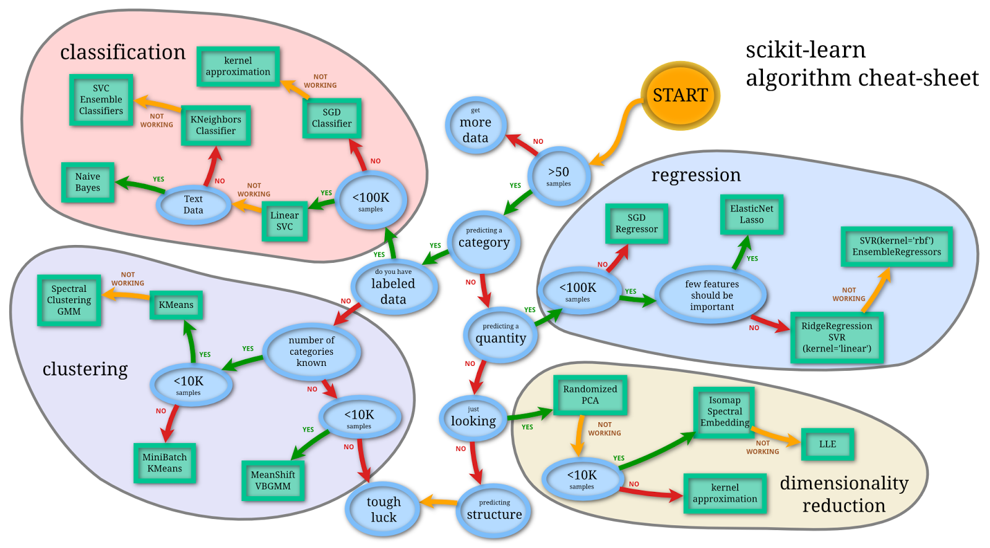

Slide 11
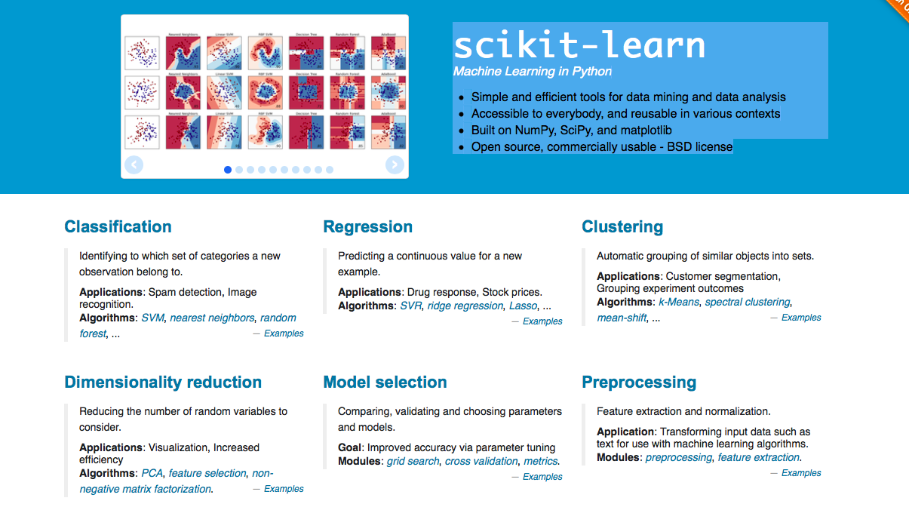
What is scikit-learn?

Slide 12
What can we learn from this?
<50 observations…get more data
Why? Inadequate power to effectively detect patterns or relationships. Visualization can still be very useful.
The power of a statistical test is the probability that it correctly rejects the null hypothesis when the null hypothesis is false.

Slide 13
What can we learn from this?
Different Categories
Regression (today)
Classification (today)
Clustering
Dimension Reduction

Slide 14
Regression

Slide 15
Regression Basics
Data/Distribution of DV/Model
Equation
R2
Statistical Testing and p Values
Beta Coefficients
Regression Assumptions
Advanced topics, Anova, Logistic Regression

Slide 16
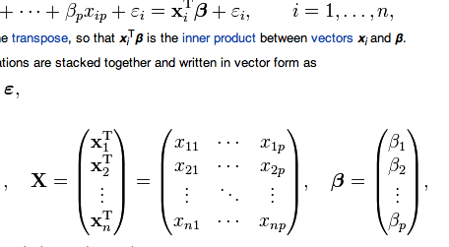
Regression Equation

Slide 17
Regression Analysis: Data/Distribution
Examine the nature of the variable you are predicting
Binary?
Ordinal?
Numeric?
Distribution?

Slide 18
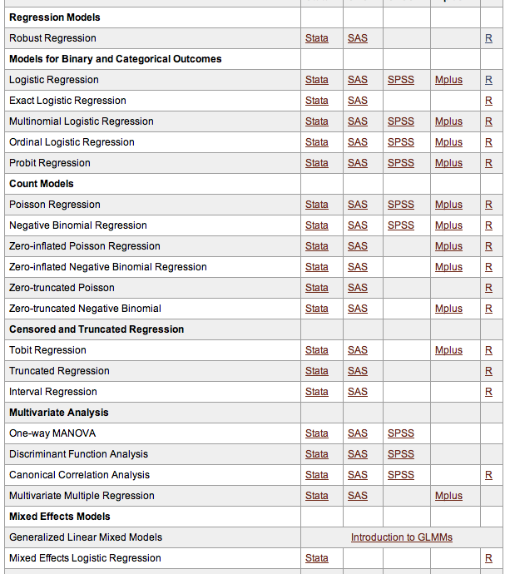
http://www.ats.ucla.edu/stat/dae/

Slide 19
Example – Online Auction
Was the reserve price met?
Yes/No -> Logistic Regression
What is the final high bid price?
Price -> OLS or Robust Regression
How many bidders were there?
Count -> Poisson Regression

Slide 20
Regression Basics: Draw a line that minimizes the total distance (error) between the line and the various points

Slide 21
R2
In statistics, the coefficient of determination, denoted R2 and pronounced R squared, indicates how well data points fit a line or curve. It provides a measure of how well observed outcomes are replicated by the model, as the proportion of total variation of outcomes explained by the model.[1]

Slide 22
Measures of Variation: The Sum of Squares
SST = Total Sum of Squares
measures the variation of the Y_{i} values around their mean Y
_
SSR = Regression Sum of Squares
explained variation attributable to the relationship between X and Y
SSE = Error Sum of Squares
variation attributable to factors other than the relationship between X and Y

Slide 23
Measures of Variation: The Sum of Squares
Y
∧
SSE =∑(Y_{i} - Y_{i} )²
Y_{i} = b₀ + b₁X_{i}
_
∧
SST = ∑(Y_{i} - Y)²
_
∧
SSR = ∑(Y_{i} - Y)²
_
Y
X
X_{i}

Slide 24
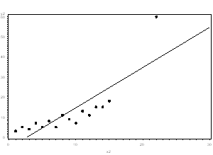
Outliers: Important to Visualize

Slide 25
Variance Explained
SSR regression sum of squares
r² = =
SST total sum of squares
Measures the proportion of variation that is explained by the independent variable X in the regression model

Slide 26

Adjusted R2
The use of an adjusted R2 (often written as and pronounced "R bar squared") is an attempt to take account of the phenomenon of the R2 automatically and spuriously increasing when extra explanatory variables are added to the model.

Slide 27
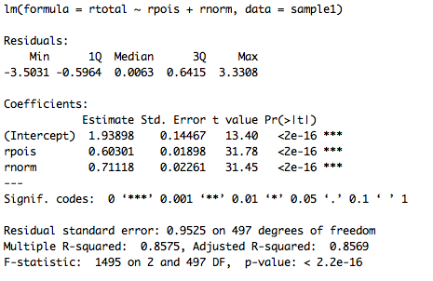
R2 in R

Slide 28
Statistical Testing
“Null Hypothesis” of no effect of independent variable on dependent variable
If the p-value is less than the required significance level (equivalently, if the observed test statistic is in the critical region), then we say the null hypothesis is rejected at the given level of significance. Rejection of the null hypothesis is a conclusion.

Slide 29
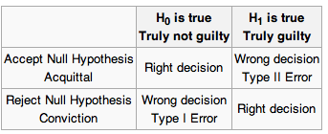
Statistical Testing
p<0.10 “Marginally Significant”
P=0.05 “Significant”
P<0.01/001 “Significant, low probability of type I error”
Rejecting the null hypothesis when it is in fact true is called a Type I error.
P value indicates how frequently you will make a Type I error

Slide 30
Statistical Testing
This is really small p values, indicating a very small chance of type I error

Slide 31
Statistical Testing
The power of a statistical test is the probability that the test will reject the null hypothesis when the alternative hypothesis is true (i.e., the probability of not committing a Type II error).
As the power increases, the chances of a Type II error occurring decrease.
Increase power by increasing sample size

Slide 32
β Coefficient
Beta coefficients indicate how the change in independent variables influence the change in dependent variables
Very difficult to interpret by themselves, dependent upon scale, relationship, significance

Slide 33

Factor Variables
Factor type variables have N levels and will report N-1 beta coefficients
Coefficients are always relative to the omitted level
EXAMPLE: 2 Levels: Vocational/General/Academic
Academic>General; Vocational < General

Slide 34
Statistical Testing
How much will change in independent variable change DV

Slide 35
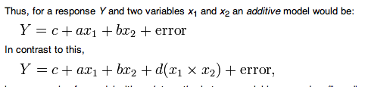
Interaction Effect Regression
In statistics, an interaction may arise when considering the relationship among three or more variables, and describes a situation in which the simultaneous influence of two variables on a third is not additive. Most commonly, interactions are considered in the context of regression analyses.

Slide 36
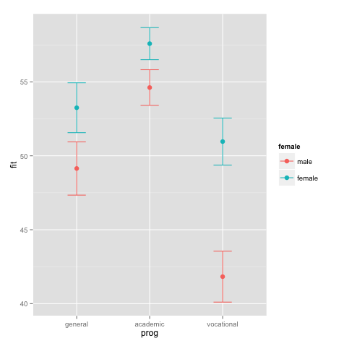
Interaction Effects
EXAMPLE
Prog*gender

Slide 37
Statistical Testing and Big Data
Statistical Significance (the is a relationship based on rejecting the null hypothesis) and practical significance two different things
Almost all variables will be significant in many analyses involving large datasets
Important to understand the marginal effect
Example: Find the effect of one standard deviation change of independent variable on a dependent variable

Slide 38
Coefficients of Determination (r²) and Correlation (r)
Y
r = +1
r² = 1,
Y
r² = 1,
r = -1
^
Y
=
b
+
b
X
i
0
1
i
^
Y
=
b
+
b
X
i
0
1
i
X
X
r² = .8,
r² = 0,
Y
r = +0.9
Y
r = 0
^
^
Y
=
b
+
b
X
Y
=
b
+
b
X
i
0
1
i
i
0
1
i
X
X

Slide 39
Statistical Test
The F-test tests the null hypothesis that the regression does not explain a significant proportion of the variation in Y
The F-Ratio is related to the R², such that the higher R², the higher the F-Ratio

Slide 40
Associated Assumptions
All models have some limitations, but many are very useful
Statistical Analysis: Close observance of assumptions is necessary in order to ensure that statistical insights are relevant
Predictive Analysis: A model’s usefulness in making predictions and can be assessed directly, making underlying assumptions less relevant

Slide 41
Regression Assumptions

Slide 42
Best Linear Unbiased Estimate (BLUE)
If the following assumptions are met:
The Model is
M1 Complete
M2 Linear
M3 Additive
Variables are
V1 measured at an interval or ratio scale
V2 without error
The regression error term is
E1 normally distributed
E2 has an expected value of 0
E3 errors are independent
E4 homoscedasticity
E5 predictors are unrelated to error
E6 In a system of interrelated equations the errors are unrelated to each other

Slide 43
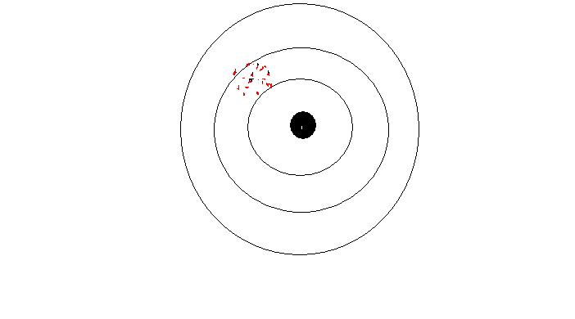
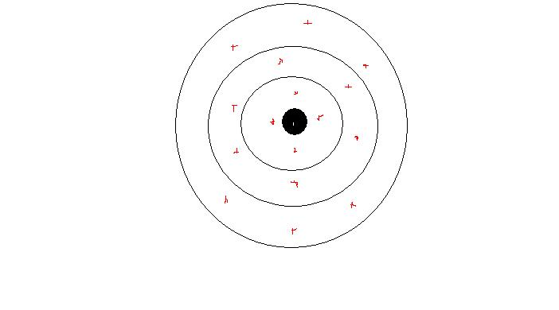
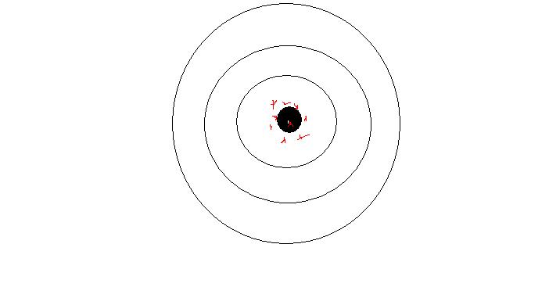
The Three Desirable Characteristics
Lack of bias
E(b)=β b is the sample β is the true, population coefficient
On the average we are on target
Efficiency
Standard error will be minimum
OLS will minimize σ² (the error variance)
Consistency
As N increases the standard error decreases
Notice: as N increases so does Σx_{i}²

Slide 44
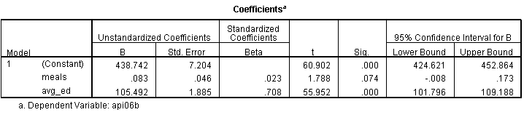
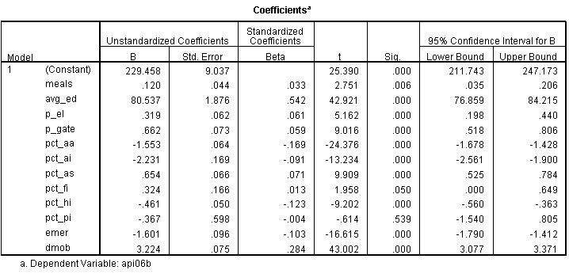
M1 Completeness
Meals
Parents’ education

Slide 45
Diagnosis and Remedy
Complete model means no relevant independent variable is omitted
Diagnosis
Theoretical
Remedy
Including new variables

Slide 46
M2 Linearity
Violation of linearity
An almost perfect relationship will appear as a weak one
Almost all linear relations stop being linear at a certain point

Slide 47
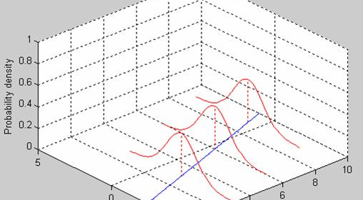
E1 Normally Distributed Error

Slide 48
Non-Normal Error
Our calculations of statistical significance depends on this assumption
Statistical inference can be robust even when error is non-normal
Diagnosis:
You can look at the distribution of the error. Because of the homoscedasticity assumption (see later) the error when summed up for each prediction should be also normal. (In principle, we have multiple observations for each prediction.)
Remember! Our measured variables (Y and X) do not have to have a normal distribution! Only the error for each prediction.
Remedy:
Any non-linear transformation will change the shape of the distribution of the error

Slide 49
E2 Error Has a Non-Zero Mean
The solid line gives a negative
The dotted line a positive mean
This can happen when we have some selection problem
Diagnosis:
Visual scatter plot will not help unless we know in advance somehow the true regression line
Remedy:
If it is a selection problem try to address it.
1.000
.998
.996
.994
.992
.990
.988
Z
.986
Rsq = 0.6211
200
400
600
800
1000
1200
X

Slide 50
E3 Non-independent errors
Example 1: Suppose you take a survey of 10 people but you interview everyone 10 times.
Now your N=100 but your errors are not independent. For the same person you will have similar errors
Example 2: Suppose you take 10 countries and you observe them in 10 different time period
Now your N=100 but your errors are not independent. For the same country you will have similar errors
Example 3: Suppose you take 100 countries and you observe them only once. Now your N=100. But countries that are next to each other are often similar (same geography and climate, similar history, cooperation etc.). If your model underpredicts Denmark, it is likely to underpredict Sweden as well.

Slide 51
Diagnosis & Remedy
It is called autocorrelation because the correlation is between cases and not variables, although autocorrelations often can be traced to certain variables such as geographic distance or same country or person or family.
Diagnosis
Visual, scatterplot
Checking groups of cases that are theoretically suspect
Certain forms of serial or spatial autocorrelations can be diagnosed by calculating certain statistics (e.g., Durbin-Watson test)
Remedy:
You can include new variables in the equation
E.g.: for serial (temporal) correlation you can include the value of Y in t-1 as an independent variable
For spatial correlation we can often model the relationships by introducing an weight matrix

Slide 52
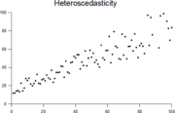
E4 Heteroscedasticity
Homoscedasticity means equal variance
Heteroscedasticity means unequal variance
We assume that each prediction is not just on target on average but also that we make the same amount of error
Heteroscedasticity results in biased standard errors and statistical significance

Slide 53
E5 Predictor Related to Error
Error represents all factors influencing Y that are not included in the regression equation
If an omitted variable is related to X the assumption is violated. This is the same as the Completeness or Omitted Variable Problem
Diagnosis:
The error will ALWAYS be uncorrelated with X, there is no way to establish the TRUE error
Theoretical
Remedy:
Adding new variables to the model

Slide 54
E6 Correlated errors across interrelated equations
We sometimes estimate more than one regression.
Suppose Y_{t}=a+b₁X_{t-1}+b₂Z_{t-1}+e but
X_{t}=a’+b’₁Y_{t-1}+b’₂Z_{t-1}+e’
e and e’ will be correlated
(whatever is omitted from both equations will show up in both e and e’ making them correlated)
This is also the case in sample selection models
S=a+b₁X+b₂Z+e S is whether one is selected into the sample (Szelenyi: does one engage in household farming)
Y=a+b’₁X+b’₂Z+b’₃W+b’₄V+e’ Y is the outcome of interest (Szelenyi: if one does engage in household farming how much value does he produce)
e and e’ will be correlated
(whatever is omitted from both equations will show up in both e and e’ making them correlated)

Slide 55
ANOVA
ANOVA is a particular form of statistical hypothesis testing heavily used in the analysis of experimental data.
A statistically significant result (when a probability (p-value) is less than a threshold (significance level)) justifies the rejection of the null hypothesis.

Slide 56
Classification

Slide 57
Logistic Regression
Logistic regression or is a type of regression analysis used for predicting the outcome of a categorical dependent variable (a dependent variable that can take on a limited number of values, whose magnitudes are not meaningful but whose ordering of magnitudes may or may not be meaningful) based on one or more predictor variables.

Slide 58
"Field of study that gives computers the ability to learn without being explicitly programmed” -Arthur Samuel (on machine learning)

Slide 59
Categories of Machine Learning Problems
Classification
Classification is the problem of identifying to which of a set of categories (sub-populations) a new observation belongs, on the basis of a training set of data containing observations (or instances) whose category membership is known.
Prediction
Prediction of a dependent variable

Slide 60

What is this????

Slide 61
When computer scientists at Google’s mysterious X lab built a neural network of 16,000 computer processors with one billion connections and let it browse YouTube, it did what many web users might do — it began to look for cats.

Slide 62
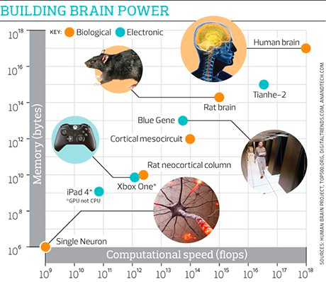

Slide 63

Building high-level features using large scale unsupervised learning
“Contrary to what appears to be a widely-held intuition, our experimental results reveal that it is possible to train a face detector without having to label images as containing a face or not. Control experiments show that this feature detector is robust not only to translation but also to scaling and out-of-plane rotation.”
Notes:
http://arxiv.org/abs/1112.6209

Slide 64
What do we mean by “unsupervised learning?”

Slide 65
Unsupervised Learning
Unsupervised Learning
In machine learning, the problem of unsupervised learning is that of trying to find hidden structure in unlabeled data.
Example: Could you create categories of customers based on their purchase behavior and demographics

Slide 66
Supervised vs. Unsupervised Learning of Cats
Unsupervised Learning
Here are a bunch of images…..classify them into different object classes
Supervised Learning
Here are a bunch of images and we have already classified them into which ones are cats
We will train our algorithm using a subset of data where we will give you the answers
Then we will test you on a group were we don’t give you the answer

Slide 67
Classification
Classification – Unsupervised Learning
K-means Clustering
Hierarchical Clustering
Classification - Supervised Learning
Logistic Regression (2 categories DV)
Naïve Bayes
Support vector machines
Decision Trees
Random Forests

Slide 68
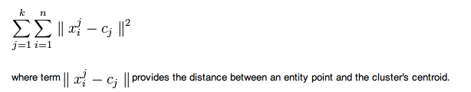
Unsupervised Learning - Classification
K-Means Clustering
A simple learning algorithm for clustering analysis. The goal of K-Means algorithm is to find the best division of n entities in k groups, so that the total distance between the group's members and its corresponding centroid, representative of the group, is minimized. Formally, the goal is to partition the n entities into k sets S_{i}, i=1, 2, ..., k in order to minimize the within-cluster sum of squares (WCSS), defined as:
Notes:
http://en.wikibooks.org/wiki/Data_Mining_Algorithms_In_R/Clustering/K-Means

Slide 69
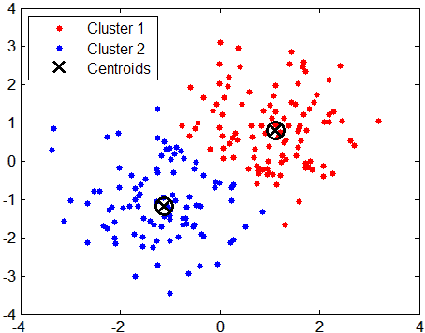
K-Means Clustering

Slide 70
K-Means
How many clusters should there be?
No predetermined amount
What are meaningful labels?
This can be an n-dimensional space

Slide 71
Supervised Learning
Machine learning focuses on prediction (not understanding relationship
Training Data – Used to tune the associated algorithm to make accurate predictions
Test Data –Used to assess the capabilities of the model
Implementation – Algorithm is implemented in the context of a business process

Slide 72
Supervised vs. Unsupervised Learning
Supervised Learning
In supervised learning, each example is a pair consisting of an input object (typically a vector) and a desired output value (also called the supervisory signal). A supervised learning algorithm analyzes the training data and produces an inferred function, which can be used for mapping new examples.

Slide 73

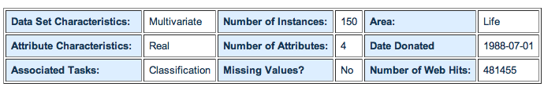
Supervised Learning Example
Categories/Group membership
How can we classify individual samples into different class?
1. sepal length in cm 2. sepal width in cm 3. petal length in cm 4. petal width in cm 5. class: -- Iris Setosa -- Iris Versicolour -- Iris Virginica
http://archive.ics.uci.edu/ml/datasets/Iris

Slide 74
Decision Tree
Decision Tree is a flow-chart like structure in which internal node represents test on an attribute, each branch represents outcome of test and each leaf node represents class label (decision taken after computing all attributes). A path from root to leaf represents classification rules.
A decision tree consists of 3 types of nodes:
Decision nodes - commonly represented by squares
Chance nodes - represented by circles
End nodes - represented by triangles

Slide 75
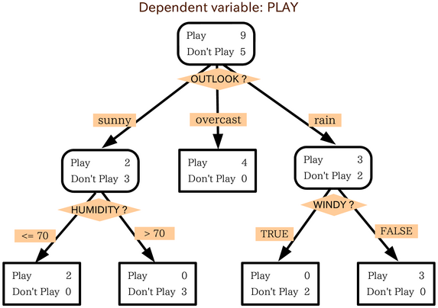
Decision Tree - Golf

Slide 76
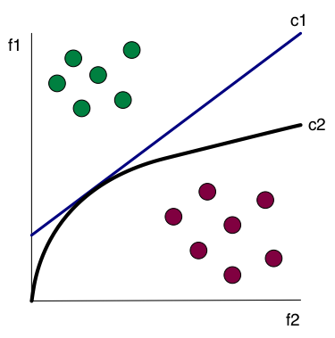
Linear (c1) and Nonlinear (c2) Classification

Slide 77
Regression Trees
A data-analysis method that recursively partitions data into sets each of which are simply modeled using regression methods.

Slide 78
Bayesian Methods
Learning and classification methods based on probability theory.
Bayes theorem plays a critical role in probabilistic learning and classification.
Uses prior probability of each category given no information about an item.
Categorization produces a posterior probability distribution over the possible categories given a description of an item.

Slide 79
Bayes Theorem
Given a hypothesis h and data D which bears on the hypothesis:
P(h): independent probability of h: prior probability
P(D): independent probability of D
P(D|h): conditional probability of D given h: likelihood
P(h|D): conditional probability of h given D: posterior probability

Slide 80
Example - Bayes
Marie is getting married tomorrow, at an outdoor ceremony in the desert. In recent years, it has rained only 5 days each year. Unfortunately, the weatherman has predicted rain for tomorrow. When it actually rains, the weatherman correctly forecasts rain 90% of the time. When it doesn't rain, he incorrectly forecasts rain 10% of the time. What is the probability that it will rain on the day of Marie's wedding?

Slide 81
Example - Bayes
Event A₁. It rains on Marie's wedding.
Event A₂. It does not rain on Marie's wedding.
Event B. The weatherman predicts rain.
P( A₁ ) = 5/365 =0.0136985 [It rains 5 days out of the year.]
P( A₂ ) = 360/365 = 0.9863014 [It does not rain 360 days out of the year.]
P( B | A₁ ) = 0.9 [When it rains, the weatherman predicts rain 90% of the time.]
P( B | A₂ ) = 0.1 [When it does not rain, the weatherman predicts rain 10% of the time.]

Slide 82
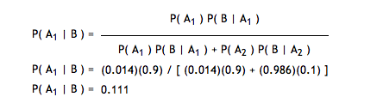
Example - Bayes
We want to know P( A₁ | B ), the probability it will rain on the day of Marie's wedding, given a forecast for rain by the weatherman. The answer can be determined from Bayes' theorem, as shown below.

Slide 83
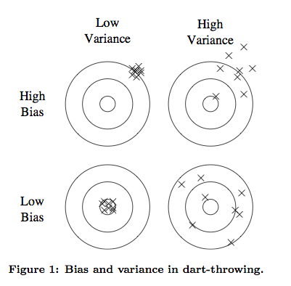
Bias and Variance in Outcome

Slide 84
Neural Networks - Prediction
artificial neural networks are computational models inspired by animal central nervous systems (in particular the brain) that are capable of machine learning and pattern recognition. They are usually presented as systems of interconnected "neurons" that can compute values from inputs by feeding information through the network.

Slide 85
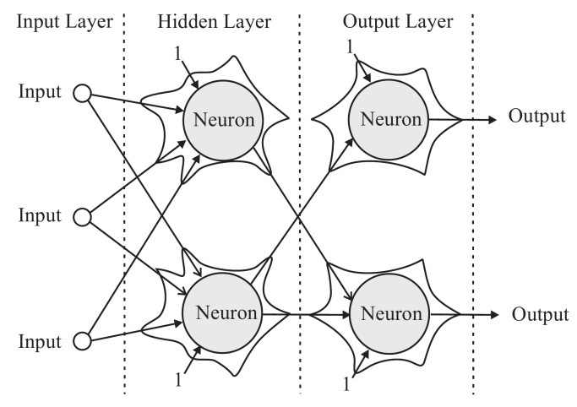
Neural Networks

Slide 86
Neural Network vs. Regression
Neural Networks are likely to provide better predictions than regression based analyses
However, unlike regression we can’t directly understand the “hidden” layer resulting from the analysis

Slide 87
Super Learners
Rather than creating each algorithm separately, we can put a wrapper class around an algorithm to validate it
http://cran.r-project.org/web/packages/SuperLearner/vignettes/SuperLearnerPresent.pdf

Slide 88
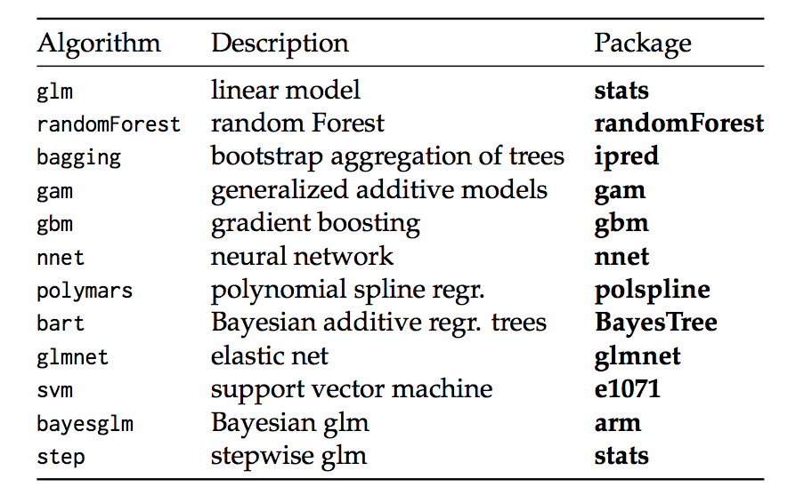
Super Learner

Slide 89
Next Time
Presentations
Midterm

